Slide 1

Nuclear Power Plants
Chapter 3 — Principles, reactors and operation
Notes:
Chapter 3: general principle, reactors, operation, review and outlook.

Slide 2





Chapter outline
1
2
3
4
5
General principle
The reactor core
Types and generations
Operation
Review and outlook
Notes:
Five parts: principle, reactor core, types and generations, operation, review.

Slide 3



What is a power plant?
Like a thermal power plant, it turns heat into electricity. Here, the heat comes from the fission of an atomic nucleus.
Nuclear fission
Heating the water
Pressurized steam
Turbine + alternator
Electricity
1974
Nuclear electricity production expanded more widely in the aftermath of the first oil crisis.
Notes:
Same principle as a thermal power plant, but the heat comes from the fission of an atomic nucleus.

Slide 4
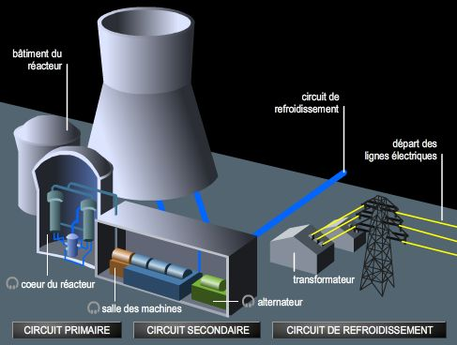


Four main parts
Reactor building
Site of the fission
Machine room
Electricity production
Power lines
Carry away and transmit
Cooling towers
River sites only
Notes:
The four parts: reactor building, machine room, power lines, cooling towers (river sites only).

Slide 5
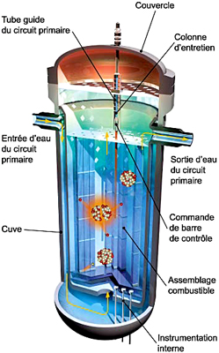
Nuclear fuel
Fissile atoms: their nucleus can split under the action of a neutron, releasing a considerable amount of energy.
U
233
U
235
Pu
239
Pu
241
Uranium 235 : the only one found in nature, so the one most often used. The fuel is placed in the reactor core.
Notes:
The fuel contains fissile atoms. Only uranium 235 occurs naturally: it is the one most used.

Slide 6
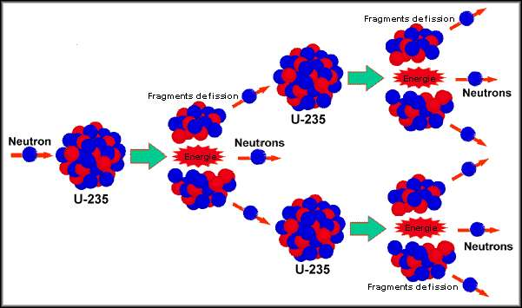
Nuclear fission
A uranium-235 nucleus absorbs a neutron.
1
It splits into two fragments and releases heat.
2
The neutrons released cause further fissions: this is the chain reaction.
3
1 g
of uranium produces more heat than burning a tonne of oil.
Notes:
A neutron strikes a uranium-235 nucleus, which splits into two fragments and releases heat and neutrons: chain reaction.

Slide 7
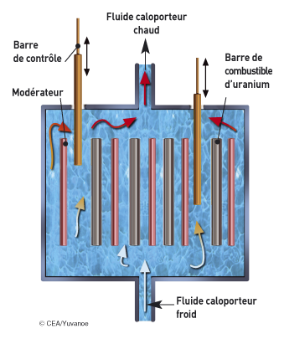



Controlling the chain reaction
Control rods
Regulate the number of neutrons.
Moderator
Slows neutrons down to increase the chances of fission.
Coolant
Gas or liquid: picks up the heat around the uranium rods and carries it out of the core.
Notes:
Control rods: number of neutrons. Moderator: speed of neutrons. Coolant: heat transport.

Slide 8
Five types of reactors
Type | Coolant | Moderator | Fuel
PWR — pressurized water | Pressurized water | Water | Enriched uranium
BWR — boiling water | Water, not pressurized | Water | Enriched uranium
Heavy water | Pressurized heavy water | Heavy water | Natural uranium
FNR — fast neutrons | Liquid metal (sodium) or gas (helium) | None | Enriched uranium or plutonium
GCR — gas-cooled | Helium | — | —
FNR: breeder reactors (Phénix reactor, France)
GCR: small size, 100 to 300 MW
Notes:
Five categories according to fuel, coolant and moderator. The Phénix reactor in France is an FNR.

Slide 9
The most widespread types
55 %
of installed reactors are PWRs: the most widespread type in the world.
22 %
are boiling water reactors (BWR).
Notes:
Pressurized water reactors account for about 55 % of the installed fleet, boiling water reactors 22 %.

Slide 10
Reactor generations
II
III
IV
Generation II
Generation III
Generation IV
In service
Being built
Under study
Current reactors (generation I for the oldest, e.g. Magnox in the United Kingdom).
EPR and AP1000: generation III or III+ (II+ for the Chinese CPR1000).
Reactors still under study.
Notes:
Generations are classified according to the age of the reactors’ design.

Slide 11

Three sealed circuits
Primary circuit
Secondary circuit
Cooling circuit
Water heated by fission stays liquid thanks to the pressure. Closed circuit.
The steam generator turns water into steam, which drives the turbine and the alternator.
A condenser turns the steam back into water using cold water from a river or the sea.
Closed circuit
Transformer
Cooling towers
The three water circuits are sealed off from one another.
Notes:
Three water circuits sealed off from one another: primary, secondary, cooling.

Slide 12
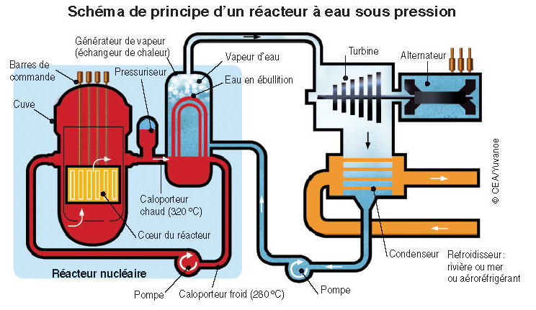
Diagram of a PWR
320 °C
temperature of the primary circuit water
3
water circuits, sealed off from one another
Notes:
Schematic diagram of a pressurized water reactor: reactor, steam generator, turbine, alternator, condenser.

Slide 13
Power and operation
900–1450 MW
1600 MW
60–100 %
Power of a PWR reactor
EPR, a 3rd-generation reactor: more electricity from the same quantity of fuel
of its power: adjustment range of the output
Base-load operation
Output cannot be adjusted to demand: the chain reaction is very difficult to stop.
Very competitive cost
Large quantities of electricity to meet ever-growing demand.
Notes:
The plant operates in base load: it is very difficult to stop the chain reaction. Output adjustable from 60 to 100 %.

Slide 14


Advantages and disadvantages
Strengths
Drawbacks
Large quantities of electricity without CO₂ emissions
Very competitive cost
Output adjustable from 60 to 100 %
Meets growing demand
Non-renewable energy: limited raw material
Dangerous radioactive waste, to be isolated for hundreds of years
Risk of rare but serious accidents (Chernobyl, 1986)
Technology not accessible to all countries
Notes:
Strengths: CO2-free electricity, competitive cost. Drawbacks: waste, limited resource, accident risk, demanding technology.

Slide 15


Future prospects
−15 to 30 %
All the uranium
3 to 4 ×
of radioactive waste
without enrichment
more abundant than uranium
EPR (3rd generation): MOX, a recycled fuel, reduces waste and safety is improved.
Breeder reactor (4th generation): a fast neutron reactor that can destroy long-lived waste.
Thorium-232/uranium-233: a fuel under consideration, well distributed on Earth.
Notes:
EPR with MOX, 4th-generation breeder reactor, thorium–uranium-233 cycle.

Slide 16
Conclusion
Nearly half
The operating principle is identical in all nuclear power plants, but there are several families of reactors.
of the world's nuclear electricity is produced by pressurized water reactors.
Notes:
Identical principle everywhere, several families of reactors. PWRs dominate nuclear production.

