Slide 1

Chapter II: Crystallochemistry
MINERAL CHEMISTRY
Process Engineering · Sciences & Technology Institute
A. Elhafidh Boussouf University Center · Dr. Merzouki S.

Slide 2
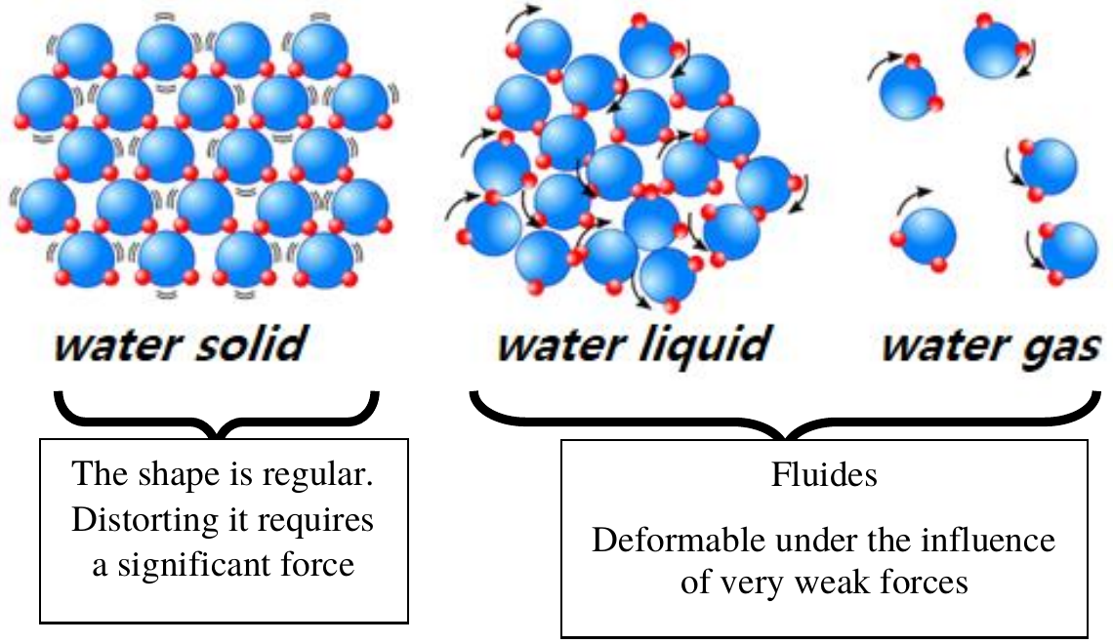
States of matter
Matter is solid, liquid or gas, depending on the interaction between its particles.
Solid: regular shape, distorting it needs a large force.
Liquid and gas: fluids, deformed by very weak forces.
Mineral Chemistry · Chapter II · 2

Slide 3
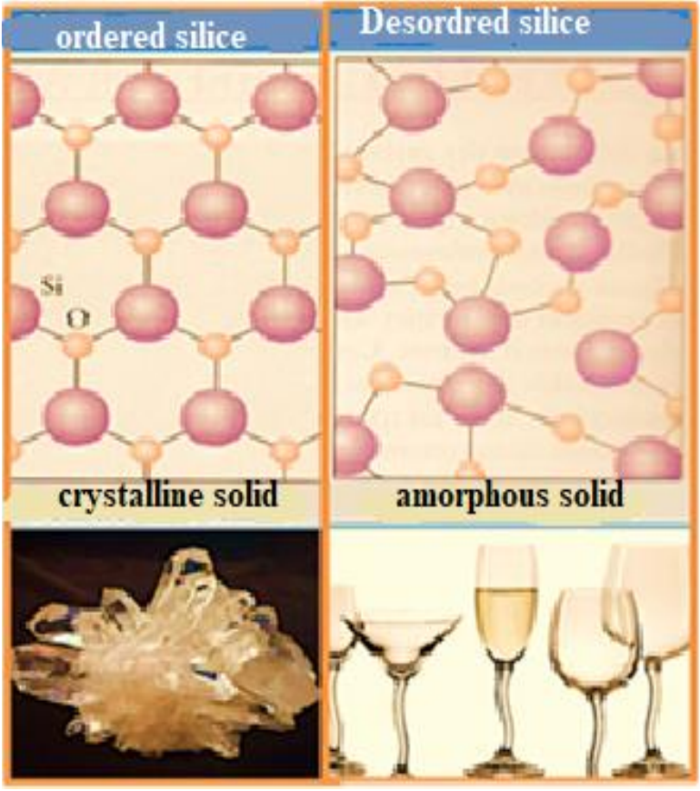
Solids: two states
Disordered state: irregular structure, as in amorphous solids such as glass.
Ordered state: structured arrangement, as in crystalline solids.
Mineral Chemistry · Chapter II · 3

Slide 4
Three types of crystals
Covalent
Metallic
Ionic
Small electronegativity difference: non-metals, H₂, dihalogens, noble gases.
Metal atoms in a regular lattice: Na, Cu, Fe.
Large electronegativity difference: NaCl.
Mineral Chemistry · Chapter II · 4

Slide 5
Melting points
Molecular | Metallic | Ionic | Covalent
He −272.2 °C | Na 97.8 °C | NaCl 801 °C | C (diamond) < 3550 °C
Cl₂ −101 °C | Zn 419.6 °C | CaO 2580 °C | C (graphite) 3670 °C
CO₂ −65.5 °C | Cu 1083 °C | CuCl₂ 620 °C | Si 1410 °C
H₂O 0 °C | Fe 1535 °C | ZnS 1020 °C | SiO₂ (quartz) 1610 °C
Metallic crystals melt over a wide range; ionic and covalent crystals melt very high.
Mineral Chemistry · Chapter II · 5

Slide 6
Electrical conductivity
Metallic
Ionic
Molecular
Covalent
The best conductors.
Conduct when molten; insulators as solids.
Insulators.
Diamond: insulator. Si, Ge: semiconductors. Graphite: one-dimensional conductor.
Mineral Chemistry · Chapter II · 6

Slide 7
X-ray diffraction
Crystals diffract X-rays in specific directions. The pattern lets us:
identify the crystal type, using a database
locate atoms in the unit cell
analyze the electron density
find the symmetry and unit-cell size
Amorphous solids, liquids and gases behave differently.
Mineral Chemistry · Chapter II · 7

Slide 8
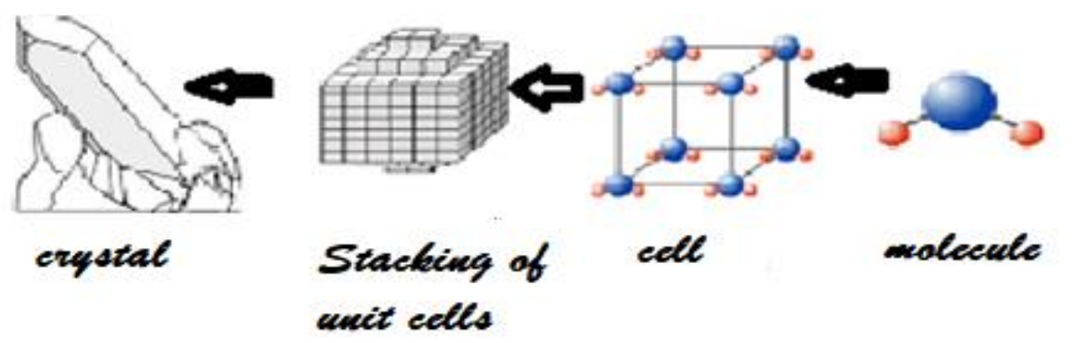
What is a crystal?
A solid with flat faces (polyhedral), formed by the periodic arrangement of atoms or molecules: a unit cell repeated in three directions.
Mineral Chemistry · Chapter II · 8

Slide 9
Polyhedra
Poly: many, hedron: face. A 3D shape with flat faces and straight edges.
Platonic polyhedron | Faces | Vertices | Edges
Tetrahedron | 4 | 4 | 6
Hexahedron (cube) | 6 | 8 | 12
Octahedron | 8 | 6 | 12
Dodecahedron | 12 | 20 | 30
Icosahedron | 20 | 12 | 30
Mineral Chemistry · Chapter II · 9

Slide 10
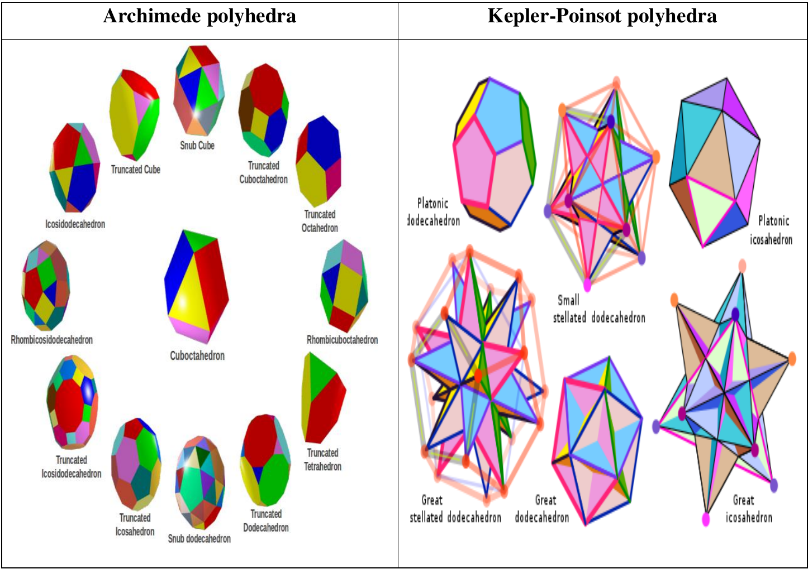
Other polyhedra
Archimedean polyhedra and Kepler-Poinsot polyhedra: more complex shapes with flat faces.
Mineral Chemistry · Chapter II · 10

Slide 11
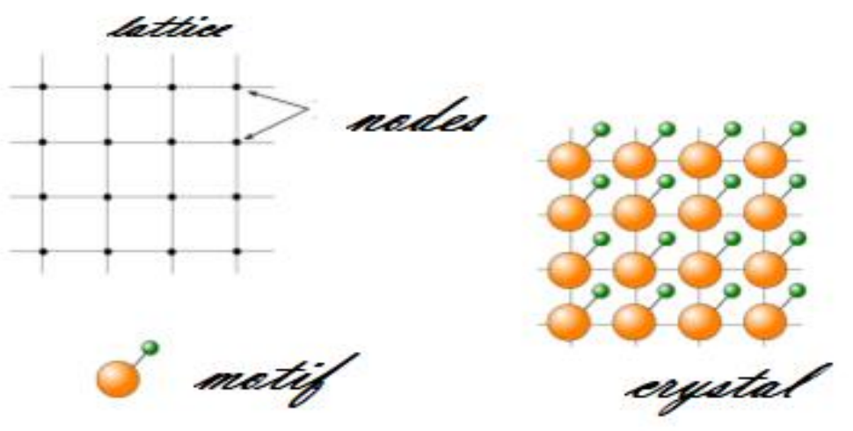
Crystalline lattice
Particles are arranged at points in space called nodes.
The lattice is their periodic arrangement in three directions.
Translation vector: T = u·a + v·b + w·c, with u, v, w integers.
Mineral Chemistry · Chapter II · 11

Slide 12
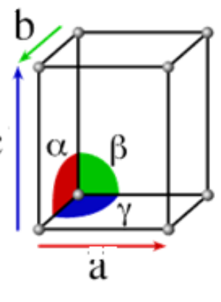
The unit cell
The smallest volume that fills the crystal space without gaps by translation.
Defined by three lengths a, b, c and three angles α, β, γ.
Mineral Chemistry · Chapter II · 12

Slide 13
Motif and sites
Motif
Crystallographic sites
The atom, molecule or ionic group on each node, repeated in three directions.
Locations where particles sit. Their occupancy shapes the electrical, magnetic and optical properties.
Mineral Chemistry · Chapter II · 13

Slide 14
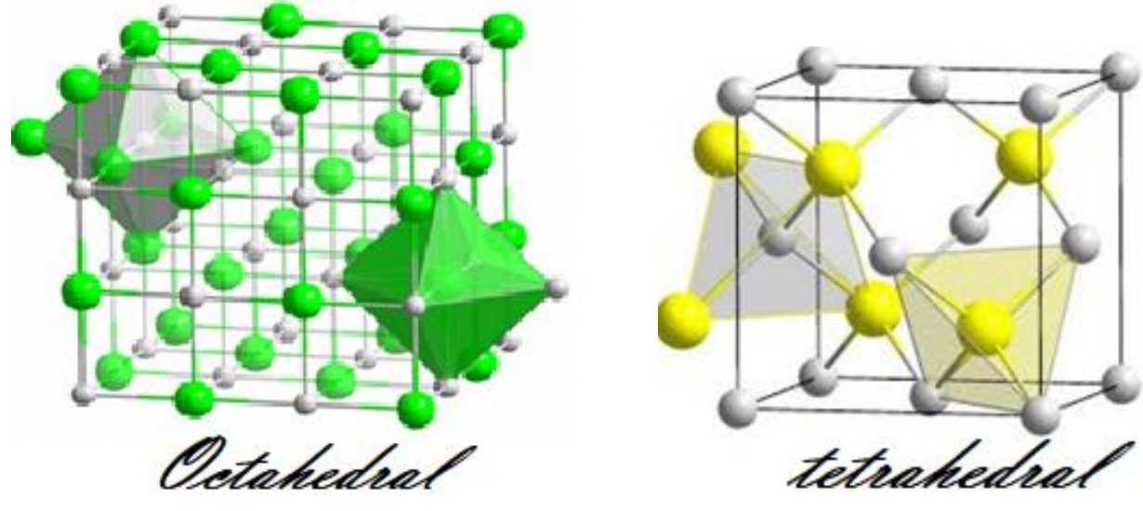
Tetrahedral and octahedral sites
Tetrahedral sites are defined by 4 atoms, octahedral sites by 6.
Mineral Chemistry · Chapter II · 14

Slide 15
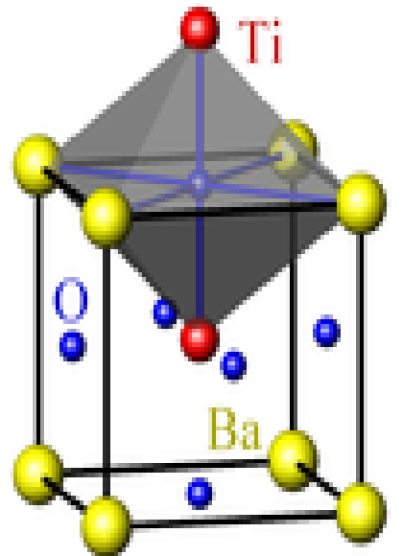
Coordination number
Nearest motifs around a central motif. Example: BaTiO₃.
Ti: 6 oxygens, octahedral, so 6
Ba: 12 oxygens, cuboctahedral, so 12
O: 2 Ti and 4 Ba, so 2 + 4
Mineral Chemistry · Chapter II · 15

Slide 16
Seven crystal systems
System | Lengths | Angles | Lattices
Cubic | a = b = c | α = β = γ = 90° | cP, cI, cF
Rhombohedral | a = b = c | α = β = γ ≠ 90° | R
Hexagonal | a = b ≠ c | α = β = 90°, γ = 120° | hP
Tetragonal | a = b ≠ c | α = β = γ = 90° | tP, tI
Orthorhombic | a ≠ b ≠ c | α = β = γ = 90° | oP, oI, oF, oC
Monoclinic | a ≠ b ≠ c | α = γ = 90°, β ≠ 90° | mP, mC
Triclinic | a ≠ b ≠ c | α ≠ β ≠ γ ≠ 90° | aP
Mineral Chemistry · Chapter II · 16

Slide 17
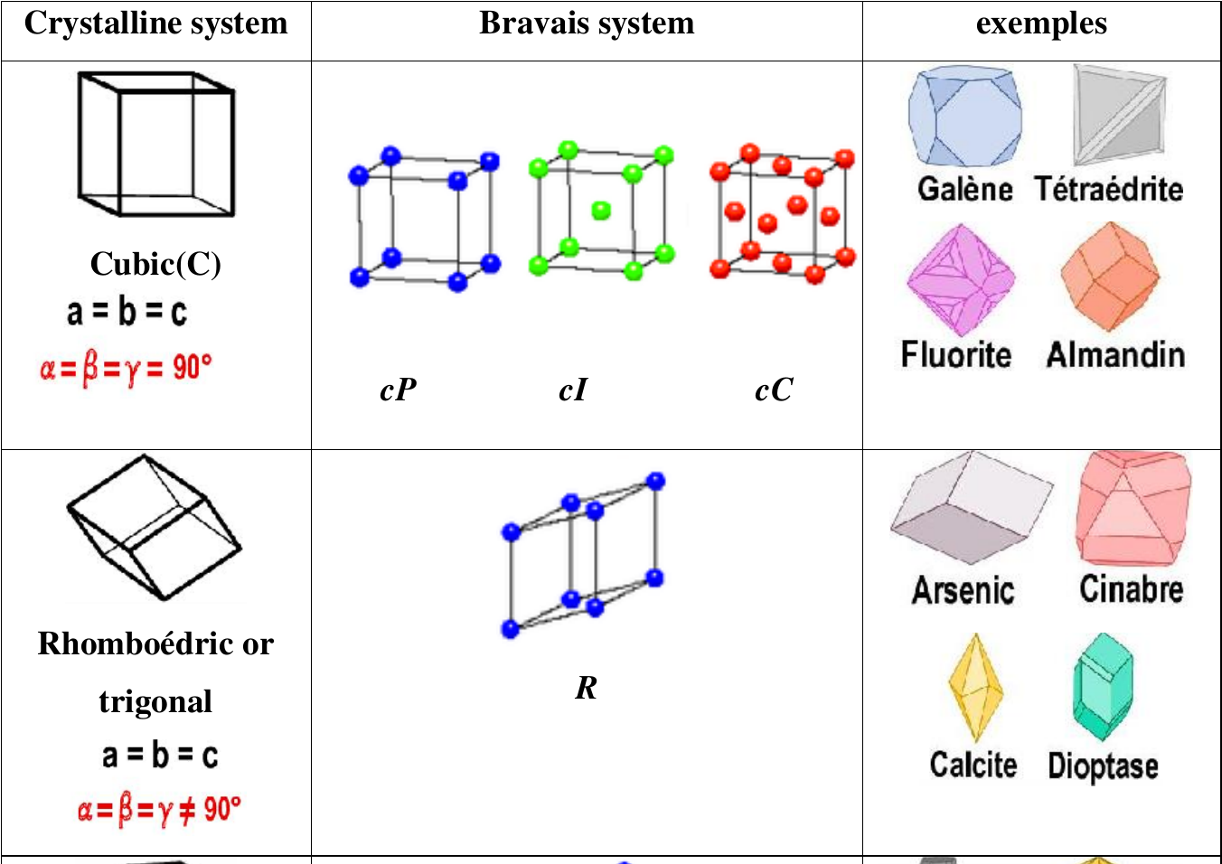
Cubic and rhombohedral
Bravais lattices: cP, cI, cF and R, with example minerals.
Mineral Chemistry · Chapter II · 17

Slide 18
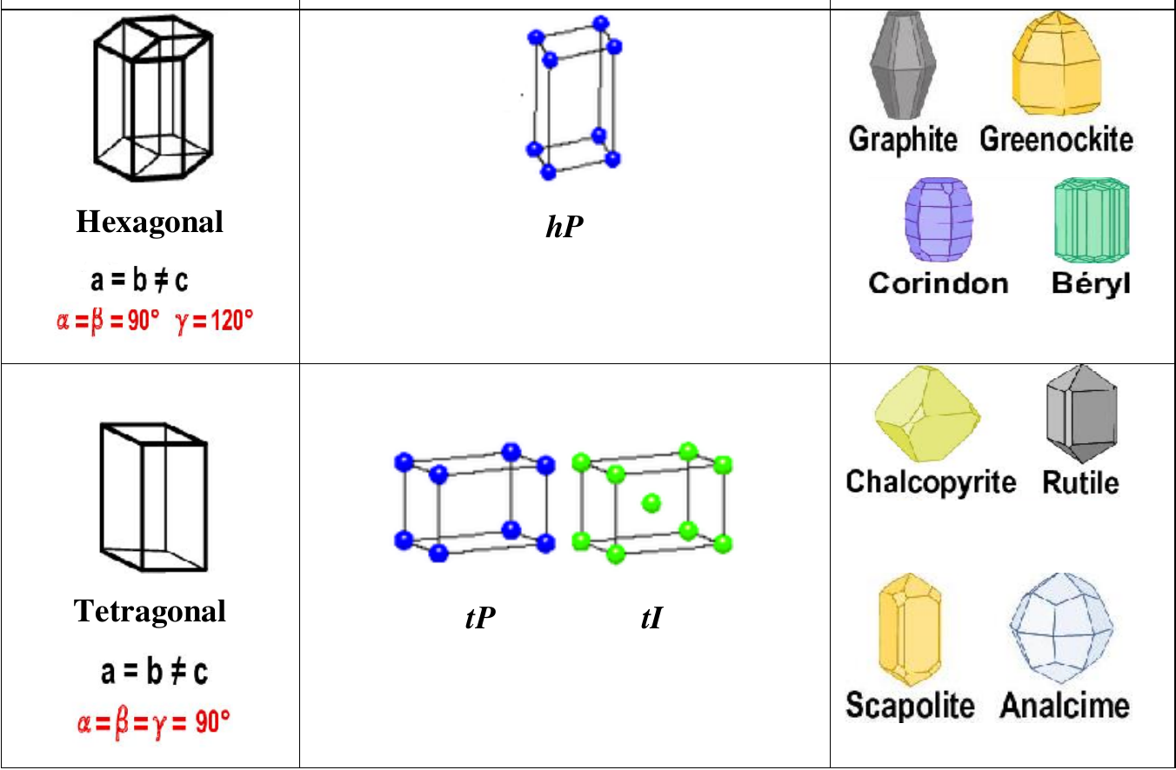
Hexagonal and tetragonal
Bravais lattices: hP, tP and tI.
Mineral Chemistry · Chapter II · 18

Slide 19
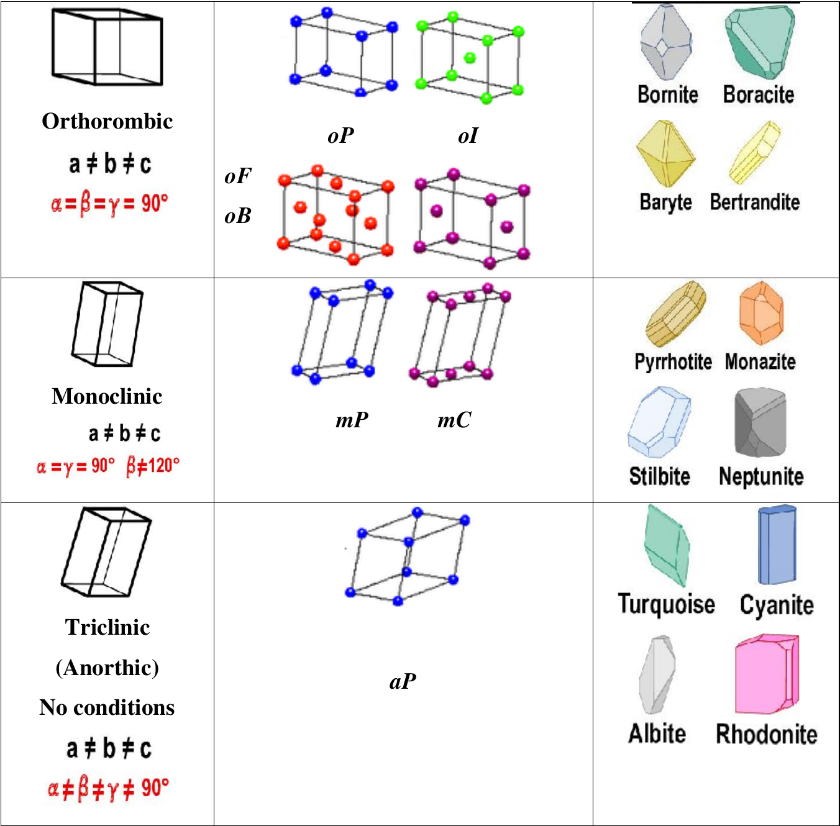
Orthorhombic to triclinic
Lattices: oP, oI, oF, oC; mP, mC; aP.
Mineral Chemistry · Chapter II · 19

Slide 20
Lattice symbols and allotropy
Two-letter symbol
Allotropy
Lowercase: system (a, m, o, t, h, c). Uppercase: P primitive, I body-centered, F face-centered, A, B, C base-centered. Rhombohedral: R.
One solid can take several crystalline forms under temperature and pressure. Diamond and graphite are allotropes of carbon.
Mineral Chemistry · Chapter II · 20

Slide 21
Examples of structures
Minerals
Alkali metals
Noble metals
Mostly cubic or hexagonal, closely packed (cI, cF, hP).
Li, Na, K, Rb, Cs: body-centered cubic (cI).
Au, Ag, Cu, Al, Pb, Ni, Pt: face-centered cubic (cF).
Hexagonal
Gases
Water
Some transition and alkaline-earth metals.
Ne, Ar, Kr, Xe, CO₂, O₂: cF.
11 stable forms; ice I is hexagonal at normal T and P.
Mineral Chemistry · Chapter II · 21

Slide 22
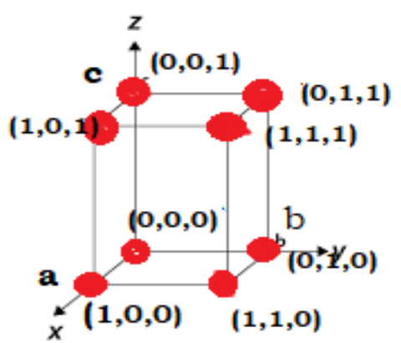
Corner coordinates
In a simple cubic cell, the eight corners are (0,0,0), (1,0,0), (0,1,0), (0,0,1), (1,1,0), (1,0,1), (0,1,1) and (1,1,1).
They are equivalent: translations along a, b and c link them.
Mineral Chemistry · Chapter II · 22

Slide 23
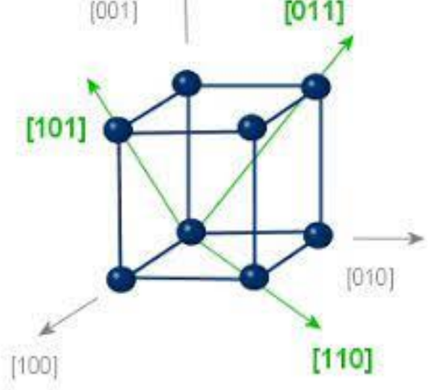
Directions [uvw]
A direction is t = u·a + v·b + w·c, written [uvw]: the smallest integers proportional to the components, in square brackets, without commas.
A negative index carries a bar above it. Examples: [110], [111], [1̅22], [31̅2].
Mineral Chemistry · Chapter II · 23

Slide 24
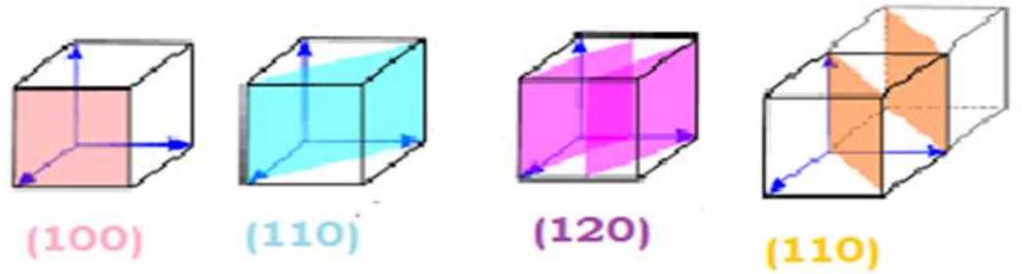
Planes (hkl)
A plane h·x + k·y + l·z = m is written (hkl). It cuts the axes at a/h, b/k and c/l. Hexagonal systems use four indices (Miller-Bravais).
Mineral Chemistry · Chapter II · 24

Slide 25
Distance between points
Origin to point [uvw]: length l of the vector.
System | Length l
Cubic | a (u² + v² + w²)1/2
Tetragonal | (a²(u² + v²) + c²w²)1/2
Orthorhombic | (a²u² + b²v² + c²w²)1/2
Hexagonal | (a²(u² + v² − uv) + c²w²)1/2
Mineral Chemistry · Chapter II · 25

Slide 26
Angle between vectors
Dot product: a · b = |a| |b| cos θ
For two directions [u₁v₁w₁] and [u₂v₂w₂], one matrix operation gives l₁ l₂ cos θ.
Cubic system: l₁ l₂ cos θ = a² (u₁u₂ + v₁v₂ + w₁w₂)
Mineral Chemistry · Chapter II · 26

Slide 27
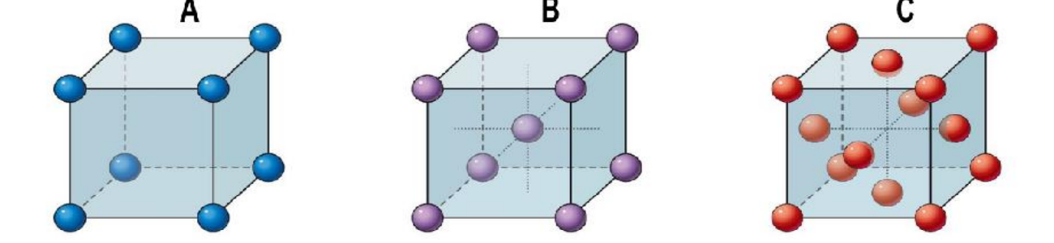
Crystal density: multiplicity
The multiplicity z is the number of motifs belonging to a cell.
Simple lattice: nodes at corners only.
Complex lattice: nodes also at the body center or face centers.
Cubic system: three structures, A, B and C.
Mineral Chemistry · Chapter II · 27

