Slide 1

Chapter I: Review of Some Important Definitions
MINERAL CHEMISTRY
Process Engineering ·
Sciences & Technology faculty
Dr. Merzouki S.

Slide 2
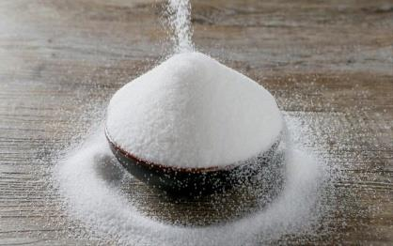
The mole
Chemists count atoms, ions and molecules in huge numbers, just as we buy sugar by the kilogram, not by the grain.
The mole is one “package” of entities, symbol n, unit mol.
Mineral Chemistry · Chapter I · 2

Slide 3
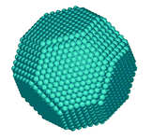
Avogadro’s number
NA = 6.022 × 10²³ mol⁻¹
The number of atoms in 12 g of carbon-12.
n = N / NA: the amount of substance is the number of moles in the sample.
Example: 3.5 g of iron contains 3.8 × 10²² atoms.
Mineral Chemistry · Chapter I · 3

Slide 4
Molar mass
Definition
Molecules
m = n × M
M(H₂O) = 2 × 1 + 16 = 18 g/mol
Sum of the atomic molar masses.
M in g/mol links the mass (balance) to the amount of substance.
Example · 150 g of water: n = 150 / 18 = 8.3 mol, N = n × NA ≈ 5 × 10²⁴ molecules.
Mineral Chemistry · Chapter I · 4

Slide 5
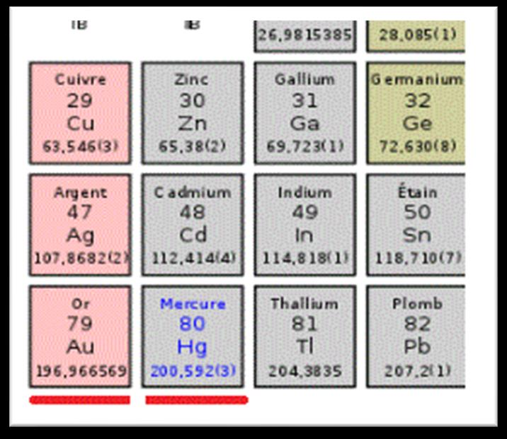
Atomic molar mass
Average mass of one mole of atoms, weighted by the natural abundance of the isotopes. Read it in the periodic table.
Chlorine: 35Cl (75.77 %) and 37Cl (24.23 %)
M = 35 × 0.7577 + 37 × 0.2423 ≈ 35.48 g/mol
Mineral Chemistry · Chapter I · 5

Slide 6
Molar volume of gases
Avogadro’s law
Reference values
Vm = V / n
Conditions | Vm
0 °C, 1 atm | 22.4 L/mol
20 °C, 1 atm | 24 L/mol
At fixed T and P, Vm does not depend on the gas. Unit: L/mol.
Mineral Chemistry · Chapter I · 6

Slide 7
Example: methane
13.4 mol of CH₄ at 0 °C and 1013 hPa
Molar mass
Volume
Mass
M = 12 + 4 × 1 = 16 g/mol
V = 22.4 × 13.4 = 300.16 L
m = 13.4 × 16 = 214.4 g
Mineral Chemistry · Chapter I · 7

Slide 8
Fractions and percentages
Molar
Mass
Volume
xi = ni / nt
Pi = mi / mt
φi = Vi / Vt
Multiply by 100 for percentages.
Example · A drain cleaner is 10 % NaOH by mass; 1 L weighs 1220 g, so m(NaOH) = 10 × 1220 / 100 = 122 g.
Mineral Chemistry · Chapter I · 8

Slide 9
Density and specific gravity
Density
Liquids and solids
Gases
ρ = m / V
d = ρ / ρwater
d = M / 29
kg/m³, kg/L or g/cm³
ρwater = 1 kg/L
ρair = 1.293 g/L
Mineral Chemistry · Chapter I · 9

Slide 10
Density examples
Kerosene
Concrete
Carbon dioxide
d = 0.78
d = 2.5
d = 44 / 29
ρ = 0.78 kg/L
ρ = 2.5 kg/L
ρ = 1.962 g/L
Mineral Chemistry · Chapter I · 10

Slide 11
Material balance
Mass is conserved: the progress x (mol) gives ni = ni0 ± vix.
aA + bB ⇌ cC + dD | A | B | C | D
t = 0 | nA0 | nB0 | 0 | 0
t | nA0 − ax | nB0 − bx | cx | dx
tmax | nA0 − axmax | nB0 − bxmax | cxmax | dxmax
Mineral Chemistry · Chapter I · 11

Slide 12
Types of transformation
Complete
Incomplete
Constant K
The limiting reactant disappears: xmax = nlimiting / coefficient.
xfinal < xmax: an equilibrium set by K.
K < 10⁻⁴ weak
K > 10⁴ complete
otherwise equilibrium
Mineral Chemistry · Chapter I · 12

Slide 13
Progress, conversion, yield
Progress rate
Conversion
Yield
τ = xfinal / xmax
XA = (n0 − n) / n0
R = actual / maximum
τ = 1: complete
Fraction consumed
× 100 for %
Mineral Chemistry · Chapter I · 13

Slide 14
Example: silver and copper
2Ag⁺ + Cu → Cu²⁺ + 2Ag, with n₀(Ag⁺) = 10⁻³ mol, n₀(Cu) = 4 × 10⁻³ mol, and 0.067 g of Ag formed.
Limiting reactant
Final progress
Ag⁺: xmax = 5 × 10⁻⁴ mol
x = 3.11 × 10⁻⁴ mol
Progress and yield
Conversion
τ = R = 62.1 %
X(Ag⁺) = 62.1 %
X(Cu) = 7.77 %
Mineral Chemistry · Chapter I · 14

