Slide 1



THE COMPANY
AND INFORMATION AND COMMUNICATION TECHNOLOGY (ICT)

Slide 2

WHY AUTOMATE THE INFORMATION SYSTEM (IS) OF THE ORGANIZATION?

Slide 3




Before ICT
All administrative tasks were done by hand
Consequences:
Complex and slow work
Risk of forgetting
Very tiring
High and frequent error rate
So the quality of the work and the results the organization expects are hurt.

Slide 4


Main benefits of ICT
Improve and simplify administrative work
Help with decisions
The computer takes care of work procedures that are heavy, repeated and complex.
The machine can give a person a lot of information in a very short time, because it picks the information it needs very quickly from its memory.

Slide 5
Improve and simplify administrative tasks
Task | Manual IS | Automated IS
Store a large amount of information (student file) | on cards in a box bulky risk of damage hard to make copies | on a hard disk takes little space possible to make several copies the information is safe
Access information: find a student's card | manual search, card by card (slow) | fast search done by the computer instant answer
Processing: make an employee's pay slip | difficult, risk of errors slow processing | automatic calculation no risk of error

Slide 6
Help with decisions? Case study
The director of a company with 1,000 employees wants to give a bonus to employees with good attendance for the month of October. The situation is:
Date today
Date the payroll files are made
03/10/2011
31/10/2011
The director can give a bonus only if:
He needs this information before the pay is calculated:
the number of employees to reward is 30 or less
the revenue of November is 5,000,000 DA or more
the attendance record of the employees
the revenue of November

Slide 7


Case of a manual information search
Search in the 1,000 employee files
Calculate the September revenue by hand
Remark:
information is processed slowly
the information is not available before the pay is calculated
Consequence: the decision may not be made at the right time.

Slide 8


Search
OK
Searching by hand in paper files

Slide 9


What if the information was stored on a computer?
Instantly
On time
The information is available to the director instantly.
Decisions are very objective and made on time.

Slide 10


The automatable IS
“Can every administrative task be handled by the computer?”
“Can all the work procedures of an organization be automated?”
The machine cannot decide or choose in place of the person.
The machine produces results that can be deduced and calculated from data given by the person.

Slide 11
Definitions
Programmed action
Decision
An action whose results are always found in the same way from the inputs. The same inputs always give the same outputs. This kind of action can be handled completely by the computer.
The result of a choice made by a person.
Example: sending away or allowing a student who arrives late.

Slide 12
Example of a programmable action
Calculating the amount of an invoice
Rule: ∑ unit price × quantity = invoice total
Programmed action
Quantity
Calculation
Invoice total
Unit price (UP)

Slide 13
The information system
The IS of the studied domain contains all the information handled by that domain.
It holds the programmable actions and also the non-programmable actions (decisions).
Programmable actions
Non-programmable actions (decisions)

Slide 14
The automatable IS / the IS to automate
The automatable IS
It contains only the programmable actions.
The IS to automate (the future automated information system)
It contains the part of the IS affected by the decision to automate, that is, by bringing in the computer tool.

Slide 15
AIS: automated information system
A subset of the automatable IS in which all tasks are done automatically by computers.
Examples:
Automatic calculation of averages and printing of grade reports
Printing the list of students in alphabetical order
→ using an average calculation program
→ using a school administration program

Slide 16


What do we expect from an automated IS?
Put all that in there!
PAPER FILES

Slide 17
Functions of the automated IS
Collection
Storage
Processing
Transmission
Input
Computers + Applications + Operating system
Storage
Information base
Outside world
Results
Access
Automatic processing

Slide 18
Example
Steps to make a grade report for a given student:
1
Access the information base to check that the student exists and to get the other information (last name, first name, ...)
2
Enter the grades obtained in the different subjects
3
Store the grades in the information base
4
Calculate the average automatically
5
Make the grade report (the result)

Slide 19


Functions of the IS on the example
Application to calculate averages
Student and subject files
Grade sheet
2 Enter grades
1 Access
Teacher
Grade report
3 Store grades
5 Print
4 Automatic processing: calculate the average
Student

Slide 20

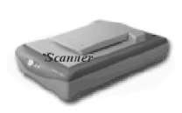
Collecting information
Feed the IS
Entering information is usually costly
  It often needs human work
Efforts to automate the collection of information
In your opinion, how?

Slide 21


Collecting information
Real-time systems
Optical reading (for example, questionnaires)
Scanning, content analysis robots, ...

Slide 22

Collecting information
Other forms:
Product
Book
Barcode reader (bluetooth)
EAN13 = 077774805926
EAN13 = 9782012100237
ISBN = 2012100236

Slide 23
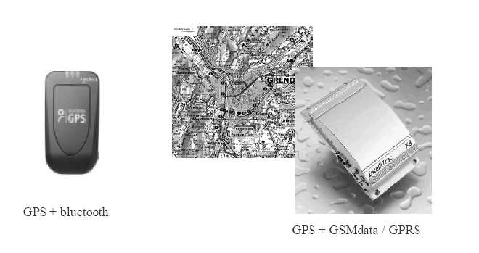
Collecting information
Automatic data acquisition in GPS systems is part of data entry!

Slide 24

Collecting information
The new trend:

Slide 25

Video: what is a QR code (short for Quick Response)?
Video

Slide 26
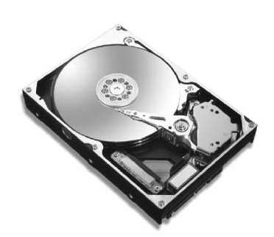
Storage
Storing or recording information on permanent memory (hard disk, CD, flash drive, ...)
Information to store:
the applications (application software)
the data (database, files)

Slide 27
Storage
Example: for the administrative activity (calculating employees' pay) we will store:
Pay calculation software
An employee file
A program that calculates the pay.
It holds all the information about employees that is needed to calculate the pay.

Slide 28


Storage
Ensuring durability means guaranteeing long-lasting and reliable storage.
Today
But
The main media are computer disks
Files on hard disk, DVD, ...
The DBMS (database management system) is a key part of the IS
Paper is still widely used in companies
Keeping paper archives
Sometimes this is required by law

Slide 29


Processing
To be usable, information goes through processing:
Sort orders by date and customer
Calculate the amount to pay
Classify, summarize, ...
This processing can be:
Manual
less and less often
Automatic
done by computers

Slide 30


Automatic processing
It works on the stored data that comes from the outside environment.
It is started by an external event that carries information to enter (inputs).
It produces results to send to the outside environment and/or to store.

Slide 31
Automatic processing
Database
Storage
Input
Automatic processing
Event / Data
Outside environment
Transmission

Slide 32
Types of automatic processing: a) Checks
Checking that the data is valid when it is entered: accept correct data and reject data that does not follow the rules of the studied subject.
Example
Entering the social security number (NSS): it must have 12 digits.
Rule: minimum age of an employee at hiring = 18 years.
Today's date = 03/11/2009 and the employee's date of birth = 13/04/1992: the date is rejected, because the candidate is only 17, not yet 18.

Slide 33
Types of automatic processing: b) Updates
Changing the data in the information base when changes happen in the outside world. There are 3 types of update operations: add, delete and change values.
Example: a company may decide to
DELETE
Remove a product from the market because it does not sell: delete it from the database.
ADD
Launch a new product: add it.
CHANGE
A product is judged too expensive, so its unit price (UP) must go down: change the UP value.

Slide 34

Types of automatic processing: c) Search and access
Choosing, from the data in the database, the data that matches the criteria set by the user.
Example
Information wanted
Information to show
Search criterion
list of students with a grade of 10 or more
last name, first name
grade ≥ 10

Slide 35
Types of automatic processing: d) Calculations
Working on the entered and stored data with calculations, to get new data (results).
Example
net salary = base salary + bonuses – deductions

Slide 36




Distribution
To be used, information must reach its recipient as fast as possible.
Oral form
Paper
Digital (more and more)
(mail, internal note, ...)
Best speed
Wide distribution
Internet (web, email, mobile phones)

Slide 37



Some examples...
Classic
Accounting, pay, invoicing
Commercial management
CRM: Customer Relationship Management
SIM: Marketing Information System
  Collect and process data to steer marketing
Human resources management (HRM)
Follow careers, skills, training, pay, leave, ... of staff

Slide 38


Some examples...
Logistics
SCM: Supply Chain Management
Following relations with suppliers and customers
In JIT (Just-in-Time) logic
GCL: Management of production, logistics and suppliers
Technical data management (TDM)
PDM: Product Data Management
For management linked to a design project; to manage and control the definition, production and maintenance of a product

Slide 39



Some examples...
Product management
PLM: Product Lifecycle Management
3A CGP-MPA with C. Merlo (+Reinforcement) – Windchill
Geographic management
GIS: Geographic Information System
Produces plans and maps
Locates sites and towns geographically
French territory: www.geoportail.fr
  Freight and vehicle fleet management
  GPS
  Land registry, weather
  Mobility of agents (smartphones, tablets, ...)

