Slide 1
Chapter 1
The Company and its Information System
Prepared by Dr. Nardjes BOUCHEMAL

Slide 2


Definition
By "company" (enterprise), we mean any organization: public or private, an academic institution or an economic institution.
A company is a socio-economic unit made to produce goods and services.
Information Systems course by Mrs F. Benabderrahmane and Mrs N. Bouchemal

Slide 3




Main goals of a company
Profit
Provide jobs
Satisfy customers
Build the base for the development of a society
Information Systems course by Mrs F. Benabderrahmane and Mrs N. Bouchemal

Slide 4
Problems when there is no organization
High breakdown rate
Conflicts
Extra costs
Out of stock
Poor results
Lower turnover (sales)
Bankruptcy
Information Systems course by Mrs F. Benabderrahmane and Mrs N. Bouchemal

Slide 5



Main functions of the company
Production function
Commercial (sales) function
Administrative function
Makes goods and services to exchange them on the market.
Sells the company's products to create added value for the company.
Gives non-commercial services, like public administration.
Information Systems course by Mrs F. Benabderrahmane and Mrs N. Bouchemal

Slide 6
The company and organization
The company is a social body, with legal, financial and social sides.
Main parts of the company
The 3 factors come together to:
People (human resources)
Equipment (material resources)
Methods
Meet needs and reach goals
Hire people and make them work
Find money
Get results
Information Systems course by Mrs F. Benabderrahmane and Mrs N. Bouchemal

Slide 7
How the company works: business areas
To reach all its goals, the company is split into areas (or domains) of activity.
Sales
Production
Purchasing
Finance
Each area does a specific function.
HR
Admin
Information Systems course by Mrs F. Benabderrahmane and Mrs N. Bouchemal

Slide 8
How are the relations between the members and the departments of a company organized?

Slide 9
The company: organization chart
Definition
The organization chart (org chart) is a diagram that shows the functional, organizational and hierarchical links of a company.
Information Systems course by Mrs F. Benabderrahmane and Mrs N. Bouchemal

Slide 10
The company: organization chart
General Management
General Secretariat
Staff (HR)
Finance
Purchasing
Production
Sales
Administration
Information Systems course by Mrs F. Benabderrahmane and Mrs N. Bouchemal

Slide 11
The company: organization chart
It gives an overview of how jobs (posts) and functions are shared inside a structure.
This simple map shows who gives orders (lines of command) and who reports to whom (subordination).
A simple and clear view of complex structures.
Information Systems course by Mrs F. Benabderrahmane and Mrs N. Bouchemal

Slide 12
Example: org chart of the PIDJI Group
President of the PIDJI Group
Management (Codir)
Human Resources (Codir) / Sales assistant
Secretariat–Accounting / Sales assistant
SALES
R&D (STUDIES & DEVELOPMENT)
METHODS & QUALITY
PRODUCTION
PURCHASING
North region
Design office / New technologies (Codir), Tech watch
Methods and quality, Documents, After-sales (SAV) management
Cutting "P": wiring planning
Supplies, Logistics
Recruitment: South
Cutting design office: industrialization "FT"
Cutting "p": winding planning
Linear design office: small-series cutting
Specific cutting
Small linear parts
Mechanical works
Information Systems course by Mrs F. Benabderrahmane and Mrs N. Bouchemal
Notes:
Redrawn in English from the original French org chart. "Codir" = management committee. "SAV" = after-sales service.

Slide 13
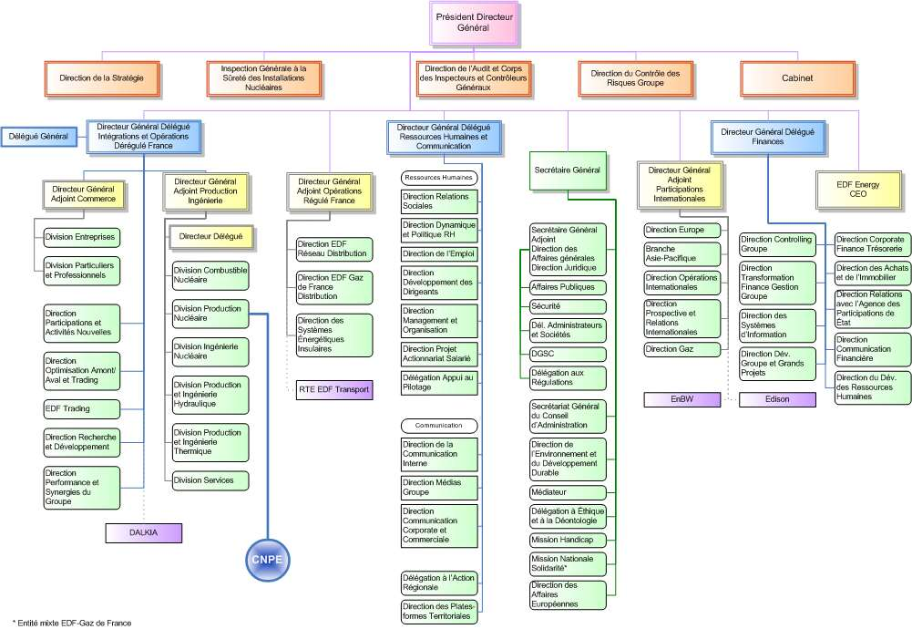
Example: org chart of a large company (EDF)
This is the real org chart of EDF (the French electricity company). The picture is the original, in French.
It shows how big companies have many levels: a CEO at the top, then deputy general managers, then many departments and divisions.
Information Systems course by Mrs F. Benabderrahmane and Mrs N. Bouchemal

Slide 14
Example: org chart of the CNPE Bugey (nuclear power plant)
Director of CNPE Bugey
Deputy Director
Quality Management Mission
Safety (Sûreté) Dept
Technical Dept
Safety, Radiation Protection & Environment Dept
Maintenance Dept
Production Dept
Economic Performance & Management Control Dept
Communication Dept
Human Resources Dept
Quality & Safety service
Site Engineering service
Environment mission head
Electrical & Mechanical service
Operations service
Management Information service
Inspection & Regulation service
New Works unit
RP safety mission head
Valves & Boilermaking service
Automation service
Safety & Radiation Protection service
Permanent Works service
Environmental Measurements service
Site protection
Fuel, Logistics & Waste service
Information Systems course by Mrs F. Benabderrahmane and Mrs N. Bouchemal
Notes:
Redrawn in English from the original French org chart. CNPE = Centre Nucléaire de Production d'Électricité (nuclear power plant). RP = radiation protection.

Slide 15
Classifying companies: (1) by name
A company is named by:
The name of its owner
What it does (its activity)
A made-up (brand) name
Cybercafé Med
S.N.T.F: National Railway Transport Company
Sonelgaz: National Electricity and Gas Company
Hotel Mercure, Sofitel…
Information Systems course by Mrs F. Benabderrahmane and Mrs N. Bouchemal

Slide 16
Classifying companies: (2) by type of activity
Commercial company
Service company
Goods production company
Goal: sell finished products
Restocks
Stores (stock)
Manages profits
Serves the public interest (customers) without focusing on profit
Examples: university, school, ministry…
Buys
Produces or transforms
Sells
Information Systems course by Mrs F. Benabderrahmane and Mrs N. Bouchemal

Slide 17
Classifying companies: (3) by size and (4) by ownership
(3) By size
(4) By ownership
Small companies
Private sector
Medium companies
Large companies
Public sector
Very large companies
Information Systems course by Mrs F. Benabderrahmane and Mrs N. Bouchemal

Slide 18


Classifying companies: (5) by economic sector
Primary sector
Secondary sector
Tertiary sector
Agriculture, fishing…
Industry
Banks, insurance, transport
Information Systems course by Mrs F. Benabderrahmane and Mrs N. Bouchemal

Slide 19
The company as an organization
To organize: create the frame where the company's activities happen. It means setting up structures, means and methods to control the flows, in line with the company's goals.
Example: making a part in a factory
1. Design office
2. Methods office
3. Scheduling office
The part is designed.
Gets the file and prepares the manufacturing steps (means, time…).
Orders all the steps needed to make the part, following which step must come first.
Information Systems course by Mrs F. Benabderrahmane and Mrs N. Bouchemal

Slide 20
To administer is to…
1
Plan
Set medium and long-term goals, and make a plan.
2
Organize
Set up the parts needed to run the plan • give the company all the means (people, equipment) it needs • create departments and job posts • decide the work of each job post.
3
Command
Give orders to do a task or a program.
4
Coordinate
Organize the tasks between the different parts.
5
Control
Check that the activities work well.
Information Systems course by Mrs F. Benabderrahmane and Mrs N. Bouchemal

Slide 21
The company as an organization: 2 points of view
View 1: a network
View 2: levels of responsibility
A network of business areas, linked by circuits. Flows move in these circuits: money, information and material.
An organization with several levels. Each level has some power to decide (general management, finance department, HR department, head of department, head of section…). Information circuits link these levels.
Money
Information
Material
Information Systems course by Mrs F. Benabderrahmane and Mrs N. Bouchemal

Slide 22
Information circuit
Banks
Insurance
As an organization, the company can be seen as a network of business areas (sales, supply, accounting…) linked by circuits where flows move.
Also, the company is not alone: it is open to the outside (customers, suppliers, banks, insurance companies, etc.). Its areas are linked to the outside by circuits where flows move.
Company
Sales
Supply
Accounting
Customers
Suppliers
Information Systems course by Mrs F. Benabderrahmane and Mrs N. Bouchemal

Slide 23




Key ideas
Functional aspects and structural aspects:
Station
Workstation (job post)
Flow
Documents
Information Systems course by Mrs F. Benabderrahmane and Mrs N. Bouchemal

Slide 24
The information flow
A flow diagram is a drawing of the actors and the flows they exchange:
a. Material flow
From raw material, the company makes changes and gives a finished product.
b. Money flow
Payments and money received.
c. Information flow
The most common flows.
Examples (information flows):
Customer orders arrive at the sales department.
The sales department sends a manufacturing order to the production units.
To enroll, the student brings a file to the registration office.
The registration office gives the students their transcript (grades).
Information Systems course by Mrs F. Benabderrahmane and Mrs N. Bouchemal

Slide 25
Flow graph
Payment (money + information)
Customers
Order
Invoice
Sales
Accounting
Banks
Manuf. order
Delivery note
Production
Director
Pay slip
Salary
Purchase order
Delivery note
Information
Staff
Purchasing
Material
Delivery note
Company
Money
Order
Suppliers
Information Systems course by Mrs F. Benabderrahmane and Mrs N. Bouchemal
Notes:
Redrawn in English from the original French graph. Original abbreviations: C = order (commande), F = invoice (facture), OF = manufacturing order (ordre de fabrication), BC = purchase order (bon de commande), BL = delivery note (bon de livraison), EP = pay slip (état de paie). Banks, Director and Staff are also actors in the original drawing.

Slide 26
Example: a bus accident
A public transport company… a bus has an accident… How is the accident handled?
1
The driver fills in an accident report, then drives the bus to the workshop.
2
The workshop makes a repair estimate (quote).
3
The administrative department decides who is responsible, based on the accident report.
Three possible cases:
Insurance pays
Driver is responsible
Third party is responsible
Report and estimate are sent to the insurance company, which pays the bill.
The company pays the injured person after they show proof (receipts).
The other person pays the bill…
Information Systems course by Mrs F. Benabderrahmane and Mrs N. Bouchemal

Slide 27


Solution: what to do
Define the actors
Define the documents
Draw the flows
Internal actors and external actors
Internal documents and external documents
Show how documents move between actors
Information Systems course by Mrs F. Benabderrahmane and Mrs N. Bouchemal
Notes:
The last line ("Show how documents move between actors") is a short simple explanation of "établir les flux".

Slide 28
The company as a system
Reminder: the idea of a system
A system is a group of material and non-material elements (people, machines, rules, methods…) that interact with each other. They are organized to reach a goal, and they change a set of inputs into a set of outputs.
Inputs
Transformation
Outputs
Information Systems course by Mrs F. Benabderrahmane and Mrs N. Bouchemal

Slide 29
The idea of a system: examples
a) Coffee maker
Goal: make coffee
Coffee + Water
Coffee maker: transformation
Liquid coffee
b) Factory
Goal: produce 1000 products per month
Raw materials + Spare parts
Factory: manufacturing
Finished products
Information Systems course by Mrs F. Benabderrahmane and Mrs N. Bouchemal
Notes:
In the original slide the goal of the factory is written "produire 1000 Produits 5/mois". It is translated here as 1000 products per month.

Slide 30
Control of a system
The outputs must match the goal that was set.
Control acts on the inputs and/or on the transformation, to make the gap between the goal and the results as small as possible.
Goals
Inputs
System
Outputs
Action on the inputs
Action on the transformation
Control: compare the outputs with the goals
Information Systems course by Mrs F. Benabderrahmane and Mrs N. Bouchemal

Slide 31
Company vs System
Since the 1970s
"A set of elements in dynamic interaction, organized for a goal."
Company = System
— Joël De Rosnay, "Le Macroscope", Éditions du Seuil, 1975
So the company is seen as a set of elements (human, material, financial and technical means) that are linked to each other (interrelated).
Any human organization (the State, a family…) can be seen as a system.
Information Systems course by Mrs F. Benabderrahmane and Mrs N. Bouchemal

Slide 32



Company vs System
Like any system, the company is:
Open
Goal-driven
Evolving
to its environment
it has a goal (goal = profit…)
it is always changing
To reach its goal, the system takes its environment into account and regulates how it works by adapting to changes.
Information Systems course by Mrs F. Benabderrahmane and Mrs N. Bouchemal

Slide 33
An organization seen as a system: examples
Goal: produce and sell goods
Raw materials
Service requests
Organization
Finished products
Services given
Staff • Equipment • Money • Work methods • Information
Goal: reach 80% success
Students to train
Training school
Trained students
Teaching • Equipment • Training programs • …
Information Systems course by Mrs F. Benabderrahmane and Mrs N. Bouchemal

Slide 34
The parts of the system
The parts of a system are also systems themselves (sub-systems).
The company can be split into 3 sub-systems:
  The decision (control) system
  The information system
  The operating system (the one that does the work)
Decision system
Environment
Information system
Operating system
Information Systems course by Mrs F. Benabderrahmane and Mrs N. Bouchemal
Notes:
"Système opérant" is translated as "operating system" here. It means the part of the company that does the actual work. Do not mix it up with a computer operating system (like Windows).

Slide 35
Each system gives services to the others
Control (steering) system
Communication
Generation
Processing
Storage (memory)
Information system
Communication
Operating system
Information Systems course by Mrs F. Benabderrahmane and Mrs N. Bouchemal

Slide 36

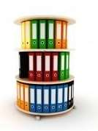

What each sub-system does
Control system
Think: adapt to the environment, design
Decide: forecasts, sharing of resources, planning
Control
Information system
Create information
Store (memorize)
Share (spread)
Process
Operating system
Transform
Produce
Information Systems course by Mrs F. Benabderrahmane and Mrs N. Bouchemal

Slide 37
What each sub-system does
a. Control (decision) system
b. Operating system
c. Information system
Makes decisions so the organization works well.
Sets the goals, and the methods and means to reach them.
Makes sure the organization reaches its goals.
The part that reaches the goal.
Turns the decisions into actions; follows the orders.
Makes goods and services (outgoing flows) from resources (incoming flows, e.g. raw materials).
Stores, processes and shares information for the people who work in the organization.
Gives decision information to the control system, and work information to the operating system.
Links the two systems.
Information Systems course by Mrs F. Benabderrahmane and Mrs N. Bouchemal
Notes:
This slide combines two slides from the original deck (a/b/c definitions and the longer explanation of each sub-system). SD = decision system, SO = operating system, SSP = steering (control) sub-system.

Slide 38
Example
Company
Control system
Selling price
Sales statistics
Information system
Delivery preparation
Stock exit
Customer order
Operating system
Invoice
Information Systems course by Mrs F. Benabderrahmane and Mrs N. Bouchemal

