Slide 1


People’s Democratic Republic of Algeria
Ministry of Higher Education and Scientific Research
Abdelhafid Boussouf-Mila University
Faculty of Science and Technology
Department of Science and Technology Presented by:
Second-Year Master’s Degree in Structural Engineering Dr. BELGHIAT Choayb
CHAPTER I
Introduction to Inelastic Structural Analysis
Academic Year 2026–2027

Slide 2
Cracking and material damage are common phenomena that may occur in structural materials and can, in some cases, lead to brutal structural failure.
Due to the limitations and uncertainties prevailing previously
Introduction
The elastic design method considers only the elastic properties of materials and does not account for their post-peak behavior, which may lead to inefficient use of the material.
With the development of computers and the appearance of sophisticated numerical models
Plastic analysis provides an accurate determination of the failure load and therefore forms the basis of the ultimate-load design method. By accounting for material behavior beyond the elastic range, it can result in significant reductions in structural weight and material cross-sections compared with the elastic design method.

Slide 3
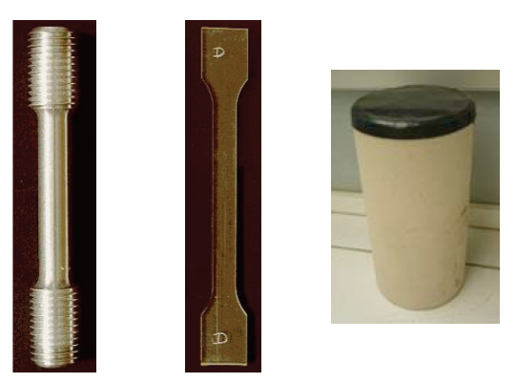
To understand the macroscopic behavior of a material, uniaxial tests are performed on standardized specimens. These tests are among the simplest experimental methods and provide a relatively uniform state of stress within the specimen.
The test results are first expressed as force–elongation diagrams. Because the stress distribution is relatively uniform in the central region of the specimen, these diagrams can be transformed into stress–strain diagrams.
Simple Tensile Test and Yielding Limits
The following figure illustrates the stress–strain curve obtained from a simple tensile test performed on a stainless-steel specimen.

Slide 4
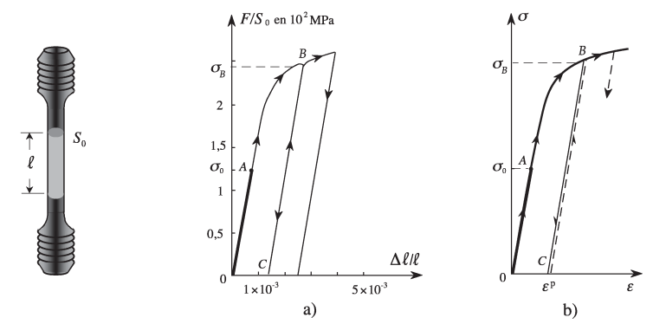
The following observations can be made:
The existence of a certain limit σ₀ (Point A), beyond which the material response becomes irreversible.
When a specimen is unloaded after being stressed beyond Point A, the unloading path follows BC rather than the original loading path BAO. Upon complete unloading, a permanent residual deformation corresponding to segment OC remains, which is referred to as plastic deformation.
Simple Tensile Test and Yielding Limits
For a new loading cycle that remains below σB, the response remains reversible along CB.
When σ exceeds σB, the curve follows the original loading path beyond Point B. Therefore, σB becomes the current elastic limit.
σ0 is called the initial elastic limit or initial yield limit.
After a loading cycle, σB is called the current yield limit or current elastic limit.
This behavior is sometimes referred to as the “Coulomb Principle.”
The permanent deformation remaining after unloading is defined as the plastic strain, εp.

Slide 5
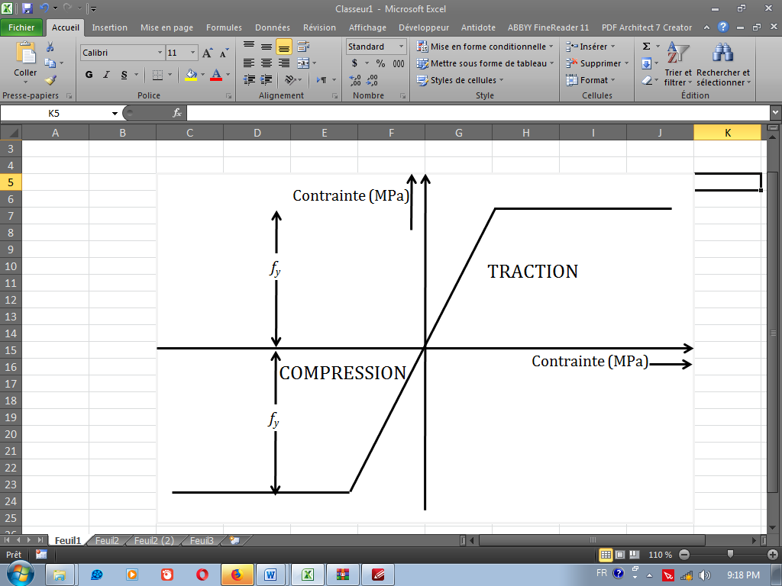
A beam subjected to a bending test exhibits deformation. As the load increases, a plastic zone develops at the first critical section, eventually forming a plastic hinge. Due to the ductility of steel, the bending moment at this section remains approximately constant. The less-stressed regions of the beam then contribute to carrying the additional load. Consequently, once the elastic limit is reached, the structure can continue to deform under an approximately constant load.
This design approach is based on the ultimate load-carrying capacity of the structure, which corresponds to its maximum resistance. The ultimate load is determined based on the plastic resistance of the steel.
Basic Theory
An ideal elastic–perfectly plastic material follows Hooke’s law up to the yield point. Beyond this point, it undergoes plastic deformation at a constant stress. Its tensile and compressive responses are assumed to be symmetric; consequently, the yield stresses in tension and compression are equal.

Slide 6
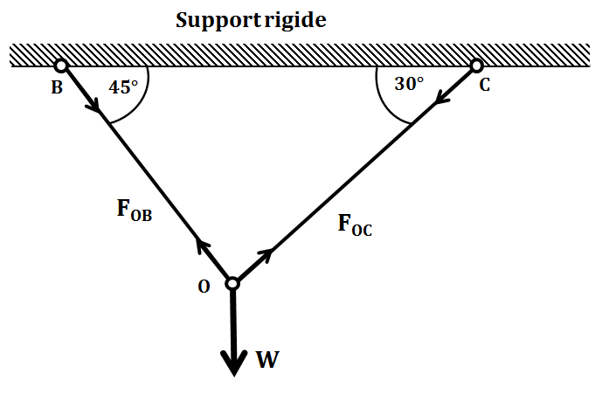
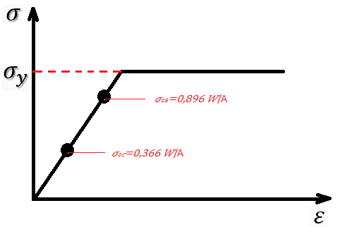



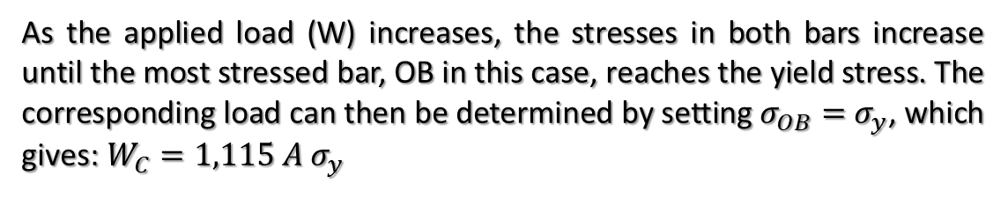
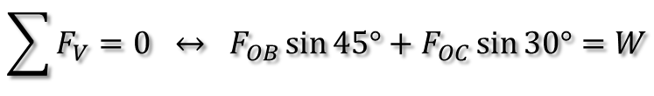
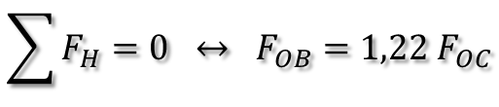

Statically Determinate Structure
Plastic analysis of the statically determinate truss allows the collapse load WC to be predicted, at which the truss members undergo plastic yielding.
$$\sum{F_{H}=0} ↔ F_{OB}={1,22 F}_{OC}$$
$$\sum{F_{V}=0} ↔ F_{OB}\sin{45°}+F_{OC}\sin{30°}=W$$
Behavior of a Structure under Variable Loading
By substitution, we obtain:
$$F_{OB}=0,896 W$$
and
$$F_{OC}=0,733 W$$
Assuming that member OB has a cross-sectional area (A), while member OC has area of (2A), the corresponding stresses are therefore given by:
$σ_{OC}=0,366 W$/A
and
$σ_{OB}=0,896 W$/A
As the applied load (W) increases, the stresses in both bars increase until the most stressed bar, OB in this case, reaches the yield stress. The corresponding load can then be determined by setting $σ_{OB}=$ $σ_{y}$, which gives:$W_{C}=1,115 A σ_{y}$

Slide 7
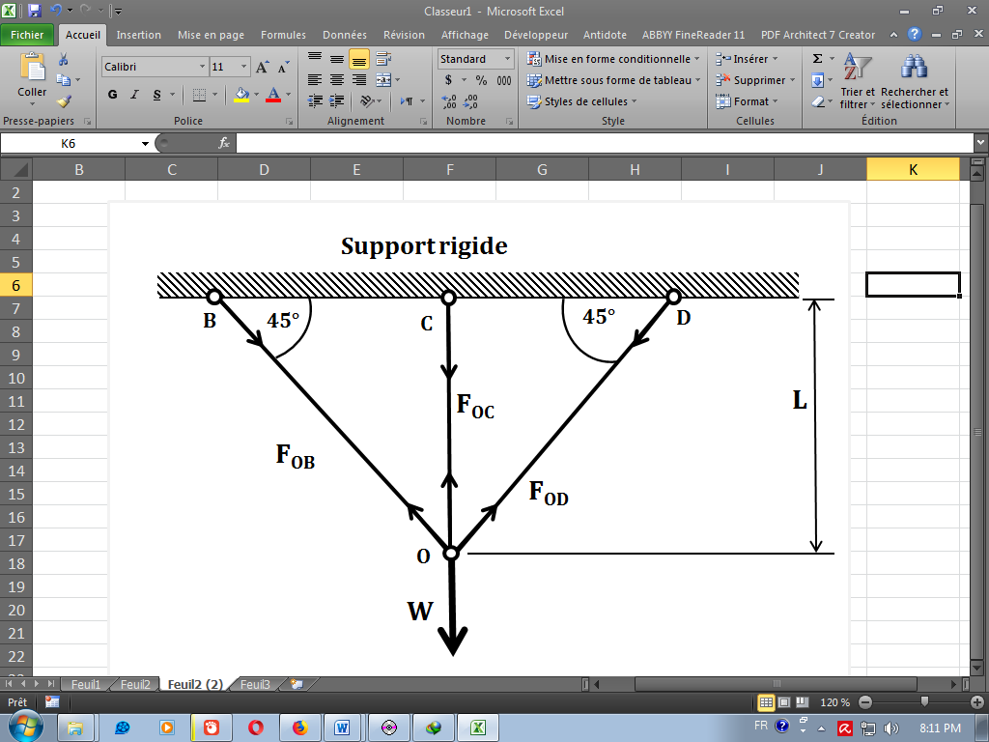
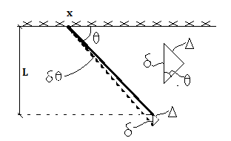
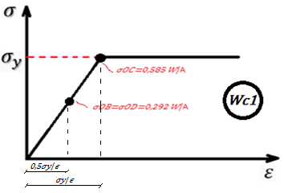

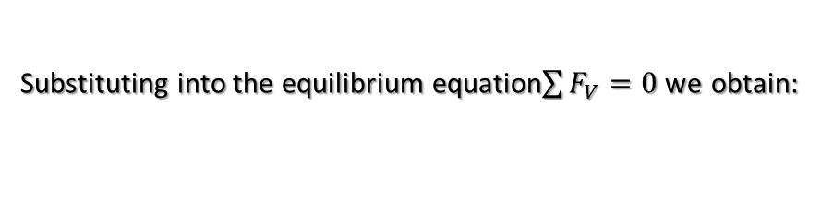
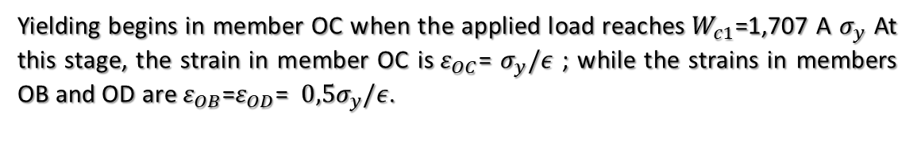



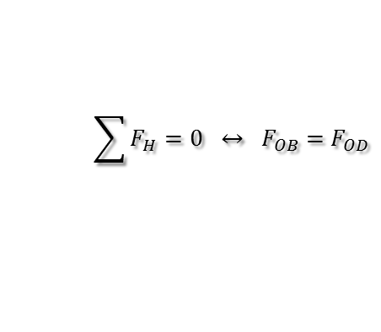
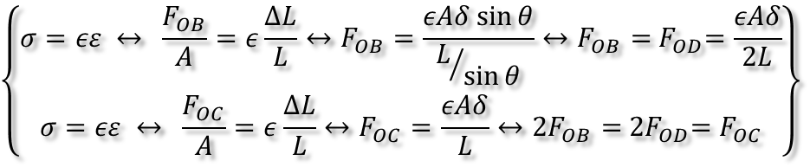
Hyperstatic Structure
$$\sum{F_{H}=0} ↔ F_{OB}={ F}_{OD}$$
and
$$\sum{F_{V}=0} ↔ F_{OB}\sin{45°}+F_{OC}+F_{OD}\sin{45°}=W$$
Since the structure is statically indeterminate, an additional compatibility equation is required to determine the unknown forces. We therefore consider the vertical displacement of point O resulting from the deformation of the members:
From the figure:
$$δ\sin{ϴ}=∆$$
Using Hooke's law, we obtain:
Behavior of a Structure under Variable Loading
$$\left\{\begin{matrix}σ=εε ↔ \frac{F_{OB}}{A}=ε\frac{∆L}{L}↔F_{OB}=\frac{εAδ\sin{θ}}{L/{\sin{θ}}}↔F_{OB}={ F}_{OD}=\frac{εAδ}{2L} \\ σ=εε ↔ \frac{F_{OC}}{A}=ε\frac{∆L}{L}↔F_{OC}=\frac{εAδ}{L}↔{2F}_{OB}={ 2F}_{OD}={ F}_{OC}\end{matrix}\right\}$$
Substituting into the equilibrium equation$\sum{F_{V}=0 }$we obtain:
$σ_{OB}=σ_{OD}=0,292 W$/A
and
$σ_{OC}=0,585 W$/A
Yielding begins in member OC when the applied load reaches$W_{c1}$=1,707 A $σ_{y}$ At this stage, the strain in member OC is$ε_{OC}$= $σ_{y}/ε$ ; while the strains in members OB and OD are $ε_{OB}$=$ε_{OD}$= ${0,5σ}_{y}/ε$.

Slide 8
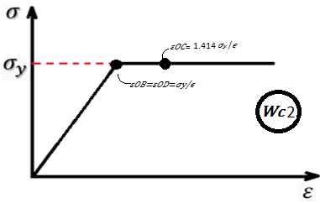
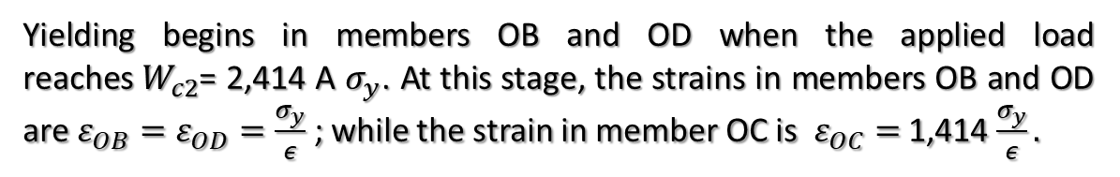
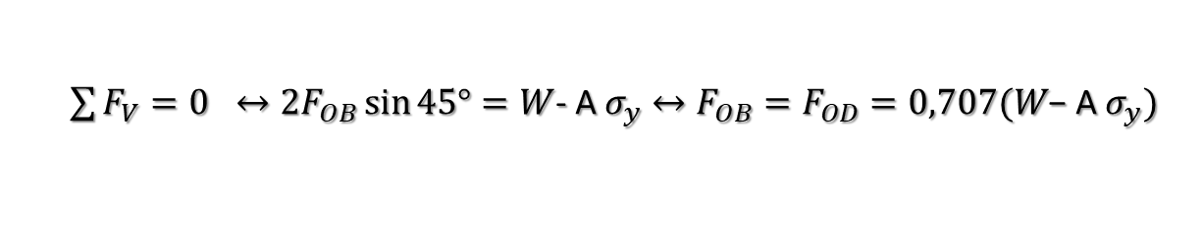
After the yielding of member OC, its resistance remains constant. Consequently, the degree of static indeterminacy decreases by one, and the structure becomes statically determinate. In this case, point O remains supported only by members OB and OD.
$\sum{F_{V}=0} ↔{2F}_{OB}\sin{45°}=W$- A $σ_{y}$ $↔F_{OB}=F_{OD}=0,707(W\text{− }\text{A} σ_{y})$
Yielding begins in members OB and OD when the applied load reaches$W_{c2}$= 2,414 A $σ_{y}$. At this stage, the strains in members OB and OD are $ε_{OB}=ε_{OD}=\frac{σ_{y}}{ε}$ ; while the strain in member OC is$ε_{OC}=$ 1,414 $\frac{σ_{y}}{ε}.$
Behavior of a Structure under Variable Loading
Conclusions:
In a statically determinate structure, collapse occurs when the most highly stressed member reaches its yield limit.
For a given structure, the collapse load depends on the geometry and material properties of its members.
The degree of static indeterminacy decreases by one (1) when a member reaches the plastic-yielding state.

