Slide 1

Module:
1
Algorithmics and data structure 2
Program
Chapter 1: 1.1Subroutines
1.2recursion
Chapter 2:The files
Chapter 3:The lists
3.1Linked lists
3.2Doubly linked lists
3.3Particular linked lists (stacks, lines)
The teacher: Kimouche Abdelkader
Notes:
1

Slide 2
Chapter 2 :
The files
The teacher:
Kimouche Abdelkader
2

Slide 3
Chapter objective
3
Learn to manipulate the files using the programming lines (practically by C++ language instructions)
Chapter 2: The files
Notes:
3

Slide 4
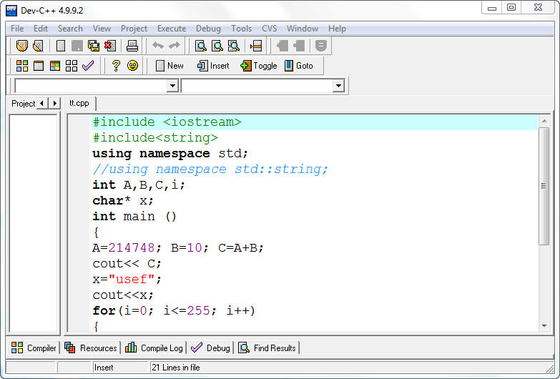

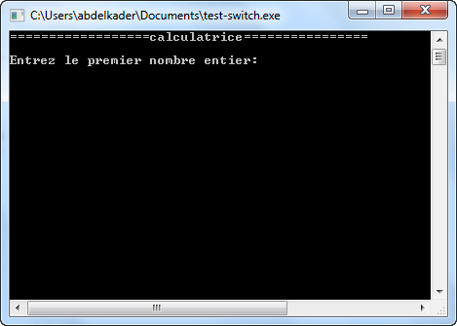
Problematic
4
A
B
Memory box
C
i
x
Central Memory
The end of execution
Data loss
Cutting off the electricity
Chapter 2: The files
Notes:
4

Slide 5
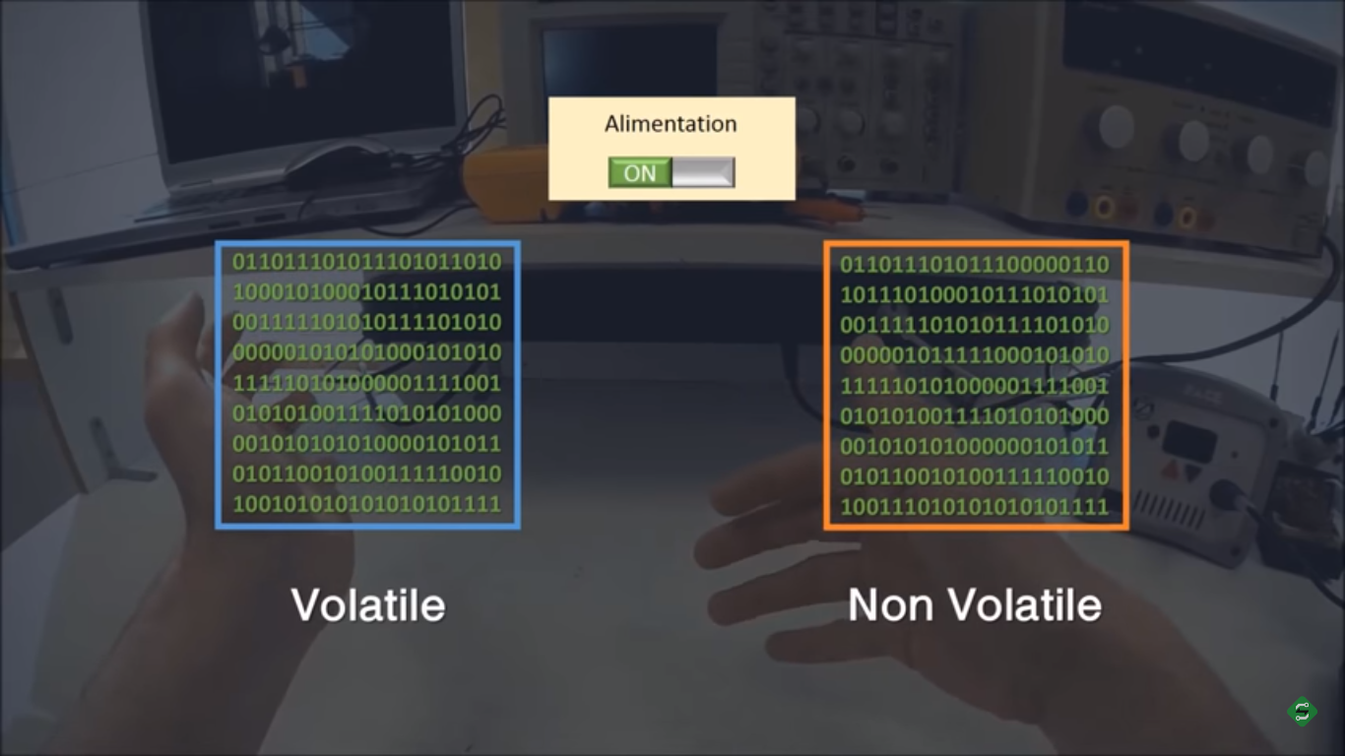
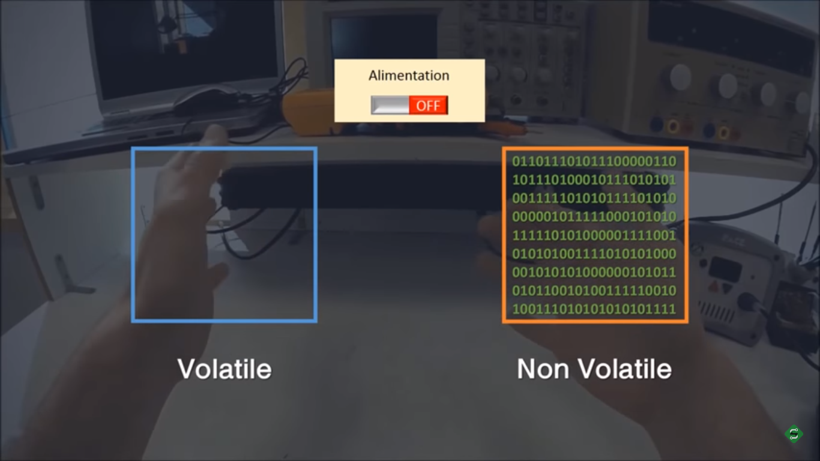
1. The volatility of a memory
5
1.1 definition
A memory is said volatile when she loss of data in the absence of power supply.
Chapter 2: The files

Slide 6
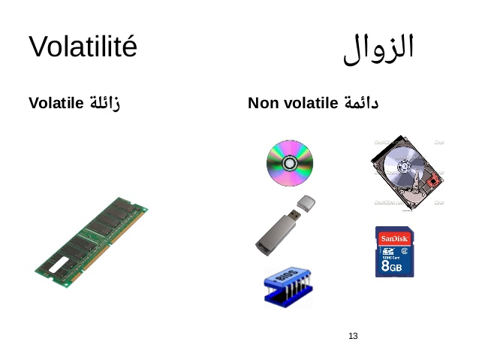
1. Volatile memories
6
1.2 examples
Chapter 2: The files

Slide 7



Problematic (solution)
7
A
B
Memory Box
C
i
x
File of data
Volatile Memory
non volatile Memory
Chapter 2: The files
Notes:
7

Slide 8



2. Files
8
2.1 definition
A set of digital data (0 and 1) united under the same name, recorded on a storage medium permanent, called mass memory
The storage medium, such as a Hard disk, a CD-ROM, flash memory, etc., and handled as a unit.
Chapter 2: The files

Slide 9
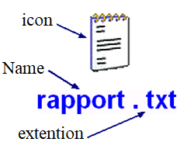
9
2. Files
2.1 definition
A file contains a name which is used to designate and access content. This name often includes a suffix called the extension, which provides information on nature information contained in the file and therefore usable software to manipulate it.
Chapter 2: The files

Slide 10
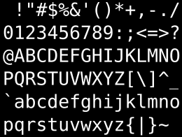



2. Files
10
2.2 file types
Depending on the nature of content
Text: content is text
Extensions: .txt .Doc .html …
Chapter 2: The files

Slide 11



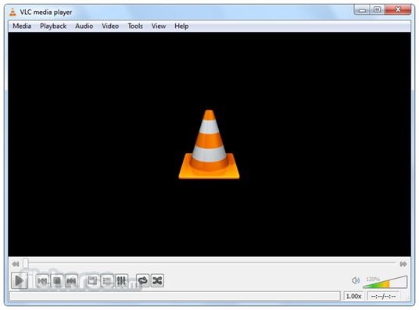
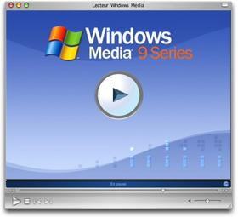

2. Files
11
2.2 file types
Depending on the nature of content
Multimedia: the content is sound, image, or video
Extensions: sound: .mp3 .wav .rm…
image: .jpg .gif .png…
video: .mp4 .avi .wmv…
Chapter 2: The files

Slide 12


2. Files
12
2.2 file types
Depending on the nature of content
executable: the content is a binary program executable directly by the processor.
Extensions: .exe .com .sh .bat …
Chapter 2: The files

Slide 13
2. Files
13
2.2 file types
In algorithmic
The text file: made up of a sequence of characters forming a text (character string).
They are used to record texts but also numerical values with a view to exchanging them with other software. They are readable using a simple text editor.
Chapter 2: The files

Slide 14
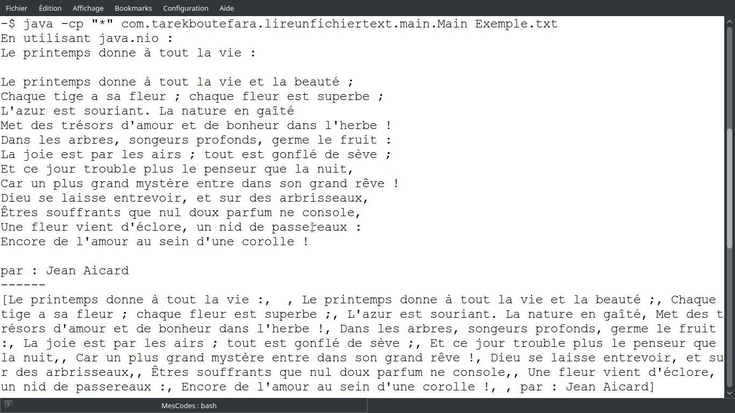
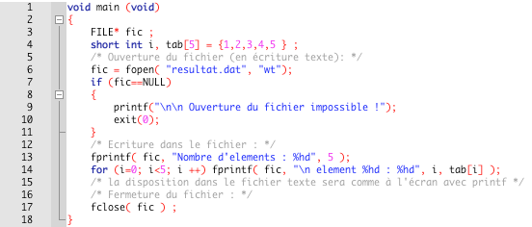
2. Files
14
2.2 file types
In algorithmic
The text file:examples
Simple text
Program source code
Chapter 2: The files

Slide 15
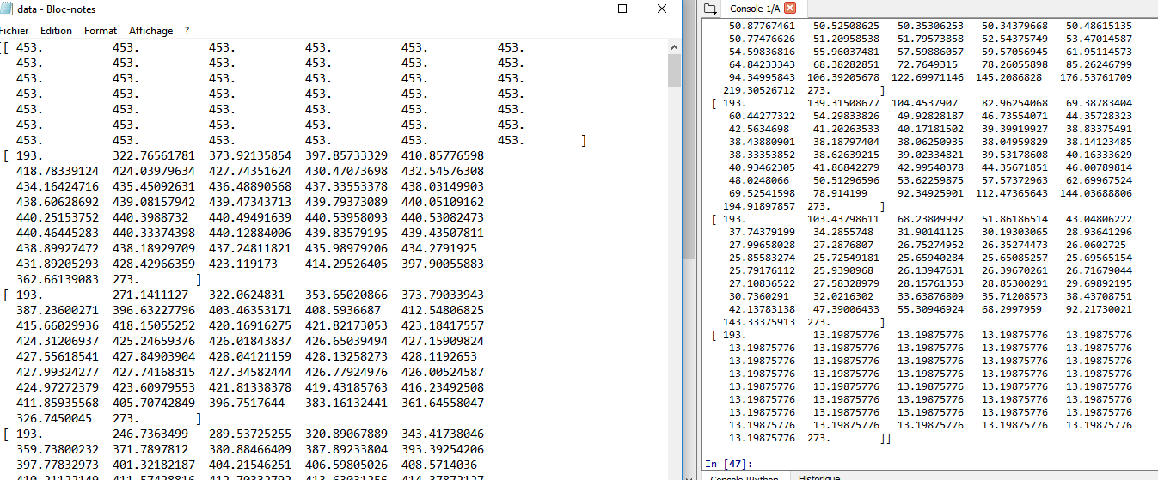
2. Files
15
2.2 file types
In algorithmic
The text file:examples
Digital data
Chapter 2: The files

Slide 16
2. Files
16
2.2 file types
In algorithmic
The binary file: containing data as bytes which therefore only make sense for the software that uses them.
this type of files is unreadable by a text editor, it is made up from a collection of recordings.
Each record containing a collection of logic units of information also called fields.
Chapter 2: The files

Slide 17
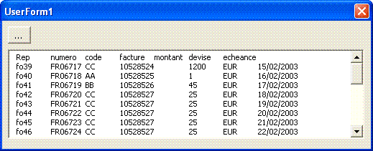
2. Files
17
2.2 file types
In algorithmic
The binary file:examples
Records file
Chapter 2: The files

Slide 18
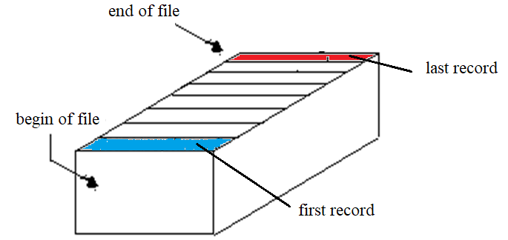
2. Files
18
2.2 file types
In algorithmic
The binary file:Organization
Records file
Chapter 2: The files

Slide 19
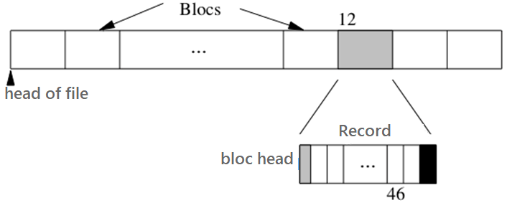
2. Files
19
2.2 file types
In algorithmic
The binary file:Organization in memory
Records file
Chapter 2: The files

Slide 20
2. Files
20
2.4 File handling
Most current programming languages ​​have instructions for manipulating files.
These instructions can be classified as follows:
Opening and creating a file,
Closing a file
Reading and writing records from the file,
Positioning in the file,
End of file detection.
Chapter 2: The files

Slide 21
2. Files
21
2.4 File handling
Opening and creating a file
To use a physical file F in an algorithm, it was necessary that this algorithm contains a file variable f. The association between f And Fwill there fore be carried out by means of a process called assignment
Syntax : ASSIGN (f, 'path_access_F') ;
After the assignment, you always have to open a file To be able to use it, the file open instruction must indicate whether the file will be read, modified or created.
Chapter 2: The files

Slide 22
2. Files
22
2.4 File handling
Opening and creating a file
Syntaxes:
OPEN(f); : if F is a file that already exists on disk (opening for reading).
REWRITE(f); : if we want to create a file F which does not exist yet on disk, or which already exists but whose entire content we want to overwrite (open for writing).
ADD(f); : if we want to open a file F by being able to add data (only at the end of the file).
Chapter 2: The files

Slide 23
2. Files
23
2.4 File handling
Opening and creating a file
Noticed :
- Open() makes F accessible and positions the pointer at the start of the file.
-In the case where F does not exist on disk, REWRITE() allows create a file whose name and path are those specified during the assignment.
Chapter 2: The files

Slide 24
2. Files
24
2.4 File handling
Opening and creating a file
Noticed :
It may happen that you open a file that does not contain any data.The start of the file will then be the end of the file. Function boolean Eof(f) allows you to check at any time whether the pointer reached the end of the file or not.
Chapter 2: The files

Slide 25
2. Files
25
2.4 File handling
Reading and writing records from the file
After opening the file, several possibilities are offered:
  Read the information it contains,
  Modify someone,
  DELETE someone,
  Add others.
Chapter 2: The files

Slide 26
2. Files
26
2.4 File handling
Reading and writing records from the file
Syntaxes:
Read (f,p); For read a recording of F and insert the data it contains into the variable p (p is of record type).
Write (f,p); For insert in F a record having the data contained in the variable p (p is of record type).
Chapter 2: The files

Slide 27
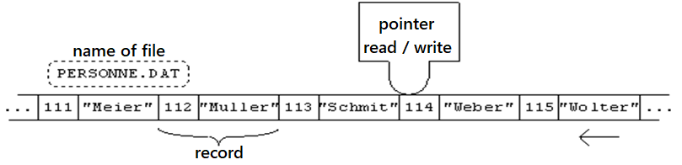
2. Files
27
2.4 File handling
Reading and writing records from the file
remark:
After reading / writing a record, the pointer moves immediately to the next record. If there are no more, the position of the pointer then becomes end of file.
Chapter 2: The files

Slide 28
2. Files
28
2.4 File handling
Closing a file
Closing is an essential operation in file manipulation. A good programmer must therefore never neglect it, because it allows to:
  avoid mistakes of input/output,
  preserve the integrity of data from a file,
  optimize an algorithm using a minimum of internal variables with a maximum of external files.
Chapter 2: The files

Slide 29
2. Files
29
2.4 File handling
Closing a file
Syntaxes:
CLOSE(f) ;
This instruction closes the file assigned by the variable f.
REMARK:
If we want to close several files, we must use one instruction for each open file.
Chapter 2: The files

Slide 30
2. Files
30
2.5 Application example
Write an algorithm that displays all the values ​​contained in an integer file F.
  Steps to follow:
    File assignment
    File opening (read, write, add)
    Make the goal
    Closing file
Chapter 2: The files

Slide 31
2. Files
31
2.5 Application example
Solution :
  Algorithm file_manipulate
  p: integer;
  f: file of integer;
  Begin
  Assign (f, 'c:\integers.txt');
  Open(f) ;
Chapter 2: The files

Slide 32
2. Files
32
2.5 Application example
  Solution :
  While (not (Eof(f)) ) do
  Read(f,p) ;
  Write ('We just read the number',p) ;
  End while
  CLOSE(f) ;
  END.
Chapter 2: The files

Slide 33
2. Files
33
2.5 Application example
Solution:
  Algorithm file_manipulate
  p: integer;
  f: file of integer;
  Begin
  Assign (f, 'c:\integers.txt');
  Open(f) ;
  While (not (Eof(f)) ) do
  Read(f,p) ;
  Write ('We just read the number',p) ;
  End while
  CLOSE(f) ;
  END.
statement
assignment
Check the end of file
Open for reading
Reading data
Closing the file
Chapter 2: The files

Slide 34
2. Files
34
End of chapter
Chapter 2: The files

