Slide 1
Bipolar Transistor in Static (DC) Operation

Slide 2
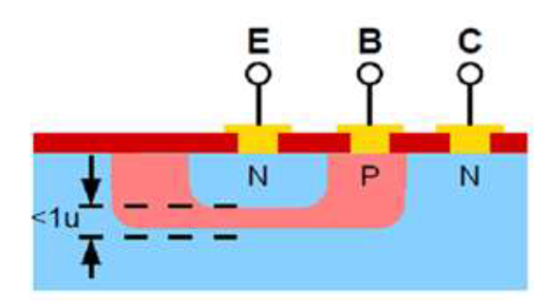
Structure of a Bipolar Transistor
A Bipolar Junction Transistor (BJT) consists of three layers of extrinsic semiconductors (Silicon or Germanium), forming two opposing PN junctions. There are two types: NPN and PNP.

Slide 3
Base (B): Controls the current through the transistor; very thin (a few microns).
Collector (C): Terminal through which current enters the transistor.
Emitter (E): Terminal through which current and output signal exit the transistor.

Slide 4
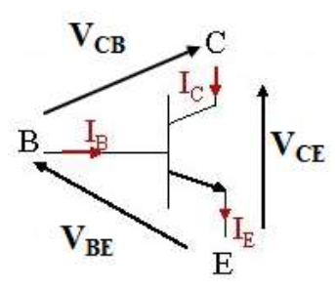
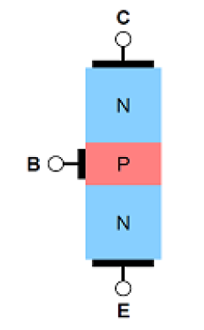
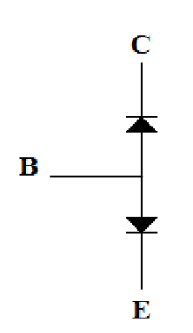
NPN:

Slide 5
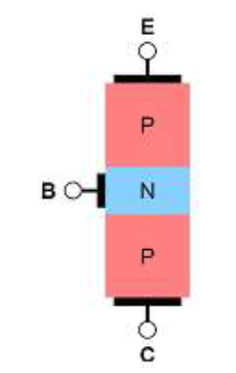
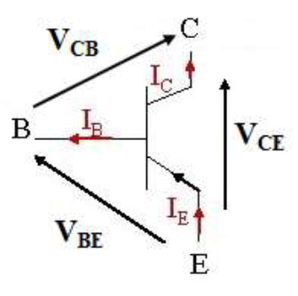
PNP:

Slide 6


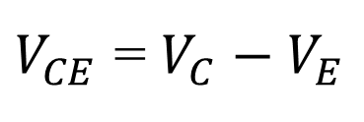

NPN Transistor:
$$I_{C}=βI_{B}$$
$I_{E}=I_{B}+I_{C}$
$$V_{BE}=V_{B}−V_{E}$$
$$V_{CB}=V_{C}−V_{B}$$
$$α=\frac{I_{C}}{I_{E}}$$
$$V_{CE}=V_{CB}+V_{BE}$$
$V_{CE}$ = $V_{C}−V_{E}$

Slide 7
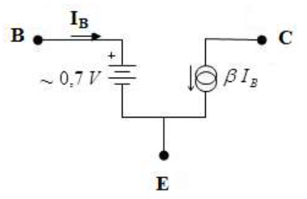
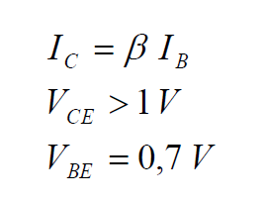
Operating Modes of an NPN Transistor
The bipolar transistor has two operating modes: linear mode (amplification) and cutoff/saturation mode.
Linear mode:

Slide 8
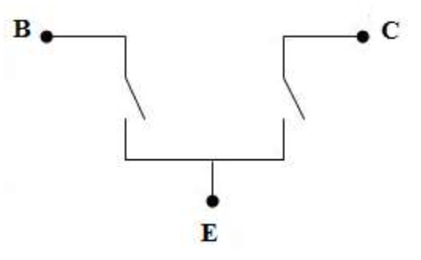
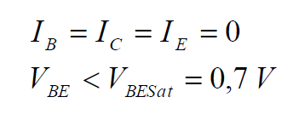
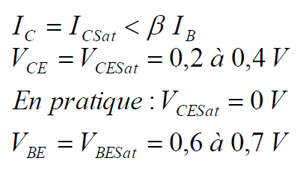
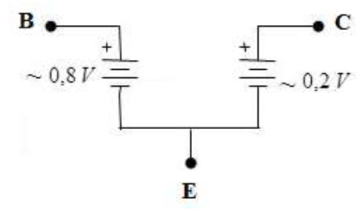
Cut off mode:
Saturation Mode:

Slide 9
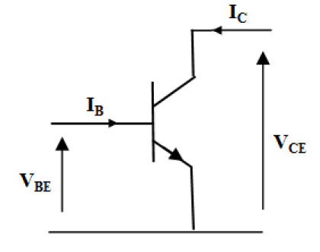
Basic Transistor Configurations
  Common Emitter (CE):
  Used at low frequencies (AF) to amplify a signal.

Slide 10
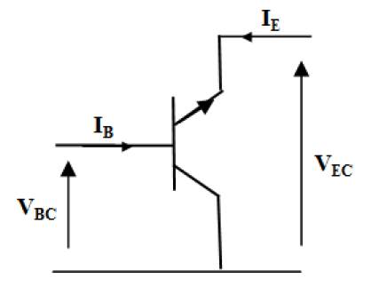
  Common Collector (CC):
  Used as an impedance adapter (buffer).

Slide 11
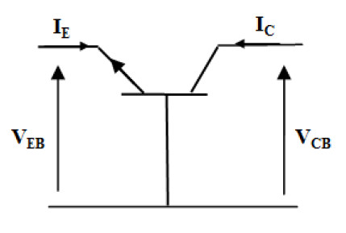
Common Base (CB):
Used at high frequencies (HF).

Slide 12
NPN Transistor Characteristic Networks
The characteristics are curves showing the relationships between the currents and voltages of a transistor. They are used to define the operating regions, determine the optimal operating point, and extract transistor parameters.

Slide 13
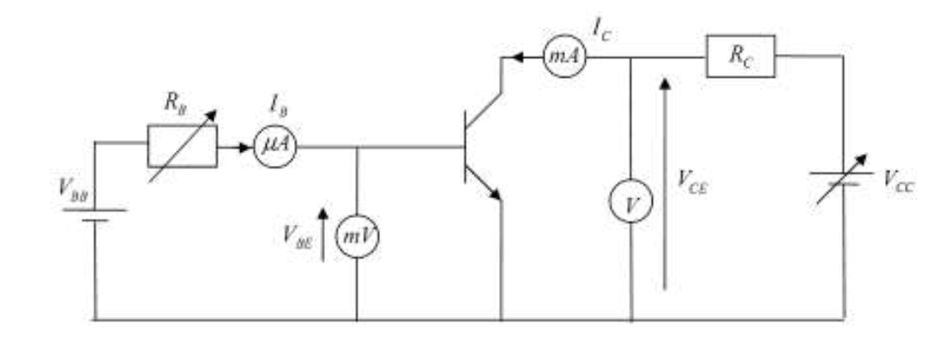

Slide 14
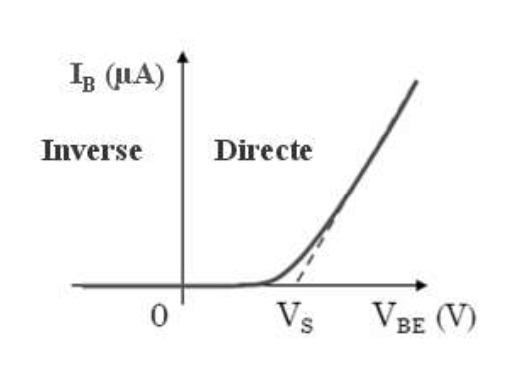


Input Characteristics ($I_{B}=f(V_{BE})$)
It is practically the same as the forward-biased diode characteristic and depends very little on ($V_{CE}$). Therefore, it is usually plotted for a single value of ($V_{CE}$).
In normal operation, ($V_{BE}$) is about 0.7 V for a silicon transistor, and the base current ($I_{B}$) is generally less than 1 mA.

Slide 15
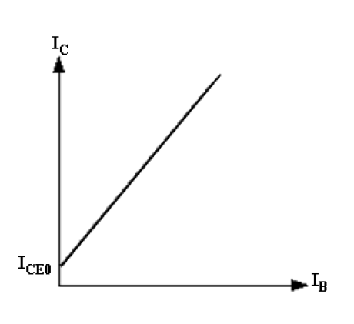

Current Transfer Characteristics ($I_{C}=f(I_{B})$ )
A bipolar transistor acts as a current
amplifier, characterized by the
relationship between the output
current ($I_{C}$) and the input current
($I_{B}$) through the current gain $β$:
$$I_{C}=βI_{B}$$

Slide 16
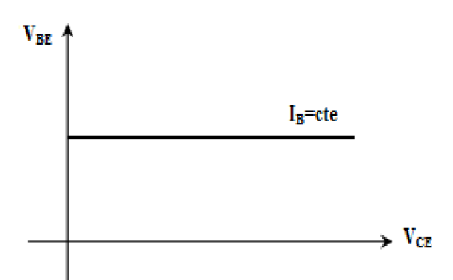
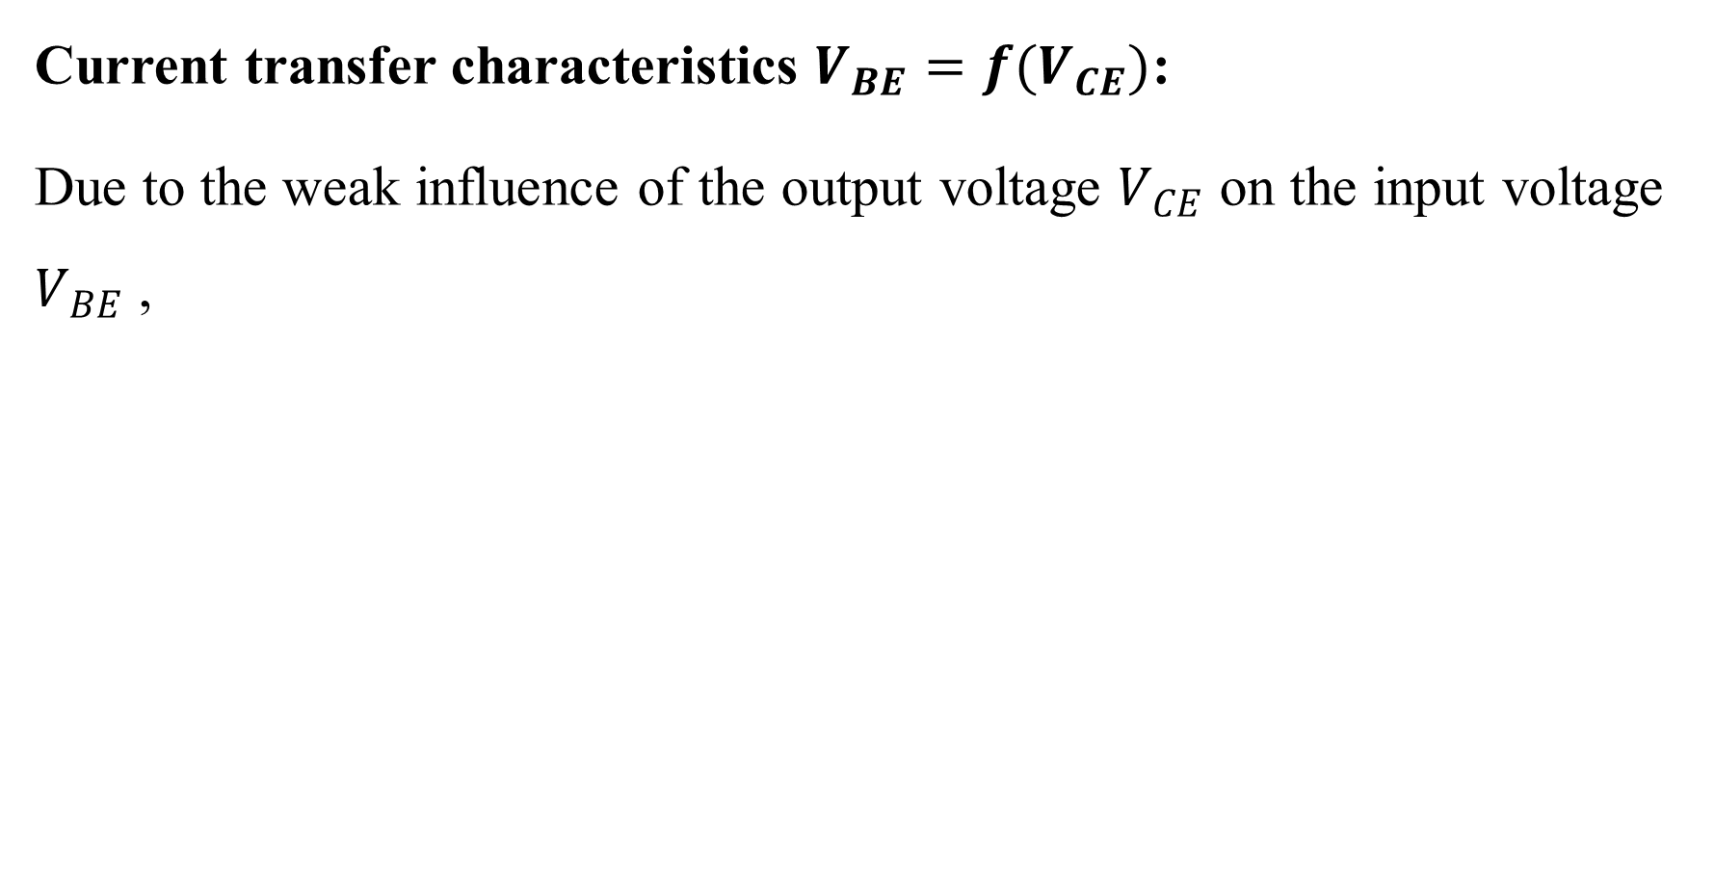
Current transfer characteristics $V_{BE}=f(V_{CE})$:
Due to the weak influence of the output voltage $V_{CE}$ on the input voltage $V_{BE}$ ,

Slide 17
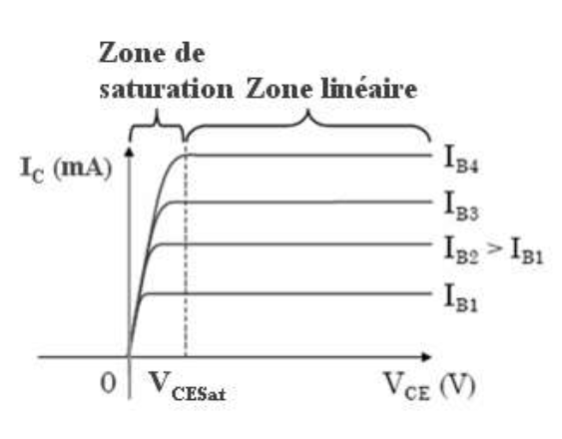

Output characteristics $I_{C}=f(V_{CE})$ :
The transistor's output characteristic is
defined by the relation $I_{C}=f(V_{CE})$
with $I_{B}$ constant. In practice, a set
of characteristics is provided for several
values of $I_{B}$.

Slide 18
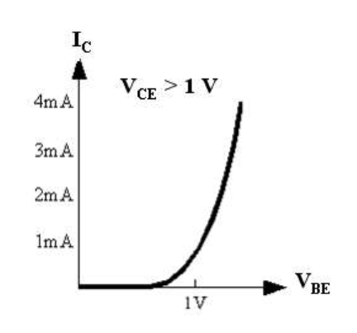

Characteristics $I_{C} = f(V_{BE})$:
The $I_{C} = f(V_{BE})$: curve shows
that, for a transistor operating
in the saturation region, the $V_{BE}$
voltage varies very little. Below
$V_{BE}= 0.7 V$, the transistor does
not conduct.

Slide 19
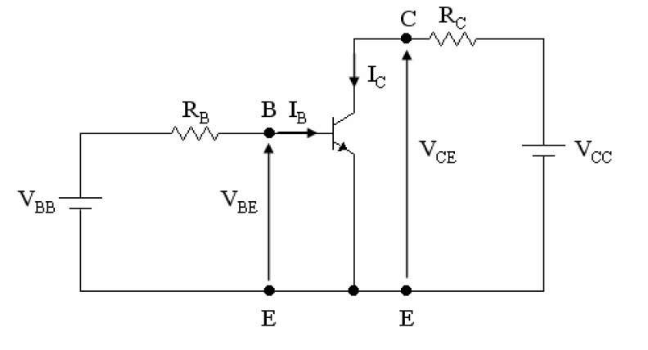
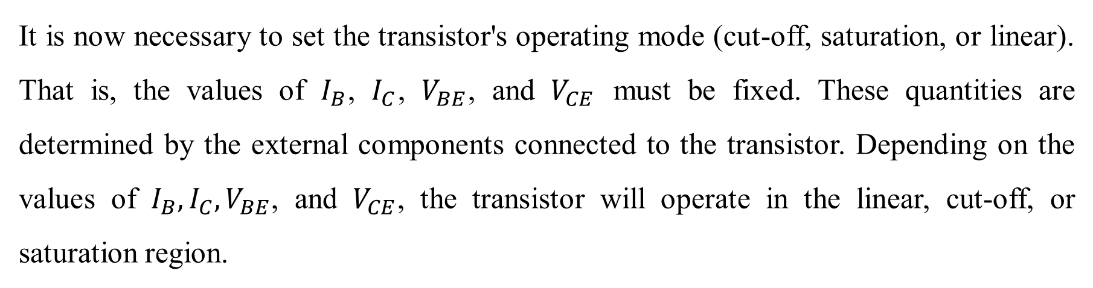
  Transistor polarization
It is now necessary to set the transistor's operating mode (cut-off, saturation, or linear). That is, the values of $I_{B}$, $I_{C}$, $V_{BE}$, and $V_{CE}$ must be fixed. These quantities are determined by the external components connected to the transistor. Depending on the values of $I_{B}, I_{C}, V_{BE}$, and $V_{CE}$, the transistor will operate in the linear, cut-off, or saturation region.

Slide 20
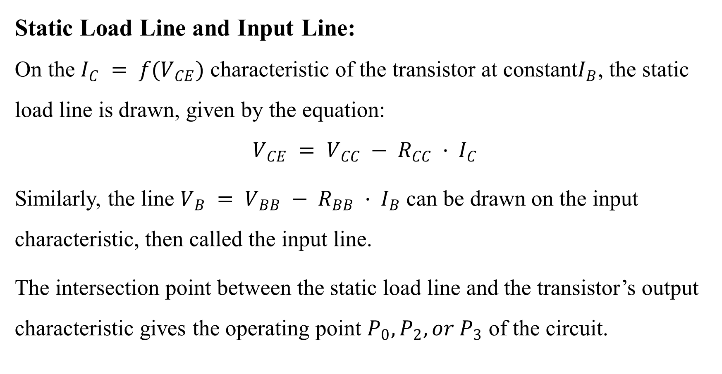
  Static Load Line and Input Line:
  On the $I_{C} = f(V_{CE})$ characteristic of the transistor at constant$I_{B}$, the static load line is drawn, given by the equation:
  $$V_{CE} = V_{CC} − R_{CC} · I_{C}$$
Similarly, the line $V_{B} = V_{BB} − R_{BB} · I_{B}$ can be drawn on the input characteristic, then called the input line.
The intersection point between the static load line and the transistor’s output characteristic gives the operating point $P_{0}, P_{2}, or P_{3}$ of the circuit.

Slide 21
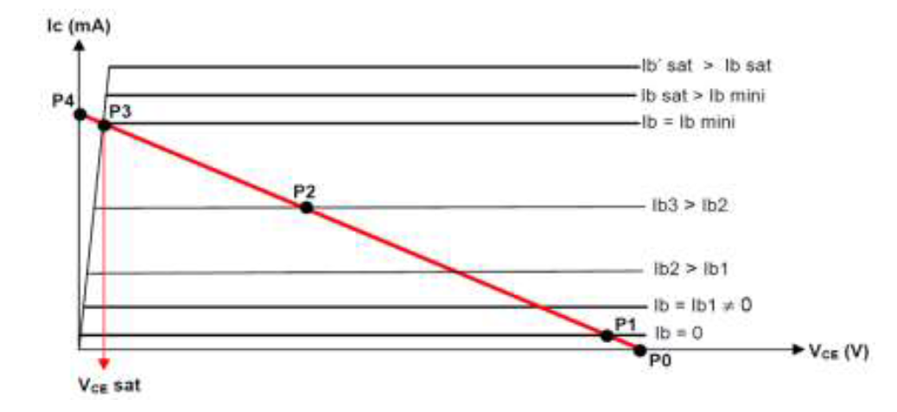
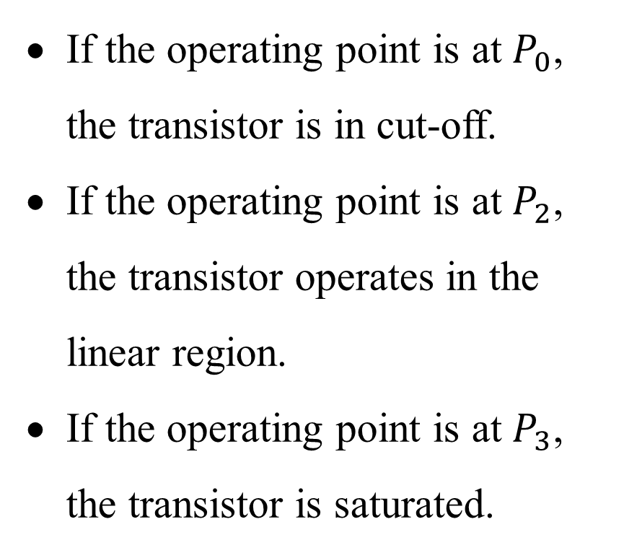
If the operating point is at $P_{0}$, the transistor is in cut-off.
If the operating point is at $P_{2}$, the transistor operates in the linear region.
If the operating point is at $P_{3}$, the transistor is saturated.

Slide 22
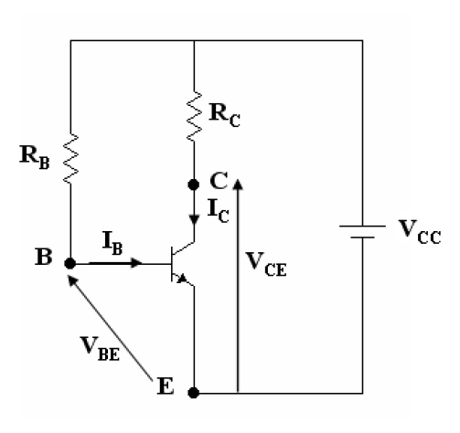

Base-resistor Polarization
The line of static charge:
$$V_{CC}=R_{C}I_{C}+V_{CE}$$
$$I_{C}=\frac{V_{CC}−V_{CE}}{R_{C}}$$
With,
$$I_{C}=βI_{B}$$
The line of static attack :
$$V_{CC}=R_{B}I_{B}+V_{BE}$$
$$I_{B}=\frac{V_{CC}−V_{BE}}{R_{B}}$$
With,
$$V_{BE}=0.7 V$$

Slide 23
Characteristics:
Few in number.
β-dependent.
Base current defined.
Applications:
Switches.
Digital circuits.

Slide 24
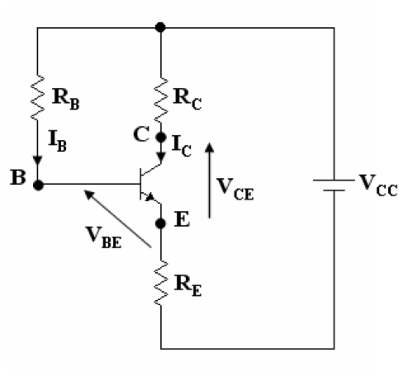
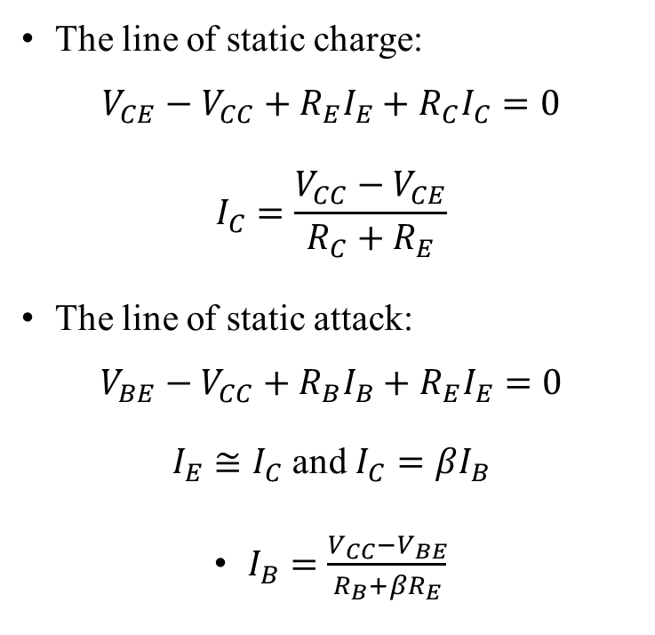
Emitter-feedback polarization
The line of static charge:
$$V_{CE}−V_{CC}+R_{E}I_{E}+R_{C}I_{C}=0$$
$$I_{C}=\frac{V_{CC}−V_{CE}}{R_{C}+R_{E}}$$
The line of static attack:
$$V_{BE}−V_{CC}+R_{B}I_{B}+R_{E}I_{E}=0$$
$I_{E}≅I_{C}$ and $I_{C}=βI_{B}$
$I_{B}=\frac{V_{CC}−V_{BE}}{R_{B}+βR_{E}}$

Slide 25
Characteristics:
Emitter current defined.
β-dependent.
Applications:
Driving integrated circuits.
Amplifiers.

Slide 26
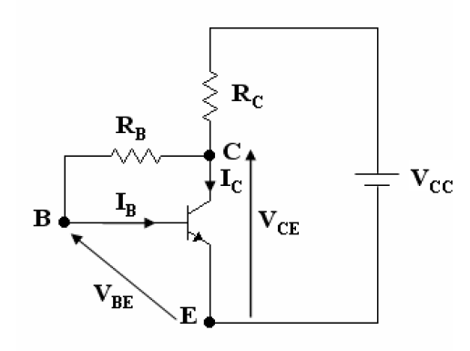
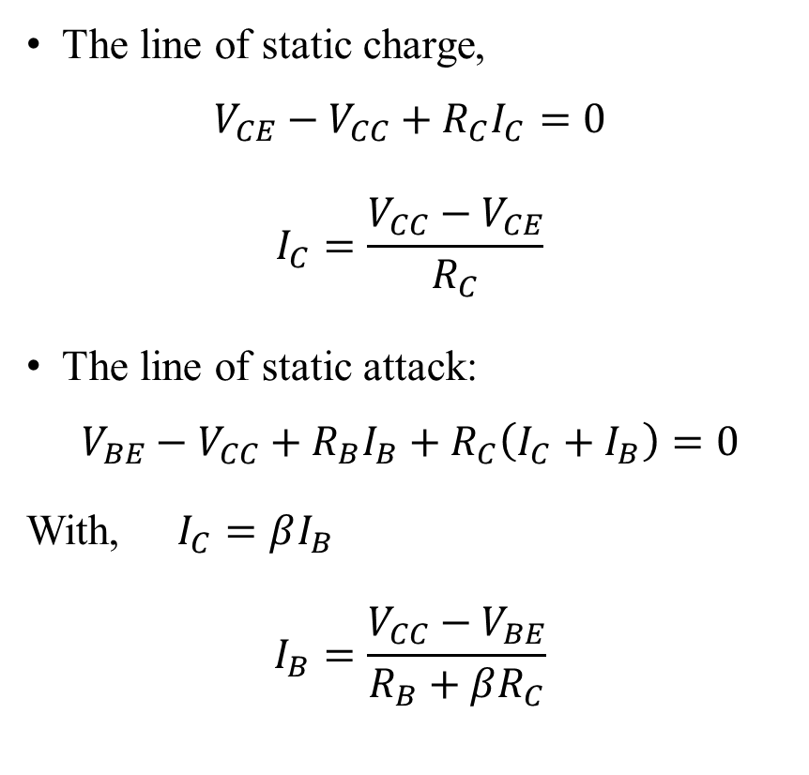
Collector-feedback polarization
The line of static charge,
$$V_{CE}−V_{CC}+R_{C}I_{C}=0$$
$$I_{C}=\frac{V_{CC}−V_{CE}}{R_{C}}$$
The line of static attack:
$$V_{BE}−V_{CC}+R_{B}I_{B}+R_{C}\left(I_{C}+I_{B}\right)=0$$
With,$I_{C}=βI_{B}$
$$I_{B}=\frac{V_{CC}−V_{BE}}{R_{B}+βR_{C}}$$

Slide 27
Characteristics:
This configuration prevents transistor saturation.
β is involved in setting the quiescent current.
Applications:
Amplifiers.

Slide 28
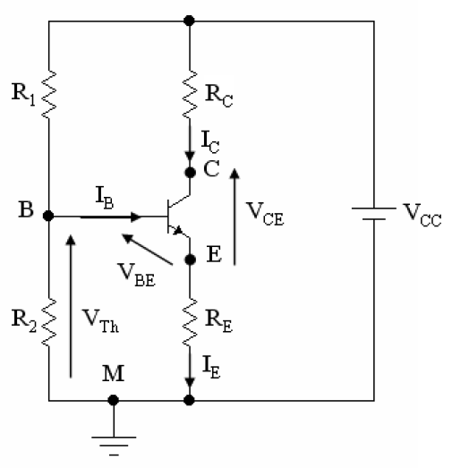
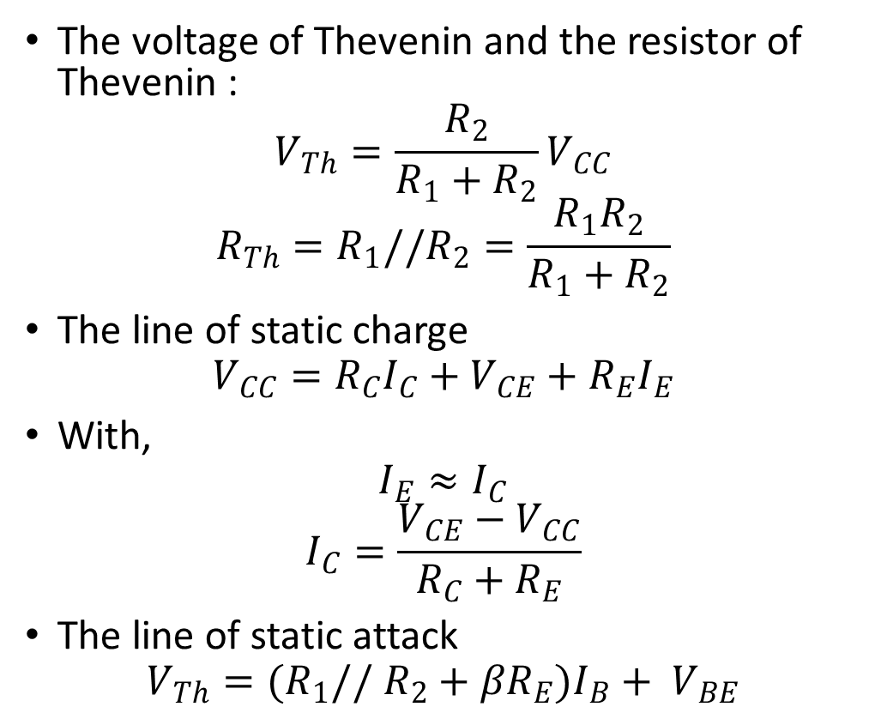
Voltage-divider polarization
The voltage of Thevenin and the resistor of Thevenin :
$$V_{Th}=\frac{R_{2}}{R_{1}+R_{2}}V_{CC}$$
$$R_{Th}=R_{1}//R_{2}=\frac{R_{1}R_{2}}{R_{1}+R_{2}}$$
The line of static charge
$$V_{CC}=R_{C}I_{C}+V_{CE}+R_{E}I_{E}$$
With,
$$I_{E}≈I_{C}$$
$$I_{C}=\frac{V_{CE}−V_{CC}}{R_{C}+R_{E}}$$
The line of static attack
$$V_{Th}=(R_{1}// R_{2}+βR_{E})I_{B}+ V_{BE}$$

Slide 29
Characteristics:
Requires more resistors.
β-independent.
Uses only one power supply.
Applications:
Amplifiers.

Slide 30
  Applications of the Bipolar Transistor:
The bipolar transistor is used in many areas, such as: alternating flasher, alarm system, fan, NTC thermistor, sliding door, flashlight, continuity tester, refrigerator lighting, 3-story elevator, radio, television, satellite, traffic lights.

