Slide 1





Slide 2


Oral presentation
What is an oral presentation?
Oral presentations, also known as public speaking or simply presentations, consist of an individual or group verbally addressing an audience on a particular topic. The aim of this is to educate, inform, entertain or present an argument.

Slide 3




Oral presentation
Oral presentations are seen within workplaces, classrooms, mosques, and even at social events such as weddings.
Where?
How about at the university ?
An oral presentation at university assesses the presenter’s ability to communicate relevant information effectively in an interesting and engaging manner.

Slide 4




Planning your oral presentation
The most important factors for a successful presentation are:
careful planning,
lots of practice and engaging the audience.
It's a good idea to watch some professional presentations online to get a sense of what good speakers do.

Slide 5




Planning your oral presentation
What to do once I have the subject ?
Review the subject outline. Look for all relevant detail that you will need to understand the requirements of the task, including when it is due, the weight of the assessment, and the length of time you have to present.
Analyze the task.
Define your goal form the presentation
Determine the purpose of the presentation.
you need to answer a specific question?

Slide 6



Planning your oral presentation
Consider the audience.
What are their expectations of your content and delivery?
?????
Brainstorm. Map out everything you already know about the topic. Write out any ideas you can use to interact with the audience, or engage them, and jot down what questions, explanations and information you want the audience to be provided with.
Do the research. Find relevant material, take notes, and remember to keep the references you used.

Slide 7




Planning your oral presentation
Organize your ideas. Create a logical presentation so the information flows well.
Pay attention to the language you are using. Presentations should be delivered in spoken or conversational language rather than written language. Spoken language is much easier for your audience to follow.

Slide 8
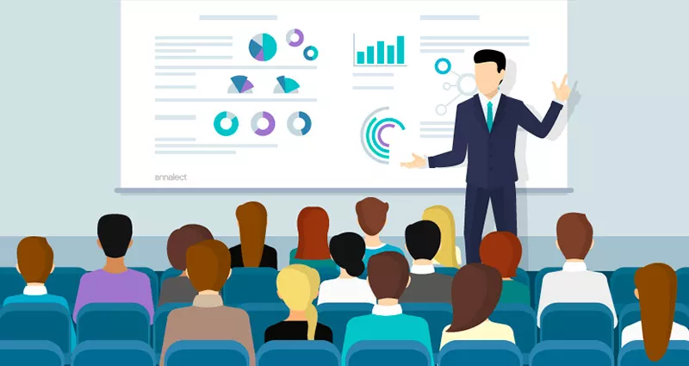
Audience interaction and engagement
Even if it isn’t a specific requirement, it is good practice to engage the audience and/or to have them interact during your presentation. Examples of ways to ensure audience interaction are:
Asking questions,
testing the audience,
providing a quiz.
Allowing the audience to ask questions.

Slide 9
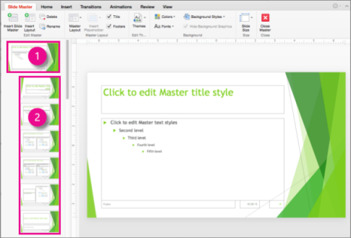

Using visual Tools
In many oral presentation assessments you will be allowed or required to use visual tools, such as :
slides,
images or videos ,
to add an interesting feature and engage the audience.
Keep your visual aids clear and to the point, and ensure that they are easily readable by your audience.
NOTE: Don’t forget to save your visual material on a USB flash drive so that you can easily access it through the class computer (if applicable), and have a back-up if you need to submit it in class or print it out.

Slide 10




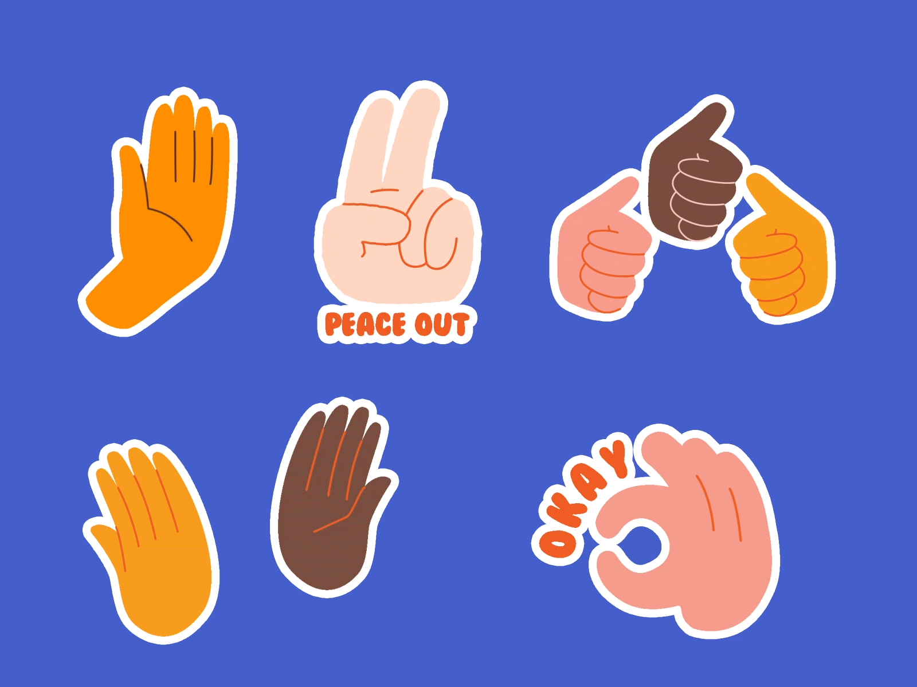


Preparing to present
Once you have completed writing your presentation – remember, this needs to sound like spoken language, not written language! - and have finalized your visual tool, it is time to practice the presentation. When practicing your speech consider these aspects:
Speak slowly and clearly.
Don’t read off your cards.
Maintain eye contact with the audience.
Maintain good posture so you can be clearly heard.
Use natural hand gestures.
Use a natural tone of voice.
Practice to improve your confidence.
Practice pronunciation of difficult words by breaking them into syllables.
Be mindful of your body language.
Time yourself to make sure you are within the time limits

Slide 11
Preparing to present
Write your speech in dot points,
Practice reading aloud,
Understand the topic and material, learn the information in your speech, don’t just memorize it, this way your presentation sounds more authentic,
Remember to smile.
Write down some more information you may need during the discussion after you finish the presentation

Slide 12
On the day of your presentation
On the day of your presentation, you might feel anxious or nervous and that is completely normally.
Have confidence in your ability, the presentation you have planned, and the preparation you have done!

