Slide 1
Chapter: Development Approaches of Expert Systems
Artificial Intelligence Course
University Center Abdelhafid Boussouf Mila
Department of Mathematics and Computer Science
Topic: Development Process of Expert Systems

Slide 2
Introduction
The term 'Expert System' includes two main parts:
A 'system' is a set of interconnected components that collect, process and distribute information.
The term 'expert' refers to systems that possess accumulated experience and deep knowledge.

Slide 3
Resources Needed for an Expert System
Human resources: domain expert, knowledge engineer, and programmers.
Technological resources: hardware and software.
Software tools store and translate expertise into computer‑understandable language.
Hardware components include elements such as the inference engine.

Slide 4
Components of Expert Systems
Expert systems mainly consist of five essential components:
Knowledge Base
Inference Engine
User Interface
Explanation Facility
Knowledge Acquisition Facility

Slide 5
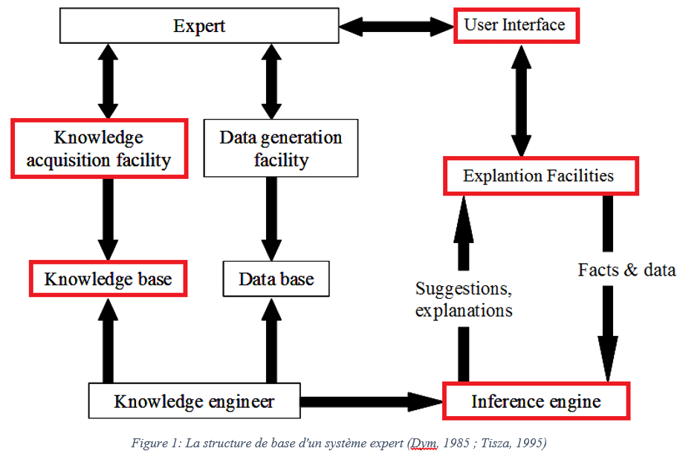

Slide 6
Knowledge Base
Contains data, knowledge, relationships and decision rules.
Represents the expertise accumulated over years by specialists.
The effectiveness of the system depends on the richness and accuracy of the knowledge base.
Often knowledge from multiple experts is required.

Slide 7
Inference Engine
Program that simulates expert reasoning.
Uses logical mechanisms to analyze stored knowledge.
Processes facts and rules to generate conclusions.
Produces recommendations and solutions for users.

Slide 8
User Interface
Allows communication between the expert system and the user.
Can include dialogue boxes, menus, forms or command prompts.
Some expert systems interact directly with other computer systems rather than humans.

Slide 9
Explanation Facility
Explains how the system reached a particular conclusion.
Helps users understand reasoning steps.
Provides justification and transparency.
Increases user confidence in the proposed solutions.

Slide 10
Knowledge Acquisition Facility
Tool used to collect and store knowledge.
Involves collaboration between domain experts and knowledge engineers.
The knowledge engineer converts human expertise into programmable representation.

Slide 11
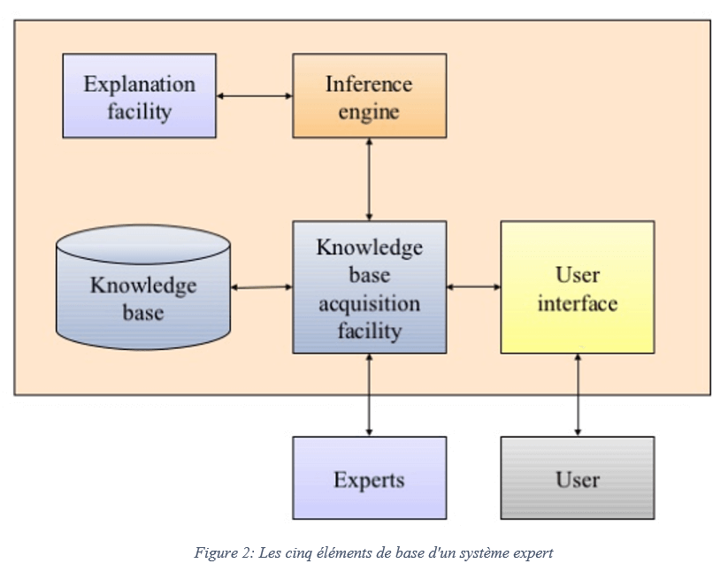

Slide 12
Actors in an Expert System
Several people participate in the development of an expert system.
These individuals form the development team.
Their collaboration ensures system success.

Slide 13
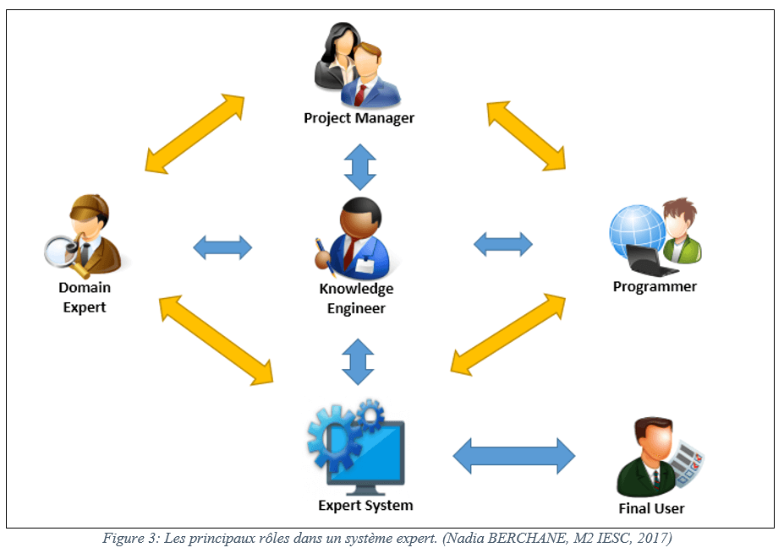

Slide 14
Project Manager
Leader of the expert system development team.
Responsible for project planning and coordination.
Ensures deadlines are met.
Manages budget and project execution.

Slide 15
Domain Expert
Person with deep knowledge in a specific domain.
Provides expertise used to build the system.
Plays a crucial role in defining rules and knowledge.

Slide 16
Knowledge Engineer
Designs and builds the expert system.
Works closely with the domain expert.
Transforms expert knowledge into machine‑readable form.
Selects development tools and programming languages.

Slide 17
Programmer
Responsible for implementing the system.
Encodes expert knowledge using programming languages.
Typical AI languages include LISP, PROLOG, and OPS5.

Slide 18
Final User
Person who ultimately uses the expert system.
Defines system requirements and usability needs.
Determines how results should be displayed.
Participates in early development stages.

Slide 19
Knowledge Transfer
Knowledge acquisition is a crucial stage.
The knowledge engineer transfers expert knowledge to the system.
The quality of this transfer determines system performance.

Slide 20
Knowledge Transfer Process
Often carried out through interviews between expert and knowledge engineer.
The expert explains reasoning strategies.
The engineer chooses an appropriate knowledge representation method.

Slide 21
Difficulties in Knowledge Transfer
Knowledge acquisition is time‑consuming.
Experts are not always available.
Information systems may not fully support the process.
Choosing the right transfer method can be challenging.

Slide 22
Methods Used in Expert System Development
Knowledge acquisition from typical situations.
Machine learning techniques.
Induction, deduction, analogy and instruction learning.
Conceptual models and graph‑based representations.

Slide 23
Development and Validation
After knowledge transfer, the system prototype is created.
The prototype undergoes iterative validation.
Experts review results and refine knowledge representation.

Slide 24
System Evolution
The prototype gradually improves over time.
The system must remain adaptable and modifiable.
Experts may add new reasoning elements during use.

Slide 25
Conclusion
Expert system development requires collaboration between several specialists.
Knowledge acquisition is the most critical stage.
A well‑structured development process ensures system success.

