Slide 1
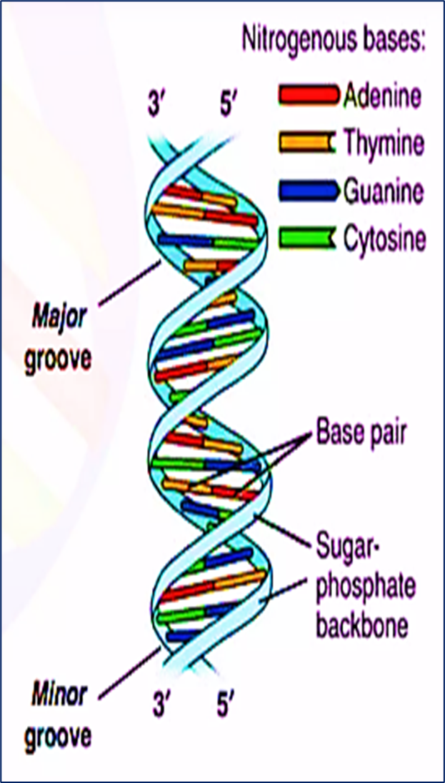
DNA Structure
DNA is made up of millions of nucleotides. These are molecules composed of a deoxyribose sugar, with a phosphate and a base attached to it. These nucleotides are attached to each other in strands via phosphodiester bonds to form a ‘sugar-phosphate backbone’. The bond formed is between the third carbon atom on the deoxyribose sugar of one nucleotide (known as the 3’) and the fifth carbon atom of another sugar on the next nucleotide (known as the 5’).
There are two strands of DNA, which run in opposite (antiparallel) directions to each other. These strands are attached to each other throughout their lengths via the bases on each nucleotide.
There are 4 different bases associated with DNA: Cytosine, Guanine, Adenine, and Thymine. In normal DNA strands, cytosine binds to guanine, and adenine binds to thymine. When bound together, the two strands form a double helix structure.

Slide 2
Characteristics of the Two DNA Strands /
DNA (deoxyribonucleic acid), described by James Watson and Francis Crick, consists of two polynucleotide strands twisted around each other to form a double helix. The two strands have two main characteristics:
1, Antiparallel Structure
The strands run in opposite directions:
One strand is oriented 5′ → 3′
The other is oriented 3′ → 5′
This opposite orientation is called antiparallel.
The nitrogenous bases face inward, while the sugar-phosphate backbone (hydrophilic) faces outward, ensuring structural stability.
2, Complementary Base Pairing
The two strands are complementary, meaning each base pairs specifically with its partner:Adenine (A) pairs with Thymine (T) Cytosine (C) pairs with Guanine (G)
𝐴−𝑇: 2ℎ𝑦𝑑𝑟𝑜𝑔𝑒𝑛𝑏𝑜𝑛𝑑𝑠;
𝐶−𝐺: 3ℎ𝑦𝑑𝑟𝑜𝑔𝑒𝑛𝑏𝑜𝑛𝑑𝑠
This pairing is due to:

Slide 3
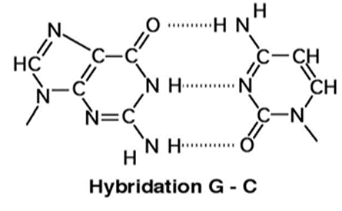
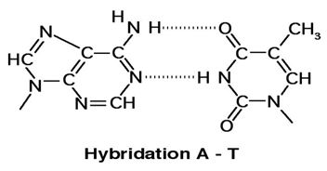
Steric reasons: A purine (A or G, two rings) pairs with a pyrimidine (T or C, one ring), maintaining constant helix diameter.
Hydrogen bonding reasons: The bases facing each other are linked by hydrogen bonds. Opposite an NH₂ group at position 6 of a purine base, there is a C=O group of a pyrimidine base, and conversely, opposite an NH₂ group at position 6 of a pyrimidine base, there is a C=O group of a purine base (Figure 1).
Figure 1: Complementarity between the bases

Slide 4
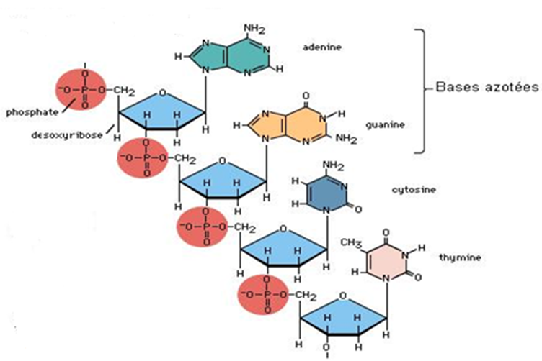
3- Helical: the two chains present a helical configuration in space, they wind around an imaginary central straight axis forming a double right helix (Figure 2)
Note: Since DNA is double-stranded and the two strands are linked by hydrogen bonds (A=T and G≡C):
A/T = 1 and G/C = 1, hence A+G/T+C = 1.
However, the asymmetry ratio: R = A+T / G+C ≠ 1. It is characteristic of each organism.
Figure 2: Detail of a strand of DNA

Slide 5
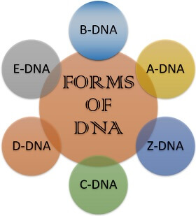
Forms of DNA
DNA (hereditary material of the cell) consists of a long polynucleotide chain and shows structural diversity by changing its structural configuration,
These different types of DNA vary slightly in their diameters, sizes, and the orientation of their base pairs.

Slide 6
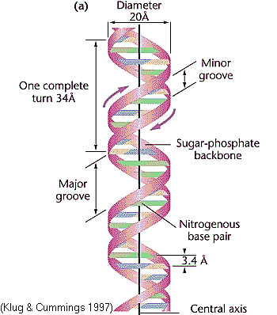
Conformation B
The B form DNA, also known as the Watson- Crick DNA is the most stable and prevalent form of DNA, which is found to be the primary native form under physiological conditions.
There are two polynucleotide chains in the DNA spirally twisted around each other to form a right handed double helix.
-The sugar-phosphate backbones remain on the outside, while the core of the helix contains the purine and pyrimidine bases.
- The diameter of DNA is 2 nm or 20 A°. The length of a complete turn of helix is 3.4 nm or 34 A° (there are ~10.5bp per turn),
-Each base pair from the next one in the DNA double helix model is 3,4 A° or 0.34 nm apart. ‘bp’ is defined as the base pair(s).
- The DNA helix has a shallow groove called minor groove (-1.2nm) and a deep groove called major groove (-2.2nm). Proteins interact with DNA through the minor and major grooves without disrupting the DNA strands.
- Angle between two successive lead plates: 36°
Essential physical features of the structure of B-DNA

Slide 7
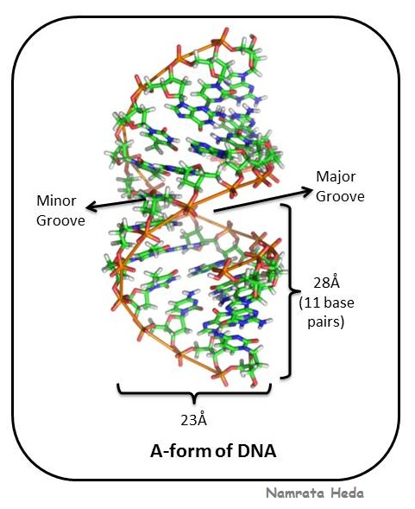
A-form DNA
A-DNA is a right-handed double helix similar to the B-DNA form. Dehydrated DNA takes an A form that protects the DNA during extreme conditions such as desiccation. Protein binding also removes the solvent from DNA, and the DNA takes an A form.
The two strands of A-DNA are anti-parallel with each other and not symmetrical. The molecule is asymmetrical is because the glycosidic bonds of a base pair are not diametrically opposite to each other. Therefore, major grooves and minor grooves can be observed in each turn. One turn of the helix consists of 11 base pairs (more than B-DNA which has 10 base pairs per turn) with a length of 28Å or 2.8 nm. The helix diameter of A-DNA is 23Å or 2.3nm. Overall, A-DNA is wider than the more commonly found B-DNA.

Slide 8
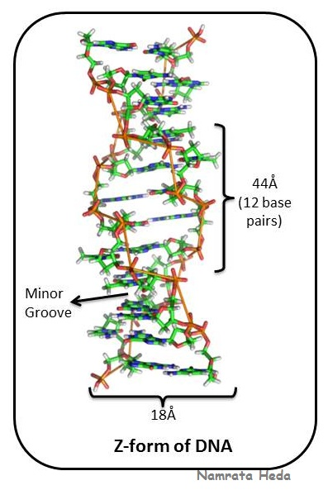
Z-form DNA (Z-DNA)
Z-DNA is a left-handed double helix, unlike the right-handed A-DNA and B-DNA. It is characterized by a distinctive zigzag sugar-phosphate backbone, which gives this form its name.
Z-DNA forms under specific conditions such as high ionic strength, hydrophobic solvents, the presence of trivalent cations, or chemical modifications (e.g., bulky alkylating agents).
Main structural features:
Diameter: 1.8 nm (the narrowest among the three DNA forms)
12 base pairs per helical turn
Helical pitch (one turn length): 44 Å
Rise per nucleotide: 0.37 nm
Base pairs are perpendicular to the helix axis
Strands are held together by hydrogen bonds
Only a minor groove is present, which is deep and narrow; the major groove is not clearly distinguishable
Z-DNA is relatively unstable and difficult to observe. Its formation is sequence-dependent, especially in alternating purine–pyrimidine sequences such as GCGCGC. In these sequences, guanine and cytosine adopt different conformations, producing the characteristic zigzag pattern.

Slide 9
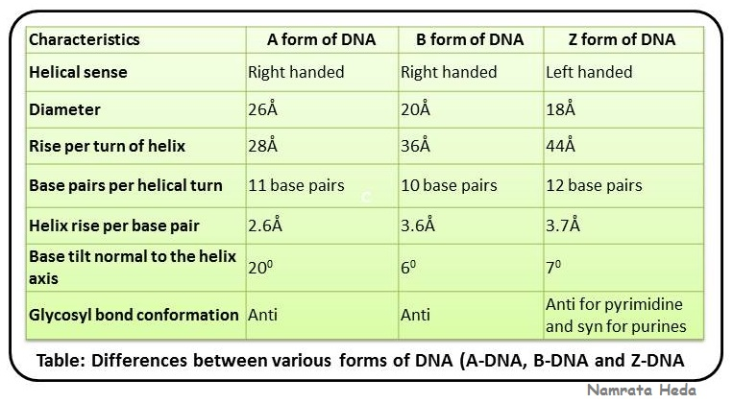
The following table will give you an idea of major structural differences between three major forms of DNA (B-DNA, A-DNA and Z-DNA).

Slide 10
Caractéristiques | Forme A de l’ADN | Forme B de l’ADN | Forme Z de l’ADN
Sens de l’hélice | Droite | Droite | Gauche
Diamètre | 26 Å | 20 Å | 18 Å
Pas de l’hélice (hauteur par tour) | 28 Å | 36 Å | 44 Å
Nombre de paires de bases par tour | 11 paires de bases | 10 paires de bases | 12 paires de bases
Élévation par paire de bases | 2,6 Å | 3,6 Å | 3,7 Å
Inclinaison des bases par rapport à l’axe de l’hélice | 20° | 6° | 7°
Conformation de la liaison glycosidique | Anti | Anti | Anti pour les pyrimidines et syn pour les purines

Slide 11
The physicochemical properties of DNA
The double helix structure gives the DNA molecule a fibrous nature, the properties of which are exploited in numerous molecular biology experiments:
Density
The density of DNA molecules is such that they can be separated by ultracentrifugation in density gradients (cesium chloride)
Charge
The charge of DNA molecules at physiological pH is negative; it is proportional to their length and solely due to the phosphate group. This property is used to separate them by electrophoresis.
Solubility
Alcohols, and in particular ethanol, precipitate DNA molecules in the form of long, stranded aggregates. It also precipitates in the presence of high salt concentrations. However, in aqueous solutions, DNA becomes an acid salt.
UV Absorption
Nucleotides absorb in the UV range, and this absorption depends on the angle of incidence of the UV rays: absorption is maximal when the rays of incidence are perpendicular, and minimal when they are parallel, as the stacking of bases hinders accessibility.
DNA absorbs less than free nucleotides of the same quantity; this phenomenon is called hypochromic absorption.
Heating DNA solutions produces an increase in absorbance at 260 nm. This phenomenon corresponds to the denaturation of double-stranded DNA into two single-stranded DNA strands, hence the doubling of optical density.
The melting temperature of DNA, denoted Tm, can be characterized as the temperature at the midpoint of this process (Figure 1).

Slide 12
Absorption UV
Les nucléotides absorbent dans les UV et cette absorption dépend de l’angle d’incidence des rayons UV : l’absorption est maximale lorsque les rayons d’incidence sont perpendiculaires, et minimale lorsque les rayons d’incidence sont parallèles, l’empilement des bases freinant l’accessibilité.
L’ADN absorbe moins que ne le fait des nucléotides libres en même quantité, on qualifie ce phénomène d’hypochrome.
Le chauffage des solutions d'ADN produit une augmentation d'absorbance à 260 nm. Ce phénomène correspond à la dénaturation de l’ADN bicaténaire en 2 brins d’ADN monocaténaires, d’où le doublement de densité optique.
On peut caractériser la température de fusion de l’ADN notée Tm qui correspond à la température à la moitié du phénomène

Slide 13
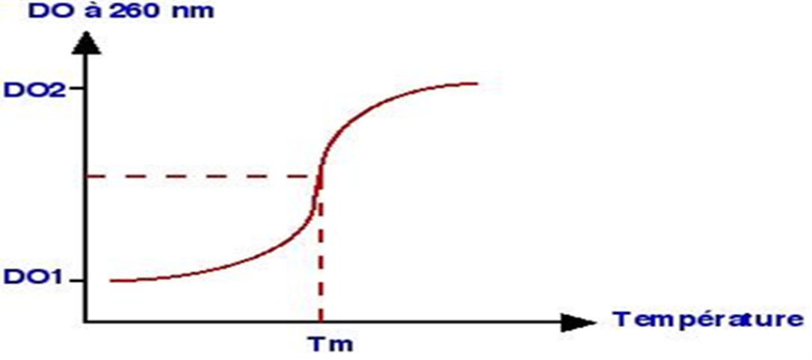

Slide 14
Thermal denaturation
Thermal denaturation occurs when the two strands of the helix separate due to the action of heat.
The melting temperature, or Tm, is the temperature at which the DNA molecule is half-denatured (or half-unzipped). It depends on the length of the DNA molecule; indeed, shorter molecules are less stable and therefore have a lower melting temperature. It also depends on the richness of C-G base pairs.
For perfect renaturation, the reverse path of the denaturation curve must be followed, which requires slow cooling. When cooling is too rapid, the reassociation is irreversible. Renaturation is only possible for small DNA molecules. These renaturation properties are utilized in molecular hybridization. Increasing the ionic strength of the reaction medium (e.g., NaCl) facilitates renaturation, as the cations neutralize the repulsive forces of the DNA.
It is possible to directly measure the melting temperature of double-stranded DNA by monitoring the increase in the solution's absorbance at 260 nm as a function of temperature. However, most of the time, an estimation based on the oligonucleotide composition is sufficient. If the sequence is 20 nucleotides or fewer in length, the rule is 2°C for every A-T pair and 4°C for every G-C pair:
Tm = 2 x (A+ T) + 4 x (G + C)
Tm = 2 x (A+ T) + 4 x (G + C) x (1+[(N-20)/20]

Slide 15
La température de fusion ou Tm est la température à laquelle la molécule d’ADN est à moitié désappariée. Elle dépend de la longueur de la molécule d’ADN, en effet les petites molécules sont moins stables et ont donc une température de fusion plus faible. Elle dépend également de la richesse en paires de bases C-G.
Pour que la renaturation soit parfaite il faut obtenir le chemin inverse de la courbe de dénaturation et donc un refroidissement lent. Lorsque le refroidissement est trop rapide, la réassociation est irréversible. La renaturation est seulement possible pour des petites molécules d’ADN. Les possibilités de renaturation sont utilisées pour faire de l’hybridation moléculaire. L’augmentation des forces ioniques du milieu réactionnel (NaCl) permet une renaturation plus facile, les cations neutralisant les forces répulsives de l’ADN.
Il est possible de mesurer directement la température de fusion d'un ADN double brin en mesurant l'augmentation de l'absorbance de la solution à 260 nm en fonction de la température. Toutefois, on se contente la plupart du temps d'une estimation à partir de la composition de l'oligonucléotide. Si celui-ci a une longueur égale ou inférieure à 20 nucléotides on compte 2°C par couple A:T et 4°C par couple G:C :
Tm = 2 x (A+ T) + 4 x (G + C)
A partir de N = 20, on corrige d'un multiplicateur proportionnel à la longueur au-delà de ce chiffre 1 + [(N-20)/20] :
Tm = 2 x (A+ T) + 4 x (G + C) x (1+[(N-20)/20]

Slide 16
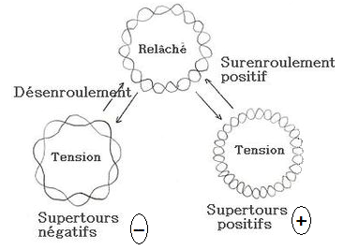
Topoisomers
Two DNA molecules are called topoisomers if they have exactly the same base sequence and differ only in their linking number (that is, the number of times one strand winds around the other).
The different states of topoisomers
There are three states:
a. The relaxed state: the strain on the DNA helix is minimal; it is the most stable configuration of the double helix.
B, Positive supercoiling: the linking number is increased; consequently, the resulting tension leads to the formation of a left-handed superturn.
c. Negative supercoiling: the linking number is decreased, and consequently, the resulting tension leads to the formation of a right-handed superturn (unwinding). (Figure 5)

Slide 17
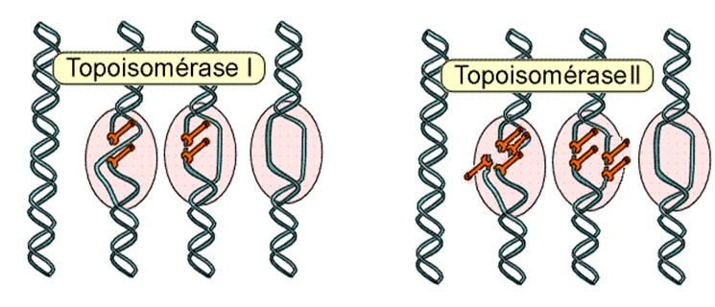
DNA supercoiling has significant consequences:
Compacting the DNA molecule, thereby reducing the volume it occupies within the cell.
The degree of coiling of the DNA double helix influences interactions between DNA and other molecules (e.g., enzymes).
5.2. Topoisomerases
Topoisomerases are enzymes that modify the linking number. They are therefore capable of increasing or decreasing the number of supercoils in DNA molecules. There are two main types of topoisomerases:
Type I Topoisomerases: These are capable of transiently cutting and resealing a single strand of double-stranded DNA.
Type II Topoisomerases: These transiently cut both strands of the DNA before resealing them. This enzyme allows for the uncoiling of DNA.
Both types of topoisomerases have been identified in prokaryotes and eukaryotes; their importance is vital in DNA replication and transcription.

Slide 18
Les topoisomères
On appelle topoisomères deux molécules d’ADN ayant exactement la même séquence de bases et qui différent uniquement par le nombre d’enlacements (c’est-à-dire le nombre de tours que fait l’un des brins autour de l’autre brin).
  Les différents états des topoisomères
Il existe trois états :
L’état relâché : la contrainte sur l’hélice d’ADN est minimale ; c’est la configuration la plus stable de la double hélice
b- Le surenroulement positif : le nombre d’enlacement est augmenté, par conséquence la tension produite conduit à la formation d’un supertours gauche.
c- Le surenroulement négatif : le nombre d’enlacement est diminué et par conséquence la tension produite conduit à la formation d’un supertours droit (un désenroulement) (Figure 5)

Slide 19
Le superenroulement de l’ADN a des conséquences importantes :
Rendre la molécule d’ADN plus compact et diminuer ainsi le volume occupé dans la cellule.
Le degré d’enroulement de la double hélice d’ADN influence sur les interactions de l’ADN avec d’autres molécules (exemple les enzymes)
5,2, Les topoisomérases
Les topoisomérases sont des enzymes qui modifient le nombre d’enlacements. Elles sont donc capables d’augmenter ou de diminuer le nombre de supertours dans les molécules d’ADN. On distingue deux grands types de topoisomérases (Fig.11):
Les topoisomérases I : sont capables de couper transitoirement et de ressouder un seul brin d’ADN double brin.
Les topoisomérases II : coupent d’une manière transitoire les deux brins de l’ADN, puis les ressouder. Cette enzyme permet de désenrouler l’ADN (Figure 6).
Les topoisomérases des deux types ont été mises en évidence chez les procaryotes et les eucaryotes leurs importance est capitale dans la réplication et la transcription de l’ADN.

Slide 20
3. DNA across different living organisms
The DNA of different living organisms shares the same type of structure—that is, two strands (except in certain viruses)—consisting of a sequence of thousands of bases. What differs from one species to another is:
The number of DNA molecules (one molecule for viruses and bacteria; multiple molecules for animal and plant cells).
The length of the molecule (from a few thousand nucleotides to several billion distributed across chromosomes).
The shape of the molecule (linear or circular).
The localization of the molecule (separated or not from the cytoplasm by a nuclear membrane).
The base sequence.
Viruses: They possess the shortest DNA. There are both DNA viruses and RNA viruses. Viral DNA ranges from a few thousand to several thousand bases.
2. Prokaryotes: Their DNA is located in the cytoplasm and is circular in shape (unique chromosome). It is 1000 times longer than viral DNA. Plasmids—small, circular pieces of DNA independent of the main DNA—are often found alongside the chromosome.
3. Eukaryotes: They possess DNA within the nucleus. Each chromosome contains a very large DNA molecule. The total number of nucleotides in a cell is nearly 1000 times greater than in bacteria. In eukaryotes, DNA is also found outside the nucleus: in the mitochondria and the chloroplast.

Slide 21
L’ADN des différents êtres vivants
L’ADN des différents êtres vivants possède le même type de structure c’est-à-dire deux brins (sauf chez certains virus), constituant d’une succession de milliers de bases ce qu’il différent d’une espèce à l’autre c’est :
Le nombre de molécules d’ADN (virus et bactérie une molécule, cellule animale et végétale plusieurs molécules)
La longueur de la molécule (quelques milliers de nucléotides à plusieurs milliards réparties sur les chromosomes)
La forme de la molécule (linéaire ou circulaire)
La localisation de la molécule (séparée ou non du cytoplasme par une membrane nucléaire)
La séquence des bases
1-Les virus : possèdent l’ADN le plus court, il existe des virus a ADN et des virus a ARN, l’ADN des virus est de quelques milliers à plusieurs milliers de bases.
2-Les procaryotes : leurs ADN est dans le cytoplasme, de forme circulaire (chromosome unique), 1000 fois plus long que l’ADN viral, on trouve souvent des plasmides qui sont des petits morceaux d’ADN circulaires à côté du chromosome et indépendant d’ADN principale.
3-Les eucaryotes : possèdent un ADN dans le noyau, chaque chromosome contint une molécule très grande d’ADN, le nombre total de nucléotides dans une cellule presque 1000 fois plus grand que chez les bactéries. On trouve chez les eucaryotes l’ADN hors noyau : dans la mitochondrie et le chloroplaste.

