Slide 1
Algorithmics and data structure 2
Module:
Program
Chapter 1: 1.1Subroutines
1.2recursion
Chapter 2:The files
Chapter 3:The lists
3.1Linked lists
3.2Doubly linked lists
3.3Special linked lists (stacks, queues)
The teacher: Kimouche Abdelkader

Slide 2
Chapter –3 -1:
Linked lists

Slide 3
1. Lists
1.1 definition
A list is a data structure consisting of a finished sequence (possibly empty) of elements of the same type.
each element contains one or multiple fields.
Each element in the list is positionned according to their rank in the list.

Slide 4
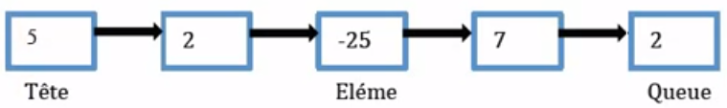
1. Lists
1.1 definition
example
A list of integers L = {5,2,-25,7,2}
the rank of the element -25 is 3.

Slide 5

1. Lists
1.2 Representation of lists
Two representations are possible:
  Contiguous representation
  Linked (chained) representation
Contiguous representation
The elements of the list are simply arranged in the boxes of a vector, one after the other.

Slide 6
1. Lists
1.2 Representation of lists
Contiguous representation
Benefits:
Access to the element k is immediate:V[k]
The next element is V[k+1]
Disadvantages
It is necessary to specify the size of the vector during the declaration
We must declare a size Max ➔ waste of memory
if you want to insert or delete an element, you must shift all the elements located after this element.

Slide 7
1. Lists
1.2 Representation of lists
Linked representation
is to use pointers to connect elements.
Benefits
The size of the list is not fixed.
the elements are scattered in the memory and linked together by pointers.
Adding or removing an element does not affect the following elements.

Slide 8
2. Linked lists
2.1 definition
A linear linked list LLL is a set of elements or nodes (dynamically allocated memory bins) linked between them.

Slide 9

2. Linked lists
2.1 definition
Structure of a node
A nodes is a structure with two fields:
Value containing the information.
Next giving the address of the next node .

Slide 10
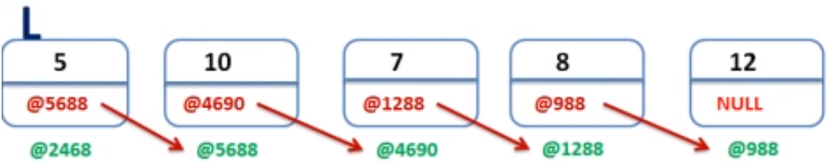
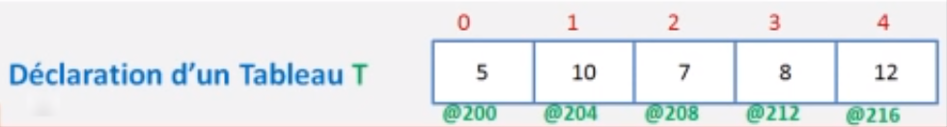
2. Linked lists
2.1 definition
a linked list VS A vector

Slide 11
2. Linked lists
2.1 definition
a linked list
The address of the first element of an LLL is often called the head of the list.
Each node is located with his address, this address is stored in the field next of the previous node .

Slide 12

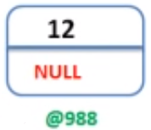
2. Linked lists
2.2 The declaration
The declaration of a node is:
Type
Structure Name_Type_node
value: Type_of_value ;
next: * Name_Type_node;
End Structure ;
type
Structure node
Element: integer;
next :*node;
End Structure ;

Slide 13
2. Linked lists
2.2 The declaration
The declaration of a linked list (pointer to a node):
type
Structure Name_Type_node
Value : Type_of_value ;
next:*Name_Type_node;
End Structure ;
List:*Name_Type_node;// the list type which designates
//any Pointer to a node
L: List;// equivalent to L:* Name_Type_node;

Slide 14
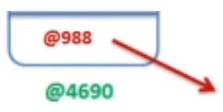
2. Linked lists
2.2 The declaration
Declaring a pointer to a node East(example 1):
L
type
Structure node
Element: integer;
next: *node;
End Structure ;
List:*node; // pointer to a node
L :List;
L, P, Q:List; // three pointers to nodes

Slide 15
2. Linked lists
2.2 The declaration
Example 2
List: *node; // pointer to a node
L :List;
type
Structure Person
name: string
first name: string
end structure
Structure node
value:Person;
next: *node;
End Structure ;
L
Name1
First name1
NULL
@988

Slide 16
2. Linked lists
2.2 The declaration
Example
The access to a field of a structure is done through the point for ordinary variables and through -> for pointer type variables.
Y
M
Example:
X: Person; so: X.name
Y:*Person ; so: Y->name.
M: node;
X
Name1
Name1
First name1
First name1
NULL
@988

Slide 17
2. Linked lists
2.3 Operations on lists
Create a node
Creates a new node contains a value x and returns a pointer containing his address.
Create_node
X: value_type
P: list
Role: create a new node

Slide 18
2. Linked lists
2.3 Operations on lists
Create a node
Function create_node (x: typeq): List;
P: List // or P: *node
Begin
P←Allocate (node); // ………….(1)
P - > value←x; //……………(2)
P -> next←Null; //……….……(3)
Return (P);
END;

Slide 19
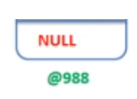
2. Linked lists
2.3 Operations on lists
Is_empty
  tests if the list is empty or not
  An empty list is a list that does not point to any node
Is_empty
P: list
B: Boolean
Role: check if the list is empty or not

Slide 20
2. Linked lists
2.3 Operations on lists
Is empty
Function Is_empty (L: List): Boolean;
Begin
If (L=Null) then
Return (true);
else
Return (false);
End if
END;
L
L

Slide 21
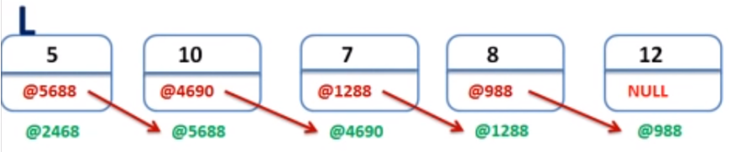
2. Linked lists
2.3 Operations on lists
the head of the list
  return the value of the first node of the list L
head
L: list
E: value_type
Role: return the value of the first node of the list

Slide 22
2. Linked lists
2.3 Operations on lists
the value of the first node of the list
Function head (L: list): type_value;
Begin
If (L == NULL) then
Write (“the list is empty”);
else
Return (L -> value);
End if
END;

Slide 23
2. Linked lists
2.3 Operations on lists
Inserting a node
  inserting a new node into the list consists of:
    Creation of the corresponding node,
    Assignment of the value of the node,
    Then the linking of the new node with the list, is done on:
      The Top of the list
      At the end of the list
      In the middle of the list
L: list
Insert
L: list
E: value_type
Role: return the list with the new node added

Slide 24
2. Linked lists
2.3 Operations on lists
Inserting a node
Top of the list
L
@6
@12
41
NULL
3
@23
5
@76
14
NULL
@12
@6
@12
@23
@76
L: list
Insert
L: list
E: integer
Role: return the list with the new node added

Slide 25
2. Linked lists
2.3 Operations on lists
Inserting an element
Top of the list
Procedure Insert_top (x: type_value, var L: List);
P: List;
Begin
P ←create_node(x);// create the new node
P-> next←L;// point the new node to L
L←P;// point the list L to this new node
END ;

Slide 26
2. Linked lists
2.3 Operations on lists
Inserting an element
At the end of the list
L
@12
@6
3
@23
5
@76
14
NULL
41
NULL
@6
@12
@23
@76
@6

Slide 27
2. Linked lists
2.3 Operations on lists
Inserting an element
At the end of the list
L
S
@12
@12
@6
3
@23
5
@76
14
NULL
41
NULL
@6
@12
@23
@76
@6

Slide 28
2. Linked lists
2.3 Operations on lists
Inserting an element
At the end of the list
Procedure Insert_end (x: type_value L: List);
S, P: List;
Begin
P ←create_node(x);
S←L;
While (S -> next != Null ) do
S← S->next;
End while
S -> next ← P;
Release (S);
END ;

Slide 29
2. Linked lists
2.3 Operations on lists
Inserting an element
At the middle of the list
L
@12
@6
3
@23
5
@76
14
NULL
@6
@12
@23
@76
41
NULL
@76
@6

Slide 30
2. Linked lists
2.3 Operations on lists
Inserting an element
At the middle of the list
L
S
@12
@12
@6
3
@23
5
@76
14
NULL
@6
@12
@23
@76
41
NULL
@76
@6

Slide 31
2. Linked lists
2.3 Operations on lists
Inserting an element
At the middle of the list
Procedure Insert_mid (x: type_value, pos_val, L: List);
S, P: List;
Begin
P ←create_node(x);
S←L;
While (S -> value != pos_val) do
S← S->next;
End while
P -> next ← S -> next;
S -> next ← P;
Release (S);
END ;

Slide 32
End of chapter

