Slide 1
Module:
1
Algorithmic and data structure 2
Program
Chapter 1: 1.1 Subroutines
1.2 recursion
Chapter 2:The files
Chapter 3:The lists
3.1Linked lists
3.2Doubly linked lists
3.3Special linked lists (stacks, queues)
The teacher: Kimouche Abdelkader
Notes:
1

Slide 2
Chapter – 3 -1:
Linked lists
pointers

Slide 3
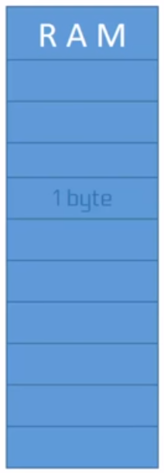
1. Introduction
3
1 byte = 8 bits
Memory box
Central memory

Slide 4
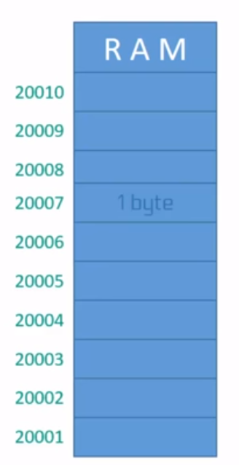
1. Introduction
4
The content of the
Memory box
1 byte = 1 byte
The address of the
Memory box
Central memory

Slide 5
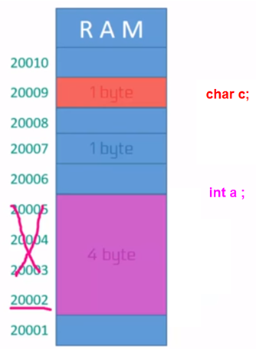
1. Introduction
5
example
The address of the
Variable c
The address of the
Variable a
a
Each variable in memory occupies contiguous bytes

Slide 6
1. Pointer type
6
definition
A pointer is a variable containing a memory address.
The address of the
Variable c
pointers
20008
P2
The address of the
Variable a
a
20002
P1

Slide 7
1. Pointer type
7
definition
Central memory (RAM) variables content address
P | 1000 | @=50
 | …
X | 15 | @=1000
X= 15
P a pointer contains the address of X in the memory
P= 1000

Slide 8
1. Pointer type
8
Declaring a pointer
In algorithmic | In C++ language
<Variable name>:*Variable type; Examples: p:*integer; Q:*real; | Variable type* <Variable name>; Examples: int *P ; float *Q ;
Symbol (*) for pointer type

Slide 9
1. Pointer type
9
Declaring a pointer(example 1)
#include <iostream>
int main ( )
{
int x=4;//declaration of an integer variable x
Int *p;//declaration of a pointer variable p on an integer
p=&x ;//p points to x (p contains the address of x)
cout<<*p;// display the contents of address p witch is x
getchar();
return 0;
}
The address of X
Result: 4

Slide 10
1. Pointer type
10
Declaring a pointer(example 2)
#include <iostream>
intmain ( )
{
int x=4;//declaration of a variable x
int *p ;//declaration of a pointer p
P=&x ;//p points to x (p contains the address of x)
*p=15;// the value 4 of x is replaced by 15
cout<< x ; // print the contents of x
Return 0;
}
The content of the address
Result: 15

Slide 11
1. Pointer type
11
Declaring a pointer(example 3)
#include <iostream>
intmain ( )
{
int x=4;//declaration of a variable x
int *p ;//declaration of a pointer p
P=&x ;//p points to x (p contains the address of x)
*p= -3;// the value 4 of x is replaced by -3
X = X*3;
cout<< // print the contents of x
Return 0;
}
Changing variable value from pointer
Result: -9

Slide 12
1. Pointer type
12
1.3 Operations on pointers
Dynamic allocation
Memory space allocation is done gradually for the execution of the program.
To be able to do this type of allocation, the user must have tow operations: allocation and release of memory space.

Slide 13
1. Pointer type
13
1.3 Operations on pointers
Dynamic allocation (allocation operation “new”)
Syntax
In algorithmic | In C++ language
P=Allocate (type) | P= new type;
Allocation of memory space, the size specified by P type.
The address of this space is returned in the variable of type Pointer P.

Slide 14
1. Pointer type
14
1.3 Operations on pointers
Dynamic allocation(allocation operation “new”)
Example 1(an integer variable)
Allocation of a memory space for an integer:
In algorithmic | In C++ language
*P: integer; p = allocate(integer); | int *p; P= new int;
Declaring an integer pointer
Reserving memory space for an integer

Slide 15
1. Pointer type
15
1.3 Operations on pointers
Dynamic allocation(allocation operation “new”)
Example 2(an array of integers)
Allocation of a memory area fora paintingof10 integers
In algorithmic | In C++ language
*P: integer; p=allocate (integer [10]); | int *p; P=new int[10];
Declaring an integer pointer
Reserving a memory space for 10 elements of integer type

Slide 16
1. Pointer type
16
1.3 Operations on pointers
Dynamic allocation(allocation operation “new”)
Example 2(an array of integers)
To access the first three boxes From our vector we can do as follows:
*(p) ← 12;// pointer p points to the first element of the array
*(p+1) ← 12;// the second is in address p+1
*(p+2) ← 12;// the third is in address p+2

Slide 17
1. Pointer type
17
1.3 Operations on pointers
Dynamic allocation(allocation operation “new”)
Example 2 (an array of integers)
To read all items From our vector we can do as follows:
For i = 0 to n-1 do
read (*(p+i));
End for

Slide 18
1. Pointer type
18
1.3 Operations on pointers
Dynamic allocation(operation of release “delete")
Syntax
In algorithmic | In C++ language
delete (P); | delete(P);
for release the memory space pointed by P

Slide 19
1. Pointer type
19
1.3 Operations on pointers
Dynamic allocation(operation of release“delete")
Complete example:
algorithm Example
A1, A2: *integer;
Nb: integer;
begin
Write("how many values:");
Read (Nb);
#include <iostream>
using namespace std;
int main ()
{ int *A1, *A2;
int nb;
cout << "how many values: " ;
cin >> nb;

Slide 20
1. Pointer type
20
1.3 Operations on pointers
Dynamic allocation(operation ofrelease“delete")
Complete example: in algorithmic
A1 = allocate (integer [Nb]);
For i = 0 to Nb-1 do
*(A1+i) = (i+1) * (i+1);
End for
Write (“here are the squares of the numbers from 1 to “,Nb);
For A2=A1 to A1+Nb-1 do
Write (*(A2));
End for
END .

Slide 21
1. Pointer type
21
1.3 Operations on pointers
Dynamic allocation(operation of release“delete")
Complete example: in c++
A1 = new int [nb];
cout << "allocation of " << nb << " integer in: " << A1 << "\n" ;
for (int i=0; i<nb; i++)
*(A1+i) = (i+1)*(i+1);
cout << "here are the squares of the numbers from 1 to " << nb << ": \n" ;
for (A2= A1; A2 < A1+nb; A2++)
cout << *A2 << " " ;
}

Slide 22
1. Pointer type
22
1.4 pointers and registration
Access to the fields of a record
To access a field of a record pointed to by a pointer P, we use the notation “->»:
Syntax
P->" field "

Slide 23
1. Pointer type
23
1.4 pointers and structure
Example :
Algorithm exp_PE
type
Structure point
x: real;
y: real;
End structure
P: * point;
Begin
P=Allocate (point);// memory space allocation
P-> x ←10.8;
P-> y ←12.5;
Write (p -> x);// displays 10.8
Delete (p);// releasing memory space
END.

