Slide 1
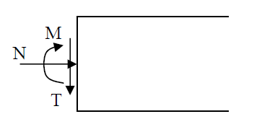
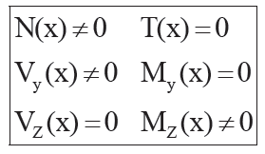
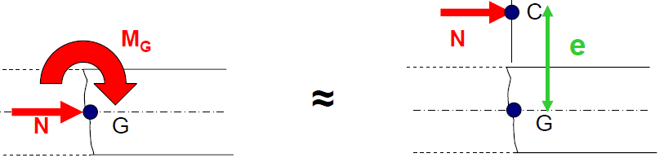
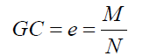
University center mila Course: Reinforced concrete 2 Chapter 03: composite bending
Definition: (Recall RDM): Composite bending arises from the combined action of bending due to lateral loading (simple bending) and an axial force (tension or compression) or only the effect of a normal force acting eccentrically with respect to the mean axis of the element. We will consider that a beam is subjected to composite bending when the elements of reduction of the torque of the internal cohesion forces reduce toN :
N normal force,
T : the shear force
M bending moment
The system formed by the bending moment (M) and the normal force (N) can be replaced by a single equivalent force (N) applied at point (C) called the point of application or center of pressure. Therefore, we replace (M, N) → N at the center of pressure such that the distance GC = e.
G: the center of gravity G: le centre de
0

Slide 2
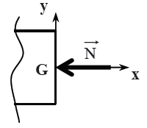
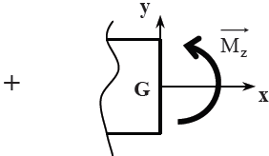
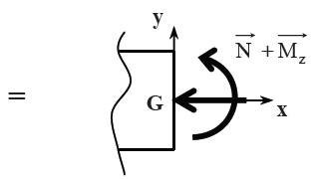
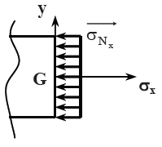
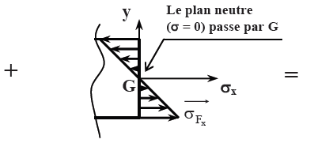
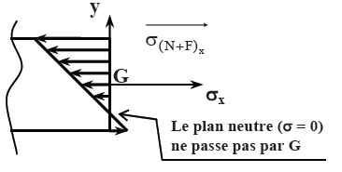
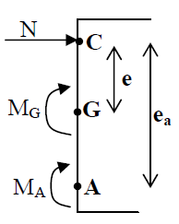




I.1°/ The expression of normal stress σx: The normal force N creates uniform normal stresses $σ_{x}=\frac{N}{S}$, which can be compressive or tensile depending on the direction of N. The bending moment Mz creates normal stresses: $σ_{Fx}=\frac{M_{Z}}{I_{GZ}}y$which result in compressive and tensile stresses depending on the y
In composite bending, it is always necessary to specify the point at which the reduction of forces is carried out because the moment values depend on this point. This point is typically either at the center of gravity of the concrete (G) or at the center of gravity of the tensioned reinforcements (A).
and
$$σ_{x}=\frac{N}{S}{ + σ}_{Fx}=−\frac{M_{Z}}{I_{GZ}}y$$
$$=\frac{N}{S}−\frac{M_{Z}}{I_{GZ}}y$$

Slide 3
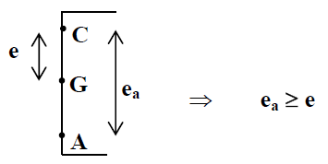
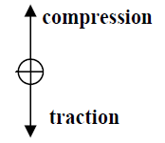
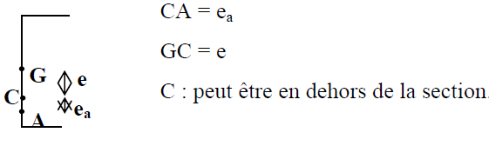
I.2°/ Neutral Axis Position:In composite bending, the first step is to determine the position of the center of pressure (C
• If (N) is a compressive force, (C) will be located above (G).
• The point (C) can be located outside the section, thus: e > h/2
• If (N) is a tensile force, (C) will be placed below (G) (next to (A)
The equilibrium equations in composite bending are established similarly to simple bending with three differences: N ≠ 0.
The section can be fully compressed.
The stresses must be calculated at the origin, typically taken as point (A)
ea > e

Slide 4
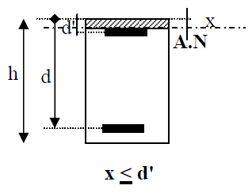
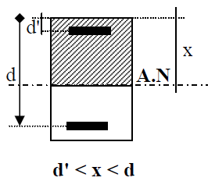
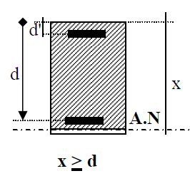
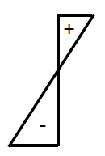
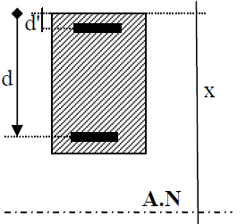
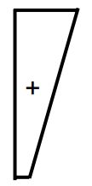
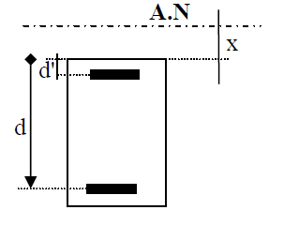
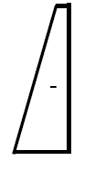
a. In composite bending, the section can be partially compressed under tensile or compressive forces. There are three cases of neutral axis positions that determine the behavior of the section under different loading conditions.
b. The section can be entirely compressed under a compressive force.
X>h
C. The section can be fully tensioned under a tensile force.
X<0

Slide 5
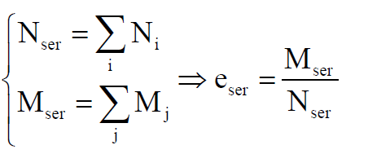
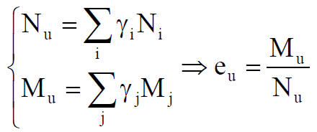
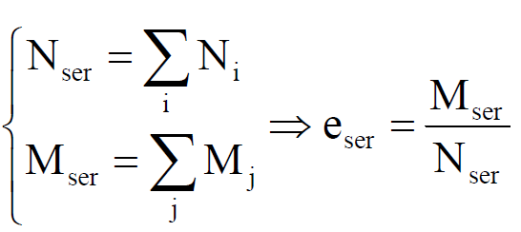
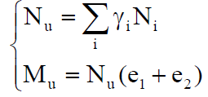
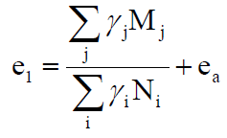


II- eccentricity:
II.1- if N<0 (tensile) : the solicitations to consider:
– E.L.S : - E.L.U:
II.2- if N>0 (Compression) :the solicitations to consider:
-E.L.S:
E.L.U:
eccentricity 1st order:
with : and
e1: First-order eccentricity resulting from applied efforts
ea: Additional eccentricity representing initial geometric imperfections; with l: length of the piece expressed in cm
The first-order eccentricity at the ELU has a value of

Slide 6





Excentricité du second ordre: Excentricity of the second order: The second-order eccentricity (e2) associated with the deformation of the structure, To determine the second-order eccentricity, two scenarios are distinguished:
If must verify the element at ELU of shape stability (buckling).
if: on détermine l'excentricité e2 de façon forfaitaire :
lf: Buckling length of the element, h: total height of the section in the direction of buckling.
φ: Ratio of the final deformation due to creep(fluage) to the instantaneous deformation under the load considered; φ = 2 in general..
Given the value of e2, the corrected internal forces and moments can be determined:

Slide 7
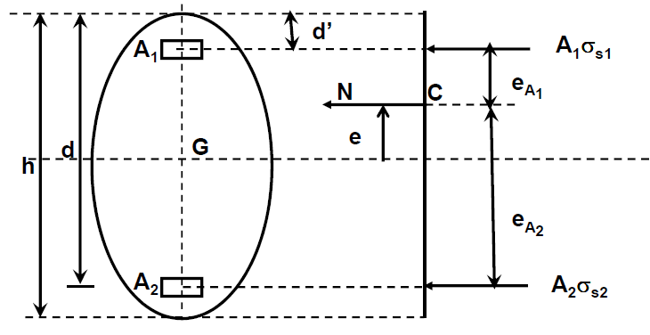






III. Determination of Reinforcement::
III.1- fully Tensioned Section:As previously discussed, a section is considered fully tensioned (at both Ultimate Limit State and Serviceability Limit State) if:
N is a tensile force (N < 0).
C falls between the reinforcement layers..
The concrete is fully tensioned and does not contribute to the section's resistance. => only the tensile steel resists, and the calculation will be around Pivot A:
III.1-1. Reinforcement Calculation:The section design is based on the following diagram. The equilibrium of the section is written with respect to the center of pressure:
Force Equilibrium:
Equilibre des moments:
Where: :
so :
From the force equilibrium equation, we can deduce the value of A2

Slide 8
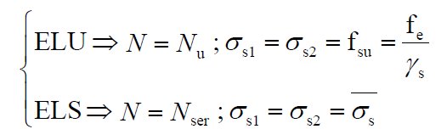

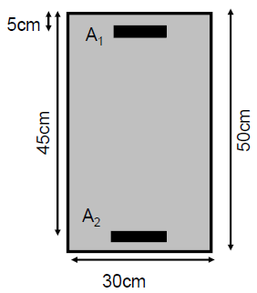
This design principle is valid for both the Ultimate Limit State (ULS) and the Serviceability Limit State (SLS). The only difference is the maximum allowable stress in the tensile reinforcement:
III.1-2 Minimum Reinforcement: In the case of a fully tensioned section, the minimum required area of reinforcement is:
Example 1:
Consider the following beam:
Loads:
ELS: Nser = -0,322MN ; Mser = 0,0385MN.m
ELU: Nu = -0,460MN ; Mu = 0,055MN.m
Material Properties: fc28 = 25MPa, FeE400
Detrimental cracking
- calculate the area of reinforcing steel (A1+A2)?

Slide 9
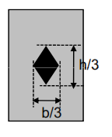
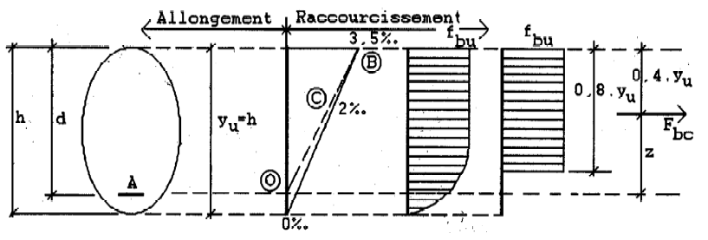



III.2- Partially Compressed/Tensioned Section (Rectangular Section):
The criteria for determining a partially tensioned section differ depending on whether the design is based on the Ultimate Limit State (ULS) or the Serviceability Limit State (SLS).
SLS:
- If N < 0 and C (center of pressure )falls outside the reinforcement layers
– Si N>0 and C falls outside central core
ULS: – N<0 and C falls outside the reinforcement layers
– N>0 the depth of the compressed concrete zone y <h
III.2.1. Approximation to Simple Bending: If N is a compressive force (Nu >0) MuA: Ultimate moment calculated with respect to the center of gravity of the tensile reinforcement.
Noyau central

Slide 10


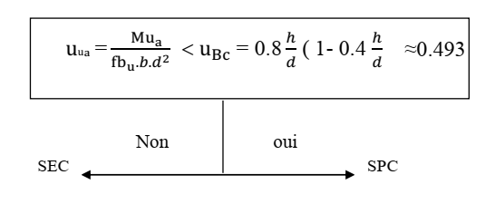
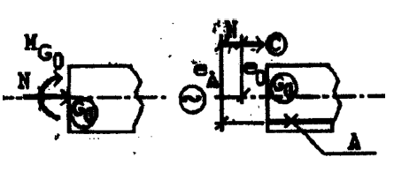

MBC: The moment MBC corresponds to the bending moment that needs to be applied to the section for it to be fully compressed (Pivot C).
So we have: when:
In practice, it is sufficient to calculate the reduced moment of the section and compare it to the value of μBC to determine whether the section is fully or partially compressed. This can be expressed as:
In the formulas we just applied, the moment MUA is calculated with respect to the center of gravity (C.O.G.) However, when determining the moment Mu=(e1+e2)Nu, it is a moment calculated with respect to the C.O.G. of the concrete section alone. Therefore, it is imperative to calculate MUA with respect to the C.O.G. of the reinforcement.
In the case of a rectangular section, we have:
Nu being caught with his sign.

Slide 11
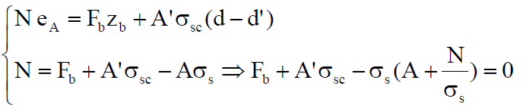
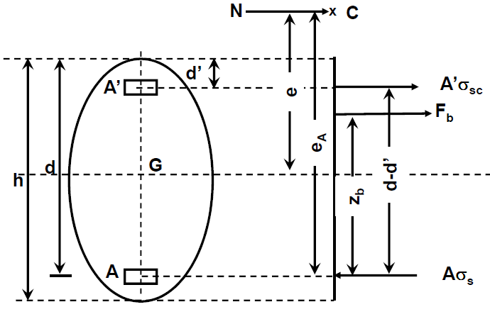
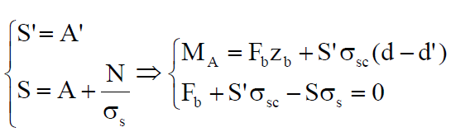
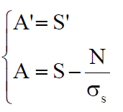
Compression (N>0) => Reduction of the tensile reinforcement area found in simple bending.
On pose :
These equations are the Equilibrium Equations of a cross-section subjected to simple bending by a bending moment MA
III.2.2. Reinforcement Calculation:
Calculate the moment MA with respect to the tensile reinforcement
Calculate the reinforcement areas S and S' for simple bending.
Return to combined bending with the reinforcement areas As and As'.
Compression (N>0) => Reduction of the tensile reinforcement area found in simple bending.
• Tension (N<0) => Increase in the tensile reinforcement area found in simple bending.
S
S
S
S
S
S

Slide 12
III.2.3. Calculation Technique:The technique for sizing a partially tensioned (compressed) section under combined bending is as follows:
Calculate the moment MA (at ULS or SLS) with respect to the tensile reinforcement.
Deduce the reinforcement areas As and A's by sizing for simple bending.
Determine the combined bending reinforcement from: A's = s' and As = S - N/σs
ATTENTION, the algebraic sign of the axial force N should be taken into account:
- If N is a compression force (N > 0) => there is a decrease in the reinforcement area found for simple bending, as the compression is favorable.
If N is a tension force (N < 0) => there is an increase in the reinforcement area found for simple bending, as the tension is unfavorable.
Note: If N is a compression force, C is opposite to the centroid of the tensile reinforcement with respect to G0.
If N is a tension force, C and the tensile reinforcement are on the same side with respect to G0.

Slide 13
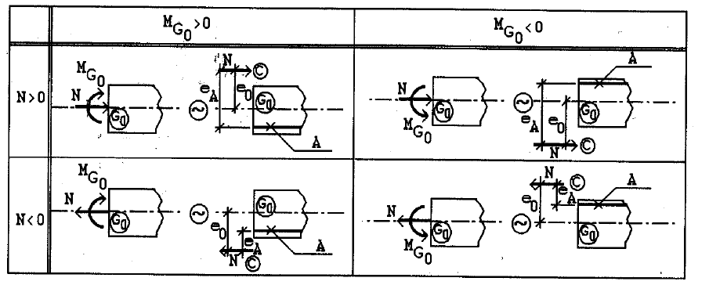

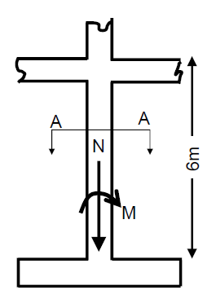
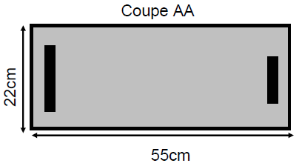
C.The position of the tensile reinforcement
d. Minimum percentage of reinforcement:For a partially tensioned (compressed) rectangular section under combined bending and axial load:
The minimum percentage of reinforcement is:
It is noted that if the eccentricity e tends towards infinity, for combined bending and axial load, we recover the minimum percentage for pure bending. CAUTION, the eccentricity e must be taken into account at the serviceability limit state (ELS) and with the same sign as the axial force N.
Application Example:
Ng = 85kN ; Nq = 75kN
• Mg = 90kN.m ; Mq = 80kN.m
• fc28 = 25MPa, FeE500
• Non-detrimental cracking
μlu= 0.305

Slide 14
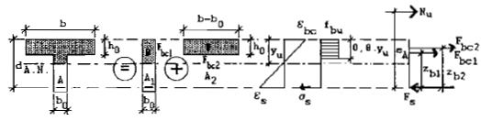







III.3. Partially Tensioned T-Sections: There are two possible scenarios:
MuA < Mtu => he design is reduced to that of a rectangular section with width b, under combined bending and axial load, subjected to (MuA and Nu)
MuA > Mtu => Calculation is performed for a T-section.
Reinforcement Design if MuA > Mtu:
Moment equilibrium:
Force equilibrium:
where:
and:
We realize that these equations integrate the terms related to sizing for simple bending. To highlight them, we set:
and: Which gives us:
By identification, we obtain the following relations:
S
ur
S
S

Slide 15
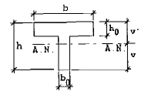
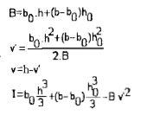
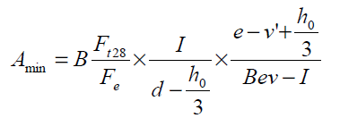
b. Calculation technique:
The technique for dimensioning a T-shaped section partially in tension under composite bending is as follows:
Calculate the moment MA(à l'ELU ou ELS) with respect to the tensioned steel..
Determine if the compression table is over-dimensioned..
If not, calculate the section as a rectangular section (see previous paragraph).
If yes, deduce the sections S and S' by a dimensioning in simple bending, with Mur and Nur.
Determine the steel bars for composite bending from :
C. Minimum percentage of reinforcement: For a partially tensioned T-section under composite bending, the minimum percentage of reinforcement is:
S
ur
S

Slide 16

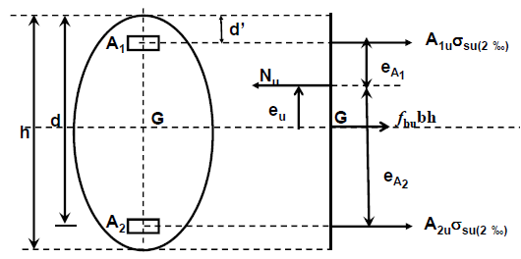

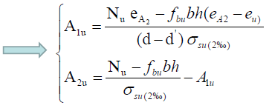


III.4- Fully Compressed Sections: We previously saw that a rectangular section can be considered partially tensioned (or partially compressed) if point C was located outside the reinforcement.
ULS: => Calculate around pivot C; Or ⇒ Bring calculation around pivot B
Or => Use interaction diagram (N, M)
It is recommended to adopt a symmetric reinforcement (A1u=A2u) to reduce the risk of buckling => most often the calculation is brought around pivot B.
ULS Calculation around Pivot C: uniform deformation over the section equal to 2‰
Balance of the section:

Slide 17
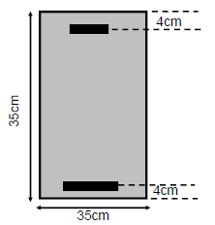
Example :
• fc28 = 25MPa, FeE400
• Slight or no cracking
• Nu = 1,045MN
• MuG = 0,1463 MN.m
• l0= 4m
• α = 0,5

