Slide 1
UNIVERSITY CENTER OF MILA
INSTITUTE OF SCIENCE AND TECHNOLOGY
DEPARTMENT OF CIVIL AND HYDRAULIC ENGINEERING
Reinforce concrete 2
(3th year Civil Engineering)

Responsible: Dr. GUETTICHE ABDELHEQ

Academic Year 2025- 2026

Slide 2
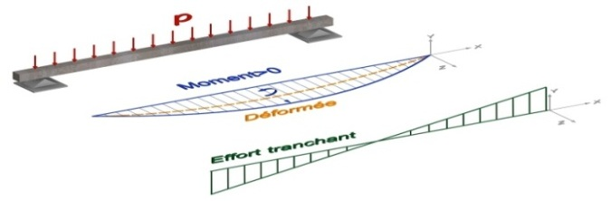
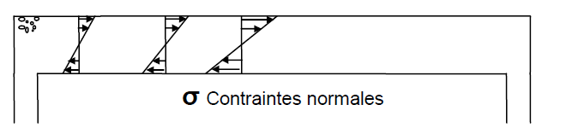
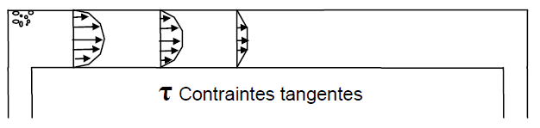
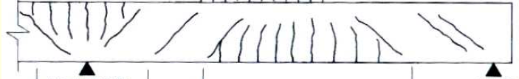
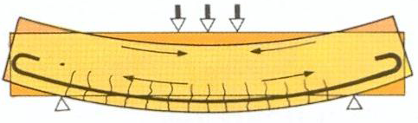
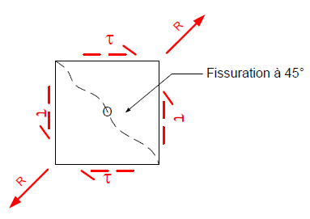
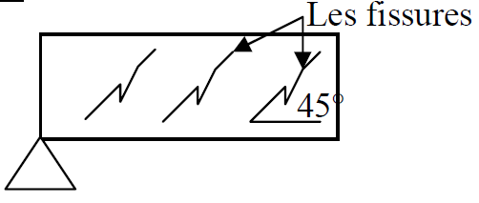
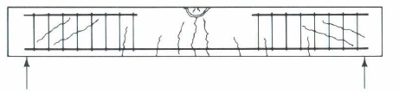
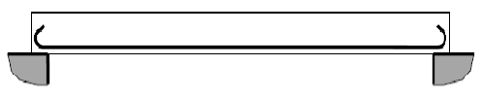
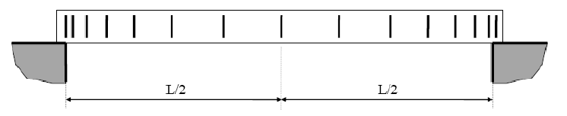
Chapter 02 : Shear forces
I. Introduction : we have examined the behavior of concrete under pure bending. In practice, reinforced concrete elements must withstand, in addition to bending, other solicitations such as shear forces (simple bending)."
In a reinforced concrete beam, the shear force is balanced by transverse reinforcement.
vu

Slide 3


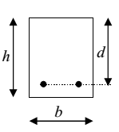
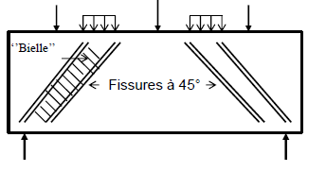
II. Calculation stress :The shear stress in the section where the shear force occurs will be given by the following equation:
Where: τ: Shear stress. T: Shear force.
S : Section's static moment..
b : Width of the section.. I : Moment of inertia of the section
Tangential (shear) stress:
The solicitation of shear force are always determined at the ultimate limit state (E.L.U). For the justification of the web of a beam, the BAELA.5.1,1 takes the tangent stress:
d: Effective height;
τu : Conventional tangent stress
b : Web width (overall width in the case of a rectangular section; rib width in the case of a T-shaped section).
In addition to the tangent stresses τ, the shear force induces on planes inclined at 45° to the neutral axis tensile stresses σt and compressive stresses σc, both with intensities equal to τ.

Slide 4
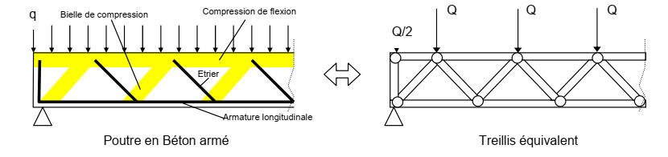
Risk of cracking at 45°, especially near the supports => need to "stitch" oblique cracks with so-called "web reinforcements.“
Risk of concrete crushing along “strut." Loads are transmitted to the supports through concrete struts. The installation of a framework prevents the opening of cracks. Similarly, longitudinal steel bars also prevent the propagation of these cracks. The assembly functions as a truss beam called Ritter-Morsch truss.
The upper flange of the fictitious beam corresponds to the compression zone in concrete, while the lower flange corresponds to the tensile reinforcement. The compressed diagonals of the truss correspond to the compression 'struts' in the web of the concrete beam, and the tensile diagonals correspond to the shear force reinforcement..

Slide 5

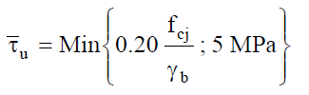
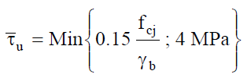


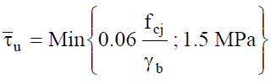
III. Ultimate Limit Tangential Stress: The BAEL considers, for the determination of the Ultimate Limit State (E.L.U) of the concrete in the web of a typical section, the following two cases:
III.1 Straight transverse reinforcements (α = TRF):
Slight cracking: A.5.1,211
b) detrimental and very detrimental cracking : A.5.1,211
III.2 Armatures transversales inclinées à 45° (α = π/ 4 ):A.5.1,212
III.3 Elements with all cross-sections subjected to compression (column): A.5.1.1
For inclined reinforcement with an angle α ∈ [45; 90], interpolation is performed on the previous values. It is necessary to check in all cases: τu ≤ τ̅.
If this condition is not met, it is advisable to review the dimensions of the beam, especially its width (b)."

Slide 6

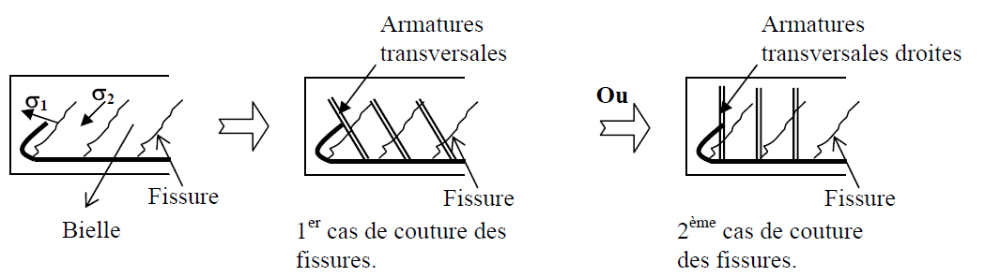
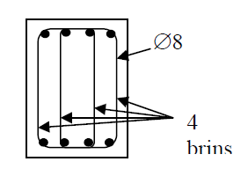
IV. Dimension of transverse reinforcements: Normal stresses in the concrete at supports (isostatic) are zero, indicating pure shear.
Due to its low tensile strength, concrete is unable to balance the tensile stresses generated by shear forces. It is therefore necessary to reinforce this deficiency with reinforcements that will bridge these cracks. Their logical arrangement will be:
Because their effectiveness remains the same and for ease of execution, the reinforcements will be arranged as per the second case. The reinforcement will be noted as follows: At is the quantity of reinforcement steel
At = n . ∅ with : n : number of legs.
∅ = The diameter of the strand in general ∅6 ou ∅8.
We have : At= 4 ∅8

Slide 7
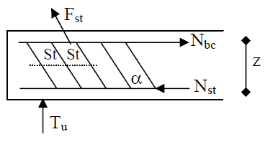
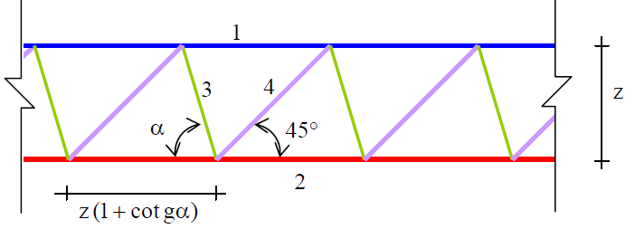


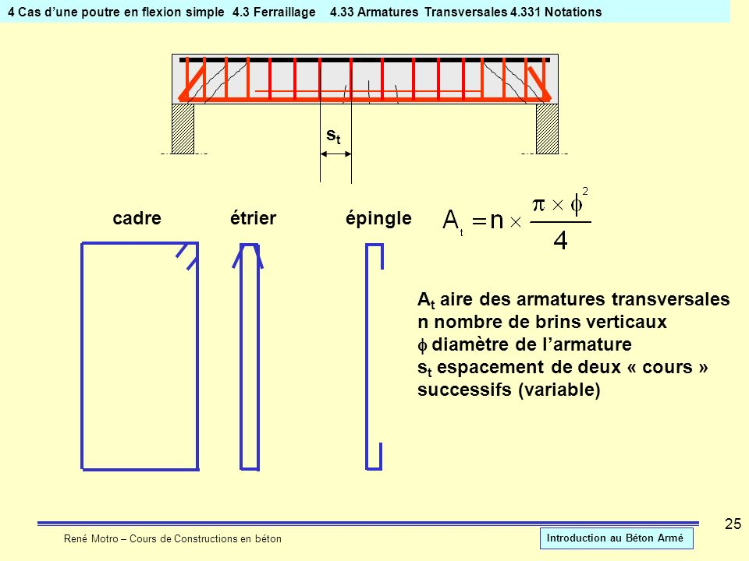
IV. 1 Spacing of transverse reinforcements: After cracking resulting from the action of shear force, the beam is assimilated to a Ritter-Mörsh truss, consisting of:
Tu = Fst . sin α
a compressed flange (1); a tensioned flange (2); tension diagonals (3); compressed diagonals (4); resulting from the 45° concrete struts.
By replacing all these forces and making the necessary transformation, and using approximations, we obtain:
fe ; fc28 ; τu en MPa with:
ft28 capped at 3.3 MPa. b ; St with m
k = 1 : in the general case (simple bending).
k = 0 : If the cracking is very detrimental or if there is concrete repair.

Slide 8

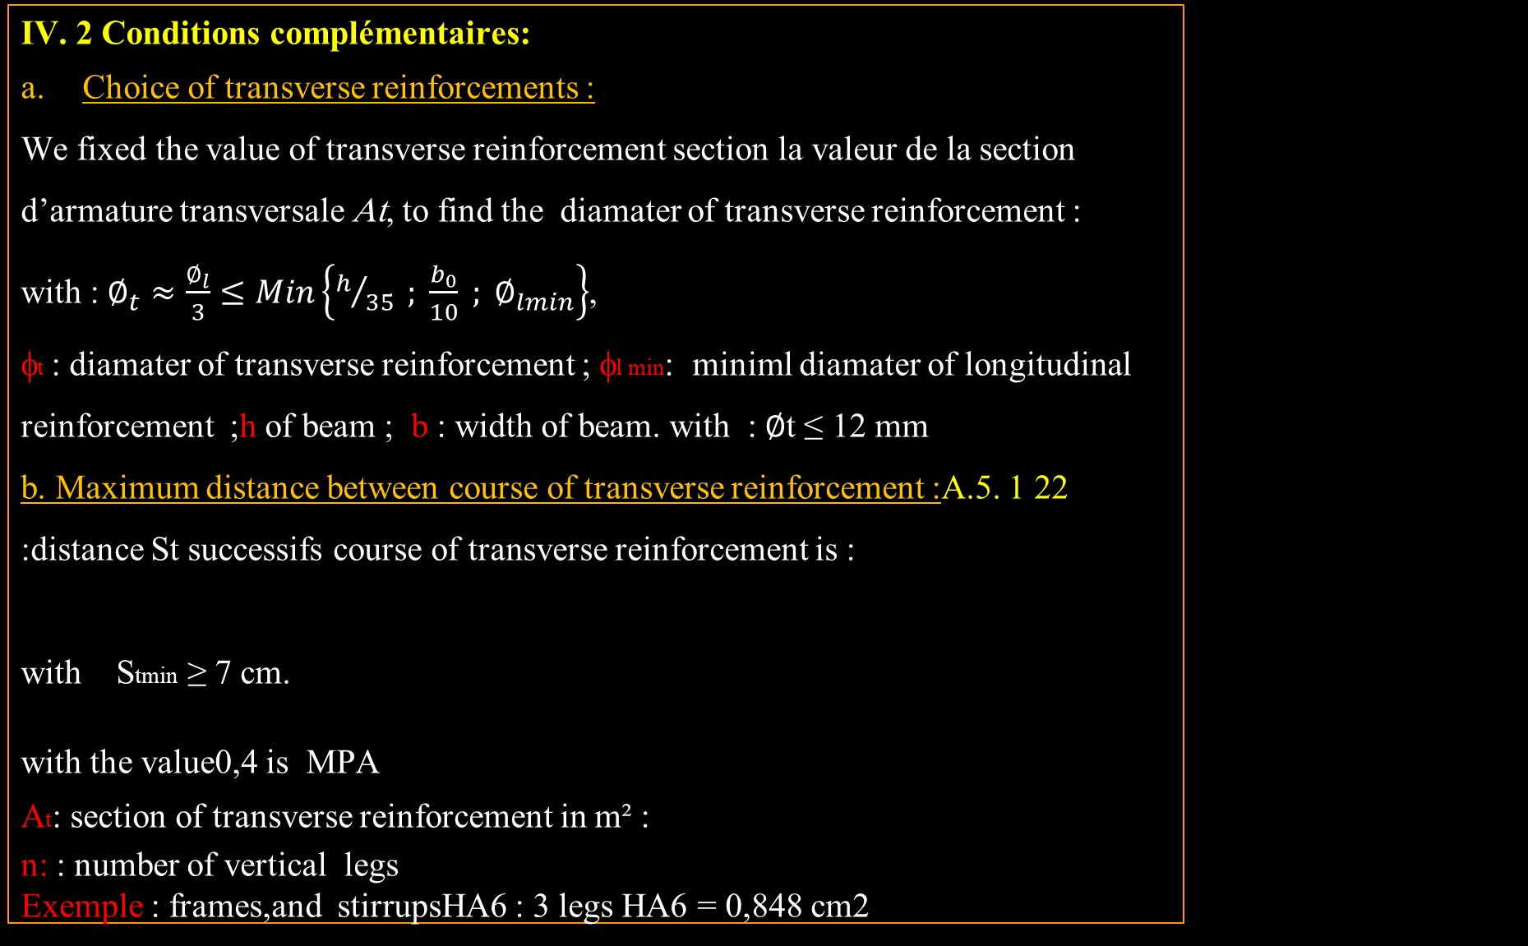
IV. 2 Conditions complémentaires:
Choice of transverse reinforcements :
We fixed the value of transverse reinforcement section la valeur de la section d’armature transversale At, to find the diamater of transverse reinforcement :
with :$∅_{t}≈\frac{∅_{l}}{3}≤Min\left\{h/{35} ; \frac{b_{0}}{10} ; ∅_{lmin}\right\}$,
φt : diamater of transverse reinforcement ; φl min: miniml diamater of longitudinal reinforcement ;h of beam ; b : width of beam. with : ∅t ≤ 12 mm
b. Maximum distance between course of transverse reinforcement :A.5. 1 22 :distance St successifs course of transverse reinforcement is :
with Stmin ≥ 7 cm.
with the value0,4 is MPA
At: section of transverse reinforcement in m² :
n: : number of vertical legs
Exemple : frames,and stirrupsHA6 : 3 legs HA6 = 0,848 cm2

Slide 9
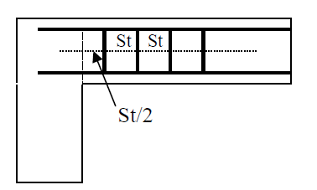
IV.3. Distribution of transverse reinforcements: Two cases may arise:
St > Stmax :- Place the first course of transverse reinforcement at a distance from the face of the support equal to Stmax /2.
- Place the first course of transverse reinforcement at a distance from the face of the support equal to constante égale à Stmax.
2) St < Stmax (méthode de caquot):
1/ Place the first course of transverse reinforcement at a distance from the face of the support = St /2.
2/ We will take the immediately smaller spacing at St in the following Caquot series:
7 ; 8 ; 9 ;10 ;11; 13;16; 20; 25; 35;40 (cm) (not mandatory, recommended).
Then repeat the spacing n times (with 'n an integer' number of meters in half the span (n=L/2) or the span of a cantilever.
After repeating n times st0, connect to the following values without exceeding StMax. This method is applicable only for uniformly loaded beams with constant cross-sectional area.
Nu d’appuis

Slide 10
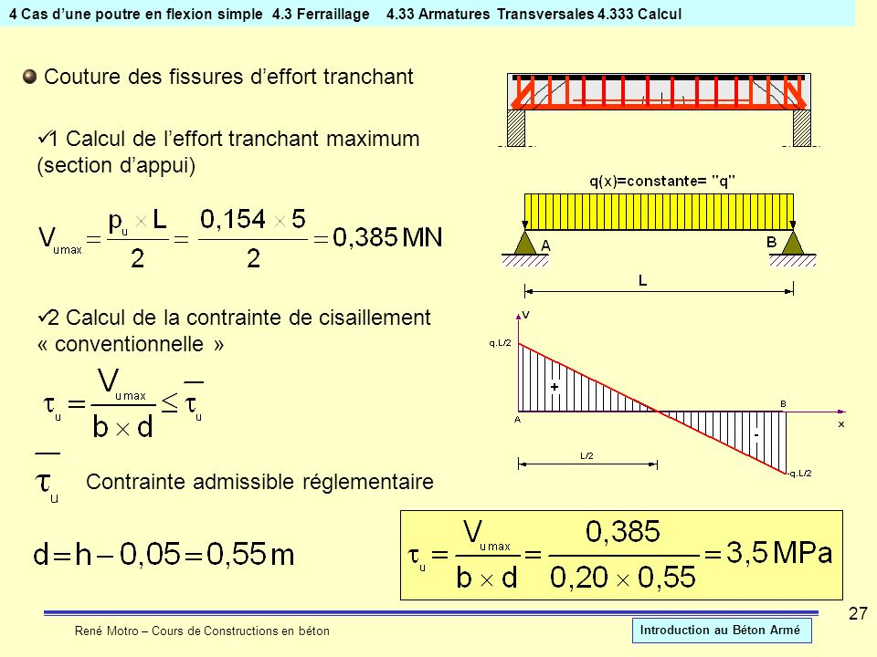
Application 1: For the beam below, we calculated the spacing between the transverse reinforcements, and we found that :St = 18.2 cm. Avec L=5m
Solution : So, according to the Caquot method, we take St as an integer value.St = 18 cm→Pour la série on prend : 18/2 ; 3 × 16; 3 × 20 ; 3 × 25; 35 ; up to half of the span. n=L/2=5/2=2.5
Application 2: a rectangular beam (20×60) cm and an effective height d=55 cm. subjected to a distributed load q=154Kn/m . With a span L= 5m simply supported at A and B.(fc28 = 25MPA; FeE215. non-detrimental cracking, α = π/ 2 , sans reprise de béton
- Calculate the maximum shear force (support section) and the stress τu et τ ̅ ?
To calculate the spacing between transverse reinforcements (St)
Question : When the values of the first spacing St0​/2 and the number of identical spacings n=L/2are decimal numbers, should they be rounded up or down?
Réponse : Common sense dictates that, for safety, spacing should be underestimated, and repetitions should be overestimated.

Slide 11
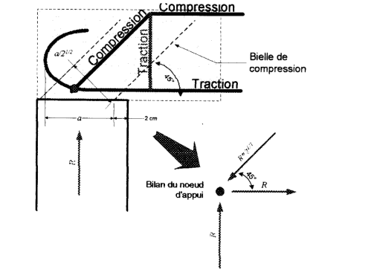
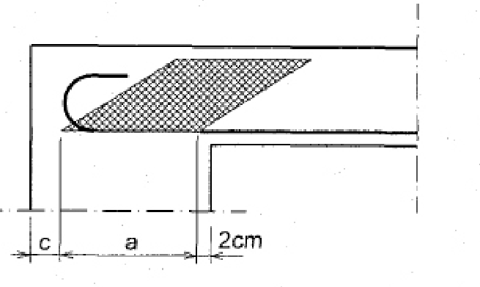
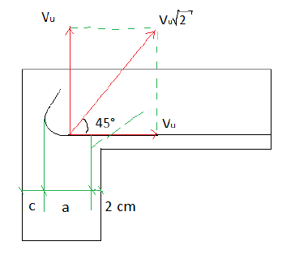

VI. Justification at supports: simple end support (Edge support): it is assumed that the loads are transmitted through a single strut “bielle” called the end strut, with a minimum depth.
VI.1. Verification of the minimum support depth: Verification of the minimum support depth: the end strut has a width that satisfies a≤ min (0.9d ; a′-2-c) ; a’ : width of the column section at supports.
Application 3: Verify the supports of a beam subjected to maximum shear force (at supports): =95KN, As(longitudinal) = 2HA16+2HA14, b =16cm
Material characteristics: fc28=25MPa ;FeE500
Tu
Tu$\sqrt{2}$
Tu
à

Slide 12








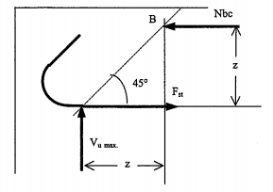

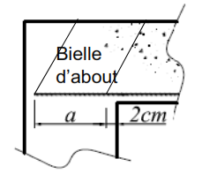
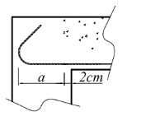
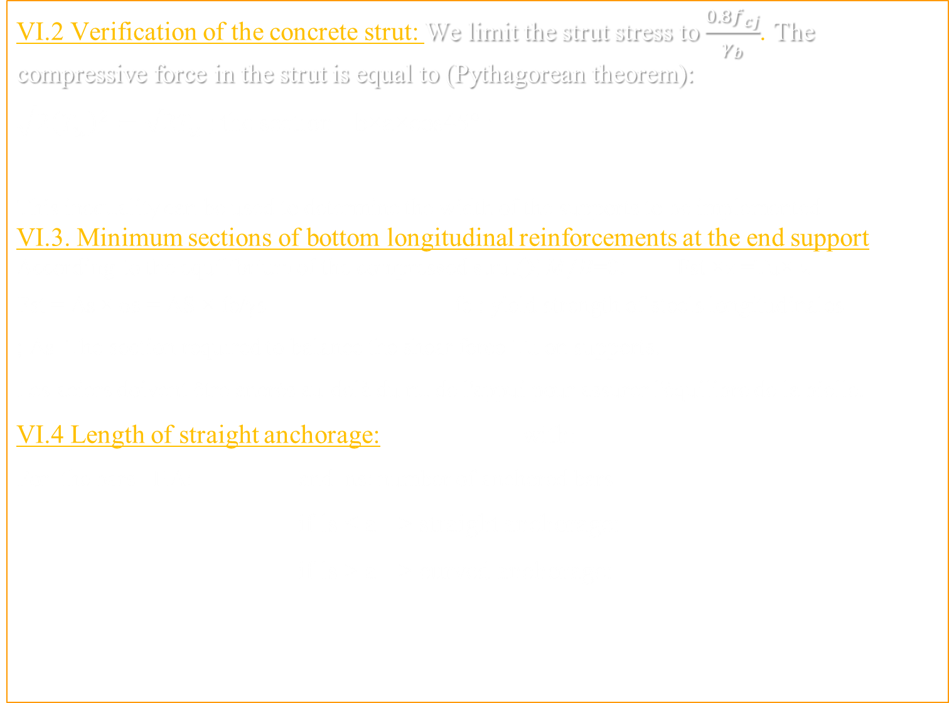
VI.2 Verification of the concrete strut: We limit the strut stress to $\frac{{0.8f}_{cj}}{γ_{b}}$. The compressive force in the strut is equal to (Pythagorean theorem):
$\sqrt{2{\left(T_{u}\right)}^{2}}={\sqrt{2}T}_{u} ;$ the section =b×a×cos45° :
This inequality can be used to determine the width of the supports to be implemented
VI.3. Minimum sections of bottom longitudinal reinforcements at the end support
According to the equilibrium of the compressed strut($\sum{M/B}$=0: Fst ×z =Tu× z
Fst = AS × σs = AS × fe/γs fe : yield strength of steels longitudinales
; AS The section required to balance the shear force Tu on supports.
Les aciers doivent être ancrés au-delà du nu de l'appui pour assurer l'équilibre de la bielle.
VI.4 Length of straight anchorage: with:
For the bars HA: and ns: number of anchored bars
if ls ≤ a => straight anchorage:
if ls > a => curved anchorage:
Tu

Slide 13
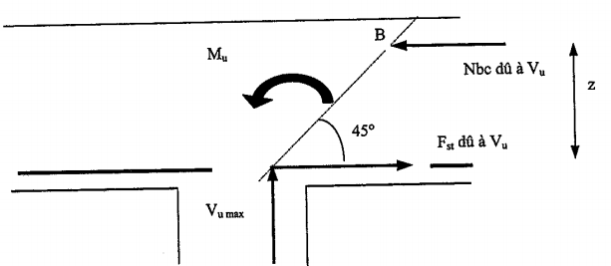

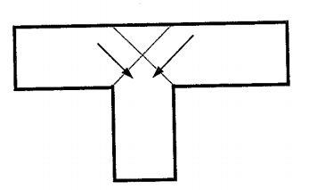


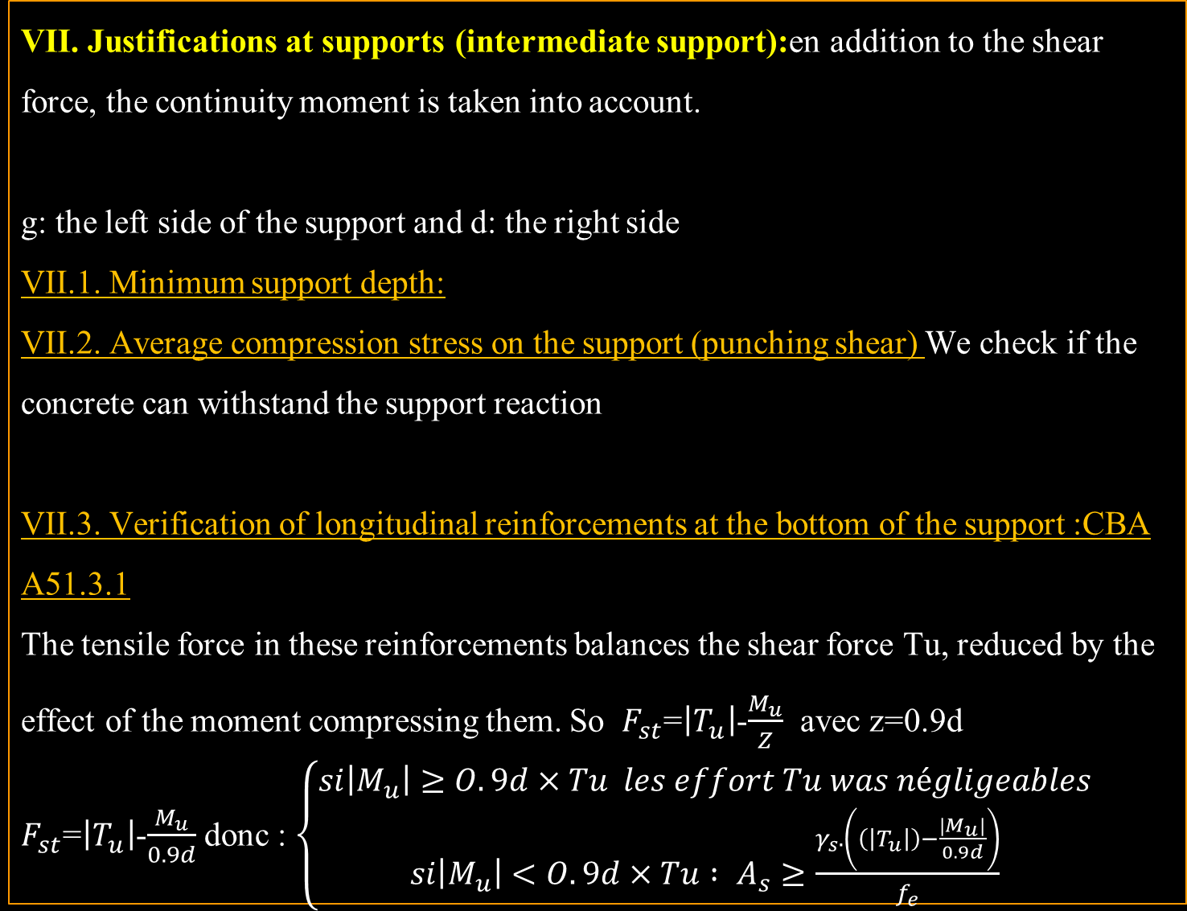
VII. Justifications at supports (intermediate support):en addition to the shear force, the continuity moment is taken into account.
g: the left side of the support and d: the right side
VII.1. Minimum support depth:
VII.2. Average compression stress on the support (punching shear) We check if the concrete can withstand the support reaction
VII.3. Verification of longitudinal reinforcements at the bottom of the support :CBA A51.3.1
The tensile force in these reinforcements balances the shear force Tu, reduced by the effect of the moment compressing them. So $F_{st}$=$\left|T_{u}\right|$-$\frac{M_{u}}{Z}$ avec z=0.9d
$F_{st}$=$\left|T_{u}\right|$-$\frac{M_{u}}{0.9d}$ donc : $\left\{\begin{aligned}si\left|M_{u}\right|≥O.9d×Tu les effort Tu was négligeables \\ si\left|M_{u}\right|<O.9d×Tu : A_{s}≥\frac{γ_{s}.\left(\left(\left|T_{u}\right|\right)−\frac{\left|M_{u}\right|}{0.9d}\right)}{f_{e}}\end{aligned}\right.$
Nbc dù à Tu
Fs dù à Tu
Tu

Slide 14

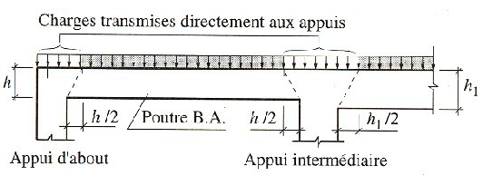
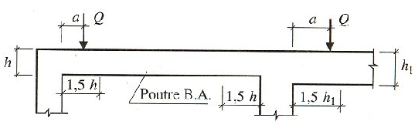


VIII. Effort tranchant réduit au voisinage d’un appuis :
Case in load located betwween limit of support and et h/2 : in this case the loa not take in account
Case in load Q located between h/2 et 3h/2: in this case the developped shear force reduced by 2a/3h:
a : distance from support and et the point load applicationQ
h: height of beam
IX. Case of floors :no transeverse reinforcement needed
with in condition the concrete not made in 2 phases.
Remarque:τ u is weak in general case .

Slide 15
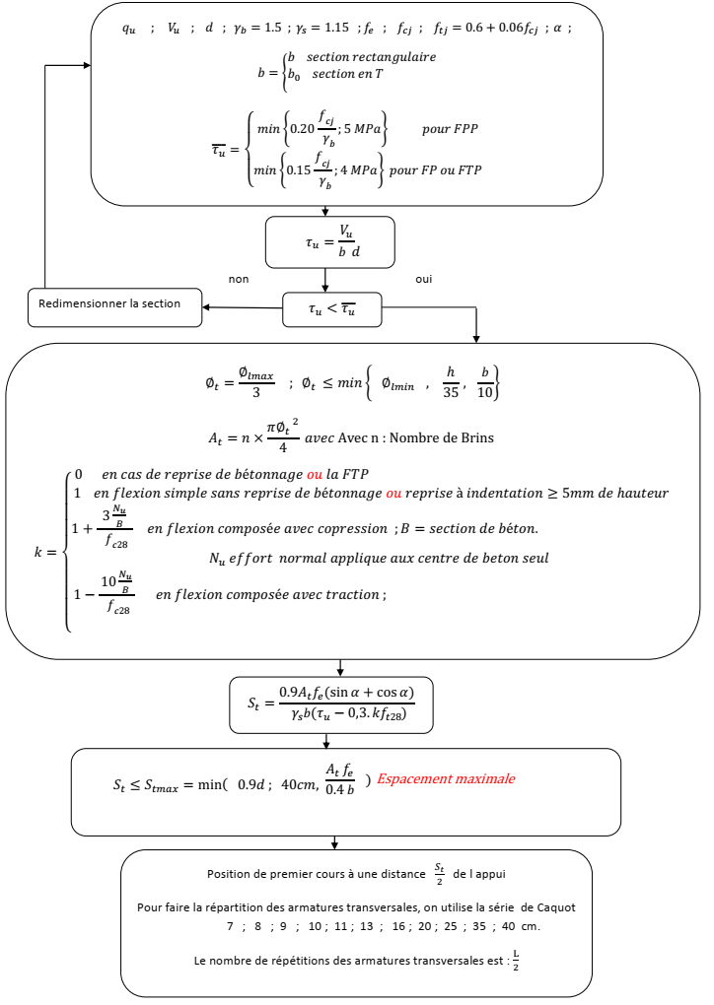

Slide 16
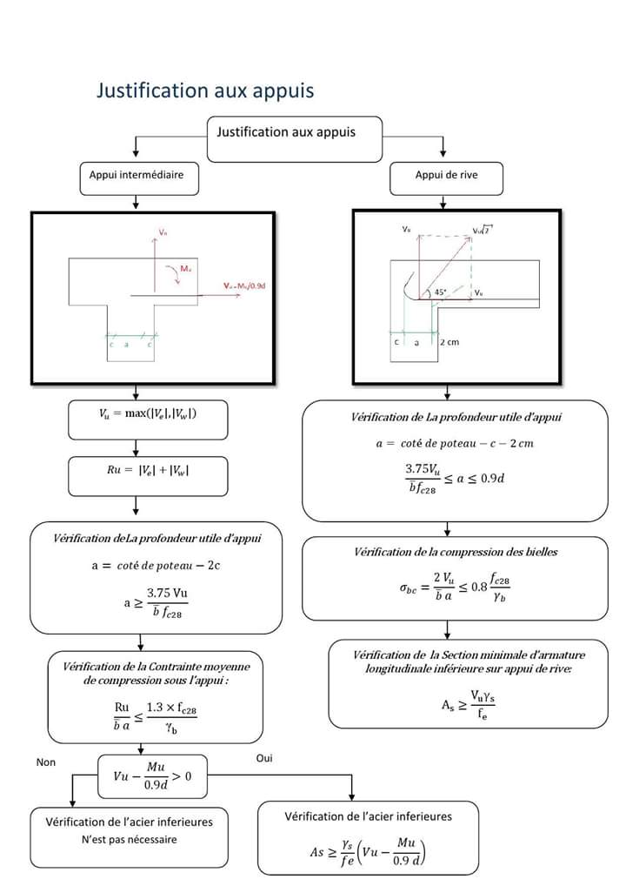
Organigramme justification aux appuis

