Slide 1
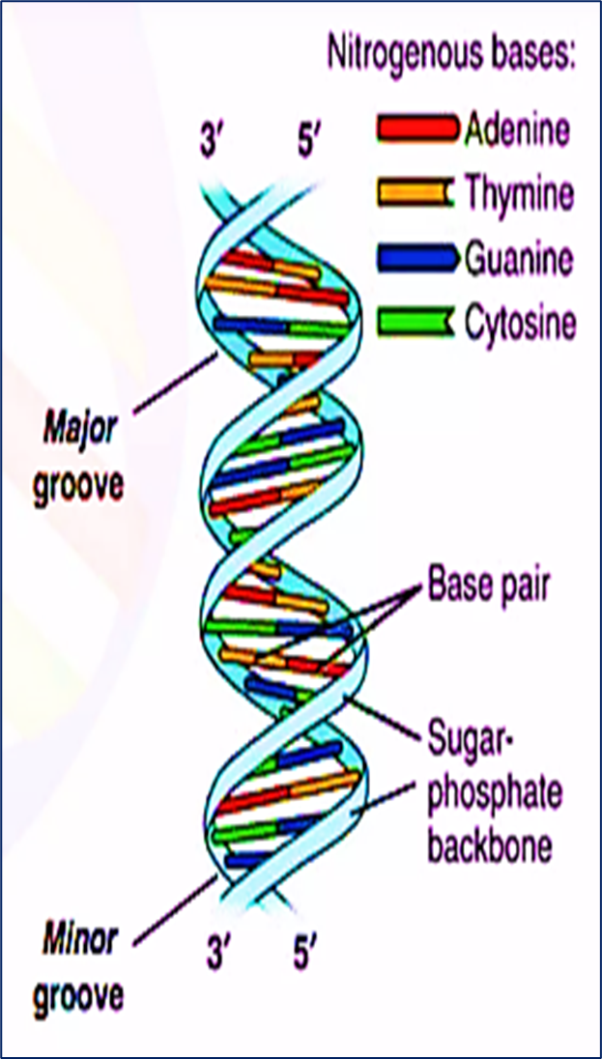
DNA Structure
DNA is made up of millions of nucleotides. These are molecules composed of a deoxyribose sugar, with a phosphate and a base attached to it. These nucleotides are attached to each other in strands via phosphodiester bonds to form a ‘sugar-phosphate backbone’. The bond formed is between the third carbon atom on the deoxyribose sugar of one nucleotide (known as the 3’) and the fifth carbon atom of another sugar on the next nucleotide (known as the 5’).
There are two strands of DNA, which run in opposite (antiparallel) directions to each other. These strands are attached to each other throughout their lengths via the bases on each nucleotide.
There are 4 different bases associated with DNA: Cytosine, Guanine, Adenine, and Thymine. In normal DNA strands, cytosine binds to guanine, and adenine binds to thymine. When bound together, the two strands form a double helix structure.

Slide 2
Characteristics of the Two DNA Strands /
DNA (deoxyribonucleic acid), described by James Watson and Francis Crick, consists of two polynucleotide strands twisted around each other to form a double helix. The two strands have two main characteristics:
1, Antiparallel Structure
The strands run in opposite directions:
One strand is oriented 5′ → 3′
The other is oriented 3′ → 5′
This opposite orientation is called antiparallel.
The nitrogenous bases face inward, while the sugar-phosphate backbone (hydrophilic) faces outward, ensuring structural stability.
2, Complementary Base Pairing
The two strands are complementary, meaning each base pairs specifically with its partner:Adenine (A) pairs with Thymine (T) Cytosine (C) pairs with Guanine (G)
𝐴−𝑇: 2ℎ𝑦𝑑𝑟𝑜𝑔𝑒𝑛𝑏𝑜𝑛𝑑𝑠;
𝐶−𝐺: 3ℎ𝑦𝑑𝑟𝑜𝑔𝑒𝑛𝑏𝑜𝑛𝑑𝑠
This pairing is due to:

Slide 3
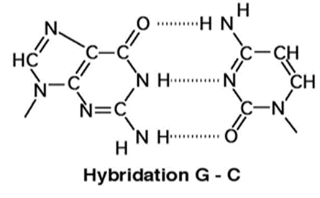
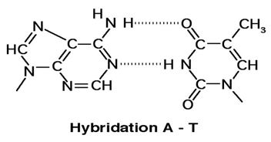
Steric reasons: A purine (A or G, two rings) pairs with a pyrimidine (T or C, one ring), maintaining constant helix diameter.
Hydrogen bonding reasons: The bases facing each other are linked by hydrogen bonds. Opposite an NH₂ group at position 6 of a purine base, there is a C=O group of a pyrimidine base, and conversely, opposite an NH₂ group at position 6 of a pyrimidine base, there is a C=O group of a purine base (Figure 1).
Figure 1: Complementarity between the bases

Slide 4
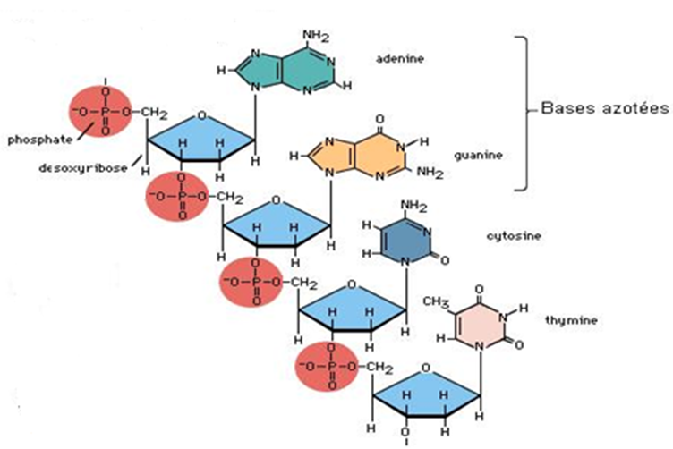
3- Helical: the two chains present a helical configuration in space, they wind around an imaginary central straight axis forming a double right helix (Figure 2)
Note: Since DNA is double-stranded and the two strands are linked by hydrogen bonds (A=T and G≡C):
A/T = 1 and G/C = 1, hence A+G/T+C = 1.
However, the asymmetry ratio: R = A+T / G+C ≠ 1. It is characteristic of each organism.
Figure 2: Detail of a strand of DNA

Slide 5
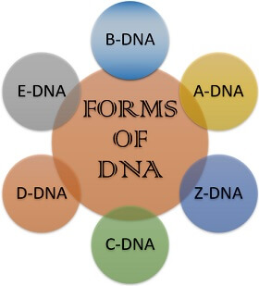
Forms of DNA
DNA (hereditary material of the cell) consists of a long polynucleotide chain and shows structural diversity by changing its structural configuration,
These different types of DNA vary slightly in their diameters, sizes, and the orientation of their base pairs.

