Slide 1
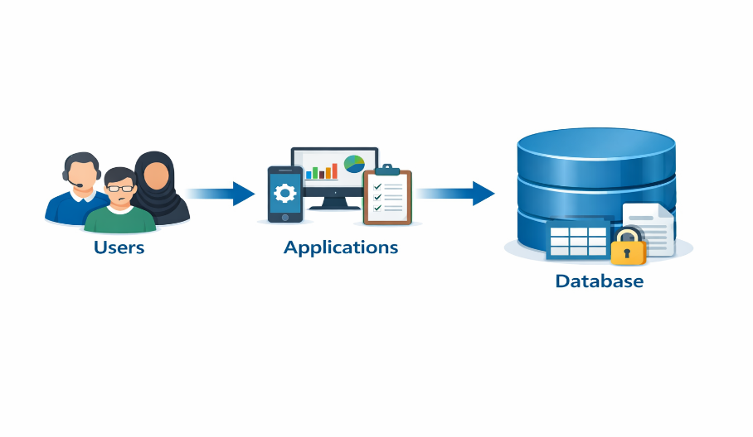
CHAPTER 1 Basic Concepts of Databases and DBMS
Part A — Motivation and Context of Databases

Slide 2
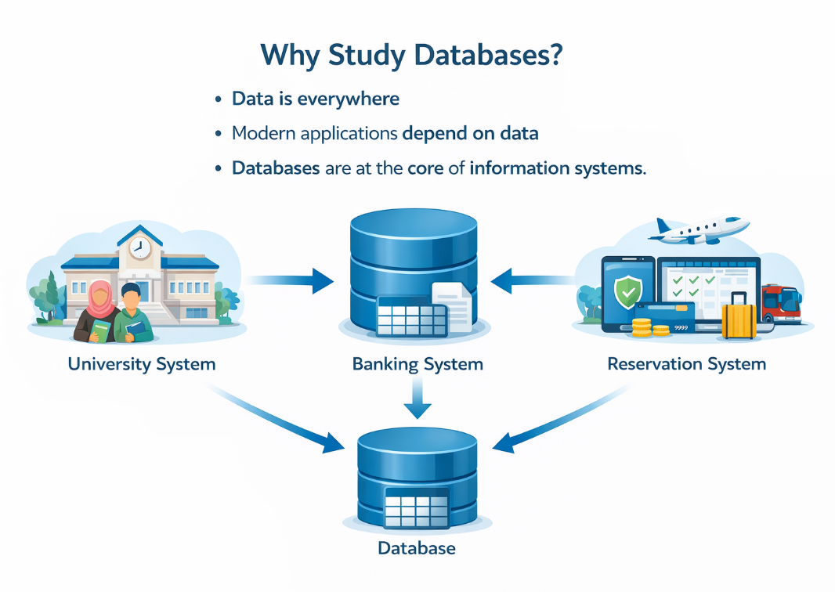
Why Study Databases?
Data is everywhere
Modern applications depend on data
Databases are at the core of information systems

Slide 3
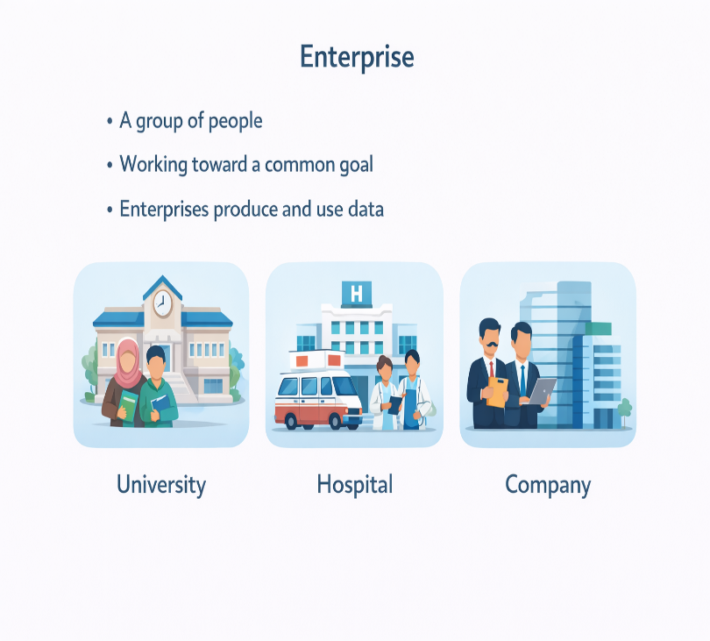
What Is an Enterprise?
An enterprise is:
  A group of people
  Working toward a common goal
  Enterprises produce and use data

Slide 4

Example: University Enterprise
Students
Teachers
Courses
Departments

Slide 5

Data Management Problem
Large amount of data
Different (Various) types of data
Strong relationships between data
for example:
  a student enrolls in a course,
  a course is taught by an instructor,
  a course is scheduled in a classroom, etc.

Slide 6
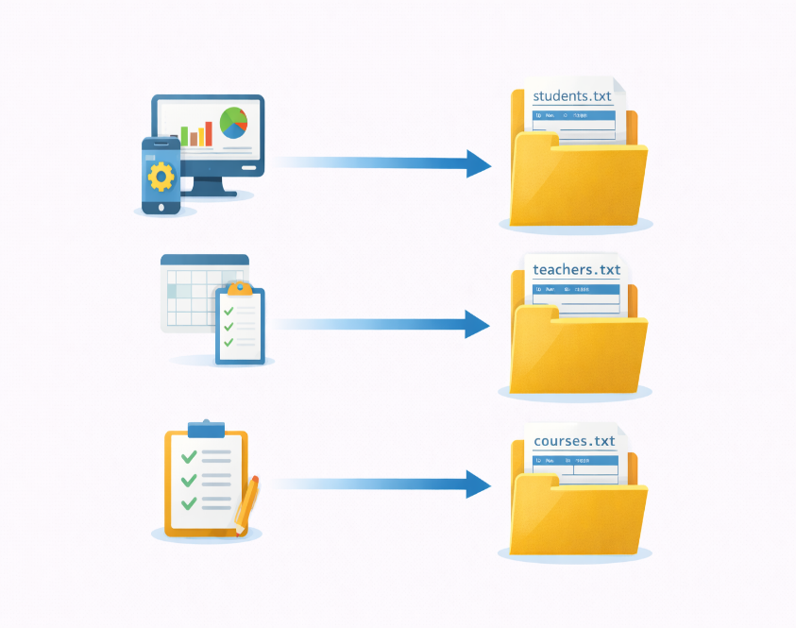
File-Based Data Management
  Data stored in files
One file per application
Programs directly access files
Data are homogeneous (subscribers of a journal, company staff, store products)

Slide 7
Example: Student File
students.txt
ID | Name | Department
101 | Ahmed | Informatique
102 | Amina | Mathématiques
103 | Karim | Économie

Slide 8
Limitations of File Systems
  Data redundancy
Same data stored in multiple files

Slide 9

More Limitations of File Systems
Data inconsistency
Difficult data sharing
Strong program–data dependency
Files are isolated
Coordination is fragile
Errors and inconsistencies occur

Slide 10

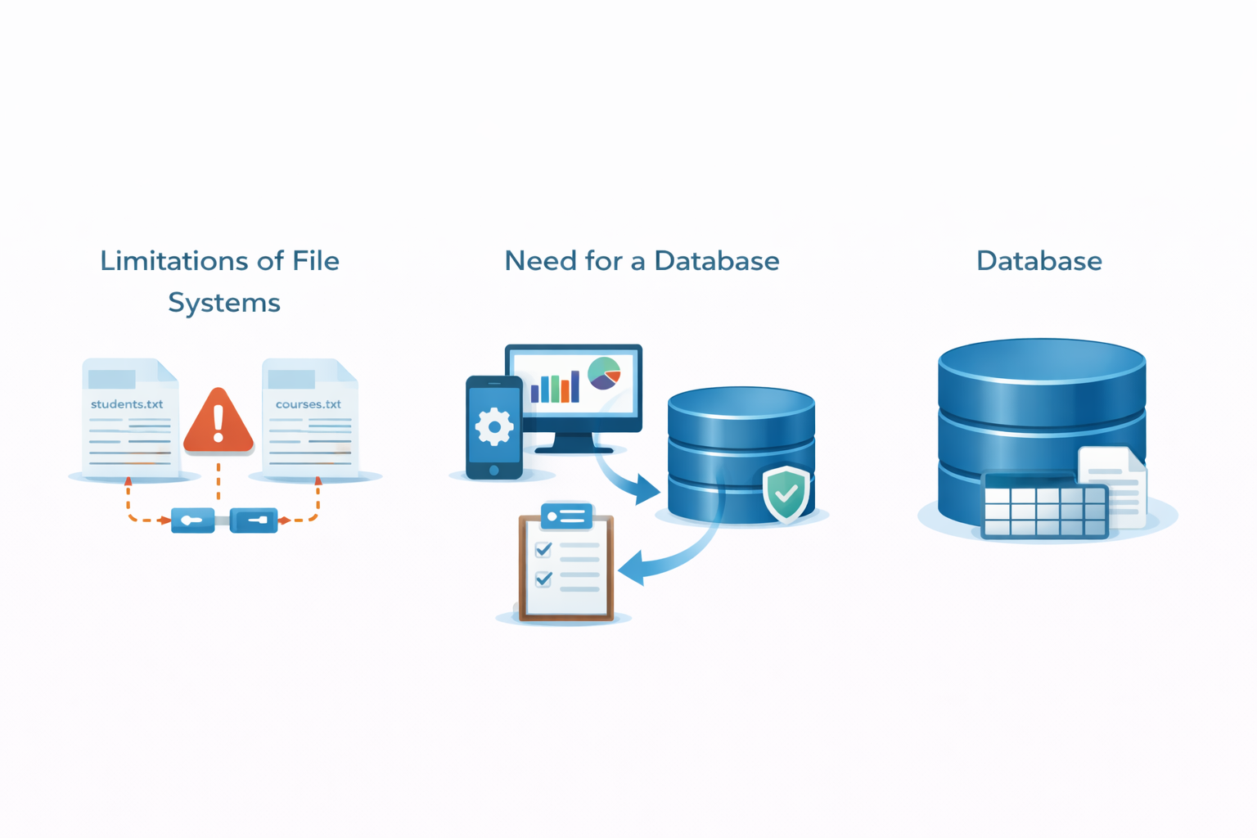
From Files to Databases: Need for a Database
Centralized data
Shared access
Controlled management

Slide 11
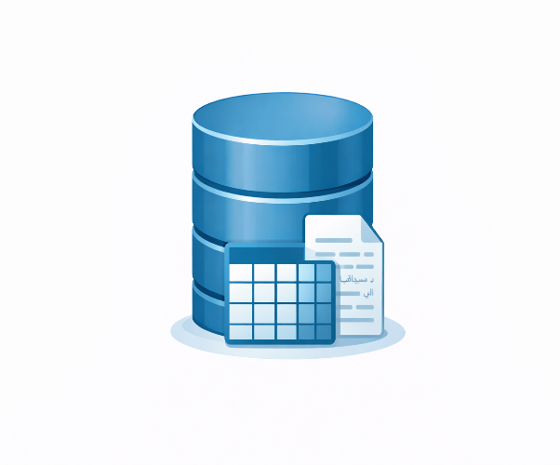
Definition of a Database
A database is:
  An organized collection of data
  Related to a specific enterprise
  Shared and coherent

Slide 12
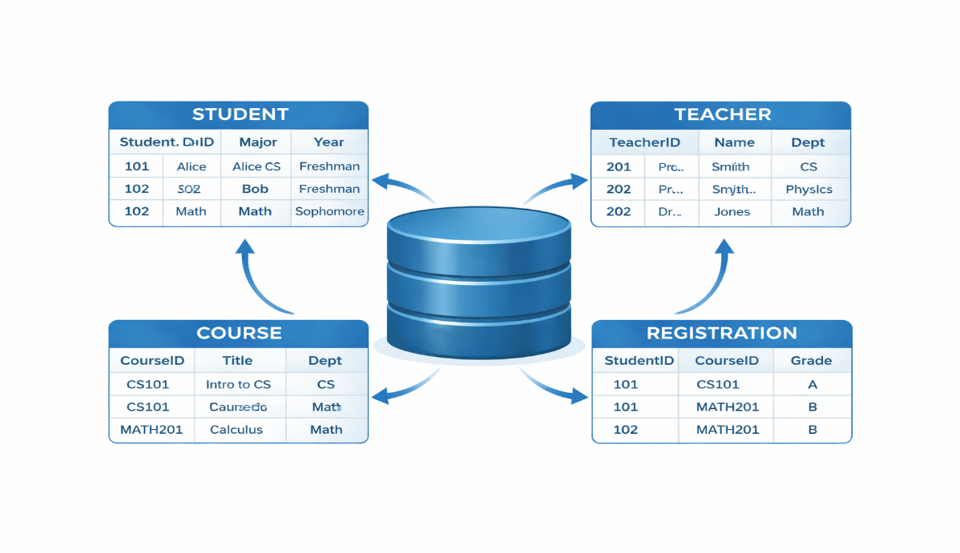
Example: University Database
Students
Teachers
Courses
Registrations

Slide 13
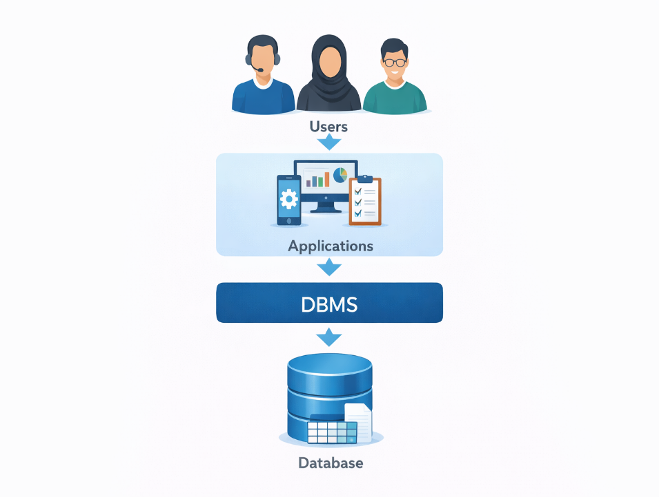
Database Management System (DBMS)
Creates and manages databases
Controls access to data
DBMS = software system
A DBMS provides controlled, concurrent, and persistent access to data while enforcing integrity, security, and data independence.

Slide 14
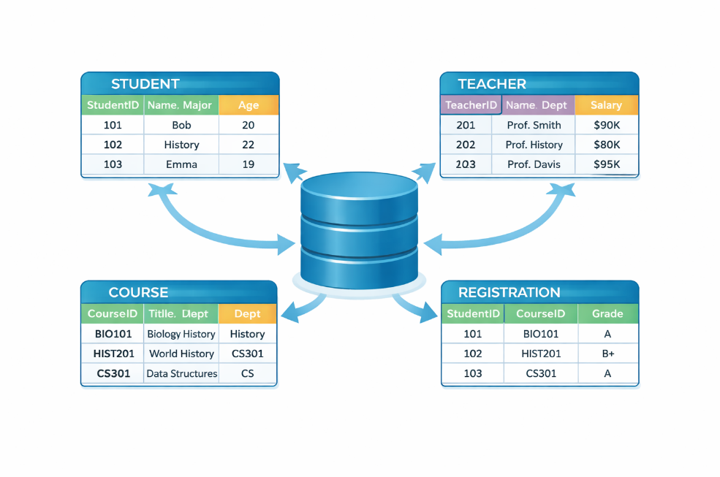
Role of the DBMS
Ensures data consistency
Ensures data security
Supports multiple users
Provides data independence

Slide 15
Database Users
End users
Application programmers
Database administrator (DBA)

Slide 16
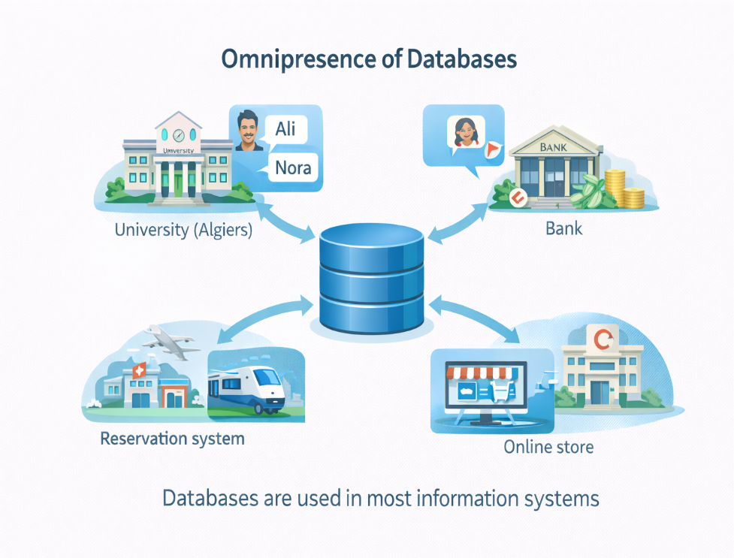
Omnipresence of Databases
Databases are used in almost all information systems
They support daily, critical, and large-scale applications
Most users interact with databases without noticing it

Slide 17
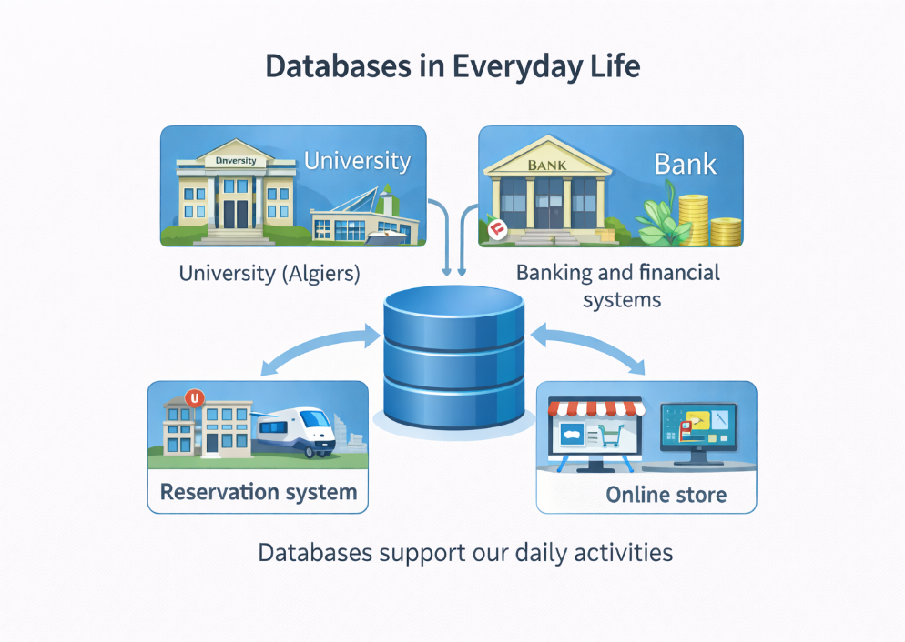
Databases in Everyday Life
University information systems
Banking and financial systems
Airline and railway reservations
E-commerce platforms

Slide 18
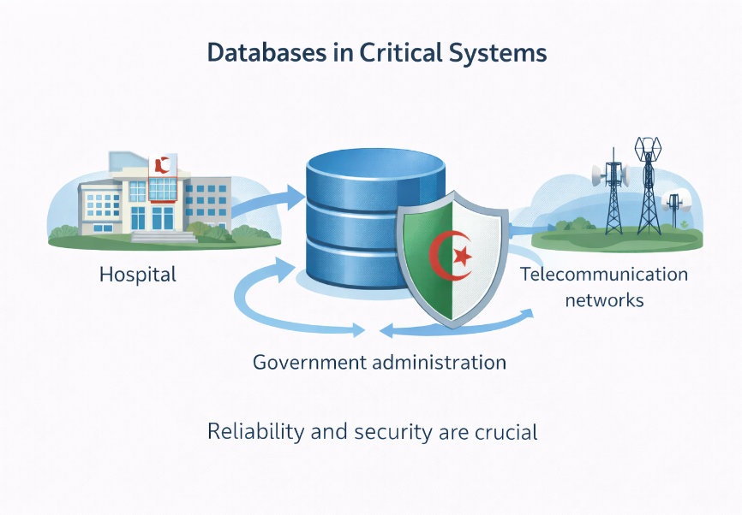
Databases in Critical Systems
Healthcare systems
Government administrations
Telecommunication networks
Industrial control systems

Slide 19
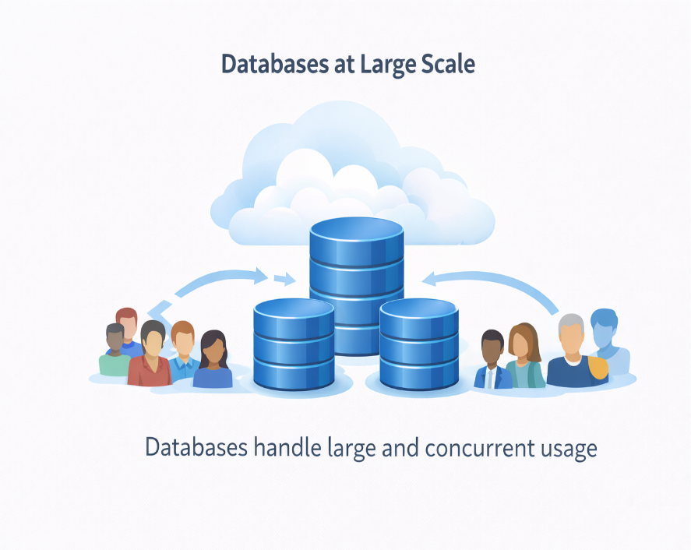
Databases at Large Scale
Social networks
Cloud platforms
Big data and analytics
Artificial intelligence systems

Slide 20
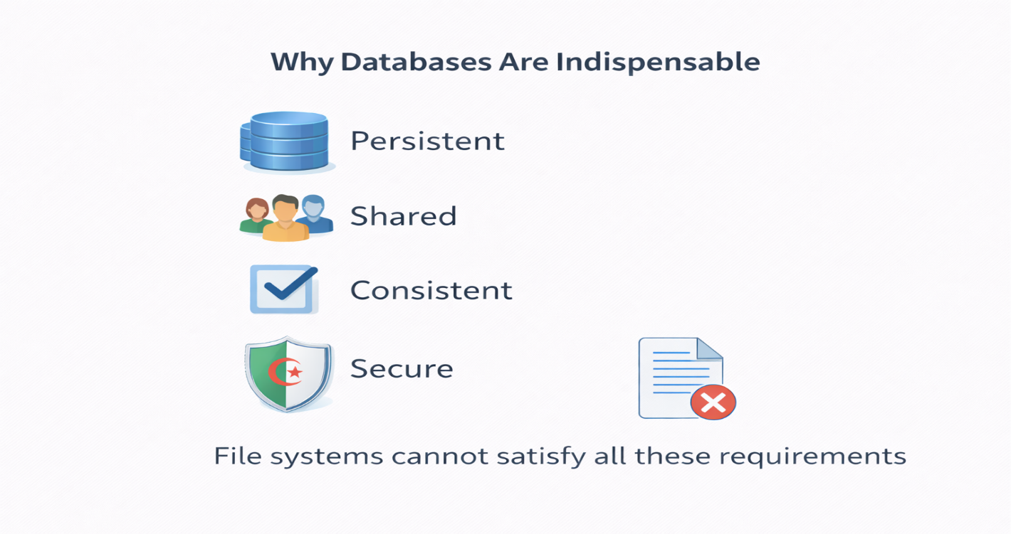
Why Databases Are Indispensable
Data must be :

Slide 21
Formal Definition of a Database
A database is defined as a shared, integrated, and persistent collection of logically related data designed to represent information about a specific enterprise.

Slide 22

Database Lifecycle
A database is not created once and used forever.
It evolves through several well-defined phases.
These phases ensure correctness, usability, and long-term maintenance.
A database follows a lifecycle that starts with design and continues through implementation and usage.

Slide 23
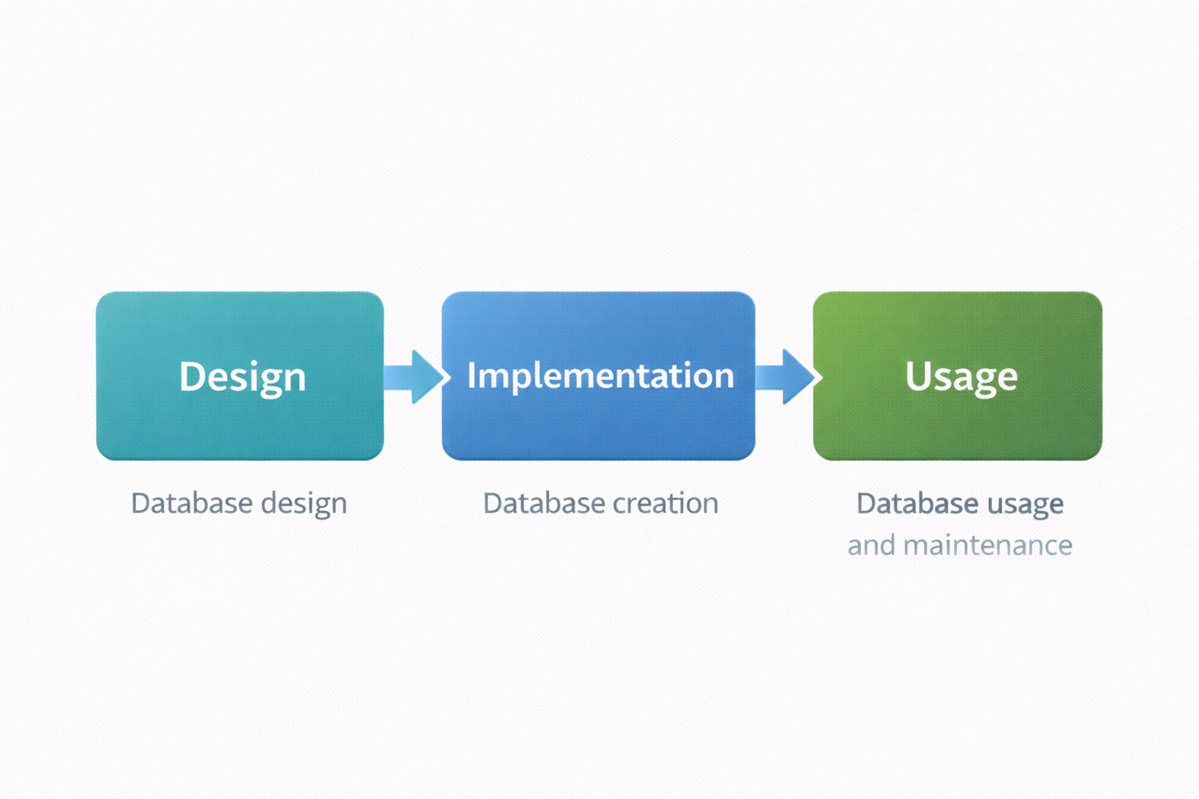
Definition of Database Lifecycle
The database lifecycle is the sequence of phases involved in:
            Designing the database
            Implementing the database
            Using and maintaining the database
Each phase has specific objectives and actors.
Each phase of the lifecycle addresses different technical and organizational needs.

Slide 24
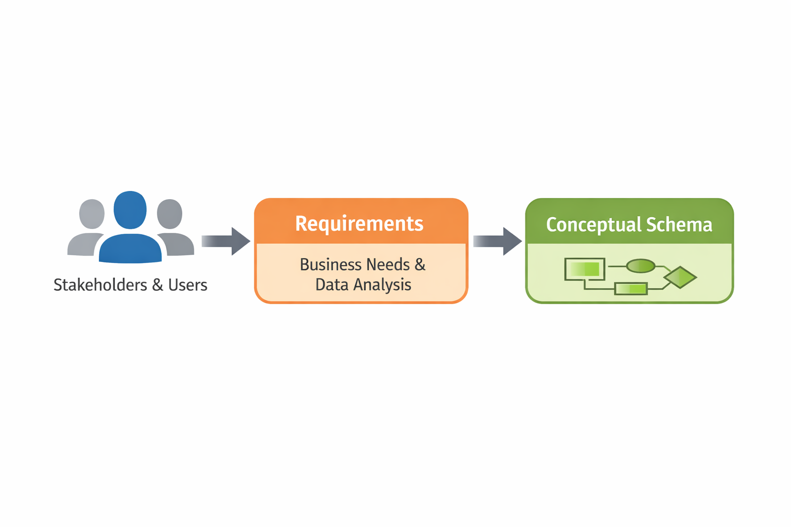
Database Design Phase
Determines what data must be stored
Identifies relationships between data
Is carried out in collaboration with future users
Is independent of technical implementation choices
The design phase focuses on understanding the enterprise and its information needs.

Slide 25
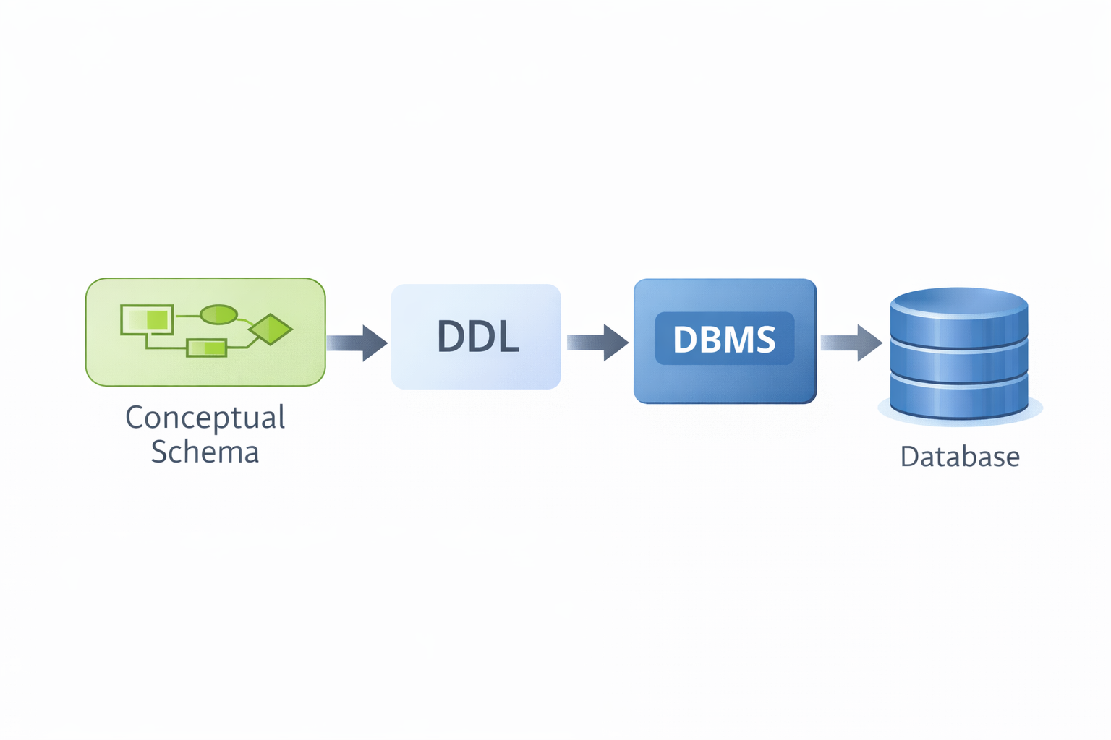
Database Implementation Phase
Translates the design into a specific DBMS language
Creates the first operational version of the database
Uses a Data Definition Language (DDL)
During implementation, abstract designs become concrete database structures.

Slide 26
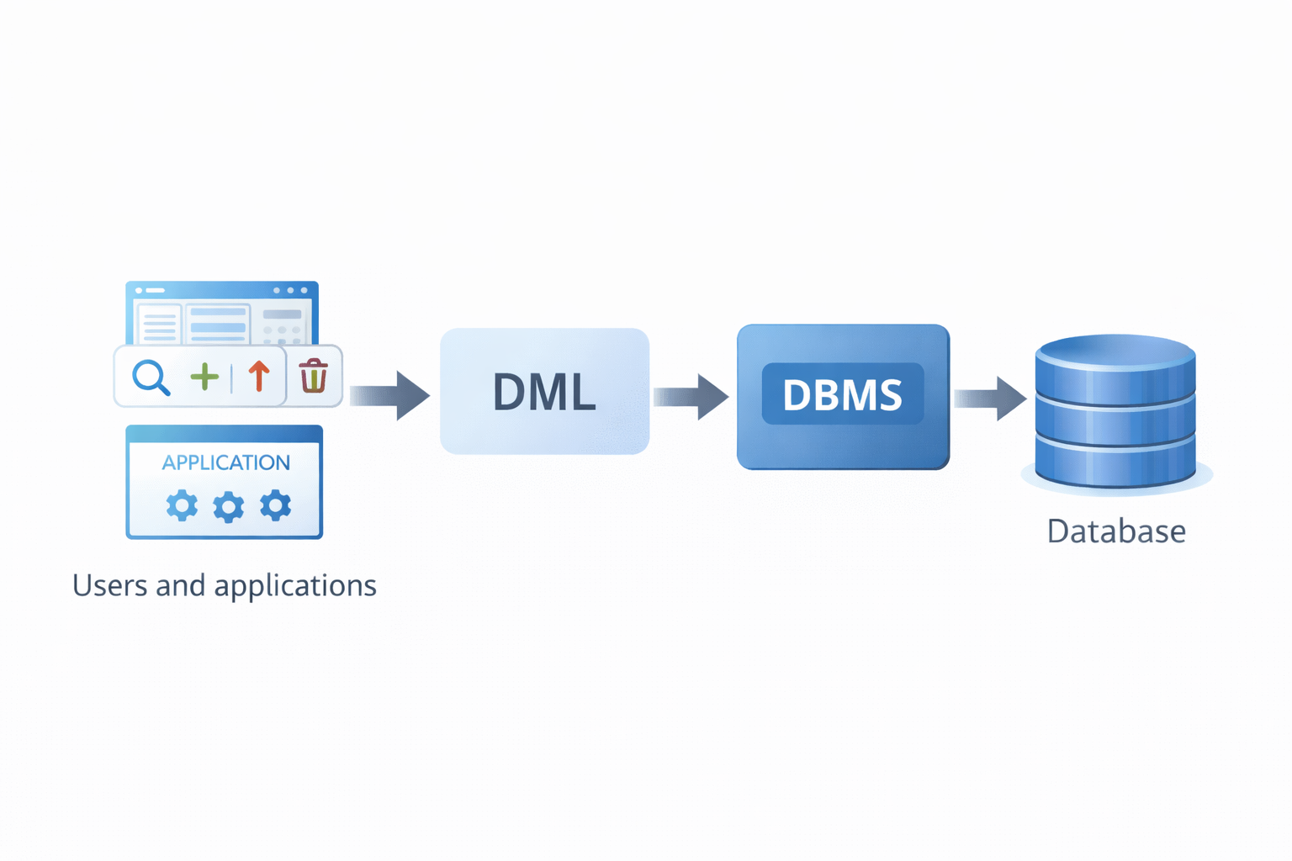
Database Usage Phase
Users interact with the database through applications
Data is queried, inserted, updated, and deleted
Uses a Data Manipulation Language (DML)
The usage phase corresponds to the daily exploitation of the database.

Slide 27
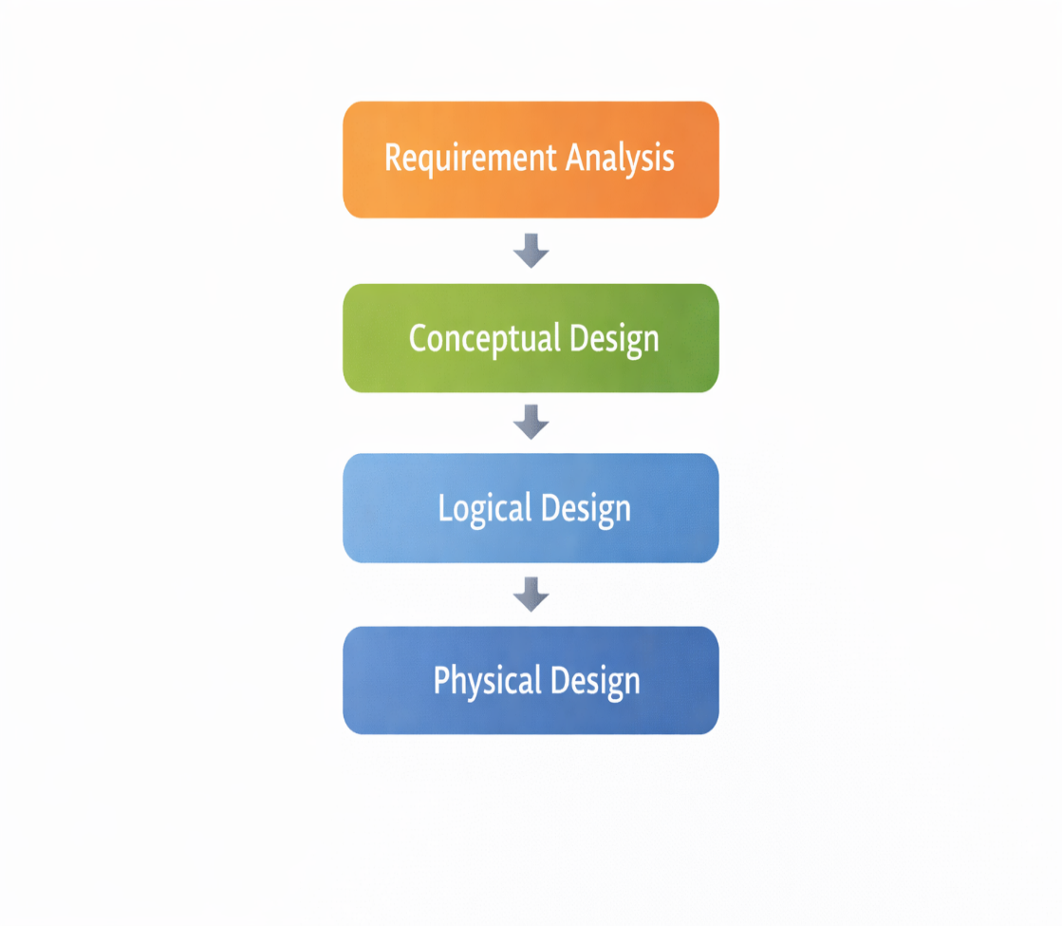
Main Steps of Database Design
Requirement analysis
Conceptual design
Logical design
Physical design
Database design proceeds gradually from informal needs to physical storage structures.

Slide 28
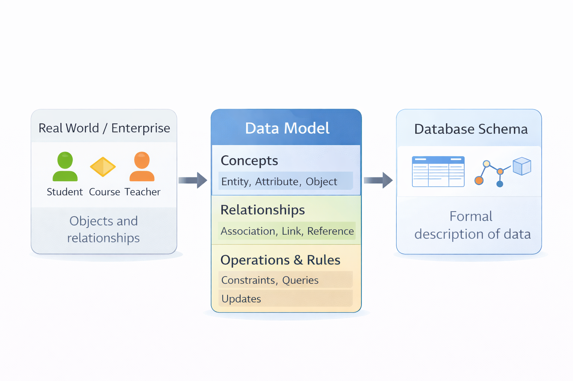
Data Models
A data model acts as a language for describing databases; it defines:
        Concepts used to describe data
        Relationships between data
        Rules for data manipulation
A data model provides a formal language that maps real-world concepts and relationships into a structured database representation.

Slide 29
Formal Definition of a Data Model
A data model is a set of concepts and rules
It allows the description of data and their relationships
It defines how data can be organized and constrained
Without a data model, database design would be ambiguous and inconsistent.

Slide 30
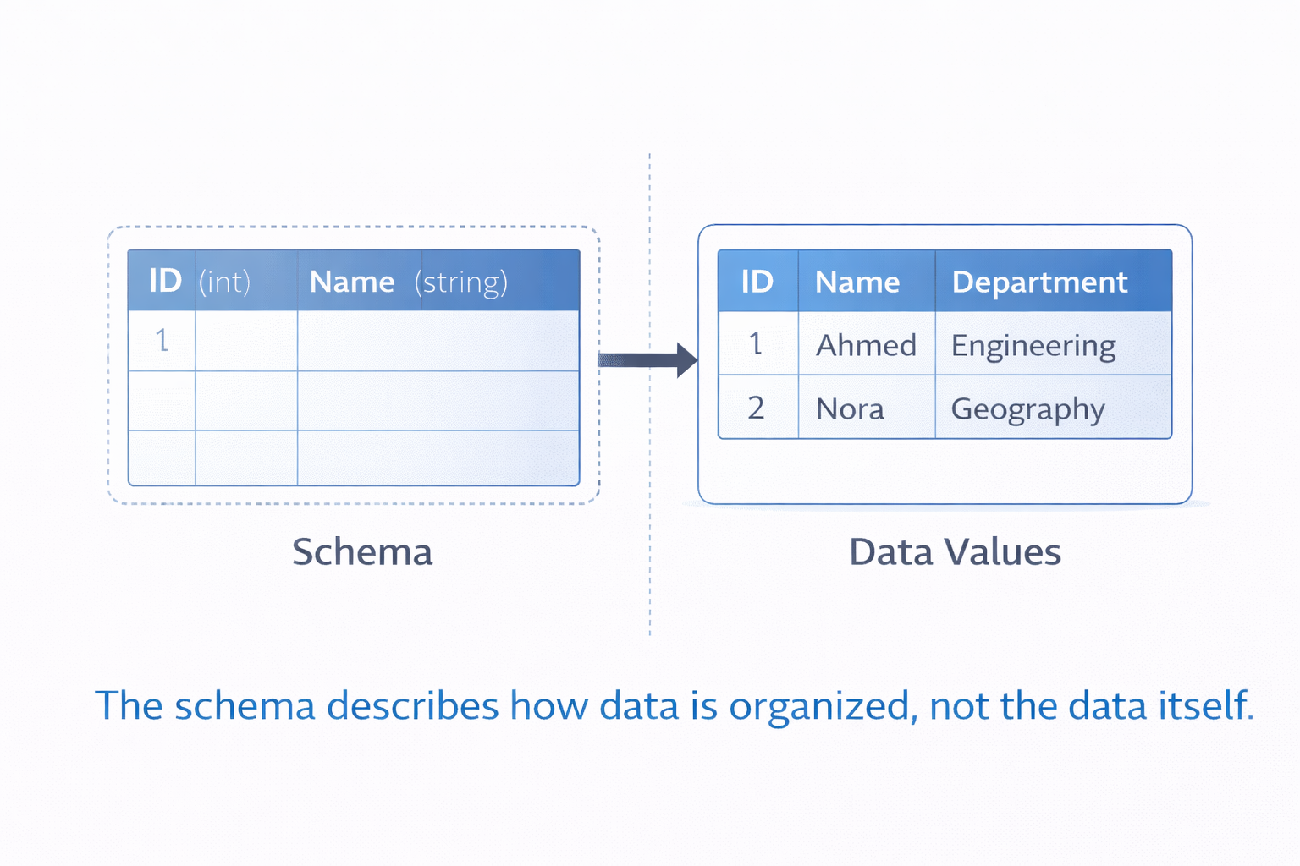
Database Schema
A database schema is the description of a database
It is expressed using a data model
The schema describes how data is organized, not the data itself.

Slide 31
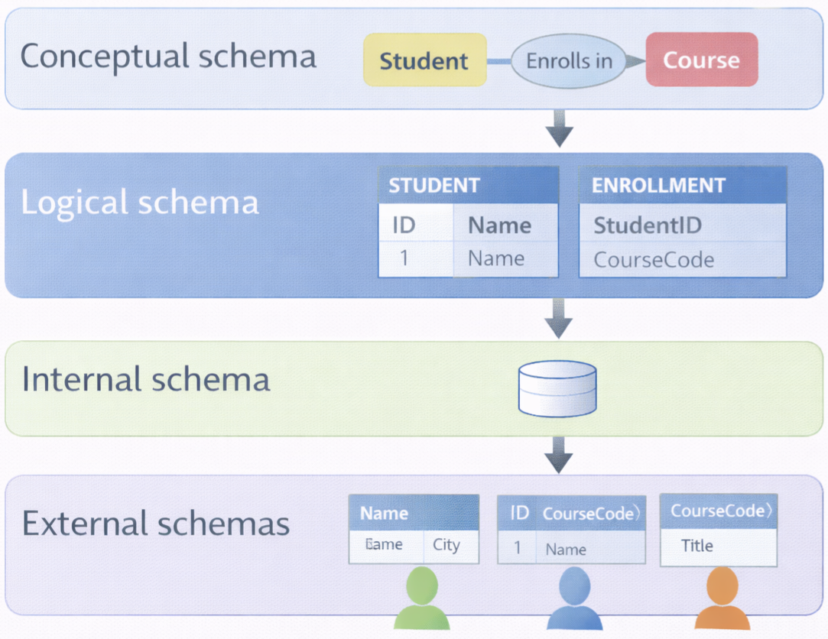
Types of Database Schemas
DBMS-independent
Conceptual schema
Logical schema
Internal schema
External schemas
Different schemas describe the database at different levels of abstraction.
DBMS-dependent

Slide 32
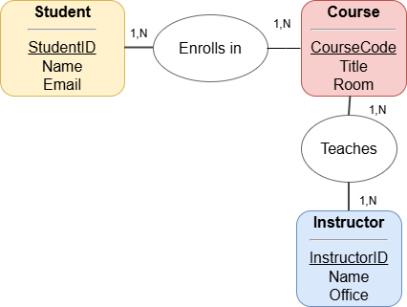
Conceptual Schema
Describes what data is needed
Independent of DBMS and hardware
Focuses on enterprise concepts and relationships
The conceptual schema represents the enterprise view of data.

Slide 33
Logical Schema
Derived from the conceptual schema
Depends on the chosen data model
Most commonly based on the relational model
The logical schema adapts enterprise concepts to a specific data model.

Slide 34
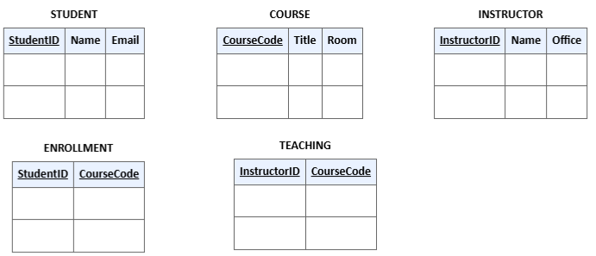
Logical Schema : Example
Relational model

Slide 35
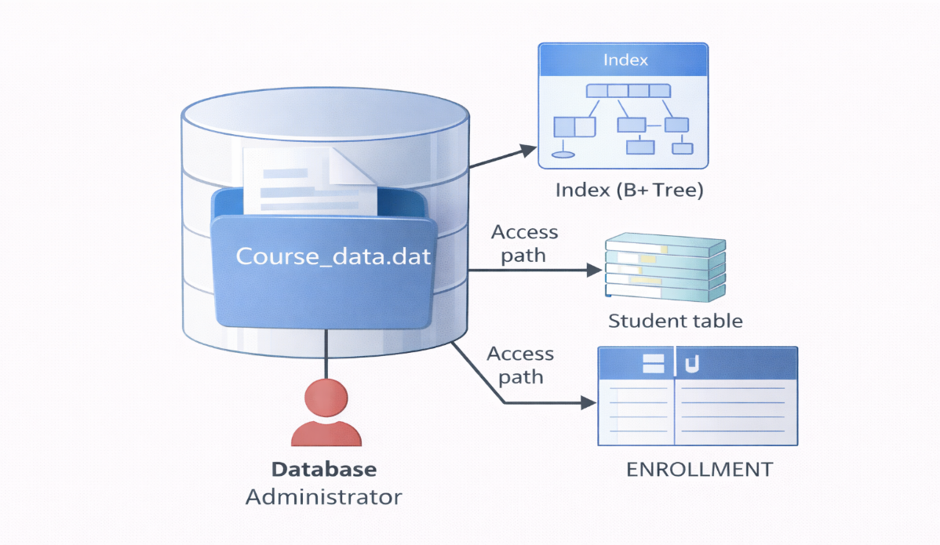
Internal Schema
Describes how data is physically stored
Includes files, indexes, and access paths
Defined by database administrators
The internal schema focuses on performance and storage optimization.

Slide 36
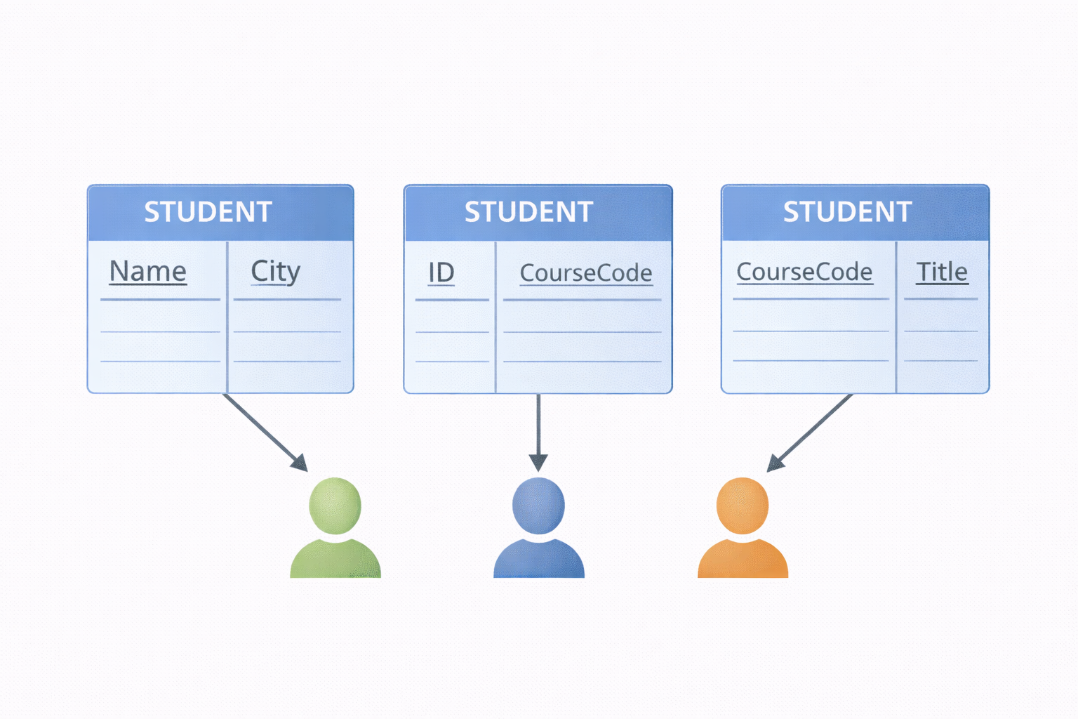
External Schemas
Each user sees only part of the database
External schemas are also called views
They simplify access and improve security
External schemas adapt the database to user-specific needs.

Slide 37
Advantages of External Schemas
Simplicity for users
Protection of sensitive data
Separation of concerns
Views make databases both easier to use and more secure.

Slide 38
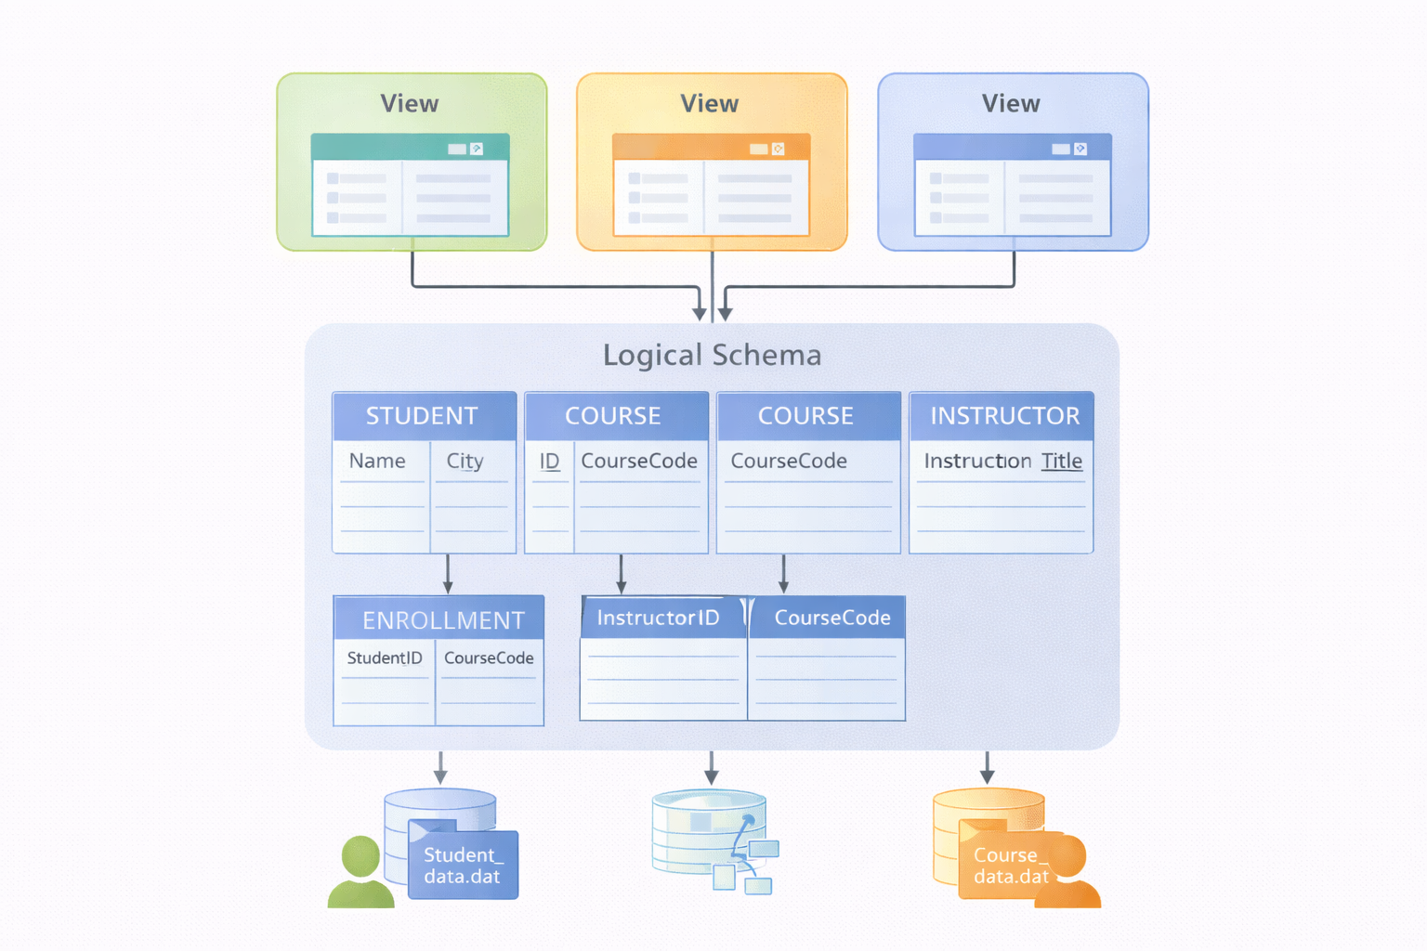
Three-Schema Architecture
External level
Conceptual level
Internal level
Basis of modern DBMS architecture
This architecture separates user views from physical storage.

Slide 39
Importance of the Three-Schema Architecture
Supports data independence
Simplifies database evolution
Protects applications from structural changes
The three-schema architecture is a cornerstone of database systems.

Slide 40
Key Concepts of Databases
Concept | Purpose
Database | Stores shared, persistent data for an organization
DBMS | Manages access, storage, security, and consistency of data
Schema | Describes the structure of the database
Data model | Defines how data is represented, related, and manipulated
These core concepts provide the foundation for understanding database systems and their organization.

Slide 41
From Concepts to the Relational Model
In this chapter, we introduced the foundations of databases.
In the next chapter, we focus on the relational model, the dominant data model used in modern DBMS.

Slide 42
End of Chapter

