Slide 1
Examples of pathologies of protien metabolism
Prepared by :
-Boumelit douaa .
-Lekired achouak .

Slide 2
Introduction :
Protein metabolism disorders are diseases resulting from a defect in the breakdown or conversion of amino acids within the body, often caused by a deficiency of a specific enzyme. This defect leads to the accumulation of harmful substances or a deficiency of essential compounds. These disorders are among the most important inherited metabolic diseases.

Slide 3
Phenylketonuria
(PKU):

Slide 4
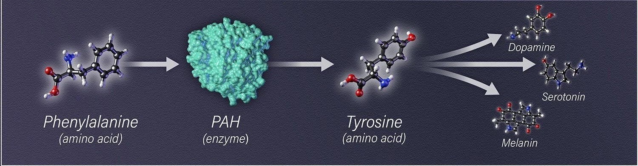
Definition :
Phenylketonuria (commonly known as PKU) is an inherited disorder that increases the levels of a substance called phenylalanine in the blood. . Phenylalanine is a protein building block (an amino acid ) that is obtained from eating certain foods (such as meat, eggs, nuts, and milk) . PAH gene variants result a version of phenylalanine hydroxylase that cannot process phenylalanine effectively. As a result, this amino acid can build up to toxic levels in the blood and other tissues .

Slide 5
Homocystinuria (HCU) :

Slide 6
Definition :
Homocystinuria is a genetic disorder of amino acid metabolism resulting from a defect in the conversion of homocysteine ​​into other compounds due to a deficiency of the enzyme cystathionine β-synthase (CBS) or a deficiency in vitamins B6, B12, and B9. This defect leads to the accumulation of homocysteine ​​in the blood and urine.

Slide 7
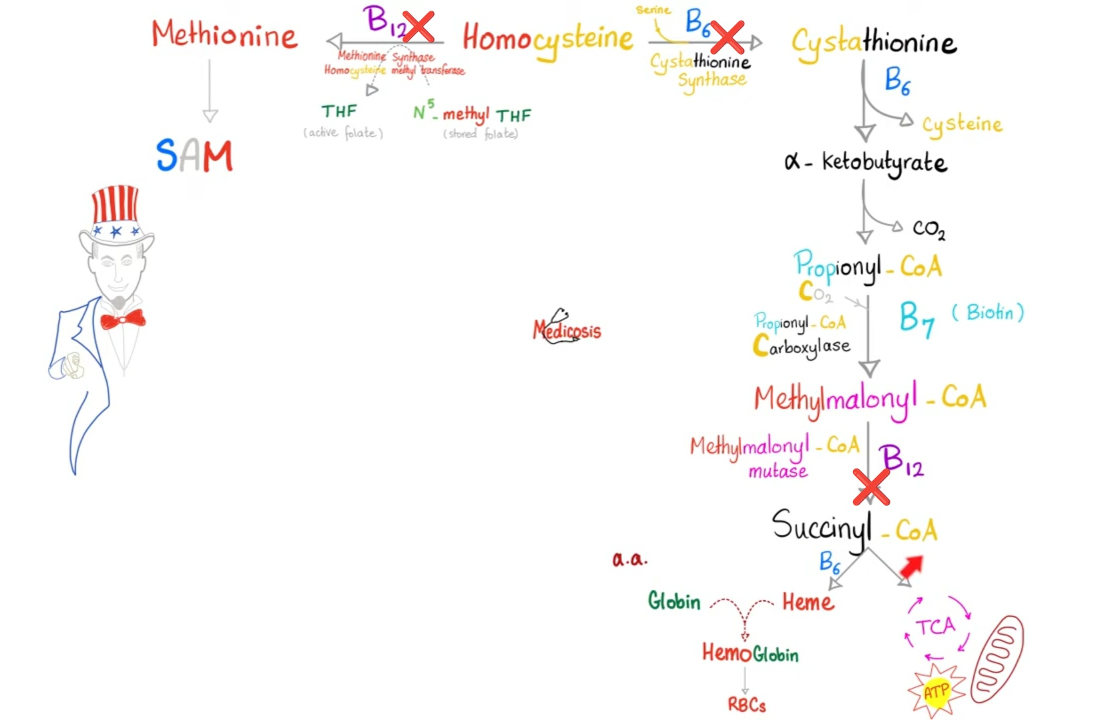
- Causes:

Slide 8
Thank you
For your attention.

