Slide 1
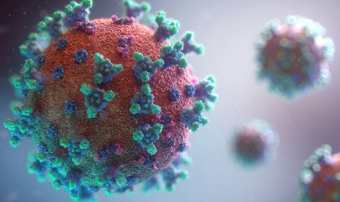
Exemples of lipid metabolism pathologies

Slide 2
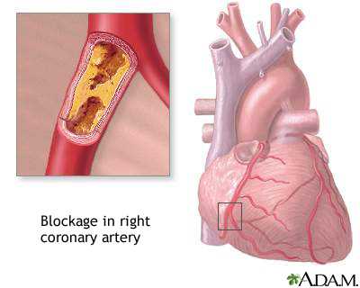
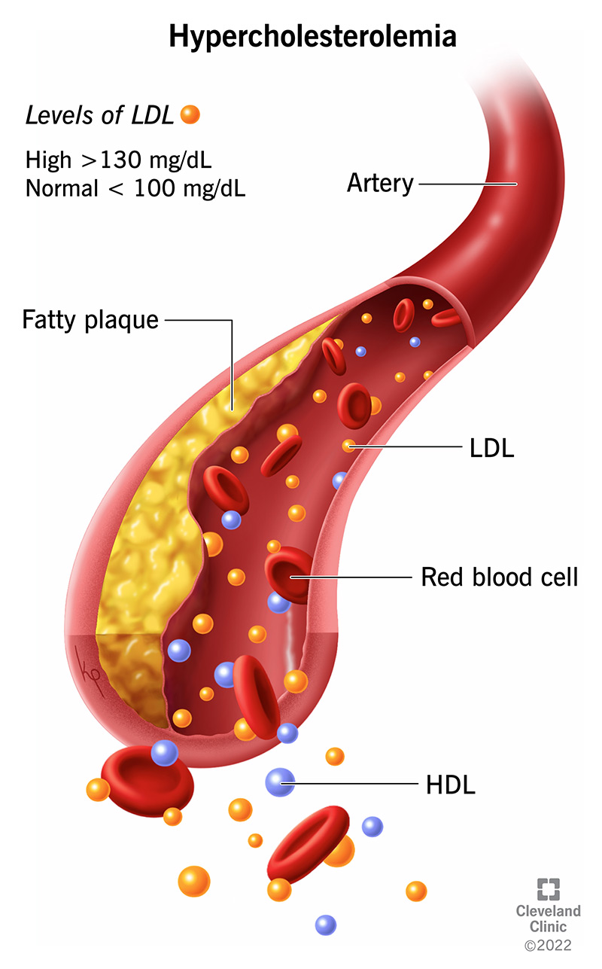
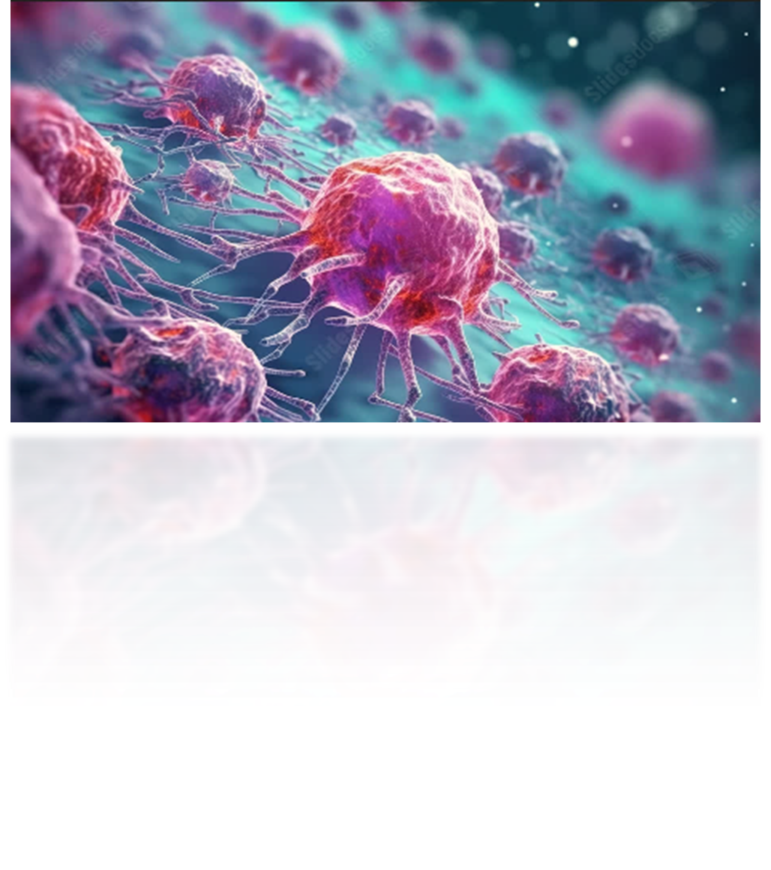
Hypercholesterolemia
Definition: Elevated cholesterol levels in the blood, especially LDL.

Slide 3

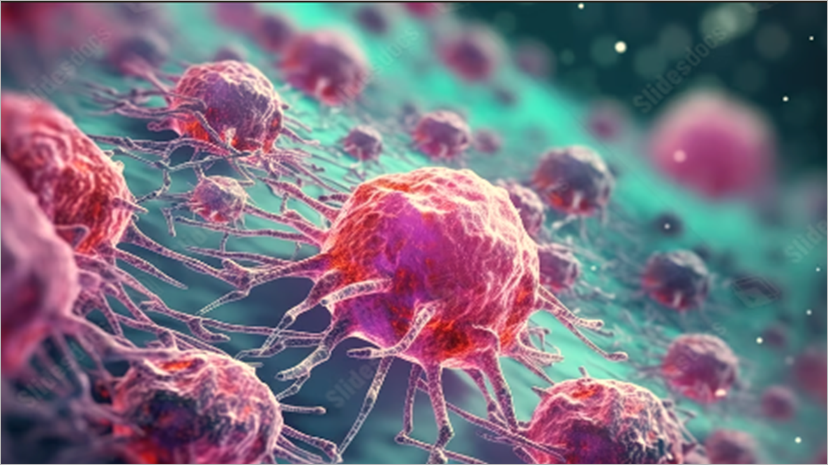
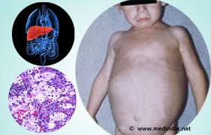
Niemann_ pick _ disease
A rare genetic disorder caused by mutations that affect lipid metabolism, leading to the accumulation of lipids—especially sphingomyelin and cholesterol—within the cells of the liver, spleen, lungs, bone marrow, and notably the nervous system.

Slide 4
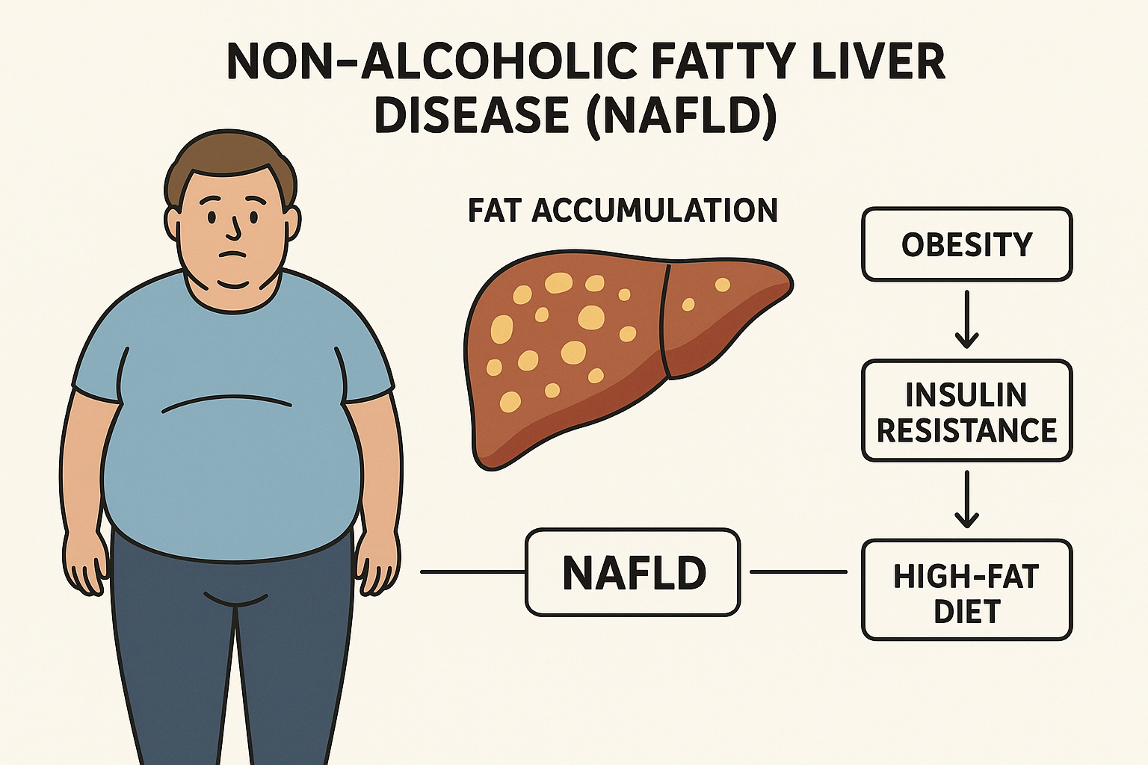
fatty Liver Disease (Hepatic Steatosis)
It is the abnormal accumulation of fat within liver cells (hepatocytes), where fat constitutes more than 5–10% of the liver’s

