Slide 1
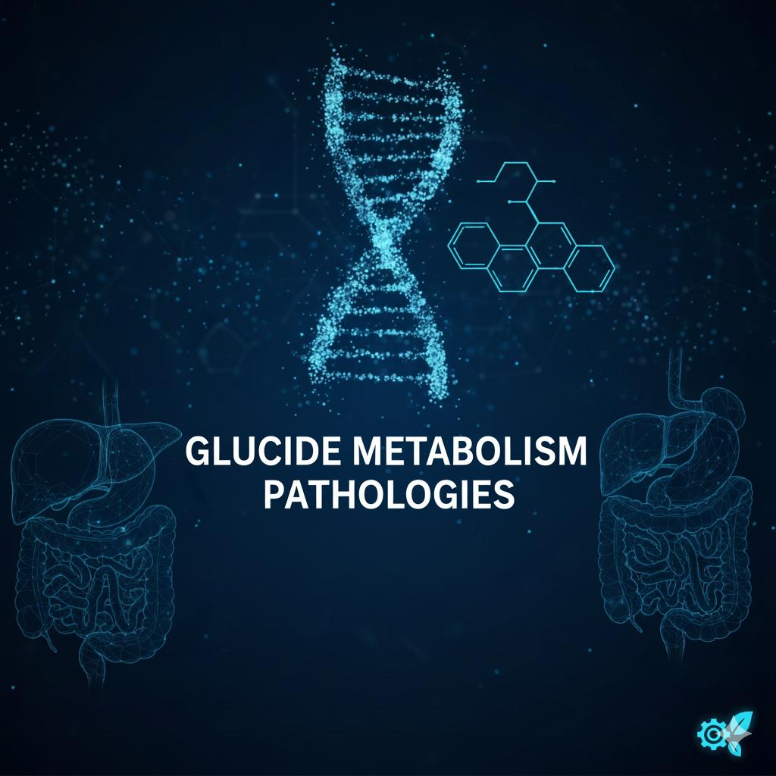
        Presented by:
  -Hamouda Ouafa
    - Boumahrouk Manar
Supervising by professor:
Salima-AMARI

Slide 2
      THE INTRODUCTION:
Pathologies of carbohydrate metabolism are disorders that interfere with the body’s ability to use or regulate glucose, its main energy source. These conditions arise from hormonal imbalances, enzyme defects, or metabolic dysfunctions and can lead to abnormal blood sugar levels and energy problems. Examples include Diabetes Mellitus,
Diabetic Ketoacidosis,
and Glycogen Storage Diseases.

Slide 3
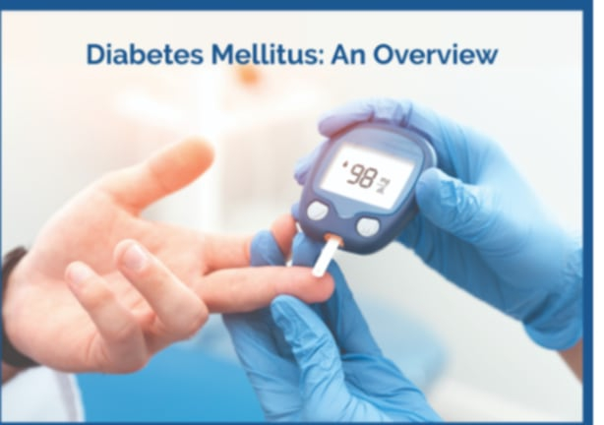
The various pathologies of glucides metabolism:
Diabete Millitus:
      Diabetes mellitus Diabetes mellitus is a chronic condition characterized by high levels of sugar (glucose) in the blood. It occurs when the body is unable to produce enough insulin or effectively use the insulin it produces.
      Insulin is a hormone that helps regulate blood sugar levels.

Slide 4
the deferent types of diabet millitus :
Type 1 DM: Autoimmune destruction of pancreatic beta cells → absolute insulin deficiency. Often diagnosed in childhood; requires lifelong insulin therapy.
Type 2 DM: Insulin resistance (cells don’t respond to insulin) combined with relative insulin deficiency. Linked to obesity, genetics, and lifestyle; managed with diet, exercise, oral meds, or insulin.
Gestational Diabetes:
Glucose intolerance diagnosed during pregnancy

Slide 5
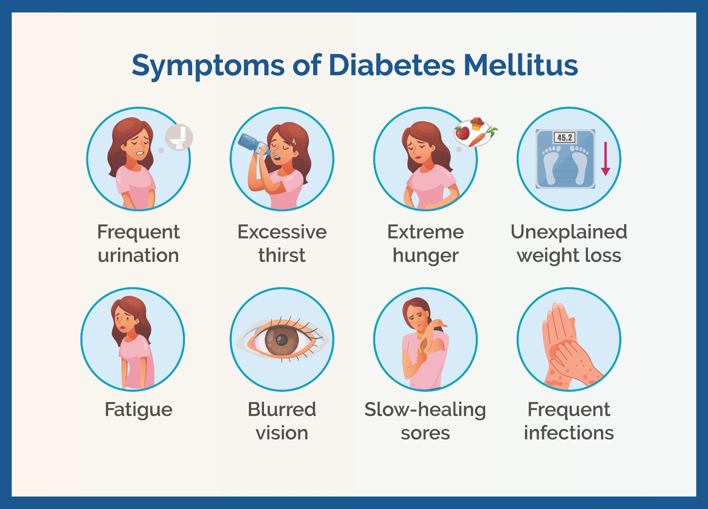

Slide 6
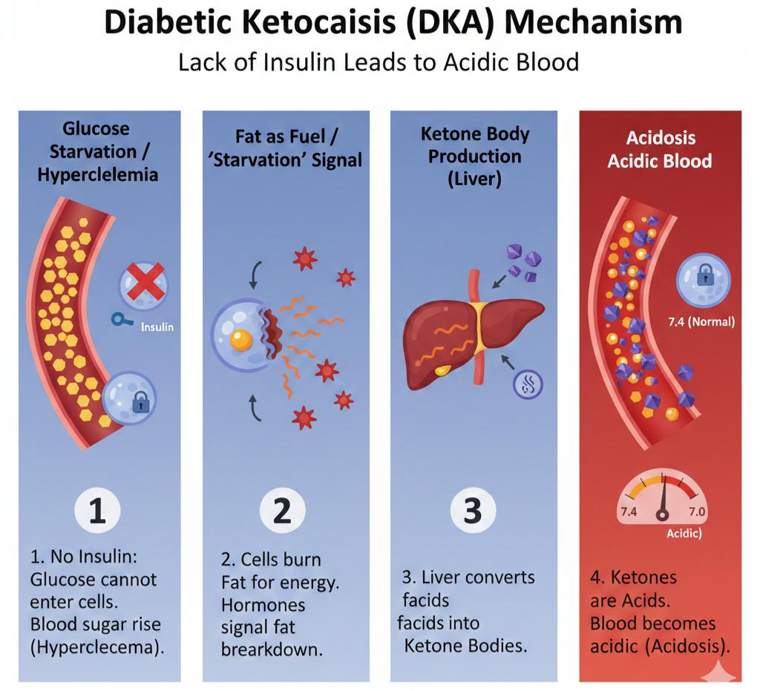
Diabetic Ketoacidosis (DKA)
  Diabetic Ketoacidosis (DKA) is a severe, life-threatening diabetes complication where the body lacking enough insulin, breaks down fat for fuel, producing acidic ketones bodies and the blood becomes acidic

Slide 7
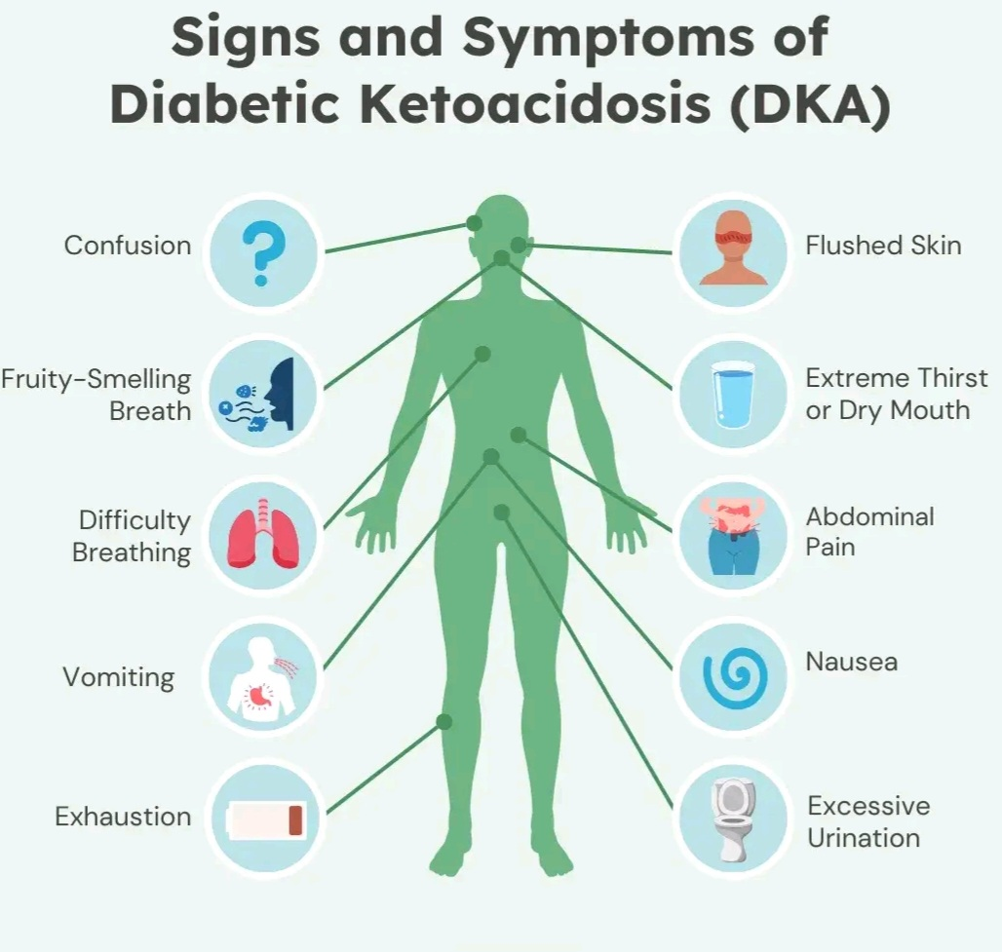

Slide 8
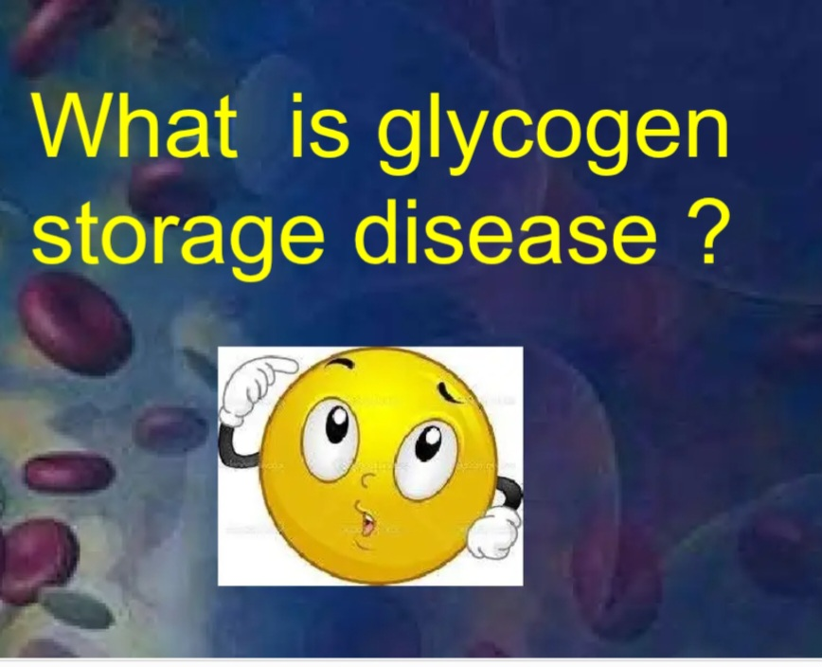
Definition:
Group of inherited metabolic disorders caused by enzyme deficiencies in glycogen synthesis or breakdown, leading to abnormal glycogen accumulation or depletion.

Slide 9
Types of glycogen storage diseases
Type I – Von Gierke Disease
•Defective enzyme: Glucose-6-phosphatase
•Mainly affects: Liver (and kidneys)
•Key problem: Liver cannot release glucose into the blood
•Result: Severe hypoglycemia and enlarged liver

Slide 10
  Type III – Cori Disease
  •Defective enzyme: Debranching enzyme
  •Mainly affects: Liver and muscles
  •Key problem: Incomplete glycogen breakdown
  •Result: Mild hypoglycemia and muscle weakness
Type V – Mc Ardle Disease
•Defective enzyme: Muscle glycogen phosphorylase
•Mainly affects: Skeletal muscle only
•Key problem: Muscles cannot use glycogen for energy
•Result: Exercise intolerance and muscle cramps

Slide 11


