Slide 1
Endocrine systems
THE ENDOCRINE SYSTEM
• The endocrine system regulates body activities by releasing hormones (chemical messengers) into the bloodstream, where they are carried throughout the entire body.
• Hormonal responses may be almost instantaneous (Sudden), or may occur days later. There is a wide variety of hormonal effects.

Slide 2
Endocrine systems
The body contains two kinds of glands
Exocrine glands
secrete their products into body ducts, which carry the products into body cavities, the lumen of an organ, or the outer surface of the body. Eg: Sudoriferous glands, sebaceous glands
Endocrine glands
secrete their products (hormones) into the extracellular space around the secretory cells. The secretions diffuse into capillaries and are carried throughout the body by the circulatory system.
The endocrine system is composed of the body‟s endocrine glands. These include:
– The pituitary gland,
– thyroid gland,
– parathyroid gland,
– adrenal
– pineal glands
– Pancreatic islets.
There are also many organs that have cells which secrete hormones, but are not exclusively endocrine organs. These include: The hypothalamus, thymus, pancreas, ovaries, testes, kidneys, stomach, liver, small intestine, skin, heart, and placenta.

Slide 3
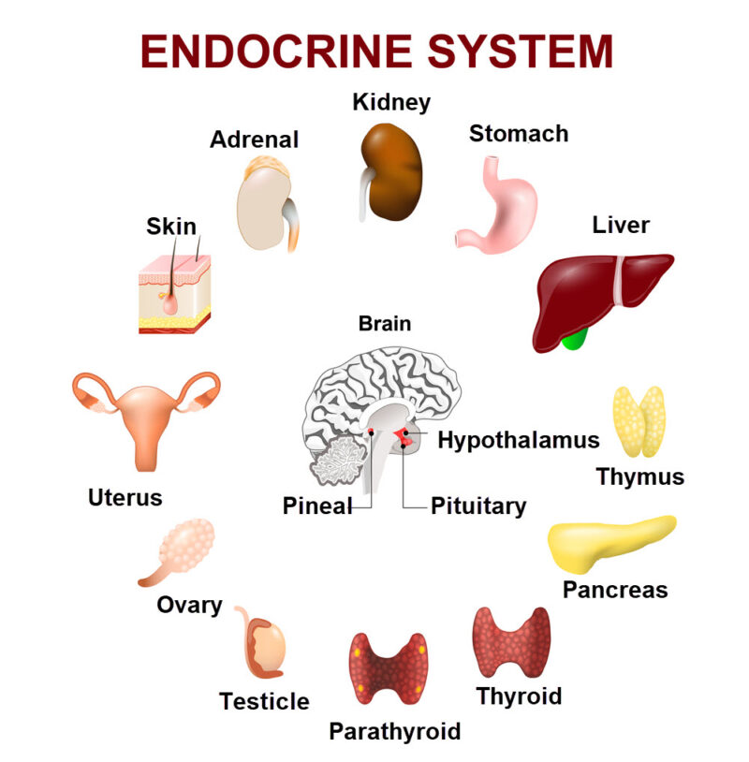

Slide 4
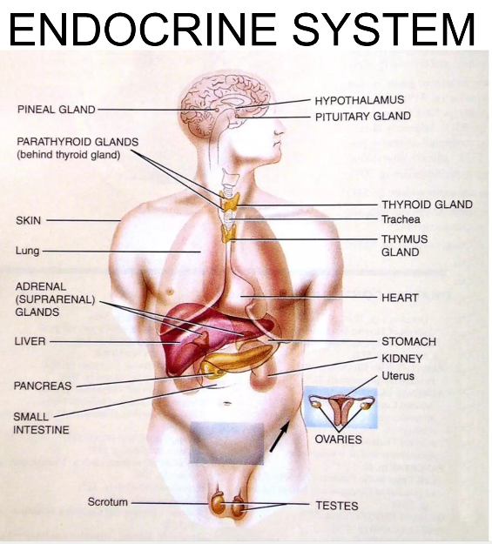

Slide 5
Hormones
Hormones are a chemical substances that are carried by a cell tissue and initiate specific action. There are approximately 50 different hormones produced in the human body.
Hormones can have very powerful effects, even when present in very low concentrations.
Transported by the circulatory system
The specific cells which are affected by a hormone are called target cellsto regulate physiology and behavior.
  Hormones influence their target cells by binding to proteins or glycoproteins in the cell membrane called receptors.
HORMONES FUNCTIONS
Help maintain homeostasis and maintain internal balance, such as blood sugar levels (insulin).
Help regulate metabolism and energy balance.
Regulate digestion, and nutrient processing (like fats, carbs, proteins).
Control sexual development, menstruation, pregnancy, and reproductive cycles (estrogen, testosterone).
Influence emotions, stress response, sleep (dopamine, serotonin).
Maintenance of body temperature
Stimulate cell division and growth
Coordinate activities between different organ systems, ensuring they work together.

Slide 6
Pituitary glands and hypothalamus
THE PITUITARY GLAND& hypothalamus
The pituitary gland or hypophysis is attached to the hypothalamus at the base of the brain.
Together, the hypothalamus and pituitary gland regulate virtually all aspects of growth, development, metabolism, and homeostasis.
The pituitary gland can be divided into the posterior pituitary and anterior pituitary.
Hormones of the pituitary gland
The anterior pituitary or adenohypophysis
produces and releases six key hormones: Growth hormone (GH), thyroid stimulating hormone (TSH) luteinizing hormone (LH), follicle-stimulating hormone (FSH), prolactin (PRL), Adrenocorticotrophic hormone (ACTH). The anterior pituitary regulate other glands (thyroid, adrenals, gonads) and bodily functions like growth, metabolism, reproduction, and lactation, all controlled by the hypothalamus.
LH Triggers progesterone in females and testosterone in males. FSH Promotes sperm production in males and prepares eggs for ovulation in females. GH stimulates general body growth and regulates certain aspects of metabolism. TSH stimulates growth and activity of the thyroid gland, which secretes the hormones thyroxine (T4) and tri- iodothyronine (T3). ACTH stimulates the adrenal glands to release cortisol and other hormones. PRL Stimulates breast milk production after childbirth and affects fertility, and influences menstrual cycles
The posterior pituitary
oxytocin (OT) and antidiuretic hormone (ADH). OT controls uterine contractions during delivery and milk ejection during breastfeeeding. ADH causes retention of body water

Slide 7
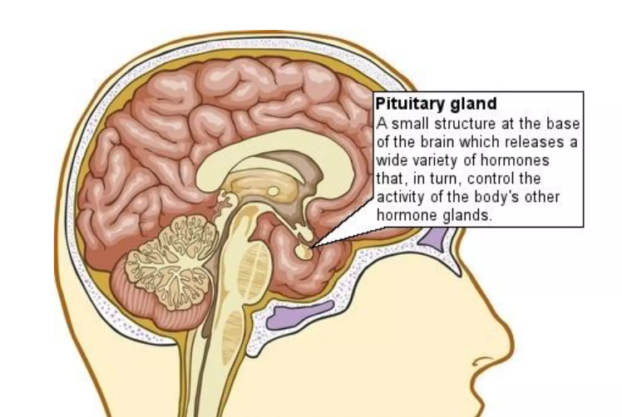
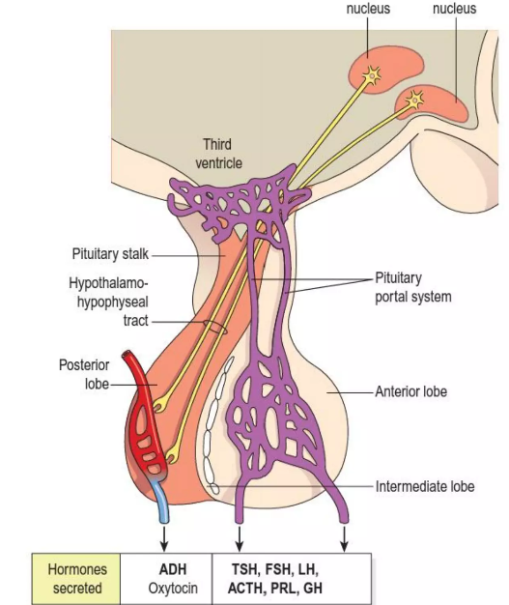
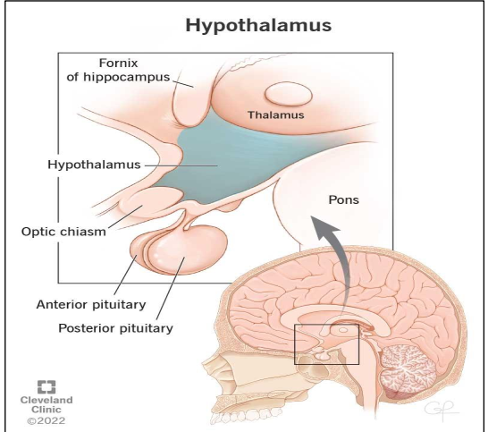

Slide 8
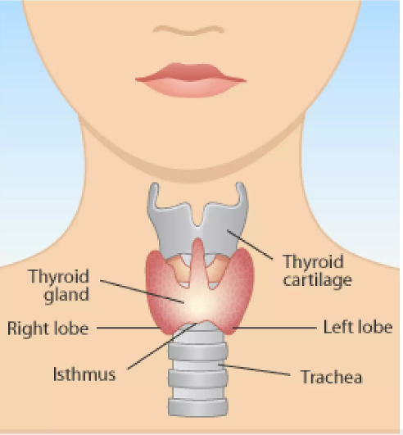
Thyroid gland
Thyroid gland
The thyroid gland is situated in the neck in front of the larynx and trachea. It is a highly vascular gland that weighs about 25 g and is surrounded by a fibrous capsule. It resembles a butterfly in shape, consisting of two lobes, one on either side of the thyroid cartilage and upper cartilaginous rings of the trachea.
Thyroid hormones
Thyroxine and tri-iodothyronine . The release of T3 and T4 into the blood is stimulated by thyroid stimulating hormone (TSH) from the anterior pituitary. The Secretion of TSH is stimulated by thyrotrophin releasing hormone (TRH) from the hypothalamus and secretion of TRH is stimulated by exercise, stress, malnutrition.
Calcitonin is secreted by the para follicular in the thyroid gland. Calcitonin lowers raised blood calcium (Ca2+) levels.

Slide 9
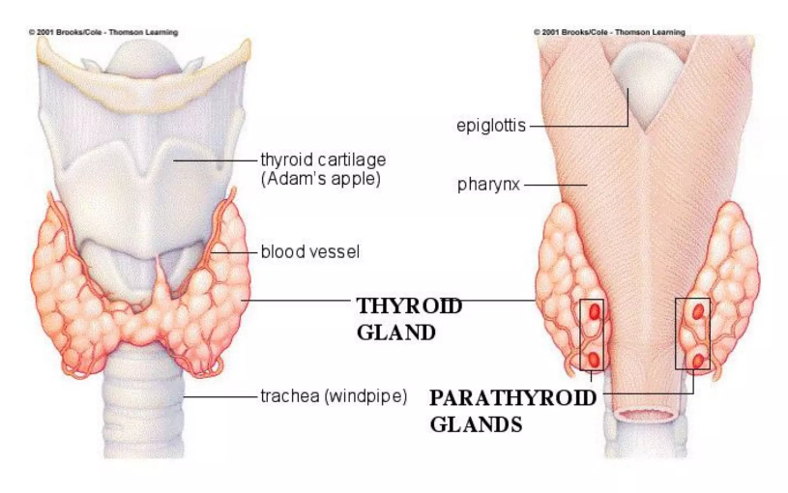
Parathyroid gland
Parathyroid gland
There are four small parathyroid glands, each weighing around 50 g, two embedded in the posterior surface of each lobe of the thyroid gland. They are surrounded by fine connective tissue capsules that contain spherical cells arranged in columns with sinusoids containing blood in between them.
Parathyroid hormone
These glands secrete parathyroid hormone (PTH, parathormone).
The main function of PTH is to increase blood calcium levels. This is achieved by increasing the calcium absorption from the small intestine and reabsorption from the renal tubules.

Slide 10
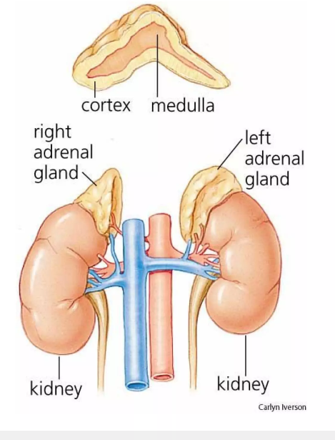
The paired adrenal glands lie superior to the kidneys enclosed within the renal fascia. The glands are composed of two parts, which have different structures and functions. The outer part is the cortex and the inner part the medulla. The adrenal cortex is essential to life but the medulla is not.
Adrenal gland

Slide 11
Hormones of the adrenal gland
Adrenal cortex
The adrenal cortex produces three groups of steroid hormones from cholesterol. They are collectively called adrenocorticocoids (corticosteroids). The groups are:
glucocorticoids such as cortisol (hydrocortisone) is the main glucocorticoid, small amounts of corticosterone and cortisone. they are essential for life, regulating metabolism and responses to stress. It is stimulated by ACTH from the anterior pituitary.
Mineralocorticoids: Aldosterone is the main mineralocorticoid. It is involved in maintaining water and electrolyte balance.
Sex hormones secreted by the adrenal cortex are mainly androgens (male sex hormones)
Adrenal medulla
Adrenaline (epinephrine) and noradrenaline (norepinephrine) . Adrenaline and some noradrenaline are released into the blood from the adrenal medulla during stimulation of the sympathetic nervous system.

Slide 12
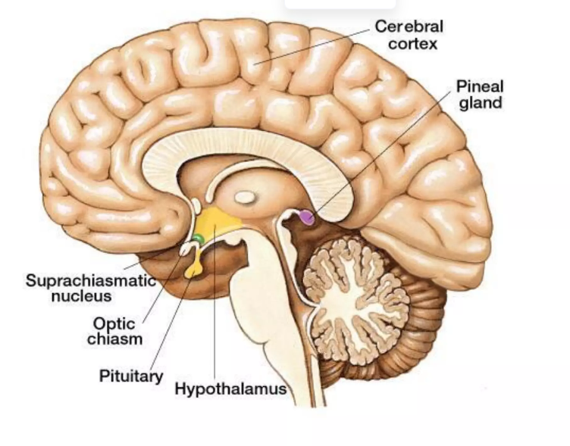
Pineal glands
The pineal gland is a small body attached to the roof of the third ventricle and is connected to it by a short stalk containing nerves, many of which terminate in the hypothalamus. The pineal gland is about 10 mm long, reddish brown in colour and surrounded by a capsule. The gland tends to atrophy after puberty and may become calcified in later life.
The pineal gland secretes melatonin, which is thought to promote sleepiness and help regulate the body‟s biological clock.

Slide 13
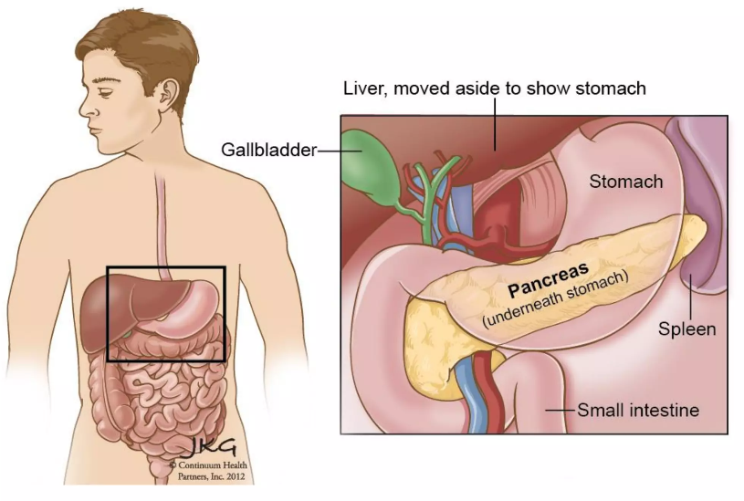
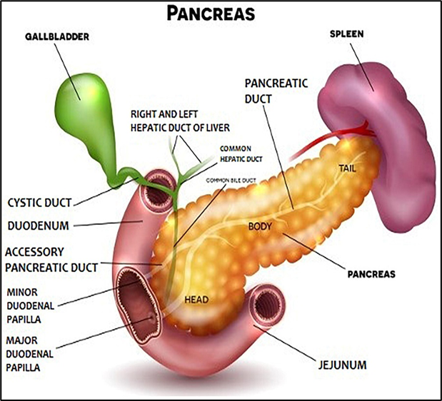
Pancreatic islets
Since the pancreas is classified as both and endocrine organ and an exocrine organ, it will also be discussed again with the digestive system.
There are three main types of cells in the pancreatic islets:
(alpha) cells, which secrete glucagon
(beta) cells, which are the most numerous, secrete insulin
(delta) cells, which secrete somatostatin (GHRIH)
Blood glucose levels are controlled mainly by the opposing actions of insulin and glucagon glucagon increases blood glucose levels. insulin reduces blood glucose levels.

Slide 14
Insulin
Its main function is to lower raised blood nutrient levels, not only glucose but also amino acids and fatty acids. Mechanism by which insulin lowers the blood glucose level:
Acting on cell membranes and stimulating uptake and use of glucose by muscle and connective tissue cells
Increasing conversion of glucose to glycogen (glycogenesis), especially in the liver and skeletal muscles
Accelerating uptake of amino acids by cells, and the synthesis of protein
Promoting synthesis of fatty acids and storage of fat in adipose tissue (lipogenesis)
Decreasing glycogenolysis (breakdown of glycogen into glucose)
Glucagon
Glucagon increases blood glucose levels by stimulating:
Conversion of glycogen to glucose in the liver and skeletal muscles (glycogenolysis)
Somatostatin (GHRIH)
This hormone, also produced by the hypothalamus, inhibits the secretion of both insulin and glucagon in addition to inhibiting the secretion of GH from the anterior pituitary

Slide 15
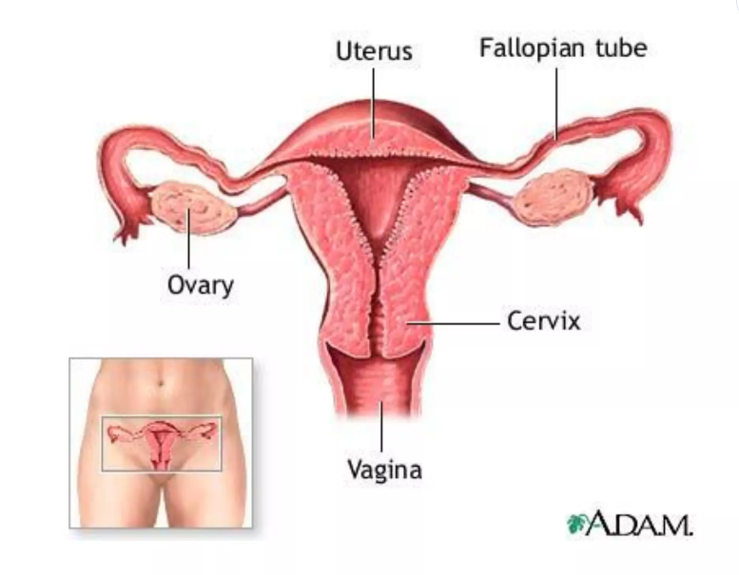
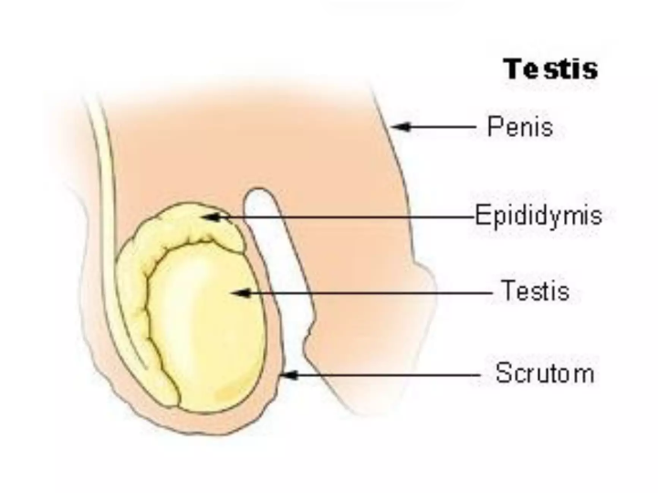
Gonads
The ovaries and testes
The ovaries and testes are paired oval organs referred to as gonads.
The ovaries are the female gonads, located in the pelvic cavity. They secrete estrogens and progesterone, which are responsible for the development and maintenance of female sexual characteristics, as well regulating the female reproductive system [in conjunction with gonadotropic hormones from the pituitary gland]). The ovaries also produce relaxin, which soften connective tissues in preparation for childbirth.
The testes are the male gonads, located in the scrotum. They secrete testosterone, which is responsible for male sexual characteristics, and inhibin, which controls sperm production by inhibiting follicle stimulating hormone.

Slide 16
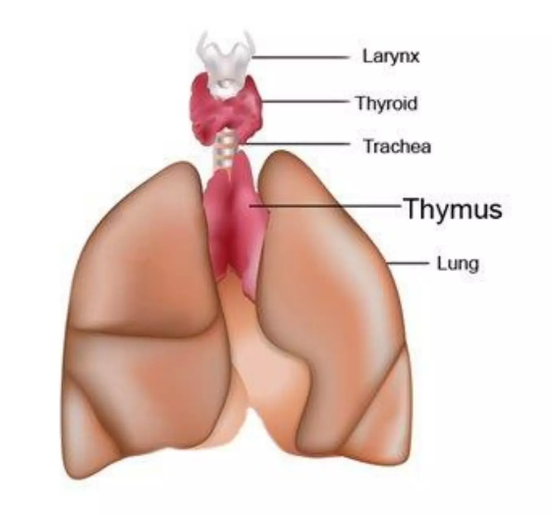
The thymus gland
Hormones produced by the thymus gland are thymosin
These hormones promote the proliferation and maturation of T cells (white blood cells which destroy microbes and foreign substances).

Slide 17
Other organs
Liver
This organ functions as both an organ and a gland, performing hundreds of functions
and producing hormones such as insulin-like growth factor (IGF) and angiotensinogen
Kidneys
Besides their role in filtering blood, the kidneys secrete hormones like
erythropoietin and rennin.
Intestines: The intestines secrete hormones responsible for hunger and satiety, such as ghrelin and somatostatin.
Placenta: During pregnancy, the placenta produces progesterone and estrogen to maintain the pregnancy and support the fetus
Adipose Tissue: Body fat, including that under the skin, around internal organs, and between muscles, produces hormones like leptin, angiotensin, and estrogen.

Slide 18
Hormone Classification
1. According to chemical structures
Three chemical types
Aldosterone, cortisol, progesterone, testosterone, estradiol
Steroid hormones
Derivatives of cholesterol,
Lipophilic molecules
water insoluble
Transported by carrier protein,
cross cell membranes to bind intracellular receptors
GH, ACTH, FSH, LH, TSH, PRL, inhibin, gonadotropin, Glucagon, insulin, somatostatin, oxytocin
Peptide/protein hormones
Hydrophilic molecules
Water soluble
Can not across cell membrane
Bind to cell surface receptors to initiate cellular responses
Amine hormones
Catecholamines such as epinephrine, norepinephrine
thyroid hormones
Derived from amino-acids tyrosine and tryptophane

Slide 19
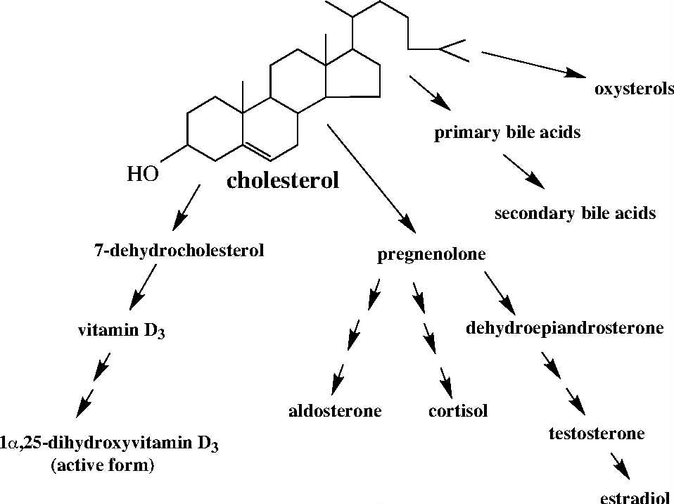
Cholesterol is a lipid molecule with a unique chemical structure consisting of a four-ring steroid nucleus attached to a hydrocarbon side chain
This distinctive structure provides a stable backbone for the biosynthesis of all steroid hormones

Slide 20
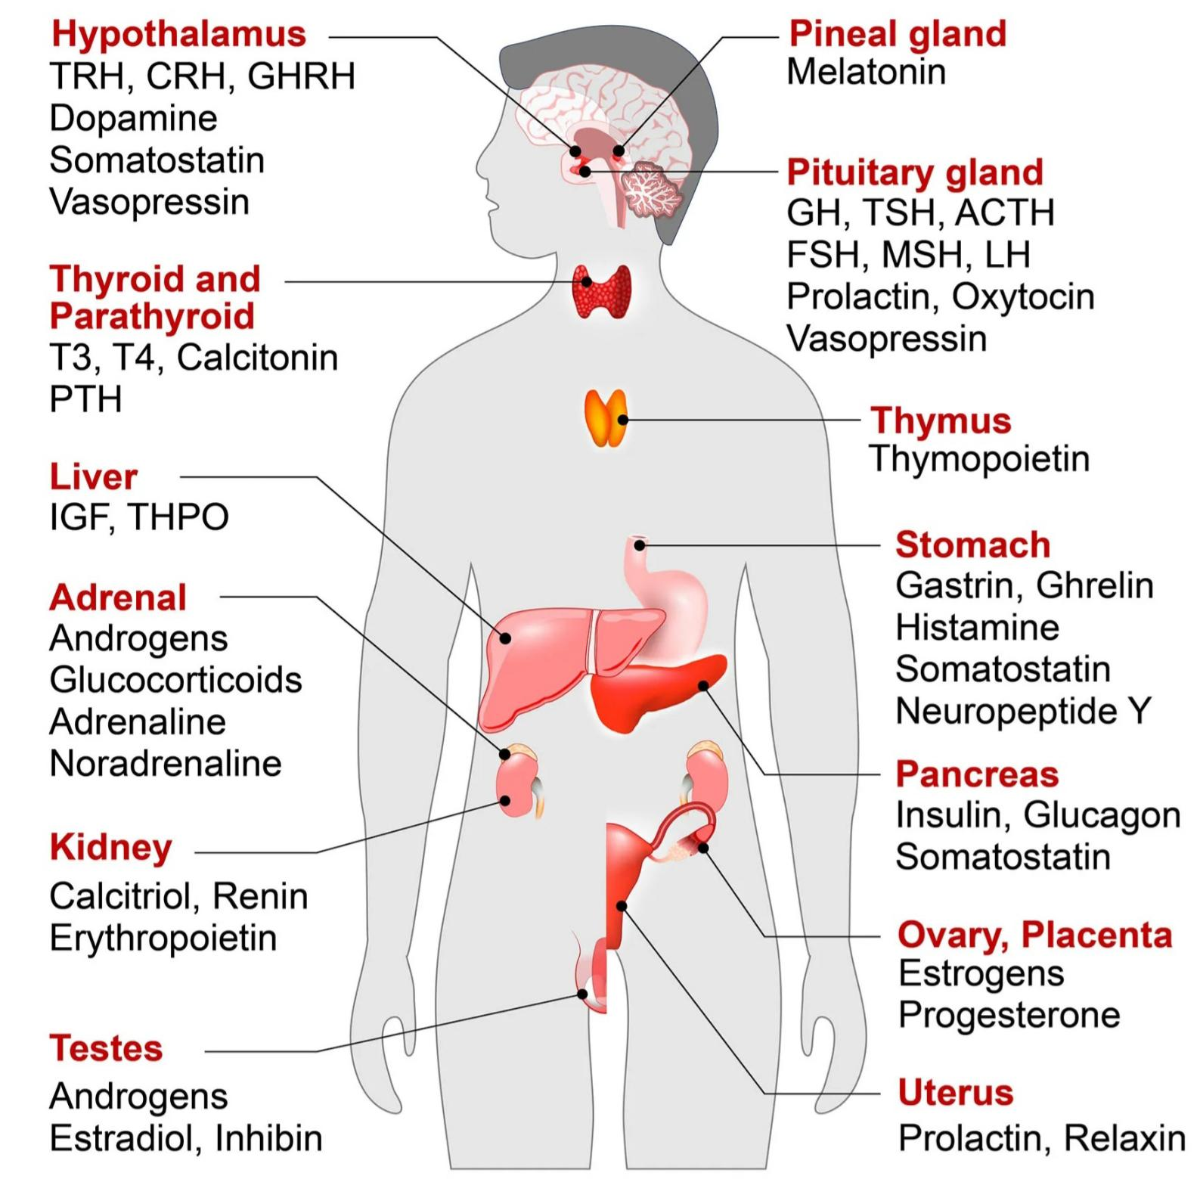
2. According to the origin

Slide 21
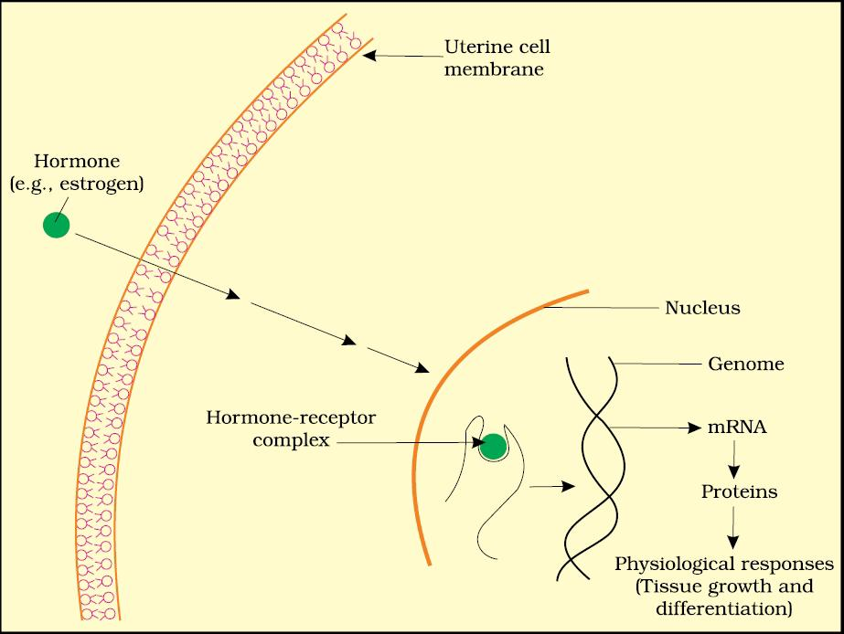
3. According to mechanism of action
  Steroid hormones are lipophilic meaning they can freely diffuse across the plasma membrane of a cell.
  bind to receptors in either the cytoplasm or nucleus of the target cell, to form an active receptor-hormone complex

Slide 22
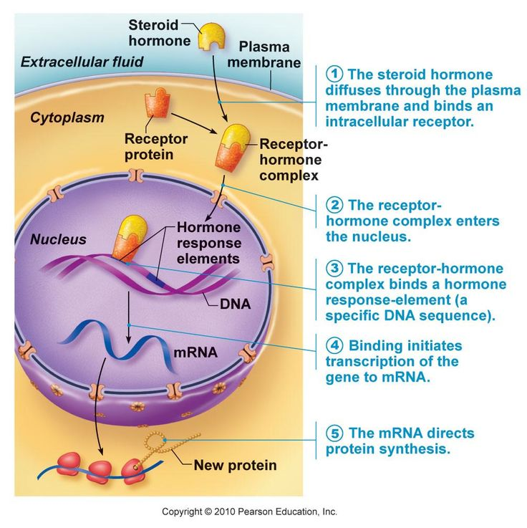
Steroid hormones

Slide 23
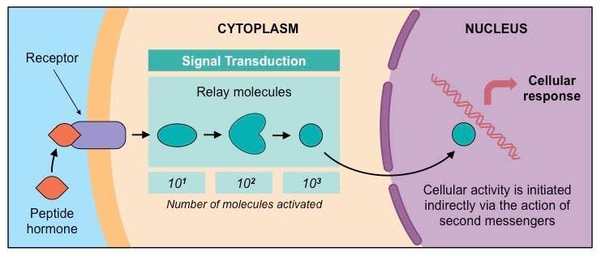
Protein hormones Are hydrophylic and lipophobic (they cannot freely cross th membrane. They bind to receptors on the surface of the cell. The receptor complex activates a series of intracellular molecules called second messengers, which initiate cell activity. This process is called signal transduction

Slide 24

Classification of hormones receptors:
1
Based on Location in the Cell
2
Based on Hormone Type

Slide 25
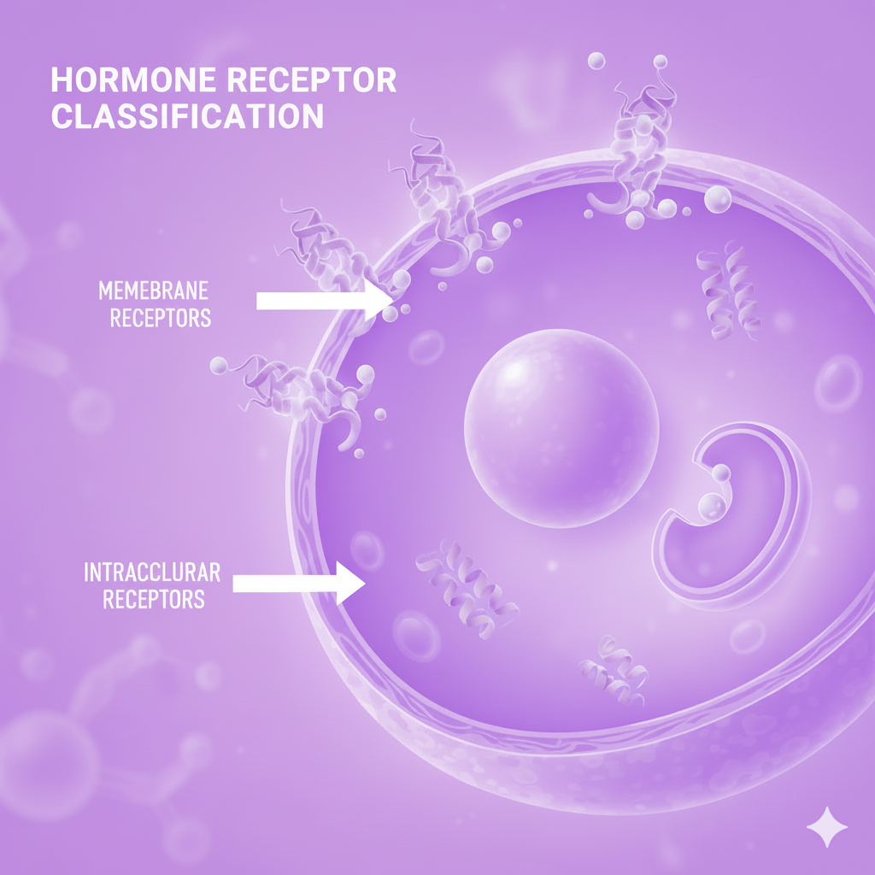
2.classification of hormones receptors:
Based on
Location
in the Cell

Slide 26
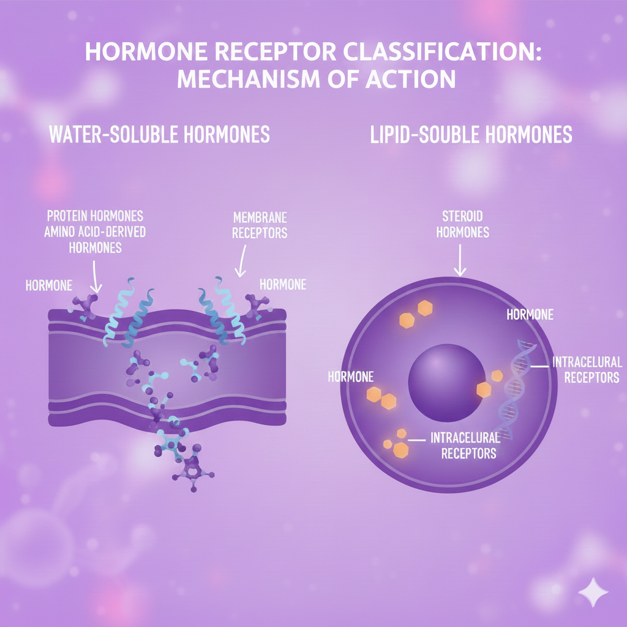
classification of hormones receptors:
Based on
Hormone
Type

