Slide 1

Non endocrine regulation
Prepared by:
Supervised by:
Radia Soula
Chaima Mekmak
Dr. Salima Amari
2025/2026

Slide 2



Learning Points
Introduction
Intracellular mechanism-
Definition
Extracellular mechanism
Mechanisms
4
Conclusion

Slide 3
Introduction
  Metabolic regulation involves interconnected control systems to maintain internal balance.
  Endocrine system play a major role through hormone secretion but many processes controlled by non endocrine regulation.
  These mechanisms are rapid, locally, and often independent of hormonal control.

Slide 4
Definition
  Control of cellular and physiological processes without the direct involvement of hormones.
  Relies on local chemical factors and allosteric enzyme regulation.
  Allows cells and tissues to respond rapidly and directly to internal /external changes.

Slide 5
Mechanisms
Intracellular mechanisms
Allosteric regulation
Feedback regulation
Feedback regulation
Covalent modification
Protein_
protein interaction
Metabolite availibility
Hepatitis
Cirrhosis

Slide 6
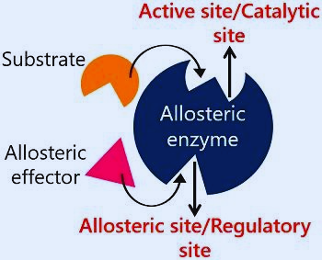
Allosteric regulation
  Allosteric enzymes composed of an even number of subunits.
  Possess two sites : a catalytic site (substrate binding site) and allosteric site (effector site).

Slide 7
Mechanism
  Effectors/metabolites control enzyme activity through non covalent interaction. Binding of the effector causes conformational changes in the catalytic site.
  Positive effectors/activators: increase enzyme activity .
  e.g: ADP for phosphofructokinqse.
  Negqtive effectors/inhibitors: decrease enzyme activity.
  e.g : ATP and citrate for phosphofructokinase.

Slide 8
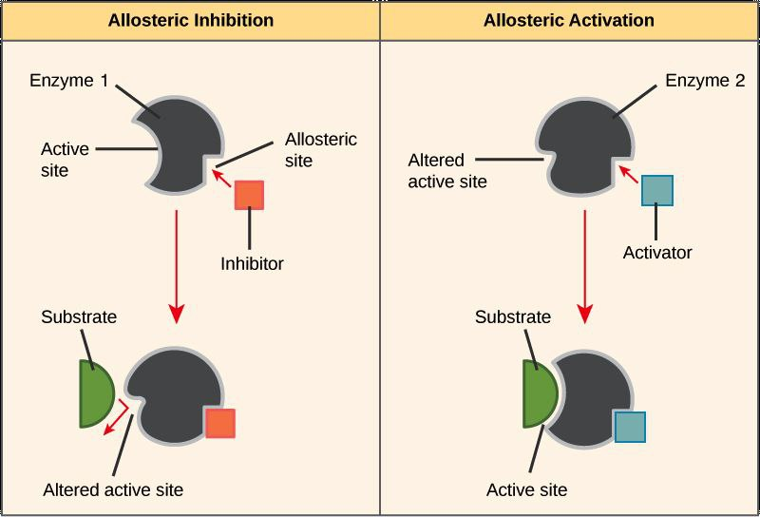

Slide 9
Feedback regulation
Mechanism
  Occurs when a product of the reaction binds to an allosteric site on the enzyme and affects its catalytic activity.
  The cell regulates further production by responding to the amount of product.

Slide 10
Mechanism
  Mechanism: A high concentration of the final product is more likely to bind to the enzyme's allosteric site, effectively shutting down the pathway.
  Negative Feedback: Results in inhibition of an earlier enzyme, reducing activity and stopping the pathway.
  Positive Feedback: Results in the activation of more enzymes, increasing product production.

Slide 11
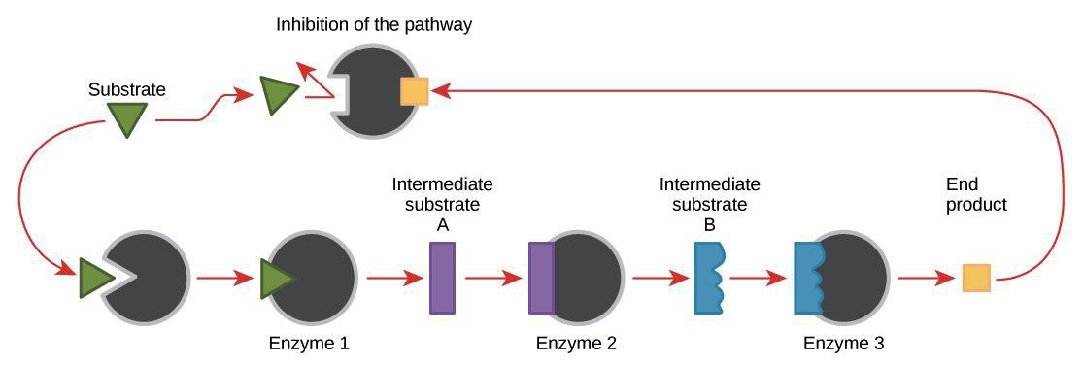

Slide 12
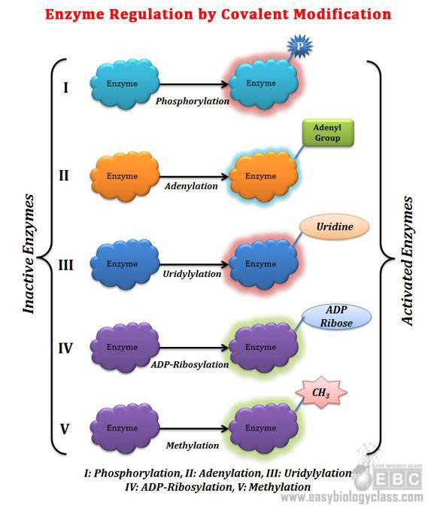
Covalent modification
  Modification of enzyme activity via the formation of covalent bonds.
  Common modifying groups include phosphoryl, methyl, adenyl, and hydroxyl.

Slide 13
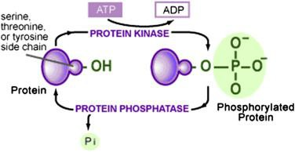
Covalent modification
  Phosphorylation: Addition of a phosphate group by protein kinase to the hydroxyl group of serine, threonine, or tyrosine.
  Dephosphorylation: Removal of a phosphate group by phosphatase.

Slide 14
Protein-protein interaction
  Inactive enzymes (e.g., those with multiple subunits) can be regulated by interaction between their subunits.
  Activation: Occurs when the catalytic subunits separate from the regulatory subunits.

Slide 15
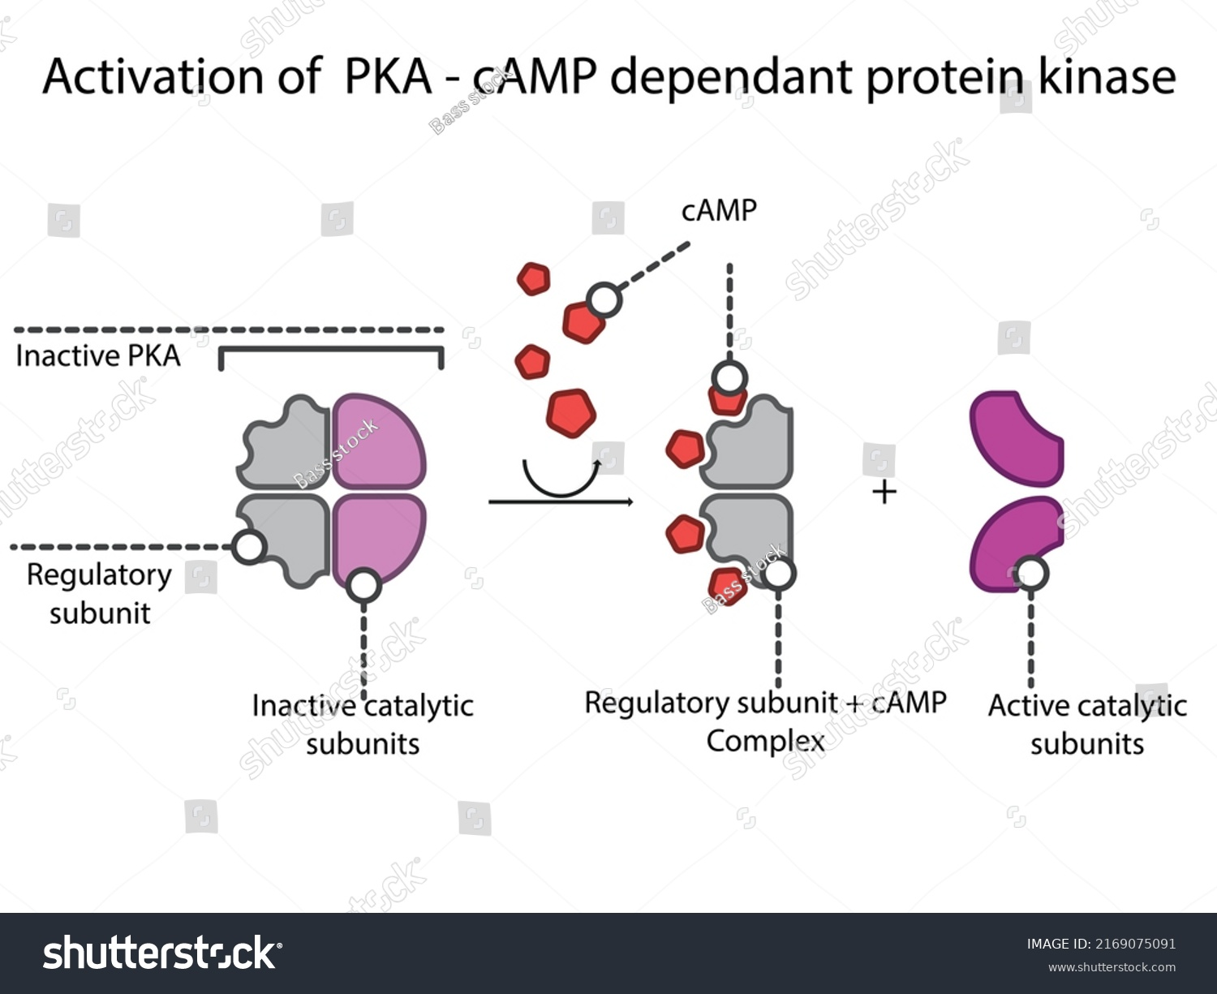
  Example:
  (Protein Kinase A - PKA): cAMP binds to the two regulatory subunits (2R), releasing and activating the two catalytic subunits (2C).

Slide 16
Metabolic availibility
  The presence, absence, or amount of substrates, intermediates, cofactors, or energy molecules directly controls the rate of a metabolic pathway.
  The pathway speeds up when substrates are available and slows down when products accumulate or substrates are missing.
  Example: High ATP inhibits PFK1 (slows glycolysis); Low ATP/High AMP activates PFK1 (speeds up glycolysis).

Slide 17
Extracellular
Autocrine signaling
Paracrine signaling
Synaptic signaling

Slide 18
Autocrine signaling
  A cell sends a signal to control its own actions.
  Example: A muscle cell produces IGF1, which acts on the same cell, leading to increased GLUT4 movement and stimulating glucose uptake.

Slide 19
Paracrine signaling
  Example: Pancreatic islet cells regulate each other (e.g: alpha-cells boost beta-cell insulin release with glucagon).
  Cells release signals that affect nearby cells; the signals are local and short-lived.

Slide 20
Synaptic signaling
  Example: A motor neuron releasing acetylcholine binds to muscle cell receptors, triggering muscle contraction and stimulating glucose uptake independently of insulin.
  Nerve cells send neurotransmitters across tiny gaps (synapses) to other nerve or muscle cells; this process is very quick.

Slide 21
Conclusion
  Non endocrine regulation offers rapid, local control of metabolism, allowing cells to quickly adjust to energy and nutrient changes. Through intracellular and extracellular signals, it maintain metabolic flexibility and supports coordinated tissue function without relying on systemic hormones.

Slide 22
Thanks for listening!

