Slide 1
Hormonal regulation of lipid metabolism
Fatty acid (part one)

Slide 2
1. Digestion of dietary lipids and mobilization of stored lipids
Lipids are primarily composed of triglycerides, phospholipids, and sterols.
Lipid digestion depends on the action of pancreatic enzymes in the small intestine such as lipases and phospholipases and bile salts. Bile salts emulsify lipids into micelles. Triglyceride lipase yields two fatty acids and monoglycerides. Once across the intestinal barrier, these can recombine into triglycerides. Lipoproteins are the transport form of hydrophobic fats. The main types are:
1) Chylomicrons (produced by intestinal cells),
2) VLDL (Very Low Density Lipoprotein), which are synthesized in the liver cells.
3) LDL (Low Density Lipoprotein),
4) HDL (High Density Lipoprotein), which are synthesized in the blood.
Lipids are transported to adipose tissue in the form of triglycerides (TG).

Slide 3
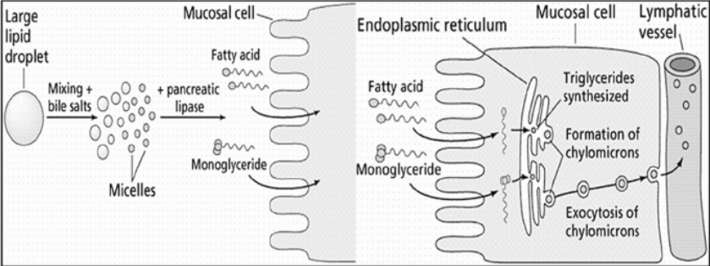

Slide 4
2. β-oxydation
= Lynen helix
It allows the oxidation of cytoplasmic acyl-coenzyme A to acetyl-coenzyme A It occurs in almost all tissues except the brain and red blood cells.
β-oxidation takes place in the mitochondrial matrix using coenzymes of the respiratory chain.
It cleaves the fatty acid at the β carbon, releasing acetyl-CoA; the process is repeated until the carbon chain is exhausted.

Slide 5
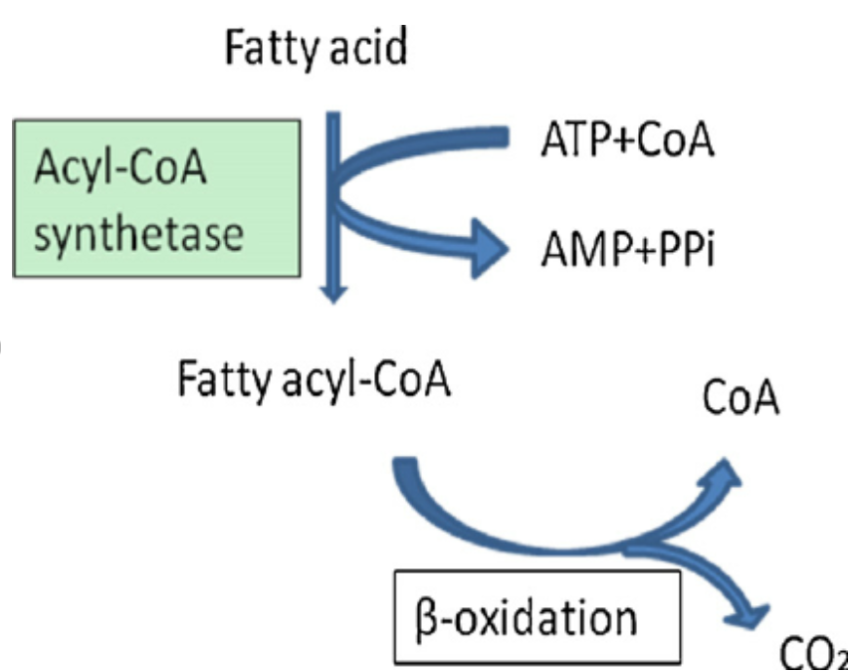
        2.1. Fatty acids activation
R—CH₂—COOH + ATP + HS—CoA
R—CH₂—CO –S—CoA + AMP + PPi
This step takes place in the cytoplasm.

Slide 6
2.2. Entry into the mitochondria
Carnitine shuttle intervention
Acyl CoA molecules cannot enter the mitochondria directly; they require a transporter (carnitine).
Components of carnitine shuttle
Carnitine
CPTI carnitine palmitoyl transferase 1 (palmitoyl or acyl)
CPTII carnitine palmitoyl transferase 2
CT Translocase

Slide 7
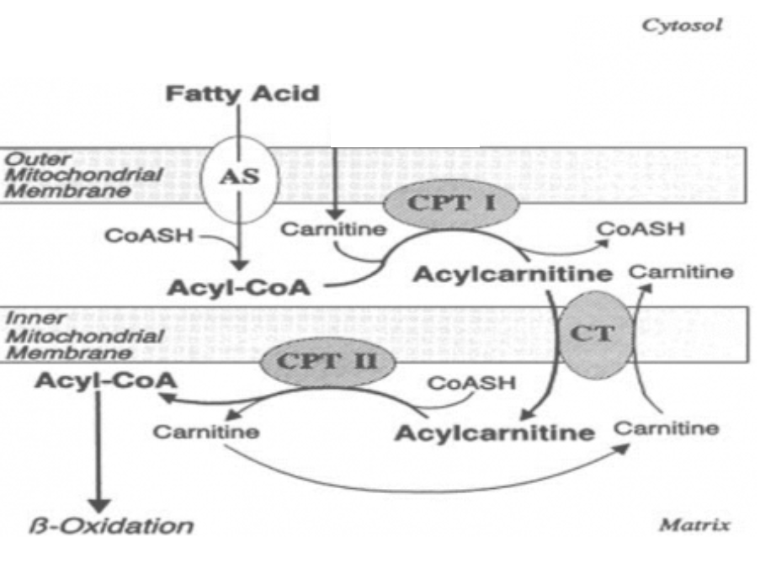
Carnitine shuttle

Slide 8
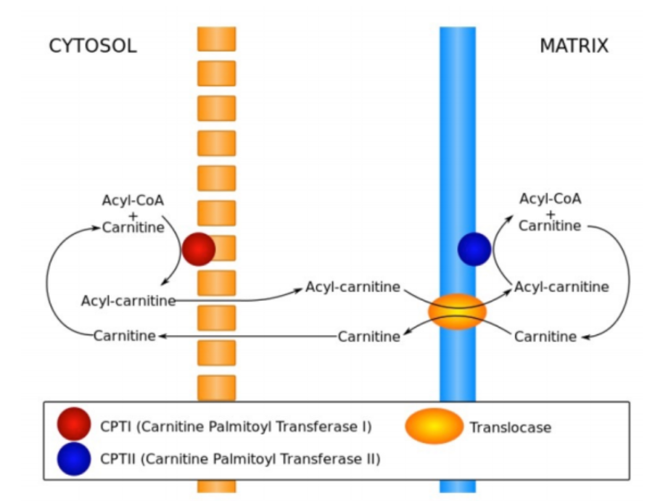
Carnitine shuttle

Slide 9
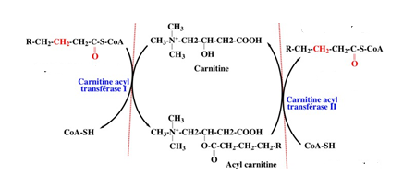
Components of carnitine shuttle
Carnitine is widely distributed and is particularly abondant in muscle. Carnitine is obtained by food, particularly animal-based food.
CPTI carnitine acyl transferase 1 the acyl group of acyl CoA is transferred in the hydroxyl group of carnitine to form acylcarnitine
CT Translocase acylcarnitine is shuttled across the inner mitochondrial membrane by a translocase
CPTII carnitine acyle transferase 2 the acyl group is transferred back to CoA on the matrix side of membrane. Finally the translocase returns carnitine to the cytosolic side in exchange for incoming acetyl carnitine

Slide 10
2.3. β-oxidation
Stages of β-oxidation of saturated fatty acids with even number
4 steps: called a turn or cycle. For a 2n-carbon fatty acid, (n-1) turn are required for its complete oxidation to n-acetyl CoA
Dehydrogenation of acyl CoA: Between C2 and C3, two hydrogen atoms (OH) are released, forming a double bond.
Hydration of the double bond: The OH group is attached to C3 (β-carbon).
3. Dehydrogenation: This involves the two hydrogen atoms on carbon 3.
4. Cleavage of the acyl CoA: Release of acetyl CoA and an n-2 acyl CoA.
The last acyl CoA can then begin a new β-oxidation cycle.

Slide 11
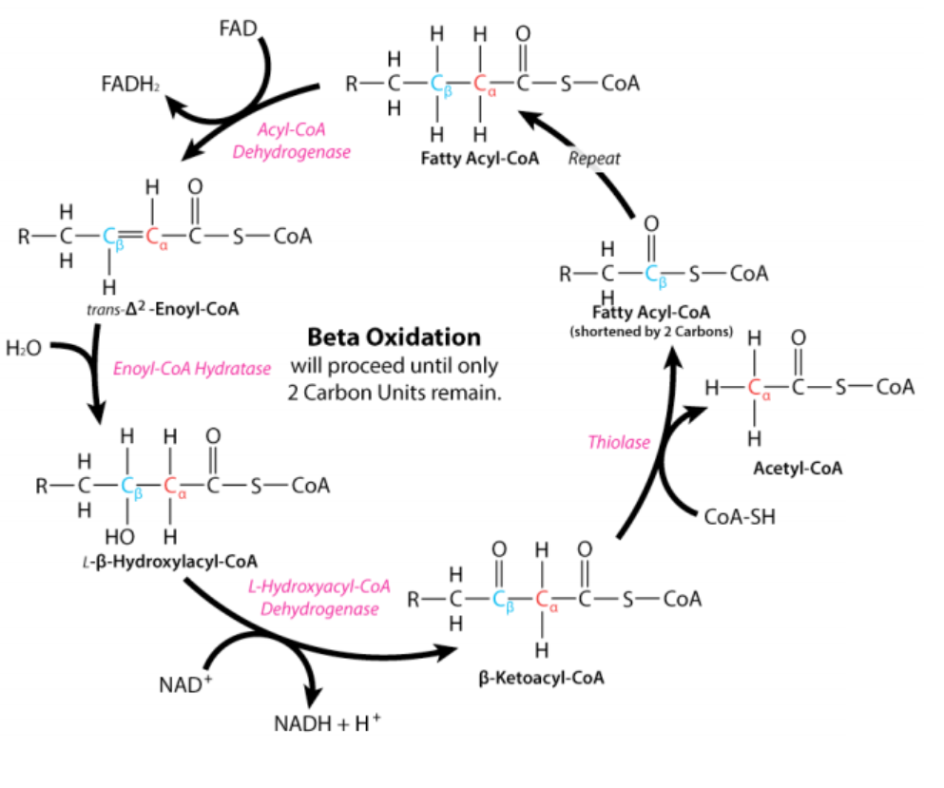
Energy balance
Turn 1: (Acyl-CoA)n+ CoA+ NAD+ FAD+H₂O
(Acyl-CoA)_{n-2}+ Acetyl-CoA + FADH₂
+ NADH⁺ + H⁺

Slide 12
2.3. Energy balance of β-oxidation saturated fatty acids even number
C18 :0 (palmitic acid: 2 x 8 is activated against ATP at palmitoyl-CoA
After 7 turn or cycle (n-1=8-1=7of the helix gives 8 acetyl-CoA.
8 Acetyl CoA = 8 x 12 ATP = 96 ATP (in KREBS cycle)
7 FADH2 = 7 x 2 ATP = 14ATP
7 NADH + H = 7 x 3 ATP = 21 ATP 40 ATP
2 phosphates bonds were consumed by the activation of fatty acid(-2ATP)
96 + 21+14 = 131 -2= 129 ATP .

Slide 13
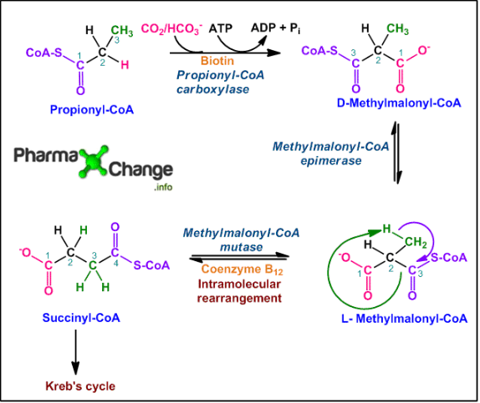
β Oxidation of saturated fatty acids with an odd number
The same process occurs as for fatty acids with an even number; during the last turn of the helix, an odd-numbered fatty acid of 3 carbons (propionyl CoA) remains. It incorporates a carbon atom to convert it from propionyl CoA to succinyl CoA (4carbons).
Special cases

Slide 14
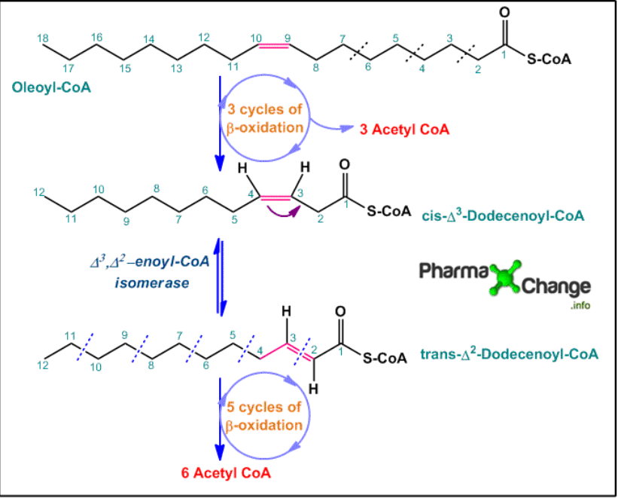
Special cases
β Oxidation of monounsaturated fatty acids
They are degraded in the same way as saturated fatty acids. However, an isomerase and an reductase are necessary for the complete oxidation of these acids (the need of auxiliary enzymes).
Oleic acid (C18) has a cis double bond at C9 and C10. After three turns of the (-6C) ring results in the formation of 12-carbon fatty acyl-CoA with a cis double bond now between carbon 3 and 4
the molecule has a double bond between carbon 3 and 4 in the cis position, which prevents the formation of a double bond between C2 and C3 and cannot further participate in β-oxidation .
The isomerase transforms the cis double bond into a trans double bond and reverses the movement between C2 and C3.
This allows β-oxidation to proceed by the enzymes in five continuous cycles to yield another 6 molecules of acetyl CoA.
When a cis double bond ends up at the position (between C3 and C4) isomerase converts it to a trans double bond at the position (between C2 and C3).

Slide 15
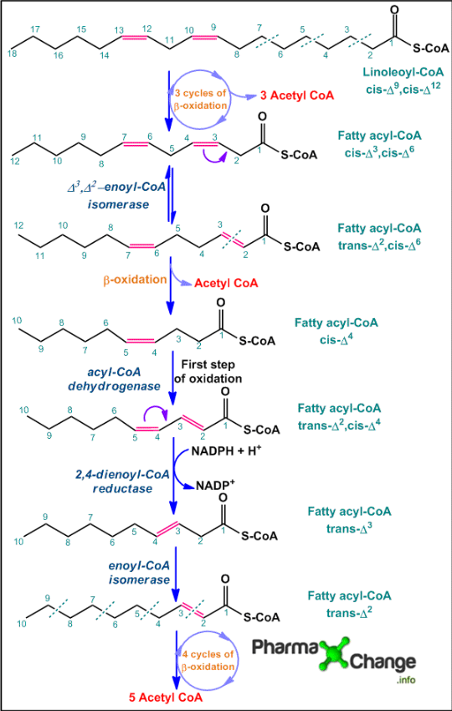
Special cases
β Oxidation of Polyunsaturated fatty acids
Linolenic acid is an unsaturated fatty acid with two cis double bonds.
Like saturated fatty acids the polysaturated fatty acid undergoes three cycles of β-oxidation to yield three molecules of acetyl CoA along with a 12 carbon chain fatty acyl-CoA with cis double bonds at position 3 and 6 (cis-Δ3,cis-Δ6).
Since the mitochondrial enzymes cannot break down cis double bonds, isomerase converts it to trans fatty acyl-CoA. The latter product now undergoes one more cycle of β-oxidation to yield one molecule of acetyl CoA
By the action of acyl-CoA dehydrogenase, the first step of β-oxidation is achieved, resulting in formation of a double bond at position 2. The newly formed product is now acted upon by the Two enzyme reductase and isomerase =
trans-Δ2 fatty acyl CoA now undergoes four cycles of β-oxidation to yield another five molecules of acetyl CoA.
The acetyl-CoA molecules now enter the Krebs cycle.
The enzyme reductase, using NADPH as a cofactor, reduces the two double bonds to a single trans double bond at trans position.

Slide 16
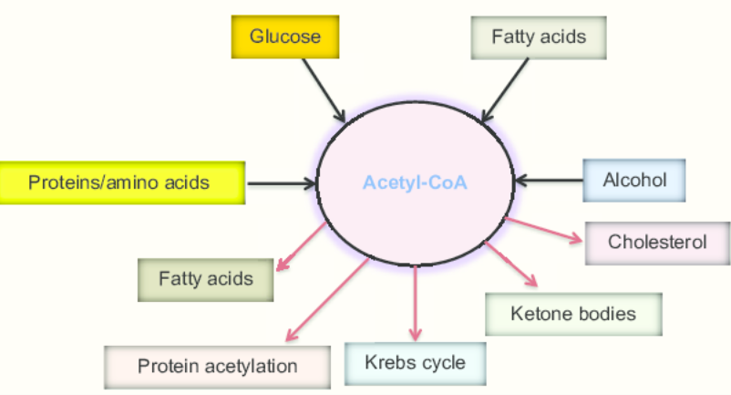
Fate of acetyl CoA
It can enter the Krebs cycle (for energy production),
or yield molecules of biological interest (Fatty acids, ketone bodies, cholesterol)

Slide 17
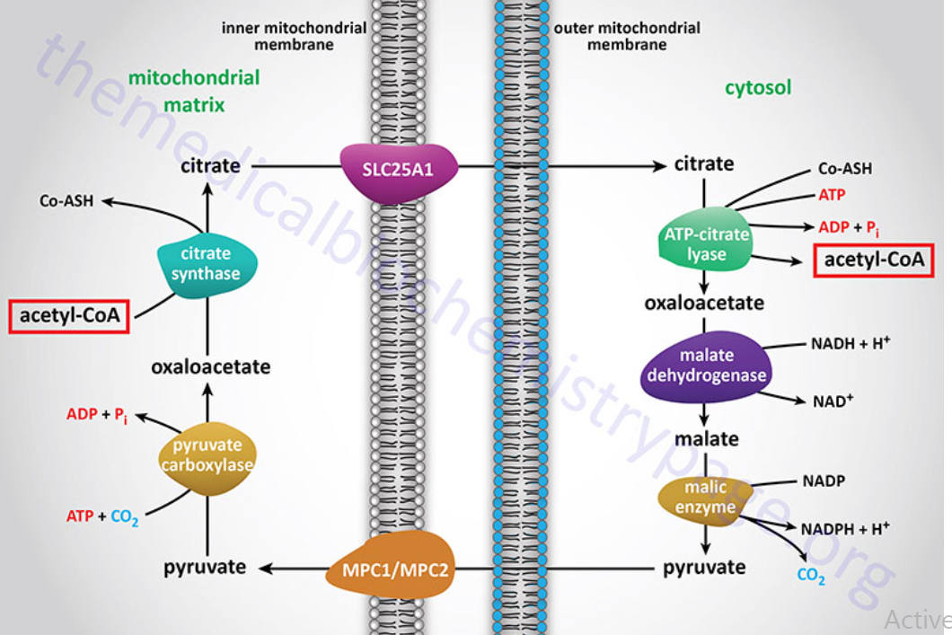
3. Fatty acids synthesis
Origin of Cytoplasmic Acetyl-CoA
Acetyl-CoA enters the cytoplasm in the form of citrate via the transport system
In the cytoplasm, citrate and coenzyme A (CoASH) are converted to oxaloacetate and acetyl-CoA by the citrate lyase reaction.
The resultant oxaloacetate is converted to malate by cytoplasmic malate dehydrogenase
The malate produced by this pathway can undergo oxidative decarboxylation by cytoplasmic malic enzyme The co-enzyme for this reaction is NADP+ generating NADPH.
The advantage of this series of reactions for converting mitochondrial acetyl-CoA into cytoplasmic acetyl-CoA is that the NADPH produced by the cytosolic malic enzyme reaction can be a major source of reducing co-factor for the enzymatic activities of the fatty acid synthase (FAS) complex.

Slide 18
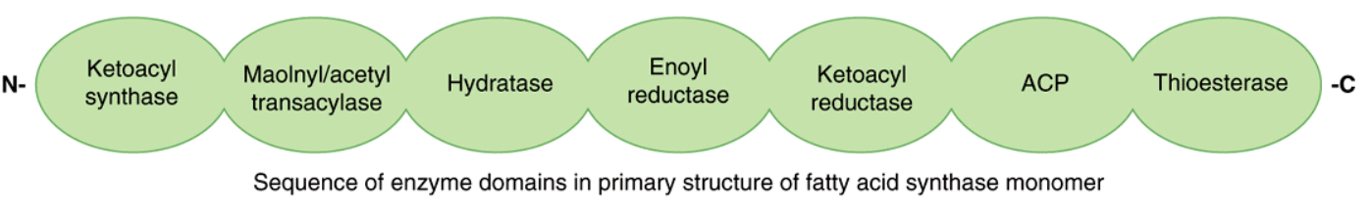
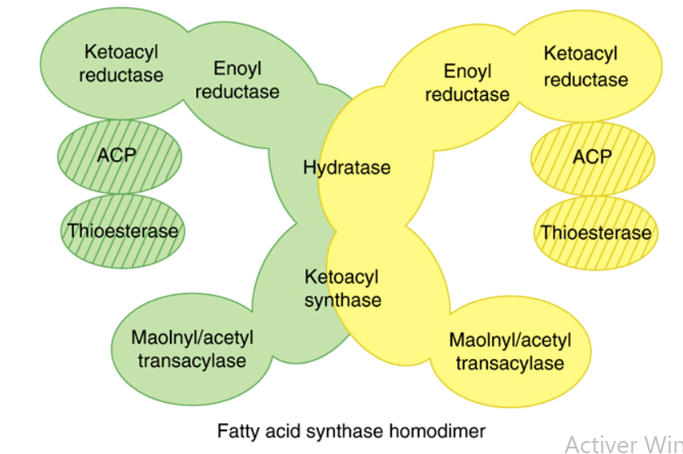
The Fatty Acid Synthase complex (multienzymatic complex)
Complex is homodimer of two polypeptide chains containing saven enzyme activities
Saven enzymes activities
Acetyltransferase
Malonyltransferase
β-ketoacyl-ACP synthase
β-ketoacyl-ACP reductase,
3-hydroxyacyl-ACP dehydratase
Enoyl-CoA reductase (
Thioesterase

Slide 19
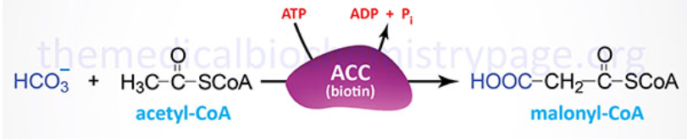
3. Fatty acids synthesis steps
3.1. Acetyl-CoA carboxylase (ACC) reaction
The synthesis of malonyl-CoA is the first committed step of fatty acid synthesis and the enzyme that catalyzes this reaction, acetyl-CoA carboxylase (ACC).

Slide 20
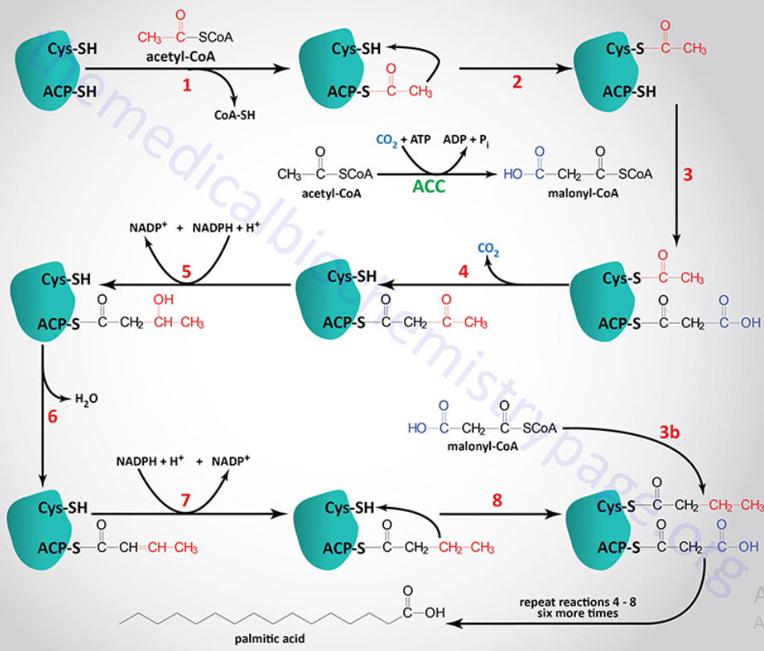
3.2 Fatty acids synthesis by enzyme fatty acid synthase (FAS)

Slide 21
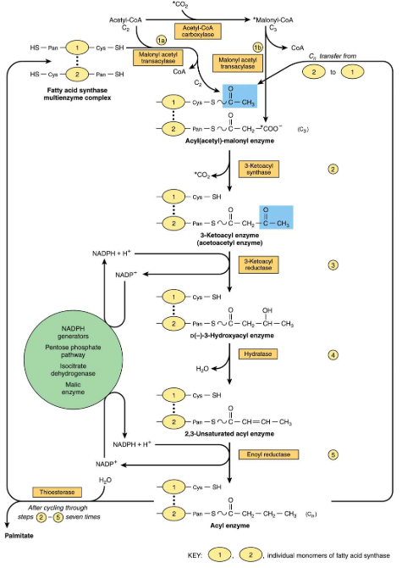
3.2 Fatty acids synthesis by enzyme fatty acid synthase (FAS)

Slide 22
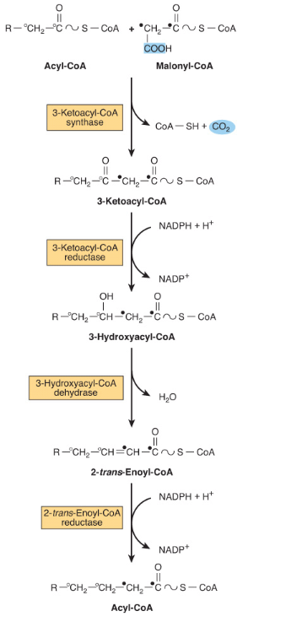
Elongation of Fatty Acid Chains Occurs in the Endoplasmic Reticulum
This pathway elongates saturated and unsaturated fatty acyl-CoAs by two carbons, using malonyl-CoA as the acetyl donor and NADPH as the reductant, and is catalyzed by the microsomal fatty acid elongase system of enzymes

Slide 23
End-product: Palmitate (C16:0)
Total of 7 cycles:
Starts with 2 carbon acetyl-CoA
Malonyl-CoA acts as a 2 carbon donor
7 Malonyl-CoA utilized (14 carbons)
NADPH (2 reduction reactions) X 7 cycles = 14 NADPH utilized
ATP (acetyl-CoA carboxylase reactions) X 7 cycles = 7 ATP
CO2 (released when malonyl-CoA donates 2 C acyl chain) X 7 cycles = 7 CO2 released
1 Acetyl-CoA (to make malonyl-CoA) X 7 cylces + 1 Acetyl-CoA (precursor in KAS end) = 8 Acetyl-CoA utilized

Slide 24
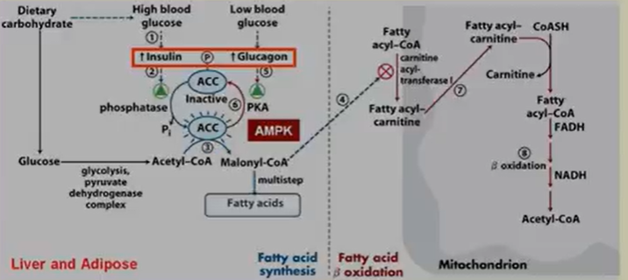
Simultaneous hormonal regulation (synthesis and β-oxidation of fatty acids)

