Slide 1
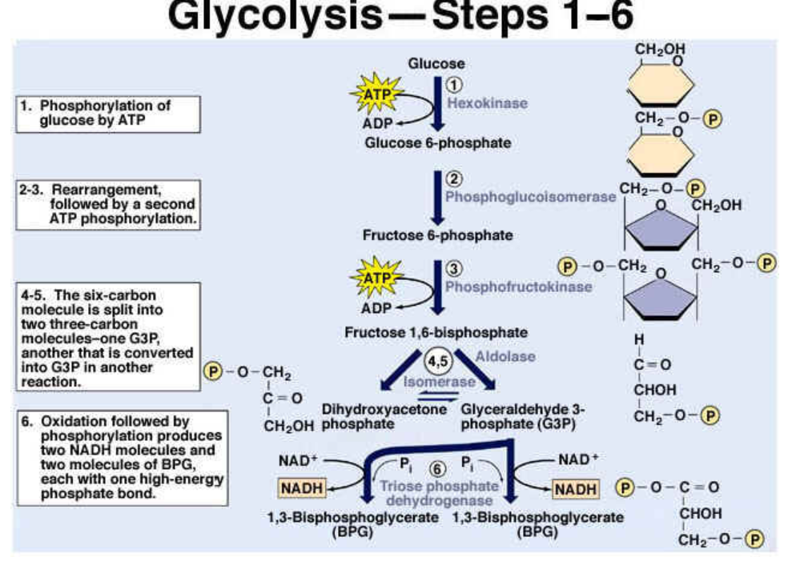

Slide 2
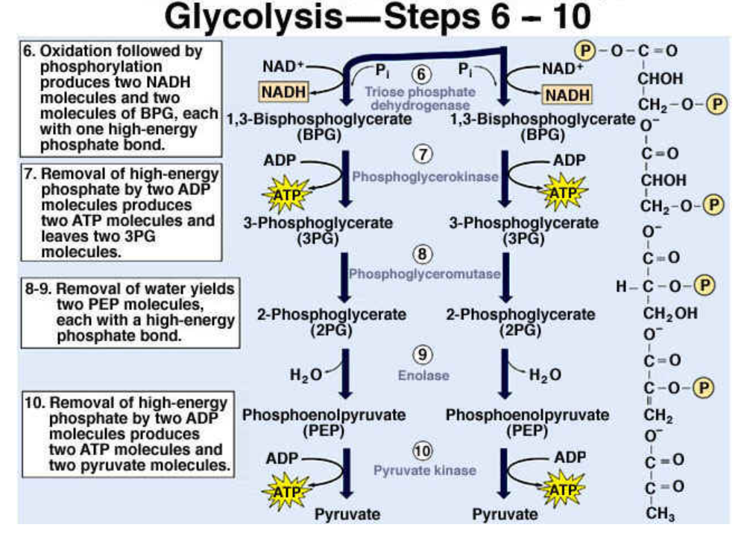

Slide 3
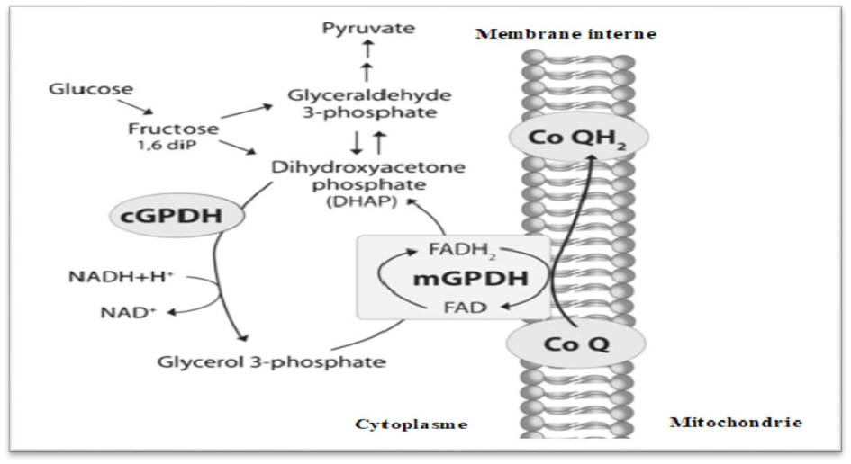
Glycerol 3 phosphate shuttle

Slide 4
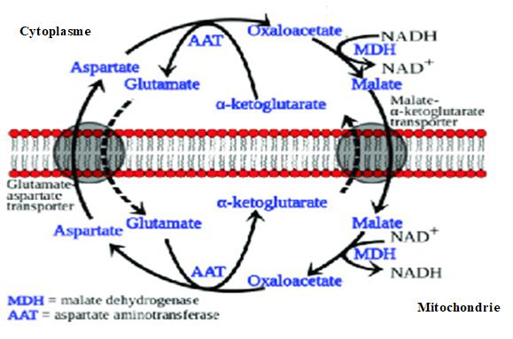
Aspartate-malate shuttle

Slide 5
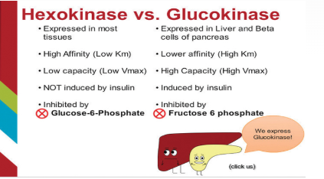
Hexokinase and glucokinase

Slide 6
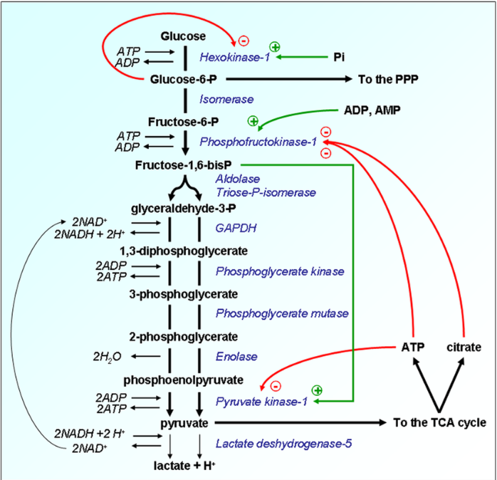
Allosteric regulation of glycolysis enzymes

Slide 7
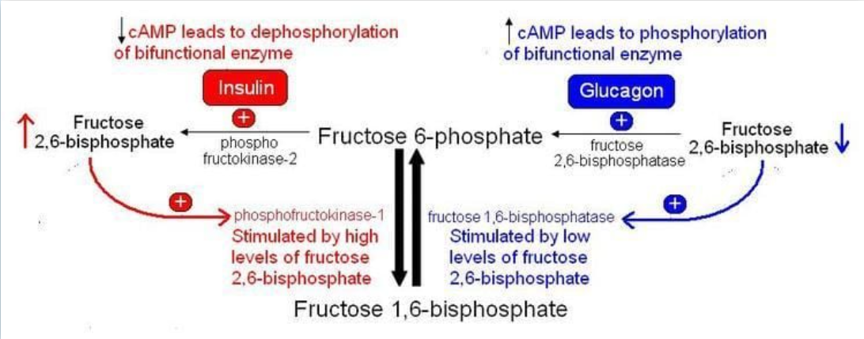
Phosphofructokinase 1 regulation

Slide 8
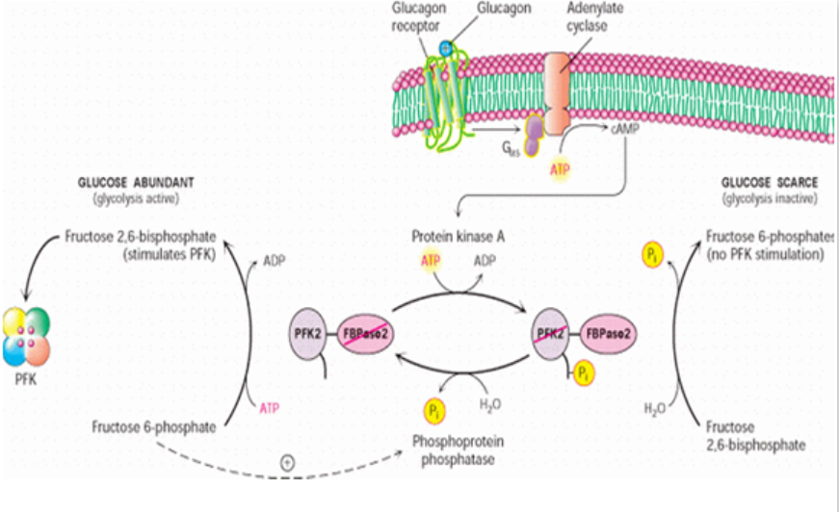
Phosphofructokinase 1 regulation

Slide 9
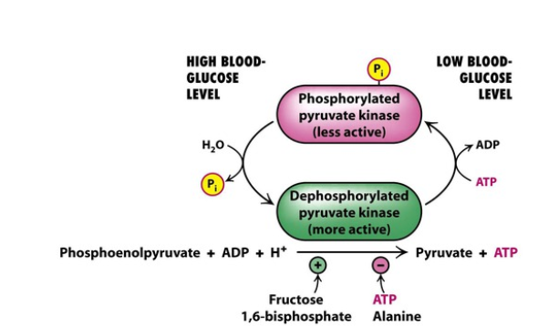
Pyruvate kinase regulation

Slide 10
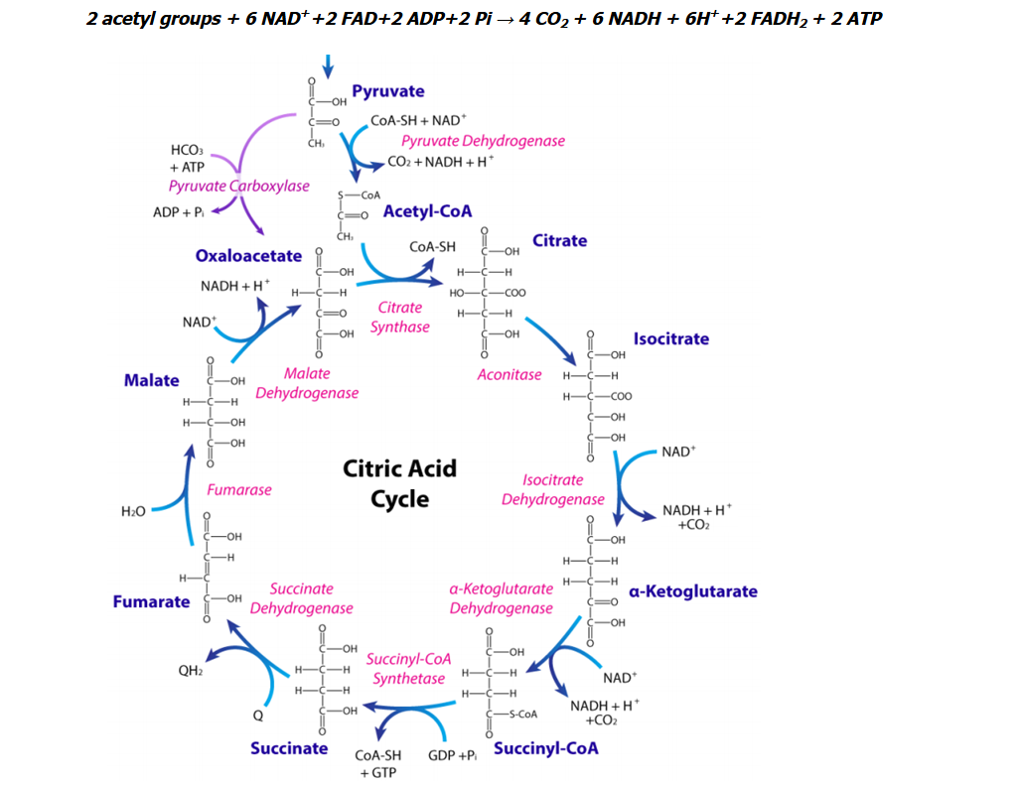
Citric acid cycle

Slide 11
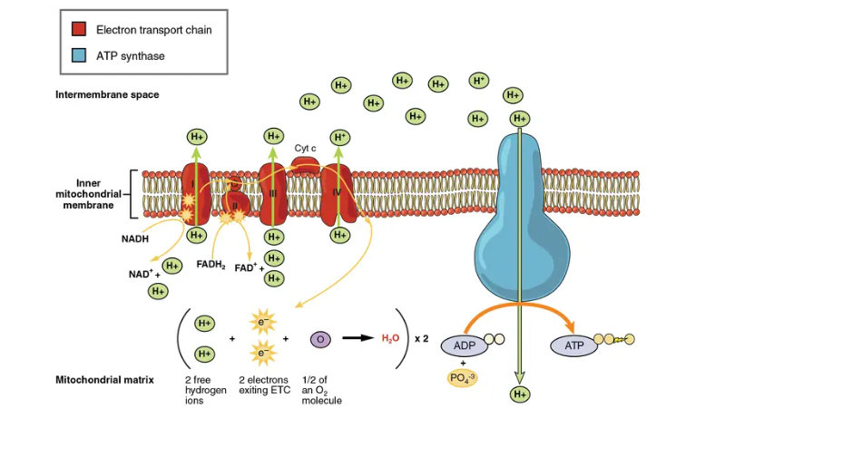
Oxidative phosphorylation mecanism

Slide 12
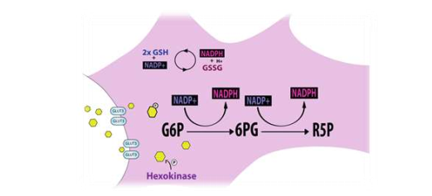
Pentose phosphate pathway

Slide 13
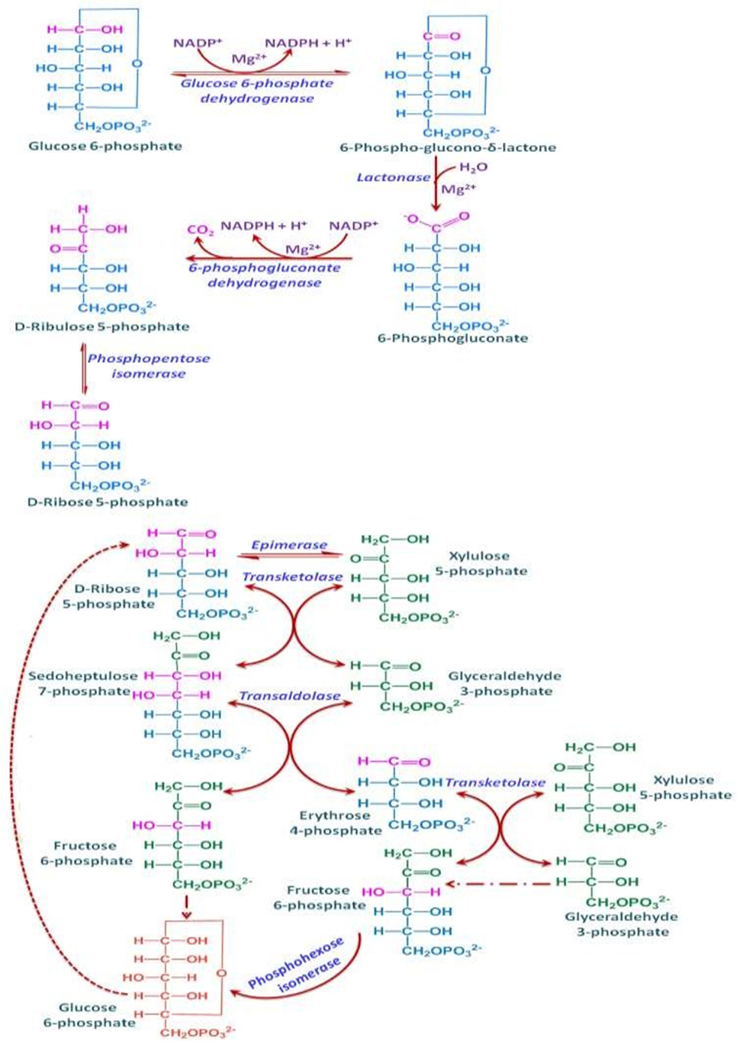
Pentose phosphate pathway

Slide 14
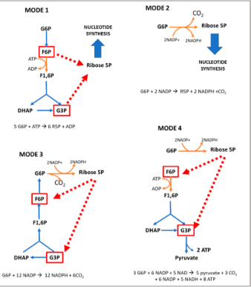
Pentose phosphate pathway

Slide 15
Glycogen structure

Slide 16
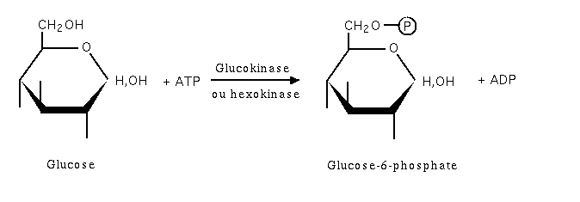
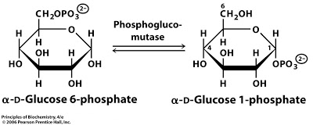
Glycogenesis
Reaction 1:Phosphorylation of glucose
Reaction 2: Conversion of glucose 6➔ into glucose 1-➔

Slide 17
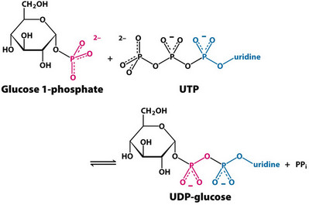
Glycogenesis
Reaction3: formation of l'UDP glucose by UDP glucose pyrophosphorylase

Slide 18
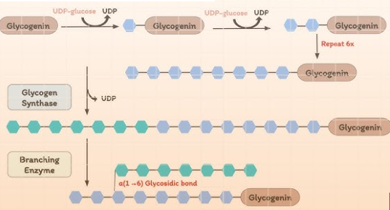
Glycogenesis
Glycogen metabolism and hormonal regulation
Reaction 4: Synthesis of a primer to initiate the glycogen formation
a fragment of glycogen in the form of dextrin
Two types of
primers
intervention of glycogenin
to form a short chain approximately 8 units of glucose

Slide 19
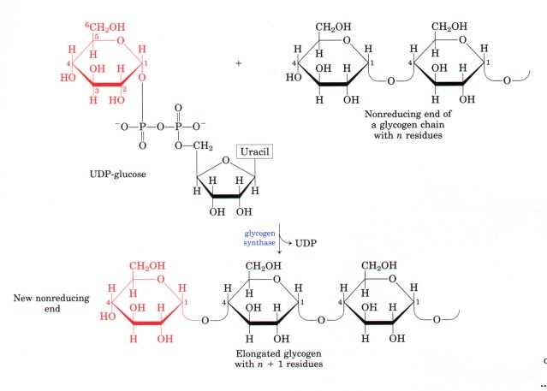
Glycogen metabolism and hormonal regulation
Glycogenesis
Reaction 5:Elongation of the chain catalyzed by glycogen synthetase
New glucosyl units added to nonreducing end terminal residues of glycogen and the formation of α(1,4) linkage

Slide 20
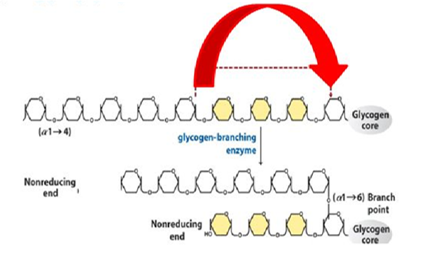
Glycogenesis
Reaction6: Glycogen branching

Slide 21
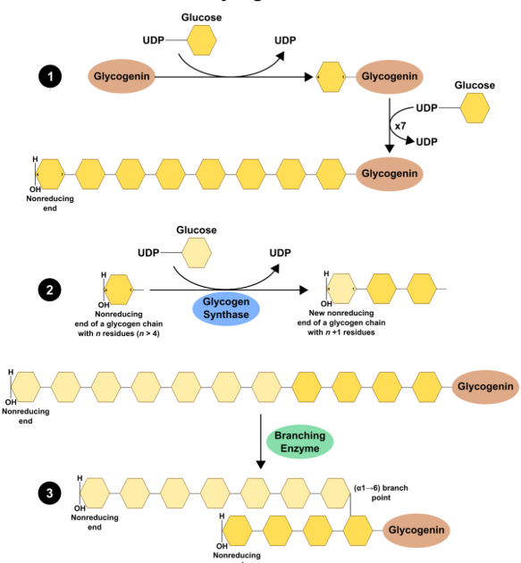
Glycogenesis

Slide 22
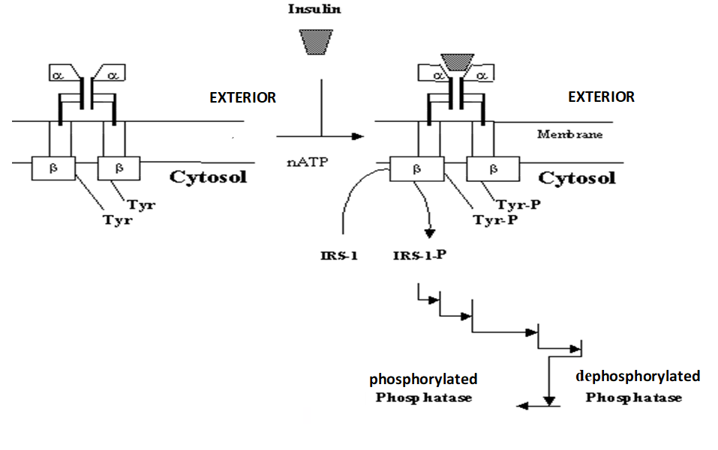
Hormonal regulation of glycogenesis
Activation mecanism of protein phosphatase by insulin

Slide 23

Glycogen metabolism and hormonal regulation
Glycogenolysis reactions

Slide 24
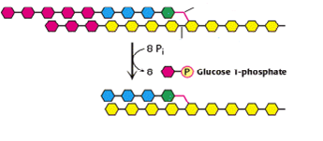
Glycogenolysis
Glycogen metabolism and hormonal regulation
Reaction 1: Glycogen phosphorolyse
Cleavage of the α (1-4) bond from the non-reducing end
Attachment of a phosphate group provided by ATP to carbon 1 of the released glucose
Phosphorolysis is repeated sequentially on glycogen until 4 glycosyl residues are encountered on each chain before the α (1-6) bond
α(1-6) bond
phosphorylase

Slide 25
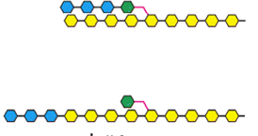
Glycogen metabolism and hormonal regulation
Glycogenolysis
Reaction2: glycosyl transferase effect by α (1-4) transglycosylase
Glycosyltransferase acts on limiting dextrin by removing an oligoside made up of 3 glucose residues from each chain
The three glucose residues are attached to another limit dextrin chain, thus allowing phosphorolysis to resume on this chain.
After the action of this enzyme, a glucose molecule linked by the α (1-6) bond remains in place of the side chain.
α (1-4) transglycosylase

Slide 26
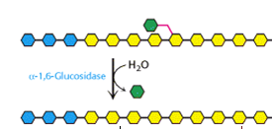
Glycogenolysis
Reaction3: Debranching (ou α (1-6) glucosidase) effect
A debranching enzyme hydrolyzes glucose residues linked by the α (1-6) bond and releases glucose molecules

Slide 27
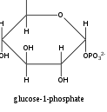
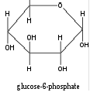
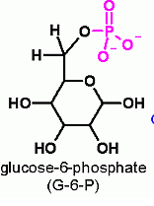
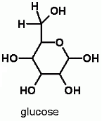

Glycogenolysis
G1P is converted to G6P by phosphoglucomutase. G6P can enter glycolysis in the liver and muscle
phosphoglucomutase
Glucose 6-phosphatase allows the hydrolysis of G6P into glucose and the release of the latter into the blood

Slide 28
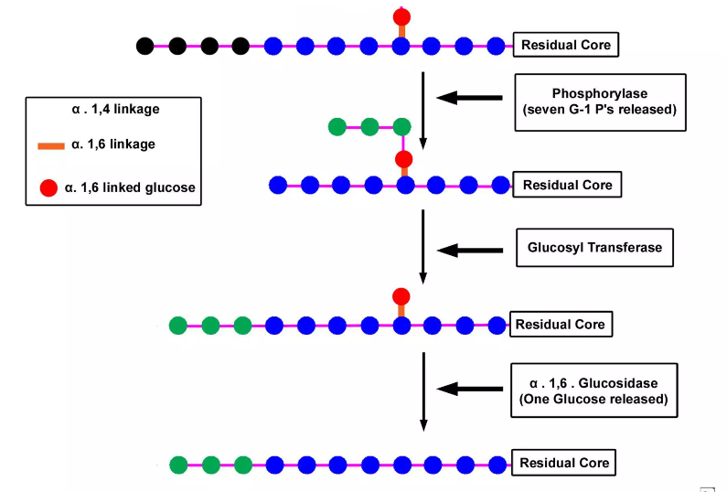
Glycogenolysis

Slide 29
Hormonal regulation of glycogenolysis
The binding of each of the hormones to its specific membrane receptor leads to the activation of a membrane adenylatecyclase (adenylate cyclase).
Activated adenylate cyclase catalyzes, through ATP hydrolysis, the formation of cyclic AMP (cAMP), considered a second messenger.
cAMP binds to protein kinase A (cAMP dependent) and combines with the regulatory subunit to release the catalytic subunit (Active Protein Kinase A).
Protein kinase A (active) phosphorylates, in the presence of ATP, glycogen phosphorylase kinase which becomes active in phosphorylated form.
Finally, this last one phosphorylates glycogen phosphorylase, changing it from the b form to the a form, which catalyzes the phosphorolysis of glycogen.

Slide 30
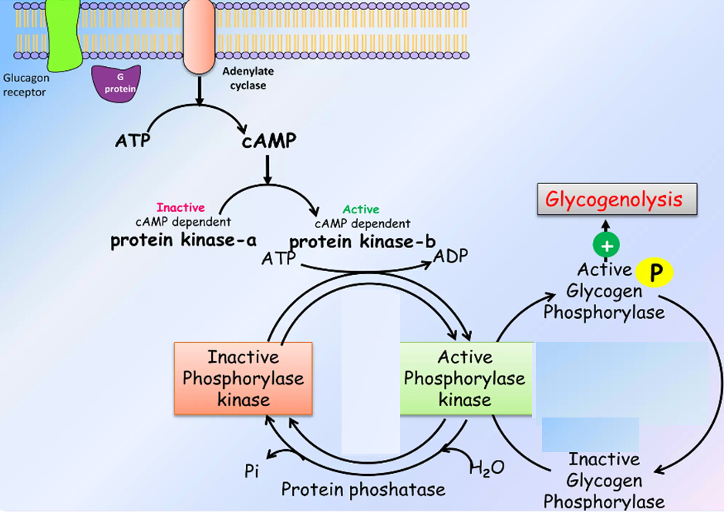
Hormonal regulation of degradation of glycogen

Slide 31
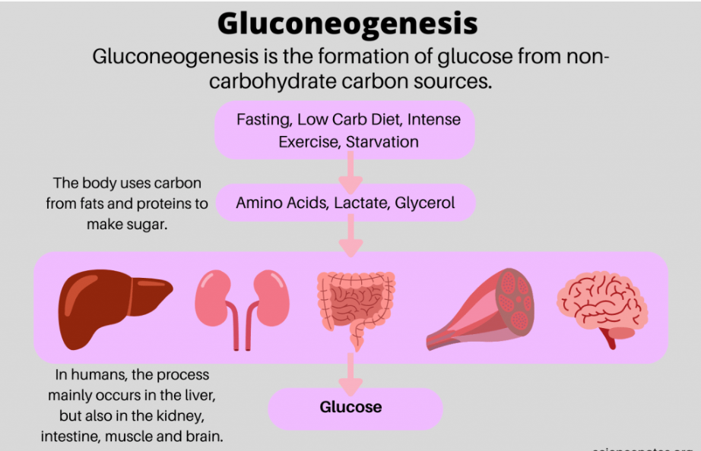

Slide 32
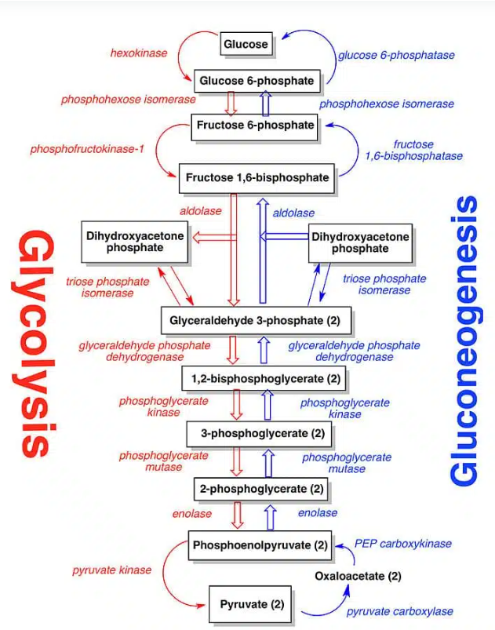
Gluconeogenesis

Slide 33
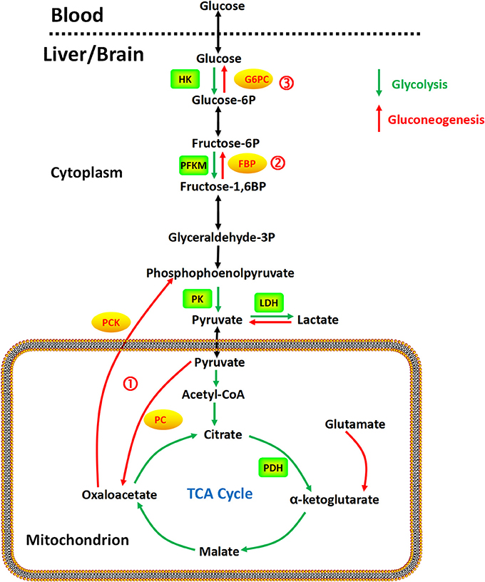
Gluconeogenesis

Slide 34
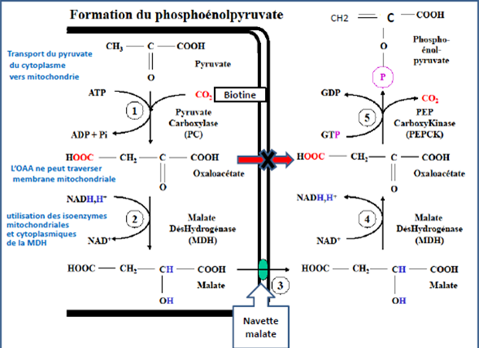

Slide 35
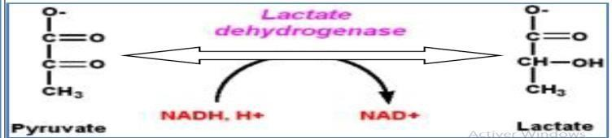
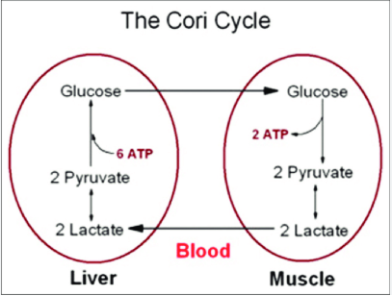
The Cori cycle is a crucial metabolic pathway that allows for the recycling of lactate produced in muscles and red blood cells, converting it back into glucose in the liver.
This process is particularly important during intense exercise or when the oxygen supply is insufficient (anaerobic metabolism).
Gluconeogenesis

Slide 36
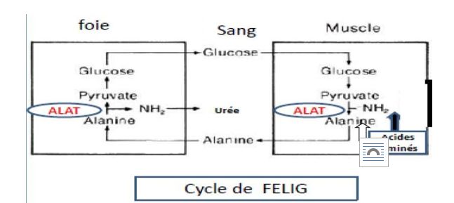
Gluconeogenesis
The Felig cycle, also known as the glucose-alanine cycle, is a metabolic pathway that ensures the transfer of nitrogen and carbon between skeletal muscles (and other peripheral tissues) and the liver, primarily during fasting or prolonged exercise.

Slide 37
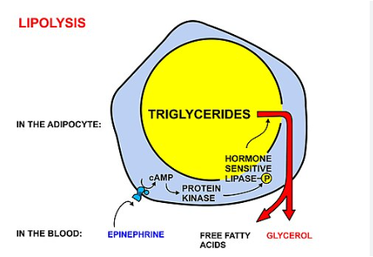
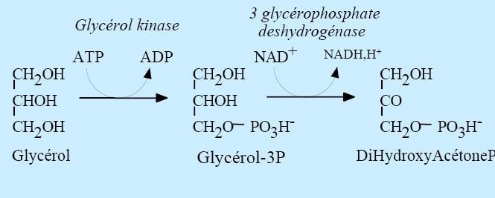
Gluconeogenesis

Slide 38
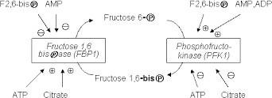
Allosteric regulation of Gluconeogenesis

Slide 39
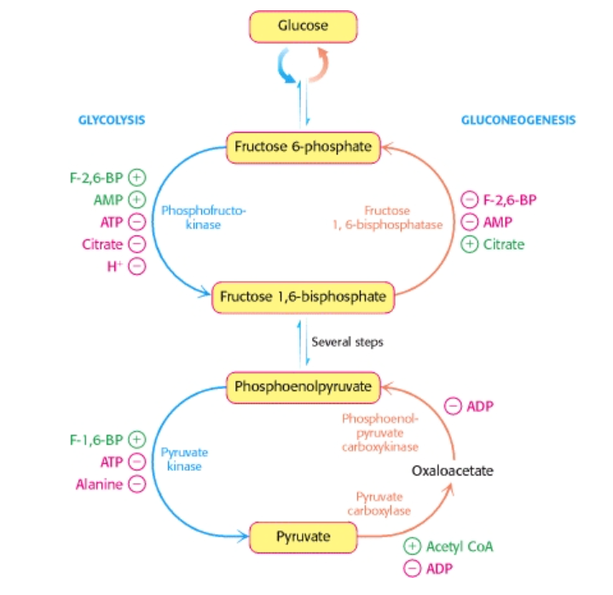
Allosteric regulation of gluconeogenesis

Slide 40
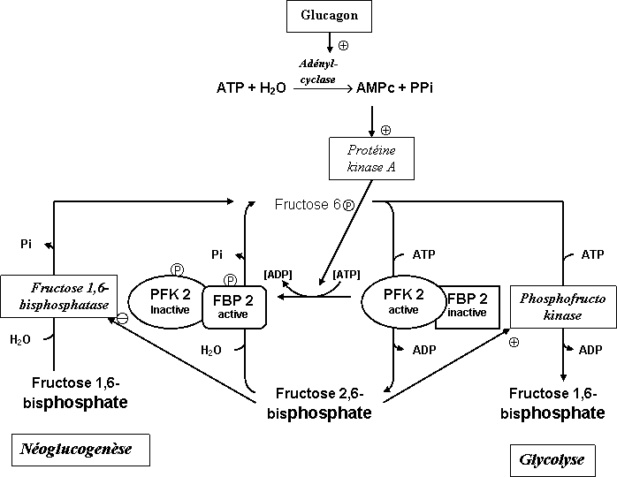
Hormonal regulation of gluconeogenesis and glycolysis

Slide 41
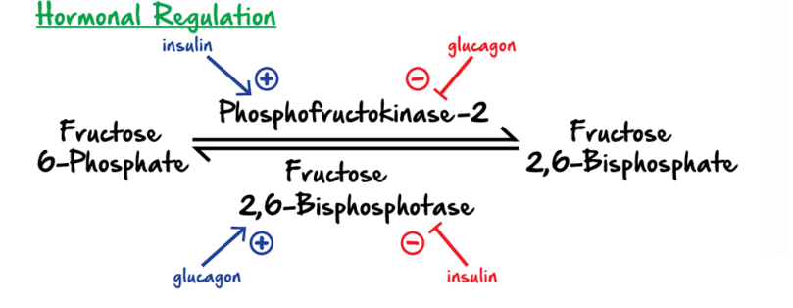
Hormonal regulation of gluconeogenesis and glycolysis

