Slide 1

Unité d’enseignement Fondamentale :
Production of plants and seeds
University center of Abdelhafid Boussouf- MILA
Dr. MEKAOUSSI Radhia
3rd year of agronomy
Specialization in plant production 2025/2026

Slide 2
Plan of cours
Part One: Woody Plants
1. General information on woody plant propagation techniques
2. Scientific basis for plant and seed production
2.1. Plant physiology
2.2. Seed physiology
3. Propagation of fruit trees and vines
3.1. Different propagation methods
3.2. Setting up a plant material propagation chain
3.3. Steps in the propagation chain for high-quality plant material
4. Production in open-field nurseries
4.1. Setting up an open-field nursery
4.2. Seed selection
4.3. Sowing
4.4. Grafting fruit trees and vines
5. Production in above-ground nurseries

Slide 3
6. Inspection and certification of plants and seeds
6.1. Purpose of inspection and certification
6.2. Definitions
6.3. Status of plant material
6.4. Approvals
6.5. Inspection
7. Production scheme for certified plants
7.1. Selection for promological quality
7.2. Production of initial material
7.3. Certification of plants and seeds
7.4. Inspection of vinewood and vine plant production
7.5. Certified propagation material
7.6. Production of rootstocks and cuttings
7.7. Inspection and certification of mother plants
7.8. Harvesting and certification of rootstocks, layering and cuttings
7.9. Certified plants

Slide 4
Part One: Woody Plants
Chapter 1: General information on woody plant propagation techniques
A woody plant is a plant that produces wood as its structural tissue and thus has a hard stem. In cold climates, woody plants further survive winter or dry season above ground.
Woody plants include trees, shrubs, or lianas.
whose stems and larger roots are reinforced with wood produced from secondary xylem
Propagation is the process of creating new plants.

Slide 5
Asexual propagation, or rooting cuttings, is the one the easiest and most effective ways to maintain an individual trait that best represents a variety. In fact, asexual propagation, or cloning, is how all cultivars are produced, because you cannot guarantee that plants grown from seed will have identical traits.
vegetative propagation, involves creating new plants from the vegetative parts of the parent plant, such as stems, leaves, or roots. This method produces offspring that are genetically identical to the parent plant, ensuring consistent traits and characteristics.

Slide 6
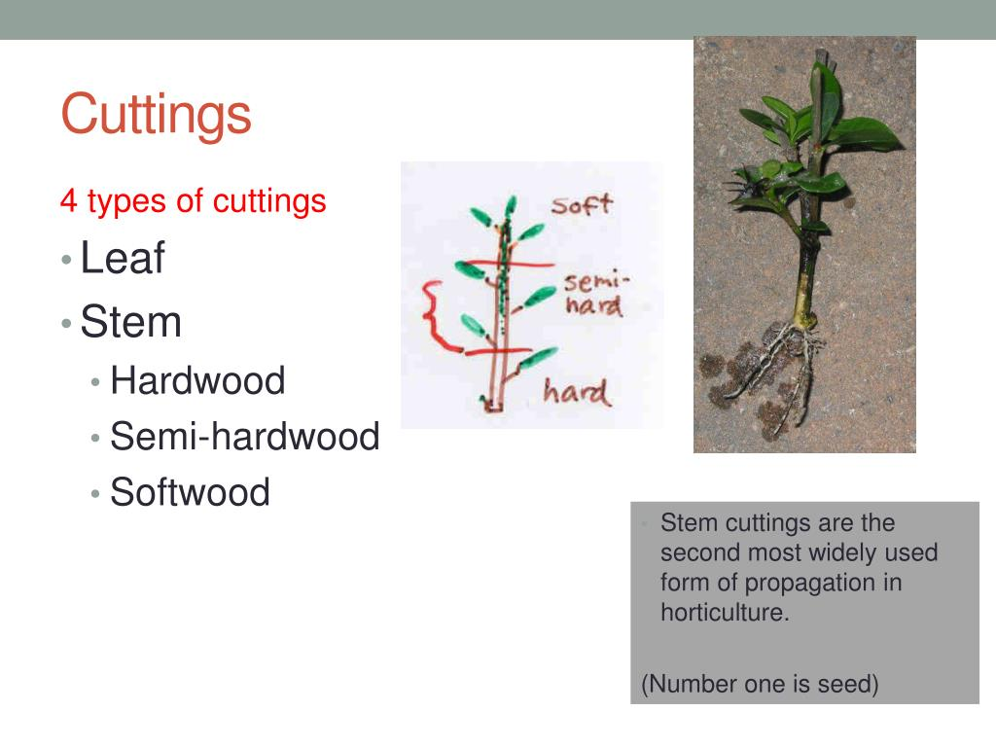
Common asexual propagation methods
There are several methods of producing plants asexually: cuttings, layering, division, tissue culture and grafting
There are several techniques used for asexual propagation of woody shrubs, including:
Cuttings are one of the most popular methods for propagating woody shrubs.
This technique involves taking a portion of the plant, usually a stem or leaf, and encouraging it to develop roots.
There are three main types of cuttings:

Slide 7
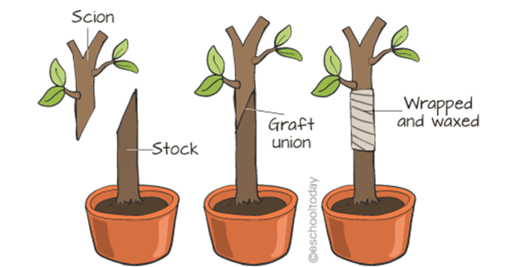
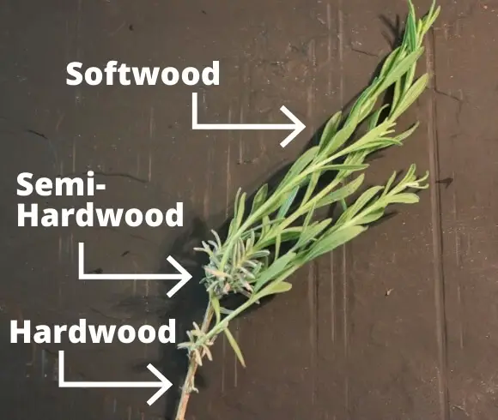
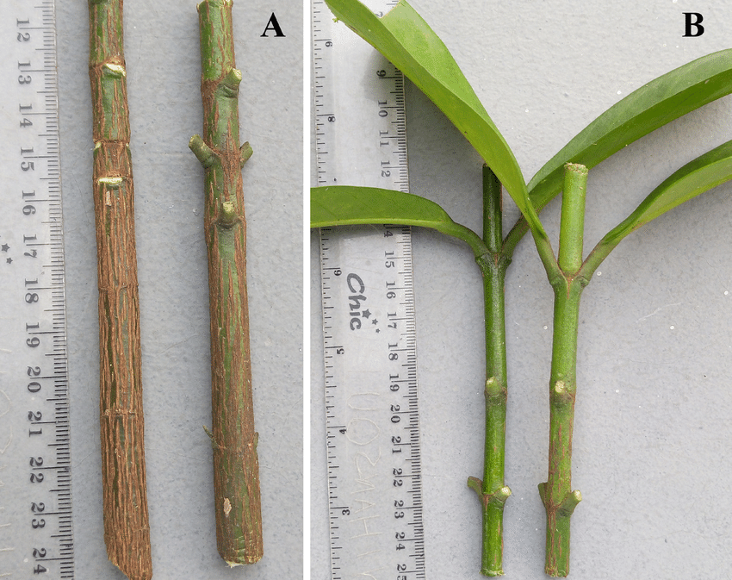
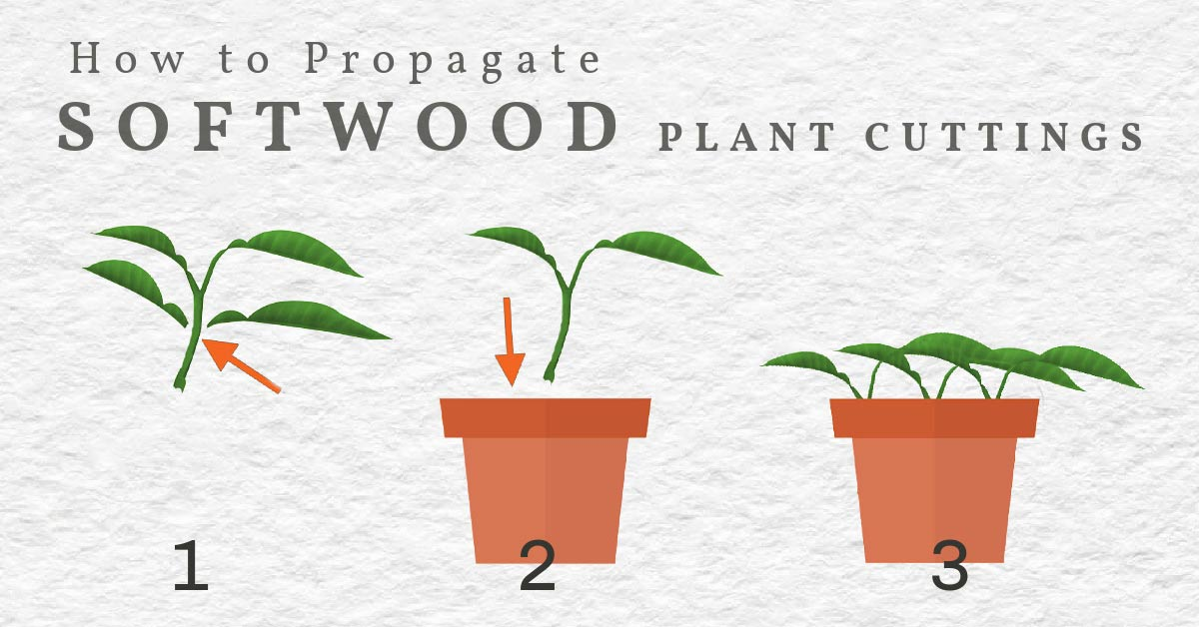
Semi-hardwood cuttings
Hardwood cuttings
Softwood cuttings: Taken from new, soft growth in the spring or early summer. These cuttings root quickly and are ideal for many ornamental shrubs.
Semi-hardwood cuttings: Taken from partially matured stems in late summer or early autumn. These cuttings are more resilient and less prone to wilting.
Hardwood cuttings: Taken from mature, woody stems in late autumn or winter. These cuttings take longer to root but are suitable for many deciduous shrubs.
Hardwood cuttings
Softwood cuttings

Slide 8
Steps for propagating with cuttings
Selecting the cutting: Choose a healthy, disease-free stem from the parent plant. Make a clean cut just below a node (the point where a leaf attaches to the stem).
Preparing the cutting: Remove the lower leaves and any flowers or buds from the cutting. Dip the cut end in rooting hormone to encourage root development.
Planting the cutting: Insert the cutting into a well-draining rooting medium, such as a mix of perlite and peat moss. Ensure that at least one node is buried in the medium.
Providing the right conditions: Keep the cuttings in a warm, humid environment with indirect light. Mist them regularly to maintain moisture levels.
Transplanting: Once the cuttings have developed a healthy root system, transplant them into individual pots or directly into the garden.

Slide 9
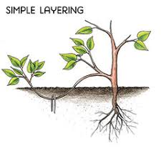
Layering
Layering is another effective method for propagating woody shrubs.
This technique involves encouraging a stem to develop roots while still attached to the parent plant.

Slide 10
There are several types of layering:
Simple layering: Bury a low-growing stem in the soil, leaving the tip exposed. Roots will develop at the buried portion, and the new plant can be separated from the parent once established.
Tip layering: Bend a stem to the ground and bury the tip. Roots will form at the buried tip, and a new plant will grow from the tip.
Air layering: This method involves wounding a stem and wrapping it with moist sphagnum moss and plastic to encourage root development. Once roots have formed, the stem can be cut and planted.

Slide 11
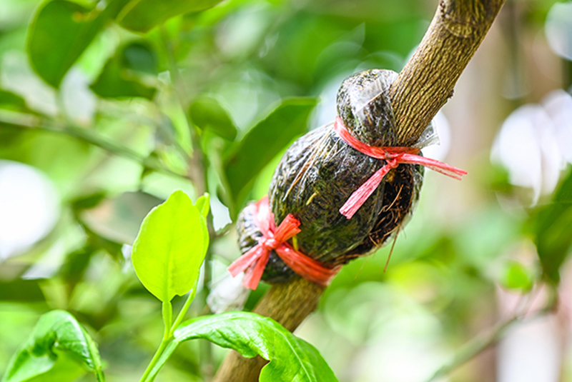
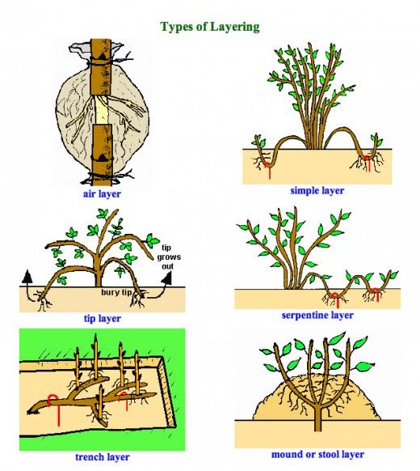
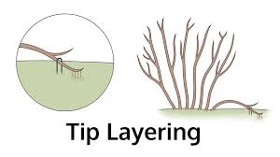

Slide 12
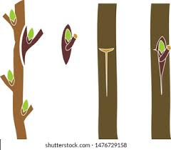
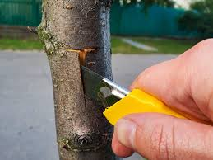
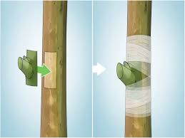
Budding
Budding is a specialized form of grafting that involves inserting a single bud from one plant onto the stem of another plant. This method is commonly used for propagating woody shrubs and fruit trees.

Slide 13
2. Scientific basis for plant and seed production
2.1. Plant physiology
2.2. Seed physiology

Slide 14
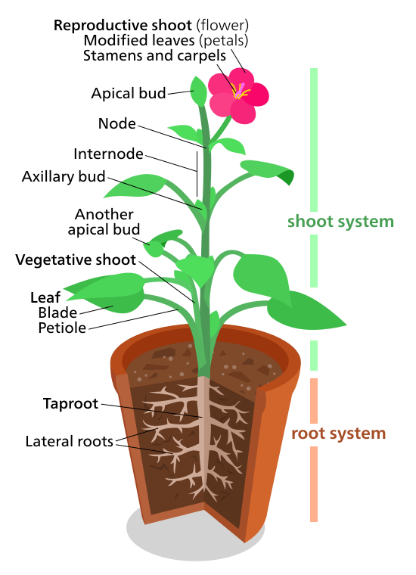
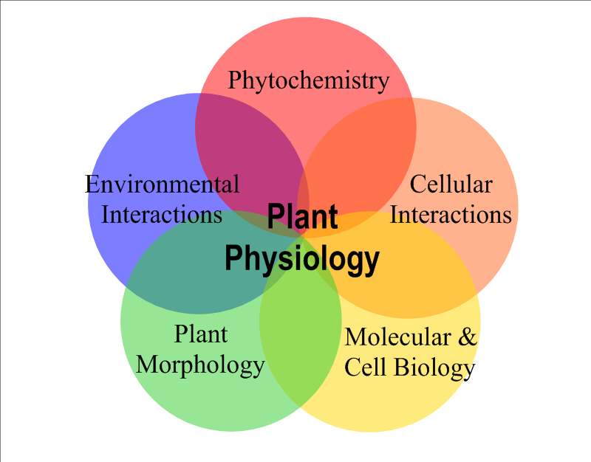
2.1. Plant physiology

Slide 15
Water Nutrition
Nutrition of green plants is different of animals
Water is an important factor for plant growth as it helps to fulfill all the vital activities of plants.
Transpiration, water absorption ….
Mineral Nutrition
MINERAL NUTRITION The process that involves absorption and utilization of mineral elements by the plants for their growth and development. Macro and micro element
Nitrogen nutrition
acquiring and utilizing soil-based forms of nitrogen, primarily nitrate (NO₃⁻) and ammonium (NH₄⁺), for synthesizing essential compounds like proteins, DNA, RNA, and chlorophyll. Nitrogen is crucial for plant growth, photosynthesis, and the formation of new cells and tissues.
Carbon nutrition
is the process by which plants acquire and utilize carbon, primarily from atmospheric carbon dioxide (CO2), to build their tissues and produce energy through photosynthesis.

Slide 16
2.2. Seed physiology
Seed production is defined as the process by which plants, particularly annual and perennial species, generate seeds through sexual reproduction, facilitating genetic variability, dispersal, and population growth. It is influenced by environmental conditions, genetic potential, and reproductive strategies, including self-compatibility and mechanisms for outcrossing.
Seed is the most vital and crucial input for crop production. It marks the beginning of the new generation and instigates the hope of ecological and economic prosperity.

Slide 17
Seed formation
Seed formation begins with the combination of a male and female gamete: a process known as fertilization.
Seed development is characterized by extensive cell divisions
The development of a seed begins with the fertilized ovule, or zygote. The early stage of seed development is characterized by extensive cell divisions that form the embryo and, in endospermic seeds, the tissues that store nutrients that will support the eventual germination of the seed and seedling development.
Germination
The process by which a seed transforms into a plant (seedling) in optimum sunlight, air, and water is called germination.

Slide 18
3. Propagation of fruit trees and vines
3.1. Different propagation methods
3.2. Setting up a plant material propagation chain
3.3. Steps in the propagation chain for high-quality plant material

Slide 19
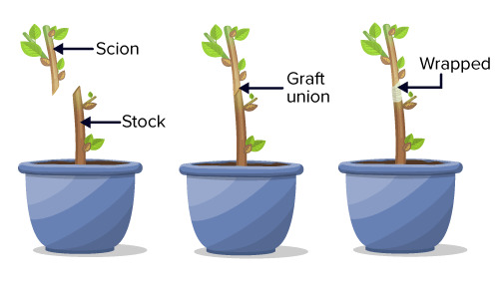
Propagation is simply multiplication or production of plants.
several techniques have been developed to grow plants. All techniques are designed to achieve specific goals, like uniformity in crops, increased productivity, disease-resistant plants, and plants with desired characters.
Mainly these techniques are divided into two categories depending on the means of propagation: Sexual means of propagation and asexual means of propagation.

Slide 20
3.1. Different propagation methods
Vines
Fruit Trees
Vines can be propagated through methods like cuttings, layering, and grafting, with cuttings being a very common technique
Fruit tree propagation is usually carried out vegetatively (non-sexually) by grafting or budding a desired variety onto a suitable rootstock.

Slide 21
Vines Propagation
Propagation by cuttings
When to take cuttings:
The best time is often during the dormant season, after the leaves have fallen.
What to choose:
Select a healthy, pencil-thick stem. Ensure the inside is a lively greenish-brown color.
How to cut:
Cut the stem into pieces that are about 6 to 12 inches long, with two to three nodes (the small bumps where leaves grow) on each cutting. Cut just below a node to help with root formation.
Prepare the cutting:
It is helpful to know which end is the bottom, which will grow roots, and which is the top.
Remove any leaves from the cutting.
Dip the bottom end of the cutting in rooting hormone to encourage root growth.

Slide 22
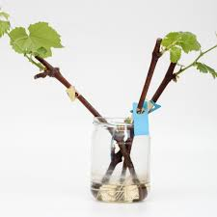
Planting:
In soil: Poke a hole in moist potting mix, place the cutting inside, and firm the soil around it, making sure at least one or two nodes are buried.
In water: Place the cuttings in a container of water, with the bottom nodes submerged.

Slide 23
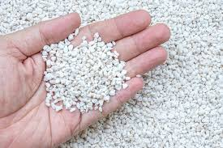
Rootstocks for various fruit trees: Myrobalan plum, Prunus Mariana, wild cherry. The various cuttings commonly taken are called "dry wood," i.e., during the dormant period when the leaves have fallen.
However, cuttings of semi-lignified and deciduous herbaceous branches can be taken during the growing season for certain fruit species such as olive, peach, pear, etc.
To accelerate rooting, you can use rooting hormones (butormone or rhizopon, chryzotec, rootone, etc.). These plant hormones can be applied in solution to the base of the cutting or in powder form.
Different types of cuttings: During the winter period, the following cuttings are taken:
▪ Simple cutting: a 20-30 cm branch fragment.
▪ Heel cutting:
the cut branch is split off from its supporting branch, simply refreshingthe 2-year-old wood fragment.

Slide 24
Fruit Trees
A fruit tree is composed of a rootstock and a variety (scion).In a few rare cases, the variety grows on its own roots: mirabelle plums, greengage plums. The production of fruit plants therefore includes the propagation of the rootstock, the propagation of the variety from which the scions are taken, and the assembly of these two elements by budding or grafting.
Application: Cuttings are not only suitable for fruit varieties, which are capable of developing roots. Their use is common for propagating olive, pomegranate, fig, grapevines, as well as table grape varieties.

Slide 25
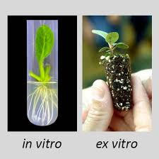
Micro-cuttingThis is a relatively new technique that is improving and showing great promise. It sobjectives are to solve the problems of reproduction and production costs of fruit plants, as well as to quickly meet professional requirements.This in vitro vegetative propagation can be achieved using three methods:
▪ Somatic embryogenesis: (from embryonic tissue).
▪ Independent neoformation: of buds and roots, from clas (undifferentiated cell mass) organogenesis.
▪ Culture of buds and apical (terminal) or auxiliary meristems.
Advantages Micro cuttings have the following advantages:
Rapid multiplication in a small space and in large numbers of rootstocks, new varieties, and species that are difficult to propagate using conventional methods (cuttings, layering, and grafting). One of the most illustrative examples is the date palm, which produces only 30 to 40 shoots in 10 years. This number can reach 100,000 plants when fragments are taken from the heart of young shoots and used on a suitable artificial nutrient medium.➢ Meristem culture allows the regeneration of plants free from mycoplasma, "parasites + viruses," and viruses. It is also used to control fungal and bacterial diseases of the vine.

Slide 26
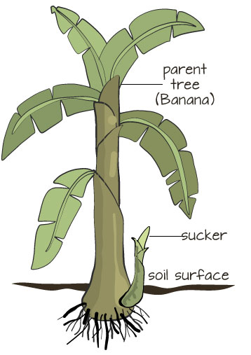
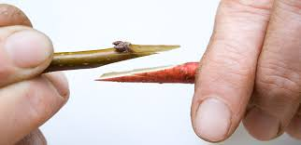
I SuckeringThis involves separating newly formed buds from their parent plant when they have reacheda certain diameter for permanent planting. Many fruit species (plum, cherry, hazelnut, raspberry, etc.) have the particularity of producingsuckers from the adventitious buds on the roots that appearsome distances from the parent plant.
Grafting Definition: Grafting involves inserting a portion of the "scion" branch representingthe vegetative part of the plant to be propagated into a young plant (subject or rootstock)representing the root part.
Once grafted, the two fused organs form a single individual withgreat potential:✓ The grafted part represents the propagated variety and possesses all its qualities.✓
The underground part belongs to the individual, which ensures its ability to anchor itself to the soiland a vigor determined by the choice of rootstock.

Slide 27
Layering Definition: Consists of cutting back young shoots from the mother plant, in order to encourage their rooting and then separating them (weaning) from their mother plants when they have become well-rooted. The roots actually form in the places that should have produced buds. Application: Layering is only applied to fruit species with sufficiently long, supple, flexible shoots that can be inclined towards the ground.

Slide 28
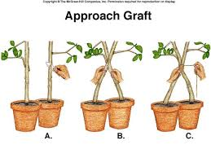
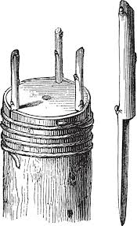
Different grafting methods
Approach grafts: these aim to join together two parts of plants that have not been detached from their original rootstock, without any loss of nutrition while awaiting the graft's establishment.
Crown Grafting is for large, strong trees (over 6 cm in diameter) that cannot be cleft or inset grafted. It is essential that the tree be well-saped and that the bark peels off easily.The tree is prepared 3 to 4 weeks in advance and then cut back with a handsaw to 10 cm above the soil surface. At the time of grafting, the tree's wound is refreshed with a pruning knife, then its bark splits lengthwise about 3 cm in length.

Slide 29
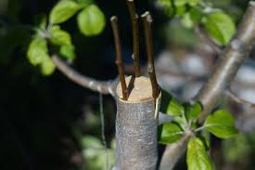
Underbark side grafting or underbark grafting
This involves placing grafts laterally under the bark of the main branches. The grafts can be young twigs or fruit buds.

Slide 30
Bud grafting
This is very important; bud grafting is responsible for 90% of our fruit trees (scion) and is the most practical method due to:
✓ Its wide range of possibilities
✓ Its rapid execution
✓ Its almost guaranteed success rate: around 90-95%. A skilled grafter can perform 1000 grafts, resulting in the smallest wound. This method is essential for trees whose tissues deteriorate easily (stone fruit trees).

Slide 31
2.2. Setting up a plant material propagation chain
involves preparing the plant material, choosing and preparing a propagation environment with the right tools, and providing consistent aftercare for the developing plants. Key steps include taking cuttings or seeds, placing them in a suitable growing medium, controlling temperature and humidity, and ensuring adequate light and moisture as they grow into new plants.

Slide 32
1. Prepare the propagation environment
Set up a dedicated space:
This could be a room, a greenhouse, or a propagation box, with access to water and light.
Ensure proper lighting:
Use artificial grow lights if natural light is insufficient, keeping them at a distance that provides enough energy without burning the plants.
Control the temperature:
Maintain a consistent temperature
Manage humidity:
Use a humidity dome, a plastic bag, or a propagation bin to maintain high humidity, which is crucial for cuttings

Slide 33
2. Prepare the plant material and medium
Take cuttings or seeds:
Use healthy cuttings from new growth, or sow seeds according to their specific needs.
Use a suitable growing medium:
A well-draining mix is essential. Consider using a blend of components like sphagnum moss, perlite, pumice, or sand.
Plant the cuttings:
After taking a cutting, remove the lower leaves and place the cutting in the prepared medium, ensuring the node is covered.
Label everything:
Label each container with the plant's name and date to keep track of your progress.

Slide 34
3. Provide aftercare and maintenance
Maintain moisture:
Keep the medium moist but not waterlogged. Misting the cuttings can also be beneficial.
Monitor regularly:
Check daily for temperature fluctuations, water levels, and seedling emergence.
Provide nutrients:
Once roots and new growth appear, start adding nutrients to the growing medium.
Acclimate new plants:
Once roots are established, gradually acclimate the new plants to the outside environment if they were started indoors.
Ensure hygiene:
Maintain hygiene and biosecurity throughout the process to prevent diseases

Slide 35
2.3. Steps in the propagation chain for high-quality plant material
The propagation chain for high-quality plant material involves selecting superior parent plants, preparing propagation material, using a suitable propagation method like cuttings or grafting, managing the environment for rooting and growth, and maintaining plant health through proper care.
Key steps include choosing healthy stock, preparing the media, inserting the material, controlling environmental factors like moisture, temperature, and light, and providing aftercare like nutrition and pest control.

Slide 36
1. Stock plant and material selection
Select superior parents:
Choose healthy, disease-free parent plants or "plus trees" that have the desired traits for your propagation.
Collect high-quality material:
Harvest seeds from ripe fruit or collect cuttings from healthy stems at the right time for the species.
Properly handle material:
Process seeds or cuttings carefully to avoid damage that could reduce viability.

Slide 37
2. Preparation
Sterilize and prepare media:
Sterilize any growing media to prevent disease, and mix in necessary nutrients or other chemicals.
Prepare the propagation environment:
Set up the area for your chosen method, whether it's a greenhouse, a misting bench, or a container for cuttings.
Process cuttings:
For cuttings, remove lower leaves, and consider using rooting hormones to encourage root development.

Slide 38
3. Propagation method
Choose a technique:
Select an appropriate method such as cuttings, grafting, layering, or tissue culture based on the plant type and desired outcome.
Insert material:
Place the prepared cuttings, grafts, or other material into the prepared media according to the specific technique.
4. Rooting and growth management
Control the environment:
Manage moisture, temperature, and light to create ideal conditions for rooting and growth. High humidity is often critical in the initial stages.
Adjust to stages:
Adapt environmental controls as the plant moves through different rooting stages, such as initial callusing to full root development.

Slide 39
5. Aftercare and health management
Provide nutrition:
Begin to provide proper nutrition as the plant establishes roots and begins to grow.
Control pests and diseases:
Monitor for pests and diseases and take appropriate action to prevent them from spreading and damaging the new plants.
Manage weeds:
Keep the area free of weeds, which compete with the new plants for resources.

Slide 40
Advantages
Precocity: The ability to induce fruitfulness without the need for completing the juvenile phase. Grafting of mature scions onto rootstocks can result in fruiting in as little as two years.
Dwarfing: To induce dwarfing or cold tolerance or other characteristics to the scion. Most apple trees in modern orchards are grafted on to dwarf or semi-dwarf trees planted at high density. They provide more fruit per unit of land, of higher quality. Care must be taken when planting dwarf or semi-dwarf trees. If such a tree is planted with the graft below the soil, then the scion portion can also grow roots and the tree will still grow to its standard size.
Ease of propagation:^{[3]} Because the scion is difficult to propagate vegetatively by other means, such as by cuttings. In this case, cuttings of an easily rooted plant are used to provide a rootstock. In some cases, the scion may be easily propagated, but grafting may still be used because it is commercially the most cost-effective way of raising a particular type of plant.

Slide 41
Hybrid breeding: To speed maturity of hybrids in fruit tree breeding programs. Hybrid seedlings may take ten or more years to flower and fruit on their own roots. Grafting can reduce the time to flowering and shorten the breeding program.
Hardiness: Because the scion has weak roots or the roots of the stock plants are tolerant of difficult conditions.

Slide 42
Disease/pest resistance: In areas where soil-borne pests or pathogens would prevent the successful planting of the desired cultivar, the use of pest/disease tolerant rootstocks allow the production from the cultivar that would be otherwise unsuccessful.
Pollen source: To provide pollenizers.
Repair: To repair damage to the trunk of a tree that would prohibit nutrient flow, such as stripping of the bark by rodents that completely girdles the trunk. In this case a bridge graft may be used to connect tissues receiving flow from the roots to tissues above the damage that have been severed from the flow.
Changing cultivars: To change the cultivar in a fruit orchard to a more profitable cultivar, called top working. It may be faster to graft a new cultivar onto existing limbs of established trees than to replant an entire orchard.
Genetic consistency: Apples are notorious for their genetic variability, even differing in multiple characteristics, such as, size, color, and flavor, of fruits located on the same tree. In the commercial farming industry, consistency is maintained by grafting a scion with desired fruit traits onto a hardy stock.
Fixation of anomalies and mutations appearing in a fruit variety, which areoften of interest, thus increasing the number of varieties andalso improving the quality of existing ones (size, flavor, and organoleptic properties).

Slide 43
Tools
Other methods include adhesive rubber bands and plastic ties, which are used in various forms. There are also "flexi-band" rubber strips sold in different lengths and widths. These elastic strips have the advantage of drying out asthe graft diameter grows, becoming brittle, and then breaking under the combined action of sun and wind.• Glues: or putties are used to cover wounds and protect them
Grafting Equipment
Grafting tools: For all grafting, it is essential to obtain the following set of tools:
A handsaw: Used to top large plants; after use, the cut is freshened with a pruning knife.
A pruning knife: To cover wounds (clean and apply sealant) – top smaller plants – make clefts and remove miters.
• A grafting knife: It must have a very sharp blade and a spatula for removing bark.
• A hardwood wedge (boxwood): To prepare the plant for cleft grafting.
• A mallet: a wooden hammer to drive the wedge in.
• A ladder
• Ligatures: the most common ligature is made from the raffia palm.
.

Slide 44
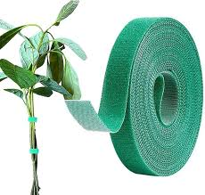
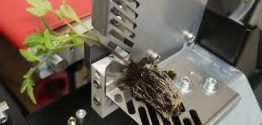
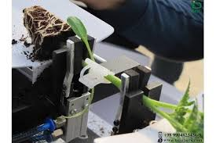
Tying and support materials: Adds support and pressure to the grafting site to hold the stock and scion together before the tissues join, which is especially important in herbaceous grafting. The employed material is often dampened before use to help protect the site from desiccation. Support equipment includes strips made from various substances, twine, nails, and splints.
Grafting machines: Because grafting can take a lot of time and skill, grafting machines have been created. Automation is particularly popular for seedling grafting in countries such as Japan and Korea where farming land is both limited and used intensively. Certain machines can graft 800 seedlings /hr.^{[6]: 496}

Slide 45
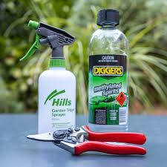
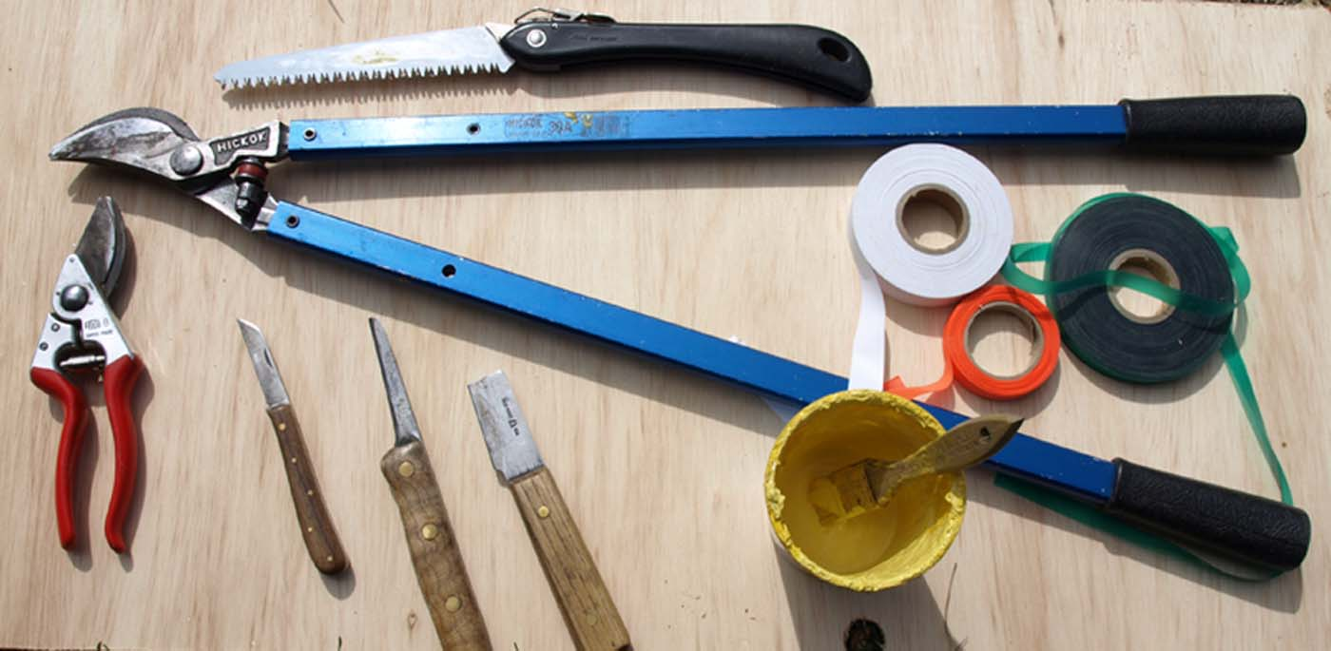
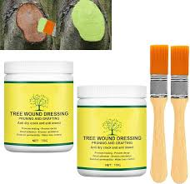
Cutting tools: It is a good procedure to keep the cutting tool sharp to minimize tissue damage and clean from dirt and other substances to avoid the spread of disease. A good knife for general grafting should have a blade and handle length of about 3 inches and 4 inches respectively. Specialized knives for grafting include bud-grafting knives, surgical knives, and pruning knives. Cleavers, chisels, and saws are utilized when the stock is too large to be cut otherwise.
Disinfecting tools: Treating the cutting tools with disinfectants ensures the grafting site is clear of pathogens. The most commonly used sterilizing agent is alcohol.
Graft seals: Keeps the grafting site hydrated. Good seals should be tight enough to retain moisture while, at the same time, loose enough to accommodate plant growth. Includes specialized types of clay, wax, petroleum jelly, and adhesive tape.

Slide 46
Cultivated plants propagated by grafting
  Apple – grafting
  Avocado – grafting
  Conifer - stem cuttings, grafting
  Citrus (lemon, orange, grapefruit, Tangerine, dayap) – grafting
  Grapes – stem cuttings, grafting, aerial layering
  Kumquat – stem cutting, grafting
  Mango- grafting, budding
  Maple – stem cuttings, grafting
  Nut crops (walnut, pecan) – grafting
  Peach – grafting
  Pear – grafting
  Rubber Plant - bud grafting
  Rose - grafting

Slide 47
4. Production in open-field nurseries
4.1. Setting up an open-field nursery
4.2. Seed selection
4.3. Sowing
4.4. Grafting fruit trees and vines

Slide 48
A nursery is an area where seedlings are produced or seeds are sown and seedlings are raised for the purpose of planting out for afforestation and reforestation purposes.
2. Based on water availability
Dry nursery: It is a type of nursery in which a permanent facility for irrigation or artificial watering does not exist.
b) Wet nursery: It is an irrigated nursery with a permanent source of water during the drier periods. Once the nursery area is identified and selected, proper planning is essential to establish the nursery. A nursery should have all infrastructures to support quality seedling production.
Types of Nursery
Based on the need and the management requirement, nurseries are classified into the following types
1. Based on longevity/duration of operation
Temporary nurseries:
• A nursery is said to be a temporary nursery when it is set up for a specific period and to fulfill the seedling requirements of a smaller area.
• The seedlings produced are used for gap-filling or causality replacement and supplementing planting stock.
b) Permanent nurseries: It is a nursery that is maintained for supplying nursery stock for a long time permanently.

Slide 49
Essential Requirements of a Nursery
Fig : Layout of a Nursery

Slide 50
Essential Requirements of a Nursery
1. Protection fence: The nursery area should be protected from the entry of cattle and intruders and also from heavy wind. For this, a chain link fence and a row of trees all around the nursery should be established.
2. Office: An office should be established for administrative purposes besides maintaining the records and stock registers.
3. Store: A store room for storing nursery tools, chemicals, fertilizers, polythene bags, etc. is very essential.
4. Storage Yard: Nursery potting mixtures like compost, topsoil, sand, etc. need a storage facility and hence a nursery storage yard is very essential.
5. Water source: To cater the water requirement of the nursery, sufficient bore wells and water tanks (both underground and overhead) are required.
6. Mist chamber: For mass multiplication and efficient rooting of clones, an organized mist chamber is essential

Slide 51
7. Hardening chamber: The propagated plants from the mist chamber need proper hardening and hence a hardening chamber of required size and capacity needs to be established.
8. Working space: Sufficient working space is required for preparing cuttings and grafting before they are placed inside the mist chamber.
9. Waste pit and compost yard: To dump unwanted materials and prepare compost for use in the nursery.
10. Green house: Provides controlled temperature, irrigation, humidity and light conditions for better plant growth. It protects seedlings from an adverse environment.
11. Shade/Net house: The main purpose is to grow plants under protection from birds, insects, animals and human beings.
12. Labour Shed/Maali Hut
13. Inspection path.
14. Motorable road: For transporting nursery materials like soil, sand, FYM, etc. for raising the nursery and for easy lifting of seedlings from the nursery to the planting site.
15. Entry gate: The entrance should be provided with a strong lockable iron gate.

Slide 52
Criteria for Site Selection

Slide 53
2.2 Site Preparation
• The site should be cleared properly by removing all the stumps, boulders, roots, grasses and large pebbles.
• The soil should be ploughed to a depth of about 30cm.
• Removal of topsoil should be avoided.
• The drainage channel should be dug as early as possible to avoid erosion.
• In plains, drainage should be adequately sloped to check the water flow.
• Mixing of soil with well-decomposed farmyard manure is necessary for getting the correct texture.
• Paths between the nursery beds can be 0.5m wide for human movement.
• Beds should be separated from the main path for vehicles.

Slide 54
Size of Nursery Beds
The size of the nursery bed varies from species to species and locality to locality. After the soil preparation, the seed beds are prepared for the sowing of the seed.
• The seed bed should be rectangular.
• The standard size of the bed is 12m × 1.2m (in plains)
• The width of the bed should not be more than 1.2m
• The bed should be in an east-west direction in the plains.
• The beds should be filled with soil: sand: FYM in the ratio of 1:1:1.
• The medium composed of soil: sand: compost in equal proportions produced the tallest and thickest seedlings (Bana et al.,1996)
• The various methods that can increase the physical, chemical and biological
properties of the soil are:
✓ Mixing well with decomposed FYM
✓ Addition of humus/surface soil of the forest
✓ Addition of compost
✓ Use of fertilizers
✓ Green manuring.

Slide 55
2.4 Types of Nursery Beds
Raised bed:
• Prepared in high rainfall areas.
• Beds are raised 15cm above the ground to increase drainage.
• Beds are given side support using bamboo, twigs, bricks, etc.
• Good for the seeds which do not require much moisture.
Sunken bed:
• Prepared in drier/arid areas to conserve moisture.
• Nursery beds are 10-15cm deeper than the normal ground level.
• Prevents outflow of rain water and reduces the rate of evaporation.
• Seeds with hard seed coat are sown in such beds.
Based on the plants growing on the beds, nursery beds are classified into:
a) Germination bed: Beds in which seeds are sown to raise seedlings.
b) Transplant bed: Seedlings from the germination beds are transplanted after germination takes place for further growth and development.
c) Storage beds: These beds are used for storing poly pots after seedlings have been pricked out into them from germination beds or trays.

Slide 56
Growing media
There are different growing media that are being used for plant/ seedling propagation.
Growing media is a combination of different materials. Better growing media produces
good-quality seedlings that have a good survival rate.
Quantity of Seeds Required
The requirement of seeds of a particular species should be worked well in advance and
procured or collected at the time of fruiting and kept ready for sowing.
The seed weight, size of beds, spacing and plant percent are the factors for calculating
the number of seeds to be sown in nursery beds.
Where, The formula is: W= A×D×100
P×N
W= Weight of seeds required in grams
A = Area of nursery bed in square meters
D = Number of plants needed per m2
P = Plant percent of the species
N = Number of seeds per gram.

Slide 57
Time of Sowing
The time of Sowing depends on:
• Time of seed ripening
• The growth rate of species
• Size of plants for transplanting
• The climatic condition of the locality
Methods of Sowing
Broadcasting:
• Seeds are spread uniformly over the mother bed and covered to the thickness of the smallest diameter of the seed.
• Usually used for small seeds (Eucalyptus), light seeds and seeds with poor germination percentage.

Slide 58
Short viable seeds : Should be sown immediately
Long viable seeds : When the temperature is moderate i.e. between September to October or between February to March
For small seedlings: Sowing time: Spring
Transplanting: Rainy Season
For tall seedlings /stumps: Sowing time: Rainy Season
B. Line Sowing:
• To prevent overcrowding of seedlings.
• To produce healthy seedlings.
• Mainly used in case of those seedlings which are directly taken out from the
mother bed to the main field.
• Lines are drawn on the mother bed and seeds are sown in these lines and covered
with soil.
• For seedlings that are to be transplanted, the line distance is close when compared to
those which is taken directly for out planting from the mother bed.
• Recommended for the species having high germination percentage.
Fig.: Line Sowing

Slide 59
C. Dibbling
• Adopted for bigger-sized seeds with high germination percentage.
• In the case of seeds with low germination, seeds are dibbled with an increased number per drill.
• Seeds are sown into the containers by making a hole to a depth of one centimeter.
• Seeds dibbled at greater depth will have delayed germination / be killed due to lack of water or air.

Slide 60
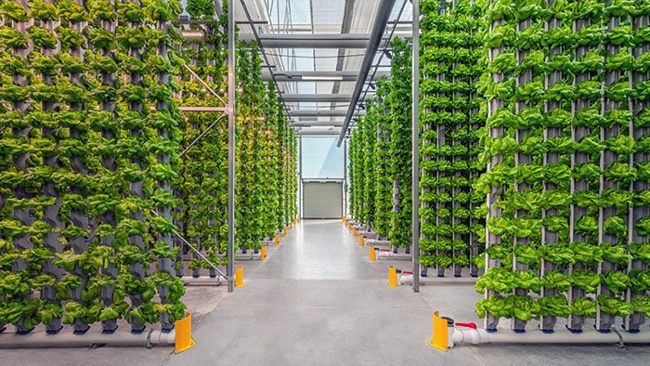
Chapter 5: Production in above-ground nurseries
Hydroponics is a type of horticulture and a subset of hydroculture which involves growing plants, usually crops or medicinal plants, without soil, by using water-based mineral nutrient solutions in an artificial environment. Terrestrial or aquatic plants may grow freely with their roots exposed to the nutritious liquid or the roots may be mechanically supported by an inert medium such as perlite, gravel, or other substrates.

Slide 61
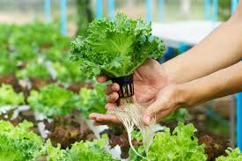
Despite inert media, roots can cause changes of the rhizosphere pH and root exudates can affect rhizosphere biology and physiological balance of the nutrient solution when secondary metabolites are produced in plants. Transgenic plants grown hydroponically allow the release of pharmaceutical proteins as part of the root exudate into the hydroponic medium.
The nutrients used in hydroponic systems can come from many different organic or inorganic sources, including fish excrement, duck manure, purchased chemical fertilizers, or artificial standard or hybrid nutrient solutions.

Slide 62
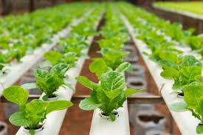
In contrast to field cultivation, plants are commonly grown hydroponically in a greenhouse or contained environment on inert media, adapted to the controlled-environment agriculture (CEA) process. Plants commonly grown hydroponically include tomatoes, peppers, cucumbers, strawberries, lettuces, and cannabis, usually for commercial use, as well as Arabidopsis thaliana, which serves as a model organism in plant science and genetics.

Slide 63
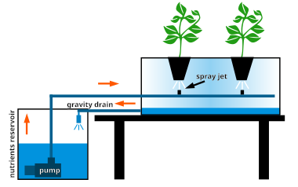
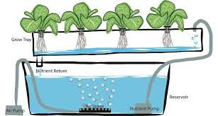
Techniques
Hydroponic systems typically fall into two irrigation categories: sub-irrigation systems, where nutrient solution is supplied from below and roots absorb moisture upward (e.g., deep water culture, ebb-and-flow), and top-irrigation systems, where nutrient solution is applied from above through drip emitters or sprayers (e.g., nutrient film technique, aeroponics).[
Hydroponic systems typically fall into two irrigation categories: sub-irrigation systems, where nutrient solution is supplied from below and roots absorb moisture upward (e.g., deep water culture, ebb-and-flow), and top-irrigation systems, where nutrient solution is applied from above through drip emitters or sprayers (e.g., nutrient film technique, aeroponics).[

Slide 64
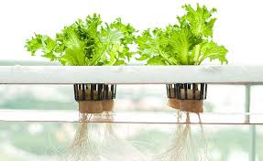
Advantages
Space optimization: Vertical farming and advanced control technologies maximize the use of limited spaces.
Resource management: Reduced water and fertilizer consumption through the recycling of nutrient solutions.
Protection for sensitive species: Controlled conditions shield plants from climatic extremes, pests, and diseases.
Hydrozones lie at the intersection of urban agriculture innovations, environmental concerns, and biodiversity conservation efforts. Notable examples include specialized botanical gardens, cultivation facilities for threatened endemic species, and domestic spaces for advanced horticulture enthusiasts.

Slide 65
Chapter 6: Inspection and certification of plants and seeds
6.1. Purpose of inspection and certification
6.2. Definition
6.3. Status of plant material
6.4. Approvals
6.5. Inspection

Slide 66
6.1. Purpose of inspection and certification
To be marketed, seeds and plants of the main varieties of field crops are subject to product certification.
This certification is mandatory and official. It is implemented by the public authorities of each Member State.
the Ministry of Agriculture has delegated to the Directorate of Quality and Official Control the public service mission relating to seed quality control and certification, as well as the delegation for the implementation of phytosanitary legislation for seeds and plants.
For most agricultural species (cereals, maize, sugar beets, oilseeds, potatoes, forage crops, etc.), the certification of seeds or plants intended for marketing. It comprises three aspects:

Slide 67
Varietal certification, which covers varietal identity and purity, is based on verifying seed lineage, rules concerning propagation plots, and crop inspections.
Technological certification guarantees the specific purity and germination capacity of seeds. These quality criteria are verified by analyses carried out according to international standards (see ISTA's international rules for seed testing).
Sanitary certification guarantees the absence or minimal presence of harmful organisms. It is ensured through crop inspections and laboratory testing. Certification is formalized by affixing an official SOC-France label to each package of seeds or plants that meet the quality standards specific to the species. For vegetable species, certification is not mandatory. However, seeds and plants must comply with rules and standards and are subject to inspections before being placed on the market. We then speak of "standard" seeds and "CAC" (Community Agricultural Conformity) plants.

Slide 68


6.2. Definition
CCLS: stands for Coopérative des Céréales et des Légumes Secs, which translates to "Cooperative of Cereals and Dried Legumes". These are agricultural cooperatives that work with the Office Algérien Interprofessionnel des Céréales (OAIC) to support cereal and dried legume farmers by collecting national production, and processing, storing, distributing, and selling both domestically produced and imported grains and legumes. They are also involved in activities like seed treatment and providing agricultural inputs and services.

Slide 69
Inspection : A process of examining plants in their growing fields and harvested seeds to ensure they meet specific quality and health standards.
Key Activities:
  Conducting field checks at different stages of crop growth, such as pre-flowering and post-flowering.
  Supervising post-harvest stages, including cleaning and packaging.
  Sampling seeds for laboratory analysis.
  Verifying that the seed crop is grown from eligible source seed.
Certification :The formal process of officially verifying that a lot of seed or a plant meets the defined standards of the certification scheme.
Key Activities:
  Issuing a certificate after the inspection and testing phases are successfully completed.
  Ensuring that certified seeds are labeled with accurate information about the variety, purity, and germination rate.
  Maintaining the genetic integrity of a product through a standardized process.
A phytosanitary certificate is required for exporting plants and plant products, certifying they have been inspected and are considered free from pests according to the importing country's regulations.

Slide 70
How are controls carried out for the marketing of seeds and plants?
There are four types of controls:
In-company controls: Controls are carried out to establish a company's capacity to implement the marketing system(s) corresponding to the species or groups of species it intends to produce.In-field controlsControls are carried out in seed and plant propagation plots to verify species purity, identity, and varietal purity (99.97% for most agricultural species), the health of the plot, and compliance with production rules.
Batch controls: Harvested seeds are sorted at the factory and packaged. Samples from each batch of seeds are taken by inspectors from the Quality and authorized personnel, following a strict procedure using specific equipment. These samples are then analyzed to determine the technological value of the seeds.

Slide 71
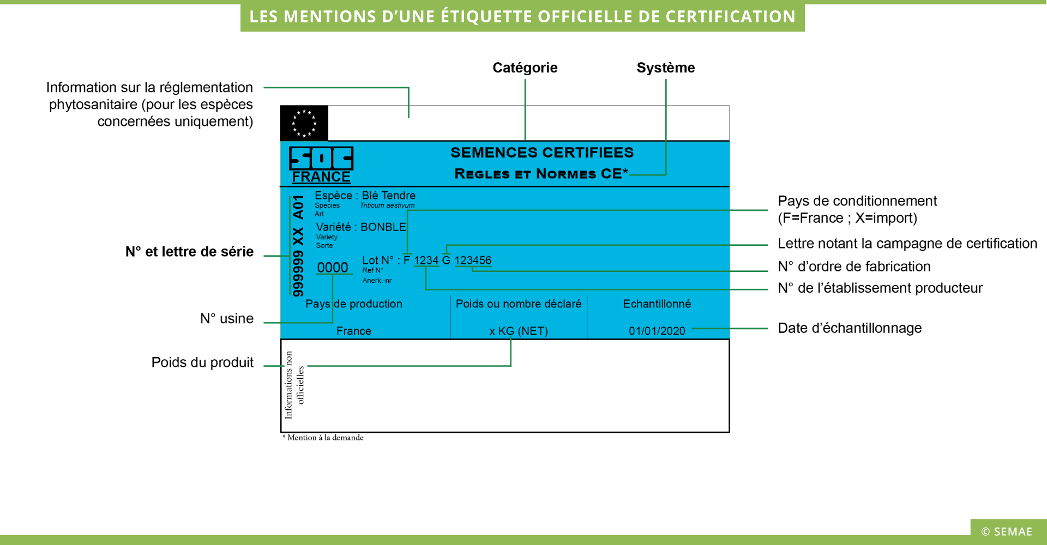
Certification analyses are carried out in a laboratory.
The laboratory determines germination rate, specific purity, the number of seeds of other species, and verifies the sanitary quality according to the species analyzed.
Each batch intended for sale is analyzed and must meet strict standards.
Marketing ControlsFraud prevention officers visit distributors to check compliance with marketing regulations, particularly regarding labeling.
They also conduct random sampling of seeds to verify that they meet the standards.

Slide 72
In Algeria, seed certification licenses are issued by the National Center for Seed and Plant Control and Certification (CNCC). To obtain a production license, a file must be submitted, including various documents, and proof of technical and land resources. The certification itself is carried out through physical and physiological quality control of the seeds by CNCC laboratories, which then affix an official label to the packaging before it is marketed.

Slide 73
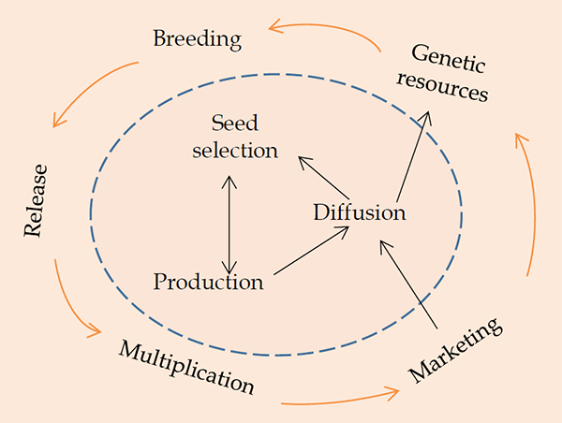
Seed systems are essential elements of broader food systems and are often criticized for performing poorly in Africa, particularly regarding securing affordable access for smallholder farmers to quality seeds in accordance with diverse demands and preferences [1,2]. Seed systems have developed in different directions across various African countries, with specific variations in terms of time and types of crops. As new food systems challenges emerge – related to issues such as climate change, healthy diets, and social inequalities – seed systems need to adapt to varying demands and expectations
Figure 1: Linkages between formal and informal seed systems. The blue circle frames the informal system and the arrows indicates seed and gene flow between the systems. Source: After Louwaars and de Boef (2012)

Slide 74
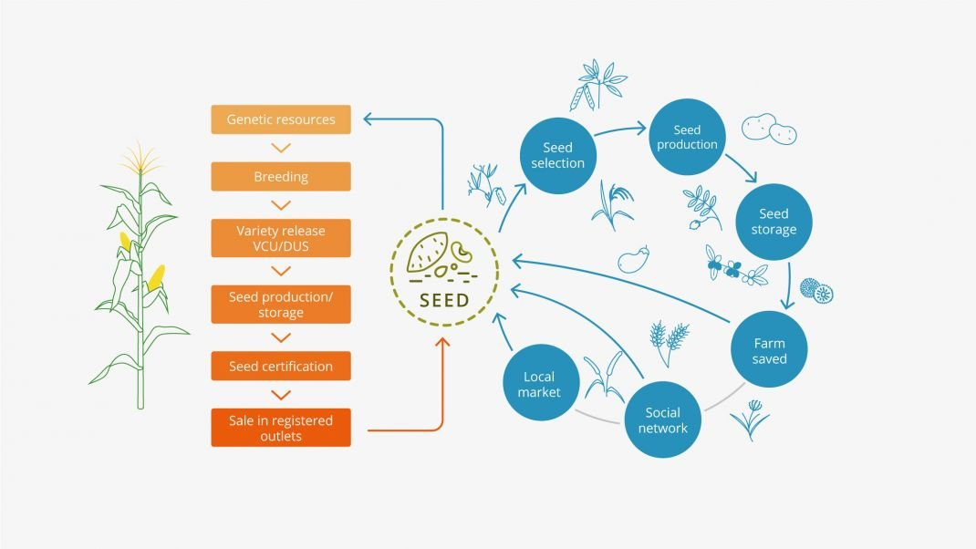
Figure 1 Seed System illustration. The formal system is depicted in orange and farmers’ seed systems in blue. Integrated seed delivery systems aim at harnessing the strengths of both formal and informal systems. Credit: Westengen, NMBU 2021.

Slide 75
Centre national de contrôle et certifTcation « CNCC )), son rôIe est de réaliser le contrôle relatif à la conformité de la variété multipliée, pureté vaùétale, existence de maladies au niveau des champs de multiplication (stades végétatif, maturité ou après épiaison, et au laboratoire). Après chaque contrôle, le CNCC délivre un certificat au producteur. Institut technique des grandes cultures « ITGC », son rôle est la production de semences de prébase et base. Multiplicateurs ou producteurs des semences certifiées (R1, R2 et R3). Ce sont des exploitations qui sont agrées par le CNCC, suite à une demande rédigée par l'exploitant.

Slide 76
Different categories of certified plant material
Starting material:This consists of plant material, originating directly from the breeder or maintainerafter registration in the Official Catalogue or on the provisional list, and recognized as authentic andhealthy.
b) Pre-basic material:This comes from the single-generation vegetative propagation of starting material.
c) Basic material:This comes from the single-generation vegetative propagation of pre-basic materialor starting material. It consists of plants from the timber yard and the seed bank.
d) Certified material:This consists of:
- Rootstock seeds harvested from seed trees;
- Rootstocks grown from certified seeds produced on seed trees;
- Cuttings taken from basic, pre-basic, or starting plants or trees;
- Grafted plants originating from basic or pre-basic or starting material.

Slide 77
7. Production scheme for certified plants
production scheme for certified plants involves a structured process of growing and maintaining plants under specific, monitored conditions to ensure their health and varietal purity, which is verified by an official certificate. The process typically requires plants to be of known lineage, grown in isolation to prevent contamination, and subject to rigorous pest and disease management and testing. Certification schemes can be broadly categorized as either certification (which traces back to individual, tested plants) or classification (which traces back to a population meeting certain standards).

Slide 78
The production scheme for certified plants in Algeria involves registration with the Ministry of Agriculture and Rural Development and the National Center for Control
and Certification of Seeds and Seedlings (CNCC), which oversees technical certification and controls. The process includes prior import authorization, on-site inspections,
and adherence to phytosanitary and phytotechnical rules for each certification stage. For imported plants, a specific import authorization must be obtained before shipping,
along with the correct documentation.
For domestic production
Registration: Seed and seedling producers must comply with the regulations set by the Ministry and the CNCC.
Planting and Isolation: Producers must adhere to rules for planting, varietal isolation, and purity.
Field Inspections: The CNCC conducts multiple inspections during the growth cycle to verify varietal authenticity, purity, and overall health.
Certification: After successful inspections, the CNCC issues a certificate for the certified plants.

Slide 79
For imported plants
Prior Import Authorization: Importers must obtain an import authorization from the Ministry's phytosanitary department at least 30 days before the planned import date.
Required Documentation: The following documents are necessary for import:
  Application for prior import authorization
  Pro-forma invoice detailing the product variety and origin
  Certificate of conformity for non-GMO materials
  Certification scheme and certificate from the official service in the country of origin
  Certificate of origin
Phytosanitary Controls: Imported plants are subject to phytosanitary controls upon arrival to ensure compliance with Algerian regulations.
Key authorities
Ministry of Agriculture and Rural Development (MADR): The overarching authority responsible for regulations and technical authorizations.
National Center for Control and Certification of Seeds and Seedlings (CNCC): The main body that carries out technical controls and certification for domestic production.

Slide 80
Registration Procedures and Responsible Bodies for Cereals(3 points)
a. Stage before registrationBefore being registered, the ITGC submits 20 kg of seeds and 200 ears of the candidate variety to the National Control and Certification Center (CNCC), along with its duly completed dossier (origin, pedigree, adaptation zone, etc.) in duplicate.The candidate variety must have a specific name and must be:Distinct, homogeneous, and stable.Demonstrate agronomic and technological value.Undergo DUS and VAT tests by the CNCC in five different agroecological zones during two successive growing cycles.Submit to the Technical Registration Council (CTH), which will then propose it for registration in the official catalog.b. Stage after registrationAfter registration, the seeds of the new
b. Post-Registration StageAfter registration, the seeds of the new varieties are maintained and multipliedthrough several generations from the original ears obtained by the breeders, toprepare the introduction of the new variety into the seed production process.6. Admission Criteria for Producing Seeds of theapple (tdgS2 Vts)-Produce in a favorable geographical area approved by the CNCC.-Conduct a pre-cultivation field each year following a protocol established by the ENCC;-Have storage capacity in appropriate warehouses, sorting equipment, and the necessary packaging for the activity;-Have qualified technical supervision with at least one agent per unit

Slide 81
7.4. Inspection of vinewood and vine plant production
Physical and visual inspection
Plant quality: Vines should be uniform in size, with a good graft union, no scars or damaged buds, and a healthy appearance.
Vigor: Avoid shriveled branches or vines with poor growth, as this can indicate low vigor.
Roots: Roots should be healthy, not excessively twisted, and show fibrous, cream-colored branch roots.
Shoots: Vines with excessively curvy shoots should be avoided as they can be difficult to train.
Diseases: Check for symptoms of specific diseases, especially trunk diseases like Phomopsis, and ensure the planting material isn't from a source with unknown disease history.
Laboratory testing
Tissue analysis (petiole testing):
  Purpose: To check the nutrient levels (like nitrogen, potassium, and magnesium) actually being absorbed by the plant.
  When to sample: Typically at bloom time or near the end of veraison.
  How to sample: Collect petioles (the leaf stem) from a specific number of healthy leaves from representative, uniform vines within a block. Discard any leaves with visible damage.
Virus testing:
  Purpose: To identify viral infections that may not be visible.
  Method: Use techniques like serological or molecular (e.g., PCR) tests to detect viruses such as leaf roll and GVA.
  Frequency: Source block inspections should occur after harvest, and regular testing (e.g., annually or every few years) is crucial.
Best practices
Source materials carefully: Only source planting materials from reputable nurseries and avoid using untested sources.
Ensure disease freedom: Prioritize plants that have been tested for freedom from harmful diseases and pathogens.
Inspect regularly: Perform visual inspections at appropriate times throughout the year, and conduct laboratory tests to get a comprehensive understanding of the plant's health and nutritional status.

Slide 82
7.5. Certified propagation material
" refers to plant material, such as seeds or cuttings, that has been officially verified to meet specific standards for quality, health, and identity. This certification ensures the material is free from pests and diseases, is genetically pure, and can be traced back to its source. Certification is a key component of best practices for nurseries and agricultural production, as seen in standards like those from Global GAP and the Organic Federation of Canada.
Key characteristics of certified propagation material
Health and quality: It is guaranteed to be free from pests, diseases, and contamination. Certification processes often involve rigorous inspection and testing to ensure a high standard of plant health.
Traceability: Each batch is clearly labeled and traceable to its origin, ensuring accountability and quality control throughout the production process.
Identity: The material is verified to be of a specific, correct type, preventing issues with misidentified or adulterated products.
Performance: Certification helps ensure consistent performance, which can lead to better yields and more reliable results for the end-user.
Compliance: Certified material adheres to specific production standards, such as those for organic production, which may involve documented use of specific substances and production methods.

Slide 83
Inspection and certification of mother plants
nspection and certification of mother plants involves a series of rigorous visual and laboratory checks to ensure plants are healthy, free from pests and diseases, and true to type. Certified plants meet specific standards for genetic purity and quality, with the process managed by government agencies or authorized bodies to guarantee the integrity of propagating material for commercial sale.
Key components of the process
Phytosanitary checks: Visual inspections and laboratory tests are conducted to detect the presence of viruses, fungi, bacteria, and nematodes.
Genetic checks: Visual inspections verify that the plants are genetically true to the specified variety and free from off-types.
Field inspections: Multiple on-site inspections are performed during the growing season to monitor plant health and characteristics.
Laboratory testing: Samples are taken for laboratory analysis, with the frequency depending on the plant and the potential pests being screened for.
Documentation: A comprehensive paper trail is maintained, including records of inspections, tests, and plant origin, which are subject to audits by certifying agencies.
Certification: Once a plant meets all the requirements, it is issued a certificate and a grade that is valid for a specific period.
Traceability: The certification process requires that the origin and production history of the material are meticulously documented and accessible for a set period.
Why inspection and certification are important
Farmer protection: It helps protect farmers from investing in unhealthy or misidentified plants that may result in poor yields.
Pest and disease control: Certification is a crucial tool for preventing the spread of pests and diseases that could devastate crops.
Quality assurance: It provides assurance of the genetic purity and overall quality of the planting material being sold to consumers.

Slide 84
Harvesting rootstocks
Harvesting rootstocks involves taking cuttings from healthy, virus-free parent plants, often in late fall or winter, and processing them for planting or storage. Layering is a method where roots are encouraged to form on a stem while it is still attached to the mother plant. Certification for rootstocks and cuttings ensures they meet specific standards, which includes inspection for pests and diseases, and that they originate from certified sources to guarantee the quality of the final propagated plant.
Harvesting and preparation
Rootstock cuttings: Harvest wood from virus-free parent blocks during the dormant season (e.g., November-December).
  Use current season's growth, about pencil diameter or 6–7 mm thick.
  Cut into 23 cm lengths, or other specified lengths, removing thorns and all but the top two buds ("de-eyeing").
  The basal ends can be dipped in rooting hormone to promote rooting and help with identification.
Cuttings (general): Prepare cuttings based on plant type (e.g., softwood, hardwood).
  Make a slanted cut just below a node and a horizontal cut above the top node, ensuring each cutting has 3–4 buds.
  Treat difficult-to-root species with growth regulators.
Layering: Roots are formed on a stem while still attached to the parent plant.
  Cover a portion of the stem with a growing medium to exclude light and stimulate root growth.
  Once roots have formed, the new plant is severed from the mother plant.

Slide 85
Certification
For certified plants: Rootstock used for grafting or budding must be of an equivalent or higher certification status.
Inspection: Certified plants are inspected by an official organization for symptoms of viruses or diseases. Any plants showing symptoms must be removed from the lot.
Source material: Certification requires that the original propagation stock is also of a certified standard.
Seed certification: For seeds, the harvested seeds from rootstock propagation stock are tested for seed-transmissible viruses and packed in sealed bags.
Planting and storage
Planting:
  Plant cuttings with at least two nodes in the soil, ensuring correct polarity (the part that was closest to the roots is planted downwards).
  Cuttings can be planted immediately after preparation.
Storage:
  If not to be planted immediately, cuttings can be stored in cold storage until planting.

Slide 86
Certifications for specific purposes
International Trade: A phytosanitary certificate is required for exporting plants. It verifies that a plant has been inspected and is free from specified pests and diseases, and meets the phytosanitary regulations of the importing country.
Plant-Based Food: The Certified Plant Based label verifies that a food product is free of animal-derived ingredients. This is a growing area of certification for consumer trust and transparency.
Industrial/Energy Efficiency: ENERGY STAR certified plants are manufacturing plants in North America that have achieved a high level of energy performance compared to similar facilities.
Horticulture/Agriculture: Certified fruit tree stock, like the WSDA certification, ensures that plants are grown from a lineage of virus-tested material and meet specific standards for propagation and health through a multi-generation process.

