Slide 1


Slide 2

People’s Democratic Republic of Algeria
Abdel hafid Bou Al-Souf University, Mila
Institute of Science and Technology
Tronc commun science and technology
Title:
Research of Ammonia (NH3)
Prepared by:
Under the supervision of Professor :
I.Mayouf
Soundous Baouta
Group : lmd 2
University year:2025/2026

Slide 3
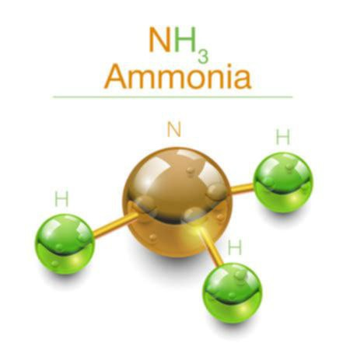
Research Plan :
1- Introductory .
2- Definition of the Ammonia compound .
3- Components and Structure of NH3 (Ammonia) .
4- Uses of Ammonia.
5- Importance of Ammonia.
6- Hazards of Ammonia.
7- Safety Measures when Handling Ammonia.
8- Conclusion.
9- Sources on Ammonia.

Slide 4
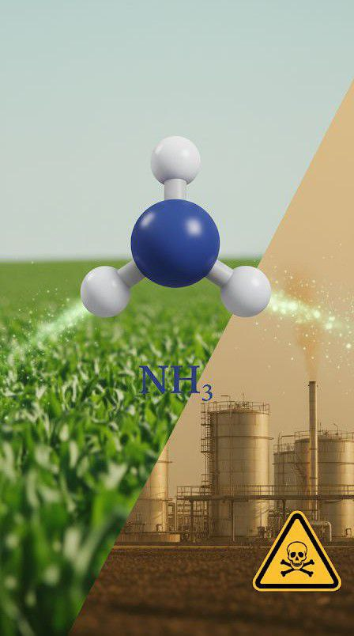
1- Introductory

Slide 5
1- Introductory
Ammonia is a simple molecule composed of nitrogen and hydrogen, but its impact is much greater than its structure. Its sharp smell quickly shows that it is a substance that must be handled carefully, as it can cause irritation and health problems when exposure is high. On the other hand, chemical industries and agriculture rely on it heavily, especially in producing fertilizers that support crops. This contrast between its importance and its risks makes NH3 a key topic for understanding its behavior and its effects on humans and the environment.

Slide 6
2- Definition of the NH3
Ammonia is a chemical compound composed of one nitrogen atom bonded to three hydrogen atoms, with the molecular formula NH3.
It usually exists as a gas and has a strong, distinctive smell. It is considered a weak base and is soluble in water, and it is widely used in the production of fertilizers and various chemical substances.

Slide 7
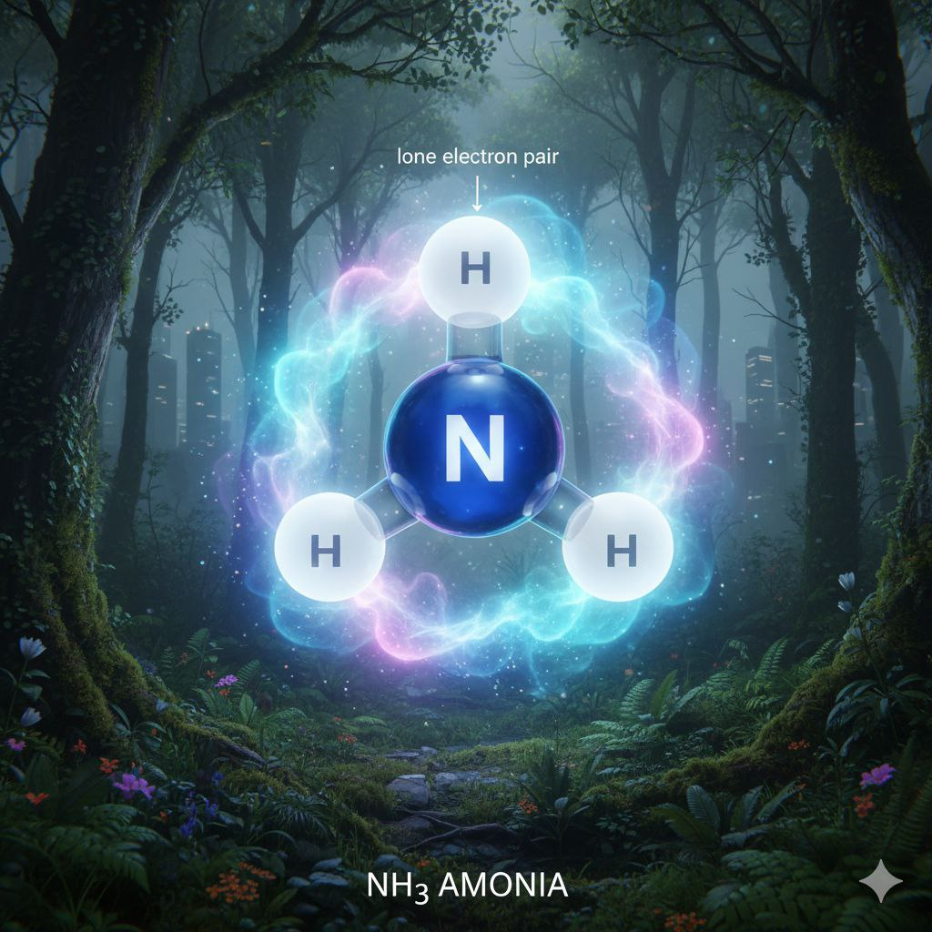
3-Components and Structure of NH3
Components: One nitrogen atom (N) and three hydrogen atoms (H).
Chemical/Molecular Structure: The molecular formula is NH3. It has a trigonal pyramidal structure, with the nitrogen atom at the apex bonded to three hydrogen atoms, and a lone electron pair on nitrogen giving the molecule its polarity.
Physical State: Gas at room temperature.
Chemical Properties: Weak base, soluble in water to form an alkaline solution known as ammonium hydroxide (NH4OH).

Slide 8
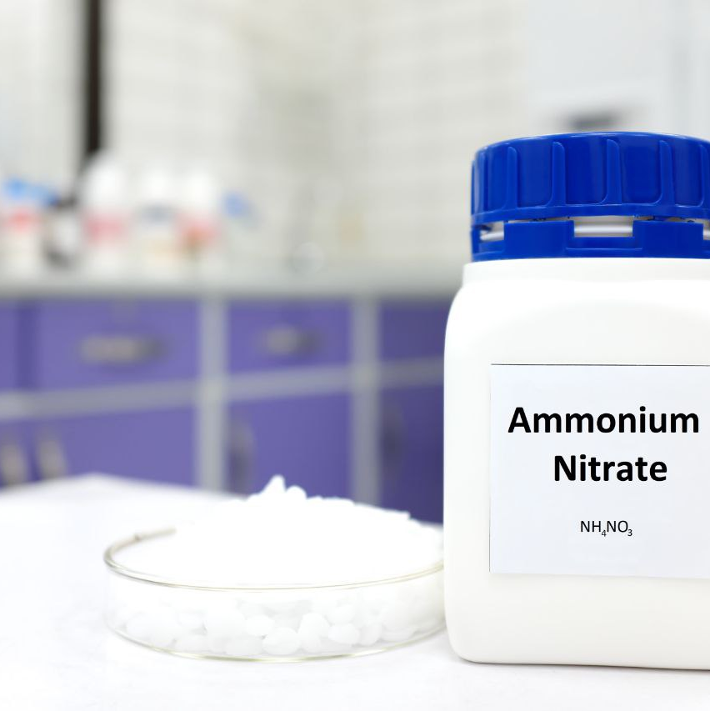
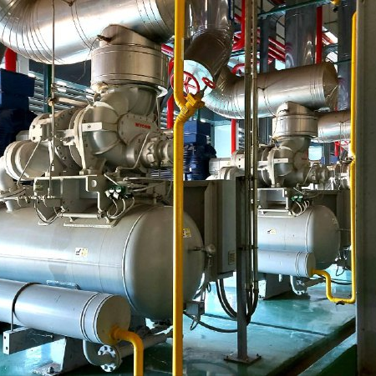
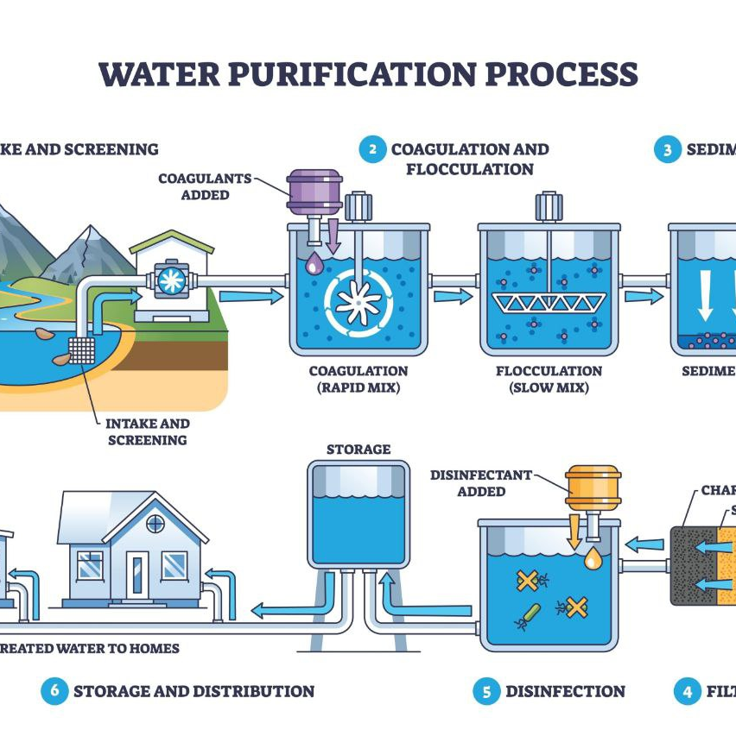
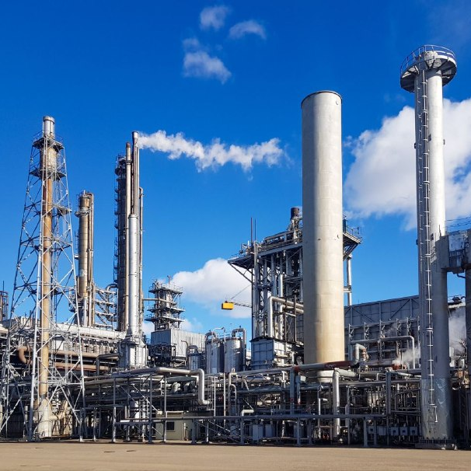
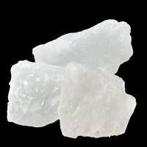

4-Uses of ammonia
Manufacturing explosives
Using it in refrigeration as a cooling gas in industrial air-conditioning systems
Using
it in water treatment to purify certain pollutants
Producing fertilizers to supply soil with the nitrogen necessary for plant growth
Producing dyes, detergents, and other chemical products
Manufacturing synthetic fibers and plastics

Slide 9
5-Importance of ammonia.
Essential for supporting agricultural
production through fertilizers
Vital for the chemical and petrochemical
industries to produce various materials
Must be handled carefully due to its
irritating and toxic properties
Helps improve the efficiency of certain
industrial processes, such as refrigeration
and water treatment
Has a significant economic impact on
agriculture and industry
Contributes to manufacturing industries
like textiles and plastics

Slide 10

6-Hazards of ammonia.
Ammonia is a highly reactive chemical that can cause severe irritation to the eyes, respiratory system, and skin upon direct exposure. Inhaling ammonia gas at high concentrations may lead to breathing difficulties and burns in the respiratory tract,and in severe cases, it can be life-threatening. Ammonia can also be flammable under certain conditions,increasing the risk of fires and explosions in industrial environments.

Slide 11

7-Safety Measures when Handling Ammonia.
>Wear personal protective equipment such as gloves, safety goggles, and appropriate masks.
>Handle ammonia in well-ventilated areas.
>Store ammonia away from heat sources, flames, or flammable materials.
>Use ammonia leak detection devices in industrial settings.
>Follow emergency procedures and provide first aid in case of exposure.

Slide 12
8- Conclusion.
Ammonia is a compound with a pivotal role in industrial and agricultural life, from fertilizer production to various chemical applications. Its economic and scientific importance is significant, yet it carries risks due to its irritating and flammable properties. Therefore, understanding how to use it, controlling its hazards, and following proper safety measures are essential to benefit from it safely while protecting humans and the environment.

Slide 13
9-Sources on Ammonia.
1.Zumdahl, Steven S., Chemical Principles, 8th Edition, Cengage Learning, 2021.
2.Greenwood, N.N. & Earnshaw, A., Chemistry of the Elements, 2nd Edition, Butterworth-Heinemann, 2012.
3.Greenwood, N.N. & Earnshaw, A., Inorganic Chemistry, 3rd Edition, Elsevier, 2002.
4.National Center for Biotechnology Information (NCBI) – PubChem: Ammonia (NH3).
5.World Health Organization (WHO), Ammonia: Environmental Health Criteria, 2000.
6.U.S. Environmental Protection Agency (EPA), Ammonia Factsheet: EPA Ammonia Information.
7.House, James E., Inorganic Chemistry, 4th Edition, Academic Press, 2016.

Slide 14
“Thank you for your attention
Any questions”

