Slide 1


بسم الله الرحمن الرحيم

Slide 2

People’s Democratic Republique of Algeria
Ministry of Higher Education and Scientific Research
Abdelhafid Boussouf University –Mila
Institute of Science and Technology
Department of Process Engineering
Academic year: 2025/2026
The phosphoric Acid
Name:Beloucif Saoussene
Under the supervision of Dr.I.Mayouf

Slide 3
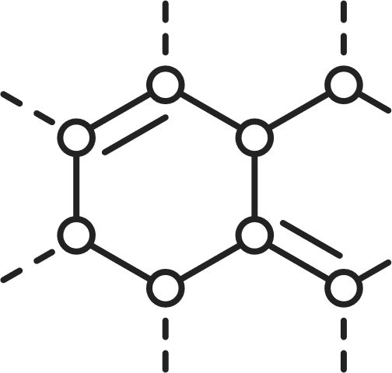

Overview
DEFINITION
Structural Formation
Compounds of H3PO4
Industrial Uses
Safety Precautions
Conclusion
Mineral Chemistry
H3PO4

Slide 4


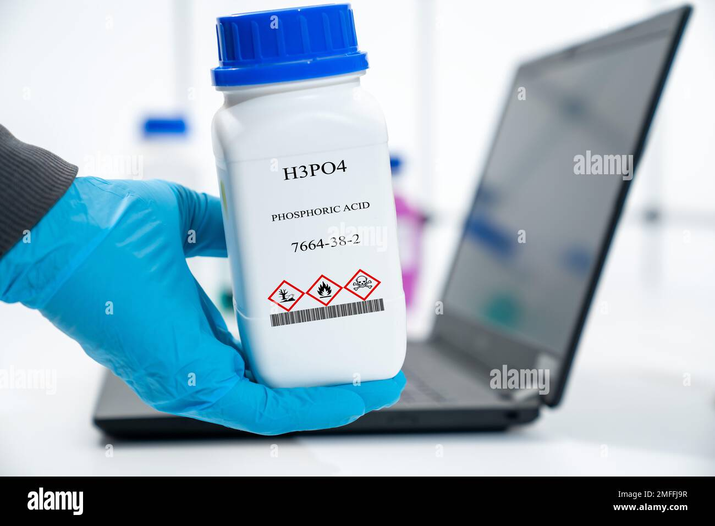
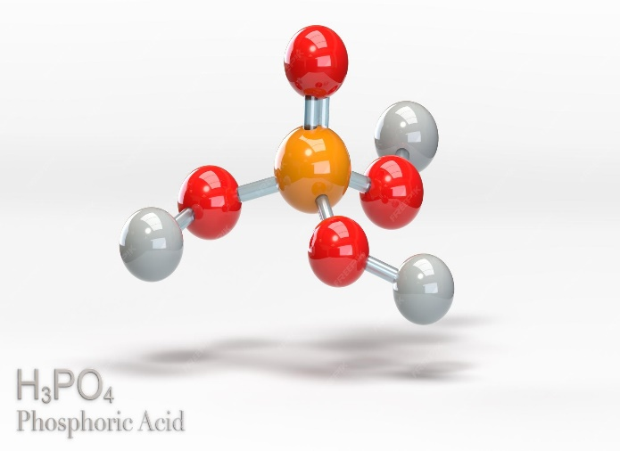

Mineral Chemistry
1.DEFINITION
Phosphoric acid, with the chemical formula H₃PO₄ and molar mass of 98 g/mol ,is an inorganic acid one of the most widely used acids in industry due to its moderate acidity and versatility. It is a weak, triprotic acid,. In its pure form. H3PO4 is a colorless, odorless, syrupy liquid that is highly soluble in water.
H3PO4

Slide 5

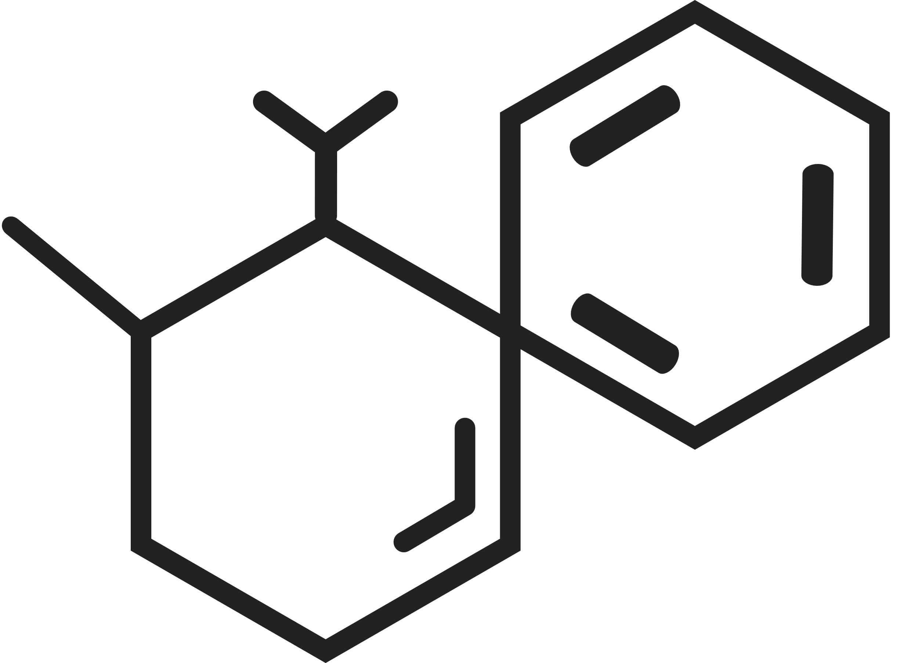
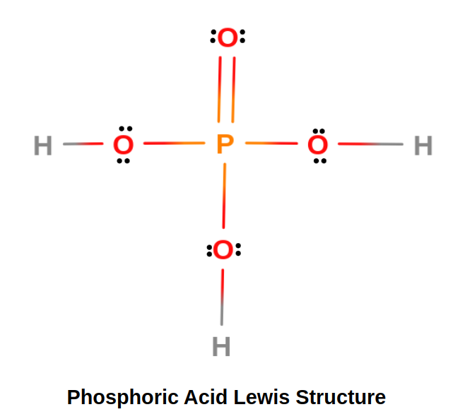
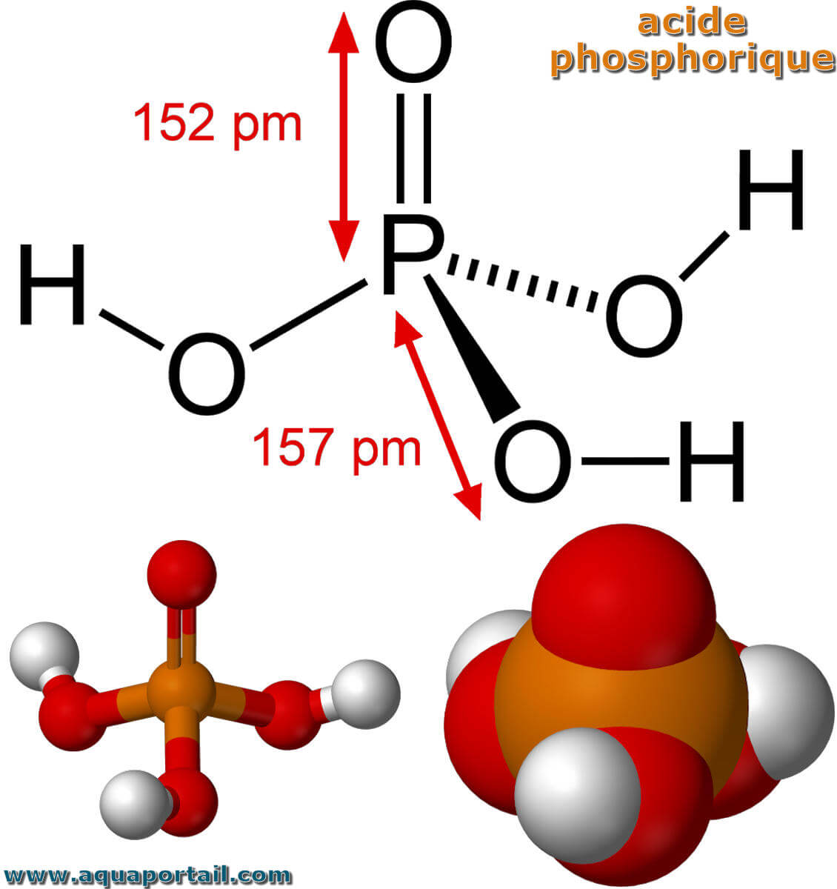
2.Structural Formation
2. Bonding and Geometry
Phosphorus forms five covalent bonds:
  One double bond with an oxygen atom
  Three single bonds with hydroxyl groups (–OH)
The molecule has a tetrahedral geometry around the phosphorus atom.
01 Molecular Structure
2. Bonding and Geometry
H3PO4 forms five covalent bonds:
  One double bond with an oxygen atom
  Three single bonds with hydroxyl groups (–OH)
The molecule has a tetrahedral geometry around the phosphorus atom.
Phosphoric acid consists of:
One central phosphorus (P) atom
Connected to four oxygen (O) atoms
Three of these oxygens are each bonded to a hydrogen (H) atom
The fourth oxygen is double-bonded to phosphorus
.

Slide 6

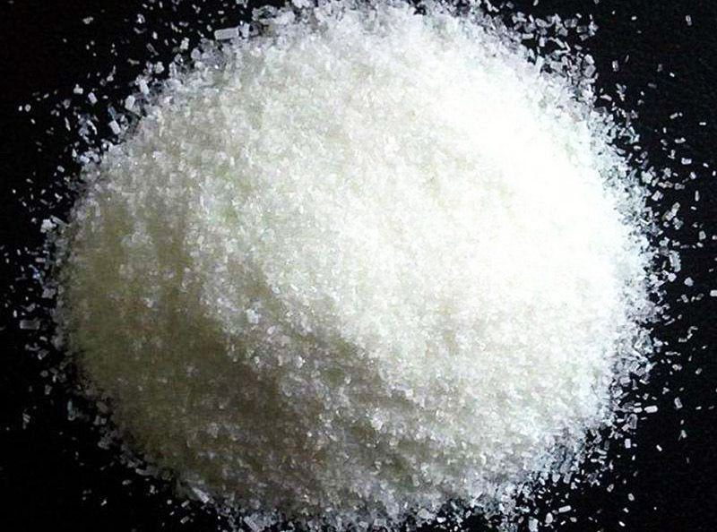
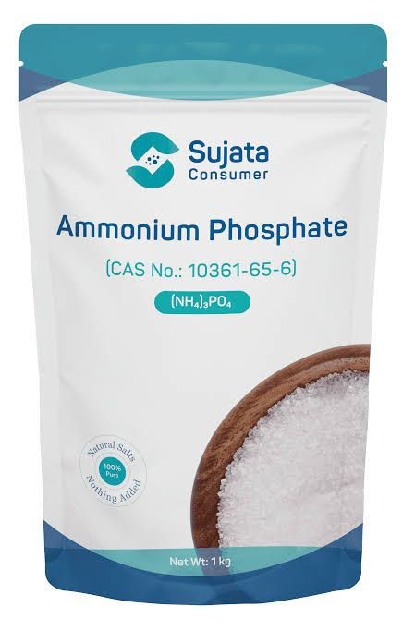
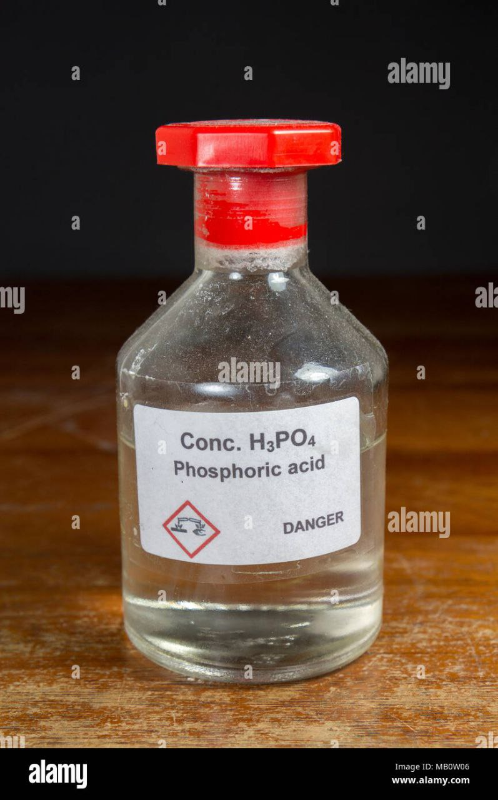
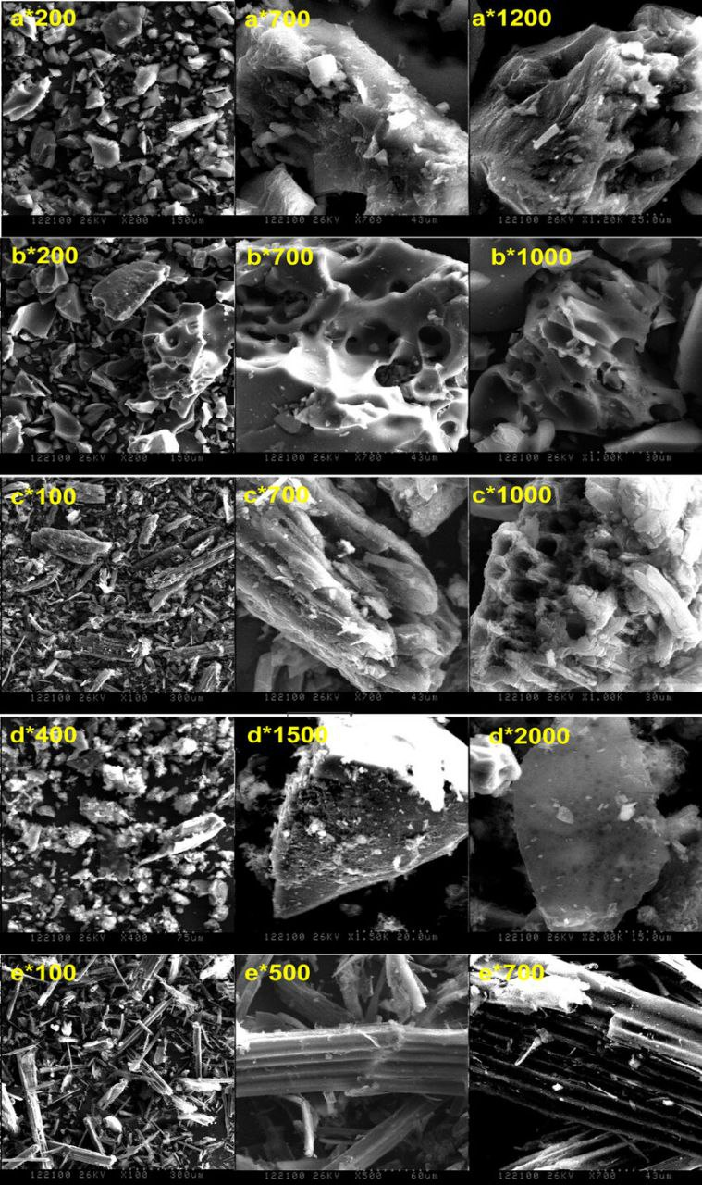
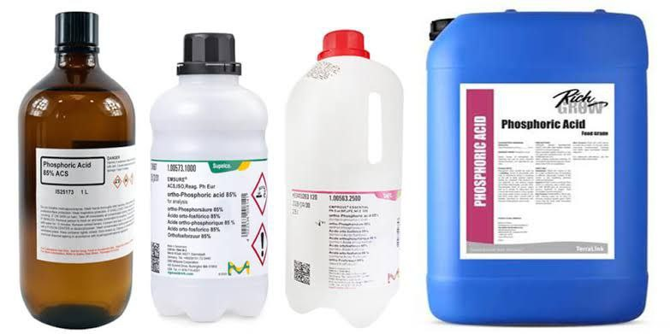
3.Compounds of H3PO4
Phosphoric acid forms a wide range of important compounds, including:
A. Phosphate Salts
Sodium phosphate (Na₃PO₄)
Calcium phosphate (Ca₃(PO₄)₂)
Ammonium phosphate ((NH₄)₃PO₄)
These are heavily used in fertilizers, detergents, and water treatment.
B. Polyphosphates
Sodium hexametaphosphate
Sodium pyrophosphate
Used in detergents and the food industry.
C. Derived Phosphoric Acids
Pyrophosphoric acid (H₄P₂O₇)
Metaphosphoric acid (HPO₃)

Slide 7



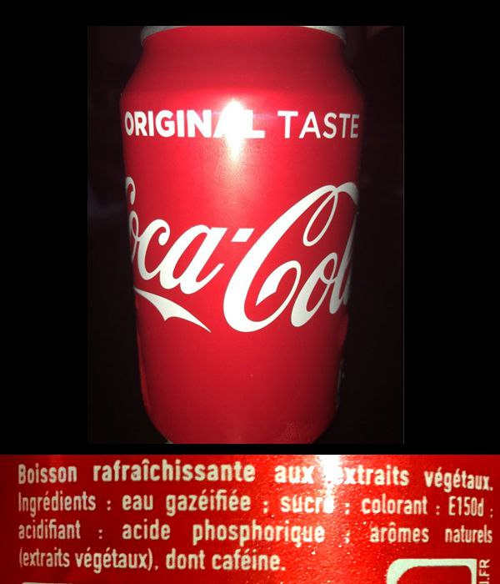

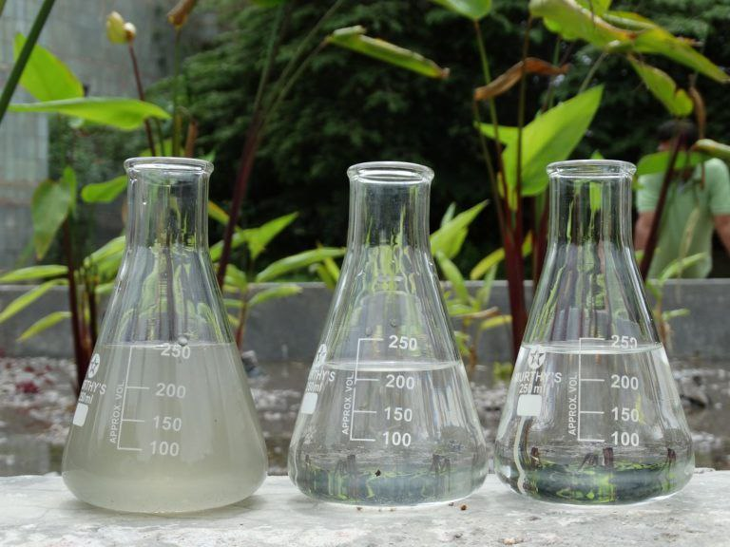
4.Industrial Uses
A. Fertilizer Industry:
Major component for producing ammonium phosphate fertilizers.
D. Pharmaceutical Applications:
pH regulator in medical solutions
Raw material for some pharmaceutical salts
B. Food Industry:
Used as:
Acidulant in soft drinks
Acidity regulator (E338)
Emulsifying agent in some dairy products
E. Water Treatment & Detergents:
Source for phosphates and polyphosphates
Helps remove hardness in water
Used in industrial and household detergents
C. Metal Treatment:
Rust removal
Metal cleaning
Producing protective phosphate coatings

Slide 8

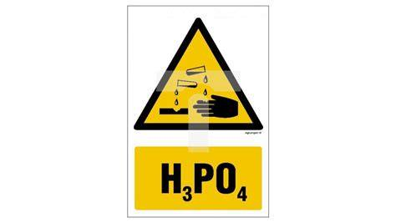

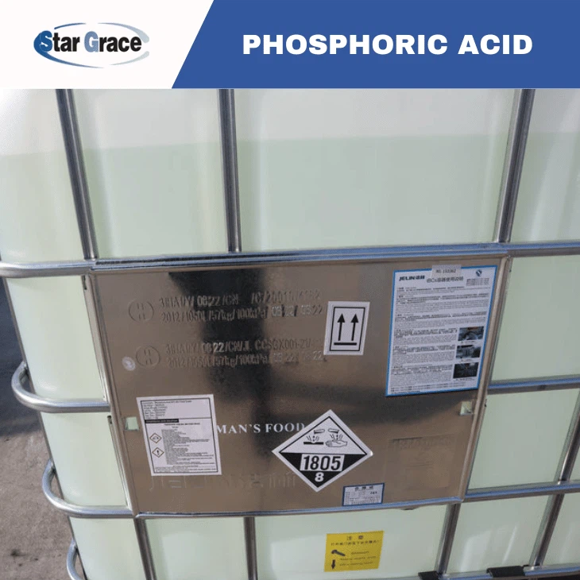


5. Safety Precautions:
H3PO4 is not highly toxic, but corrosive, especially in concentrated form,must be disposed of according to environmental safety regulations.
In case of Handling
Wear acid-resistant gloves and protective eyewear.
Work in well-ventilated areas.
Avoid contact with skin and eyes.
In case of Storing
Keep away from strong bases and reactive metals.
Store in corrosion-resistant containers.
In case of Spills
Dilute with plenty of water.
Avoid direct contact.
Use corrosion-resistant tools for cleanup.

Slide 9


Conclusion
phosphoric acid (H₃PO₄) is a vital chemical with wide industrial uses, from fertilizers to food processing. Its unique structure gives it valuable properties, but it must always be handled with proper safety precautions. Understanding its composition, uses, and risks helps ensure that it is applied effectively and safely in modern industry.

Slide 10


Thank you for your listning

