Slide 1


Slide 2



University centre Abdelhafid Boussouf-Mila Institute of science and Technology
Department of Methods Engineering 2 nd year (LMD)
Title:
Nitric Acid( HNO₃)
Add your title
Subject:
Research in metal chemistry
Asma Berbache
Professor:
A. Muayouf
Student:
Add your text
University year: 2025/2026

Slide 3

1_the introduction
2_Physical and Chemical Properties
Index:
3_Industrial Production
4_Industrial and Practical Uses
5_Safety and Handling Precautions
6_Transport and storage
7_Environmental lmpact
8_Conclusion
9_References

Slide 4

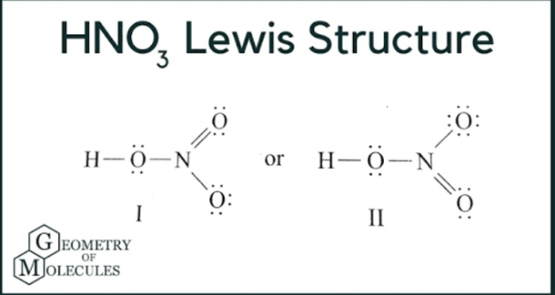
1
Introduction:
Nitric acid (HNO₃) is a strong mineral acid commonly used in industry and laboratories. It is colorless in its pure form but turns yellow over time due to the presence of nitrogen oxides.

Slide 5
2.Physical and Chemical Properties
Melting point: -42⁰c
Density:
Molecular weight:
1,41g/ml at 20⁰c
63,01g/mol
Highly solublle
in water and acts as a strong oxidizing agent
Boiling point:120,5⁰c

Slide 6
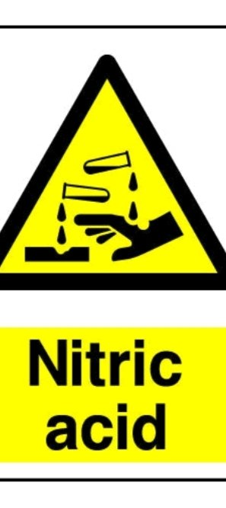
3.Industrial production:
The main industrial method of producing nitric acid is the
Ostwald Process, which involves the catalytic oxidation of ammonia (NH₃) to form nitrogen oxides (NO and NO₂), which are then absorbed in water to produce HNO₃.

Slide 7
4.Industrial and practical uses:
Manufacture of explosives
(TNT,nitroglycerin)
Metal cleaning and etching
Fertilizer production
(ammonium nitrate)
Laboratory reagent for
analysis and synthesis

Slide 8

5.Safety and Handling Precautions
• Always wear gloves, goggles, and a lab coat when handling HNO₃.
• Work in a well-ventilated area or under a fume hood.
• Avoid skin contact and inhalation of vapors.
• Store in glass or compatible plastic containers, away from heat and direct sunlight.

Slide 9
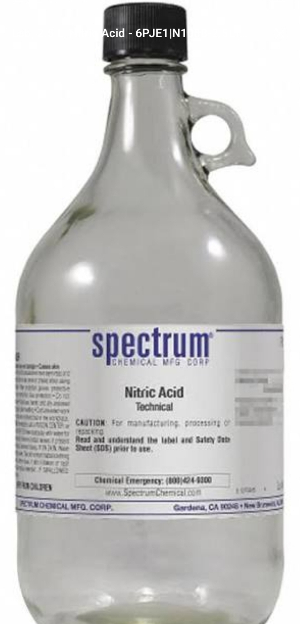

6. Transport and Storage
• Keep away from flammable or organic materials.
• Avoid exposure to extreme temperatures.
• Transport in corrosion-resistant containers, clearly labeled as 'Corrosive Material'.

Slide 10
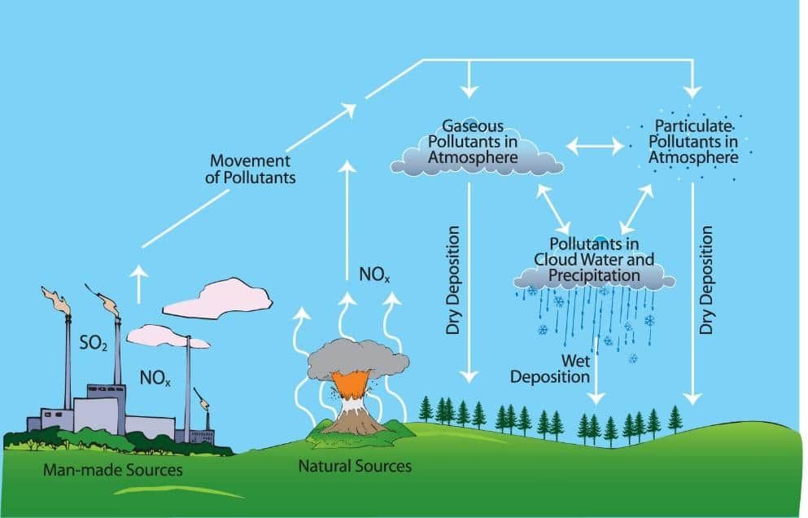
7. Environmental Impact
Nitric acid contributes to air pollution when released as nitrogen oxides (NOx). These gases can cause acid rain and respiratory problems. Proper neutralization and disposal methods are required.
Create
Factors affecting the spread of pollutants in the atmosphere

Slide 11
8. Conclusion
Nitric acid (HNO₃) is a vital industrial chemical with many applications in fertilizers, explosives, and laboratory work. However, its strong oxidizing and corrosive nature requires strict safety precautions during handling, storage, and transportation.

Slide 12
9. References
1. Wikipedia, 'Nitric Acid', accessed October 2025.
2. ChemicalBook, 'Nitric Acid Properties', 2025.
3. Alchemie Labs, 'Exploring Nitric Acid (HNO₃)', 2025.
4.Intrnet (Retrieved form online educational resources)

Slide 13
Thank you for listening and watching.

