Slide 1
Chimie verte microwaves in processes engineering
Students :
BOUCHAIR IKRAM
DERMOUCHI Asma
DERMOUCHI NORHANE

Slide 2
plan
1) Introduction | 6) Advantages of Using Microwaves Compared to Conventional Methods
2) Definition | 7) Challenges and Limitations of Microwave Processing
3) Principle of Microwave Operation in Process Engineering | 8) Future Prospects and Recommendations in Microwave Processing
4) Equipment and Techniques for Microwave Processing | 9) Conclusion
5) Industrial Applications of Microwaves in Process Engineering

Slide 3
01
Introduction

Slide 4
Introduction
Microwave technology in process engineering is an advanced method that uses high-frequency electromagnetic waves to heat and process materials quickly and efficiently.
It enables direct energy transfer to the material, reducing energy loss compared to traditional heating methods.
This technology is applied in drying, extraction, chemical reactions, and material production, improving both efficiency and product quality.
Additionally, it is considered a more sustainable and environmentally friendly option due to its high energy efficiency and lower environmental impact.

Slide 5
02
Definition

Slide 6
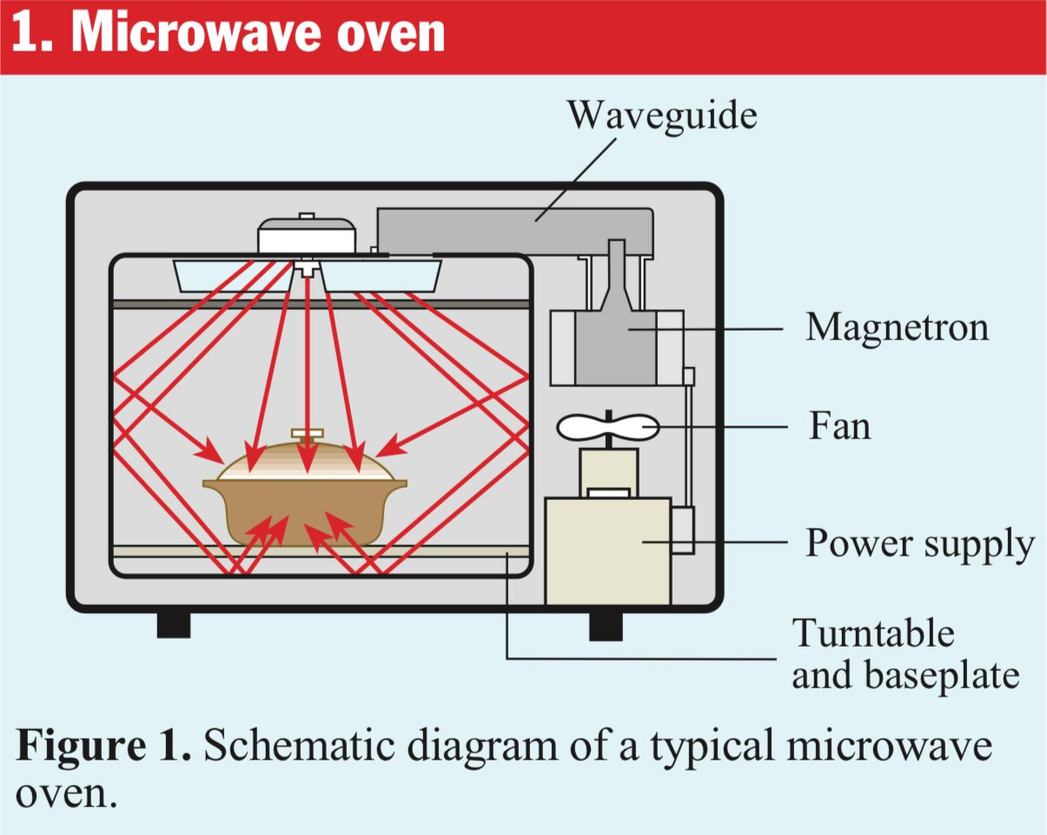
Microwave in process engineering refers to the use of electromagnetic waves in the microwave frequency range (typically 300 MHz to 300 GHz) to heat materials or stimulate chemical and physical processes in engineering industries .
This technology is employed in operations such as drying, extraction, chemical reactions, and thermal processing, providing rapid, uniform, and energy-efficient heating compared to conventional methods such as direct heating or heat conduction.

Slide 7
03
Principle of Microwave Operation in Process Engineering

Slide 8
Principle
2 . Dipolar Polarization
1. Internal Heating of the Material
3. Ionic Conduction
4. Selective Heating
5. High Energy Efficiency
6. Processing Speed and Reaction Rate

Slide 9
04
Equipment and Techniques for Microwave Processing

Slide 10
1) Monomode Microwave Ovens
2) Multimode Microwave Ovens
4) Multiphase Microwave Reactors
3) Continuous Flow Reactors
6) Auxiliary Equipment for Improved Distribution
5) Power and Frequency Control

Slide 11
05
Industrial Applications of Microwaves in Process Engineering

Slide 12
01
02
03
Drying of materials
Example:
Drying herbs or vegetables without losing aroma or color
Extraction of valuable compounds
Example:
Extracting essential oils from rose or mint faster.
Acceleration of chemical reactions
Example:
Preparing chemical compounds or polymers in less time with higher efficiency.

Slide 13
04
05
06
Manufacturing of solids and ceramics
Example:
Sintering ceramics to produce strong and homogeneous materials.
Waste and pollutant treatment
Example:
Breaking down organic pollutants or treating industrial waste efficiently.
Advanced and hybrid processes
Example:
Processing liquid and solid materials together or preparing sensitive chemical products safely.

Slide 14
06
Advantages of Using Microwaves Compared to Conventional Methods

Slide 15
- Faster heating from the inside of the material.
- Lower energy consumption.
- Improved quality of the final products.
- Shorter processing and reaction times.
- Ability to selectively heat specific areas of the material.
- More environmentally friendly than conventional heating methods

Slide 16
07
Challenges and Limitations of Microwave Processing

Slide 17
Non-uniform heating: Some parts of the material heat faster than others.
Material dependence: Certain materials do not absorb microwaves well, causing slow heating.
Difficulty in handling large quantities: Scaling up the process for large industrial plants requires specialized and expensive equipment.
Impact on sensitive materials: Rapid heating may damage or alter the properties of some materials.
Need for precise equipment design: To avoid non-uniform heating, ovens and reactors must be carefully designed

Slide 18
08
Future Prospects and Recommendations in Microwave Processing

Slide 19
- Improving Oven and Reactor Design: Enhancing wave distribution to reduce uneven heating.
- Integrating Microwaves with Other Techniques: Such as hybrid heating or continuous flow reactors to increase efficiency.
- Expanding Industrial Applications: Processing a wider variety of materials and increasing production on an industrial scale.
- Enhancing Energy Efficiency and Environmental Performance: Using microwaves in a more economical and eco-friendly manner.
- Studying New Materials: Researching materials with improved microwave response to achieve better results

Slide 20
09
Conclusions

Slide 21
Conclusions
The research shows that microwaves represent a revolution in process engineering by providing effective and sustainable solutions to industrial challenges.
Despite technical challenges, their wide applications in areas such as food and chemical industries justify investment in research and development. Further studies are recommended to improve safety and efficiency, opening new horizons for innovation in industrial processes.
This topic reflects technological advancement towards more sustainable and efficient operations.

