Slide 1
Professor : Mayouf .I
......
......
......
......
......
......
......
......
......
......
......
......
Water as solvent
And
Solvent free reaction
......
......
......
......
......
......
......
Prepared by:
......
......
......
......
......
Bentebbal Douaâ
Chabbi Safaa

Slide 2
......
......
......
......
1
......
......
4
......
Water as solvent Vs Solvent free reaction
......
......
......
......
1
......
Introduction
WORK PLAN
5
Application in Chemistry
& industry
2
Water as solvent
6
Challenges & Future
Perspectives
3
Solvent free reaction
7
Conclusion

Slide 3
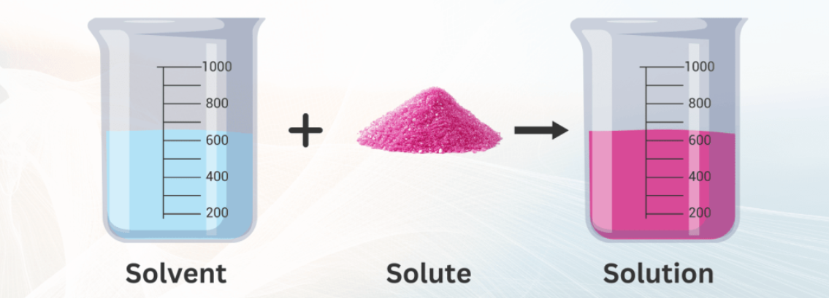
1- INTRODUCTION
A solvent is a substance that dissolves solutes to create solutions, serving as a medium for chemical reactions.
Many organic solvents pose toxicity and flammability risks, raising environmental and safety concerns.
Green chemistry offers two sustainable alternatives: using water as a solvent, which is safe and can enhance reactions, and conducting solvent-free reactions to minimize waste and energy use.
This presentation will discuss the benefits, challenges, and applications of these approaches.
......
......
......
......
......
......
......
......
......
......
......
......

Slide 4
......
......
......
......
......
......
......
......
......
......
......
......
2
Definition and role :
Water is a polar, safe, abundant, and environmentally friendly solvent.
Thanks to its ability to dissolve a wide range of solutes, water is sometimes called the "universal solvent“. It is good at dissolving ions and polar molecules, but poor at dissolving nonpolar molecules.
Facilitates reactions through hydrogen bonding and hydrophobic effects, sometimes accelerating reaction rates.
Can improve selectivity and simplify purification in some organic and inorganic reactions.
......
......
Water as solvent
......
......
......
......
......
......
......
......
......
......
......
......
......
......
......
......
Examples:
Diels–Alder reactions in water.
Catalyzed reactions using micelles or heterogeneous catalysts.
Oxidation/reduction reactions in aqueous media.
......
......
......
......
......
......
......
......
......
......
......
......
......
......
......
......
......
......

Slide 5
vv
ADVANTAGES:
Non-toxic and environmentally friendly.
Can accelerate some reactions (e.g., due to hydrophobic effect or hydrogen bonding).
Often reduces the need for protecting groups in organic reactions.
LIMITATIONS:
Poor solubility of non-polar compounds.
High boiling point can increase energy consumption.
Corrosion of equipment at high temperatures.

Slide 6
3- Solvent free reaction
......
......
......
......
......
......
......
......
Definition:
A solvent-free reaction is a chemical process conducted without any solvent, where reactants interact directly in solid, liquid, or gas states to promote green chemistry and reduce waste.​
Principle:
It relies on direct reactant interaction without dilution, increasing molecular collisions and reaction rates through high concentrations, often aided by techniques like grinding or microwaves.
Example:
- Halogenation reactions.
- Michael addition.
- Aldol condensation.
- Oxidative coupling of phenols.
......
......
......
......

Slide 7
Advantages:
Limitations:
Reduced environmental pollution due to no solvent waste.
Lower costs since no solvent purchase, handling, or disposal is needed.
Simplicity in process and product isolation.
Often increased efficiency, higher yields, and selectivity.
Sometimes longer reaction times or need for higher temperatures.
Limited to reactants that can interact well without solvents
Possible difficulty in controlling reaction conditions like temperature and mixing
......
......
......
......
......
......
......
......
......
......

Slide 8
4-Water as solvent Vs Solvent
free reaction
Prefer solvent‑free conditions when reactants are liquids or low‑melting solids that mix well, or when using mechanochemical or microwave methods to obtain high productivity
with minimal waste.
Prefer water as solvent when reagents are reasonably stable in water, at least partly water‑soluble, and when polar or ionic mechanisms are involved (e.g., many substitutions, cycloadditions, catalysis “in water”).​​
......
......
......
......
......
......
......
......
......
......
......
......

Slide 9
5- Application in Chemistry
& industry
In chemistry:
  - Water as solvent is used in acid–base reactions, substitution reactions, catalyzed reactions in aqueous media, and enzymatic and organic reactions that need a polar medium with strong hydrogen bonding.
  - Solvent‑free conditions are used for reactions such as aldol condensation, Michael addition, Diels–Alder reactions and polymerization
  In industry:
  - Water is used as a solvent or reaction medium in the production of pharmaceuticals, food and beverages, cleaning and polishing processes, surface treatments, electrochemical processes, and for cooling and heat transfer.
  - Solvent‑free reactions are used in the manufacture of drugs, pesticides, perfumes, polymers, coatings, and fine chemicals to reduce solvent consumption, lower cost, and decrease pollution.

Slide 10
......
......
......
......
......
......
6- Challenges & Future Perspectives
Challenges
Future Perspectives
limited solubility or compatibility of many reagents with water or solvent‑free conditions.
difficult heat and mixing control at high concentration or in solids.
need for new equipment and catalysts.
economic and technical barriers in industry.
Design of modern reactors and operation techniques to improve mixing and heat control.
Development of new catalysts that tolerate water and work in the solid state or under grinding/microwave activation.
Integrating these technologies into green‑chemistry strategies to reduce organic solvents, emissions, and treatment costs.
.

Slide 11
......
......
......
......
......
......
......
......
......
......
Water as a solvent and solvent‑free conditions are both key strategies in green chemistry that reduce hazardous organic solvents and waste. Water provides a cheap, safe, polar medium for many reactions, while solvent‑free conditions eliminate solvents completely by letting reactants contact directly. Together they enable more sustainable synthesis and industry, but still need better catalysts, reactors, and solutions for solubility and scale‑up challenges.
7-CONCLUSION
......
......
......
......
......
......
......
......
......
......
......
......
......
......
......

Slide 12
......
......
......
......
......
......
......
......
......
......
......
THANK YOU
FOR YOUR
ATTENTION
......
......
......
......
......
......
......
......
......
......
......
......
......

