Slide 1
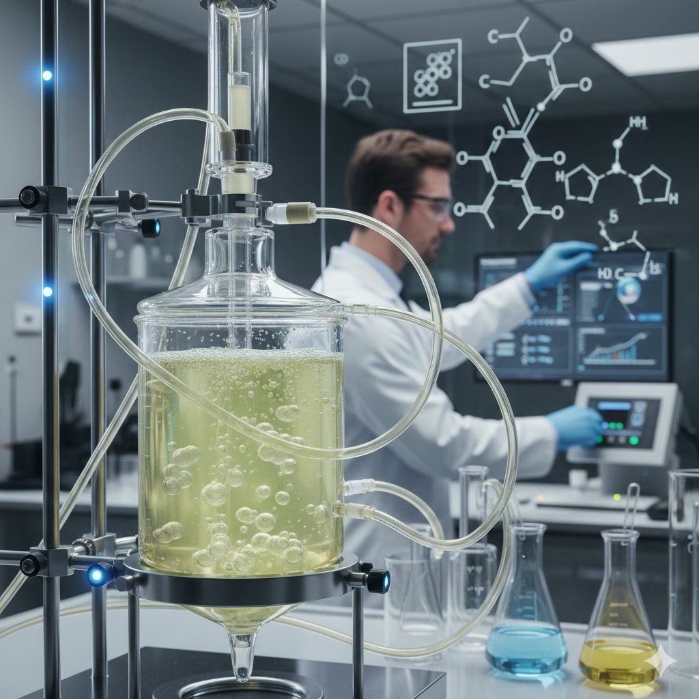

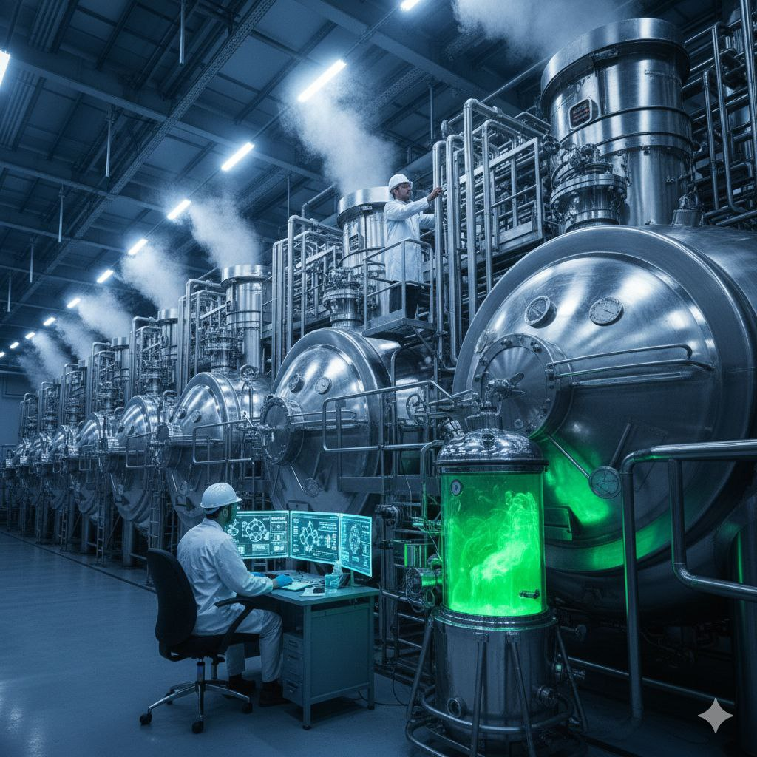
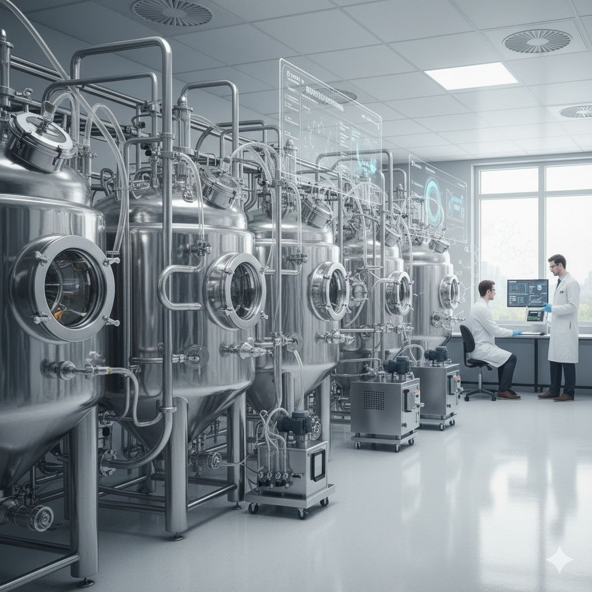
People's Democratic Republic of Algeria
Abdelhafidh Boussouf University
Faculty of Science and Technology
specialty: Master 1 Génie chimique
Biocatalysis and Bioprocesses: Their Role
in Green Chemistry
work by:
Hierche anfal
Blkessour aya
under surveillance of:
DR.Mayouf Imane.

Slide 2

plan de travail
01
Introduction
02
Biocatalysis (Definition/Main Features/Applications)
03
Bioprocesses (Definition/Key Areas/Advantages)
04
Link to Green Chemistry
05
Case Studies
06
Challenges and Future Perspectives
07
Conclusion

Slide 3
INTRODUCTION
Environmental pollution, climate change, and resource depletion have increased the need for sustainable chemical practices. Green Chemistry focuses on designing safer processes that minimize waste and use renewable materials. In this context, biocatalysis and bioprocesses provide cleaner and more environmentally friendly alternatives to traditional chemistry.

Slide 4
Biocatalysis
Definition:
Biocatalysis uses enzymes or whole cells to speed up chemical reactions..

Slide 5


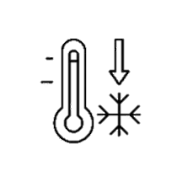



Main Features
Highly selective → fewer by-products
Works under mild temperature and pressure
Reduces the use of harmful organic solvents

Slide 6
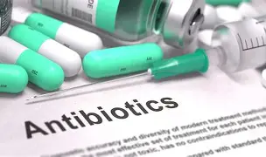
Applications
Making pharmaceuticals (antibiotics, vitamins)

Slide 7
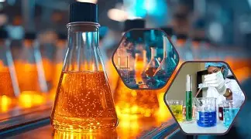
Applications
Producing fine chemicals and food ingredients
Making pharmaceuticals (antibiotics, vitamins)
04

Slide 8
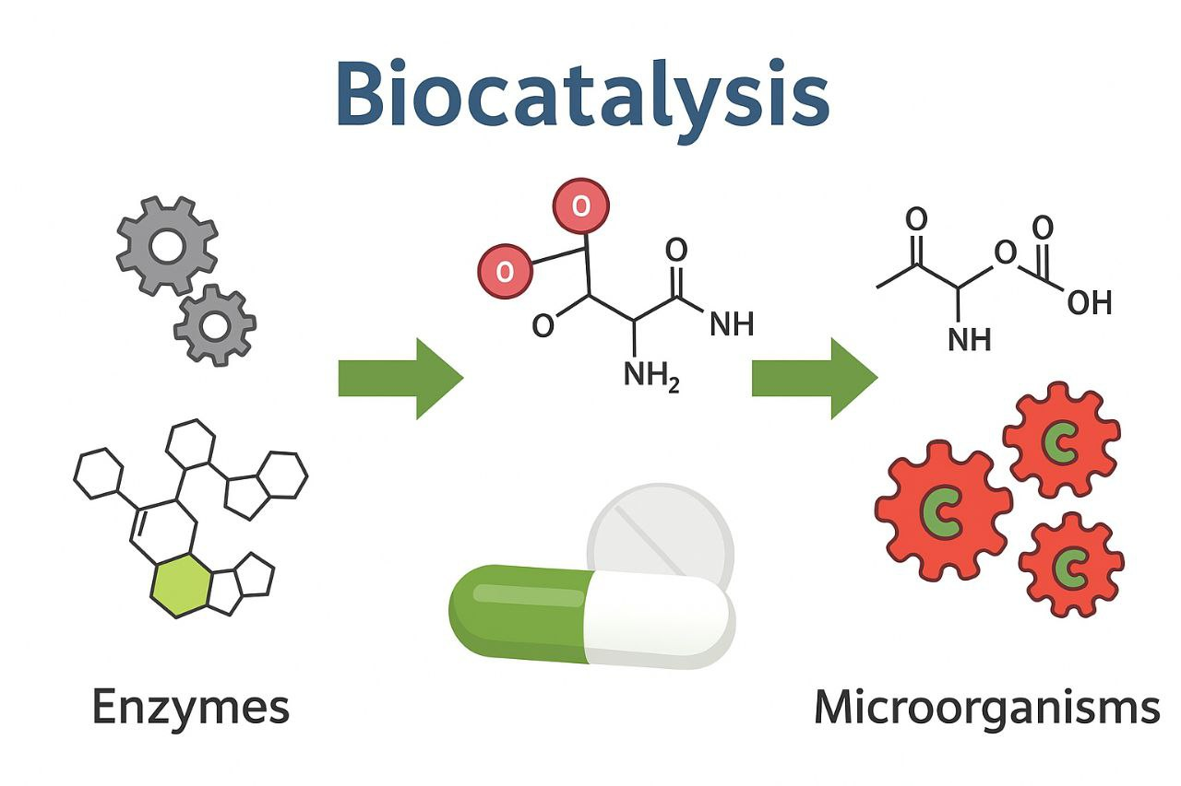
Applications
Producing fine chemicals and food ingredients
Making pharmaceuticals (antibiotics, vitamins)
Converting renewable materials into valuable compounds
04

Slide 9
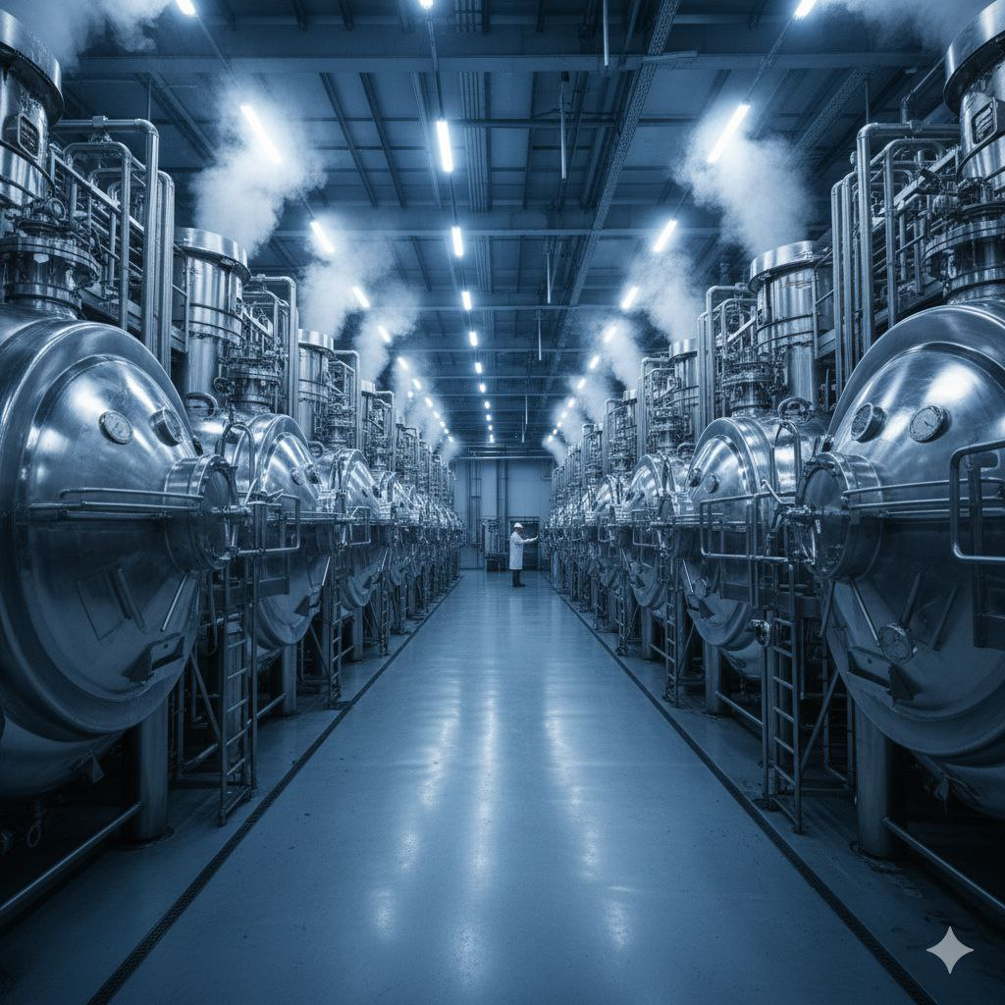
Bioprocesses
Definition:
Bioprocesses rely on microorganisms or cell cultures to produce chemicals, fuels, and materials.

Slide 10
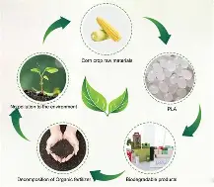
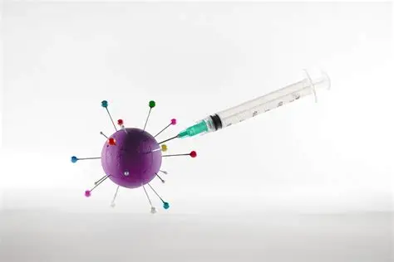
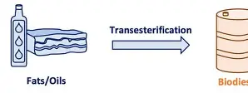
Key Areas
Biofuels
Pharmaceuticals
Bioplastics
ethanol, biodiesel
antibiotics, hormones, vaccines
biodegradable polymers like PLA

Slide 11
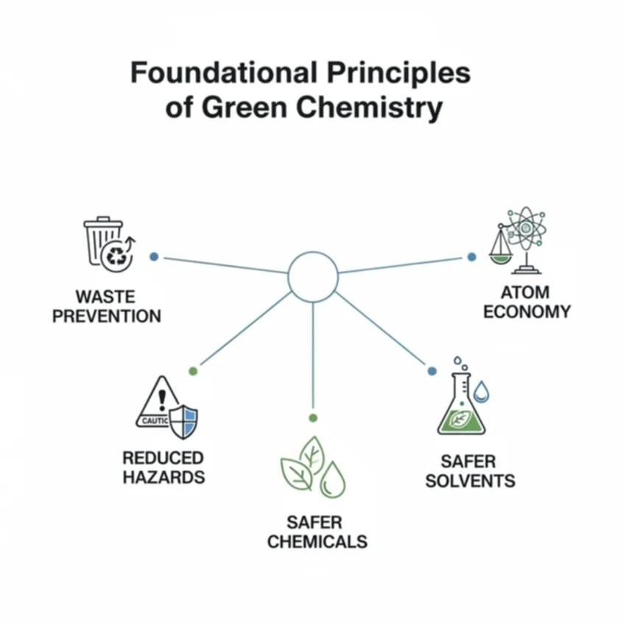


Advantages
Uses renewable resources
Lower carbon emissions
Can be scaled to industrial production
07

Slide 12


Link to Green Chemistry
Green Chemistry has 12 principles (waste prevention, energy efficiency, renewable feedstocks, etc.).
08

Slide 13








Link to Green Chemistry
Bioprocesses
Biocatalysis
01
01
Replacing hazardous reactions with safer biological ones
Producing less waste
02
02
Producing biodegradable materials
Using renewable substrates
03
Saving energy thanks to mild reaction conditions
03
Turning waste into useful products

Slide 14
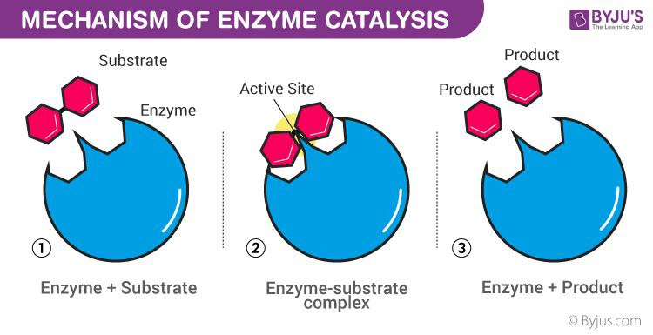


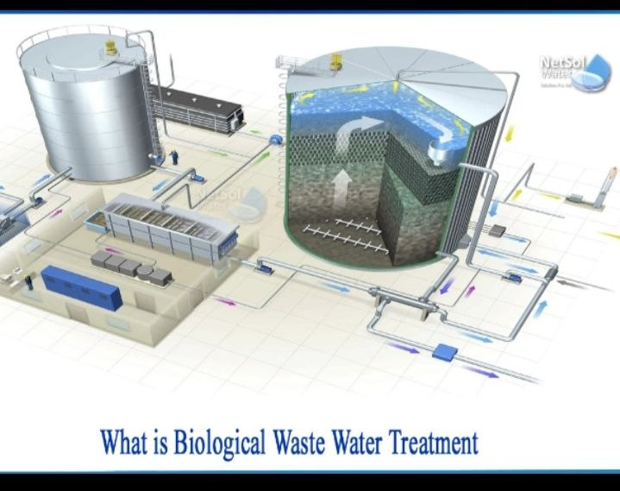



Case Studies
01
02
03
04
Biofuels
Pharmaceuticals
Bioplastics
Environment
ethanol from biomass as a cleaner fuell.
enzymes used to synthesize complex drugs
PLA from plants for sustainable packaging.
microorganisms used in wastewater treatment.

Slide 15

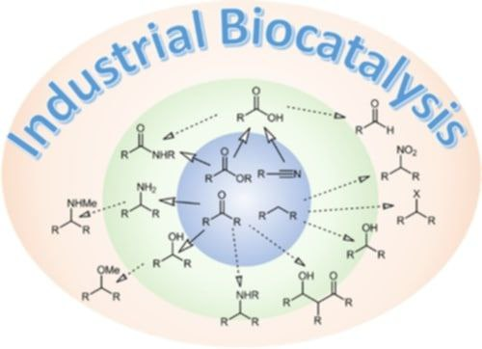

Case Studies

Slide 16
Case Studies

Slide 17





Challenges and Future Perspectives
Challenges
Limited renewable feedstocks in some regions
High cost of enzymes and microbial strains
Difficulty in scaling processes industrially
13

Slide 18





Challenges and Future Perspectives
Future Directions
Expanding bioprocesses to areas like textiles and construction
Better enzymes through genetic engineering
Combining nanotechnology with biocatalysis

Slide 19
CONCLUSION
Biocatalysis and bioprocesses are essential tools in Green Chemistry. They help reduce waste, save energy, and use renewable resources. With progress in biotechnology, they will play an even bigger role in building a more sustainable future.

Slide 20
References
SpringerLink (2024). Biocatalysis in Industrial Green Chemistry. .
Sheldon, R. A. (2024). Green chemistry and biocatalysis: Engineering a
sustainable future.
3. Lozano, P., & García-Verdugo, E. (2023). From green to circular chemistry
paved by biocatalysis.
4. MDPI Catalysts Journal (2017). The Protagonism of Biocatalysis in Green Chemistry and Its Environmental Benefits.

Slide 21
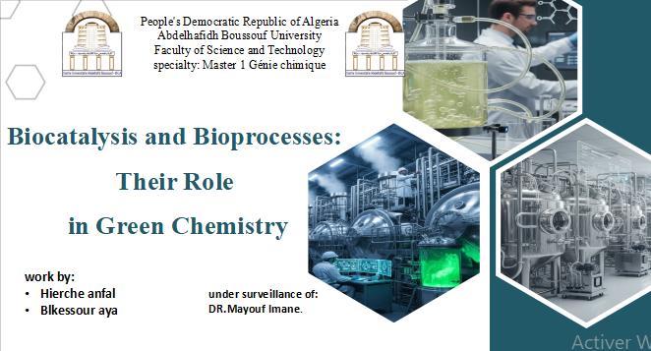
THANK YOU

