Slide 1
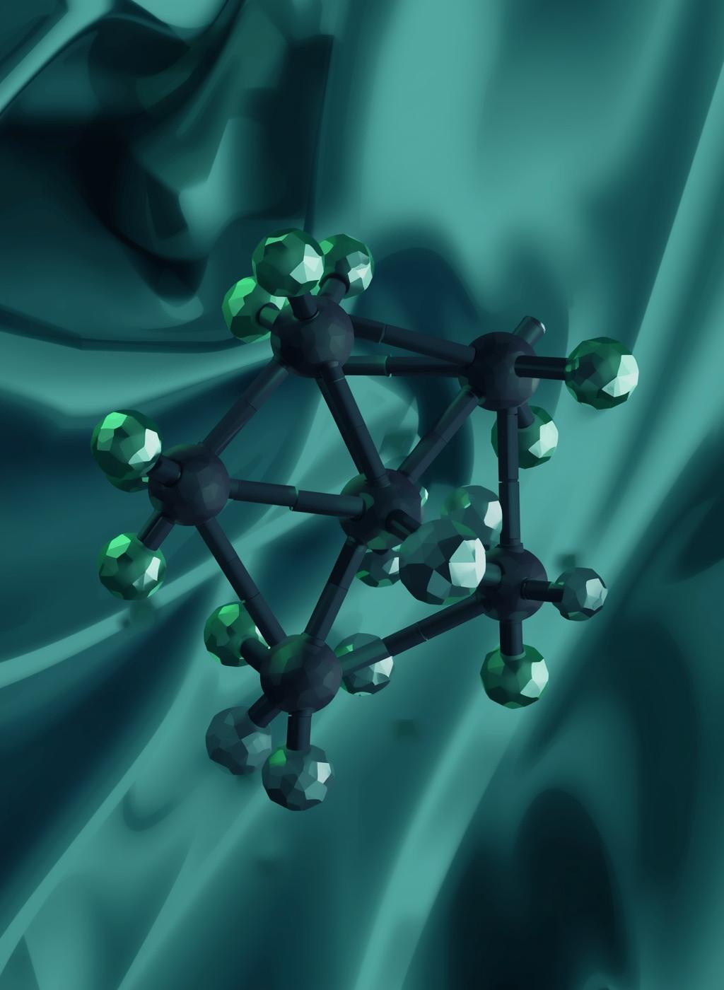
Ionic Liquids
Green Solvent for the Future
BABOURI SARAB

Slide 2
Welcome to the Future!

Slide 3

Plan :
Introduction to Ionic Liquids
Properties and Advantages
Applications in Green Chemistry
Limitations
Future Trends

Slide 4
Introduction :
To begin, ionic liquids are simply salts that remain in a liquid state at relatively low temperatures. They are made of large organic cations and small anions, and what makes them special is their unique properties such as very low vapor pressure, high stability, and the ability to be designed for specific tasks. This is why they are considered important materials in green chemistry.

Slide 5
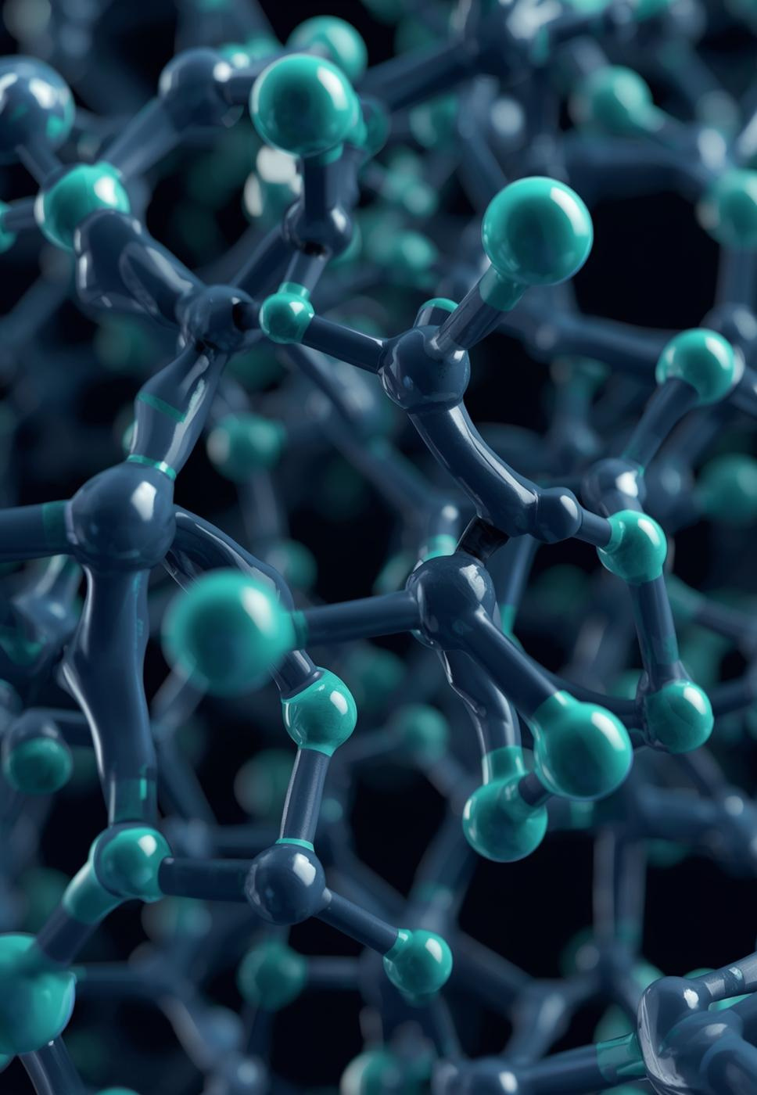
What are Ionic Liquids ?
Ionic liquids are salts composed entirely of ions that remain in a liquid state at temperatures below 100 °C, often at room temperature.
Unlike ordinary liquids (like water or gasoline) which are composed of neutral molecules, ionic liquids are composed entirely of ions—specifically, a combination of a cation and an anion.
Why are they important ?
Because they're "designer solvents" with tunable properties, offering green chemistry solutions (low volatility, reusability) and enabling advanced tech like batteries, solar cells, CO2 capture, and catalysis, replacing harmful traditional solvents in energy, pharma, and industry for better efficiency and sustainability.

Slide 6
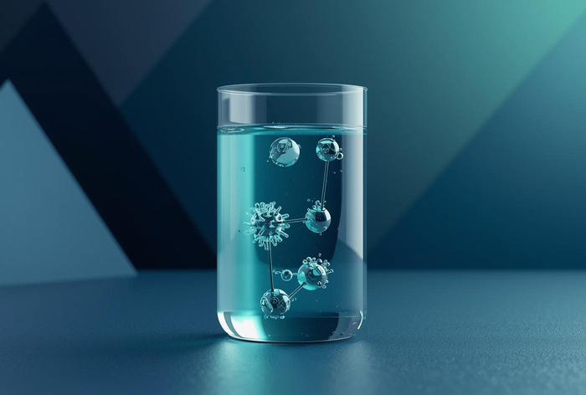
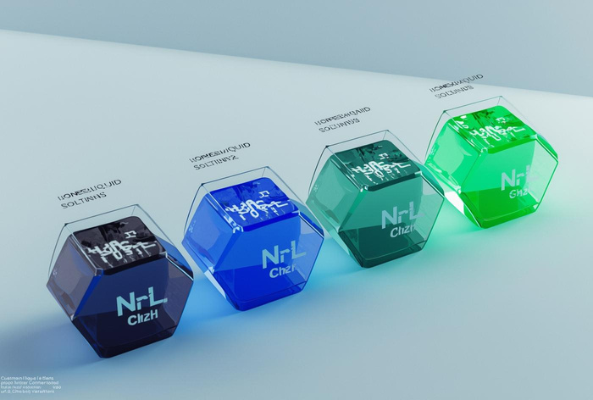
  Low melting point
They remain liquid below 100 °C, and many are liquid at room temperature.
  Very low vapor pressure
They do not evaporate easily, which reduces air pollution and makes them safer to use.
Properties of Ionic Liquids
  High thermal stability
Ionic liquids can withstand high temperatures without decomposing.
  Non-flammable
This makes them safer than many organic solvents.

Slide 7
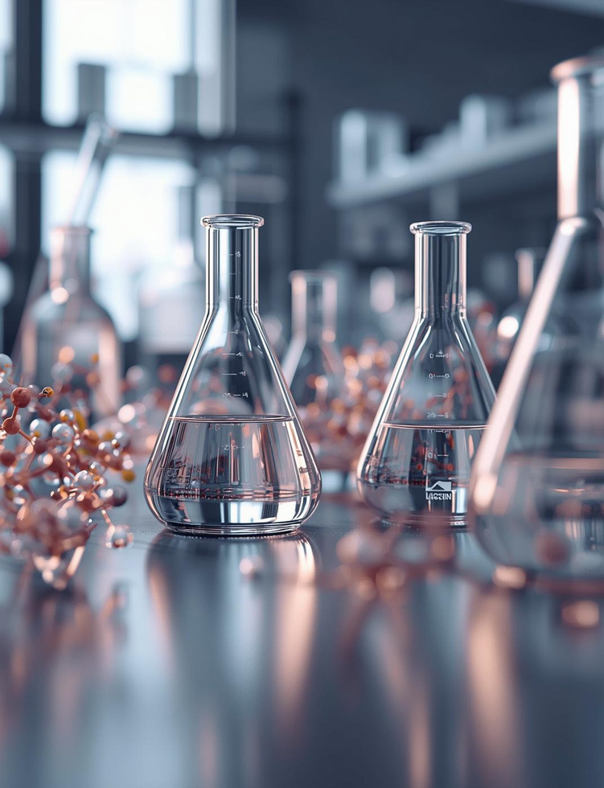
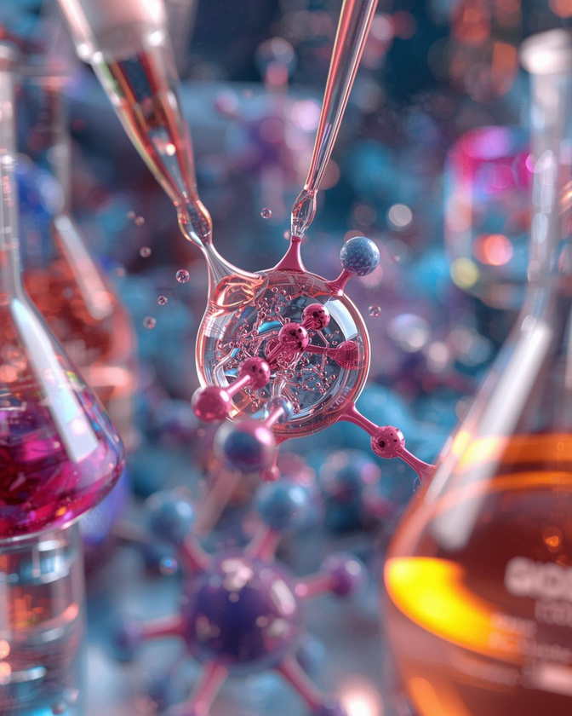
  High ionic conductivity
Due to the presence of ions, they conduct electricity well.
  Wide solvation ability
They can dissolve many organic, inorganic, and polymeric materials.
  Tunable properties
By changing the cation or anion, properties such as polarity, viscosity, and solubility can be adjusted.
  High viscosity (in many cases)
Compared to traditional solvents, many ionic liquids are more viscous.

Slide 8
Advantages of Ionic Liquids

Slide 9
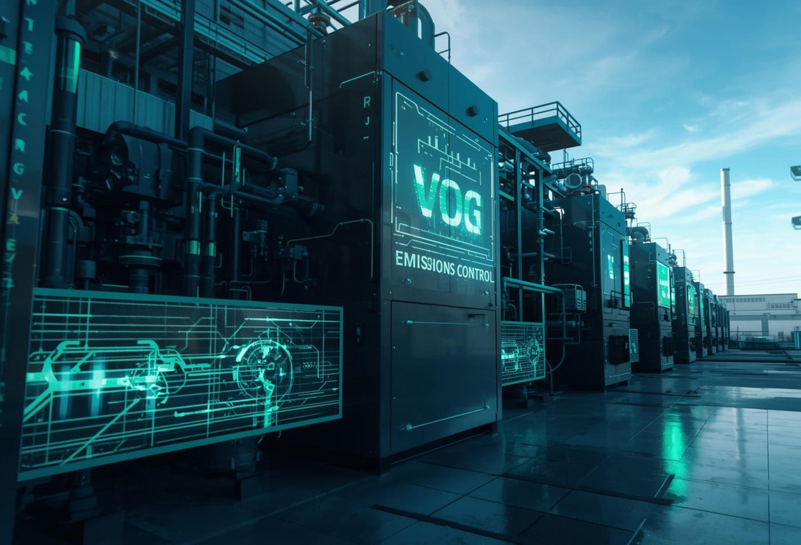
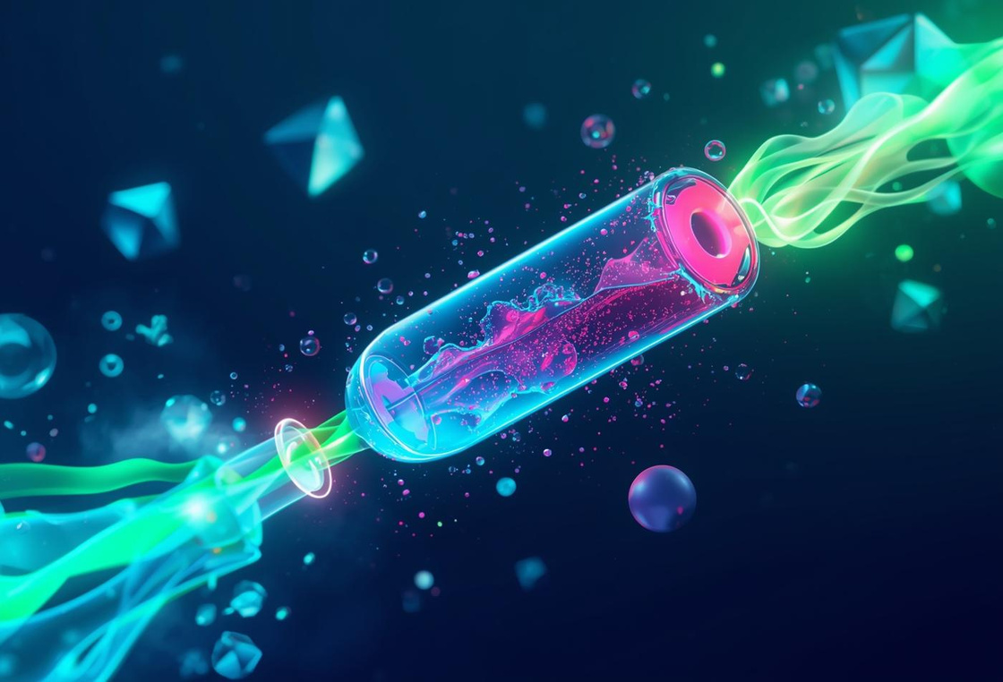

  Very low vapor pressure
which minimizes air pollution and exposure to toxic fumes.
  Non-flammable and safer
to use than conventional organic solvents.
  Recyclable and reusable
reducing chemical waste.
  High thermal and chemical
stability, allowing efficient reactions under mild or controlled conditions.
  Tunable (designer) properties
enabling the design of cleaner and more efficient processes.
  Improved reaction efficiency and selectivity
which lowers energy consumption and by-product formation.
  Reduced use of hazardous solvents
supporting the principles of sustainable and green chemistry.

Slide 10
IONIC LIQUIDS
PRESENTATION
SECTION 3
Applications in Green Chemistry

Slide 11

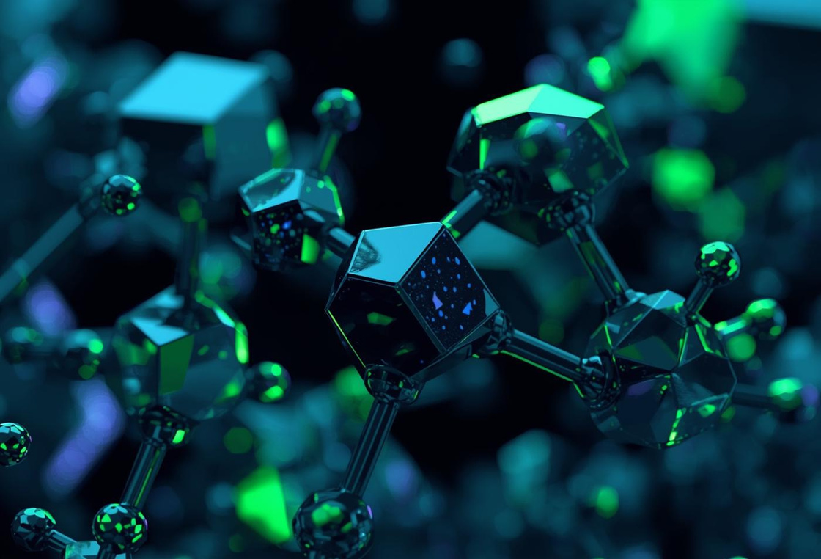
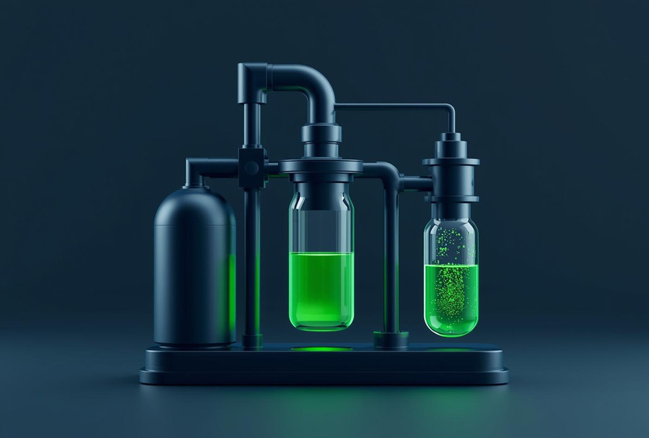
Pharmaceuticals and fine chemicals:
Ionic liquids enable cleaner, more efficient synthesis of drugs and high-value chemical products.
Electrochemistry and energy systems:
Used in batteries, fuel cells, and supercapacitors due to their high ionic conductivity and thermal stability.
Green solvents for chemical reactions:
Ionic liquids are used as environmentally friendly alternatives to volatile organic solvents, reducing pollution and improving process safety.

Slide 12

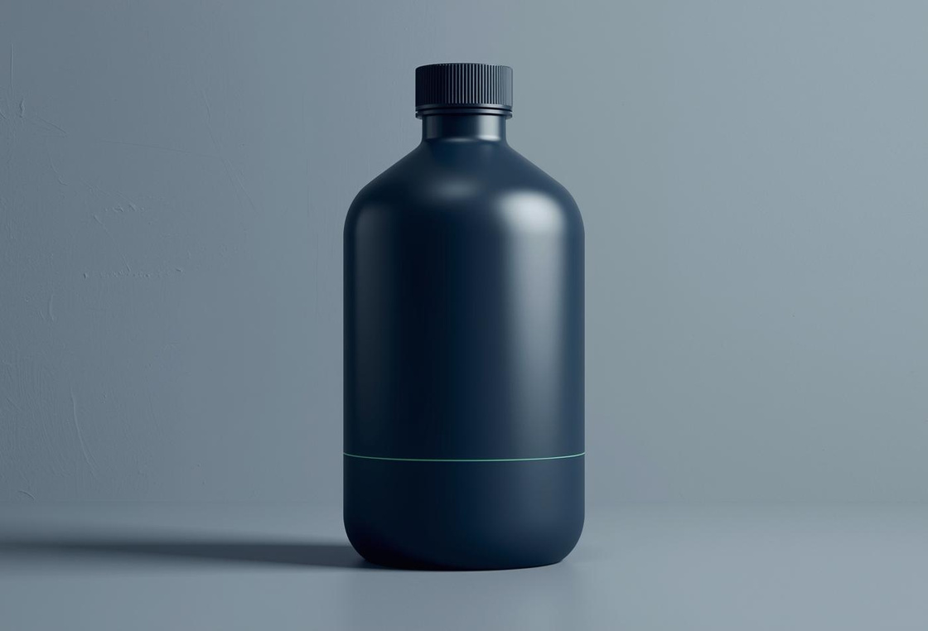

Separation and extraction processes:
Ionic liquids are applied in the extraction of metals, organic compounds, and in separating difficult mixtures with high efficiency and lower environmental impact.
Catalysis:
They can act as solvents and catalytic media at the same time, enhancing reaction rates, selectivity, and yield while minimizing by-products.
CO₂ capture and gas absorption:
Certain ionic liquids can absorb carbon dioxide efficiently, contributing to the reduction of greenhouse gas emissions.

Slide 13
Future Prospects and Conclusion
Integration in industrial processes
ILs for biomass conversion
ILs in carbon neutrality projects
Expansion in electrochemical devices

Slide 14
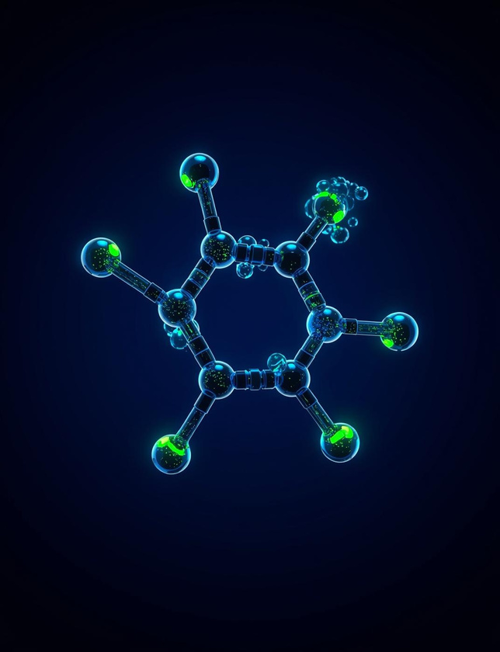
“Thank you for listening.
I’m ready to take your questions.”

