Slide 1





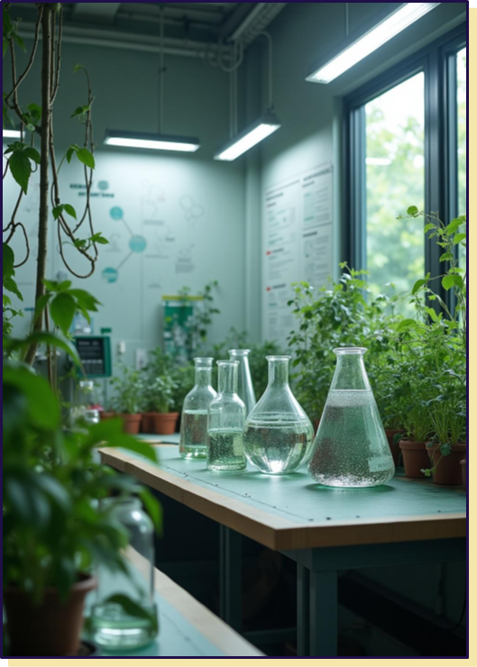




GREEN CHEMISTRY

Slide 2
Chapter 1

Slide 3
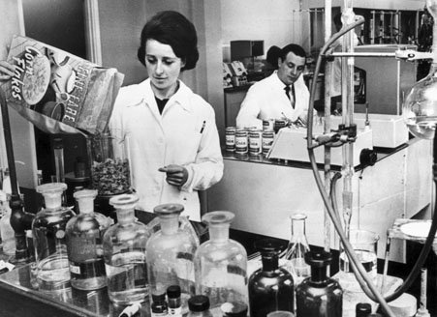
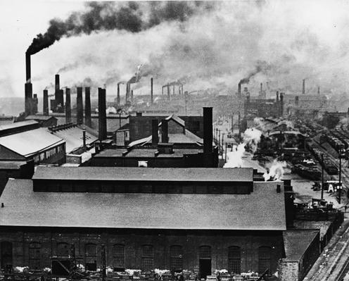
Introduction to the Chemical Industry
The chemical industry grew very rapidly during the 20th century, particularly after World War II.

Slide 4
Introduction to the Chemical Industry
It is now essential to our daily lives, because almost all the products we use such as medicines, processed foods, cosmetics and even building materials depend on chemistry.

Slide 5
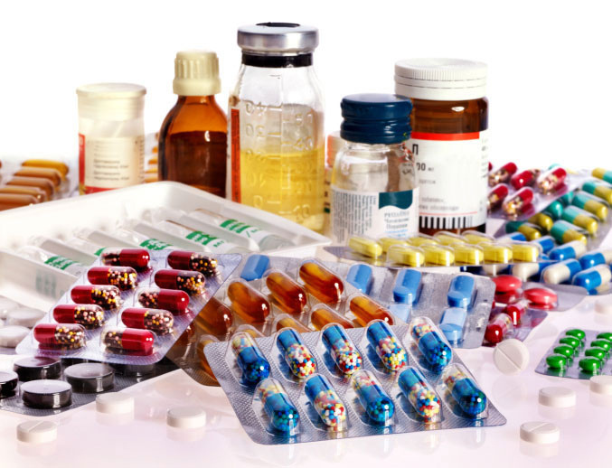
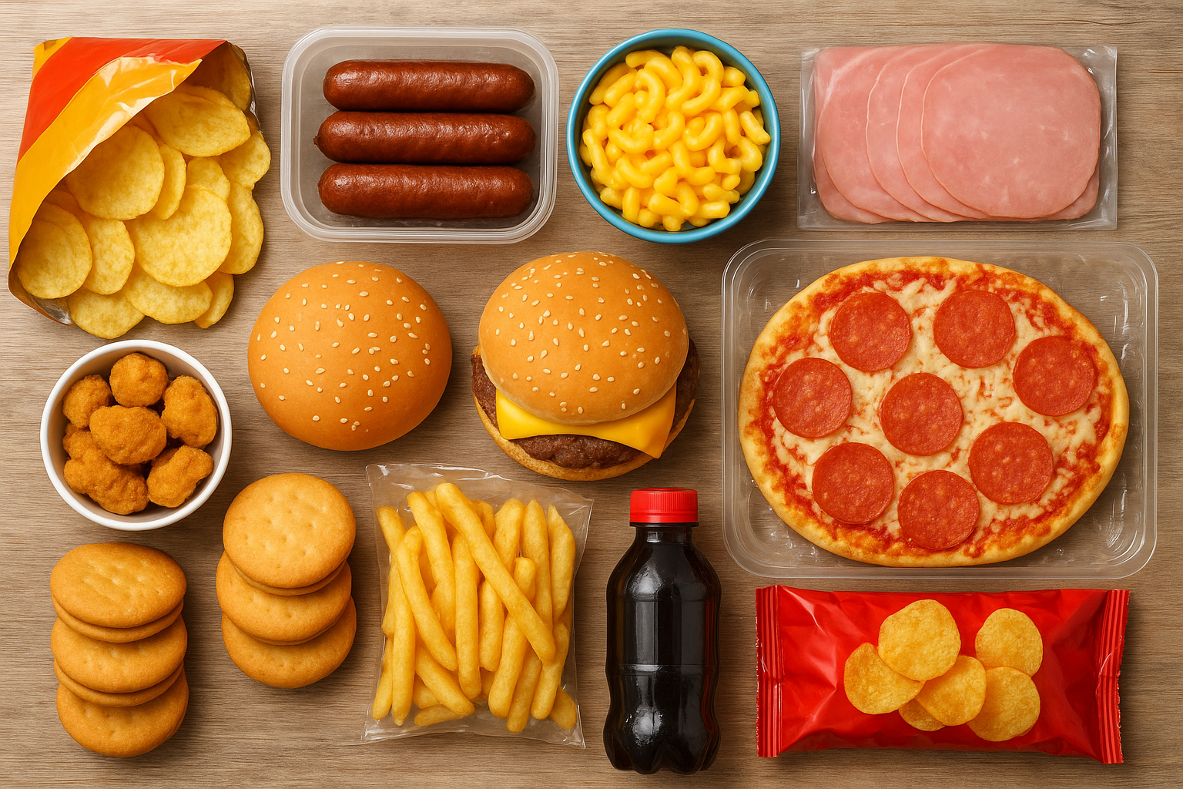

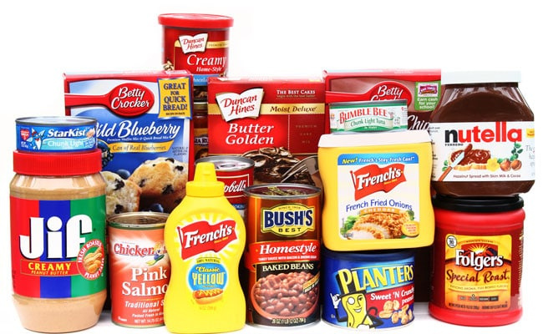


Slide 6
Introduction to the Chemical Industry
However, this expansion has also brought major problems. On the one hand, there is heavy pollution of air, water and soil;

Slide 7
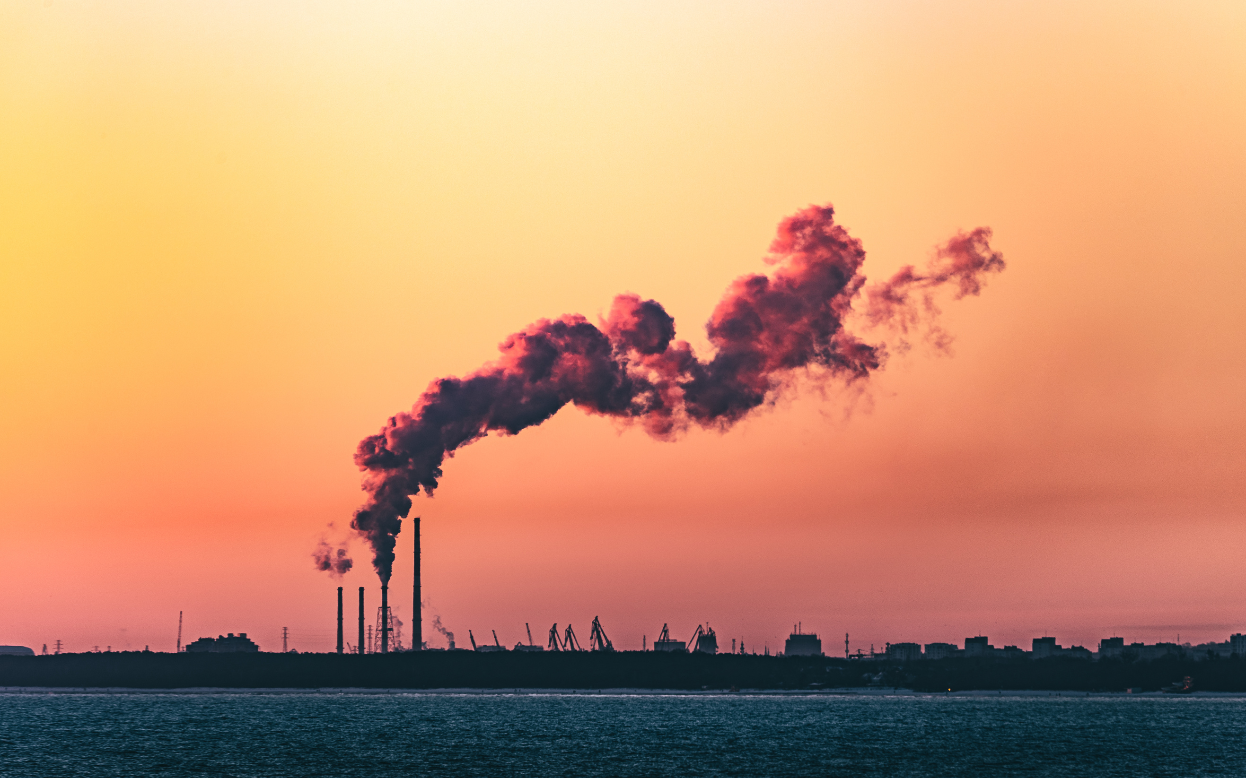
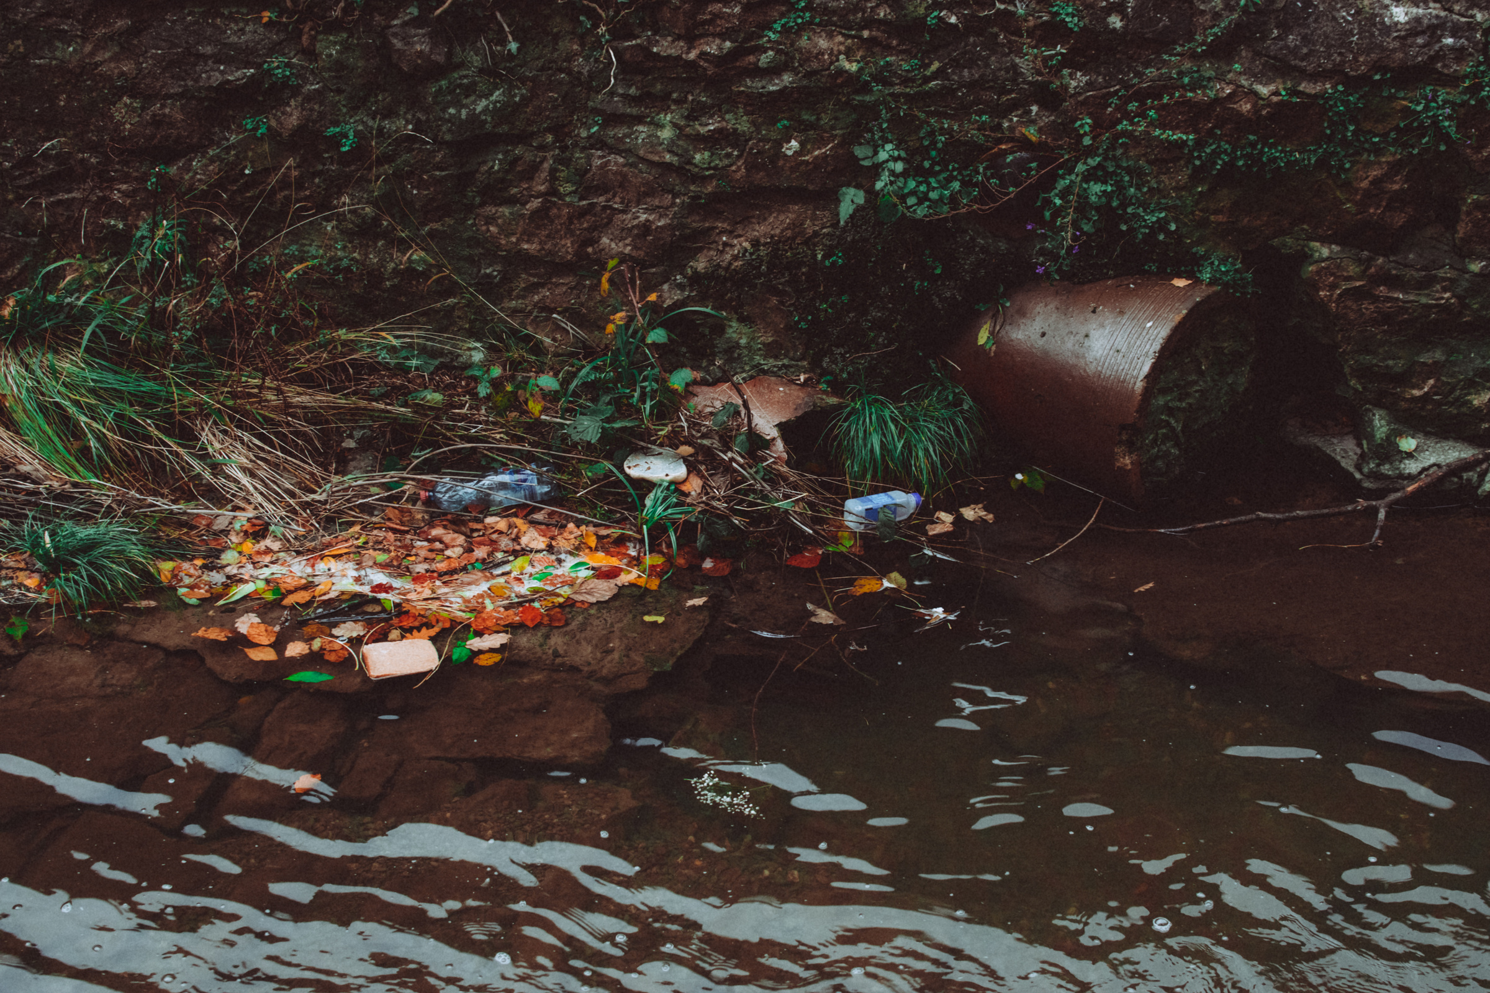
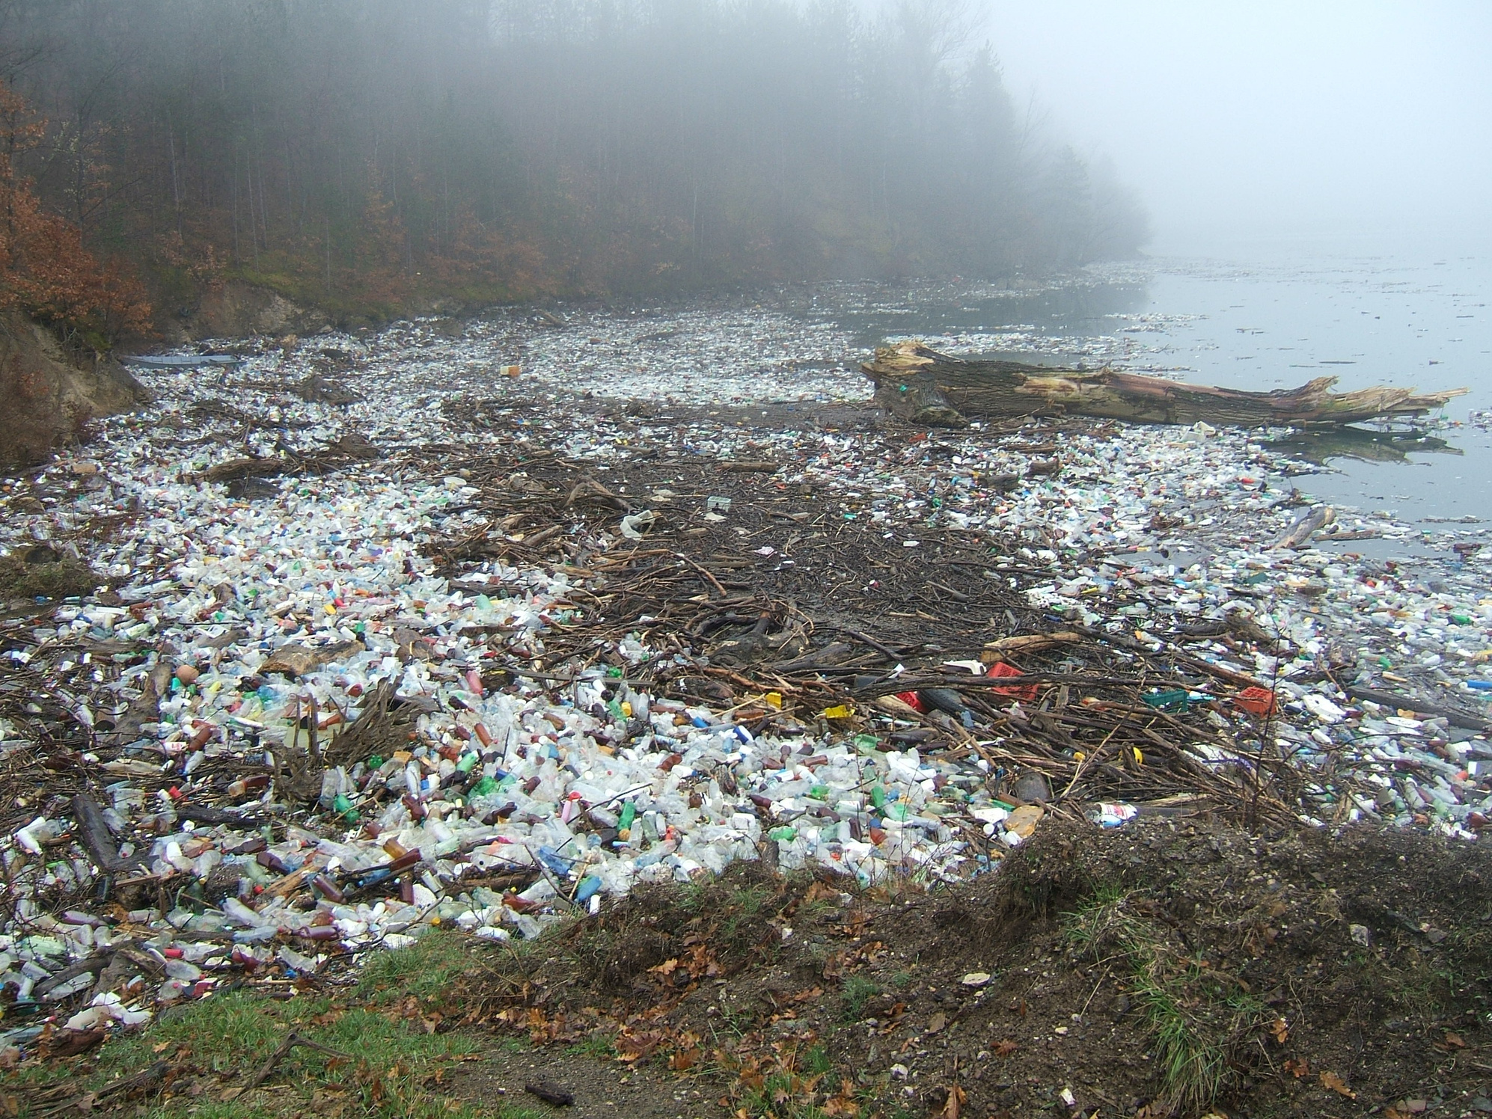

Slide 8
Introduction to the Chemical Industry
On the other hand, excessive consumption of natural resources such as water, energy and fossil fuels. This clearly shows that while chemistry is essential to human development, it must also evolve towards more responsible practices.

Slide 9
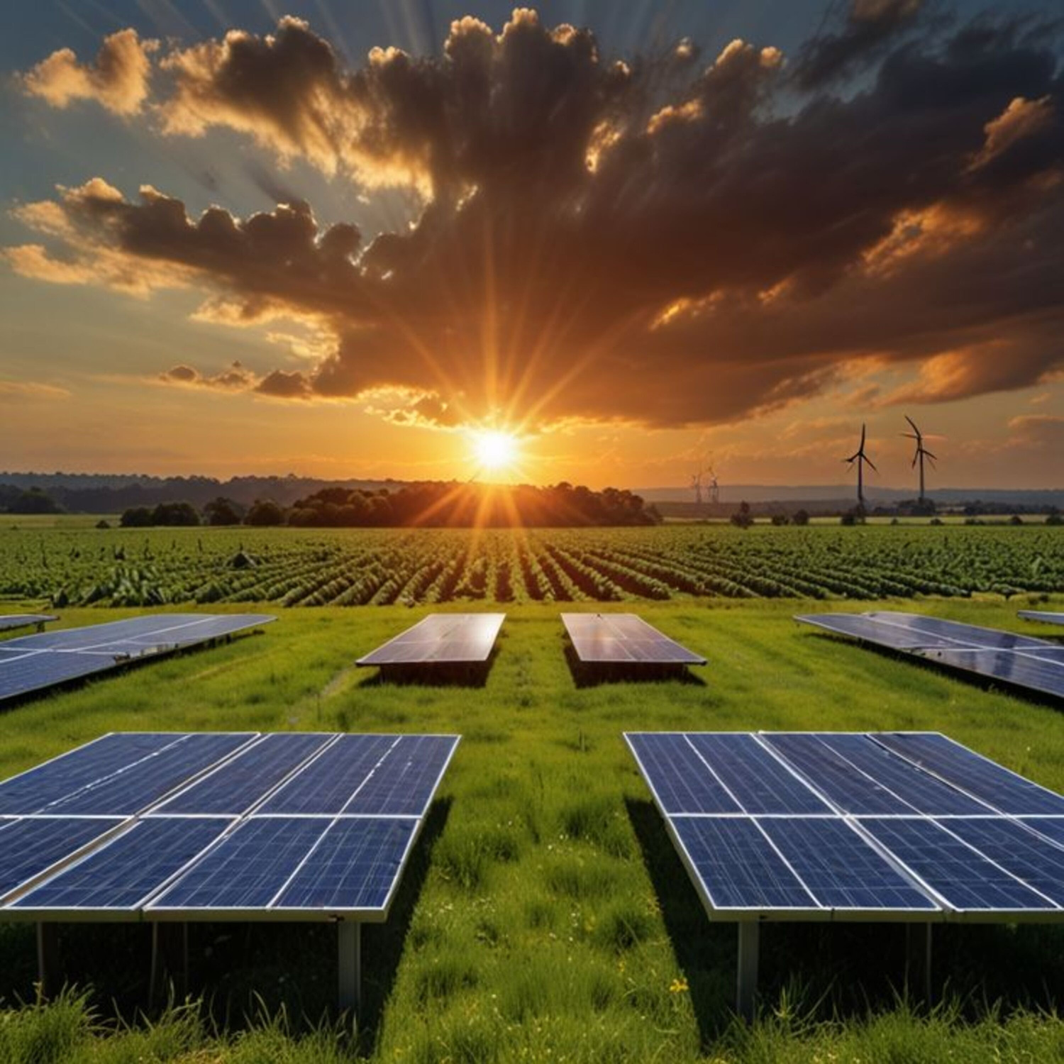

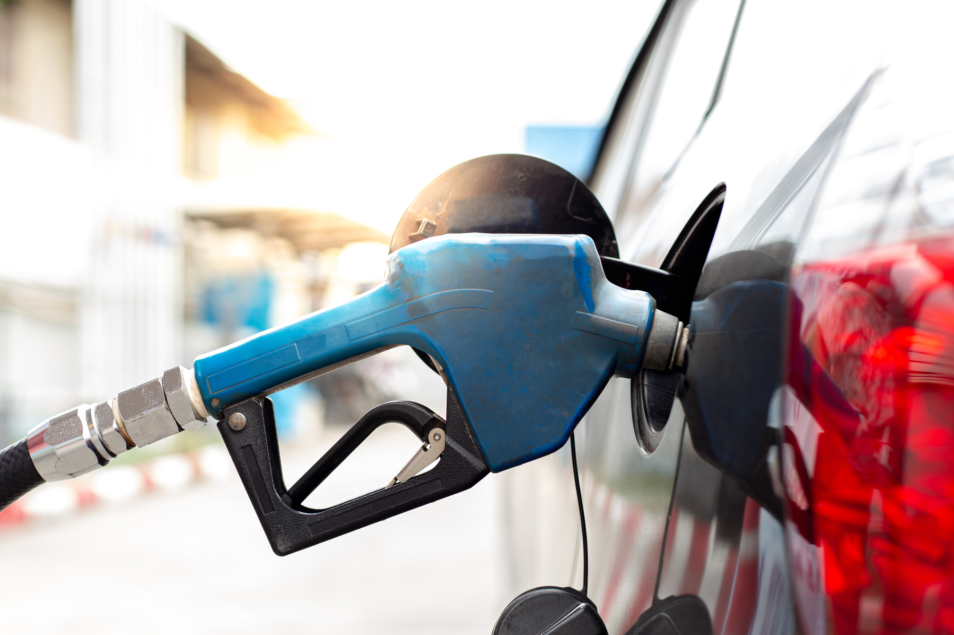

Slide 10

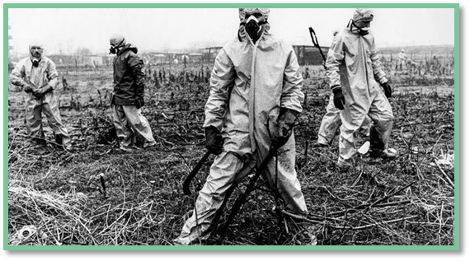
Accidents and Negative Impact
Despite its many benefits, the chemical industry has also been marked by serious accidents which have deeply affected public opinion.
Seveso 1976
In 1976, the Seveso accident in Italy released a large quantity of dioxin, an extremely toxic product, contaminating the environment and the local population.

Slide 11
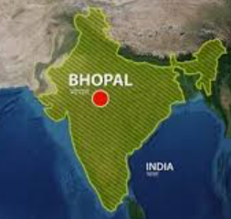
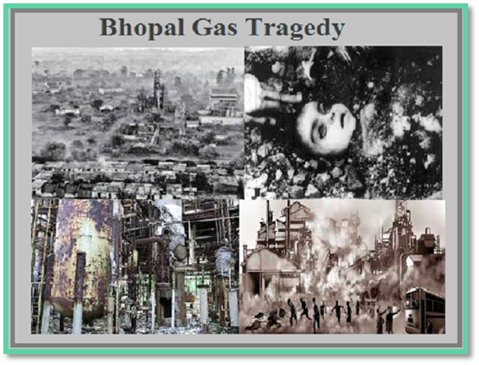
Accidents and Negative Impact
Despite its many benefits, the chemical industry has also been marked by serious accidents which have deeply affected public opinion.
Bhopal 1984
In 1984, in Bhopal, India, a massive toxic gas leak at a pesticide factory caused thousands of deaths and remains one of the worst industrial disasters in history.

Slide 12

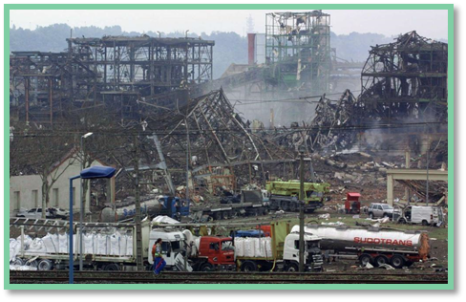
Accidents and Negative Impact
Despite its many benefits, the chemical industry has also been marked by serious accidents which have deeply affected public opinion.
AZF 2001
More recently, in 2001, the explosion at the AZF factory in Toulouse, France, caused heavy material and human damage.

Slide 13
Accidents and Negative Impact
These disasters have permanently tarnished the image of chemistry in the eyes of the public, often associating this science with danger and pollution, rather than its benefits.
These negative consequences, make scientists around the globe in situation of alert, they were in the obligation of looking for a quick solutions in order to avoid this disaster in the future.

Slide 14
The E-Factor : Measuring Industrial Waste
  One of the major problems related to the chemical industry is the production of waste. To measure this impact, researchers use an indicator called the E-Factor.
  The E-Factor is defined as the ratio between the mass of waste generated and the mass of the final product obtained. The higher this ratio, the more polluting the industry is.
  Contrary to what one might think, it is often the high value-added industries, such as pharmaceuticals and fine chemicals, that generate proportionally the most waste. In comparison, heavy industries, such as petroleum refining, produce less waste per unit of manufactured product.

Slide 15

The E-Factor : Measuring Industrial Waste
  This indicator clearly shows the urgency of rethinking our chemical processes in order to limit waste production at the source.

Slide 16
Birth of Green Chemistry
  “The concept of Green Chemistry was officially introduced in 1991 by the U.S. Environmental Protection Agency (EPA).
  The EPA defined green chemistry as ‘the design and development of chemical products and processes that reduce or eliminate the use and creation of dangerous substances.’
  This definition is important because it shows a shift in thinking: instead of focusing on treating pollution after it happens, the goal of green chemistry is to prevent pollution at the source.
  From this point forward, green chemistry became a new philosophy for scientists and industries, guiding them to design processes that are safer, cleaner, and more sustainable.”

Slide 17
Definition
Green Chemistry also called sustainable chemistry or renewable chemistry, is defined as the practice of promoting environmental sustainability through the reduction of waste and pollution in chemical processes, aligning with the broader principles of resource conservation and climate change prevention.
الكيمياء الخضراء تسمى أيضًا الكيمياء المستدامة أو الكيمياء المتجددة، ويتم تعريفها على أنها ممارسة تعزيز الاستدامة البيئية من خلال الحد من النفايات والتلوث في العمليات الكيميائية، بما يتماشى مع المبادئ الأوسع للحفاظ على الموارد والوقاية من تغير المناخ.

Slide 18
Objectives
The main objectives of green chemistry are:
  To prevent pollution rather than trying to clean it up afterward.
  To reduce energy consumption by designing more efficient reactions.
  To use renewable resources instead of limited fossil fuels.
  To improve the safety of chemical processes for both humans and the environment.
In short, green chemistry aims to make the chemical industry more sustainable, efficient, and safe.

Slide 19

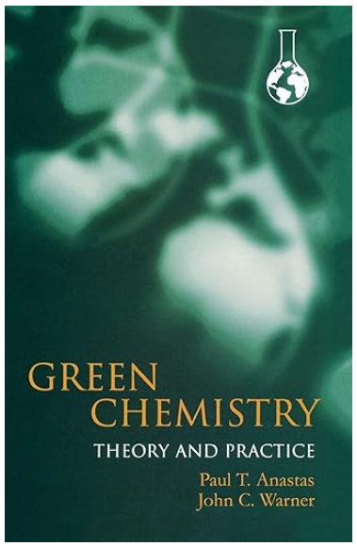

The 12 principles of Green Chemistry
In 1998, Paul Anastas and John Warner published the book ‘’Green Chemistry: Theory and Practice’’. They explained the 12 principles of Green Chemistry, which are still the main guide today for creating safe, efficient, and environmentally friendly chemical processes.
Paul Anastas
John Warner

Slide 20
The 12 principles of Green Chemistry

Slide 21
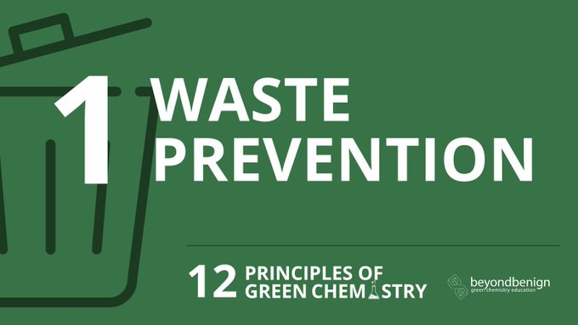

Slide 22
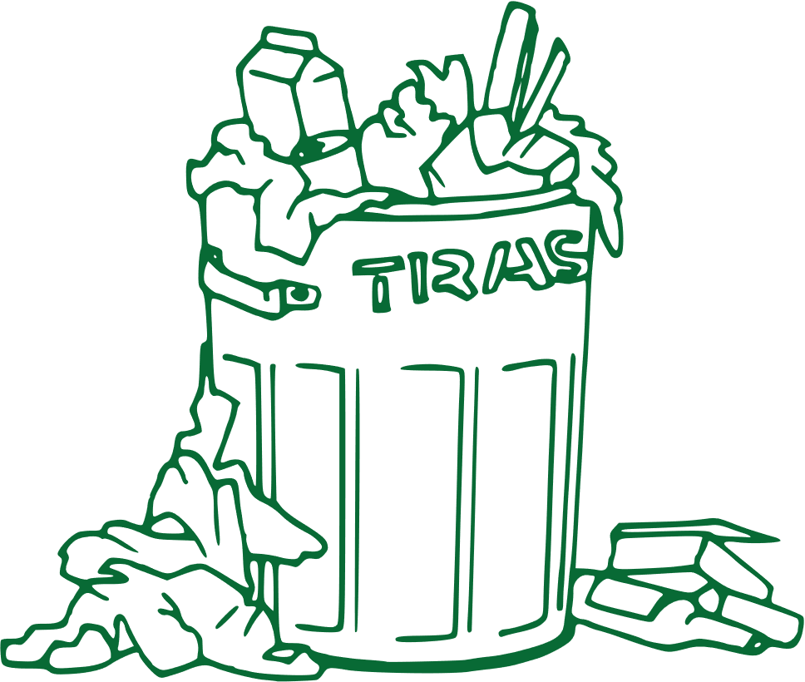
1. Prevent Waste:
It is better to prevent waste than to treat or clean up waste after it has been created.

Slide 23
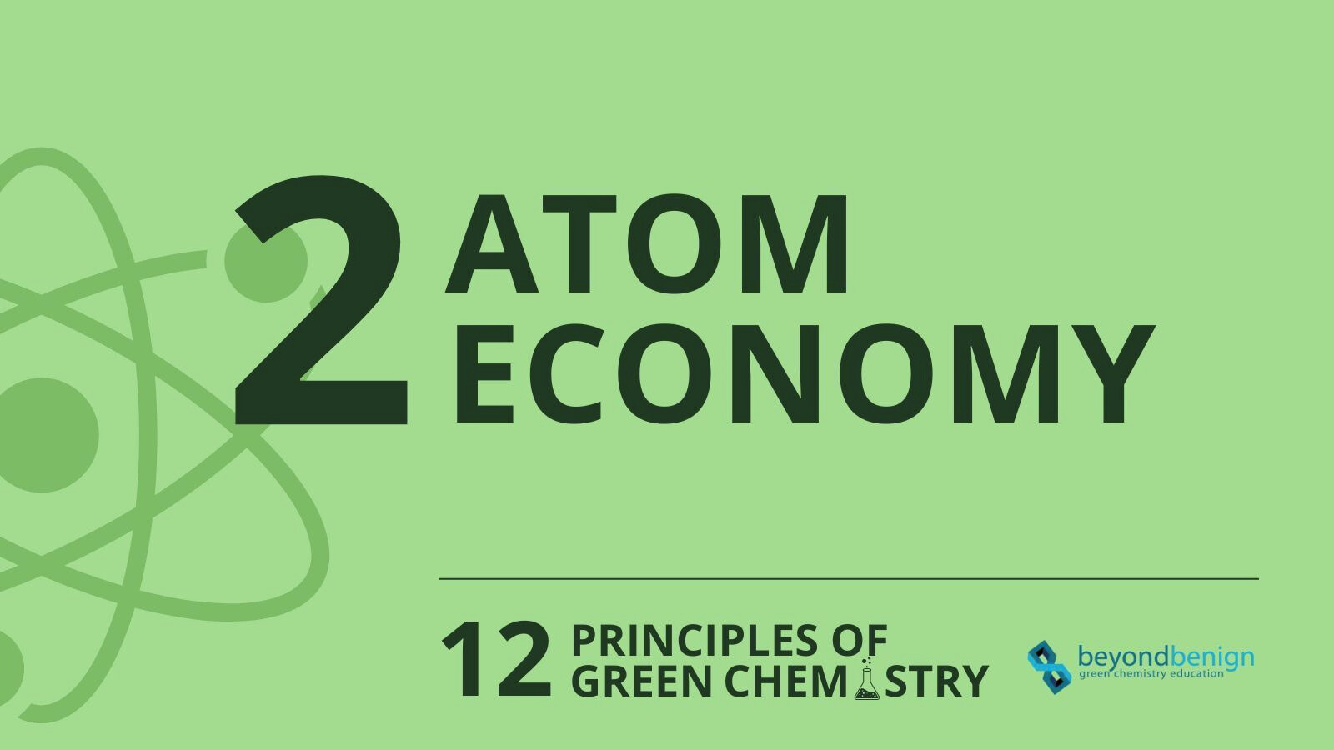

Slide 24
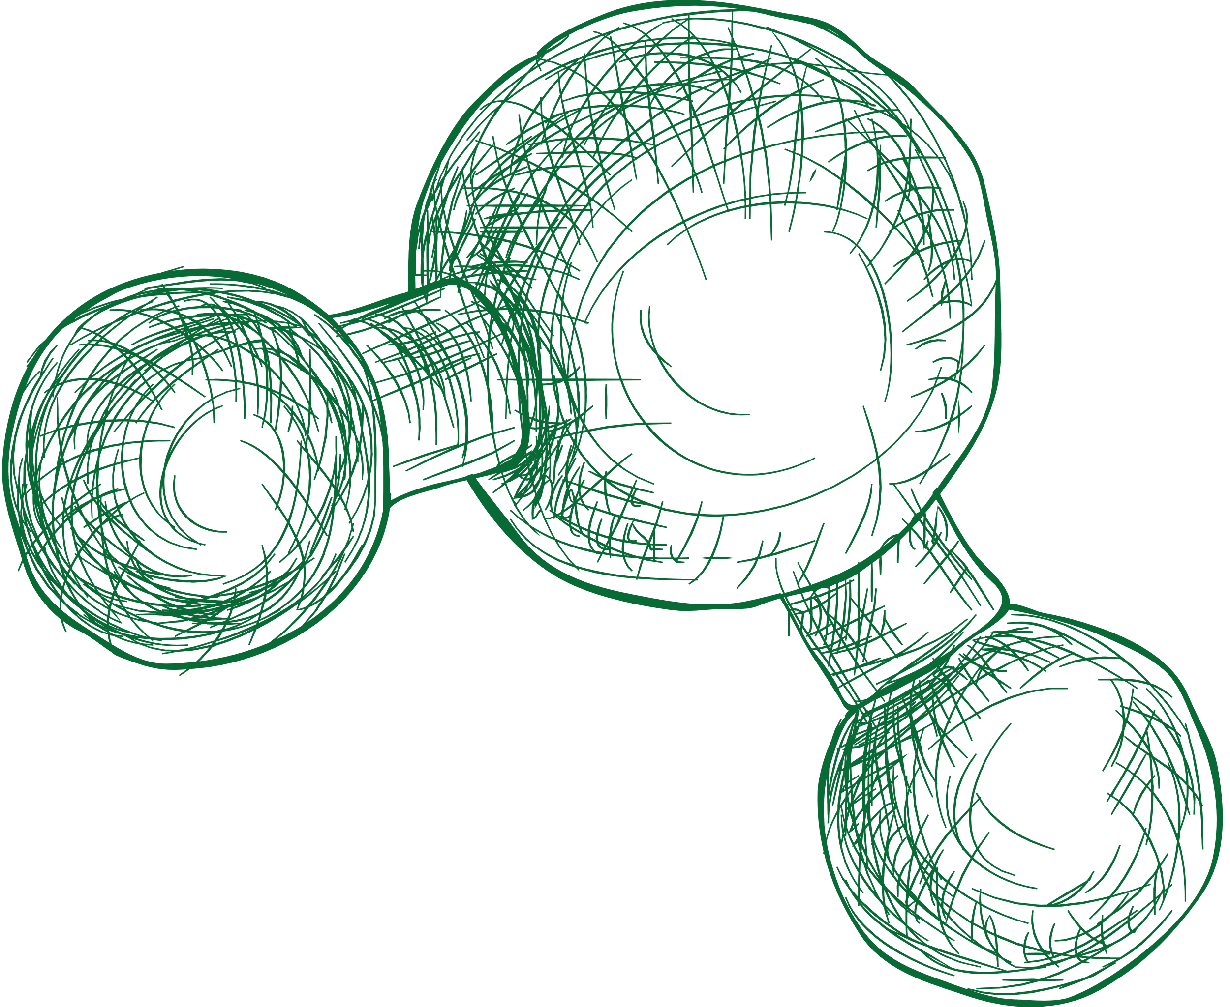
2. Atom Economy:
Synthetic methods should be designed to maximize the incorporation of all materials used in the process into the
final product.

Slide 25
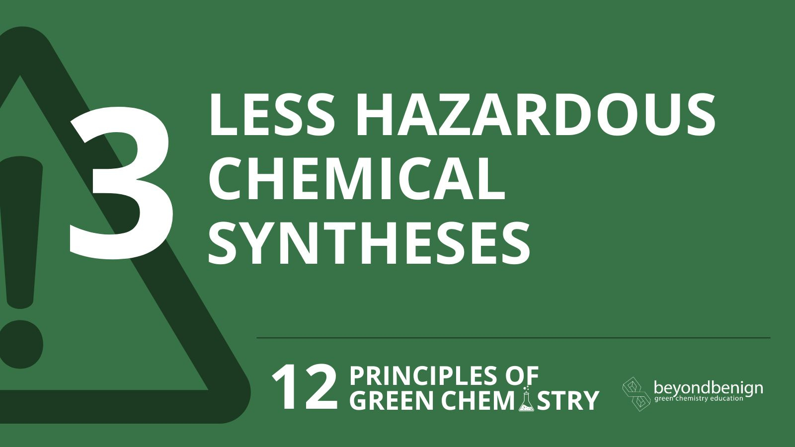

Slide 26

3. Less Hazardous Chemical
Syntheses:
Design synthetic methodologies to use and generate substances with little or no toxicity to human health and the environment.

Slide 27

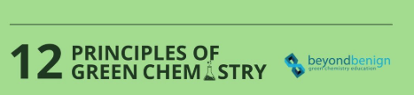
4
Designing Safer Chemicals

Slide 28

4. Designing Safer Chemicals:
Chemical products should be designed to be fully
effective yet have little or no toxicity.

Slide 29


5
Safer Solvents
and Auxiliaries

Slide 30

5. Safer Solvents and Auxiliaries:
The use of auxiliary substances (e.g., solvents, separation agents) should be minimized or eliminated when possible, or be innocuous.

Slide 31

6
Design for
Energy
Efficiency

Slide 32

6. Design for Energy Efficiency:
Recognize the environmental and economic impacts of energy requirements and minimize them, ideally by conducting syntheses at ambient temperature and pressure.

Slide 33
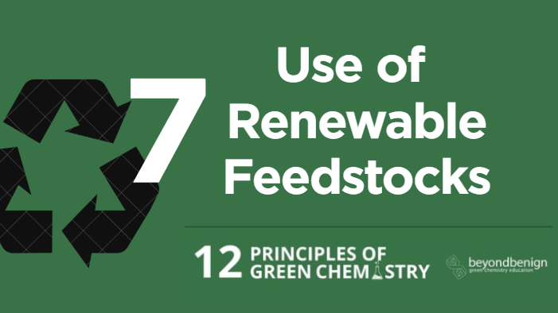
Use of
Renewable Feedstocks

Slide 34

7. Use of Renewable Feedstocks:
A raw material or feedstock should be renewable rather than depleting whenever technically and economically practicable.

Slide 35
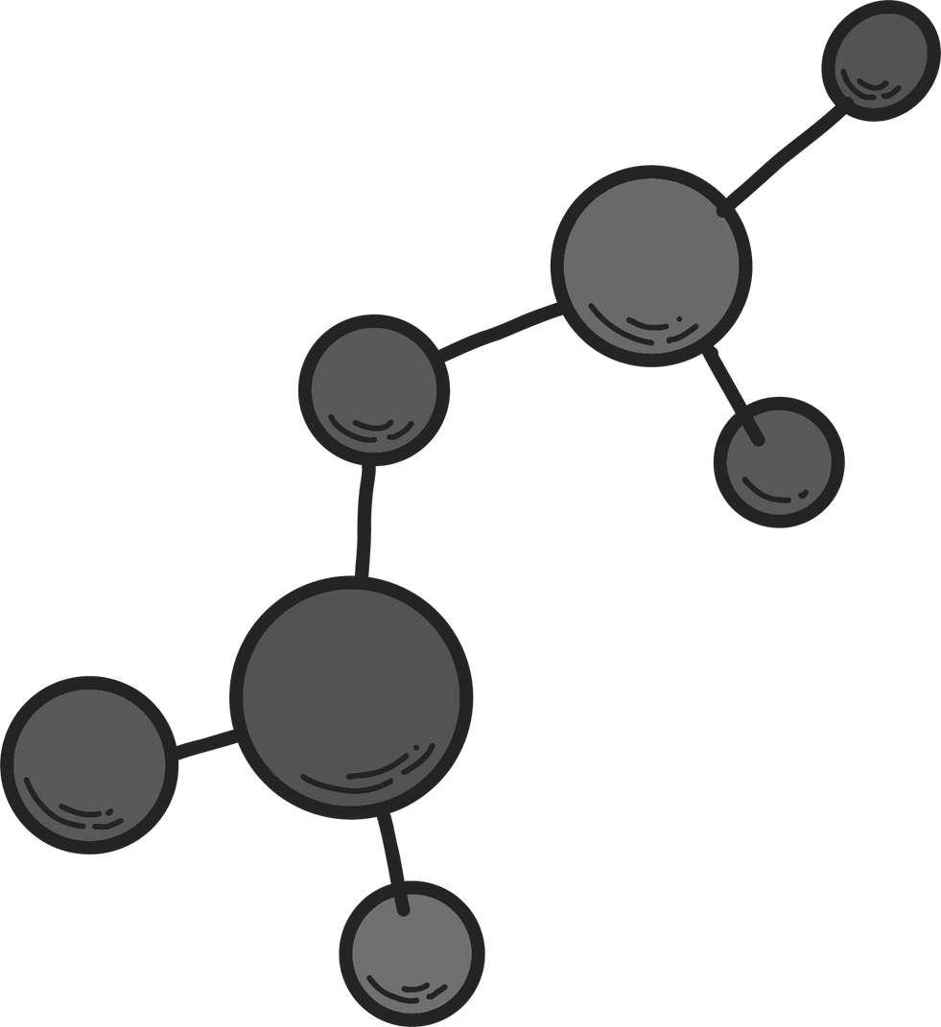
8
Reduce Derivatives

Slide 36
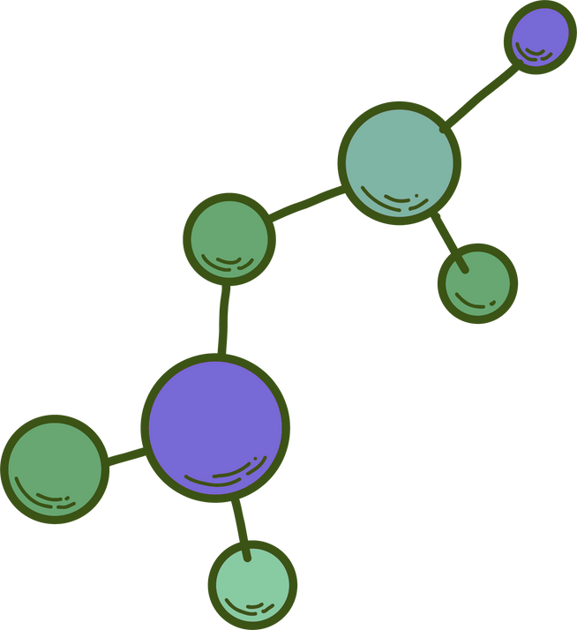
8. Reduce Derivatives:
Avoid unnecessary derivatization, such as the use of
blocking or protecting groups, which requires additional reagents and generates waste.

Slide 37
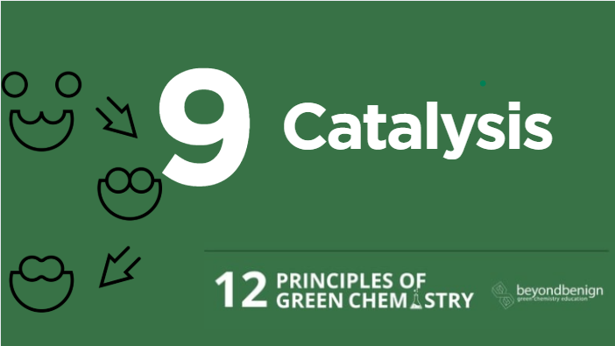

Slide 38

9. Catalysis:
Catalytic reagents, which are used in small amounts and can carry out a reaction multiple times, are superior to stoichiometric reagents.

Slide 39

10
Design for Degradation

Slide 40

10. Design for Degradation:
Chemical products should be designed so that they break down into innocuous substances after use and do not
persist in the environment.

Slide 41
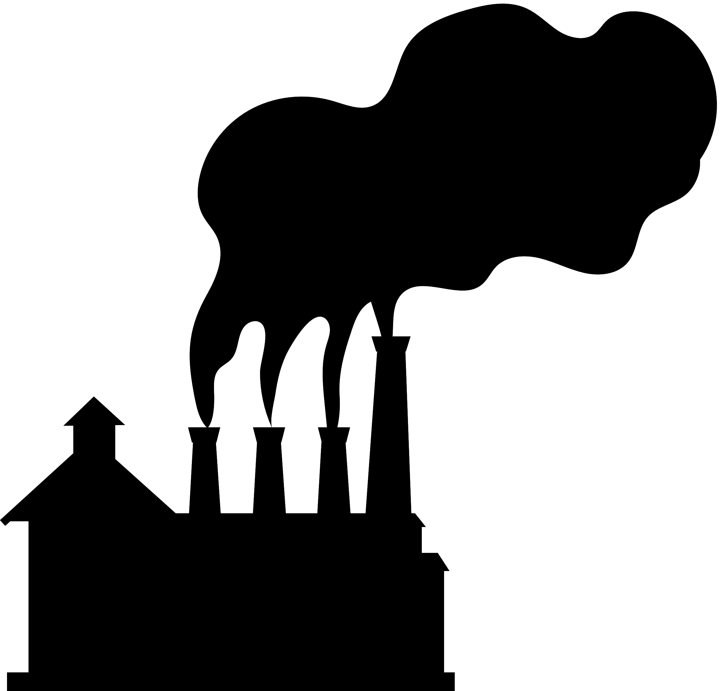
11
Real-Time Analysis
for Pollution Prevention

Slide 42

11. Real-Time Analysis for Pollution Prevention:
Develop analytical methodologies to allow for real-time monitoring and control during a process to prevent the formation of hazardous substances.

Slide 43
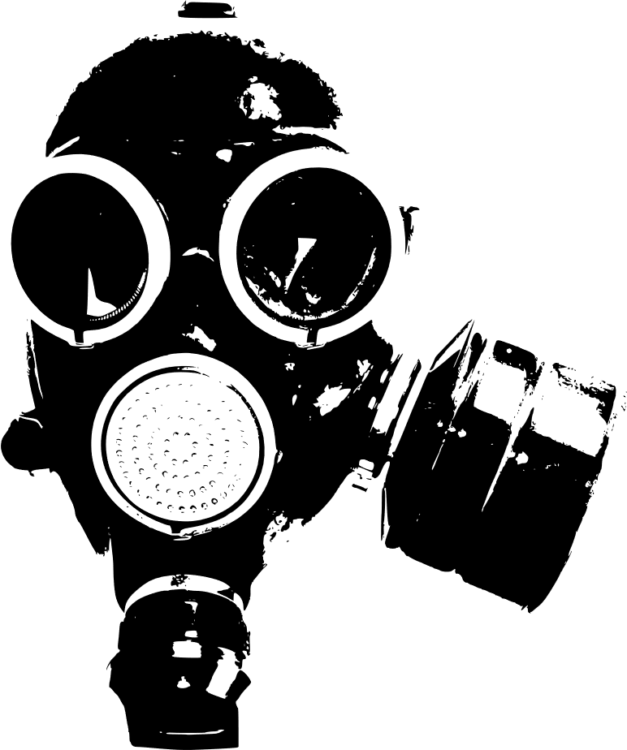
Inherently Safer Chemistry for Accident
Prevention
12

Slide 44

12. Inherently Safer Chemistry for Accident Prevention:
Choose substances and the form of a substance used in a chemical process to minimize the potential for chemical accidents, including releases, explosions, and fires.

Slide 45
Conclusions
Green Chemistry is essential for creating chemical processes that are safer, more efficient, and environmentally friendly.
Its principles guide the industry toward reducing waste, hazards, and energy use, while promoting renewable resources.
Adoption of these practices supports sustainable development and addresses global environmental challenges.

Slide 46

THANK YOU FOR YOUR ATTENTION!

