Slide 1


Slide 2

People’s Democratic Republic of Algeria
Abdel hafid Bou Al-Souf University, Mila
Institute of Science and Technology
Tronc commun science and technology
Title:
Prepared by: Under the supervision of
Mengah Wissam Professor :
A.Mayouf
Group :
University year: 2025/2026
Research on Sulfuric Acid(H₂SO₄)

Slide 3
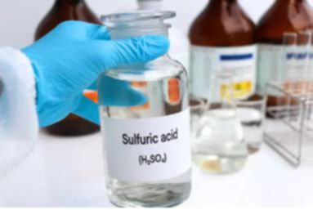
Research Plan :
1- Introductory .
2- Research on Sulfuric Acid(H₂SO₄).
> Definition of Sulfuric Acid (H₂SO₄).
> Components of Sulfuric Acid.
> Chemical Structure and Molecular
Formation of (H₂SO₄).
> Uses of Sulfuric Acid.
> Safety Precautions When Using Sulfuric
Acid.
3- Conclusion.

Slide 4
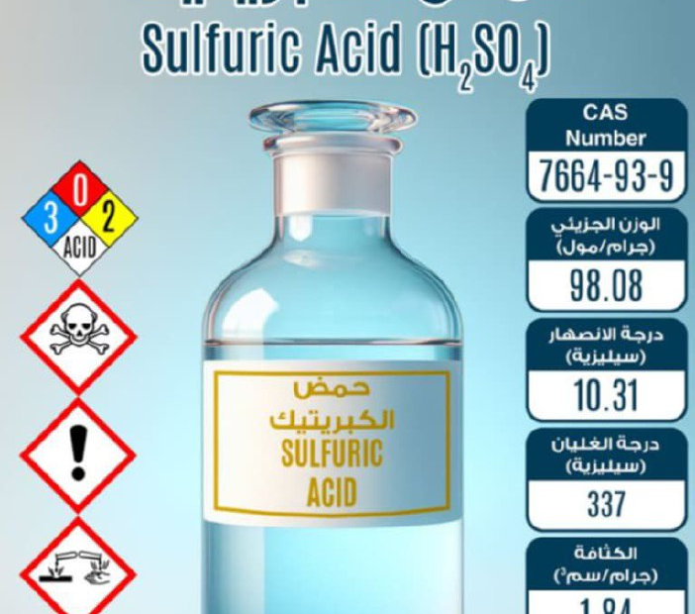
1-Introductory Paragraph

Slide 5
1-Introductory Paragraph
Sulfuric acid (H₂SO₄) is one of the most important chemical substances used in daily life and in various industrial fields. It is a strong acid known for its unique properties, making it essential in the production of fertilizers, batteries, oil refining, and many other industries. Because of its wide importance and applications, it is necessary to understand its components, chemical structure, uses, and the safety precautions required when handling it to ensure proper and safe usage.

Slide 6
2- Research on Sulfuric Acid(H₂SO₄)
> Definition of Sulfuric Acid (H₂SO₄)
Sulfuric acid is a very strong mineral acid and one of the most important industrial chemicals worldwide.
Its molecular formula is H₂SO₄, and it is a colorless, oily liquid that dissolves in water with the release of a large amount of heat.
It is historically known as Oil of Vitriol.

Slide 7

> Components of Sulfuric Acid.
Sulfuric acid is composed of:
These atoms are bonded together with covalent bonds, and the acid has a high ability to release hydrogen ions (H⁺) in water, making it one of the strongest acids.
• Two hydrogen atoms (H₂)
• One sulfur atom (S)
• Four oxygen atoms (O₄)

Slide 8
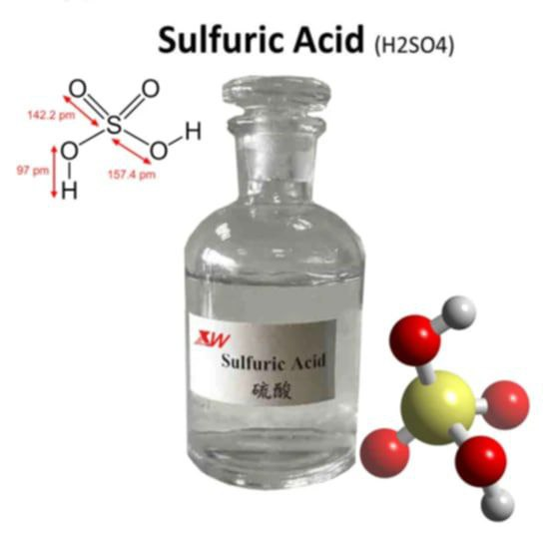
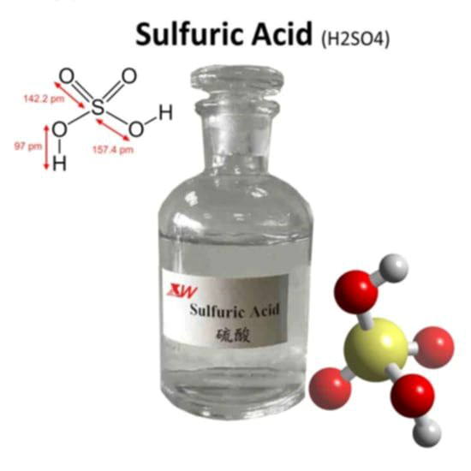
> Chemical Structure and Molecular
Formation of (H₂SO₄).
Industrial Preparation (Contact Process)
Molecular Structure
1) Burning sulfur to produce SO₂:
S + O₂ SO₂
2) Oxidizing SO₂ to SO₃ using vanadium pentoxide catalyst (V₂O₅):
2SO₂ + O₂ 2SO₃
3) Dissolving SO₃ in concentrated sulfuric
acid to form oleum:
SO₃ + H₂SO₄ H₂S2O7
4) Diluting oleum with water to obtain sulfuric acid:
H₂S₂O7+ H₂O 2H₂SO₄
The molecule consists of:
One central sulfur atom
Four oxygen atoms:
• Two oxygen atoms connected by double bonds
• Two oxygen atoms connected by single bonds, each carrying one hydrogen atom
O
||
H – O – S – O – H
||
O

Slide 9
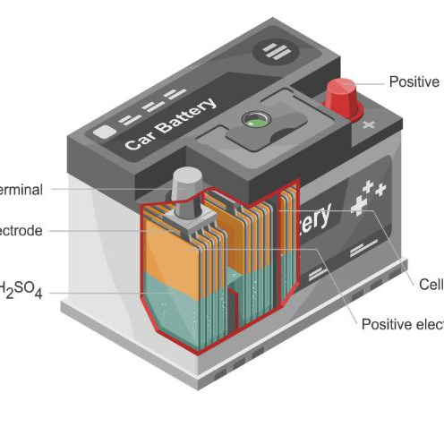
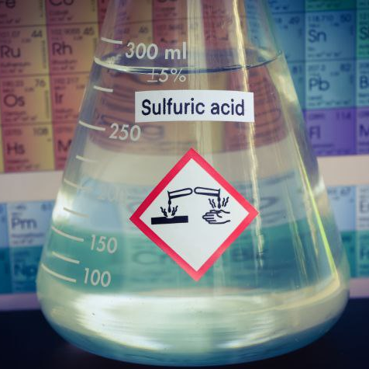
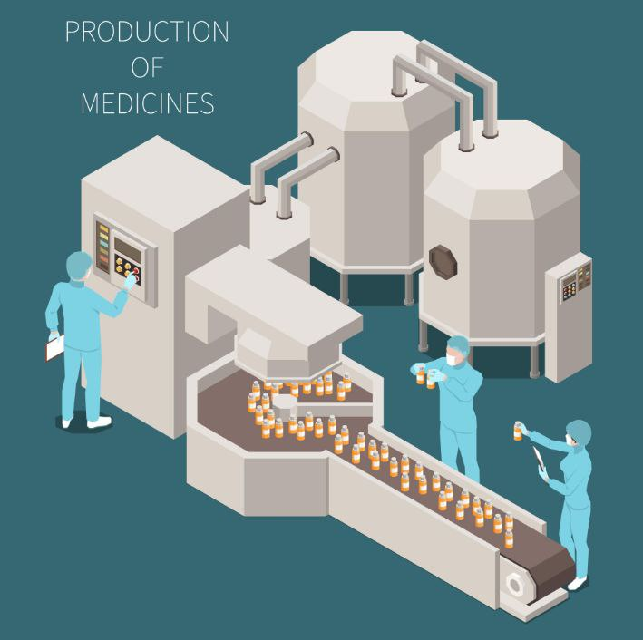
> Uses of Sulfuric Acid.
Sulfuric acid is one of the most widely used chemicals in the world. Its major applications include:
• Industry
>Production of fertilizers, especially ammonium phosphate .
>Petroleum refining.
Lead-acid batteries (car batteries) .
>Manufacture of dyes, paints, and textiles.
>Production of explosives such as TNT.
>Manufacture of detergents and soaps
• Laboratories
>Used as a strong dehydrating agent.
>In oxidation-reduction reactions.
>Preparation of other acids, such as hydrochloric acid.
• Medicine
>Used indirectly in the manufacture of some pharmaceuticals (in low concentrations).

Slide 10
>Safety Precautions When Using Sulfuric Acid.
>Safety goggles.
>Rubber gloves
>Protective clothing .
>Respiratory mask (for industrial use)
Sulfuric acid is a highly dangerous substance and must be handled with great care:
1. Wear protective equipment
3. When diluting: Follow the golden rule
4. Storage
5. Spill handling
2. Avoid contact with skin or eyes
>Avoid contact
with skin
>It can cause
severe chemical
burns.
>Cover the spill with absorbing materials like sand or baking soda.
>Always add acid to water, not water to acid
This prevents violent reactions and splashing.
>Store in corrosion-resistant containers
Keep away from heat, moisture, and flammable substances

Slide 11
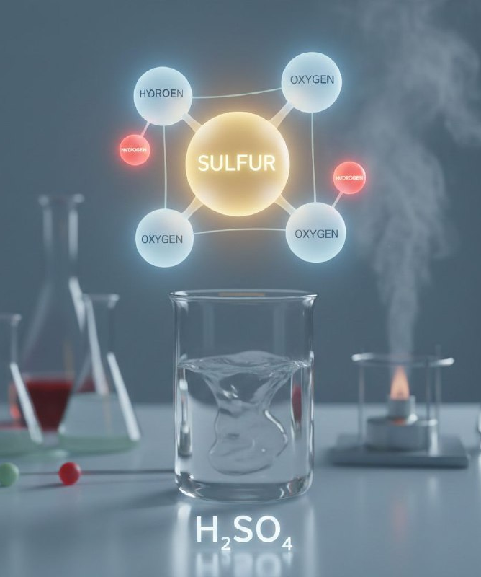
3-Conclusion
Sulfuric acid (H_2SO_4) is one of the most important mineral acids and has extensive industrial applications. Its strong chemical properties make it essential in producing fertilizers, batteries, detergents, and explosives. However, due to its highly corrosive nature, it must be used with strict safety measures to ensure safe and effective handling.

Slide 12
“Thank you for your attention
Any questions”

