Slide 1
بسم الله الرحمان الرحيم

Slide 2
University Abdelhafide Buossof –Mila-
Faculty of:Science and Technology. Department of: Process Engineering.
Module: Inorganic Chemistry.
Study on:
the Copper Element
Prepared by student: Guennifi Hiba Under the supervision of Professor:
Mayouf.
Academic Year: 2025\2026

Slide 3
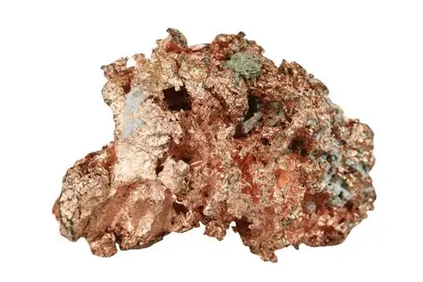
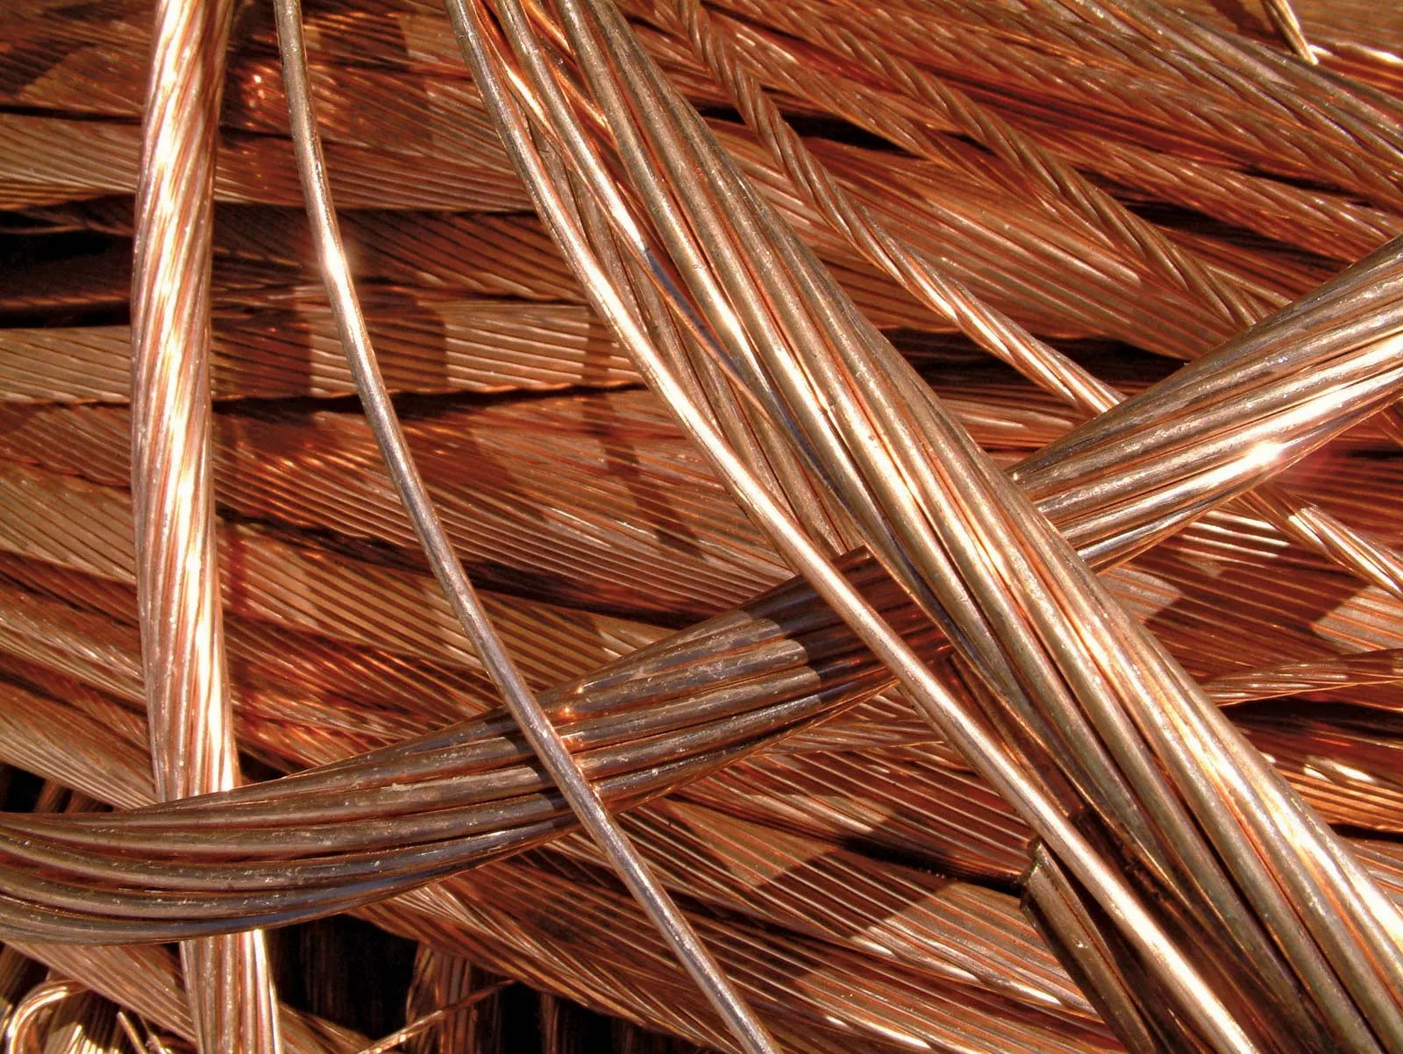
Introduction:
Copper (Cu) is a chemical element and transition metal characterized by its reddish-orange color, high flexibility, malleability, and excellent conductivity of electricity and heat. These unique properties make it one of the most important metals in human civilization and modern industry.

Slide 4
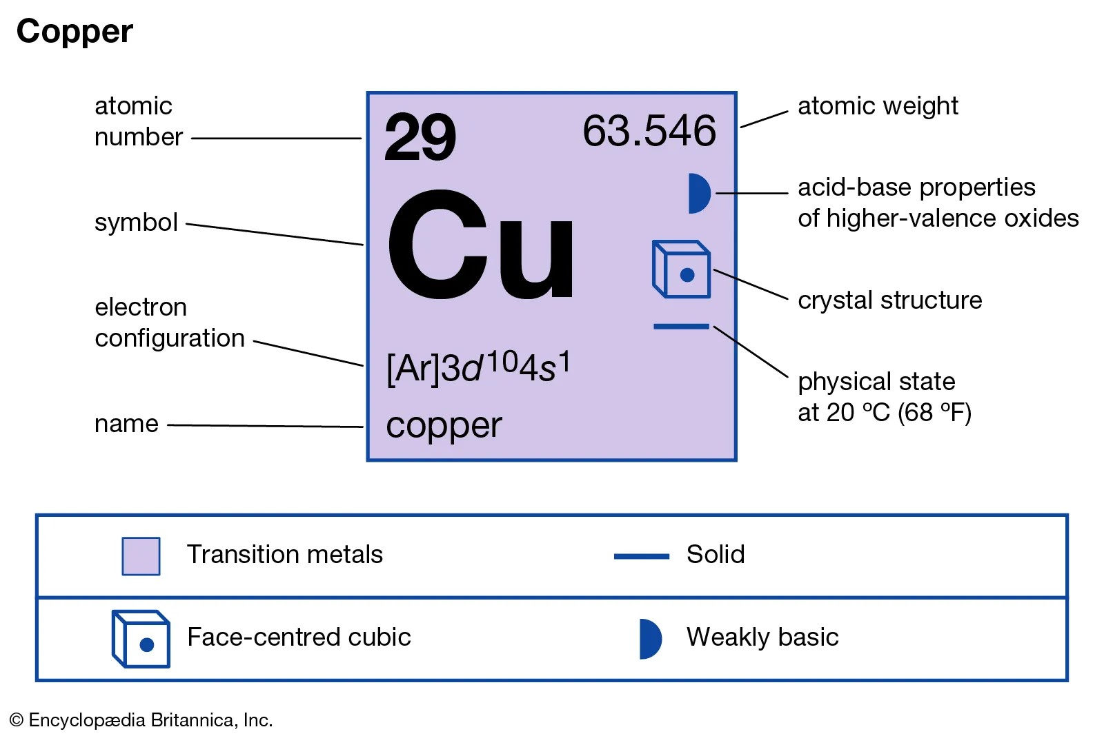
Definition:
Cooper(Cu)is a transition metal ,atomic number 29 belonging to group 11of the periodic table. It is known for its high electrical and thermal conductivity and is used in wires, alloys, and pipes.

Slide 5
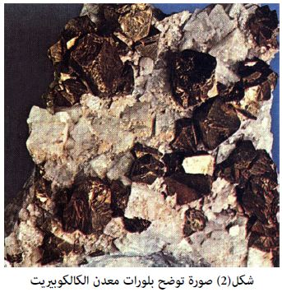
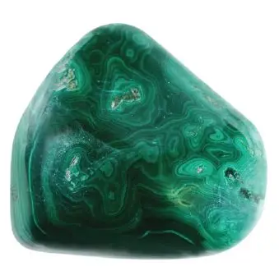
Sources of Copper:
Copper is a natural metal found in the Earth’s crust, ofter in the form of:
.Chalcopyrite (CuFeS 2)
.Malachite (Cu 2 CO 3 (OH) 2 )
.Azurite
.Rarely found as a pure
native metal
It is mainly extracted through mining,followed by smelting to separate it from other elements.

Slide 6
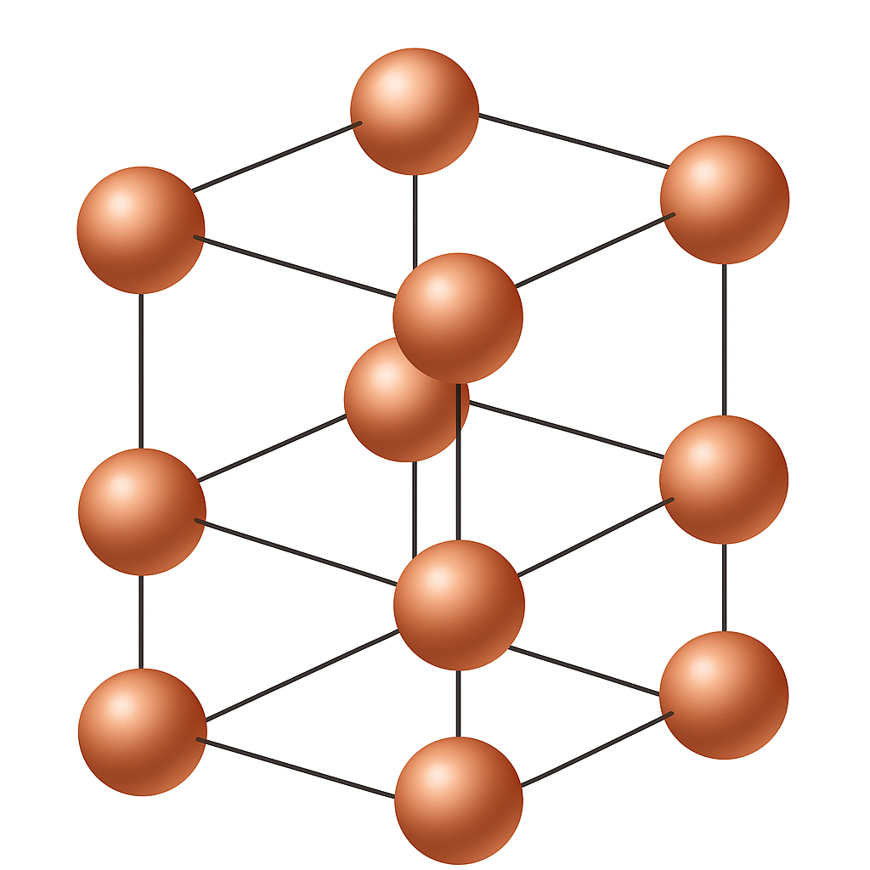
Copper crystal structure:
The crystal structure of copper (Cu) is face-centered cubic (FCC). This structure gives copper good ductivity and malleability, as well as high strength and flexibility.

Slide 7
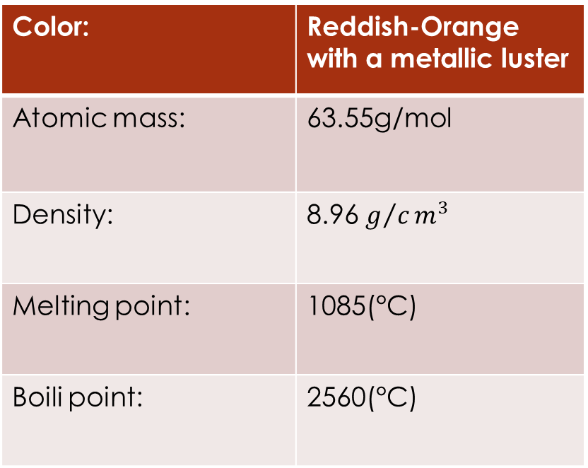
Properties of Copper:
Physical : Chemical:
-Reacts slowly with oxygen to
form a green layer called patina
-Does not react easily with cold
or hot water .
-Dissolves in strong asids like nitric
asid .
-Shows two main oxidation
states: +1 and +2
Excellent conductor of heat and
electricity
Color: | Reddish-Orange with a metallic luster
Atomic mass: | 63.55g/mol
Density: | 8.96 $g/cm^{3}$
Melting point: | 1085(°C)
Boili point: | 2560(°C)

Slide 8
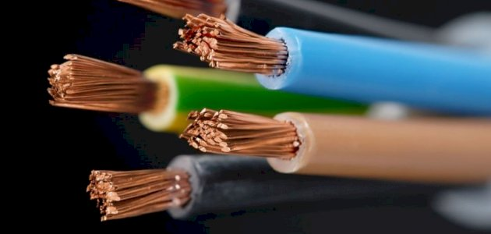
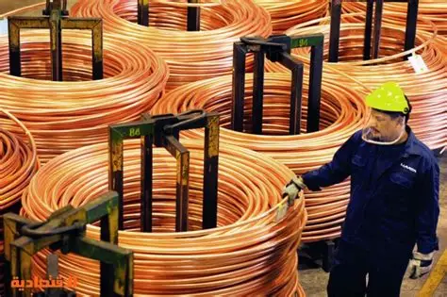
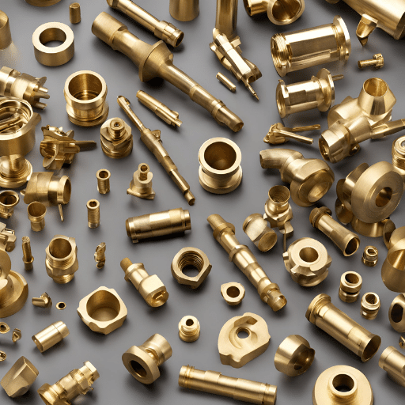
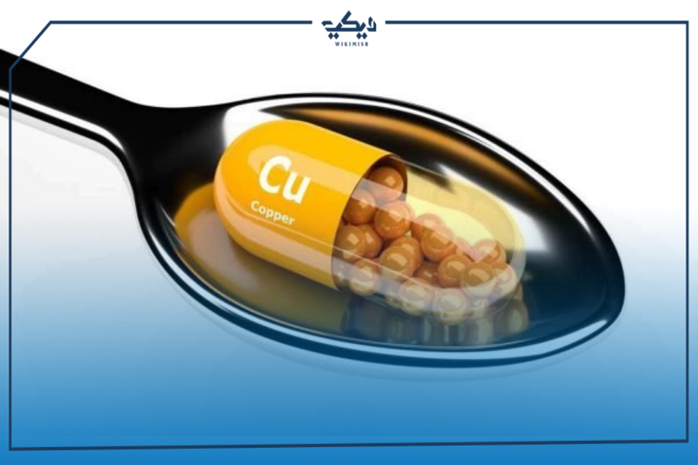
Uses of Copper:
1. Electricity and Electronics:Foor wires, transformers, and electrical boards.
2. Construction: In pipes, roofs, and sanitary tools.
3. Jewelry and Coins: Dto its shine and malleability.
4.Medicine: Antibacterial properties and usud in some medical devices.
5. Chemical Industry: As a catalyst in certain chemical reactions.

Slide 9
Risks of Copper:
Advantages of Cpper:
Excellent conductor of electricity and heat.
Resistant to corrosion in some condition.
Antibacterial properties.
Fully recyclable.
Inhaling or ingesting large amounts may cause copper poisoning.
Prolonged skin contact may cause irritation or allergies.
Environmental impact: Accumulation in soil and water can harm living organisms

Slide 10
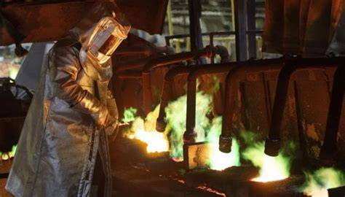
Precautions for Using Copper:
Wear gloves when handling raw copper or reated chemicals.
Avoid inhaling dust or fumes from copper smelting.
Keep away from children and animals.
Dispose of copper waste safely.

Slide 11
Conclusion:
Copper is a vital and important metal in our daily and industrial life. Despite its many benefits, it should be handled carefully to avoid health and environmental risks . Copper combines beauty and functionality and continues to be widely used in various fields throughout history.

