Slide 1


Slide 2


People’s Democratic Republic of Algeria
Abdel hafid Bou Al-Souf University Mila
  Institute of Science and Technology
Genie des procédés
:
  Title:
IRON ELEMENT (Fe)
Prepared by:
Under The Supervision of Professor::
Mayouf Imane
Prepared by:
Fatima Belhadri
Group: 1
University year: 2025/2026
University year: 2025/2026

Slide 3
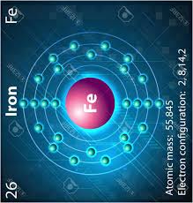
Research Outline:
01/Introduction.
02/Definition of the Element Iron.
03/ Composition and Constituents of Iron.
04/ Natural Sources of Iron.
05/ Industrial and Biological Uses.
06/ Potential Risks and Hazards
07/ Conclusion.
08/ Academic References.

Slide 4
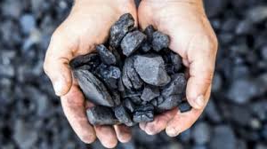
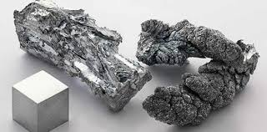
01/ Introduction:
  Iron is one of the most important and widely used elements on Earth. It has played a crucial role in the development of human civilization and continues to be essential in modern industries.

Slide 5
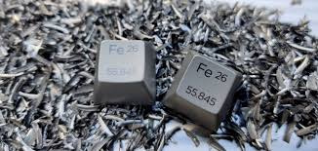
02/ Definition of the Element Iron:
is a chemical element with the symbol Fe and atomic number 26. It is a metal belonging to the transition group in the periodic table. Iron is strong, ductile, and magnetic in nature.

Slide 6
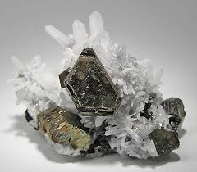
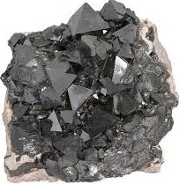
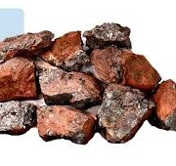
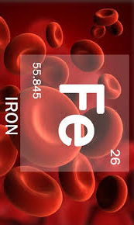
03/ Composition and Constituents of Iron :
Pure iron consists mainly of iron atoms, but in nature, it is often found combined with other elements such as:
oxygen, carbon, and sulfur. Common iron ores include hematite (Fe₂ O₃) and magnetite (Fe₃ O₄).

Slide 7
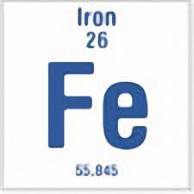
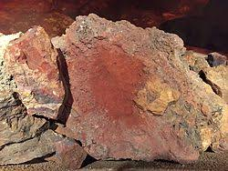
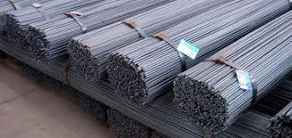


04/ Natural Sources of Iron:
Natural geological sources :
main iron ores like hematite (Fe₂O₃) and magnetite (Fe₃o₄)
Industrial
Sources:
iron supplements
Such as( ferrous sulfate ) and iron-fortified
foods.
Plant food sources: Legumes , spinach, nuts, and dried fruits
Animal food Sources:
Red meat liver, and seafood.

Slide 8
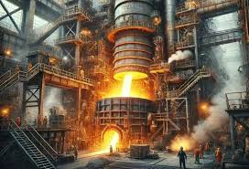
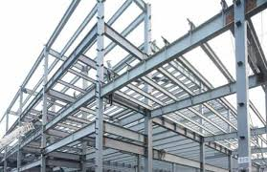


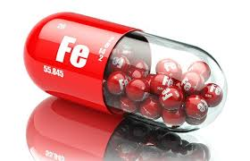
05/ Industrial and Biological Uses:
1/ In construction, to make steel for buildings and bridges.
2/ In transportation, for cars, trains, and ships.
3/ In manufacturing tools and machines.
4/ In the human body, iron is essential for producing hemoglobin in red blood cells.

Slide 9

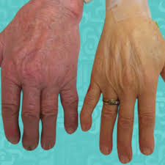
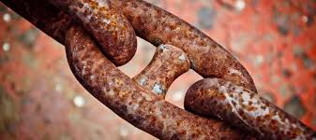
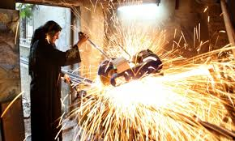
06/ Potential Risks and Hazards :
Iron
Excessive exposure to iron dust or fumes can cause respiratory problems or lung diseases.
Too much iron in the body may lead to serious conditions such as hemochromatosis.
Iron can rust easily when exposed to water and air, which reduces its strength and quality.
In some industries, sparks from iron tools can cause fire hazards or injuries.
Iron

Slide 10
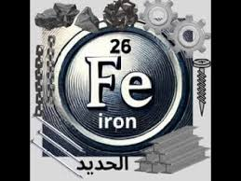
07/ Conclusion.
remains one of the most valuable elements in human life. It has shaped history, supported industries, and sustained life itself. Despite some risks, its benefits are far greater.

Slide 11
09/ Academic References
1/ Britannica, Iron (Fe) Element Overview.
2/Chemicool , Iron Element Facts.
3/ThoughtCo , Properties and Uses of Iron.

Slide 12
Thank you for listening

Slide 13
Please feel free to share your questions

