Slide 1

Democratic and Popular Republic of Algeria
Ministry of Higher Education and Scientific Research
Abd El-Hafid Boussouf University - Mila
Faculty of Sciences & Technology
Department of Process Engineering
HSE in Industrial Installations – UED2.1
Week V:
Risk Prevention and Control Strategies

Slide 2
Learning Outcomes
By the end of this session, you will be able to:
Understand the philosophy of risk prevention.
Apply the hierarchy of controls.
Select appropriate control measures for physical, chemical, and biological hazards.
Develop safe work procedures and permit-to-work systems.
Understand emergency preparedness principles.

Slide 3
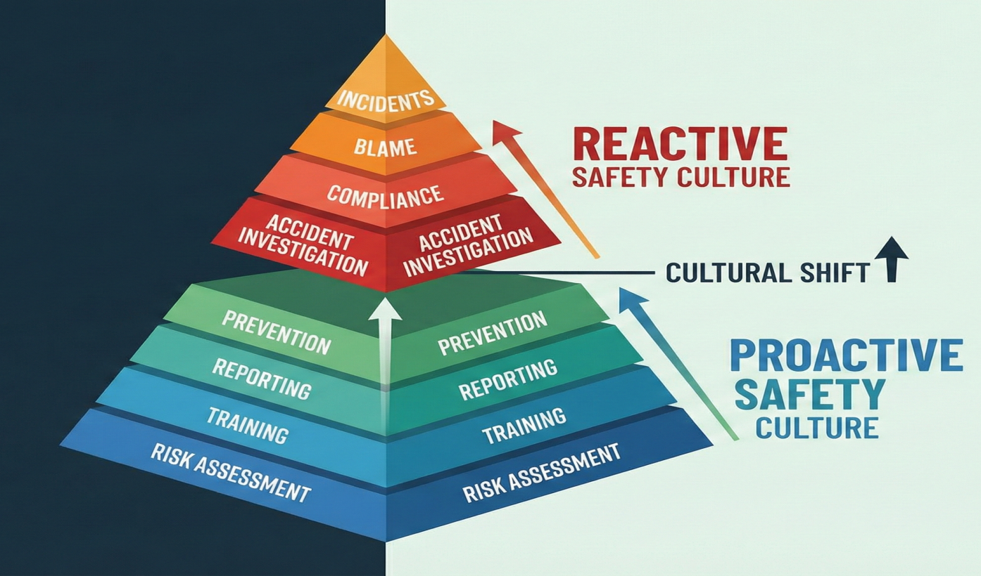
1. Prevention Philosophy:
Prevention is proactive, not reactive.
Goal: eliminate hazards at their source.
Prevention integrates into the organizational management system (ISO 45001, ISO 14001).
Optimizes safety performance and reduces incident frequency.

Slide 4
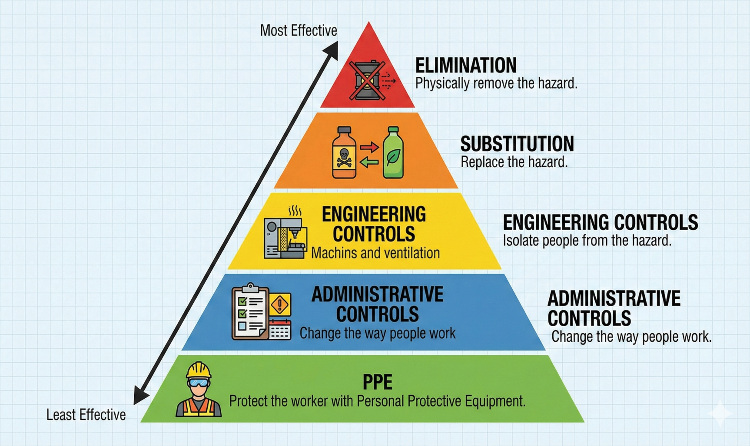
II. Hierarchy of Controls (HC)
HC is internationally recognized strategy to control workplace risks.
Prioritize engineering and elimination over administrative measures and PPE.
Applied to all industrial sectors.

Slide 5
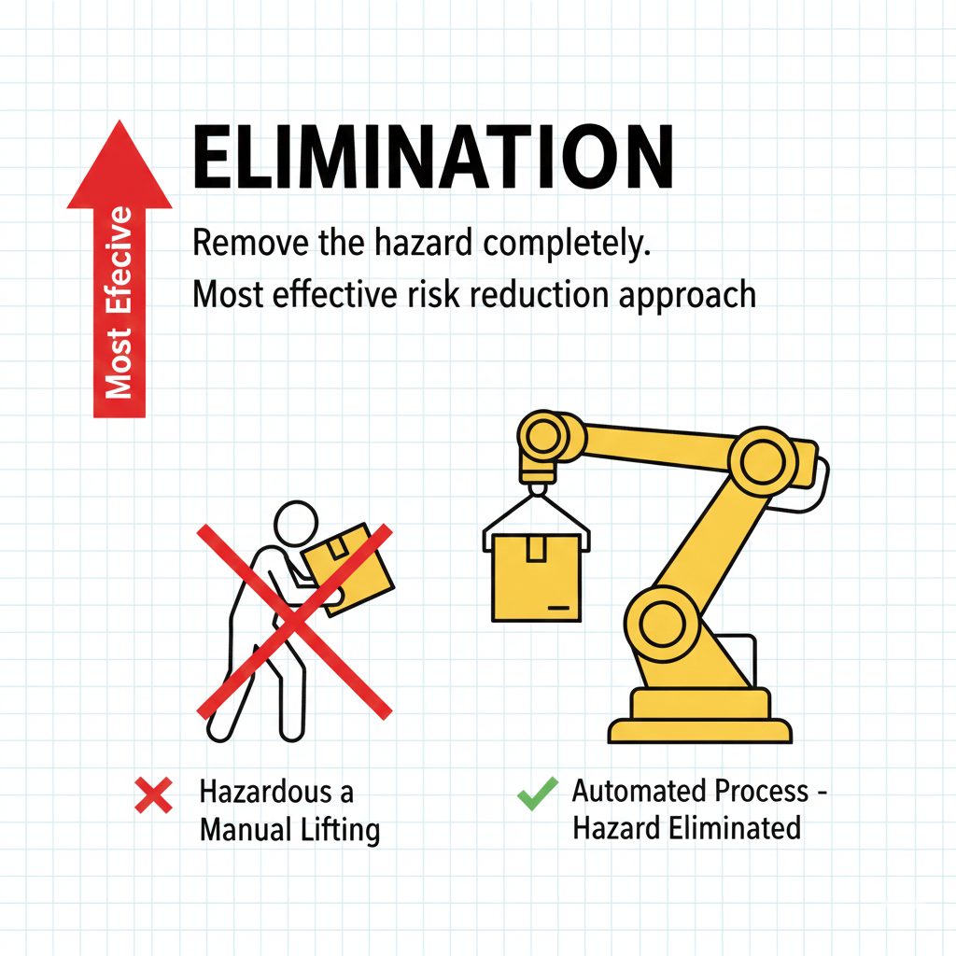
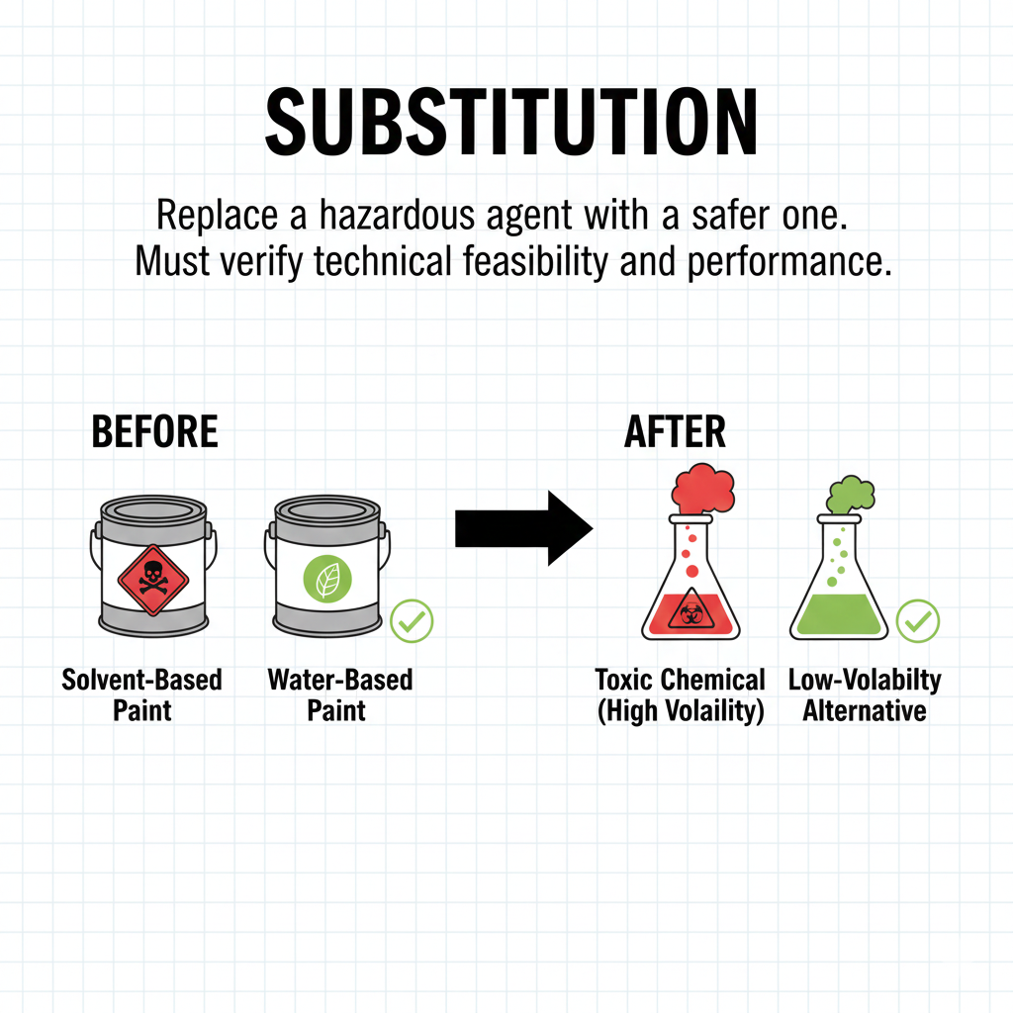
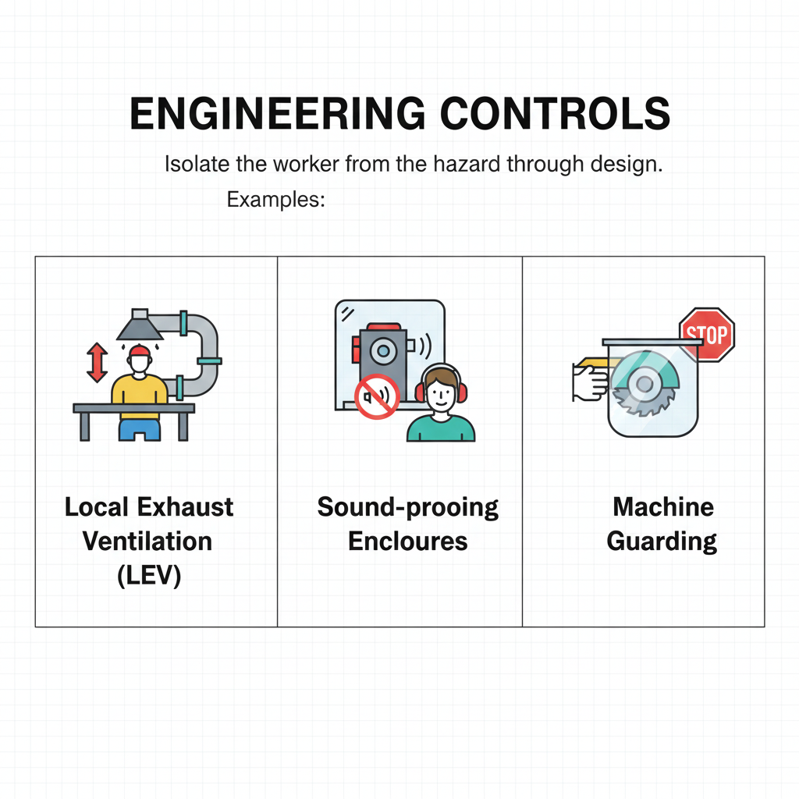

Slide 6
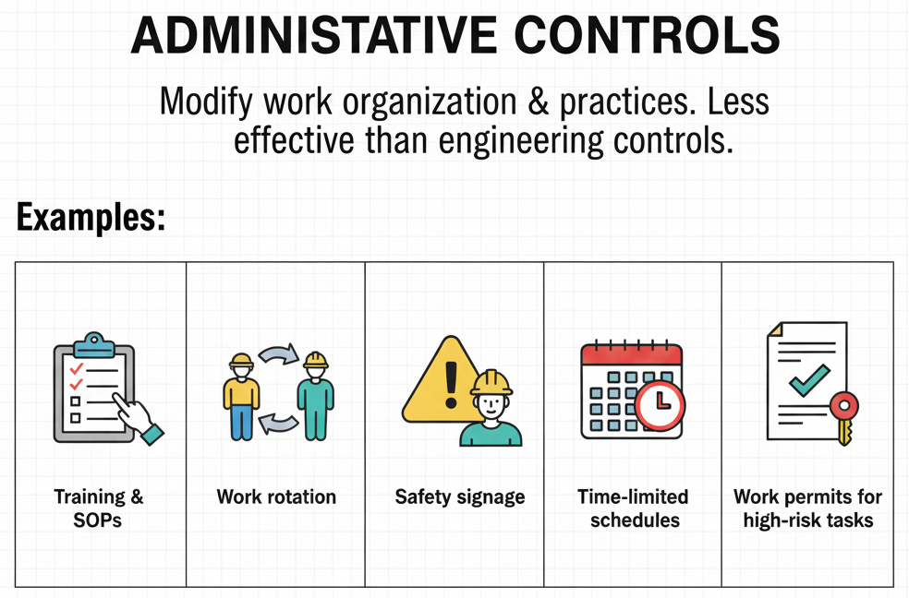
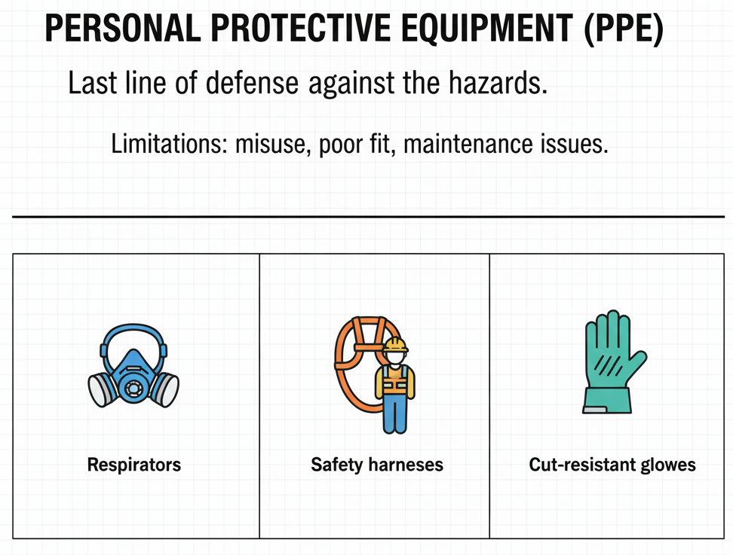

Slide 7
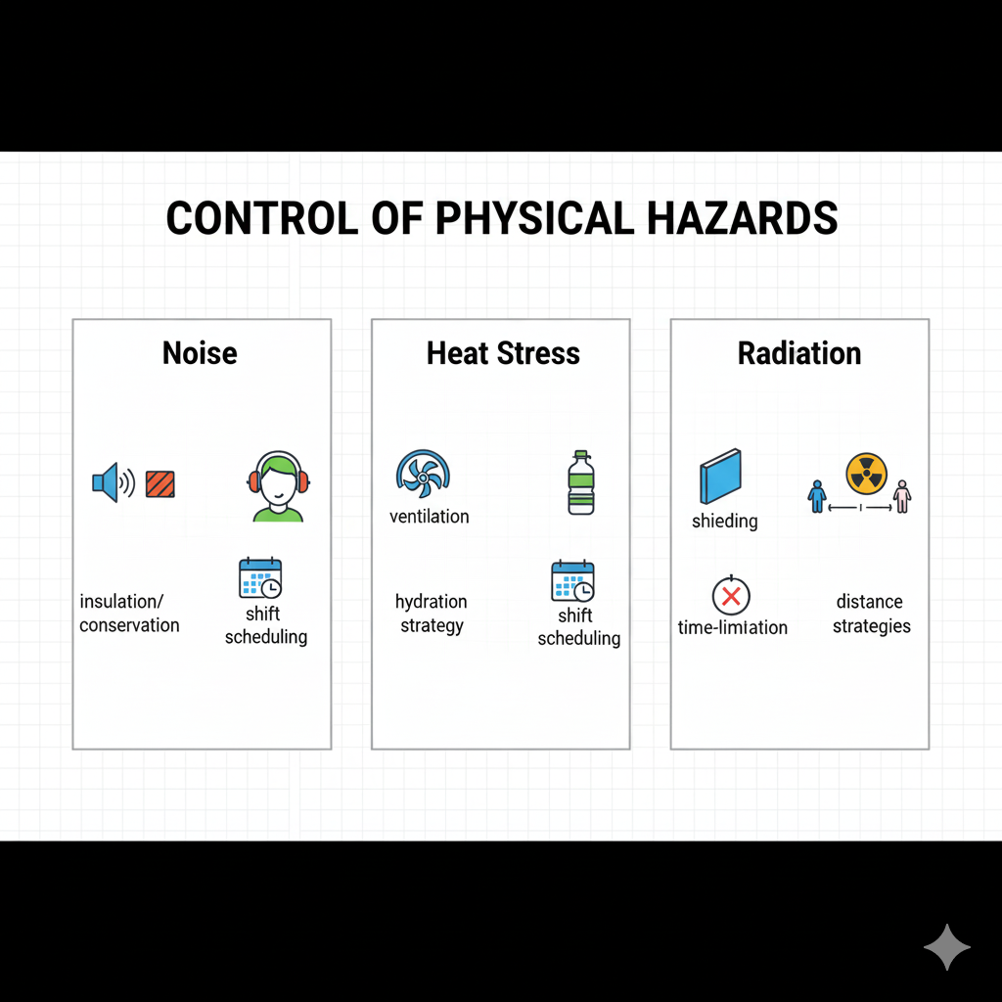
III. Control of Physical Hazards

Slide 8
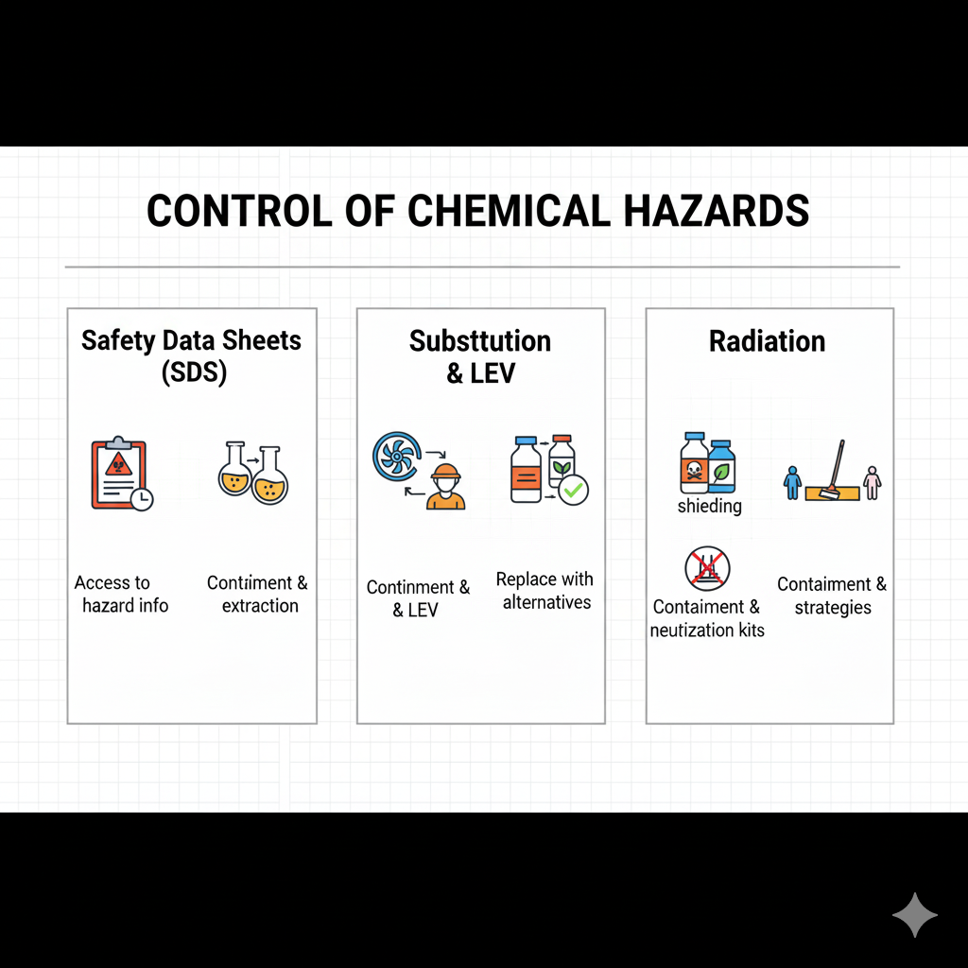
IV. Control of Chemical Hazards

Slide 9
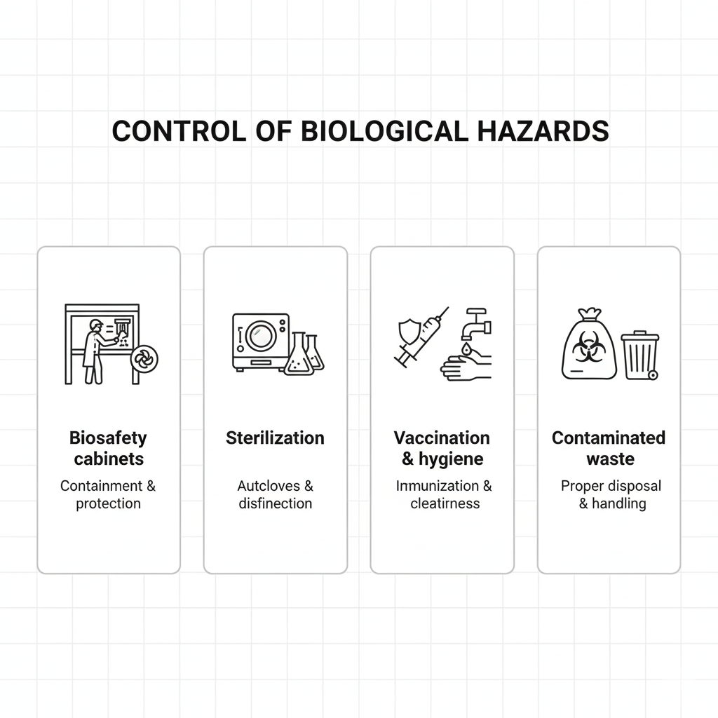
V. Control of Biological Hazards

Slide 10
IIX. Summary:
Prevention prioritizes eliminating risk at the source.
The hierarchy of controls guides decision-making.

Slide 11
IX. Next Session
Week 7: Introduction to Hygiene and Occupational Health
Thank you for your attention!
See you next class.

