Slide 1


Slide 2

Centre universitaire mila
AbdelHafid boussouf
Réglementation et normes (R N)
Science et technologies
Filière : Génie des procédés
Troisième Semestre
Dirigé par :
MllE: Lanani Amani
2025-2026

Slide 3


Chapitre :02
Chapter 02
International standardization and standardization in Algeria (INAPI)”
urpose and development
Standardization associations and organizations

Slide 4


Chapitre :02
Standards: what are they used for?
Standardization, or the setting of standards, serves to establish norms and industrial standards—that is, a common and documented reference framework intended to harmonize the activities within a sector. It is carried out by specialized organizations, which are most often either state institutions or organizations created by professionals within a given field.

Slide 5


Chaptre :02
Définition :
A standard is a reference document on a given subject. It indicates the state of science, technology, and know-how at the time it is written.

Slide 6


Chaptre :02
A standard is the set of technical parameters.
Industrial technical parameters for the manufacturing of products.
The users who purchase them
Les légistes

Slide 7

Chaptre :02
Objective:
-an economic factor
- Better productivity.
- Standards provide solutions that ensure a better balance between the state of a technique and economic constraints.They are tools for institutions to standardize agreements between manufacturers and traders at both national and international levels.They serve as references for public administrations to establish specifications and documents required by the public procurement code.

Slide 8

Chaptre :02
Fundamental standards: they provide rules in the field of technology
Specific standards: they indicate the characteristics of a product.
Four types of standards::
Testing and analysis standards: they define the methods and means for performing a test on a product
Organizational standards: they describe the functions and organizational relationships within an entity

Slide 9


Chapitre :02
Purpose, Aspects, and Levels of Standards
a- Purpose: :
It relates to the intended use and the field of application of the standard. This is generally explained by the title. Depending on the case, a standard may include definitions, dimensions, and physical, chemical, thermal, biological, and mechanical characteristics..
b- Aspect:
It is in A4 format (21 × 29.7 cm) and is identified by an index and a date that corresponds exactly to what appears in the current catalog. Standards with the same index but different dates are considered different. Only the most recent version is valid.

Slide 10






Chapitre :02
A-Normalisation international
A global network covering over 156 countries.
, publishing more than 16,500 standards
IIndustrial
ISO
in scope, it lacks certain capabilities-

Slide 11





Chaptre :02
Each member may choose to participate or not, depending on their own interests
Le choix?
Based on their ownership
Research

Slide 12
ISO is a global network of national standardization institutes from 156 countries. To date, it has published around 16,500 standards intended for industry, public authorities, and society as a whole.Nevertheless, ISO does not have the power to enforce its standards. Indeed, ISO develops them, and each member may participate or not according to their own interests. Once the technical committee responsible for a standard has validated it, each country decides whether or not to adopt it. Moreover, standards are reviewed approximately every five years to maintain, update, or withdraw them depending on their relevance at that time.

Slide 13

Merci pour votre attention

Slide 14
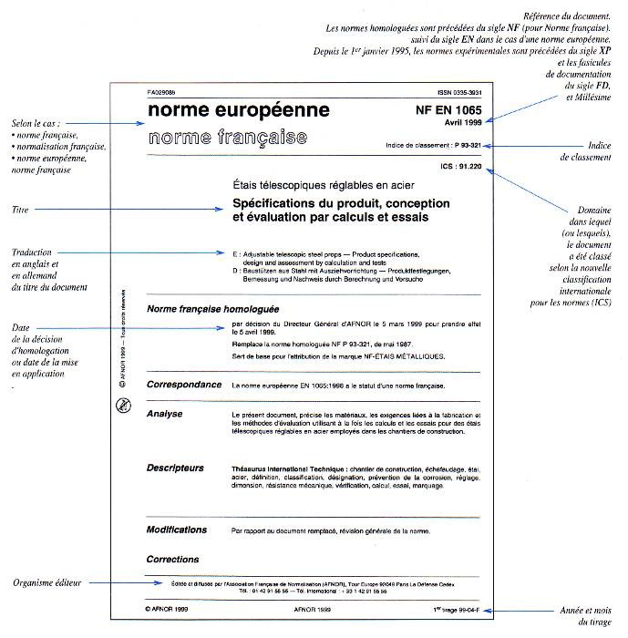
Chapitre :02

