Slide 1

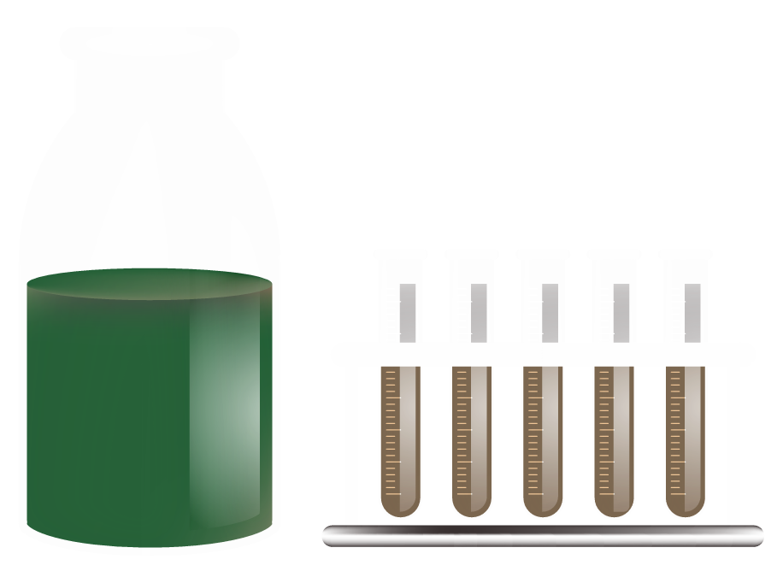
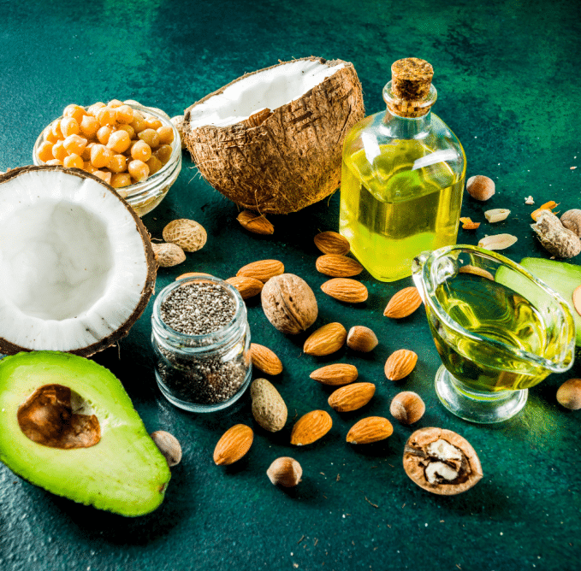
Chapter 03: Lipids or Fats

Slide 2
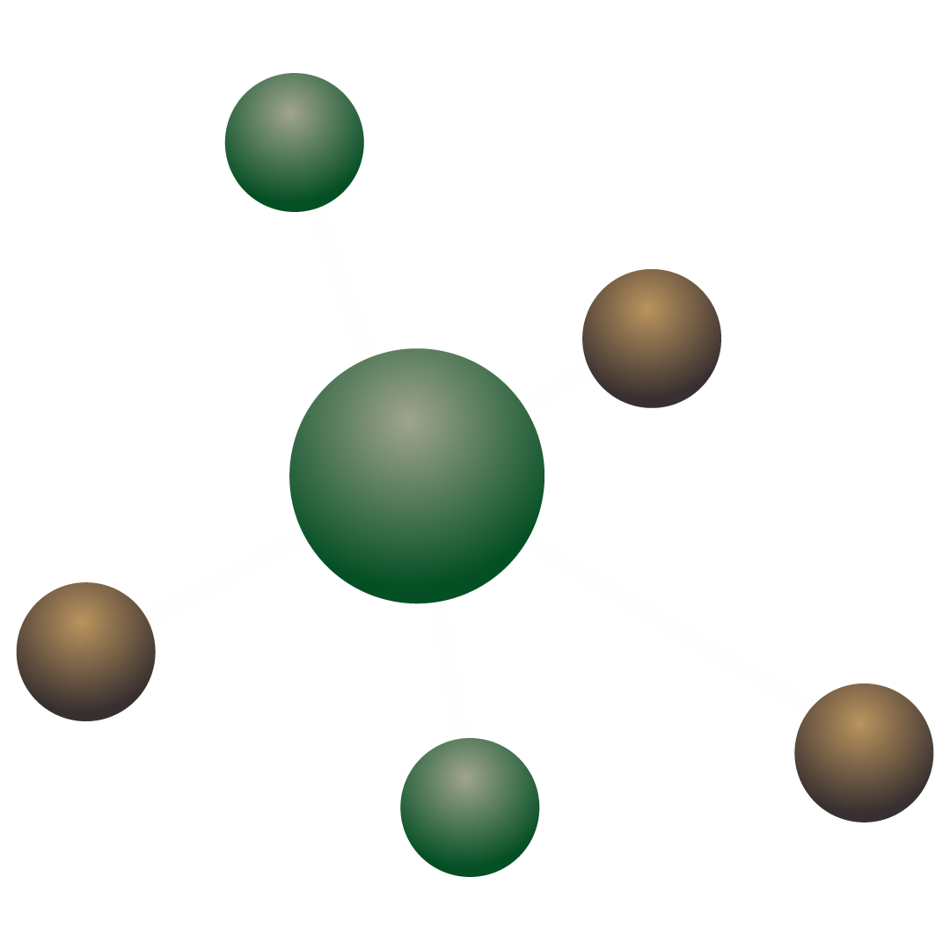
Chapter 03: Lipids or Fats
3.1. Physicochemical Properties of Lipids
3.2. Functional Properties of Fats
3.3. Nutritional Requirements for Fats
3.4. Preservation and Deterioration of Fats

Slide 3
Introduction
Fats, oils, or lipids are made up of a large number of organic compounds, including fatty acids, monoacylglycerols, diacylglycerols, triacylglycerols (TG), phospholipids (PL), eicosanoids, resolvins, docosanoids, sterols, sterol esters, carotenoids, vitamins A and E, fatty alcohols, hydrocarbons, and wax esters. Classically, lipids were defined as substances soluble in organic solvents. This is a vague definition and could include a number of non-lipid organic compounds. A new definition and a comprehensive classification system for lipids were proposed in 2005. The new definition is based on chemistry and defines lipids as small hydrophobic or amphipathic (or amphiphilic) molecules that may originate entirely or in part from condensations of thioester and/or isoprene units.

Slide 4
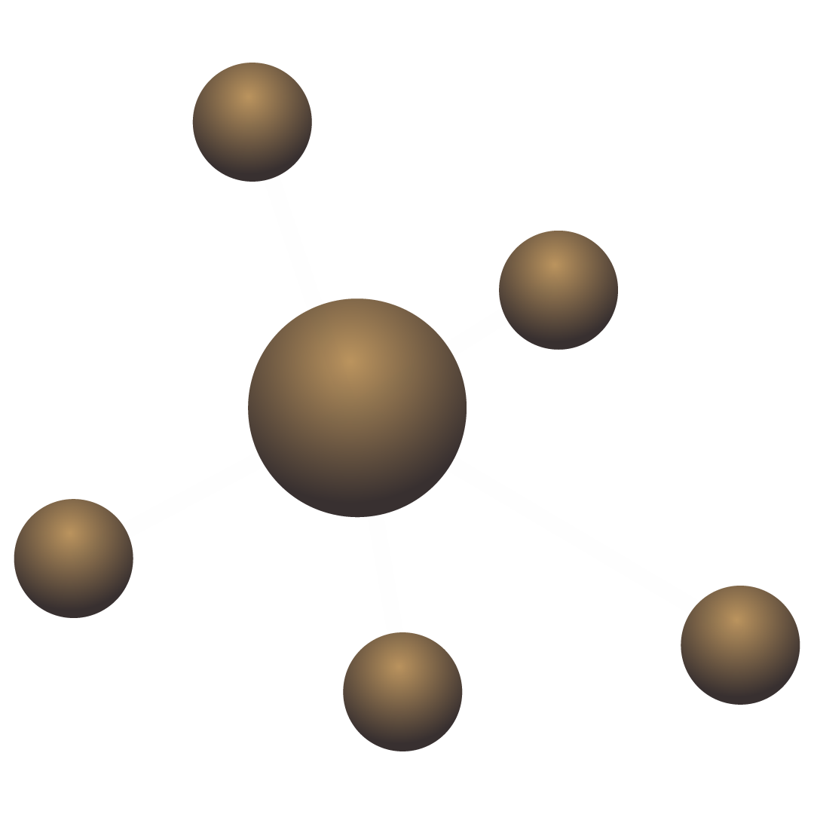
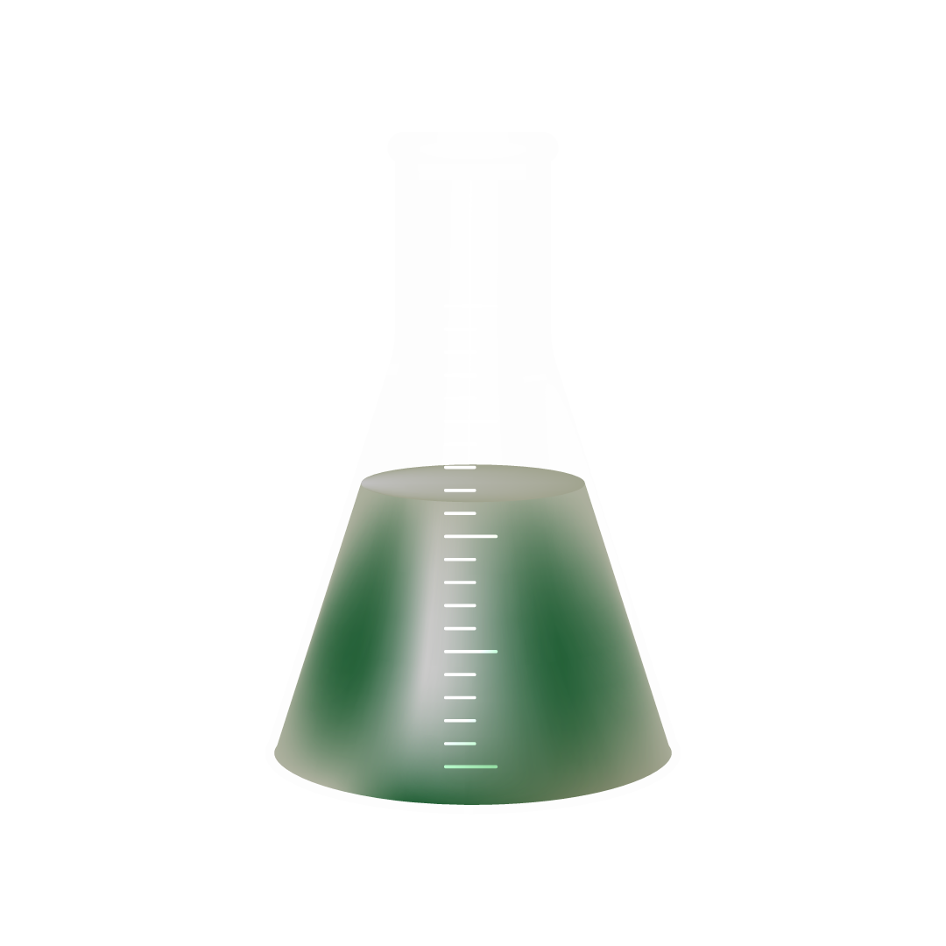
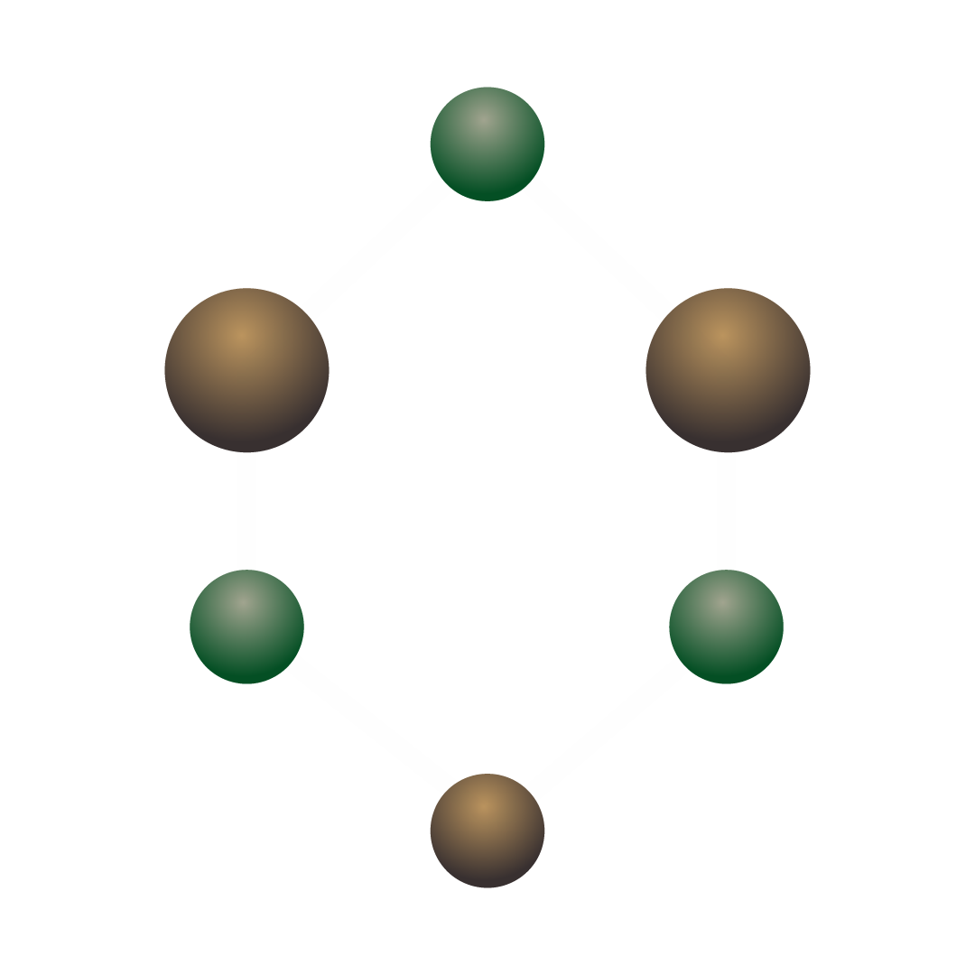
1. What are lipids?
Lipids are a diverse group of molecules found in living organisms. They are best known for their insolubility in water (hydrophobic) and solubility in non-polar solvents like chloroform or ether.
Classic Definition: Substances soluble in organic solvents.
Modern Definition: Small hydrophobic or amphipathic molecules, often built from fatty acids or isoprene units.
To bring order to this diversity, scientists have classified lipids into eight main categories. Here are some key categories with familiar examples:

Slide 5
1. What are lipids?
Lipids are a diverse group of molecules found in living organisms. They are best known for their insolubility in water (hydrophobic) and solubility in non-polar solvents like chloroform or ether.
Classic Definition: Substances soluble in organic solvents.
Modern Definition: Small hydrophobic or amphipathic molecules, often built from fatty acids or isoprene units.
To bring order to this diversity, scientists have classified lipids into eight main categories. Here are some key categories with familiar examples:

Slide 6
1. Chemical and Physical Properties of Lipids
Category | Example & Common Source
Fatty Acyls | Oleic Acid (Olive Oil)
Glycerolipids | Triacylglycerols = Fats & Oils (Butter, Cooking Oil)
Glycerophospholipids | Phosphatidylcholine (Lecithin in Egg Yolks)
Sterols | Cholesterol (Animal Cells), Plant Sterols

Slide 7
2. Physical properties of lipids
a) Solubility: The "Oil and Water"
This is a fundamental property of lipids.
- Short Chains are Soluble: Very small fatty acids (like butyric acid with 4 carbons) are somewhat soluble in water.
- Long Chains are Insoluble: As the carbon chain lengthens, the molecule becomes more hydrophobic.
  Fatty acids with 10 or more carbons are essentially insoluble in water.
  They dissolve easily in non-polar solvents (e.g., benzene, chloroform, ether).
Simple Analogy: Think of trying to mix salad oil (a lipid) with water. They separate. This is the hydrophobic effect in action!

Slide 8
b) Melting Point: What makes a fat solid or liquid?
The melting point of a lipid determines whether it is a solid (fat) or liquid (oil) at room temperature. It depends on two main factors:
1. Chain Length:
  Longer chains have higher melting points. More atoms = stronger attraction between molecules.
2. Degree of saturation (Number of Double Bonds):
  Saturated chains (no double bonds) are straight and pack tightly together, leading to higher melting points (solids).
  Unsaturated chains (with double bonds) have "kinks" that prevent tight packing, leading to lower melting points (liquids).

Slide 9
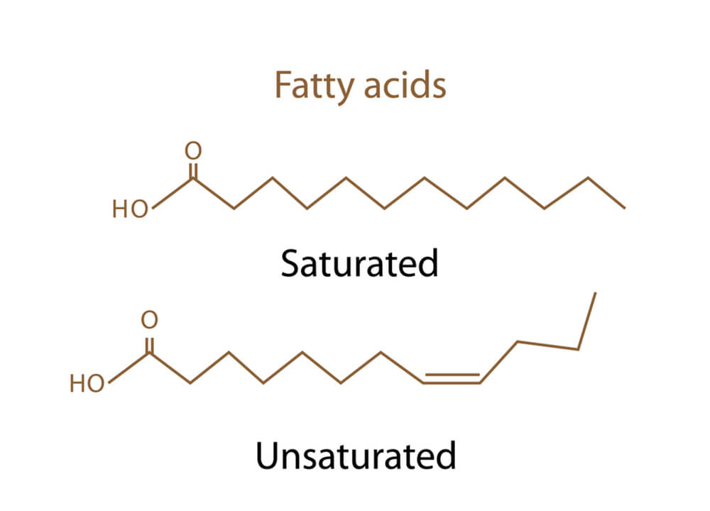
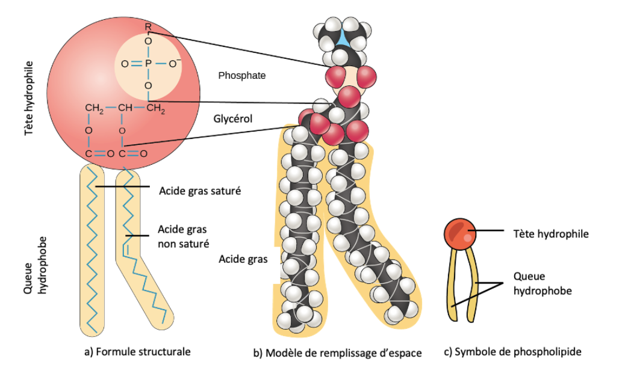
b) Melting Point: What makes a fat solid or liquid?

Slide 10
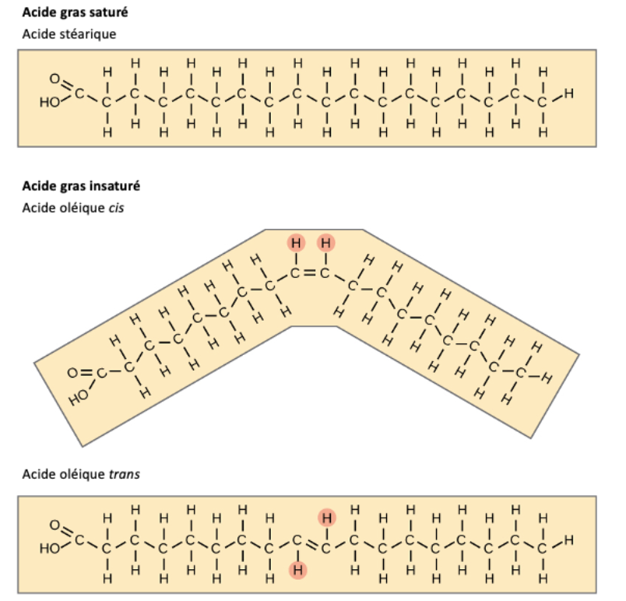

Slide 11
b) Melting Point: What makes a fat solid or liquid?
Feature | Effect on Melting Point | Example at Room Temp
Short Chain | Lowers it | Liquid (Butyric Acid)
Long Chain | Raises it | Solid (Stearic Acid in wax)
Saturated | Raises it | Solid (Butter)
Unsaturated | Lowers it | Liquid (Olive Oil, Sunflower Oil)
Rule of Thumb: Fatty acids with fewer than 10 carbons are usually liquids at room temperature, while those with 10 or more are solids.

Slide 12
Summary Table for Quick Review
Property | Key idea | Why it matters
Solubility | Insoluble in water, soluble in organic solvents. | Defines lipids; explains cell membrane structure (phospholipid bilayer).
Melting Point | Determined by chain length and saturation. | Explains why some lipids are solid (fats) and others are liquid (oils).
Oxidation | Double bonds react with oxygen. | Causes food spoilage (rancidity) but is also used to make vital signaling molecules (e.g., prostaglandins).

Slide 13
3. Chemical Properties of Lipids
3.1. Oxidation of Double Bonds
The double bonds in unsaturated lipids are chemically reactive sites.
3.1.1. Rancidity (Spoilage of Food):
Process: When fats and oils are exposed to oxygen in the air, the double bonds can break and react with oxygen molecules.
Result: This reaction, called auto-oxidation, produces compounds like aldehydes and ketones, which have unpleasant smells and flavors. This is what makes old cooking oil or butter smell "rancid."
3.1.2. Enzymatic Oxidation & Eicosanoid Synthesis (Biological Signaling):
Process: Inside our cells, a highly controlled enzymatic reaction occurs. The enzyme Cyclooxygenase (COX) adds oxygen to Arachidonic Acid (a 20-carbon fatty acid), transforming it through cyclization and oxidation.

Slide 14
3. Chemical Properties of Lipids
3.2. Formation of Sodium or Potassium Salts (Saponification)
This is the chemical reaction that produces soap.
Process: When a fatty acid reacts with a strong base (like Sodium Hydroxide, NaOH, or Potassium Hydroxide, KOH), it forms a salt. This salt is what we call soap.
General Reaction: Fatty Acid + NaOH → Sodium Salt of Fatty Acid (Soap) + Water
Notes:
Biological Roles of Prostaglandins:
Prostaglandins are like local messengers with diverse and powerful effects:
Smooth Muscle Contraction: They regulate the contraction of involuntary muscles in the intestines, the uterus (important for labor), and blood vessels (affecting blood pressure).
Metabolism Regulation: They can influence various metabolic processes.
Platelet Aggregation: They play a role in blood clotting; one type (Thromboxane A2) promotes clotting, while another (Prostacyclin) inhibits it.

Slide 15
3. Chemical Properties of Lipids
Structure and Function of Soap Molecules
  In water, soaps dissociate into their ions: Sodium (Na⁺) and the fatty acid anion (R-COO⁻).
  The fatty acid anion has a unique amphipathic structure with two distinct poles:
    - Hydrophilic Head: The carboxylate group (-COO⁻) is polar and is attracted to water.
    - Hydrophobic Tail: The hydrocarbon chain (R-) is non-polar and is repelled by water but attracted to grease and oil.
This dual nature allows soap to act as an emulsifier. The hydrophobic tails surround and trap grease (dirt), while the hydrophilic heads face outwards, allowing the entire structure to be rinsed away in water. This is the basis for their foaming, wetting, and emulsifying properties.
Notes:
Biological Roles of Prostaglandins:
Prostaglandins are like local messengers with diverse and powerful effects:
Smooth Muscle Contraction: They regulate the contraction of involuntary muscles in the intestines, the uterus (important for labor), and blood vessels (affecting blood pressure).
Metabolism Regulation: They can influence various metabolic processes.
Platelet Aggregation: They play a role in blood clotting; one type (Thromboxane A2) promotes clotting, while another (Prostacyclin) inhibits it.

Slide 16
3.3. Formation of Esters and Thioesters
Esters (with Glycerol or Cholesterol):
  Reaction: Fatty acid + alcohol (glycerol/cholesterol) → Ester + water.
  With Glycerol: Forms triglycerides → Energy storage (body fats, oils).
  With Cholesterol: Forms cholesterol esters → Transport in blood (lipoproteins).
Thioester (with Coenzyme A):
- Reaction: Fatty acid + CoA-SH → Acyl-CoA (thioester).
- Role: Metabolic activation → Prepares fatty acids for:
- Energy production (breakdown in mitochondria).
- Synthesis of other lipids.

Slide 17
3.3. Formation of Esters and Thioesters

Slide 18
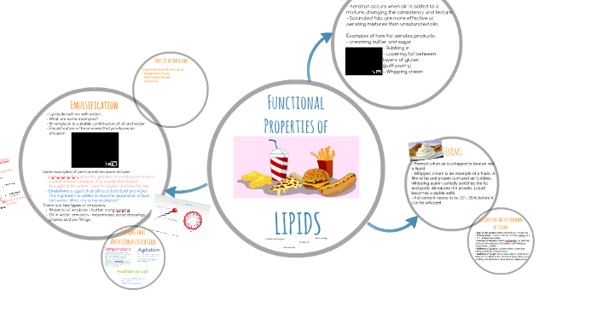

Slide 19
How Fats Behave? (Functional Properties)
Think of fats like butter, olive oil, and lard. Why is butter solid in the fridge but olive oil is always liquid? This is what "functional properties" means.
Notes:
Butter is solid in the fridge due to its high saturated fat content, while olive oil remains liquid because it is mainly unsaturated fat. Lard creates flaky pastry because it is 100% fat with a high melting point, which allows it to create a distinct barrier between dough layers that melts during baking, releasing steam to create puffiness.

Slide 20
4. Main Functional Properties of Fats
4. 1. Melting and Solidification
- Concept: Fats do not have a single melting point like ice. They melt over a temperature range.
- Why it matters: This property determines whether a fat is a solid (butter), liquid (oil), or spreadable (margarine) at a given temperature.
- Main Factor: Determined by the fatty acid composition.
  Saturated Fats (straight chains): Pack tightly → High Melting Point → Solid at room temperature.
  Unsaturated Fats (bent chains): Pack loosely → Low Melting Point → Liquid at room temperature.

Slide 21
4. Main Functional Properties of Fats
  Saturated Fatty Acids (SFA): No double bonds. Straight chains pack tightly into crystals. Strong molecular forces = High Melting Point = Solid at room temp. (e.g., Stearic acid, C18:0, MP = 70°C).
  Unsaturated Fatty Acids: Have double bonds.
                - Monounsaturated (MUFA): One double bond. A cis double bond creates a kink, preventing tight packing. Weaker forces = Lower Melting Point = Liquid oil. (e.g., Oleic acid, C18:1 cis, MP = 13°C).
    - Polyunsaturated (PUFA): Multiple double bonds. Multiple kinks. Very weak forces = Very Low Melting Point = Highly fluid oil. (e.g., Linoleic acid, C18:2, MP = -5°C).

Slide 22
4. Main Functional Properties of Fats
The Geometry of Unsaturation: Cis vs. Trans
The spatial arrangement around a double bond drastically alters functionality.
Cis Configuration (Natural): The hydrogen atoms are on the same side, creating a pronounced bend in the chain. This results in a low melting point.
Trans Configuration (Often from industrial hydrogenation): The hydrogen atoms are on opposite sides, leading to a straighter chain that resembles a SFA. This results in a higher melting point.

Slide 23
4. Main Functional Properties of Fats
Practical Example: The C18 Family
Fatty Acid | Type | Melting Point | Physical State (20°C)
Stearic Acid | Saturated (C18:0) | 70°C | Solid
Elaidic Acid | Trans MUFA (C18:1 trans) | 45°C | Solid
Oleic Acid | Cis MUFA (C18:1 cis) | 13°C | Liquid
Conclusion: For a given chain length: MP(SFA) > MP(Trans) > MP(Cis).

Slide 24
4. Main Functional Properties of Fats
4. 2. Crystallization and Polymorphism
- Concept: When fats solidify, they can form different types of crystals. This is called polymorphism.
Why it matters: The crystal type defines the texture of the fat.
Beta-Prime (β') Crystals: Small, needle-like. Give a smooth and creamy texture (ideal for margarine, shortening).
Beta (β) Crystals: Large, coarse. Give a gritty or sandy texture (a defect in products like chocolate).

Slide 25
4. Main Functional Properties of Fats
4. 3. Plasticity
Concept: The ability of a fat to hold its shape but be easily spread or worked under pressure.
- Why it matters: Essential for the spreadability of butter and margarine, and for creating flaky layers in pastry.
- Main Factor: A mixture of solid fat crystals and liquid oil. The crystals form a network that traps the liquid oil, giving it a plastic, spreadable consistency.

Slide 26
4. Main Functional Properties of Fats
4.4. Oxidative Stability
- Concept: The resistance of a fat to react with oxygen and become rancid.
- Why it matters: Rancidity causes off-flavors and odors, reducing the shelf life of food products.
- Main Factor: Determined by the degree of unsaturation.
Saturated Fats: High stability, slow to become rancid.
Polyunsaturated Fats (many bends): Low stability, very prone to rancidity.

Slide 27
4. Main Functional Properties of Fats
5. Rheology (Viscosity and Flow)
- Concept: How a fat flows or resists flow.
- Why it matters: Important for pumping fats in processing, for the "mouthfeel" of foods, and for the behavior of frying oils.

Slide 28
Functional Property | What it is | Why it is important | Example
Melting Behavior | The temperature range where a fat melts. | Determines if the product is solid or liquid. | Butter (solid) vs. Sunflower Oil (liquid).
Crystallization | The formation of solid crystals when fat cools. | Controls the final texture (smooth vs. gritty). | Smooth margarine (β' crystals) vs. Grainy butter (β crystals).
Plasticity | Ability to be shaped and spread. | Gives spreadability to butter and structure to dough. | The perfect consistency of margarine on bread.
Oxidative Stability | Resistance to spoilage (rancidity). | Determines the shelf life of the product. | Olive oil must be stored in a dark bottle to stay fresh.
Rheology | How the fat flows. | Affects processing and the feeling in the mouth. | The thick flow of heavy cream versus light oil.

Slide 29
4. Preservation and Deterioration of Fats
Fats are essential macronutrients in food that provide energy, essential fatty acids, and influence food texture and flavor. However, fats are susceptible to deterioration due to chemical and enzymatic reactions, which can degrade food quality and nutritional value
Lipids in muscle tissues, especially those rich in polyunsaturated fatty acids (such as in fish), are highly susceptible to oxidation. This degradation leads to:
Loss of nutritional quality
Alteration of flavors (rancidity)
Changes in texture and color

Slide 30
The oxidation of lipids can result from several reaction pathways depending on the environment and initiating agents:
Auto-oxidation catalyzed by temperature, metal ions, and free radicals;
Photo-oxidation, initiated by light in the presence of photosensitizers;
Enzymatic oxidation initiated by lipoxygenase.

Slide 31


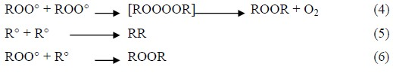
Auto-oxydation
Mechanism in 3 steps
Initiation: Formation of free radicals
  Unsaturated fatty acids lose a hydrogen atom.
  Triggers: heat, metals, light.
Propagation: Chain reaction
  Free radicals react with oxygen.
  Formation of hydroperoxides (primary oxidation products).
Termination: Formation of stable products
  Radicals combine with each other.
  Production of aldehydes, ketones
  (unpleasant odors).
  Characteristic: Self-sustaining reaction that accelerates over time.
Notes:
An antioxidant is a substance that slows or prevents the oxidation process by combating free radicals. These free radicals are unstable molecules that can damage cells and tissues, and an excess of these radicals can cause oxidative stress. Antioxidants neutralize free radicals by donating electrons to them, making them less reactive and harmless.
How They Work
Neutralizing Free Radicals: Antioxidants protect cells from oxidative stress caused by free radicals, which are formed during normal cellular metabolism and due to external factors like pollution, UV radiation, or stress.
Preventing Damage: By neutralizing free radicals, antioxidants help protect DNA and cells, preventing premature aging and maintaining the integrity of the body and skin.
Types of Antioxidants
Natural: Antioxidants are naturally found in foods and include vitamins (such as A, C, and E), minerals (zinc, selenium), flavonoids, and other compounds present in fruits and vegetables.
Synthetic: They are also used in industrial processes, such as food preservation, to prevent the rancidity of fats and color degradation.

Slide 32
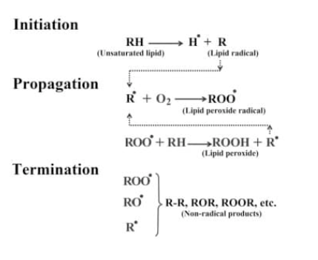
Auto-oxydation
Notes:
An antioxidant is a substance that slows or prevents the oxidation process by combating free radicals. These free radicals are unstable molecules that can damage cells and tissues, and an excess of these radicals can cause oxidative stress. Antioxidants neutralize free radicals by donating electrons to them, making them less reactive and harmless.
How They Work
Neutralizing Free Radicals: Antioxidants protect cells from oxidative stress caused by free radicals, which are formed during normal cellular metabolism and due to external factors like pollution, UV radiation, or stress.
Preventing Damage: By neutralizing free radicals, antioxidants help protect DNA and cells, preventing premature aging and maintaining the integrity of the body and skin.
Types of Antioxidants
Natural: Antioxidants are naturally found in foods and include vitamins (such as A, C, and E), minerals (zinc, selenium), flavonoids, and other compounds present in fruits and vegetables.
Synthetic: They are also used in industrial processes, such as food preservation, to prevent the rancidity of fats and color degradation.

Slide 33

4. Deterioration of Fats
B. Photo-Oxidation (Oxidation by Light)
Photo-oxidation is an important pathway for the production of hydroperoxides in the presence of oxygen, light energy, and photosensitizers such as hemoproteins or riboflavin. Photosensitizers (Sens) absorb light energy and transition to an excited triplet state (³Sens). Photosensitizers participate in lipid oxidation through two types of mechanisms.
Two Possible Mechanisms:
Type I: Photosensitizers (e.g., riboflavin) generate free radicals.
Type I photosensitizers, such as riboflavin, act as initiating free radicals. In their triplet state, they abstract a hydrogen atom or an electron from lipid molecules to form a radical capable of reacting with oxygen
Specificity: Faster than auto-oxidation.

Slide 34
4. Deterioration of Fats
Type II: Production of highly reactive singlet oxygen.
According to the second mechanism, Type II photosensitive molecules, such as chlorophyll and erythrosine, react in their excited state (³Sens) with triplet oxygen (³O₂)
to which they transfer their energy, yielding singlet oxygen (¹O₂).
The singlet oxygen thus formed is highly electrophilic and can react directly with an unsaturated fatty acid (RH), thereby forming a hydroperoxide (ROOH)
Specificity: Faster than auto-oxidation.

Slide 35
4. Deterioration of Fats
C. Enzymatic Oxidation
The oxidation of unsaturated fatty acids can be of enzymatic origin. The two main enzymes involved are lipoxygenase and cyclooxygenase.
Key Enzymes:
- Lipoxygenases: Found in fish skin and gills.
- Cyclooxygenases: Transform fatty acids into specific compounds.
- Lipoxygenase catalyzes the insertion of an oxygen molecule into an unsaturated fatty acid via a stereospecific reaction, leading to the formation of hydroperoxides. It acts specifically on non-esterified fatty acids. Its activity is therefore often coupled with that of lipases and phospholipases .
- Cyclooxygenase is a type of lipoxygenase that incorporates two oxygen molecules into a fatty acid to form specific hydroperoxides. In vivo, cyclooxygenases catalyze the formation of prostaglandins and thromboxanes, while lipoxygenases catalyze the formation of leukotrienes.

Slide 36
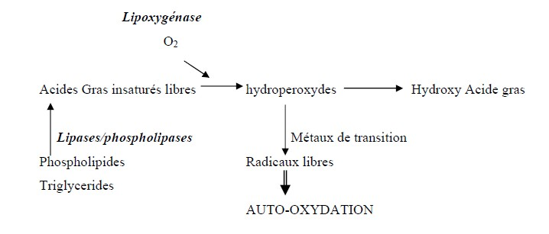
4. Main Functional Properties of Fats
Specificity:
- Active even at low temperatures.
- Resumes during thawing.
- Produces enzyme-specific oxidation products.
Mechanism of Lipid Peroxidation Initiation by Lipoxygenase Activity.

Slide 37
Enzymatic oxidation occurs even at low temperatures. During frozen storage, enzymatic activity is very low. However, once thawing begins and temperatures of 0°C to 4°C are reached, this activity appears to resume and intensify. This lipoxygenase activity is primarily present in the gills and skin of fish. In fish, the lipoxygenases present are believed to be 12-lipoxygenase, 15-lipoxygenase, and 9-lipoxygenase, whose activity leads to the formation of 12-hydroperoxides, 15-hydroperoxides, and 9-hydroperoxides. The activities of 12-lipoxygenase, 15-lipoxygenase, and 9-lipoxygenase have been identified in the skin of herring (Clupea harengus) and sardine (Sardina pilchardus), with a predominant activity of 12-lipoxygenase. The activity of 12-lipoxygenase is also present in mackerel muscle.

Slide 38
Factors Influencing Oxidation
Internal (Intrinsic) Factors:
- Fatty acid composition: More unsaturation = higher sensitivity.
- Presence of pro-oxidants: Free iron, heme proteins.
- Natural antioxidants: Tocopherols (Vitamin E), carotenoids.
External (Extrinsic) Factors:
- Temperature: Accelerates all reactions.
- Light: Activates photo-oxidation.
- Oxygen: Essential for oxidation.
- Technological treatments: Cutting, grinding, cooking.

Slide 39
Consequences of Oxidation
On Sensory Quality:
Odor: Rancidity, "fishy" or "metallic" notes.
Flavor: Unpleasant taste, bitterness.
Color: Pigment degradation.
On Nutritional Value:
Destruction of essential fatty acids.
Loss of fat-soluble vitamins.
Formation of potentially toxic compounds.
.

Slide 40
5. Prevention Methods
Storage Condition Control:
Temperature: Refrigeration/freezing.
Packaging: Protection from light and oxygen.
Modified atmosphere: Replacing oxygen with nitrogen.

Slide 41
Preservation Methods of Fats
Reducing Oxygen Exposure
- Vacuum packaging or airtight containers limit oxygen contact and slow oxidation.
- Using inert gases such as nitrogen prevents oxygen-induced rancidity.​
2. Controlling Temperature
- Low-temperature storage (refrigeration or freezing) slows oxidation and enzymatic activity.
- Avoid high-temperature processes that accelerate fat oxidation.​
3. Use of Antioxidants
- Natural antioxidants like ascorbic acid (Vitamn C), rosemary extract, and Vitamin E inhibit oxidation.
- These can be added during processing to extend shelf life and preserve nutritional quality.​

Slide 42
Preservation Methods of Fats
4. Light Protection
- Packaging that blocks light can reduce photo-oxidation that damages fats.​
5. Minimizing Processing Time and Heat
- Gentle processing methods such as low-temperature preservation and short cooking times help maintain fat quality.​

