Slide 1
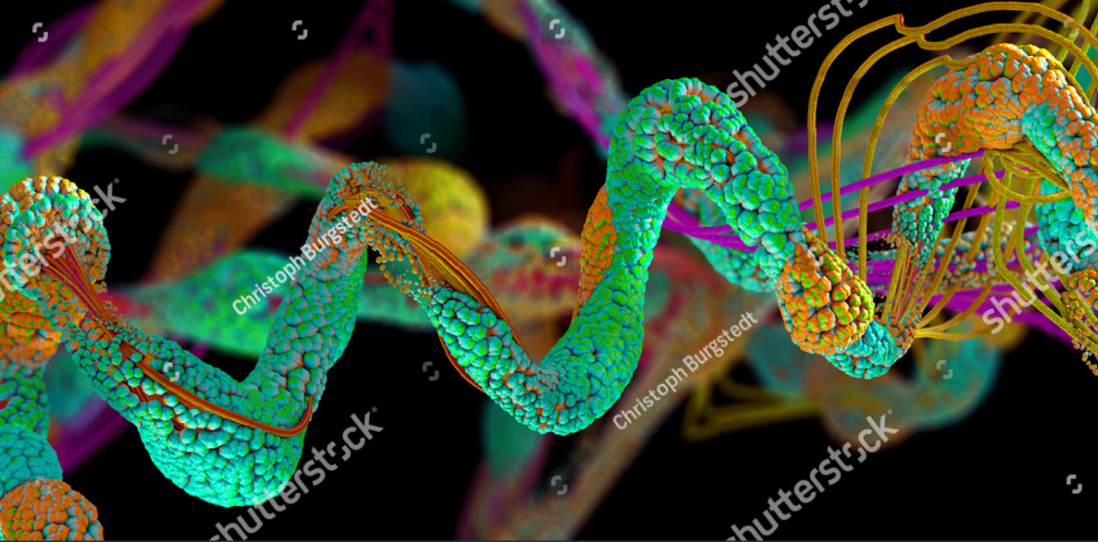
Chapter 02. Proteins in Food
2.1. Physical properties of proteins
2.2. Extraction of food proteins
2.3. Egg proteins: properties and applications
2.4. Functional properties of milk proteins and their enhancement
2.5. Protein ingredients

Slide 2
Introduction
Food is more than just fuel; it is a complex matrix of biological molecules that sustain life and provide pleasure. Among these molecules, proteins stand out as truly versatile and indispensable components. They are not only fundamental to our nutrition but are also the cornerstone of food structure, texture, and stability.
Proteins are polymeric chains of amino acids, folded into precise three-dimensional structures. This unique structure, from the linear sequence of amino acids (primary structure) to the complex folding into globular or fibrous shapes (tertiary and quaternary structures), dictates their functionality. In living organisms, these functions are biological—serving as enzymes, transporters, and structural elements. However, when incorporated into food systems, these same molecular properties are harnessed for their technological functionalities.

Slide 3
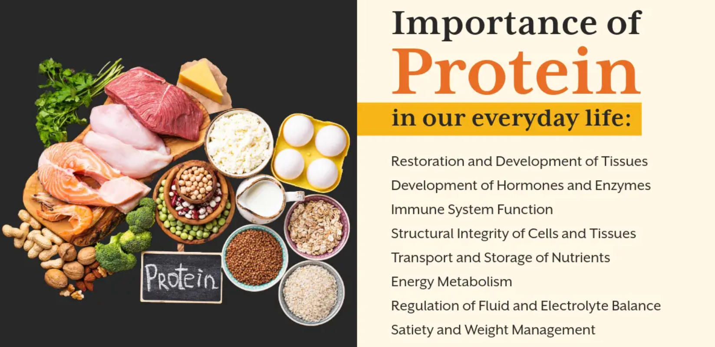
The importance of food proteins
The nutritional role
The functional role

Slide 4
The importance of food proteins
The nutritional role
Proteins are essential for human health, providing the nitrogen and amino acids necessary for growth, tissue repair, and the synthesis of vital molecules. The nutritional quality of a protein is determined by its amino acid profile and its digestibility. While animal proteins (from eggs, milk, and meat) are typically "complete," providing all nine essential amino acids, many plant proteins may be deficient in one or more. This understanding drives agronomic research into improving the nutritional profile of plant-based crops and the development of smart food combinations to ensure balanced diets.

Slide 5
The importance of food proteins
The functional role
This is where proteins reveal their true magic in food science and technology. Through processes like denaturation and aggregation, proteins transform the physical properties of food. Their ability to interact with water, lipids, and other molecules makes them powerful, natural, and often multifunctional ingredients. Key functional properties include:

Slide 6
The functional role
• Solubility: The foundation for many applications, influencing other properties like foaming and emulsification.
• Gelation: The ability to form a three-dimensional network that traps water, giving structure to products like yogurt, cheese.
• Emulsification: The capacity to stabilize mixtures of oil and water, crucial for mayonnaises, sauces, and sausages.
• Foaming: The formation and stabilization of air bubbles, essential for the light texture of mousses, meringues, and whipped cream.
• Water-Holding and Fat-Binding: Directly impacting the juiciness, yield, and texture of meat products and baked goods.

Slide 7
1. What is a Protein?
A protein is a biological macromolecule, a linear polymer made up of basic units called amino acids, linked together by peptide bonds.
Proteins are the "workhorses" of the cell. Their functions are extremely diverse:
  Structural: Collagen (skin, bones), Keratin (hair, nails).
  Enzymatic: Amylase (starch digestion), Rennet (milk coagulation).
  Transport: Hemoglobin (oxygen transport), Serum Albumin.
  Contractile: Actin and Myosin (muscles).
  Defense: Antibodies (immunity).
  Storage: Ovalbumin (egg), Casein (milk).

Slide 8
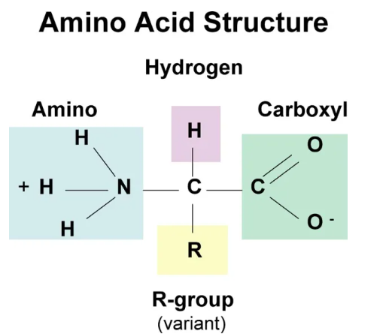
2. Amino Acids: The Building Blocks
There are 20 standard amino acids that make up all proteins. Each amino acid has a common structure:
• An amine group (-NH₂)
• A carboxyl group (-COOH)
• A hydrogen atom (-H)
• A side chain (-R) unique to each amino acid.
The nature of the side chain (R) determines the properties of the amino acid.

Slide 9
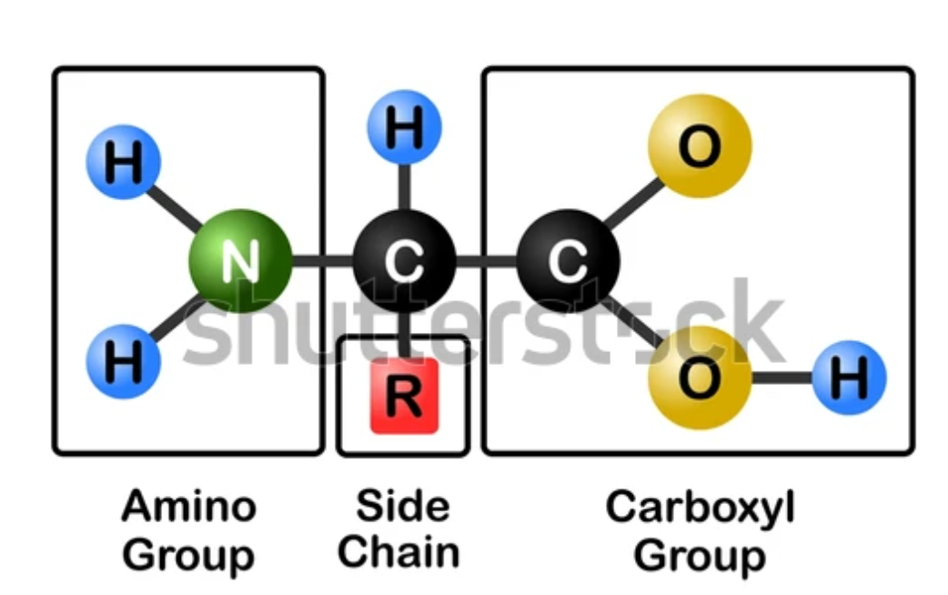
2. Amino Acids: The Building Blocks

Slide 10
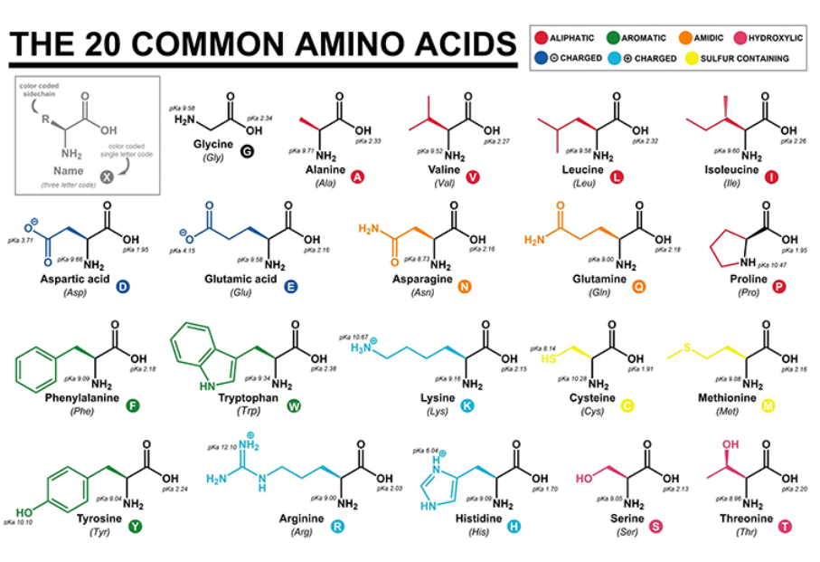

Slide 11
2. Amino Acids: The Building Blocks
Type | Property of the R Group | Examples | Importance in Food Technology
Non-Polar / Hydrophobic | Insoluble in water | Valine, Leucine, Phenylalanine | Hide inside the protein; involved in hydrophobic interactions.
Polar / Hydrophilic | Soluble in water | Serine, Threonine, Asparagine | Found on the surface; interact with water (hydration).
Acidic (Negative) | Has a -COOH group | Aspartic acid, Glutamic acid | Negatively charged at neutral pH; important for solubility and ionic interactions.
Basic (Positive) | Has a -NH₂ group | Lysine, Arginine, Histidine | Positively charged at neutral pH; important for solubility and ionic interactions.

Slide 12

2. Amino Acids: The Building Blocks

Slide 13
3. Protein Structure
Protein structure is organized into four levels:
Primary Structure: This is the specific linear sequence of amino acids in the polypeptide chain, held together by peptide bonds. It is the "code" that determines all higher structural levels.
Secondary Structure: This is the local folding of the polypeptide chain, stabilized by hydrogen bonds. The most common forms are:
  - Alpha-helix (α): A spring-like chain.
  - Beta-sheet (β): Chains aligned side by side.

Slide 14
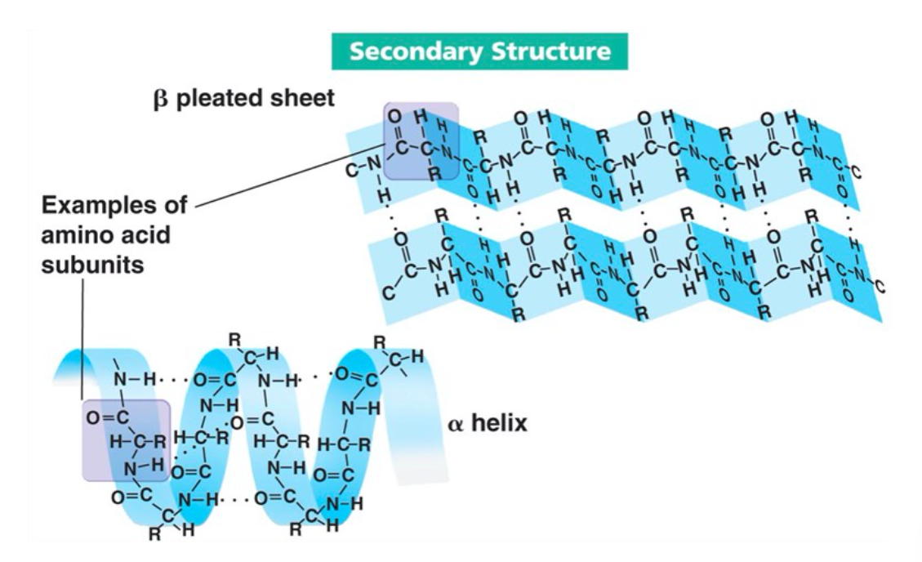

Slide 15
3. Protein Structure
Tertiary Structure
In a protein, the tertiary structure describes the three-dimensional arrangement of all the amino acids in the polypeptide chain. It is a native, biologically active conformation, maintained by multiple bonds primarily formed by the amino acid side chains (Figure 25). Listed in order of decreasing stability:
Covalent disulfide bonds between two cysteine residues;
Electrostatic interactions between groups of opposite charges (-NH₃⁺ and -COO⁻);
Hydrogen bonds;
Hydrophobic interactions.
The tertiary structure allows the protein to form spatial "domains" that are essential for its function (for example, an active site for an enzyme).

Slide 16
3. Protein Structure
Figure : Stabilization of the Tertiary Structure
Notes:
[This figure would typically illustrate the different types of bonds and interactions that stabilize the three-dimensional fold of a single polypeptide chain, including:]
Disulfide Bridge (Covalent Bond): A strong covalent bond between the sulfur atoms of two cysteine side chains.
Ionic Bond (Electrostatic Interaction): An attraction between positively charged (e.g., Lysine or Arginine) and negatively charged (e.g., Aspartate or Glutamate) amino acid side chains.
Hydrogen Bond: A dipole-dipole interaction where a hydrogen atom is shared between electronegative atoms (like oxygen or nitrogen), often found between polar side chains or between side chains and the polypeptide backbone.
Hydrophobic Interactions / Van der Waals Forces: The clustering of non-polar, hydrophobic side chains (e.g., Leucine, Valine, Phenylalanine) away from the aqueous environment, stabilized by numerous weak Van der Waals forces.

Slide 17
Quaternary Structure
A fourth level of protein structure can be identified for proteins containing more than one polypeptide chain. The quaternary structure is the spatial arrangement of the different polypeptide subunits (protomers) and a description of the interactions that bind them. The interactions between the subunits are of the same nature as the interactions within the chains (covalent or non-covalent). The dissociation of these assemblies is reversible.
Hemoglobin is an example of a protein with a quaternary structure: it is composed of four polypeptide chains (Figure 27), each of which has its own three-dimensional structure. The polypeptide chains are identical in pairs: two α-chains with 141 AA and two β-chains with 146 AA. Each chain contains a heme prosthetic group.

Slide 18
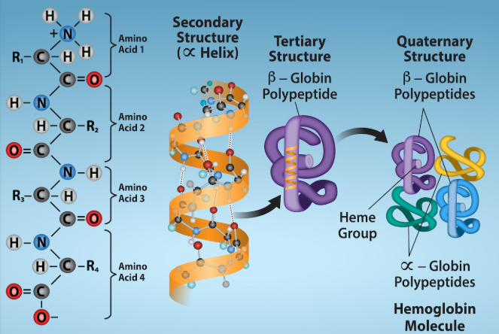
Protein Structure

Slide 19
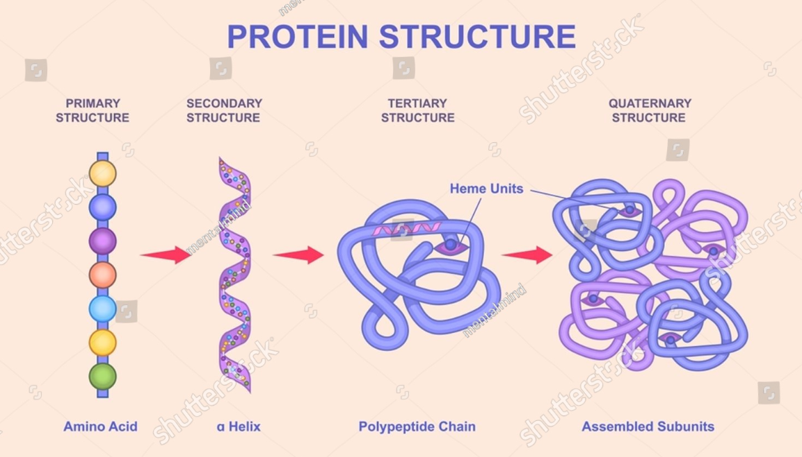

Slide 20
4. Protein Denaturation
Denaturation is the loss of the tertiary and secondary structure of a protein, without breaking the peptide bonds (the primary structure remains intact).
The denatured protein loses its native shape and thus its biological function (if it is an enzyme), but it can gain new functional properties for food.
Common Denaturing Agents in the Food Industry:
• Heat (Cooking an egg): Thermal agitation that breaks weak bonds.
• PH (Acidification of milk to make yogurt): Alters the charges of amino acids,

Slide 21
4. Protein Denaturation
Disrupting ionic interactions.
• Salts (Ionic Strength): Can shield charges and disrupt interactions.
• Organic Solvents: Alter the hydrophobic environment.
• Mechanical Agitation (Whipping egg white): Introduces energy and air-water interfaces.
Major Consequence: Denaturation often makes the protein insoluble and can expose hydrophobic groups, making it more likely to aggregate. It is this aggregation process that leads to phenomena such as gelation or coagulation.
Notes:
تعطيل التفاعلات الأيونية.
• الأملاح (القوة الأيونية): يمكنها حجب الشحنات وتعطيل التفاعلات.
• المذيبات العضوية: تُغيّر البيئة الكارهة للماء.
• التحريك الميكانيكي (خفق بياض البيض): يُدخل الطاقة وواجهات الهواء والماء

Slide 22
5. Classification of food proteins
According to their composition, proteins can belong to two different groups: holoproteins and heteroproteins.
Holoproteins = simple proteins
Heteroproteins = conjugated proteins
Proteins composed exclusively
of amino acids. They are divided into protamines, histones, glutelins, albumins, prolamins, globulins, and scleroproteins.
Example:
- Albumin (egg),
- Globulins (legumes).
Composed of a protein part and a non-protein part called a prosthetic group. This group can be:
- A metallic group (chromoproteins) or organic group (phosphoproteins); (e.g., Casein in milk, essential for its functional properties).
- A carbohydrate part linked covalently: glycoproteins; (e.g., Mucin in saliva).
- A lipid part linked covalently: lipoproteins (e.g., Lipoproteins in egg yolk).
Notes:
Selon leur composition, les protéines peuvent appartenir à deux groupes différents : les holoprotéines et les hétéroprotéines.

Slide 23
5. Classification of food proteins
According to their shape, proteins can be divided into two main categories: fibrous and globular.
Fibrous proteins
Globular proteins
These are called structural proteins because they constitute the main building material in vertebrates. They are linear, insoluble in water, and highly stable (providing mechanical support to tissues and resistance to traction). The main fibrous proteins are collagen, keratin, fibrinogen, and muscle proteins.
Unlike fibrous proteins, globular proteins are spherical and highly soluble. They play an important role in metabolism, such as albumins, globulins, casein, and protein hormones. Albumins and globulins are abundant in animal cells, blood serum, milk, and eggs.
Notes:
Selon leur composition, les protéines peuvent appartenir à deux groupes différents : les holoprotéines et les hétéroprotéines.

Slide 24
4. Physical Properties
4.1. Solubility
Solubility is defined as the maximum amount of protein that can dissolve in one liter of solvent. Proteins are insoluble in organic solvents, and their solubility in water depends on several factors:
- The size, shape, and mass of the protein molecule;
- The distribution and proportion of polar and non-polar amino acids;
- The solution conditions (ionic strength, pH, solvent, etc.)

Slide 25
4.1. Solubility
4.1. Effect of the Ionic Strength of the Solution
The figure shows that the solubility curve of a protein, as a function of salt concentration, is bell-shaped and unique to each protein:
At low ionic strength: Neutral salts have a dissolving effect (Salting-in) (Part I). Ions from the dissociation of the salt decrease the electrostatic interactions between the charged groups of the proteins. They promote the hydration of polar groups and thus the solubilization of the proteins.
Figure : Protein solubility curve versus salt concentration
Notes:
Les interactions électrostatiques sont des forces d'attraction ou de répulsion entre des particules portant des charges électriques.

Slide 26
4. Physical Properties
4.1. Solubility
→ Effect of the Ionic Strength of the Solution
At high ionic strength: Neutral salts have an insolubilizing, precipitating, or "salting-out" effect (Salting-out) (Part III). At high concentrations, the ions bind water at the expense of the polar groups on the protein surface. They therefore promote the dehydration of proteins and their insolubility, which is also called protein "salting-out."
Between these two zones, there is an area of maximum protein solubility (Part II)

Slide 27
4. Physical Properties
4.1. Solubility
→ Effect of Organic Solvents
Water-miscible organic solvents (ethanol, acetone, methanol, etc.) decrease the dielectric constant. This reduces the repulsive forces between proteins and promotes their dehydration, leading to aggregation and hence their precipitation.
→ Effect of of pH
The solubility curve as a function of the medium's pH has a "U" shape .A protein has minimum solubility when its net charge is zero, i.e., when pH = pI (isoelectric point). There is no electrostatic repulsion between neighboring protein molecules, causing them to aggregate and precipitate.

Slide 28
→ Effect of of pH
Solubility is at its minimum due to maximized electrostatic attractions between the charged groups of the proteins, forming aggregates. Solubility is always lower at the pI than at pH values above (negative charge) or below (positive charge); some proteins are practically insoluble at the pI.
Note: Proteins precipitated near the pI retain their conformation (tertiary structure) and can be redissolved in a suitable medium; thus, there is no denaturation.
Figure : Solubility curve of a protein as a function of the medium's pH

Slide 29
4. Physical Properties
4.2. Optical Properties
Protein solutions are opalescent: they absorb and scatter light. Optical properties are related to the concentration of the solution, as well as the size and shape of the molecules. These properties are important for studying and assaying proteins, and also for determining the geometric characteristics of a protein by light scattering.
4.3. Osmotic Properties
Proteins are neither ultrafiltrable nor dialyzable because they cannot diffuse through a permeable membrane due to their large size. A protein solution placed in a compartment bounded by a membrane develops an osmotic pressure called oncotic pressure, which plays a role in cellular exchanges and fluid balance between the body's water compartments (as in the case of plasma proteins).

Slide 30
4. Physical Properties
4.4. Ionization Properties
Every protein possesses a significant number of ionizable groups characterized by their pK. These properties form the basis of protein separation and characterization techniques (such as electrophoresis or chromatography).

Slide 31
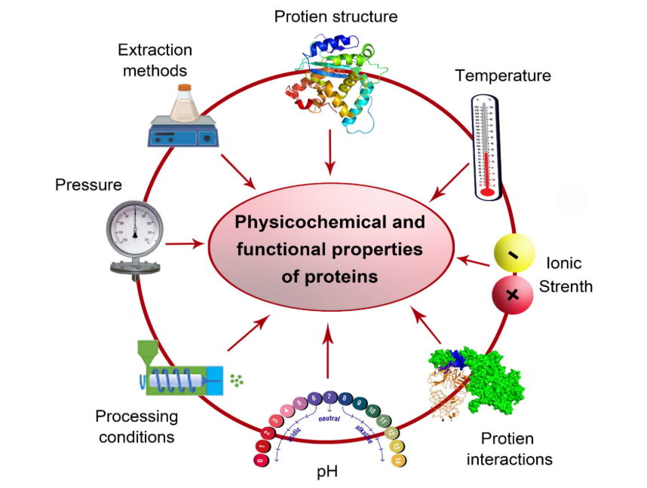
Figure . The potential environmental factors affecting the physicochemical and functional properties of proteins.
Notes:
Figure . The potential environmental factors affecting the physicochemical and functional properties of proteins.

Slide 32
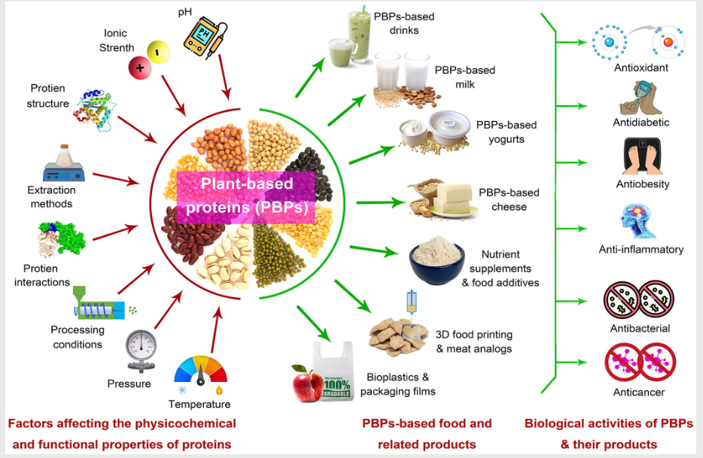
Figure . The potential environmental factors affecting the physicochemical and functional properties of proteins.
Notes:
Figure . The potential environmental factors affecting the physicochemical and functional properties of proteins.

Slide 33
4. Extraction of Food Proteins
Protein extraction from food involves separating proteins from other components through methods like wet extraction (using water with pH adjustments) and dry fractionation (using mechanical processes like milling and air classification). Both conventional and newer techniques use pre-treatments like grinding or enzymatic treatment to improve efficiency, and the final step involves recovering the protein concentrate or isolate, often via precipitation at its isoelectric point.

Slide 34
4. Extraction of Food Proteins/Novel and assisted methods
Proteins are vital components of food, both for their nutritional value and their functional properties in food processing. To use proteins effectively, it is important to extract them from complex food matrices. Different advanced techniques have been developed for protein extraction, each with specific benefits and suitable applications:
1. Enzyme-assisted extraction
Together, these techniques allow food scientists to maximize protein yield while maintaining quality, ushering in new possibilities for food production and innovation.
2. Cavitation-assisted extraction
3. Microwave-assisted extraction
4. Supercritical fluid extraction
5. Pulsed electric field extraction
Notes:
Novel and assisted methods
These methods can be more efficient, faster, or gentler on the proteins:

Slide 35
4.1 Enzyme-Assisted Extraction
In recent years, there has been growing interest in the use of enzymes for protein extraction, primarily for food and nutraceutical purposes. Enzymes are globular proteins derived from microorganisms, plants, animals, and humans, functioning as catalysts. Intentionally used in dairy products (cheese, yogurt), baking (bread making), and meat processing, enzymes are being increasingly utilized. In fact, a range of food-grade enzymes is now also commercially available. Enzymes commonly used in the industry at present include carbohydrase, lipase, and primarily proteases.

Slide 36
4.1 Enzyme-Assisted Extraction
Uses biological catalysts to break down cell walls and release proteins gently, preserving their quality
→ Fundamental Principle: the basic principle of Enzyme-Assisted Extraction (EAE) is to use biological catalysts (enzymes) to specifically target and degrade the structures that trap or retain the compound of interest (such as a protein) inside the cells of a raw material.
Unlike chemical methods (acids, alkalis, organic solvents) or harsh physical methods (high temperature, pressure), enzymes act in a gentle, selective, and eco-friendly manner. They simply accelerate natural biochemical reactions of degradation.

Slide 37
4. How It Works: The Mechanism in Steps
Imagine a plant or animal cell in a food waste product. The protein we want to extract is locked within a structural "network."
Step 1: Targeting the Barriers
The cell walls (in plants) or membranes (in animals) are the primary barriers. They are often composed of:
Complex polysaccharides: cellulose, hemicellulose, pectin (in plants).
Lipids (in membranes).
Structural proteins.
Enzymes are chosen to precisely "dismantle" these barriers:

Slide 38
4.1 Enzyme-Assisted Extraction
For plants: A mixture of enzymes called "cellulase" and "pectinase" is used.
- Cellulase degrades cellulose, the "backbone" of the cell wall.
- Pectinase degrades pectin, the "cement" that holds cells together.
For fatty materials: Lipase degrades lipids (fats) that can trap proteins.
- For starch: Amylase degrades starch, which can form a viscous gel and hinder extraction.
By degrading these compounds, enzymes weaken the cellular structure, making it porous

Slide 39
4.1 Enzyme-Assisted Extraction
Step 2: Release and Liquefaction
Once the walls are weakened, the cell's content (cytoplasm), where the proteins are located, can be more easily released into the aqueous solution (the extraction medium). This process also makes the raw material more liquid, facilitating subsequent steps.
Step 3: Hydrolysis
This is the most important step for protein extraction. Proteases (enzymes that cut proteins) are used. Their action can have two objectives:
- Releasing insoluble proteins: Some proteins are bound to other structures (walls, membranes). Proteases cut these "bonds," releasing the protein.

Slide 40
- Hydrolyzing proteins into peptides: Proteases can cut long protein chains into smaller fragments, called peptides or protein hydrolysates.
Advantage:
- These peptides are more soluble in water, which significantly increases the extraction yield.
- They can have new biological properties (antioxidant, antihypertensive) and are often easier to digest.
It is this specific action of proteases that allows for the extraction of sensitive amino acids like glutamine and asparagine, which would be destroyed by the more aggressive acid or alkaline methods.

Slide 41
Key Process Factors (Operational Parameters)
Parameter | Importance | Consequence of Poor Control
Substrate-to-Enzyme Ratio | Determines the amount of enzyme available to act on the raw material. | Too little enzyme: slow and incomplete reaction. Too much enzyme: unnecessary cost.
Temperature | Influences enzyme activity. Each enzyme has an optimal temperature. | Too cold: enzymatic activity is slow. Too hot: the enzyme denatures (it gets "cooked" and becomes inactive).
pH | Influences the 3D shape of the enzyme and thus its ability to bind to its target. Each enzyme has an optimal pH. | An unsuitable pH makes the enzyme slightly or completely inactive.
Extraction Time | Determines the contact duration between the enzyme and the substrate. | Time too short: incomplete extraction. Time too long: risk of contamination, energy cost, excessive degradation of peptides.
Agitation | Ensures homogeneous mixing and optimal contact between the enzyme and the substrate. | Poor mixing: untreated areas, inefficient extraction.
Notes:
The effectiveness of EAE depends on carefully controlled parameters:

Slide 42
Advantages and Disadvantages
Advantages | Disadvantages
• Eco-friendly (Green): Reduces the use of solvents and aggressive chemicals. | • Cost of enzymes: Food-grade enzymes can be expensive.
• Specificity: Enzymes target specific compounds, avoiding degradation of the product of interest | • Processing time: Can be longer than chemical methods.
• Mild Conditions: Preserves sensitive compounds (amino acids, vitamins). | • Complex optimization: Requires finding the right enzymes and parameters for each matrix.
• High Yields: Allows for more protein to be extracted from the same amount of raw material. | • Risk of microbial contamination if conditions (temperature, pH) are not sterile.
• Waste Valorization: Ideal technology for extracting proteins from agro-industrial by-products.
Notes:
The effectiveness of EAE depends on carefully controlled parameters:

Slide 43
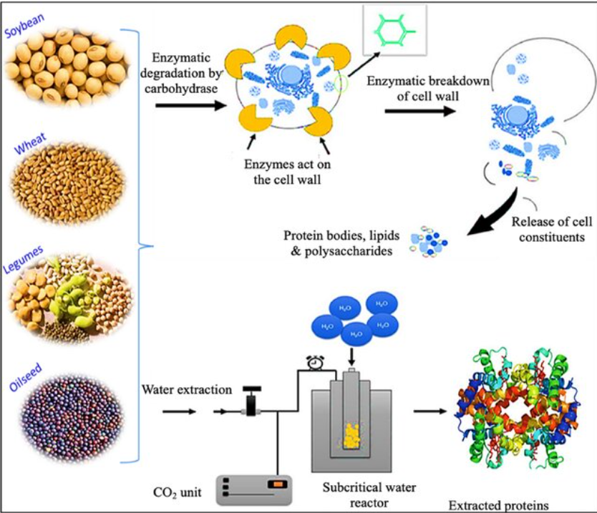
4.1 Enzyme-Assisted
Extraction
In summary, enzyme-assisted extraction is a precision biotechnology that mimics and accelerates natural decomposition processes to effectively and sustainably release high-value compounds from complex matrices.
Notes:
The effectiveness of EAE depends on carefully controlled parameters:

Slide 44
4.2 Cavitation-assisted extraction
Is a technique that uses cavitation bubbles, formed by high-frequency sound (acoustic cavitation) or fluid flow (hydrodynamic cavitation), to break cell walls and enhance the release of intracellular compounds. The violent collapse of these bubbles creates shock waves, microjets, and extreme localized pressures and temperatures, which effectively disrupt cells and improve mass transfer. This method is used to extract valuable components like natural products, proteins, and essential oils from various matrices, often resulting in higher yields, faster extraction times, and lower energy consumption compared to conventional methods.
Notes:
إنها تقنية تستخدم فقاعات التجويف، التي تتشكل بواسطة الصوت عالي التردد (التجويف الصوتي) أو تدفق السوائل (التجويه الهيدروديناميكي)، لتحطيم جدران الخلايا وتعزيز إطلاق المركبات داخل الخلوية. يؤدي الانهيار العنيف لهذه الفقاعات إلى创造出 موجات صدمية ونفاثات دقيقة وضغوط ودرجات حرارة عالية موضعية، مما يُحطم الخلايا بشكل فعال ويحسن نقل الكتلة. تُستخدم هذه الطريقة لاستخراج مكونات قيمة مثل المنتجات الطبيعية والبروتينات والزيوت العطرية من matrices مختلفة، وغالباً ما تُحقق عوائد أعلى وأوقات استخراج أسرع واستهلاكاً طاقياً أقل مقارنة بالطرق التقليدية.

Slide 45
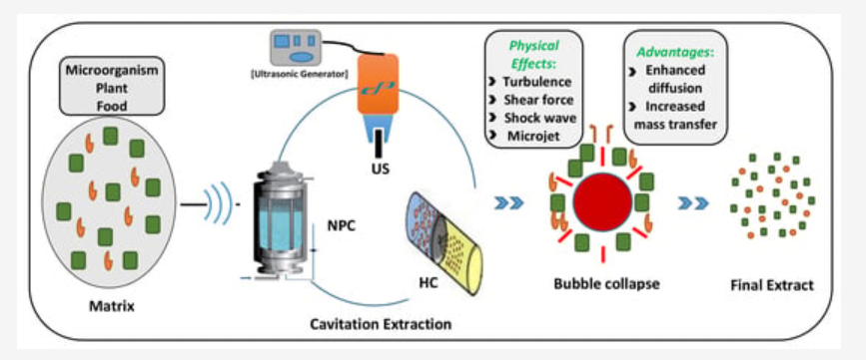
4.2 Cavitation-assisted extraction
Notes:
From:

Slide 46
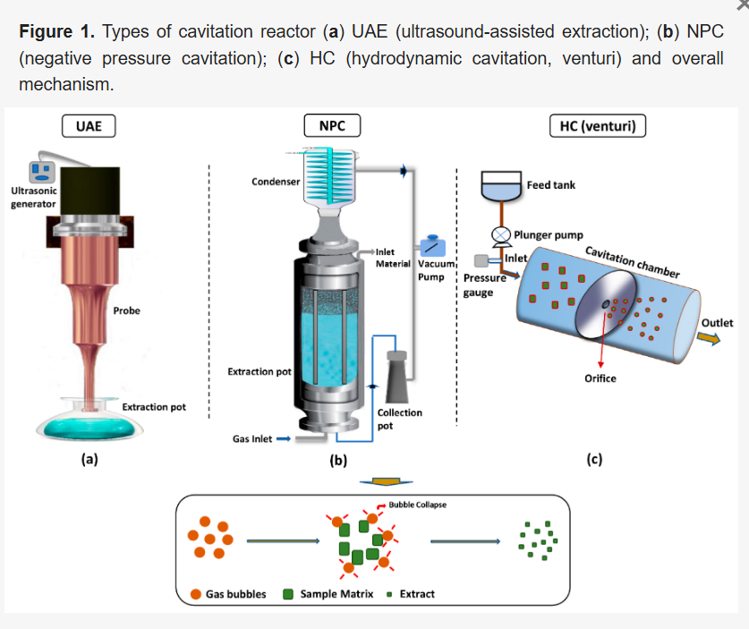
4.2 Cavitation-assisted
extraction
Notes:
From:

Slide 47
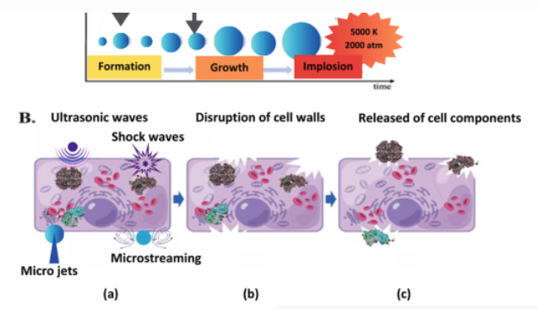
4.2 Cavitation-assisted extraction
Notes:
From:

Slide 48
4.3 Microwave-assisted extraction
Uses microwave energy to rapidly heat water inside cells, causing them to burst and release proteins efficiently.
MAE is a technique that uses microwave energy to rapidly heat a solvent and a sample mixture, allowing for the extraction of compounds from a matrix. By using closed vessels, the process can be performed at higher temperatures to increase the speed of mass transfer, leading to faster extraction times, lower solvent volumes, and often improved yields and reproducibility compared to conventional methods. This method is used in various fields, including food testing, environmental analysis, and pharmaceutical production.

Slide 49
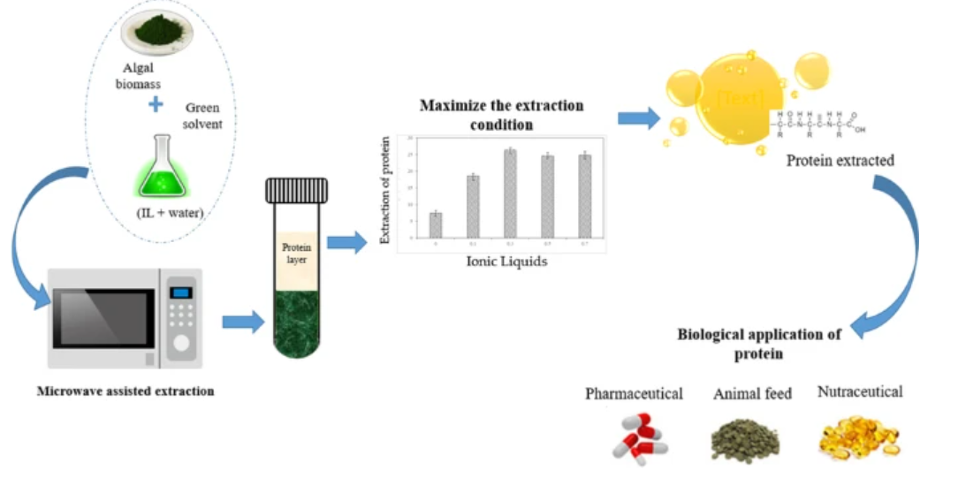
4.3 Microwave-assisted extraction

Slide 50
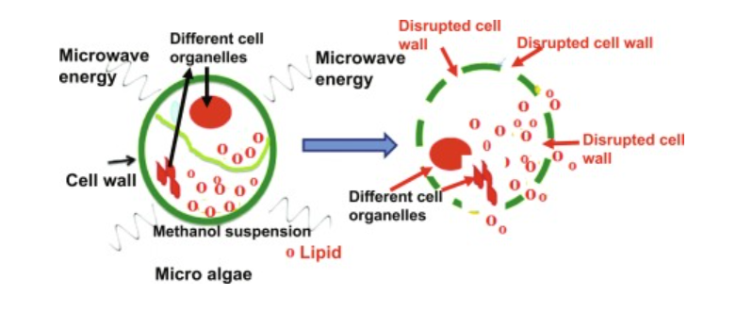
4.3 Microwave-assisted extraction

Slide 51
4.4 Supercritical fluid extraction
Supercritical fluid extraction (SFE) is a separation technique that uses a fluid above its critical point to selectively extract compounds from a solid or liquid matrix. Supercritical carbon dioxide (CO2) is the most common solvent, as it acts as both a liquid and a gas to efficiently dissolve and separate compounds. This process is environmentally friendly because it minimizes or eliminates the use of organic solvents and can produce high-purity, residue-free extracts
Notes:
Extraction par fluide supercritique (SFE)
L'extraction par fluide supercritique est une technique de séparation qui utilise un fluide au-delà de son point critique pour extraire sélectivement des composés d'une matrice solide ou liquide. Le dioxyde de carbone supercritique (CO₂) est le solvant le plus couramment utilisé, car il agit à la fois comme un liquide et un gaz pour dissoudre et séparer efficacement les composés. Ce procédé est respectueux de l'environnement car il minimise ou élimine l'utilisation de solvants organiques et permet d'obtenir des extraits de haute pureté, sans résidus.
En bref : principe de la technique
Utilisation d'un fluide dans un état supercritique (combinant les propriétés des liquides et des gaz).
Le dioxyde de carbone (CO₂) comme solvant principal.
Extraction sélective des composés.
Procédé propre et écologique.
Produits de haute pureté sans résidus.

Slide 52
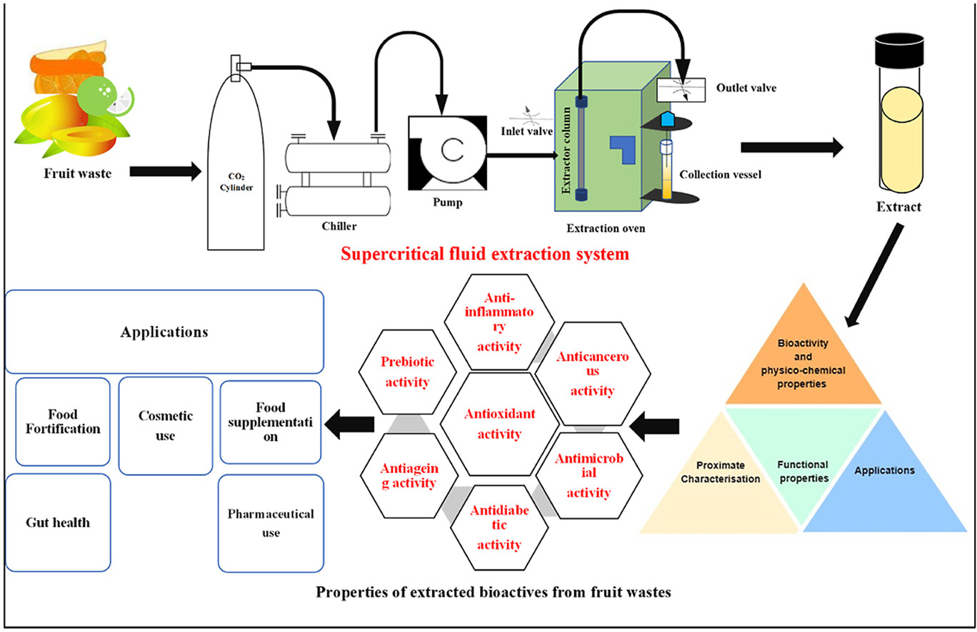

Slide 53
4.5 Pulsed electric field extraction
Applies short, high-voltage pulses to food material, creating pores in cell membranes so proteins can escape without damaging their functionality.
Pulsed Electric Field (PEF) extraction is a non-thermal method that uses short, high-voltage electrical pulses to increase the permeability of cell membranes, allowing for more efficient and faster extraction of compounds. This technique is used to extract bioactive compounds from plants, microbes, and food waste, and can reduce energy and solvent consumption. It also has applications in food preservation by inactivating microorganisms and in food processing by modifying texture and improving other steps like drying and peeling.
Notes:
الاستخلاص باستخدام المجال الكهربائي النبضي (PEF) هو طريقة غير حرارية تستخدم نبضات كهربائية قصيرة وعالية الجهد لزيادة نفاذية أغشية الخلايا، مما يسمح باستخلاص المركبات بكفاءة وسرعة أكبر. تُستخدم هذه التقنية لاستخلاص المركبات النشطة بيولوجيًا من النباتات والميكروبات ونفايات الطعام، ويمكنها تقليل استهلاك الطاقة والمذيبات. كما تُستخدم في حفظ الأغذية عن طريق تثبيط الكائنات الدقيقة، وفي معالجة الأغذية عن طريق تعديل الملمس وتحسين خطوات أخرى مثل التجفيف والتقشير

Slide 54
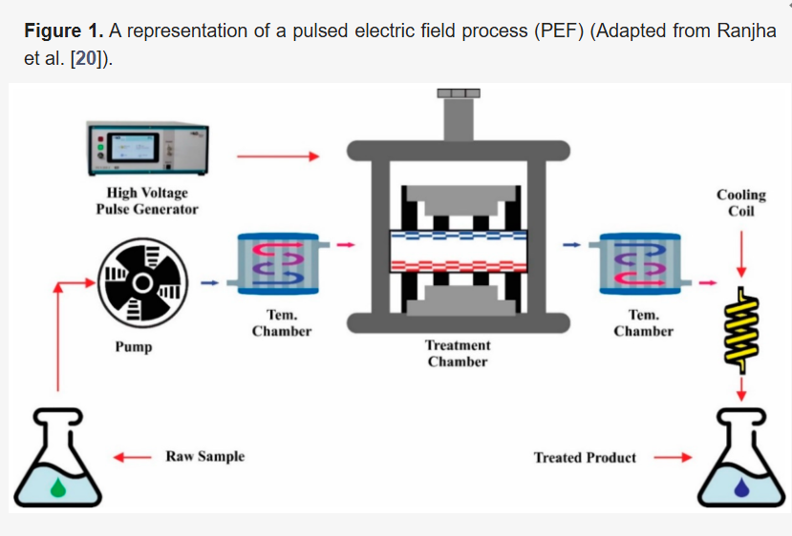
4.5 Pulsed electric field extraction

Slide 55
4. Protein Extraction Techniques: Principles and Industrial Examples
Extraction Technique | Fundamental Principle | Examples in the Agri-Food Industry
Enzyme-Assisted Extraction (EAE) | Uses enzymes (proteases, carbohydrases) to specifically hydrolyze cell walls and structural components, thereby releasing intracellular proteins. | • Fish proteins: Recovery of proteins and bioactive peptides from fish waste (bones, skins). • Oilseed cakes: Enhanced extraction of proteins from rapeseed or sunflower meal after oil pressing. • Dairy proteins: Production of casein or whey hydrolysates for infant formula or nutritional supplements.
Cavitation-Assisted Extraction (e.g., Ultrasonics) | Generation of cavitation bubbles (via ultrasound) that implode, creating localized extreme conditions (pressure, temperature) that disrupt cell walls and enhance mass transfer. | • Algae: Extraction of proteins and pigments (phycocyanin) from microalgae. • Brewery waste: Valorization of brewer's spent grain to extract residual proteins. • Corn gluten: Improved extraction of gluten from corn flour.

Slide 56
4. Protein Extraction Techniques: Principles and Industrial Examples
Extraction Technique | Fundamental Principle | Examples in the Agri-Food Industry
Microwave-Assisted Extraction (MAE) | Dielectric heating by microwaves causes intense molecular agitation and volumetric heating, leading to rapid vaporization of intracellular water which ruptures the cells. | • Soy proteins: Rapid and efficient extraction of proteins from defatted soybean flour. • Rice by-products: Extraction of proteins from rice bran. • Green leaves: Extraction of Rubisco protein (a promising future ingredient) from alfalfa or nettle leaves.
Supercritical Fluid Extraction (SFE) | Uses a fluid (typically CO₂) in a supercritical state, which has a density close to a liquid and viscosity near a gas, allowing it to effectively penetrate the matrix and dissolve target compounds. | • Meal De-oiling: This technique is primarily used to de-oil raw materials (e.g., rapeseed meal) upstream. The proteins, not extracted by supercritical CO₂, are preserved (not denatured) in the oil-depleted meal, which can then be treated by other methods (EAE, alkaline extraction) for high-quality protein extraction.

Slide 57
4. Protein Extraction Techniques: Principles and Industrial Examples
Extraction Technique | Fundamental Principle | Examples in the Agri-Food Industry
Pulsed Electric Field (PEF) Extraction | Application of short, high-intensity electric pulses that create permanent or temporary pores (electroporation) in cell membranes, allowing the release of intracellular compounds. | • Potatoes: Enhanced extraction of proteins and starch from tubers. • Vegetables with rigid cells: Pre-treatment of sugar beets, carrots, or other plants to facilitate subsequent extraction of proteins and other compounds. • Yeast: Extraction of proteins and flavor compounds from yeast cells.

Slide 58
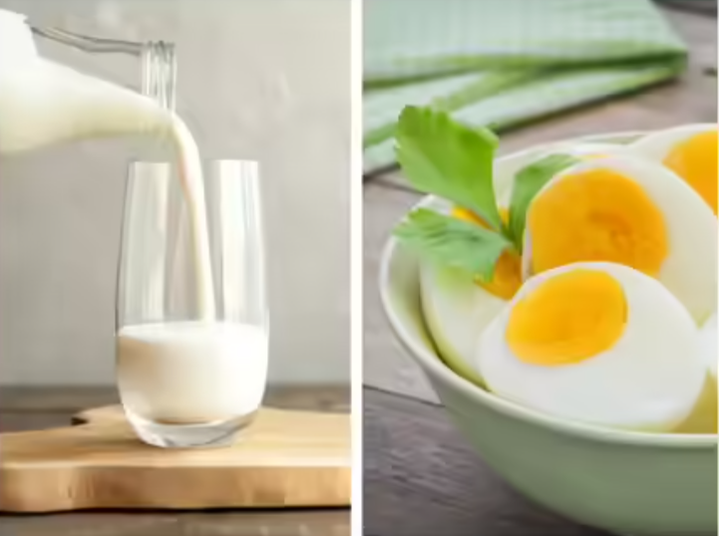
Proteins are the "building blocks" of our body. Among them, the proteins from eggs and milk are considered absolute nutritional references. Their amino acids are not only complete but also perfectly balanced to meet human needs. Beyond their nutritional value, their unique physico-chemical properties, known as techno-functional properties, make them indispensable ingredients in cooking and the food industry for structuring, texturing, and stabilizing foods.
Notes:
Techno-functional properties are the physical and chemical characteristics of a food ingredient that determine its performance and behavior during food preparation, processing, storage, and consumption. These are not nutritional properties (like vitamin content), but rather the functional attributes that influence the texture, appearance, stability, and overall sensory quality of the final food product.

Slide 59
thanks do you know a tool of IA tht can terensform this suppoet on slide ppt automatecly
Property | Definition
Gelling / Coagulation Power | The ability of proteins to form a continuous, three-dimensional network that traps water and other liquids, transforming a liquid or semi-liquid into a solid or semi-solid gel.
Foaming Power | The ability to form and stabilize a gas-in-liquid foam by trapping air bubbles within a liquid film, significantly increasing the volume and lightness of a preparation.
Emulsifying Power | The ability to stabilize a mixture of two immiscible liquids, like oil and water, by preventing the dispersed droplets from coalescing and separating.
Binding Power | The ability to act as a "glue" that holds other ingredients together in a cohesive structure, improving texture and reducing crumbling.
Anti-Crystallizing Power | The ability to inhibit the formation and growth of large, undesirable crystals (e.g., sugar or ice crystals), ensuring a smooth and pleasant texture.

Slide 60
Part I:Egg proteins
1.1. Definition and Overall Composition
The egg is both a simple and complex food. Its composition makes it a "low-cost" food with very high nutritional value.
Water Content: 74.4%. This is the major component, explaining why eggs are low in calories.
Macronutrient Distribution
  - Proteins: 12.3%. This is the most important nutritional aspect.
  - Lipids: 11.9%. Found almost exclusively in the yolk, these are high-quality, easily digestible lipids.
- Micronutrients: Eggs are an exceptional source of vitamins (A, D, E, B12) and minerals (iron, selenium, zinc). 100g of egg (about 2 eggs) cover 20 to 30% of the daily requirements for many of these micronutrients.

Slide 61
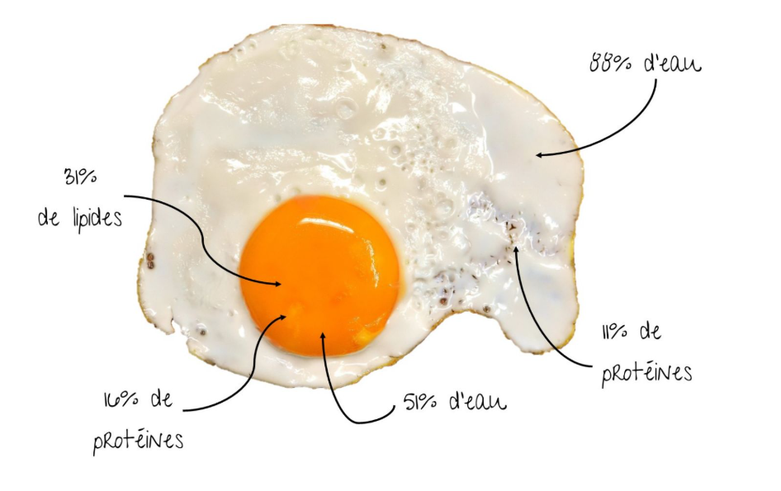

Slide 62
Egg proteins
1.2. Composition and Roles of Proteins: The Winning Duo of White and Yolk
Proteins are not uniformly distributed, and each part of the egg has a specific function.
A. The Egg White: A Biochemical Fortress
The white is an aqueous solution containing about ten main proteins, each with a specific role.
Protein | Percentage | Detailed Roles and Properties
Ovalbumin | 54% | Main function: Gelling property. This is the protein that coagulates with heat, allowing the solidification of cooked eggs, custards, and cakes.
Ovotransferrin | 12-13% | Functions 1) Iron binding: Deprives bacteria of this essential nutrient, limiting their growth (antimicrobial effect). 2) Gelation: Coagulates at a lower temperature than ovalbumin (~60°C).

Slide 63
5. Egg proteins
Protein | Percentage | Detailed Roles and Properties
Ovomucoid | 11% | Crucial role: It is a trypsin inhibitor. Trypsin is a key digestive enzyme. Ovomucoid blocks it, making raw egg white proteins poorly digestible (51%). Cooking denatures it, thereby significantly improving digestibility.
Lysozyme | 3.5% | Antimicrobial action: Destroys the cell wall of Gram+ bacteria (like some Lactobacillus). It is even extracted industrially as a natural preservative (cheeses, cured meats).
Avidin | 0.05% | Vitamin interaction: It binds to biotin (Vitamin B8) to form an insoluble complex, making this vitamin unavailable. Cooking also destroys this property, eliminating the (very rare) risk of deficiency.

Slide 64
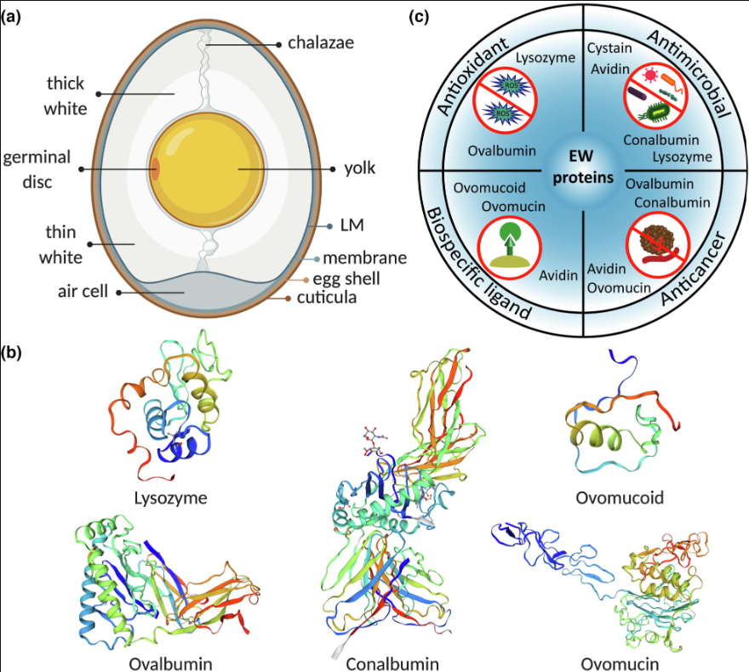
Figure.
(a) Major components of chicken egg are shell, shell membrane, yolk and white. Egg white is located between eggshell membrane layers (i.e. outer, inner and limiting (LM) membranes) and yolk (created with Biorender.com).
(b) 3D structure of five main egg white proteins; ovalbumin, conalbumin, lysozyme, ovomucoid and ovomucin.
(c) Egg white proteins exhibits different biological properties, making them ideal bioactive compounds for multiple medical, pharmaceutical and bioengineering areas.

Slide 65
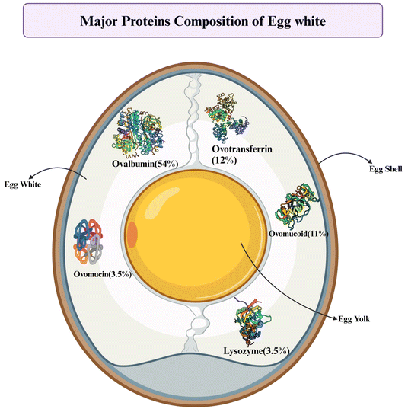

Slide 66
5. Egg proteins
B. The Egg Yolk: A Complex Natural Emulsion
The yolk is a naturally stabilized oil-in-water structure. It is much more than a simple fat reservoir.
Structure: The yolk consists of:
  Plasma: The liquid phase containing LDL (Low-Density Lipoproteins), the main contributors to emulsifying power.
  Granules: Insoluble particles containing HDL (High-Density Lipoproteins) and Phosvitin.

Slide 67
5. Egg proteins
Protein | Location | Detailed Primary Role
LDL (Low-Density Lipoproteins) | Plasma | The number one emulsifier. These lipoproteins are natural surfactants. They position themselves at the interface between oil and water, stabilizing fat droplets in mayonnaise, sauces, and cakes.
HDL (High-Density Lipoproteins) & Lipovitellin | Granules | Contribute to coagulation during cooking. They help form the solid structure of the cooked yolk.
Phosvitin | Granules | Mineral binding. This is the most phosphorylated protein in nature. It strongly binds ferrous ions (Fe²⁺), preventing lipid oxidation (rancidity) and contributing to the stability of the emulsion.
Lecithin | (Lipid component) | Major emulsifier. Although it is a phospholipid and not a protein, it works in synergy with LDL to stabilize emulsions.

Slide 68
5. Egg proteins
1.3. Exceptional Nutritional Value: Why the Egg is a Reference
The Impact of Cooking on Digestibility: This is a key point.
  Raw white: 51% digestibility due to ovomucoid inhibiting trypsin.
  Cooked white: Heat denatures ovomucoid. The coagulated proteins are more easily attacked by digestive enzymes, increasing digestibility to 91-94%.
  Yolk: Overcooking can harden the lipoproteins and slightly decrease the digestibility of the lipids. Proper cooking is ideal.
Amino Acid Score and WHO Reference: Egg proteins contain all the essential amino acids in ideal proportions for human protein synthesis. This is why the WHO has chosen it as the reference protein (score of 100) for evaluating the quality of other dietary proteins. It is slightly superior to human milk for children.

Slide 69
5. Egg proteins
Biological Value: This concept goes beyond simple composition. It measures the efficiency with which absorbed proteins are used for the synthesis of body proteins. Thanks to its perfect balance and high digestibility once cooked, egg is 15% more efficient than milk, 20% more than meat, and 40% more than wheat.

Slide 70
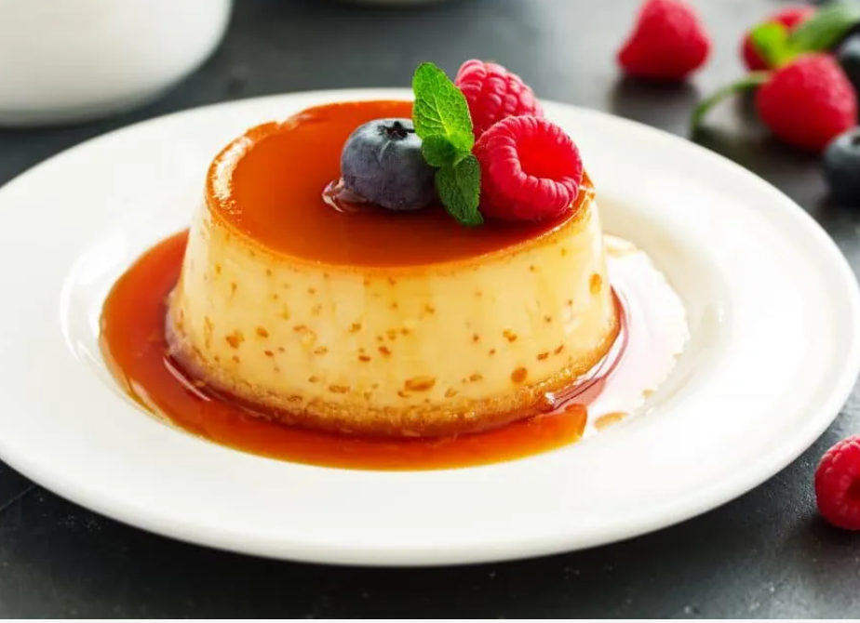
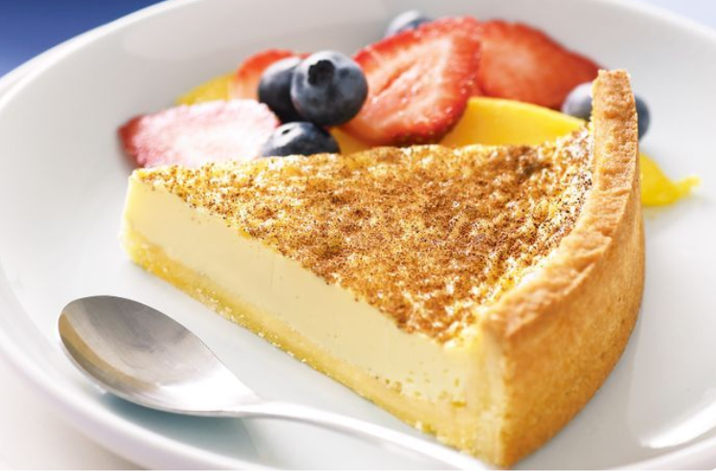

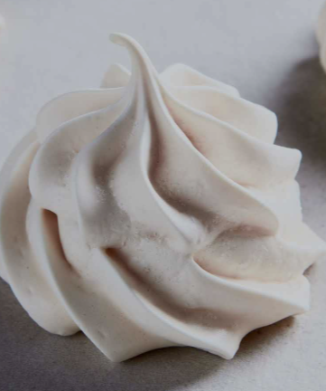
1.4. Techno-Functional Properties: The Egg, an Indispensable Culinary Tool
Property | Physico-Chemical Mechanism | Concrete Culinary Applications
Gelling / Coagulation Power | Under the effect of heat, proteins unfold (denaturation) and then associate with each other to form a three-dimensional network that traps water. | Baked custard, crème caramel: The whole egg gel provides a firm, smooth texture. Cake, quiche: Coagulation binds all the ingredients. Charcuterie (pâté): Binds the stuffing and prevents the loss of water and fat.
Foaming Power | When beaten, the proteins in the white (ovalbumin, globulins) unfold and form an elastic film around the air bubbles. Ovomucin stabilizes this foam. | Meringue: The foam is stabilized by baking. Soufflé, chocolate mousse: The foam provides lightness and volume to the preparation.
Notes:
عند الضرب، تتكشف البروتينات الموجودة في البياض (الألبومين البيضاوي، الجلوبيولين) وتشكل غشاءً مرنًا حول فقاعات الهواء. يعمل الأوفوموسين على تثبيت هذه الرغوة.

Slide 71

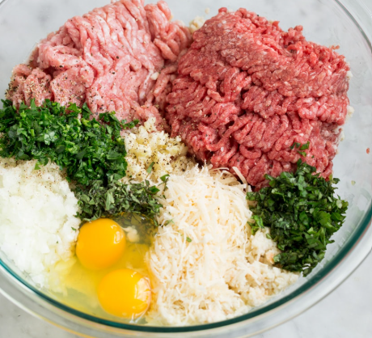
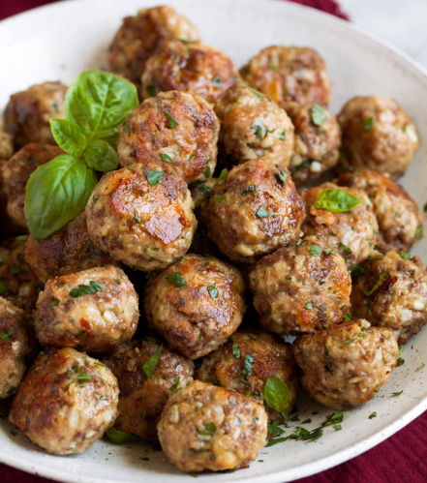
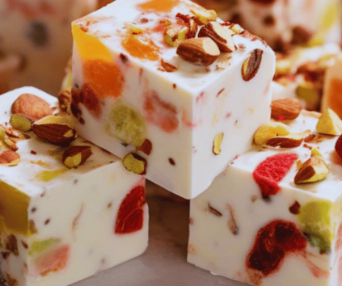
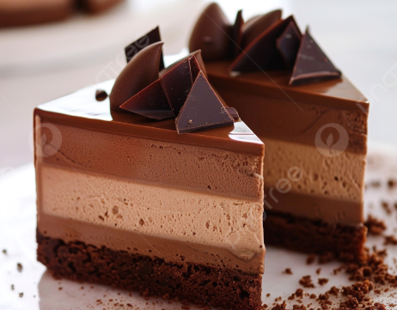
Emulsifying Power | The surfactant molecules in the yolk (LDL, lecithin) position themselves at the oil-water interface. Their hydrophilic part is in the water and their lipophilic part is in the oil, preventing the droplets from coalescing. | Mayonnaise: Stabilization of the oil-in-vinegar/water emulsion. Cake: Emulsification of the fat in the batter for an airy texture.
Binding Power | Combination of emulsifying power (for fats), coagulating power (for water), and the ability to retain moisture. | Meatballs, vegetable patties: The egg binds the breadcrumbs, minced meat, or vegetables so they don't crumble.
Anti-Crystallizing Power | The proteins in the white physically interfere with the growth of sucrose crystals. | Nougat, fondant, soft caramel: Allows for a sweet but smooth, non-gritty texture.

Slide 72
Part 2: Milk Proteins
2.1. Milk Composition: A Complex Colloidal System
Milk is not a simple solution; it is a complex biological fluid where proteins coexist in a delicate balance.
The Two Main Families:
  Caseins (≈ 80%): These are phosphoproteins. They assemble into large spherical structures called micelles, held together by calcium phosphate. The 4 main ones are: αS1, αS2, β, and κ-casein. The κ-casein, on the surface, ensures the stability of the micelles.
  Whey Proteins (≈ 20%): Also called "serum proteins," they are soluble in the aqueous phase of milk. The main ones are:
    - β-lactoglobulin: Absent from human milk, it is the major protein in cow's whey. It has a transport role and has excellent gelling properties.

Slide 73
    - α-lactalbumin: Rich in tryptophan, it is important in the synthesis of lactose.
    - Lactoferrin: A protein with a powerful antimicrobial effect by "capturing" iron.
    - Immunoglobulins: Antibodies that provide passive immunity.
Bioactive Molecules: Milk is much more than just a food. It is a source of compounds with physiological activity:
Hormones and Growth factors (IGF1, TGFβ): Highly concentrated in colostrum (first milk).
Bioactive peptides: Released during digestion or processing, they can have antihypertensive (ACE inhibitors), immunomodulatory, or antimicrobial effects.
2.2. Dairy Ingredients and Their Uses: Mastering Transformation
The dairy industry transforms milk into a range of ingredients with specific functionalities.

Slide 74
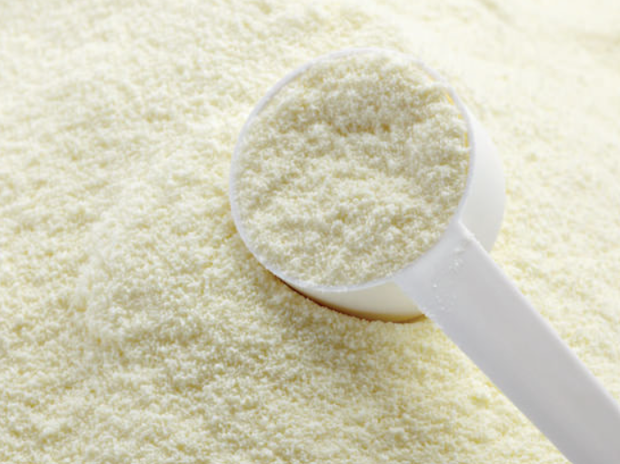
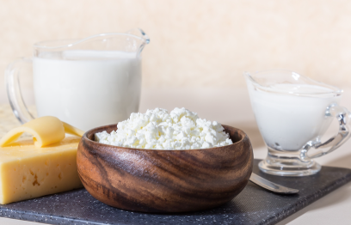
Ingredient | Manufacturons Process | Detailed Characteristics and Applications
Skimmed Milk Powder | Skimmed milk → Concentration → Spray drying. | The heat treatment before drying is crucial: - Low-heat: Native proteins. Used to reconstitute milk, make yogurts (good gelation), and ice cream (solubility). - High-heat: Denatured proteins. Better water retention. Ideal in baking to strengthen the dough structure and improve crust color.
Caseins & Caseinates | Precipitation of caseins from skimmed milk, then drying. | - Acid casein: Precipitated at pH 4.6. Low solubility. - Sodium caseinate: Obtained by redissolving acid casein with soda. Very soluble, excellent emulsifier and foamer. Used in instant coffee whiteners, sausages (binder), meat analogues. - Calcium caseinate: Less soluble, forms a suspension. Provides texture and body to protein drinks and processed cheese.
Notes:
Les caséines sont les protéines principales du lait, insolubles, et les caséinates sont des dérivés plus solubles obtenus en neutralisant la caséine acide avec une base. Les caséines sont utilisées pour fabriquer du fromage et des yaourts, tandis que les caséinates, du fait de leur meilleure solubilité, sont utilisés dans une grande variété de produits alimentaires comme émulsifiants, épaississants ou pour améliorer la texture, selon l'agent neutralisant utilisé (par exemple, le caséinate de calcium).

Slide 75
Ingredient | Manufacturing Process | Detailed Characteristics and Applications
Whey Protein Concentrates/Isolates (WPC/WPI) | Membrane filtration (ultrafiltration) of whey to concentrate proteins. | - WPC (35-80% protein): Good balance between functionality and cost. Used in fermented dairy products, ice cream, pastries. - WPI (>90% protein): Almost pure protein. Highly soluble, even at acidic pH. It is the star ingredient of sports drinks and supplements.
Notes:
Whey Protein Concentrates (WPC) and Isolates (WPI) are both derived from whey but differ in processing, resulting in WPC having a lower protein content and higher fat/lactose levels than WPI. WPI undergoes additional filtration to become a purer product (90%+ protein), while WPC typically ranges from 70-80% protein. This makes WPI a better option for those with lactose intolerance, whereas WPC is often more cost-effective.

Slide 76
2.3. Key Functional Properties
- Gelation:
Acid gel (for yogurt): Acidification by lactic acid bacteria neutralizes the negative charges on the casein micelles, which then assemble into a gel.
Rennet gel (for cheese): The rennet enzyme cuts the κ-casein, destroying the stability of the micelles, which coagulate.
- Emulsification: Caseinates, due to their amphiphilic structure (hydrophobic and hydrophilic parts), are excellent emulsion stabilizers (sausages, creamy desserts).
- Foaming: Whey proteins (especially β-lactoglobulin) form stable, aerated foams, used in chocolate mousses, cappuccinos.

Slide 77
2.4. Effects of Technological Processes: Mastering Heat
- Maillard Reaction: At high temperatures, the amine group of proteins (especially β-lactoglobulin) reacts with lactose (a sugar). This leads to browning and the development of flavors, but can also reduce the availability of certain amino acids (like lysine) and modify digestibility.
- UHT (Ultra-High Temperature) Treatment: This treatment (140°C for a few seconds) allows for long shelf life without refrigeration. However, it induces protein-protein and protein-lactose interactions that destroy the milk's ability to coagulate with rennet (making it unsuitable for cheesemaking).

Slide 78
Principle of Chromatography
The main principle of chromatography is that different substances interact differently with the stationary and mobile phases and this difference in interaction separates the compounds.
As the mobile phase moves with the sample through the fixed stationary phase, each compound moves at a different speed based on its properties like size, charge, or affinity to the stationary phase resulting in separation. The separated components are represented as peaks on a chromatogram and identified by its retention time which is the time a compound takes to move through the system.

Slide 79
Components and Parts of Chromatography
The sample or analyte
Chromatography Column
A stationary phase
A mobile phase
The sample or analyte is the mixture that needs to be separated. Different components of the sample behave differently and are separated based on how they interact with the mobile and stationary phases.
This is the fixed material that can be solid or liquid coated on a surface. As the analyte passes through it, the stationary phase holds or slows down certain molecules based on their properties. Some of the commonly used stationary phases are filter paper, silica, and beads.
This is the moving fluid or solvent that carries the mixture and flows through the stationary phase. The mobile phase can be a liquid or a gas. Some of the commonly used mobile phases are water, acetic acid, or gases like hydrogen and nitrogen..
It is the container that holds the stationary phase where separation occurs. It is used in column-based methods like gas chromatography and HPLC.
Notes:
Chromatography columns are usually cylindrical in shape. The size and material can vary depending on the type of chromatography.

Slide 80
Components and Parts of Chromatography
Detector
A detector is used at the end of the system to identify and measure the individual components as they separate. It shows results as peaks on a graph called a chromatogram. Different types of detectors are used like UV light, mass spectrometry, or flame ionization.
Notes:
Chromatography columns are usually cylindrical in shape. The size and material can vary depending on the type of chromatography.

Slide 81
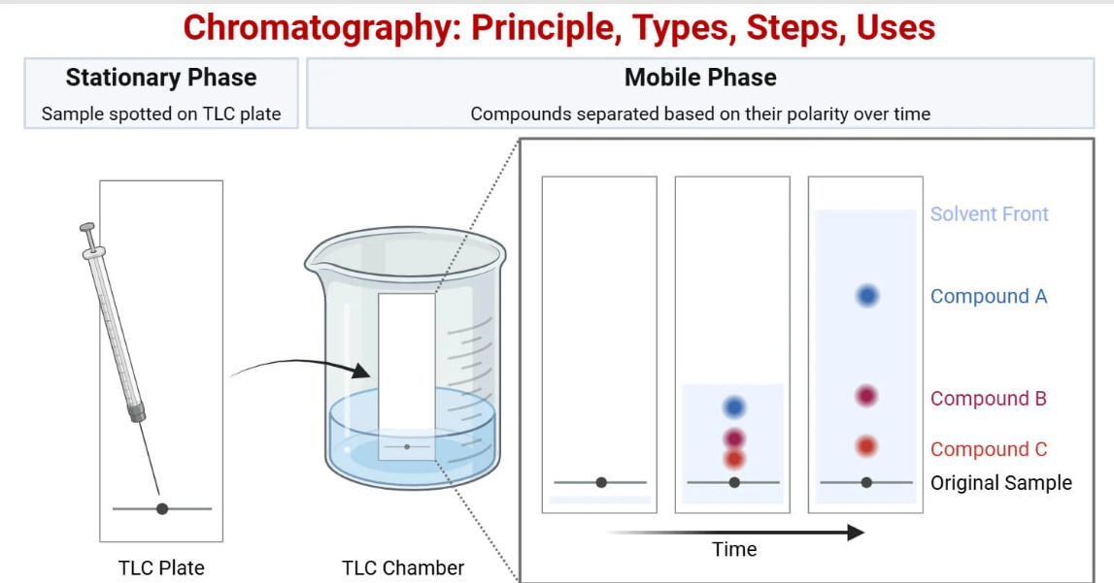

Slide 82
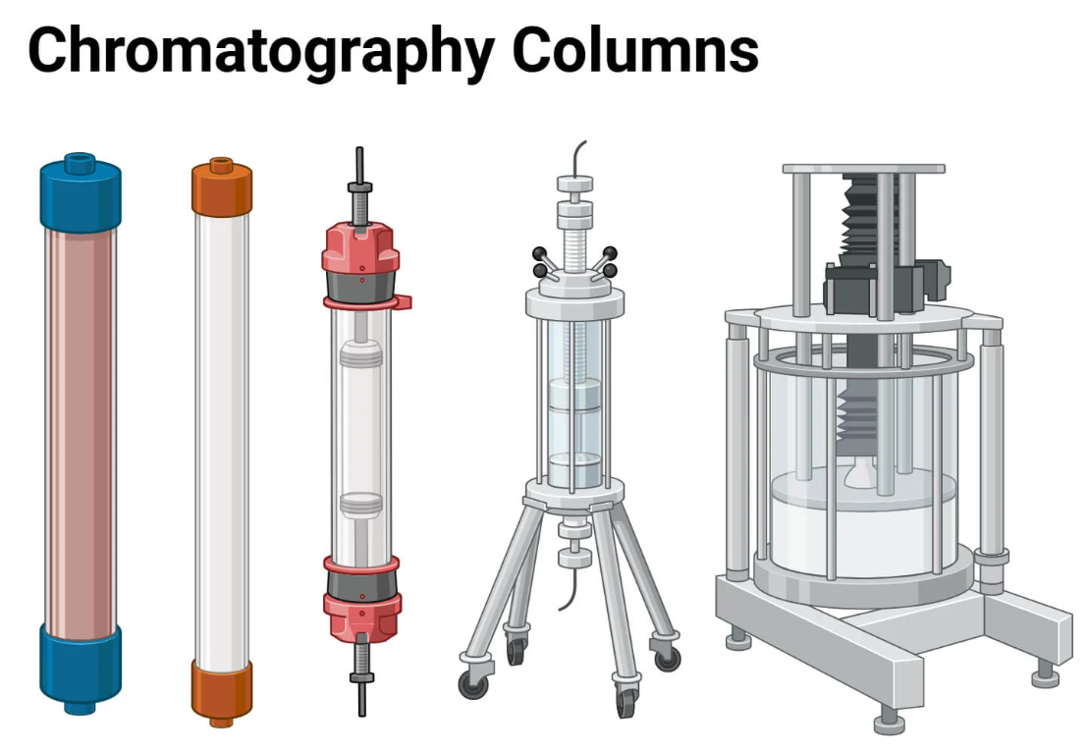

Slide 83
Components and Parts of Chromatography
Chromatography is a family of essential separation techniques in food biochemistry. Its fundamental principle relies on the differential distribution of mixture components (here, proteins) between two phases:
A stationary phase
A mobile phase
Fixed, with specific properties.
Liquid or gaseous, which carries the mixture through the stationary phase.

Slide 84
Proteins, depending on their physicochemical characteristics (size, charge, hydrophobicity, affinity), interact differently with the stationary phase. This difference in their retention time (the time they take to traverse the system) allows them to be separated from each other.
Most commonly used chromatography techniques for food proteins
Here are the four main techniques, classified by their separation principle, commonly used in the food industry and research.

Slide 85
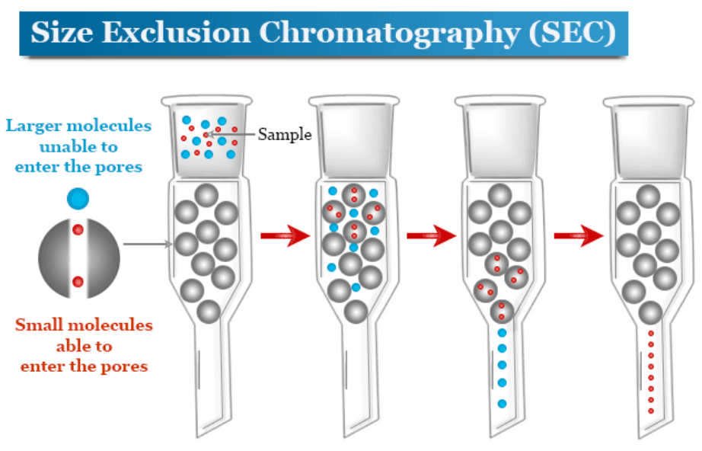
1. Size Exclusion Chromatography (SEC) or Gel Filtration
Separation Principle: Molecular Size and Shape
How it Works?
The stationary phase consists of microbeads of porous gel. Large proteins, unable to enter the pores, are excluded and are eluted first. Small proteins penetrate the pores, travel a longer path, and are thus slowed down, exiting the column later.
Notes:
Size exclusion chromatography (SEC) is a chromatographic separation procedure that separates analyte molecules according to their size or geometry and some cases by their molecular weight. The size exclusion chromatography principle or instrumentation uses a chromatography column for the separation of macromolecules like proteins, enzymes, antibodies, nucleic acids (DNA and RNA), and industrial polymers. The size exclusion chromatography principle is based on the exclusion of analyte molecules through a column containing porous beads. When we use an aqueous solution for the transportation of samples through the column, the procedure is called gel-filtration or gel permeation chromatography.

Slide 86
1. Size Exclusion Chromatography (SEC) or Gel Filtration
Applications in food proteins
  Determining the molecular weight profile of proteins (e.g., in protein hydrolysates).
  Studying protein aggregation or denaturation (detecting dimers or larger aggregates).
  Purification by separating target proteins from other smaller or larger components.
Notes:
Size exclusion chromatography (SEC) is a chromatographic separation procedure that separates analyte molecules according to their size or geometry and some cases by their molecular weight. The size exclusion chromatography principle or instrumentation uses a chromatography column for the separation of macromolecules like proteins, enzymes, antibodies, nucleic acids (DNA and RNA), and industrial polymers. The size exclusion chromatography principle is based on the exclusion of analyte molecules through a column containing porous beads. When we use an aqueous solution for the transportation of samples through the column, the procedure is called gel-filtration or gel permeation chromatography.

Slide 87
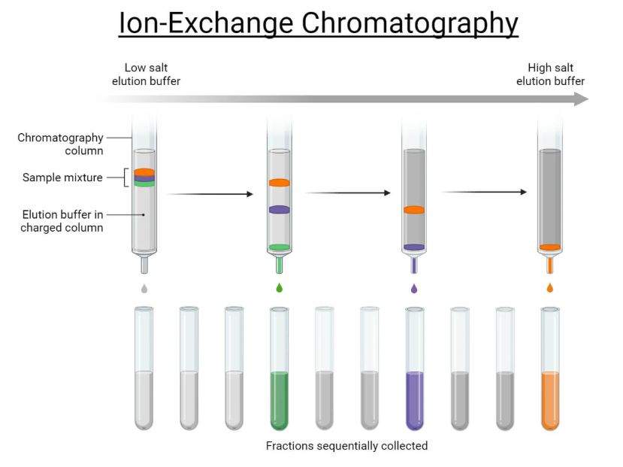
Ion Exchange Chromatography (IEC)
Separation principle: The net electric charge of the protein.
How it Works?
The stationary phase has charged groups (cationic or anionic).
  Cation Exchangers: Negatively charged, they retain positively charged proteins (at a given pH).
  Anion Exchangers: Positively charged, they retain negatively charged proteins.
  Elution is achieved by increasing the ionic strength (salt gradient) of the mobile phase, which competes with the proteins for binding to the resin.
Notes:
Size exclusion chromatography (SEC) is a chromatographic separation procedure that separates analyte molecules according to their size or geometry and some cases by their molecular weight. The size exclusion chromatography principle or instrumentation uses a chromatography column for the separation of macromolecules like proteins, enzymes, antibodies, nucleic acids (DNA and RNA), and industrial polymers. The size exclusion chromatography principle is based on the exclusion of analyte molecules through a column containing porous beads. When we use an aqueous solution for the transportation of samples through the column, the procedure is called gel-filtration or gel permeation chromatography.

Slide 88
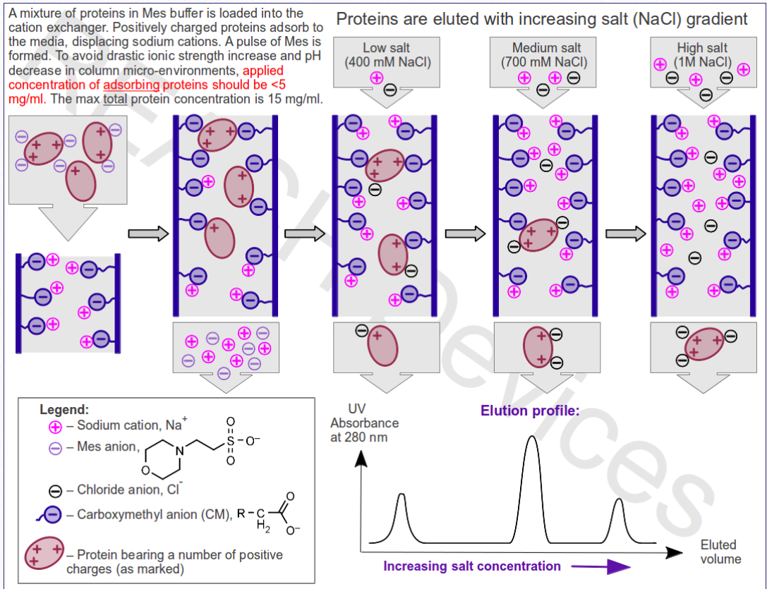

Slide 89
Ion Exchange Chromatography (IEC)
Applications in food proteins
  Fractionation of whey proteins (α-lactalbumin, β-lactoglobulin) which have different isoelectric points (pI).
  Purification of specific proteins from complex extracts (e.g., lysozyme from egg white).
  "De-bittering" of food products by removing undesirable proteins or peptides.
Notes:
Size exclusion chromatography (SEC) is a chromatographic separation procedure that separates analyte molecules according to their size or geometry and some cases by their molecular weight. The size exclusion chromatography principle or instrumentation uses a chromatography column for the separation of macromolecules like proteins, enzymes, antibodies, nucleic acids (DNA and RNA), and industrial polymers. The size exclusion chromatography principle is based on the exclusion of analyte molecules through a column containing porous beads. When we use an aqueous solution for the transportation of samples through the column, the procedure is called gel-filtration or gel permeation chromatography.

Slide 90
Hydrophobic Interaction Chromatography (HIC)
Hydrophobic Interaction Chromatography (HIC) is a powerful, non-denaturing technique used to separate and purify proteins and other biomolecules based on differences in their surface hydrophobicity
Separation Principle: Protein surface Hydrophobicity.
How it Works?
- HIC separates molecules according to their hydrophobic regions, using a stationary phase (e.g., agarose or silica beads) coated with hydrophobic ligands such as phenyl, octyl, or butyl groups.​
- Samples are loaded onto the HIC column in a buffer with a high salt concentration, which enhances hydrophobic interactions, causing hydrophobic molecules to bind to the stationary phase.​
- As the salt concentration is gradually decreased, hydrophobic interactions weaken, and proteins elute from the column according to their degree of hydrophobicity
Notes:
Size exclusion chromatography (SEC) is a chromatographic separation procedure that separates analyte molecules according to their size or geometry and some cases by their molecular weight. The size exclusion chromatography principle or instrumentation uses a chromatography column for the separation of macromolecules like proteins, enzymes, antibodies, nucleic acids (DNA and RNA), and industrial polymers. The size exclusion chromatography principle is based on the exclusion of analyte molecules through a column containing porous beads. When we use an aqueous solution for the transportation of samples through the column, the procedure is called gel-filtration or gel permeation chromatography.

Slide 91
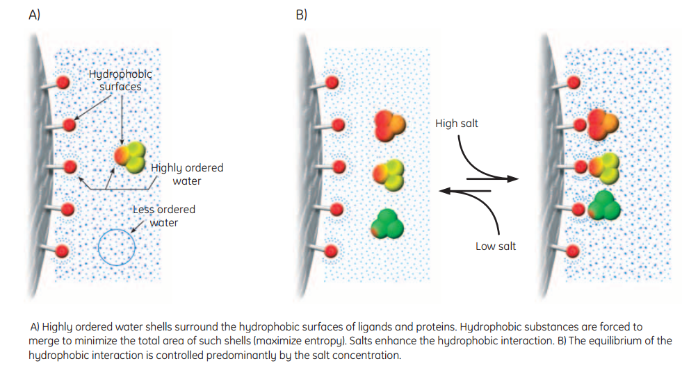
Hydrophobic Interaction Chromatography (HIC)
Notes:
Size exclusion chromatography (SEC) is a chromatographic separation procedure that separates analyte molecules according to their size or geometry and some cases by their molecular weight. The size exclusion chromatography principle or instrumentation uses a chromatography column for the separation of macromolecules like proteins, enzymes, antibodies, nucleic acids (DNA and RNA), and industrial polymers. The size exclusion chromatography principle is based on the exclusion of analyte molecules through a column containing porous beads. When we use an aqueous solution for the transportation of samples through the column, the procedure is called gel-filtration or gel permeation chromatography.

Slide 92
Affinity Chromatography
  Affinity chromatography is a powerful and highly selective technique used to separate and purify biomolecules such as proteins, nucleic acids, and antibodies from complex mixtures, based on specific binding interactions between a target molecule and an immobilized ligand on a stationary support
Notes:
Size exclusion chromatography (SEC) is a chromatographic separation procedure that separates analyte molecules according to their size or geometry and some cases by their molecular weight. The size exclusion chromatography principle or instrumentation uses a chromatography column for the separation of macromolecules like proteins, enzymes, antibodies, nucleic acids (DNA and RNA), and industrial polymers. The size exclusion chromatography principle is based on the exclusion of analyte molecules through a column containing porous beads. When we use an aqueous solution for the transportation of samples through the column, the procedure is called gel-filtration or gel permeation chromatography.

Slide 93
Affinity Chromatography
Separation Principle: A Specific Biological Interaction (like a key and lock).
How it Works?
The stationary phase is coupled to a "ligand" that binds specifically and reversibly to the target protein. Examples:
Immobilized Metal Affinity Chromatography (IMAC): For purifying recombinant proteins tagged with a polyhistidine-tag.
Protein A/G Chromatography: For purifying antibodies.
Lectin Affinity Chromatography: For isolating glycoproteins.
Elution is performed using an agent that breaks the specific interaction (e.g., a competitor or a pH change).
Notes:
Size exclusion chromatography (SEC) is a chromatographic separation procedure that separates analyte molecules according to their size or geometry and some cases by their molecular weight. The size exclusion chromatography principle or instrumentation uses a chromatography column for the separation of macromolecules like proteins, enzymes, antibodies, nucleic acids (DNA and RNA), and industrial polymers. The size exclusion chromatography principle is based on the exclusion of analyte molecules through a column containing porous beads. When we use an aqueous solution for the transportation of samples through the column, the procedure is called gel-filtration or gel permeation chromatography.

Slide 94
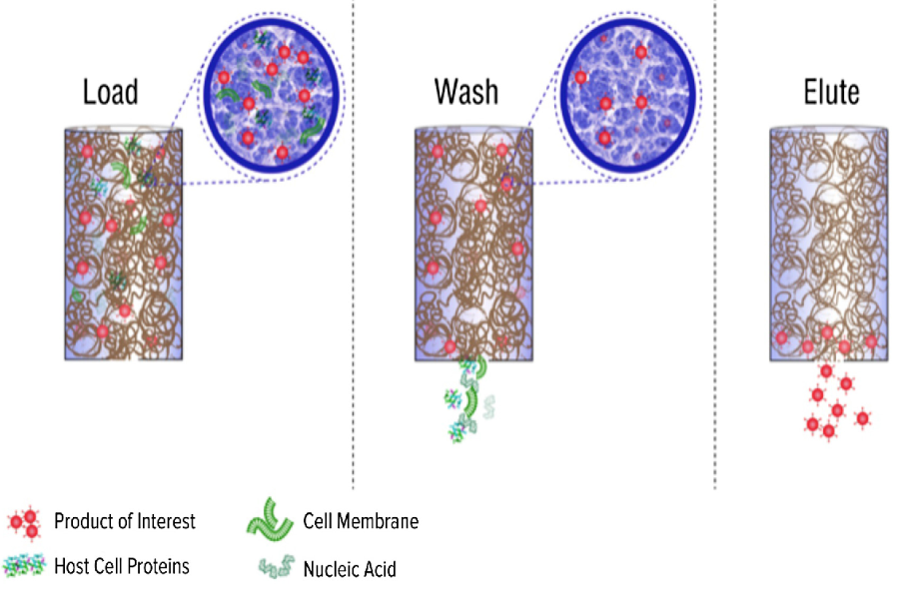
Affinity Chromatography
Notes:
Size exclusion chromatography (SEC) is a chromatographic separation procedure that separates analyte molecules according to their size or geometry and some cases by their molecular weight. The size exclusion chromatography principle or instrumentation uses a chromatography column for the separation of macromolecules like proteins, enzymes, antibodies, nucleic acids (DNA and RNA), and industrial polymers. The size exclusion chromatography principle is based on the exclusion of analyte molecules through a column containing porous beads. When we use an aqueous solution for the transportation of samples through the column, the procedure is called gel-filtration or gel permeation chromatography.

Slide 95
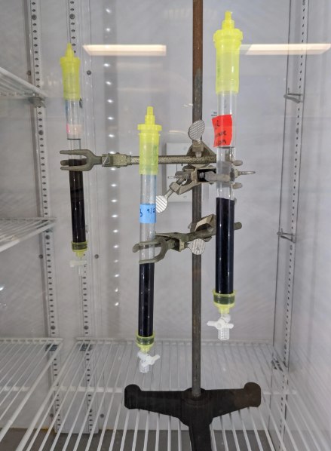
Affinity Chromatography
Applications in food proteins
  High-yield purification of a specific protein of nutritional or functional interest.
  Dosage and purification of enzymes used in food processes (e.g., chymosin in cheesemaking).
  Study of protein-ligand interactions.
Notes:
Size exclusion chromatography (SEC) is a chromatographic separation procedure that separates analyte molecules according to their size or geometry and some cases by their molecular weight. The size exclusion chromatography principle or instrumentation uses a chromatography column for the separation of macromolecules like proteins, enzymes, antibodies, nucleic acids (DNA and RNA), and industrial polymers. The size exclusion chromatography principle is based on the exclusion of analyte molecules through a column containing porous beads. When we use an aqueous solution for the transportation of samples through the column, the procedure is called gel-filtration or gel permeation chromatography.

Slide 96
High Performance/Pressure Liquid Chromatography (HPLC)
The Reference Analytical Tool
High Performance Liquid Chromatography (HPLC) is an advanced analytical technique used to separate, identify, and quantify the individual components in a chemical mixture
It is crucial to understand that the techniques above (SEC, IEC, HIC, Affinity) are separation modes. They are very often implemented using an HPLC (or FPLC for fragile proteins) system.

Slide 97
High Performance/Pressure Liquid Chromatography (HPLC)
HPLC provides
High Pressure: Allows the use of stationary phases with very small particles, significantly increasing the resolution and speed of analysis.
Automation and Reproducibility.
Sensitive Detection (UV, fluorescence) allowing precise quantification of separated proteins.
Concrete HPLC example for food proteins:
An HPLC analysis in anion exchange chromatography mode is a standard method for separating and quantifying different whey proteins in less than 30 minutes with excellent precision.

Slide 98
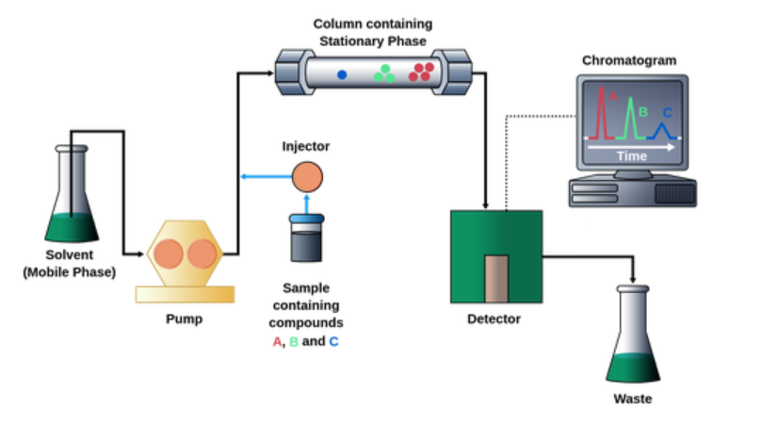
High Performance/Pressure Liquid Chromatography (HPLC)

Slide 99
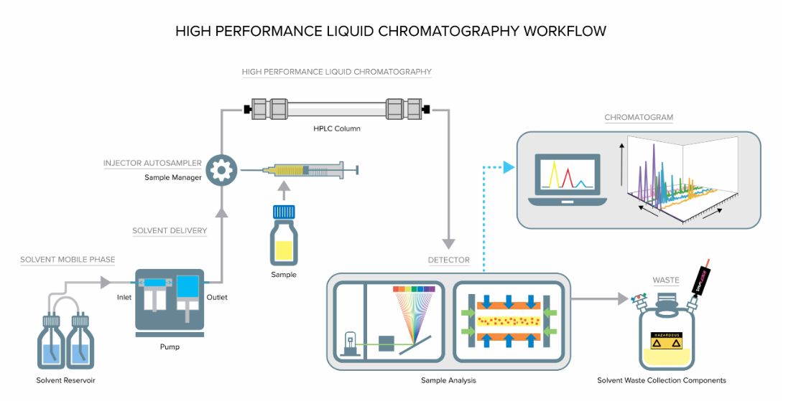
High Performance/Pressure Liquid Chromatography (HPLC)

Slide 100
Comparison between the main types of chromatography used in food biochemistry
Type | Separation Principle | Advantages | Drawbacks | Main Uses/Axes
Gel/Size Exclusion | Molecules pass through pores based on size | Mild, non-destructive, suitable for proteins | Limited resolution for small differences | Purification, polymer, protein analysis
Ion Exchange | Opposite charge affinity | Highly selective, high capacity | Needs pH optimization | AA, protein separation, water, enzymes
Hydrophobic Interaction | Affinity to hydrophobic resin | Good for proteins, mild conditions | Depends on salt, pH adjustment | Protein purification, biochemistry
Affinity | Specific recognition (ligand/antibody) | Highly selective, high purity | Ligand/target required | Enzyme, protein, antibody purification
HPLC | Partition/affinity under high pressure | Fast, precise, versatile, multi-detection | Expensive, technical | Protein, AA, contaminant analysis

