Slide 1
Electronics and system components
Chapter 4. Microprocessor

Slide 2
Presentation plan
1. Microprocesseur definition
2. How does a microprocessor work with other components of
motherboard ?
3. Micro-processor Architecture
3.1. Register definition
3.2. Decoder
3.3. The main elements of microprocessor
3.4.The control unit blocks (and theirs roles)
3.5.The processing unit blocks (and theirs role)
3.6. Bus
3.7. The buffer register
4. Buffer memory
5. Multi-core architecture

Slide 3
1. Microprocesseur definition
Reminder
See 3. Von Neumann Architecture and 4. Composition of a Personal Computer and 5.
General diagram showing how a computer work from ch.2 and 2.6. CPU support from ch.3.
See as well as exercise 2 Von Neumann Architecture and exercise 4 Microprocessor support
from TD 1 and TD 2 respectively.
A microprocessor is a complex transistor based IC capable to perform digital
electronic functions (the most known microprocessors are based on MOS transistor)
Digital signals processed by microprocessor are synchronized using clock signal
(see 2.3. Real Time Clock from ch.3)

Slide 4
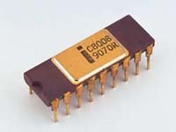
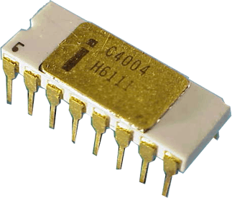
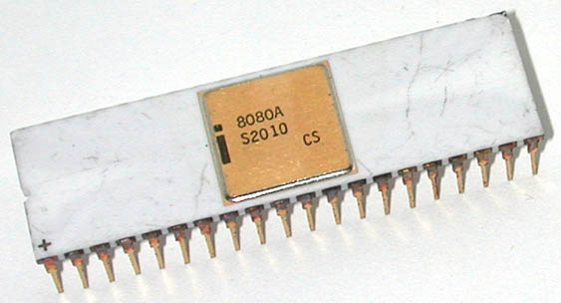
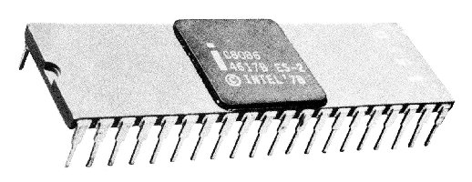
1. Microprocesseur definition (following)
1972 Intel® 8008 :
8 bits, 200 kHz,
3500 transistors
Intel in 1971➔ Microprocessor 4004
1971 Intel® 4004 :
4/8 bits, 108 kHz,
2300 transistors
1974 Intel® 8080 :
8 bits, 2 Mhz,
4500 transistors
1978 Intel® 8086-8088 : 16 bits, 5 MHz,

Slide 5
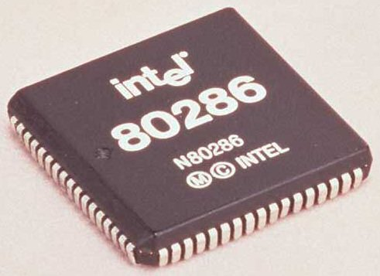
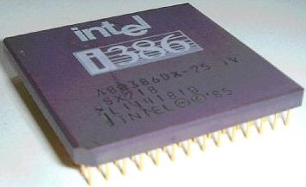
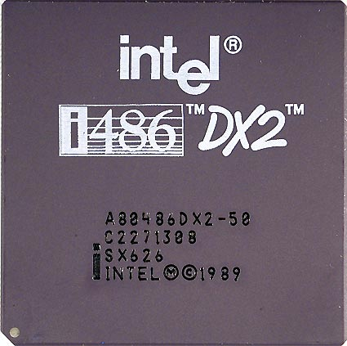
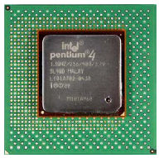
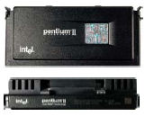
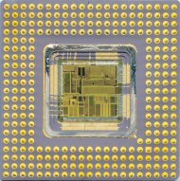
1. Microprocesseur definition (following)
1982 Intel® 80286 :
16/32 bits, plus de 100.000 transistors
1985 Intel® 80386 : 32 bits,
275.000 transistor
1989 Intel® 80486 :
32 bits, 25 à 66 MHz,
1,6 millions de transistors
1993 Intel® Intel® Pentium® :
32 bits, 75 à 133 MHz,
3.1 millions de transistors
2000 Intel® Pentium® 4 : 32 bits, 1,5 GHz, 42 millions de transistors
1997 Intel® Intel® Pentium® II : 32 bits, 7,5 millions de transistors

Slide 6
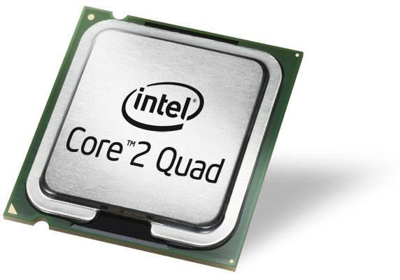
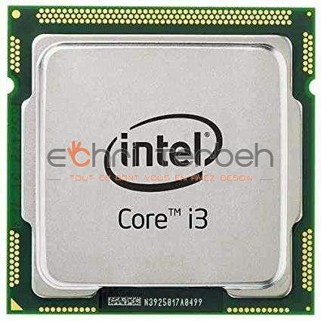
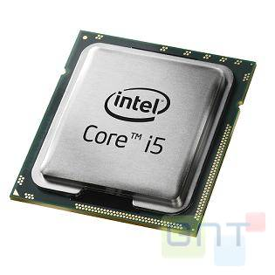
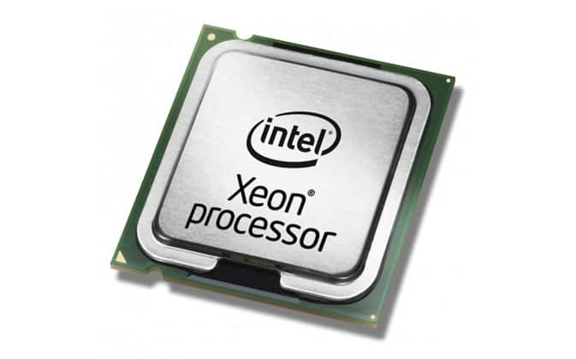
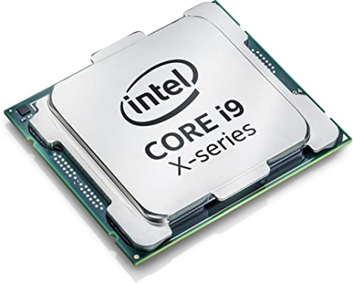
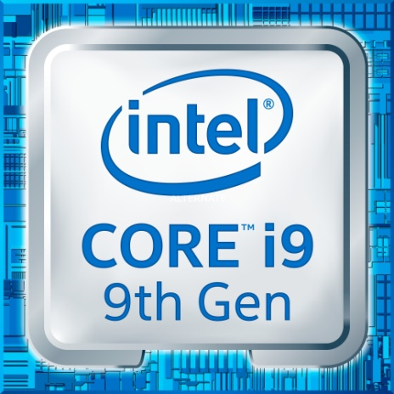
1. Microprocesseur definition (following)
2006 Intel® :
64 bits, plus de 291.000.000 transistors
2011 Intel® : 64 bits,
1.160.000.000 transistors
2011 Intel® :
64 bits,
2011 Intel® core i7/Xeon (Sundy Bridge-E) :
64 bits/64 bits bus, vitesse 3,5 GHz, 2.270.000.000 de transistors

Slide 7
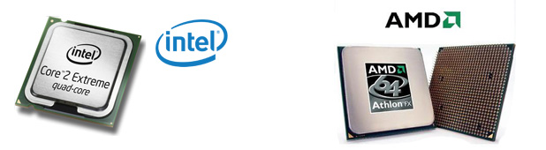
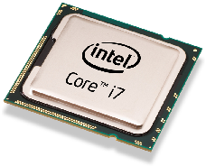
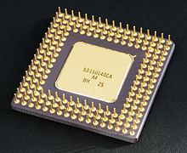
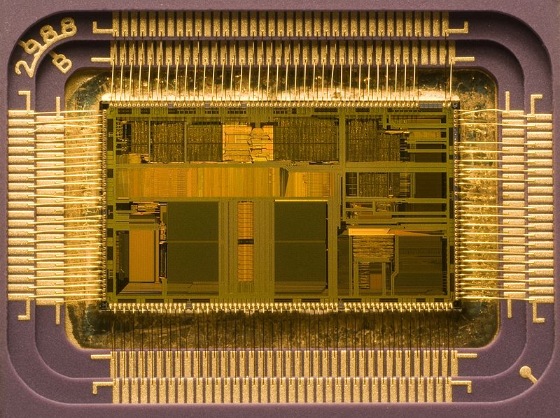
1. Microprocesseur definition (following)

Slide 8
2. How does a microprocessor work with other components of
motherboard ?
BIOS (see 2.5.BIOS from ch.3)➔Load operating system and a program into RAM (-1)
(Instructions are arranged at increasing addresses in memory) (0)
Data provided by input devices (after pressing Enter) ➔ Chipset (southbridge ➔
northbridge) ➔ RAM ➔ Microprocessor (0)
The microprocessor Calls an instruction (from RAM) (1)
The microprocessor reads instruction (2)
The microprocessor decodes instruction using internal commands (3)
The microprocessor executes instruction (4)

Slide 9
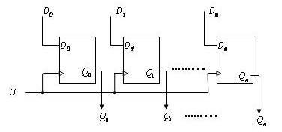
3. 3. Micro-processor Architecture
3.1. Register definition
A flip-flop stores a single bit
Register = an ordered set of flip-flops ➔The register stores information on n bits
un registre qui mémorise n bits

Slide 10
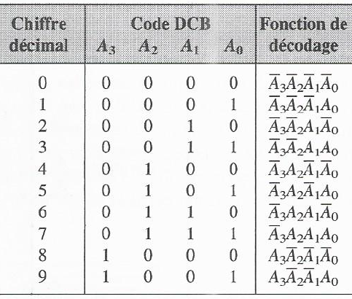
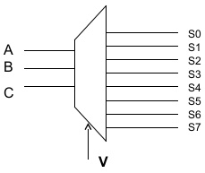
3. 3. Micro-processeur Architecture (following)
3.2. Decoder
A decoder is a combinational circuit consisting of n data inputs and outputs in which for each input binary combination, we have only one active output at a time.
4-line input decoder 10-line output
3-line input decoder 8-line output
DCB-decimal decoder

Slide 11
3. Micro-processor Architecture (following)
3.3. The main elements of microprocessor
Microprocessor (see 4.1. Microprocessor definition)
Microprocesseur
  Control unit (CU)
  Processing unit (contains Arithmetic and Logic Unit (ALU))
  Registers (see 1.3.4. Digital electronic functions from chapitre 1)
  Internal buses between units CU and ALU ➔ Exchange data between unites
  and registers
    Adresses bus
    Data bus

Slide 12
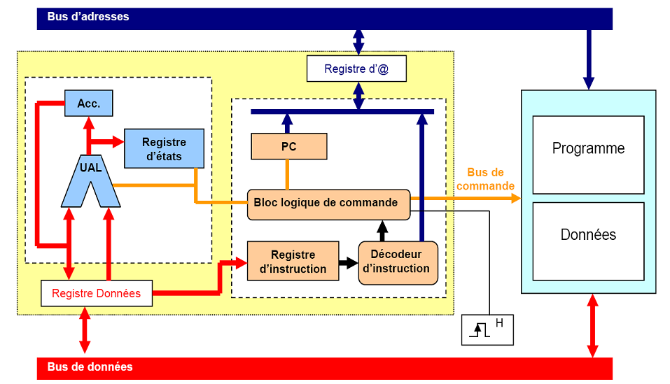
3. Micro-processor Architecture
3.3. The main elements of microprocessor (following)

Slide 13
3. Micro-processor Architecture (following)
3.4.The control unit blocks (and theirs roles)
Program Counter (PC) (register)
  Initialization with first instruction address of program ➔
  Memorizes next instruction address (to execute)
Instruction register (IR) (stores instruction currently being processed)
Instruction decoder (It decodes instruction using internal commands)
Logic control block or sequencer
  Firmware ➔ Depending on clock signal, it produces internal and external synchronization signals ➔ Command bus
  ➔ To sequence instructions executed by UAL, i.e. it determines the order in which the instructions (arithmetic and logic opearations) are executed by UAL.
  ➔ To control the operations on memories (reading and writing), i.e. it calls instruction from RAM.

Slide 14
3. Micro-processor Architecture
3.5.The processing unit blocks (and theirs roles)
Accumulators (working registers)
➔ Store an operand in the beginning of an arithmetic operation
➔ Store the result at the end of the operation (arithmetic or logical)
Arithmetic and Logic Unit (ALU)
  Basic logic operations processing one bit (Buffer, Inverter) or two and more bits (AND gate, NAND gate, NOR gate, etc.)
  Basic logic functions
    Comparison function
    Arithmetic function
      Adder (subtraction)
      Multiplier
  Shift functions

Slide 15
3. Micro-processor Architecture
3.5.The processing unit blocks (and theirs roles) (following)
The state register
  8-bit register (8 flip-flops)
  State of each bit among 8 bits = f (last operation done by the UAL)
  ➔ Status indicator (flag)
  Following program = f (status indicator or flag)
  Status indicator or flag
    Carry : C
    Overflow : OV ou V
    Zero (Z)
    etc …

Slide 16
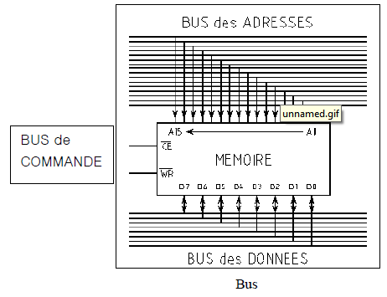
3. Microprocessor Architecture
3.6. Bus
Data bus ➔ Transport data or instructions
Adresses bus ➔ Transports addresses of memory cells
Bus de commandes ➔ Transports signals allowing to control different microprocessor tasks.

Slide 17
3. Microprocessor Architecture
3.7. The buffer register
The buffer register stores temporarily data received from memory.

Slide 18
4. Buffer memory
Microprocessor operating speed << operating speed of central memory (RAM + ROM)
solution
Buffer memory (fast or ultra-fast memory used to store information frequently processed by the microprocessor) ➔ That reduces waiting time in comparaison to time observed when information is stored in RAM
CPU Microprocesseur
Mémoire centrale
Cache L2
Cache L3
Cache L1
Les Niveaux de Mémoire Cache

Slide 19
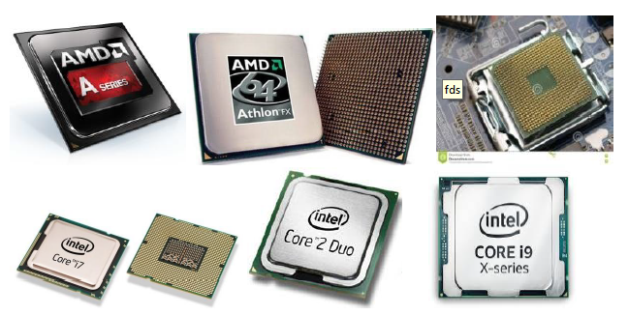
5. Multi-core architecture
A multi-core microprocessor is an architecture such as a processor has several physical cores (2 or 4 or 8 autonomous microprocessor) operating simultaneously and buffer memory assigned to each microprocessor or shared

Slide 20
5. Multi-core architecture (following)
Intel Core i3 ➔ 2 physical cores
Intel Core i5 ➔ 2 or 4 physical cores
Intel Core i7 ➔ 4 physical cores

