Slide 1
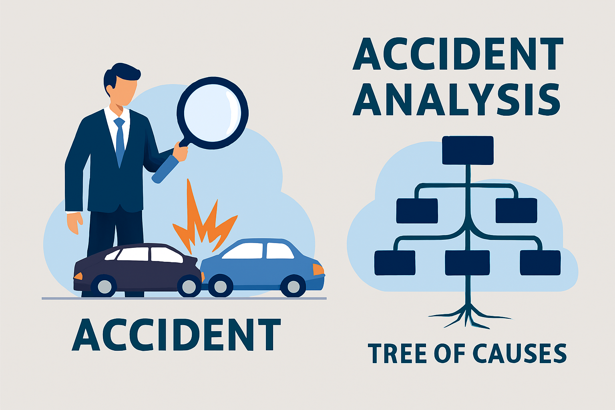
Democratic and Popular Republic of Algeria
Ministry of Higher Education and Scientific Research
Abd El-Hafid Boussouf University - Mila
Faculty of Sciences & Technology
Department of Process Engineering
HSE in Industrial Installations – UED2.1
Week V:
Accident Analysis
Introduction to Tree of Causes

Slide 2
Learning Outcomes
Accident analysis is a key component of industrial safety. It enables engineers to understand why an accident occurred and to identify preventive actions to avoid recurrence.
By the end of this session, you will be able to:
Explain the purpose of accident analysis.
Describe the principles of the Tree of Causes.
Build a simple tree of causes based on an accident scenario.
Propose corrective measures based on the analysis.

Slide 3

1. What is an Industrial Accident ?
An industrial accident is an unforeseen event resulting in:
human injury,
property damage, or
business interruption.
EXAMPLE:
An operator slips on a wet floor in the washing area and breaks his wrist → work stoppage, loss of production.

Slide 4
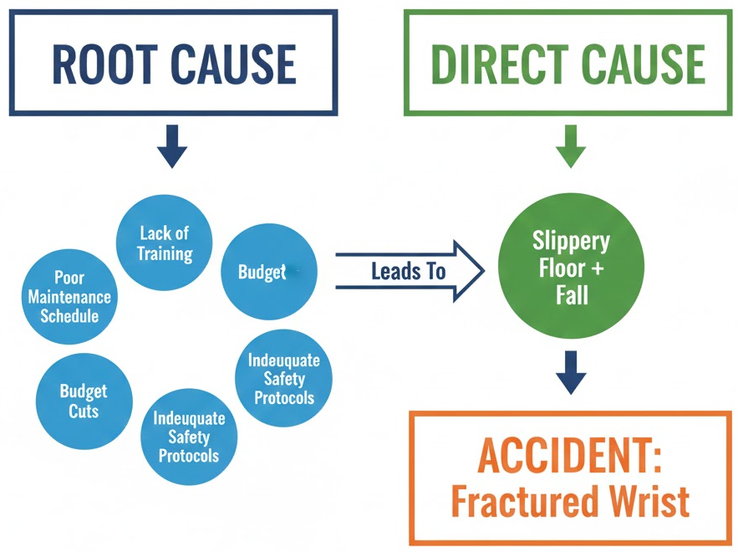
II. Why Analyze Accidents ?
Understand the root causes.
Prevent similar accidents from happening again.
Identify weaknesses in the HSE system.
Advance the safety culture.

Slide 5
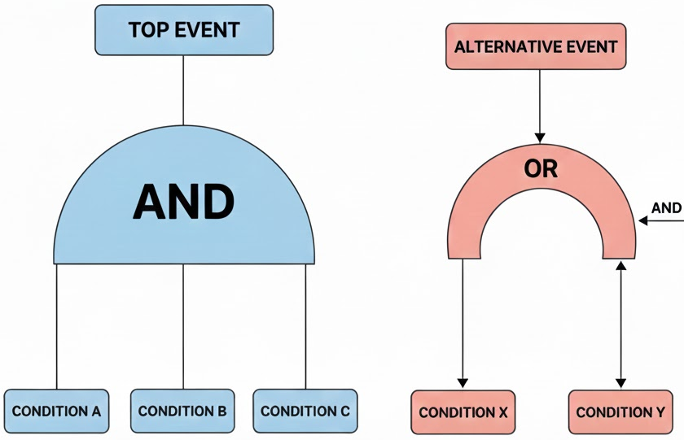
III. Concept of the Tree of Causes:
The Cause Tree is a graphical tool using logical links that:
traces back from the final event (accident) to the contributing events,
including latent conditions (organization, training, environment, etc.).
Types of relationships:
AND (conjunction): several causes had to come together to produce the event.
OR (disjunction): one cause is sufficient to create the event.

Slide 6
IV. Steps to Build a Tree of Causes:
Step 1 – Describe the accident in detail.
Step 2 – Identify the immediate facts.
Step 3 – Look for contributing causes.
Step 4 – Represent the logical links
Step 5 – Validate and propose corrective actions
What? Where? When? Who? Circumstances?
What happened just before the accident.
Procedures, training, equipment, environment, organization.
Build the tree: Dependency relationships Trunks, branches, leaves
Involve the HSE team, supervisors, operators.

Slide 7

V. Example Case Study:
Scenario: Accident in a pumping area
An operator receives a corrosive splash when opening a valve.
Immediate facts:
Valve under slight pressure.
The operator did not check the residual pressure.
Inappropriate PPE (gloves not resistant to acids).
Possible contributing causes:
Incomplete procedure.
Insufficient training.
Missing signage.
Delayed maintenance → increased slow leak.

Slide 8
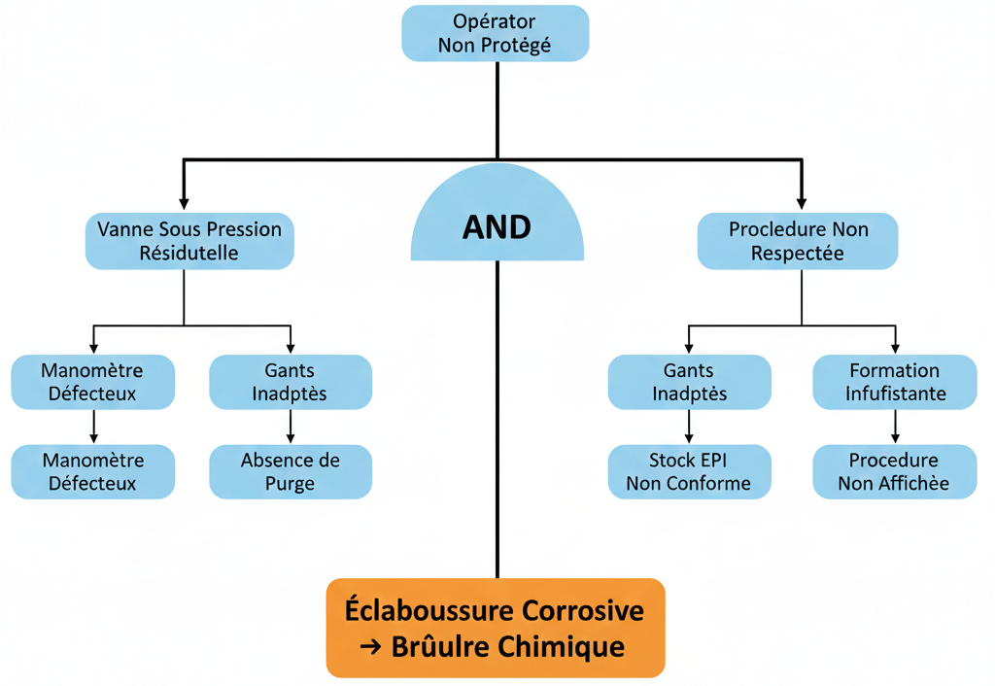
VI. Tree of Causes Diagram:

Slide 9
IIIX. Corrective Measures:
Each identified cause must lead to realistic corrective action, for example:
Technical actions:
Install valves or automatic purge systems.
Replace defective pressure gauges.
Organizational actions:
Revise the pumping procedure.
Clarify the purge steps.
Human actions:
Enhanced training on handling under pressure.
Monitor the use of PPE.

Slide 10
IIX. Summary:
The cause tree is a structured and logical analysis tool.
It allows you to trace the root causes of the accident.
It separates immediate, contributing, and organizational causes.
It guides the implementation of effective corrective actions.
It reinforces the culture of prevention within the company.

Slide 11
IX. Next Session
Week 6: Risk Prevention and Control Strategies
Thank you for your attention!
See you next class.

