Slide 1

Glycogen metabolism and hormonal regulation
Introduction
definitions
Glycogenesis
Glycogenesis Regulation
Glycogenolysis
Glycogenolysis regulation
Simultaneous regulation between glycogenolysis and glycogenesis
Conclusion

Slide 2
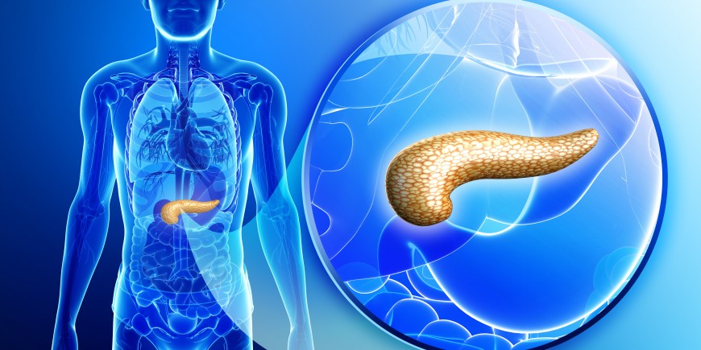
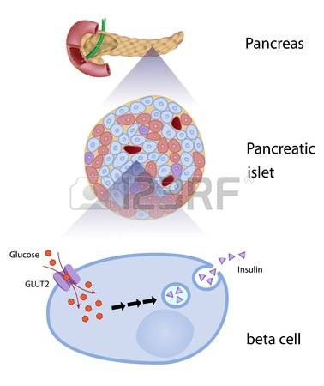

Glycogen metabolism and hormonal regulation
Métabolisme de glycogène et régulation hormonale
Introduction

Slide 3
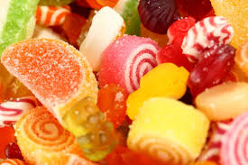
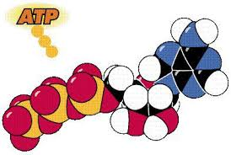
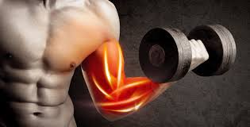
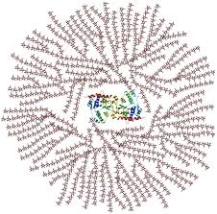
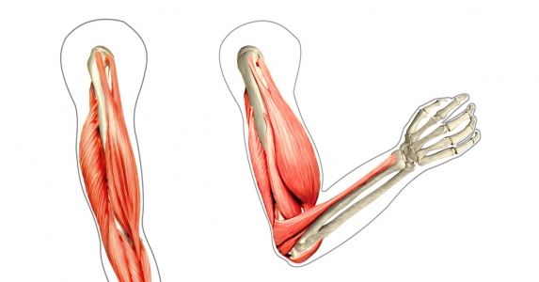
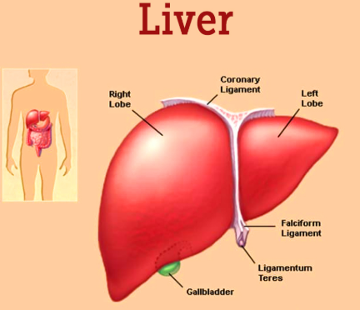
Glycogen metabolism and hormonal regulation
Carbohydrates
Important energy source for cells .
10%
1 %
The glycogen is synthetized in hepatocytes and muscles cell
glycogen

Slide 4
During fasting, glycogen is broken down to maintain blood glucose levels in peripheral tissues
What organs and hormones are involved in glycogen metabolism and hormonal regulation?

Slide 5
Pancreas
Exocrine pancreas 80% :
Digestives enzymes
70 to 80 g
Endocrine pancreas 1 to 2 %:
islets of Langerhans which secrete the hormones: insulin, glucagon

Slide 6
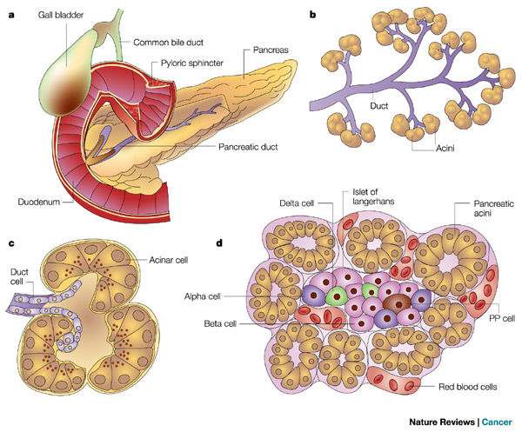

Slide 7
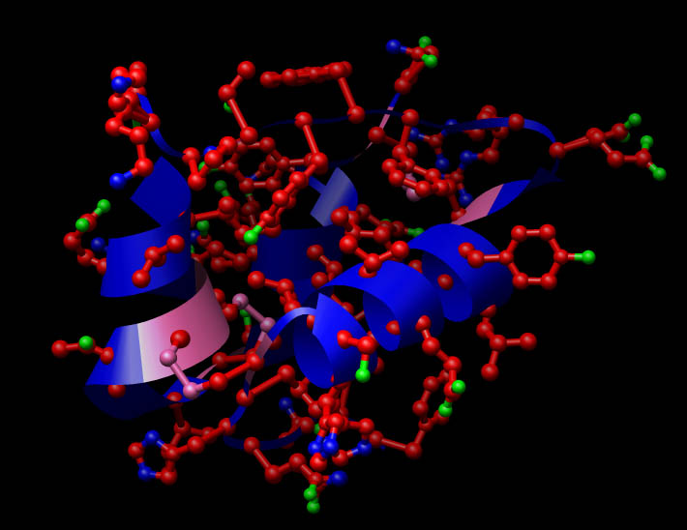
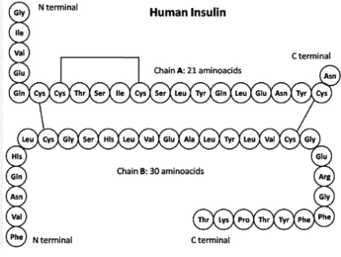
Glycogen metabolism and hormonal regulation
Insulin
Hypoglycemiant horrmon
Two chains of 21 and 30 aminoacides
secreted by the beta cells of the pancreas

Slide 8
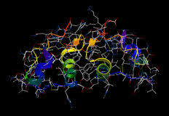
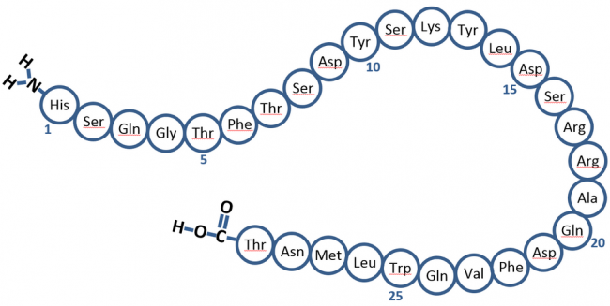
Métabolisme de glycogène et régulation hormonale
Glucagon
Hyperglycemiant horrmon
Only chain of 29 aminoacids
secreted by the alpha cells of the pancreas

Slide 9

Glycogen metabolism and hormonal regulation
Activation
Inhibition

Slide 10
Glycogen metabolism and hormonal regulation
  Activation of
  Glycogenesis
  Lipogenesis
Insulin
Inhibition of :
Glycogenolysis
Lipolysis
Activation of :
Gluconeogenesis
Glycogenolysis
lipolysis
glucagon
Inhibition of :
Glycogenesis
Lipogenesis

Slide 11
Glycogen
Glycogen metabolism and hormonal regulation
Formed of thousands
Of glucose molecules
branched by α(1-6) bond
Linearly linked by α (1,4) bond

Slide 12
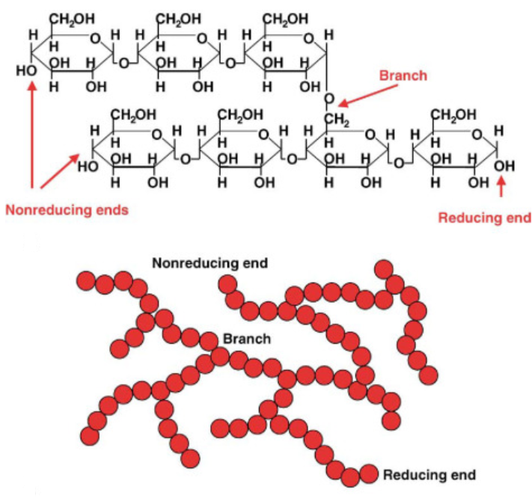
Glycogen metabolism and hormonal regulation

Slide 13

Carbohydrates hemeostasis
Glycogen metabolism and hormonal regulation
The body's ability to maintain glucose levels at approximately 1 g/L results from complex regulatory mechanisms involving multiple interacting organs. This is essential for optimal blood glucose regulation.

Slide 14
Carbohydrates hemeostasis
Meal
➔ ↓ glycemia
Glycemia Value of 1g/L
➔ ↑ glycemia
Receptor-Effector
Sonsor- transmitter
Liver : Storage of glucose in the form of glycogen
Pancreas
➔ ↑ glycogenesis and ↓ glycogenolysis
Cells α Cell β
Transmetter
Glucagon/Insuline
Muscle : Utilization of glucose and storage of glucose in the form of glycogen
➔ ↑ glycogenesis and ↓ glycogenolysis
➔ ↑ Insulin and ↓ Glucagon
Adipose tissue :
Transformation of glucose on lipids
➔ ↑ lipogenesis ↓ lipolysis
Regulating system

Slide 15

Glycogen metabolism and hormonal regulation
transport of glucose

Slide 16
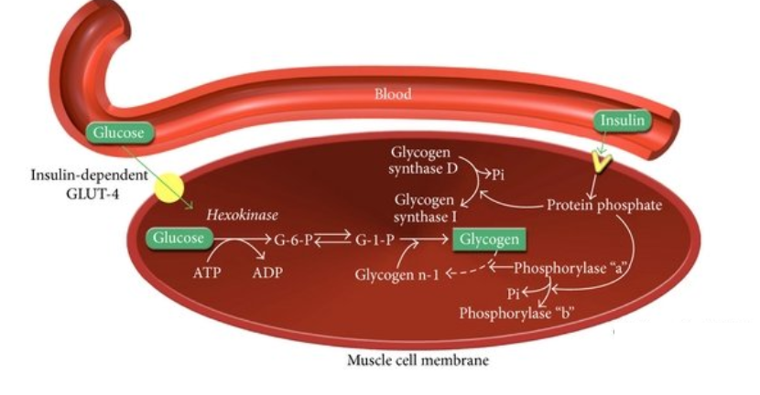
Glycogen metabolism and hormonal regulation
Facilitated transport or facilitated diffusion
It is provided by members of the GLUT ("Glucose Transporter") family of transporters, the most important of which aret:
GLUT4
Skeletal muscles
Adipose tissue
GLUT2
Hepatocytes
Cells β of endocrine pancreas.

Slide 17
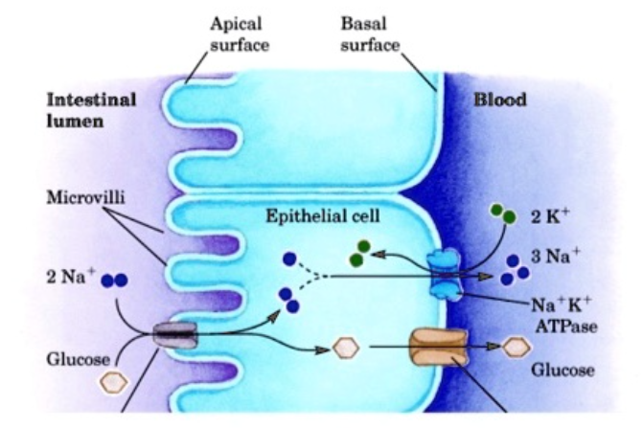
Secondary active transport
Glycogen metabolism and hormonal regulation
carried out by the Na+-glucose symport
abondant in :
digestif system

Slide 18

Glycogenesis
(post - prandial period )
Glycogen metabolism and hormonal regulation

Slide 19

Glycogen metabolism and hormonal regulation
objective
In the liver:
Storage of excess glucose
In the muscles:
Regeneration of glycogen stores

Slide 20
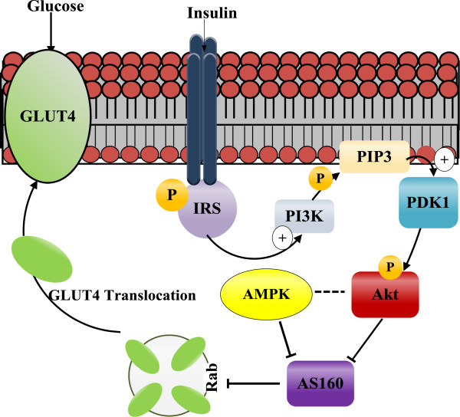
Glycogen metabolism and hormonal regulation
GLUT4 translocation and diffusion of glucose
The released insulin binds to its receptor in liver, muscle, and fat cells.
diffusion du glucose via une augmentation de la synthèse et de la translocation des transporteurs insulinodépendante (GLUT4 ) vers la membrane plasmique
The concentration of GLUT4 on the plasma membrane is increased.
GLUT4 facilitates the diffusion of glucose down its concentration gradient into liver and muscle cells where it is stored as glycogen.

Slide 21

Glycogen metabolism and hormonal regulation
Glycogenesis reactions

Slide 22
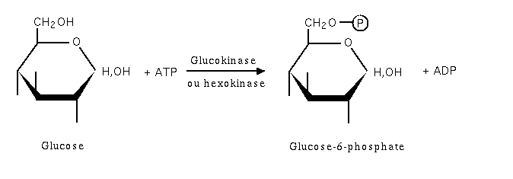
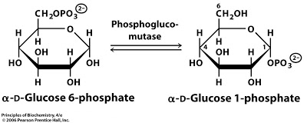
Glycogen metabolism and hormonal regulation
Reaction 1:Phosphorylation of glucose
Reaction 2: Conversion of glucose 6➔ into glucose 1-➔

Slide 23
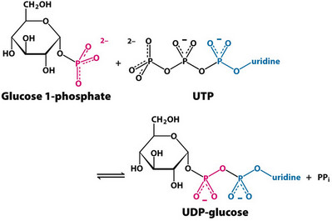
Glycogen metabolism and hormonal regulation
Reaction3: formation of l'UDP glucose by UDP glucose pyrophosphorylase

Slide 24
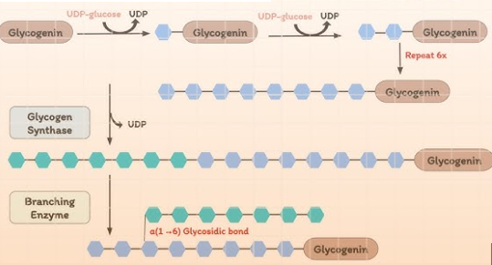
Glycogen metabolism and hormonal regulation
Reaction 4: Synthesis of a primer to initiate the glycogen formation
a fragment of glycogen in the form of dextrin
Two types of
primers
intervention of glycogenin
to form a short chain approximately 8 units of glucose

Slide 25
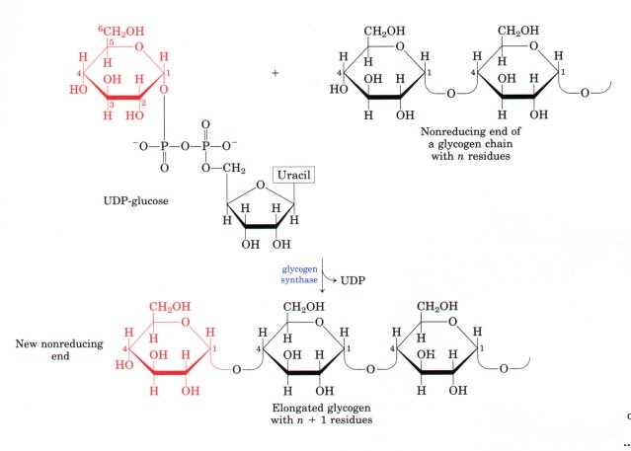
Glycogen metabolism and hormonal regulation
Reaction 5:Elongation of the chain catalyzed by glycogen synthetase
New glucosyl units added to nonreducing end terminal residues of glycogen and the formation of α(1,4) linkage

Slide 26
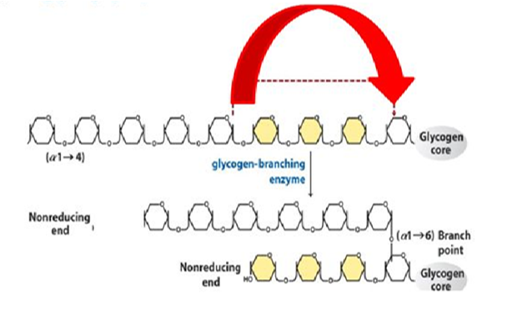
Glycogen metabolism and hormonal regulation
le
Reaction6: Glycogen branching

Slide 27
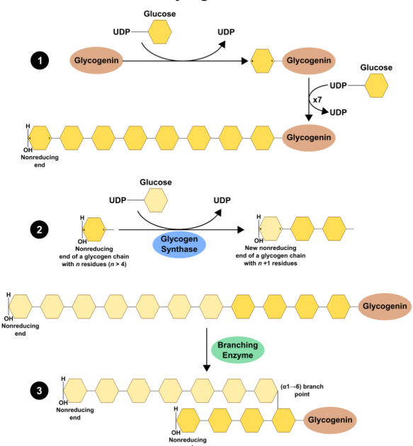
Glycogen metabolism and hormonal regulation

Slide 28

Glycogen metabolism and hormonal regulation
Energy balance of glycogenesis
Adding a glucose molecule to a glycogen molecule consumes 2 ATP:
1ATP: phosphorylation of glucose
1 UTP: formation of UDP- Glucose

Slide 29
Glycogen metabolism and hormonal regulation
Regulation of glycogenesis

Slide 30
Glycogen metabolism and hormonal regulation
Two forms of glycogen synthase
Glycogen synthase a active
dephosphoryleted
protein kinase A
protein phosphatase
glycogen synthase inactive
phosphorylated

Slide 31

Glycogen metabolism and hormonal regulation
activation of glycogen
synthase
Insulin binds to its receptor and the receptor's tyrosine kinase phosphorylates a specific tyrosine of each β subunit (autophosphorylation)
Tyrosine kinase then phosphorylates the tyrosine of a first protein substrate called IRS-1
The phosphorylated IRS 1 will initiate a series of cascading phosphorylation reactions, the final step of which is the activation, by phosphorylation, of a protein phosphatase.
This last step dephosphorylates the
glycogen synthase

Slide 32
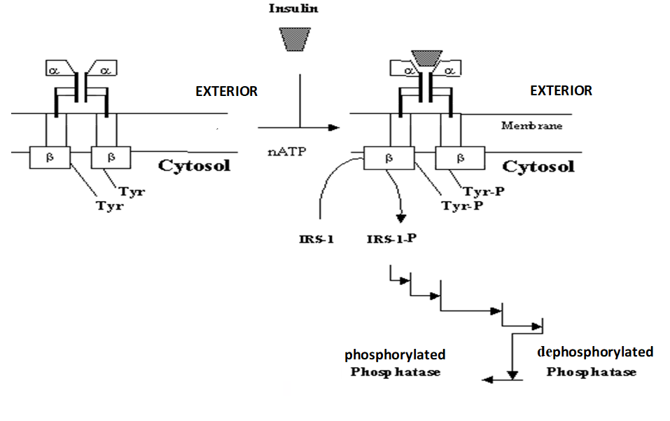
Glycogen metabolism and hormonal regulation
Activation mecanism of protein phosphatase by insulin

Slide 33

Glycogen metabolism and hormonal regulation
Glycogenolysis
( fasting situation)

Slide 34
Glycogen metabolism and hormonal regulation
objective
In the liver:
Hepatic glycogen is mobilized for
maintain blood glucose levels
Nourish peripheral tissues
In the muscles:
Muscle glycogen is mobilized and consumed locally for their function

Slide 35
Glycogen metabolism and hormonal regulation
Glycogenolysis reactions

Slide 36
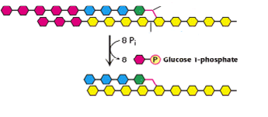
Glycogen metabolism and hormonal regulation
Reaction 1: Glycogen phosphorolyse
Cleavage of the α (1-4) bond from the non-reducing end
Attachment of a phosphate group provided by ATP to carbon 1 of the released glucose
Phosphorolysis is repeated sequentially on glycogen until 4 glycosyl residues are encountered on each chain before the α (1-6) bond
α(1-6) bond
phosphorylase

Slide 37
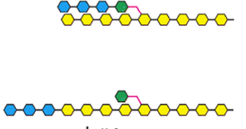
Glycogen metabolism and hormonal regulation
Reaction2: glycosyl transferase effect by α (1-4) transglycosylase
Glycosyltransferase acts on limiting dextrin by removing an oligoside made up of 3 glucose residues from each chain
The three glucose residues are attached to another limit dextrin chain, thus allowing phosphorolysis to resume on this chain.
After the action of this enzyme, a glucose molecule linked by the α (1-6) bond remains in place of the side chain.
α (1-4) transglycosylase

Slide 38
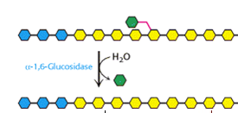
Glycogen metabolism and hormonal regulation
Reaction3: Debranching (ou α (1-6) glucosidase) effect
A debranching enzyme hydrolyzes glucose residues linked by the α (1-6) bond and releases glucose molecules

Slide 39
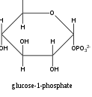
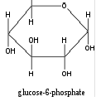
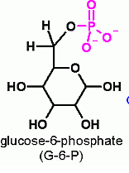
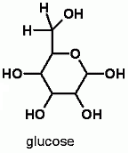

Glycogen metabolism and hormonal regulation
G1P is converted to G6P by phosphoglucomutase. G6P can enter glycolysis in the liver and muscle
phosphoglucomutase
Glucose 6-phosphatase allows the hydrolysis of G6P into glucose and the release of the latter into the blood

Slide 40
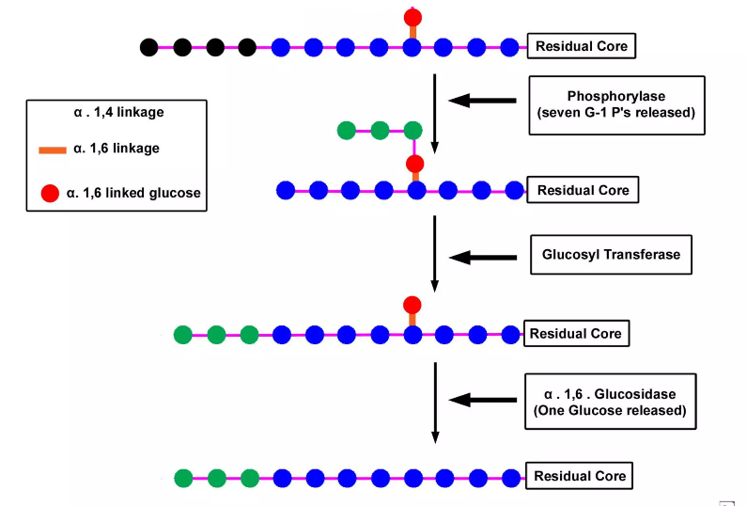
Glycogen metabolism and hormonal regulation

Slide 41

Glycogen metabolism and hormonal regulation
Energy balance of glycogenolysis
Glycogenolysis does not consume ATP
Hepatic glycogenolysis
Release the blood glucose
Muscle glycogenolysis
Release the ATP for muscle contraction

Slide 42
Glycogen metabolism and hormonal regulation
Regulation of glycogen degradation

Slide 43

Glycogen metabolism and hormonal regulation
Two types of regulation
Hormonal regulation
regulation by calcium
ions
glucagon
adrénaline

Slide 44
Hormonal regulation
glycogen phosphorylase
Glycogen phosphorylase a active
phosphorylated
protein kinase
protein phosphatase
Glycogen phosphorylaseb inactive
dephosphorylated

Slide 45
Hormonal regulation
The binding of each of the hormones to its specific membrane receptor leads to the activation of a membrane adenylatecyclase (adenylate cyclase).
Activated adenylate cyclase catalyzes, through ATP hydrolysis, the formation of cyclic AMP (cAMP), considered a second messenger.
cAMP binds to protein kinase A (cAMP dependent) and combines with the regulatory subunit to release the catalytic subunit (Active Protein Kinase A).
Protein kinase A (active) phosphorylates, in the presence of ATP, glycogen phosphorylase kinase which becomes active in phosphorylated form.
Finally, this last one phosphorylates glycogen phosphorylase, changing it from the b form to the a form, which catalyzes the phosphorolysis of glycogen.

Slide 46
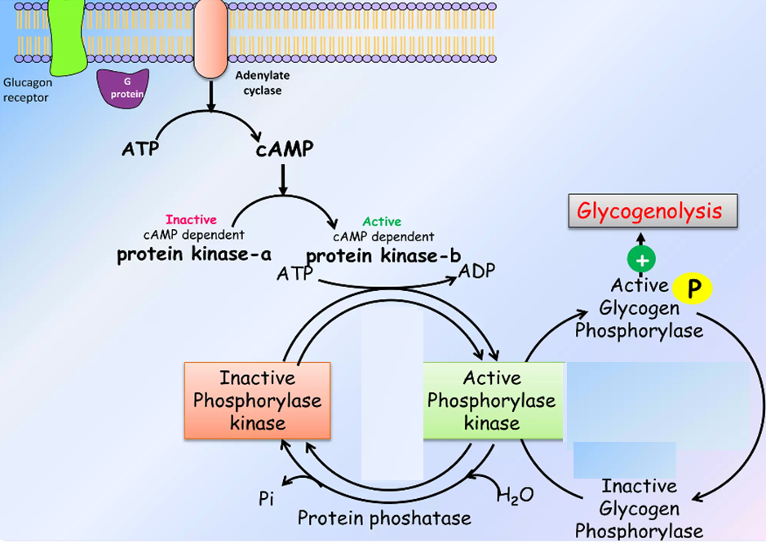
Hormonal regulation of degradation of glycogen

Slide 47

Glycogen metabolism and hormonal regulation
Simultaneous regulation of glycogenolysis and glycogenesis

Slide 48

Glycogen metabolism and hormonal regulation
Coordination by the hormons
Insulin stimulates protein phosphatase
Glucagon and adrenaline stimulate the protein kinase A
Activate the glycogen phosphorylase and inactivate the glycogen synthase
Activate the glycogen synthase et inactivate the glycogen
phosphorylase
Activate the glycogenolysis
Inhibit the glycogenesis

Slide 49
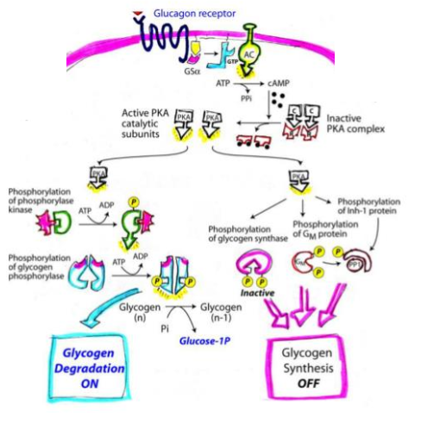
Glycogen metabolism and hormonal regulation
monale

Slide 50


