Slide 1

Email Basics for Beginners: Your Step-by-Step Guide
By: MABOUD Amani

Slide 2
What is Email and Why Use It?
What is Email?
Instant Global Communication
An email is a digital message you send from one address to another. It works like a letter, but travels through a network instead of roads or mailboxes.
Email (Electronic Mail) allows you to send messages and information instantly to anyone, anywhere in the world, going beyond geographical barriers.
Rich Media Sharing
Universal Accessibility
Beyond text, email supports the easy attachment and sharing of various file types, including pictures, videos, and important documents.
Access your emails seamlessly across all your devices—computers, tablets, and smartphones—ensuring you're always connected and updated.

Slide 3
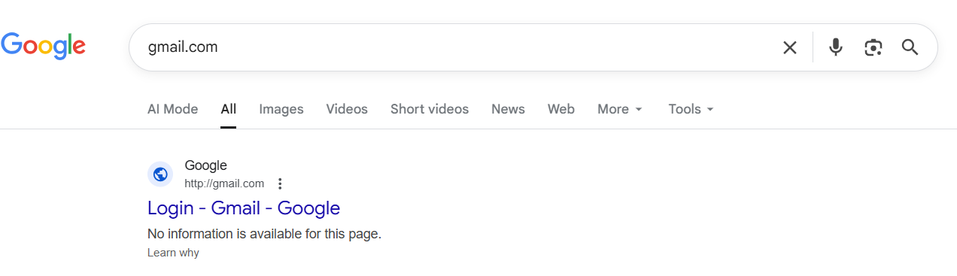
Setting Up Your Email Account (Example: Gmail)
Creating your first email account is simple and quick. We'll use Gmail as an example, but the process is similar for most providers.
Step 1: Navigate to gmail.com.

Slide 4
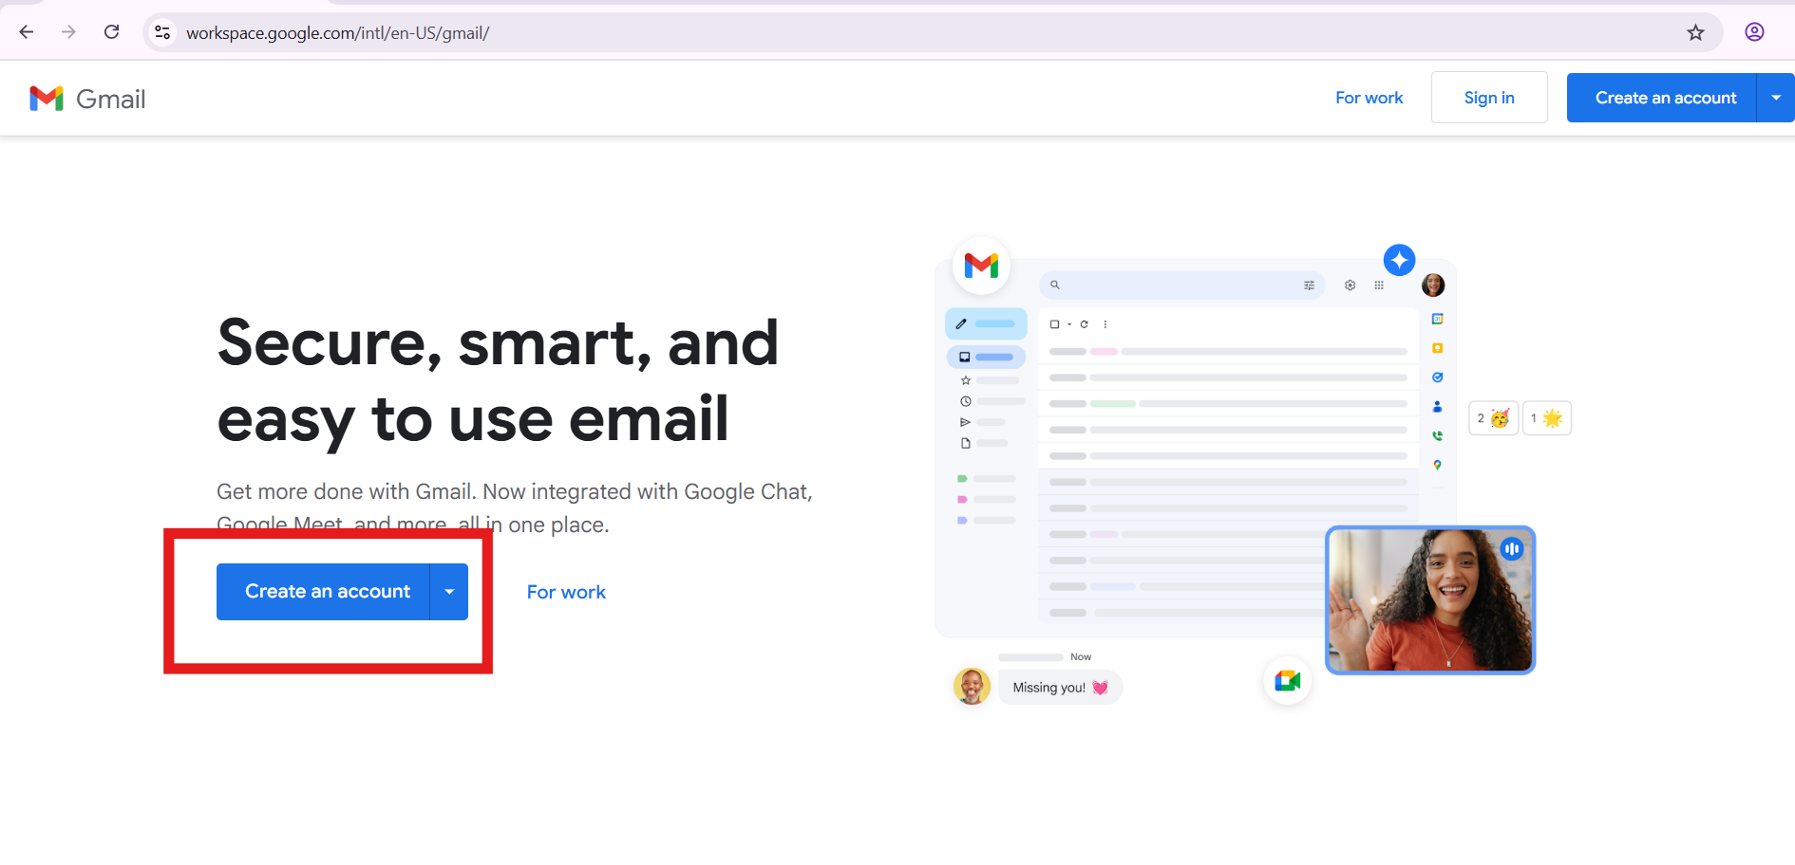
Step 2: Click on the "Create account" button.

Slide 5
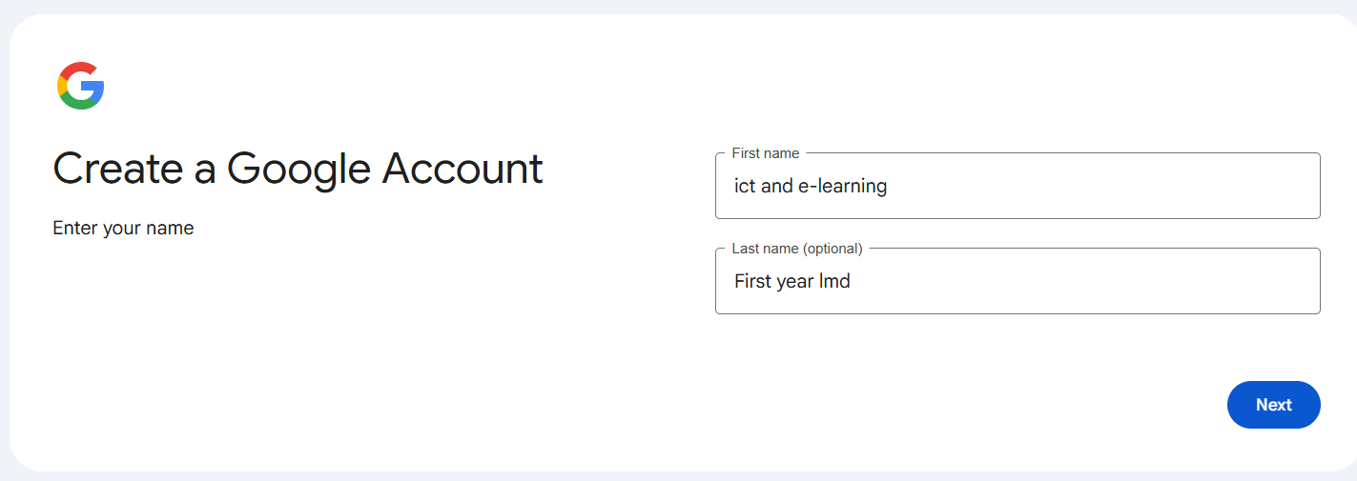
Step 3: Fill in your personal details, choose a unique username, and create a strong, memorable password.
Step 4: Follow the on-screen prompts to verify your phone number and agree to the terms of service.
Step 5: Start Using Your Email: Once the account is created, you can send and receive emails. Learn the interface: inbox, compose, reply, attachments, etc.

Slide 6
Cracking the Email Address Code 🕵️‍♀️
An email address might look like a secret code, but it's actually pretty simple once you know the parts. Let's take a closer look at an example:
amina.benali23@gmail.com
amina.benali23
@
gmail.com
This is the username. It's the unique name you choose for yourself. Think of it as your personal identifier on the internet!
This symbol is read as "at." It connects your username to your service provider.
This is the service provider or domain name. It tells you which company hosts the email, like Gmail, Outlook, or Yahoo.
Here's a cool secret: email addresses never have spaces, and whether you use capital letters or not, it all works the same!

Slide 7

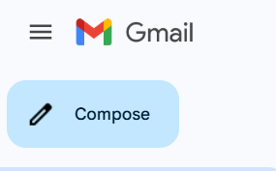

Anatomy of an Email: What Goes Where?
Click "Compose"
Look for the "Compose" button, often represented by a pencil or plus sign icon, to start a new message.

Slide 8
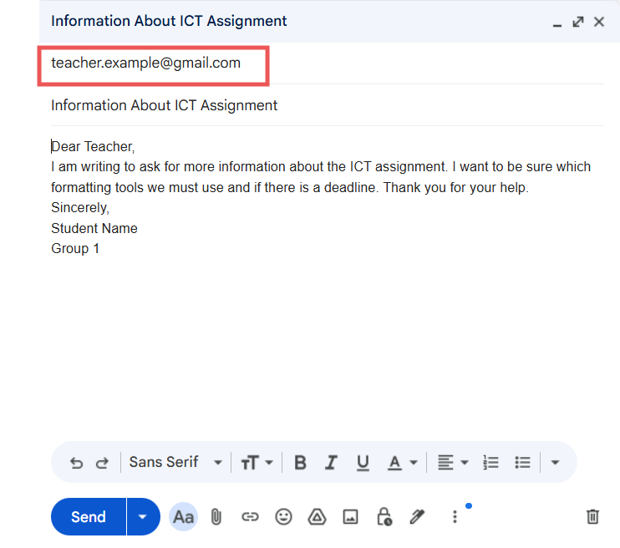
Anatomy of an Email: What Goes Where?
Add Recipients
Type the recipient's email address in the "To" field.

Slide 9
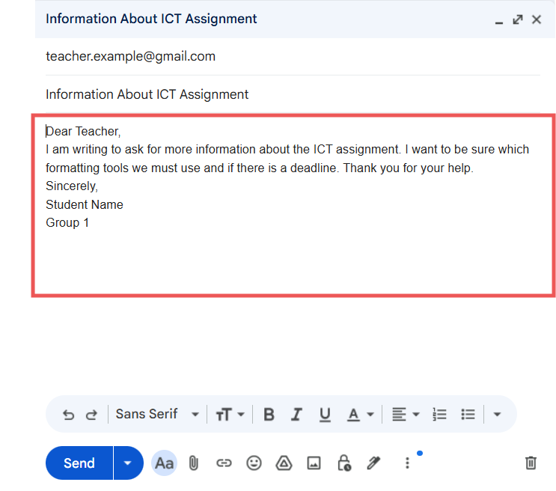
Anatomy of an Email: What Goes Where?
Write Your Message
Enter your message content clearly and directly in the main body area.

Slide 10
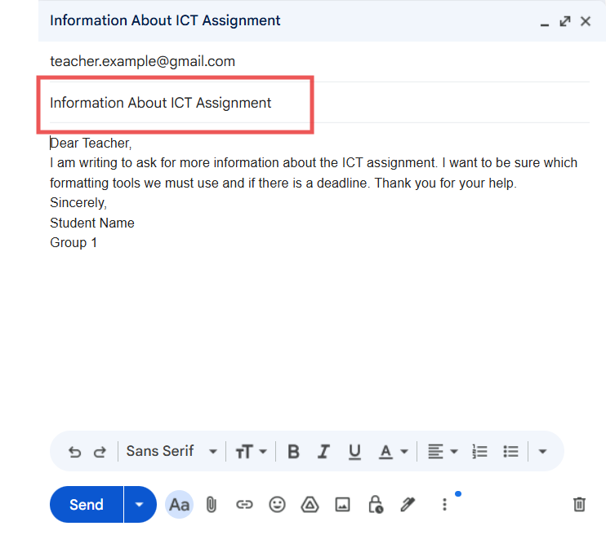
Anatomy of an Email: What Goes Where?
Subject Line:
The subject line should be clear, concise, and specific, summarizing the email's purpose in a few words (ideally under 50 characters). This helps the recipient prioritize the email.

Slide 11
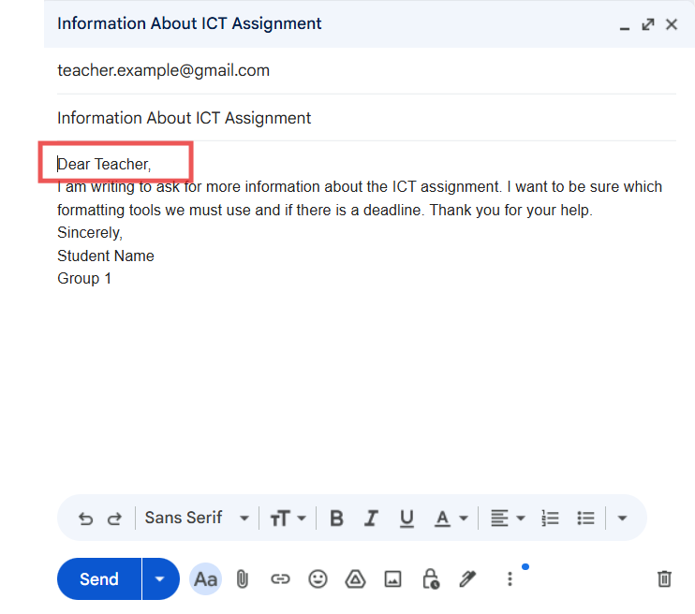

Anatomy of an Email: What Goes Where?
Salutation (Greeting) Use a professional and respectful greeting. The formality depends on your relationship with the recipient.
If you know the recipient's name: Dear Mr./Ms./Dr. [Last Name]
If the name is unknown: Dear Sir or Madam, or To Whom It May Concern,
A slightly less formal but still professional option for known contacts or teams is Hello [Name], or Dear Team,.

Slide 12
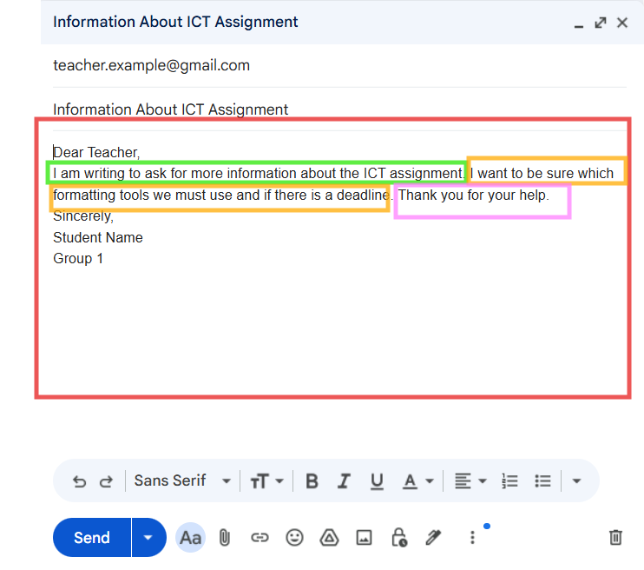

Anatomy of an Email: What Goes Where?
Body The body is where you present your message. It should be organized into short, focused paragraphs and use a professional tone.
Start with the purpose: The first sentence tells you why you are writing. (In green)
Add short, clear details: explain the stuation in one or two sentences. (in orange)
End politely: A simple closing sentence to show respect. (in pink)

Slide 13
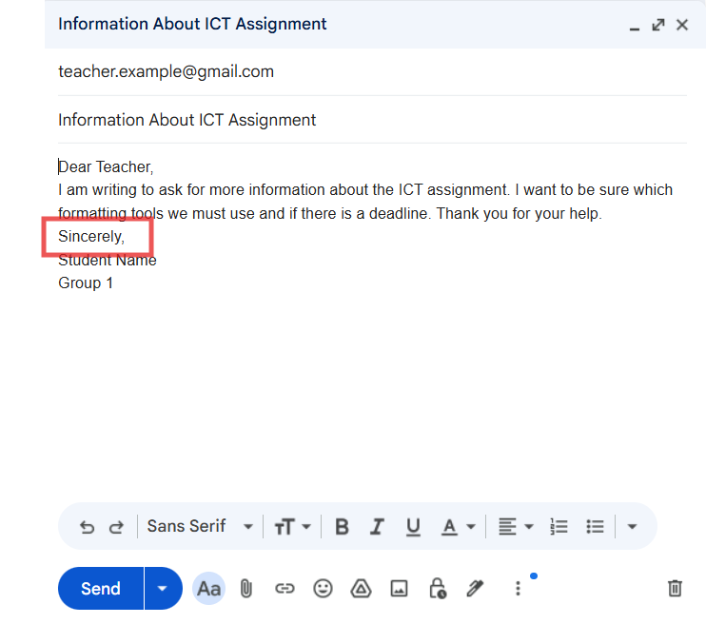

Anatomy of an Email: What Goes Where?
Close: like salutation, it can vary from formal to informal. Sign-off End your email with a polite and professional closing phrase.
Formal examples: Sincerely, Regards, Best regards, Yours faithfully, (use "Yours faithfully" if you started with "Dear Sir or Madam")
Informal examples: Bye, All the best, Best, James, Mary.

Slide 14
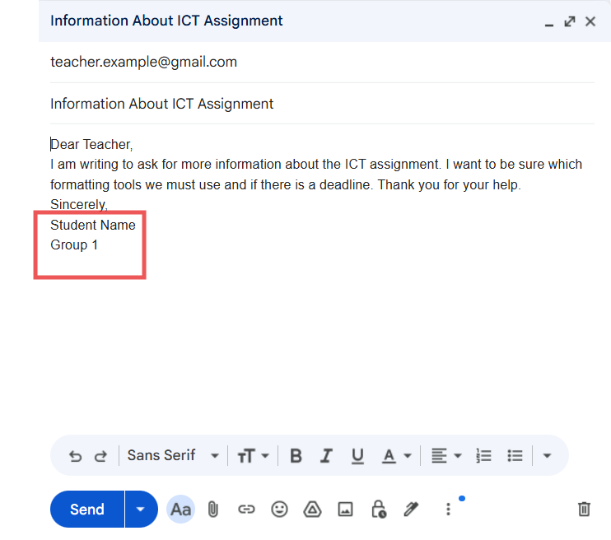
Anatomy of an Email: What Goes Where?
Signature Include a professional email signature that provides your contact information. Most email programs allow you to set this up automatically. Include: Full name, job title, company, and phone number.

Slide 15
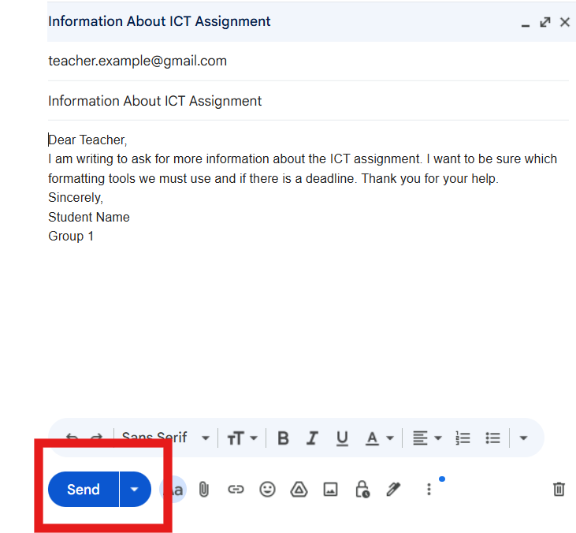
Anatomy of an Email: What Goes Where?
Send It Off
Once complete, click the "Send" button to deliver your email.

Slide 16
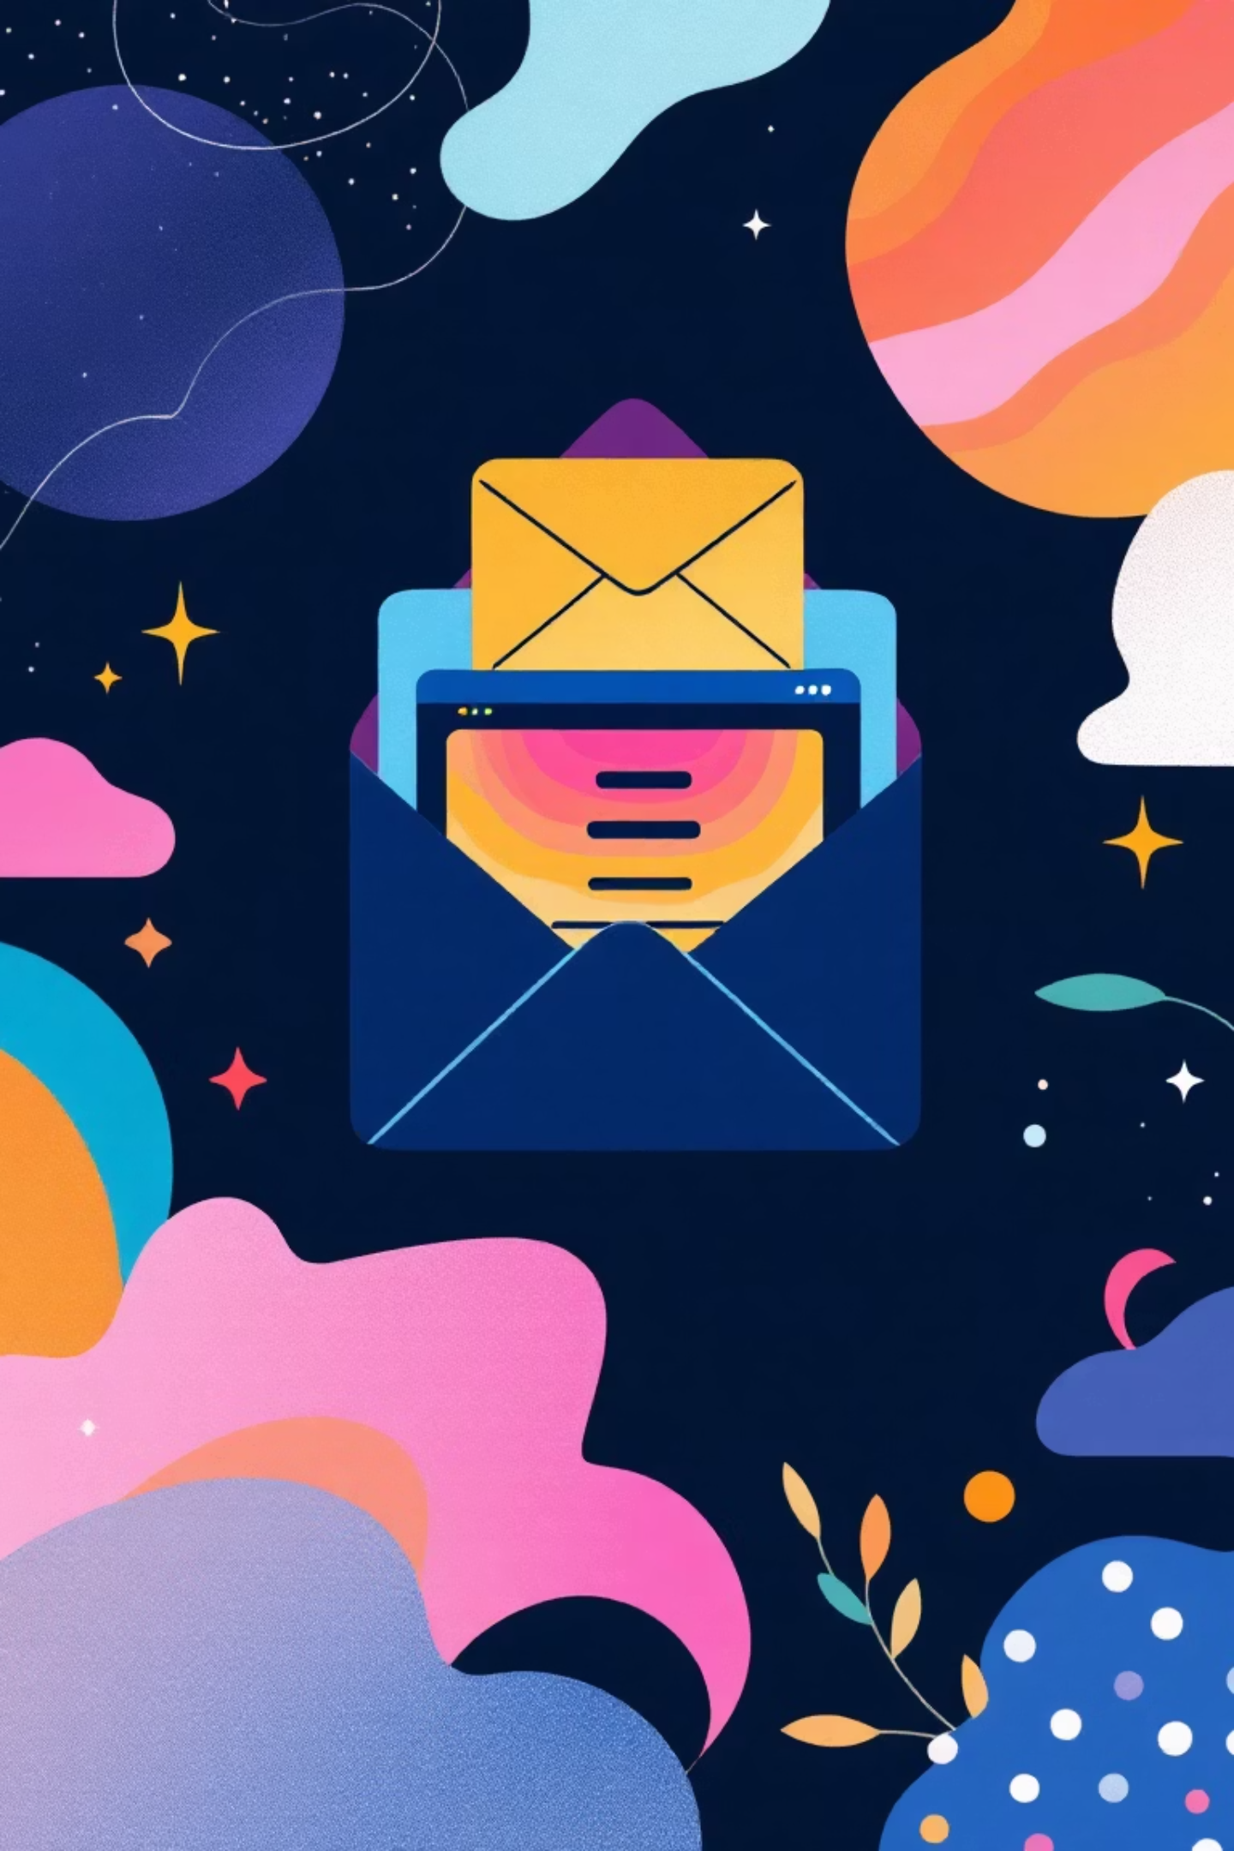
Attaching Files to Emails
Enhance your emails by adding files, photos, or documents to convey more information.
The Paperclip Icon
Drag and Drop
Locate the paperclip icon (📎), usually at the bottom of the compose window, to open your file explorer and select documents from your device.
For quick attachments, simply drag files or images directly from your computer into the email body. Many email clients support this convenient feature.

Slide 17

Email Etiquette Tips for Beginners
Good email etiquette ensures your messages are clear, professional, and well-received.
Clear Subject Lines
Always use a concise and informative subject line that accurately reflects the email's content.
Proofread Carefully
Before hitting send, take a moment to proofread for any typos, grammatical errors, or unclear phrasing.
Draft Before Adding Recipients
Write your entire message first, then add the recipient's email address to avoid accidental early sends.
Double-Check Addresses
Verify recipient email addresses to prevent sending sensitive information to the wrong person.
Keep It Concise
Be respectful of the recipient's time; get straight to the point and keep your emails brief and polite.
Professional Greetings & Closings
Start with a polite greeting like "Hello" or "Dear [Name]" and end with a suitable closing such as "Kind regards" or "Sincerely."

Slide 18
Email Mission: Time to Practice Your Skills!
Now it's your turn to shine! Open up Microsoft Word and design a practice email. This isn't a real email you'll send, but it will help you master the parts:
To: (Choose any realistic email address, like your teacher's or a fictional one)
Subject: (Make it clear and relevant – no empty subjects!)
Body: Write 5–6 lines of text for your message.
Signature: End with your full name and your class group.
Once you've got the basics down, pick ONE of the exciting topics on the next card to craft your message. Good luck, digital communicators!

Slide 19
Choose Your Email Adventure! 🗺️
1
Clarification Request
Ask your teacher to explain a part of last session’s ICT lesson that you didn’t quite understand.
2
Polite Request
Ask for the PowerPoint slides of a previous lesson because you misplaced your notes.
3
Technical Problem Report
Inform your teacher that a computer you used in the lab wasn't working correctly and describe the issue.
4
Formatting Help
Ask your teacher how to insert a table or image in Word to improve your assignment.
5
Absence Notification
Explain why you missed last week’s ICT session and politely ask what you need to catch up on.
6
Suggest an Idea
Recommend adding a new activity to the ICT module and explain why it would be useful.

