Slide 1

Microsoft Word

Slide 2
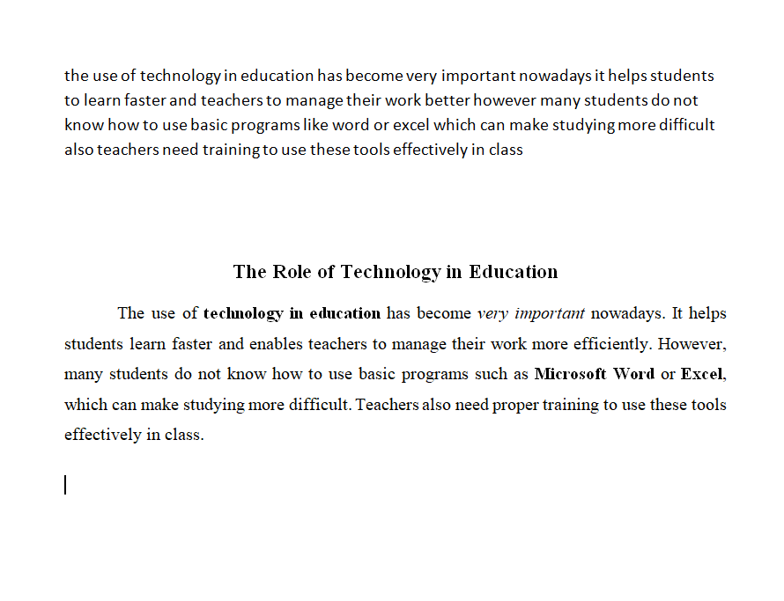
Notice the difference between:

Slide 3
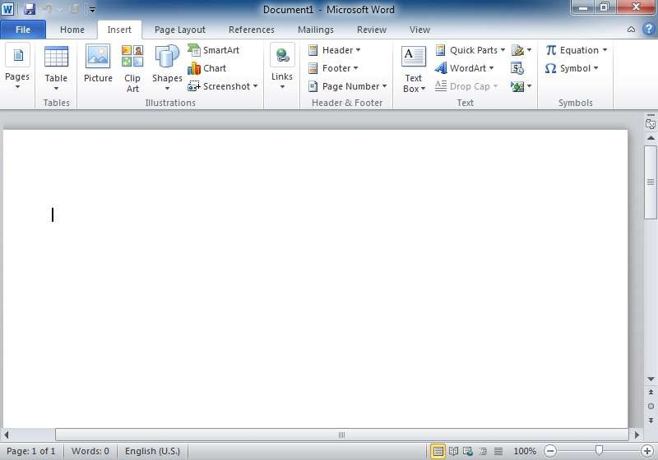
Introduction
Microsoft Word (often called Word) is a graphical word processing program that users can type with. It is made by the computer company Microsoft. The purpose of the MS Word is to allow the users to type and save documents.
Title bar
Menu bar
Document window
Scroll bar

Slide 4
Features of MS Word
Creating and saving a file
Editing and formatting a document
Paragraph formatting
Inserting header and footer and Page number
Checking spelling and grammar
Subscript and superscript
Inserting symbols
Print preview and printing
Inserting clipart, word art, and picture
Page setting
Bullets and number
Border and shading
Searching a word and replacing it by another word
Inserting table

Slide 5
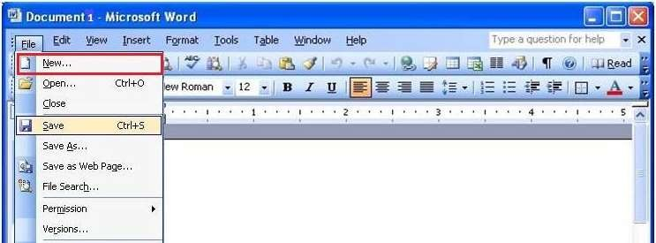
Creating and saving a file
Create new file (ctrl+N)
Save file(ctrl+s)

Slide 6
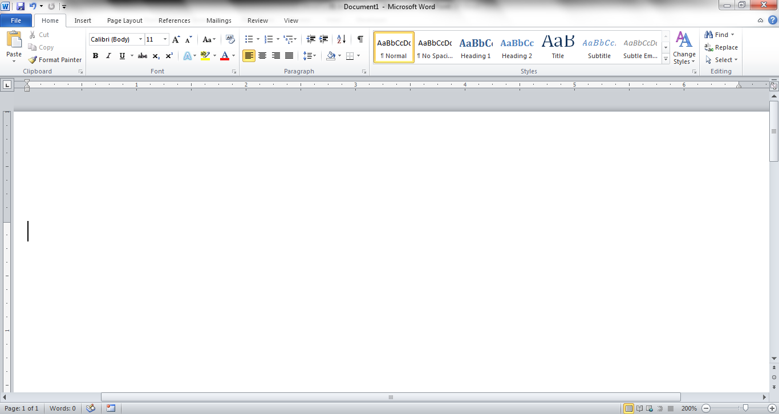
The area outlined in red is called the quick access toolbar.
It contains the most commonly used commands in Microsoft Word:
    Save
    Undo
    Repeat\ REDO

Slide 7
Microsoft Office 2007 & 2010 use what is referred to as the “Ribbon” interface. The area outlined in red comprises the Ribbon.

Slide 8
The Words File, Home, Insert, etc… outlined in red are referred to as tabs. Each tab has several Groups attached to it.

Slide 9
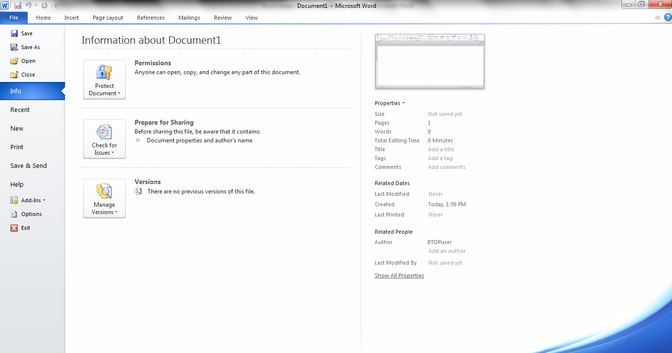
      The File Tab menu contains the commands most commonly associated with the file.

Slide 10
The Home Tab Groups contain the commands most commonly associated with the formatting and editing of text.
Clipboard
Font
Paragraph
Styles
Editing

Slide 11
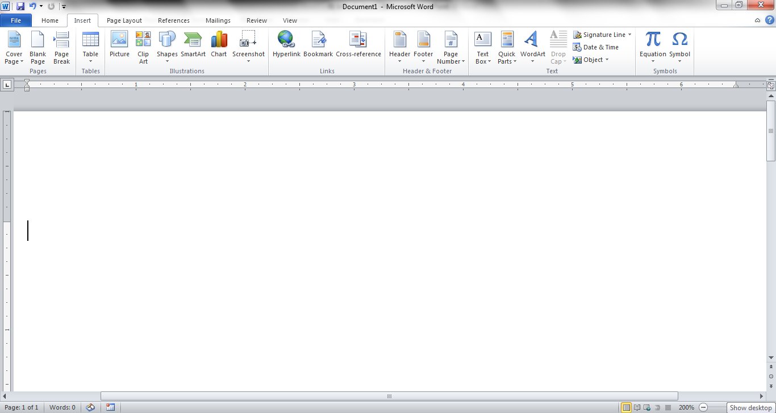
The Insert Tab Groups contain the commands most commonly associated with adding something to the document.
Pages
Tables
Illustrations
Header/Footer
Links
Text
Symbols

Slide 12
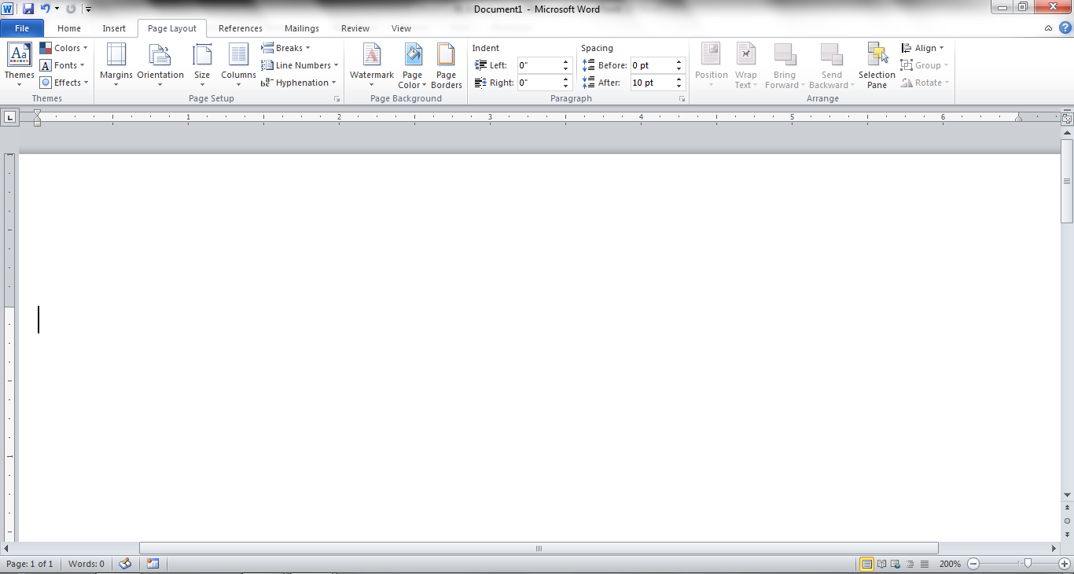
The Page Layout Groups contain the commands most commonly associated with settings that would affect the entire page or document.
Themes
Page
Setup
Page
Background
Paragraph
Arrange

Slide 13
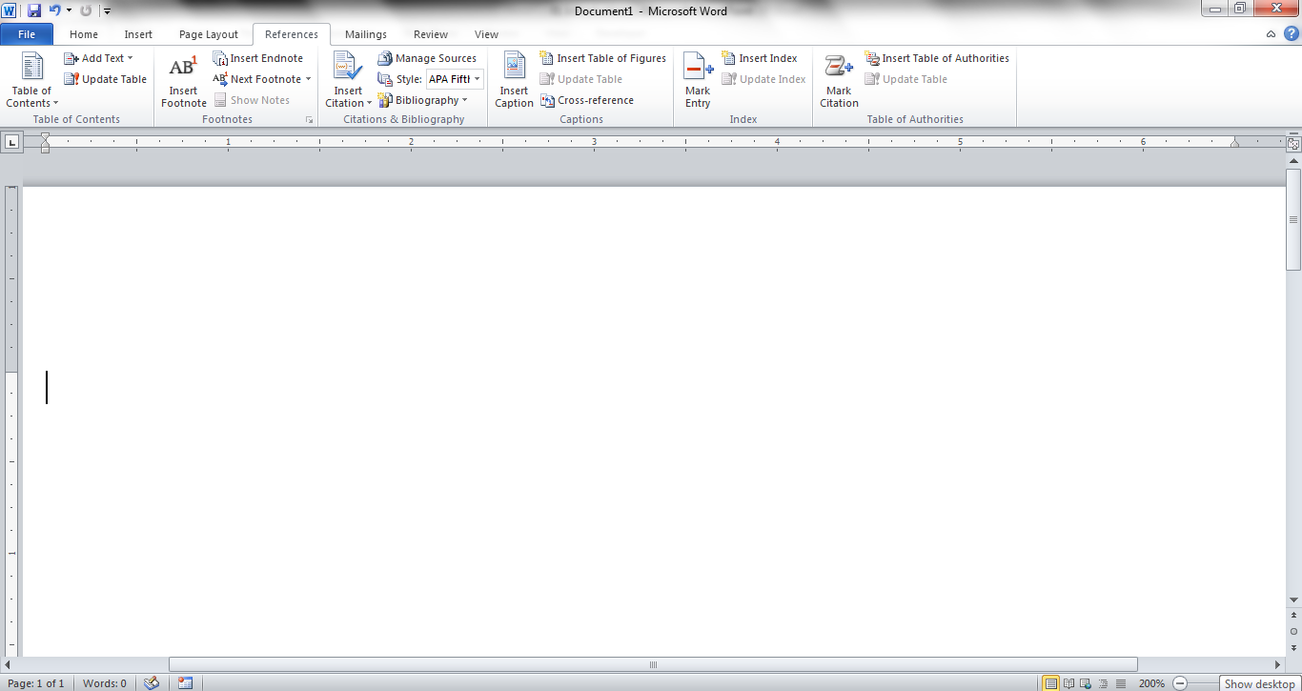
The References Groups contain the commands most commonly associated with writing a research paper, essay, term paper or similarly formal documents.
Table
of Contents
Footnotes
Citations &
Bibliography
Captions
Index
Table of
Authorities

Slide 14
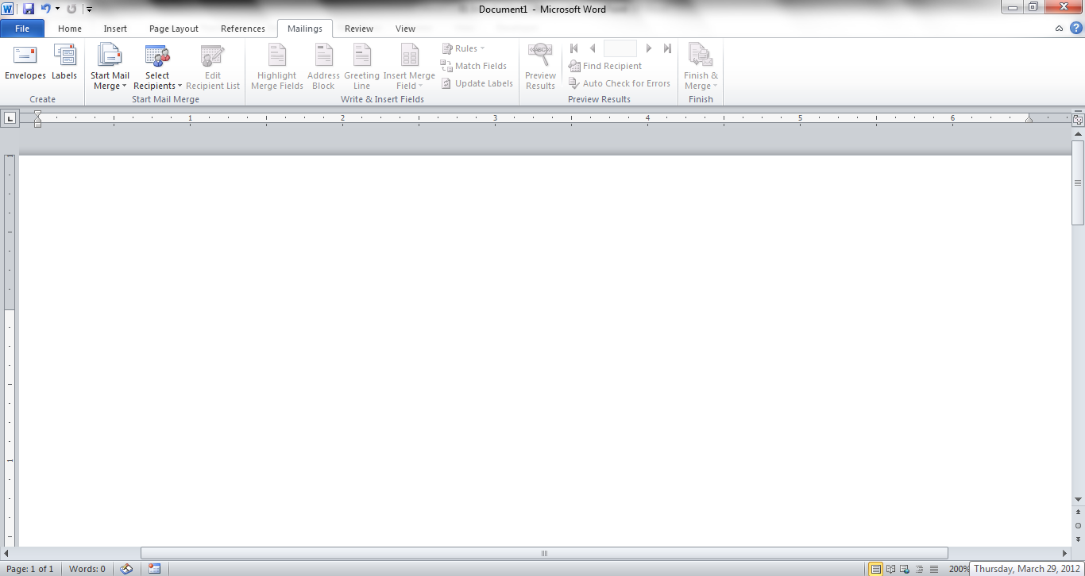
The Mailings Tab groups contain the commands most commonly associated with documents and files created for mass mailing.
Create
Start
Mail Merge
Write & Insert
Fields
Preview
Results
Finish

Slide 15
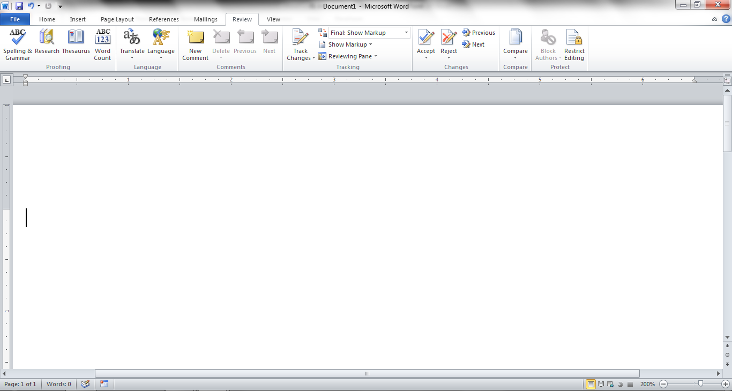
The Review Tabs groups contain the commands most commonly associated with documents which are shared or being prepared for publication.
Proofing
Language
Comments
Changes
Tracking
Compare
Protect

Slide 16
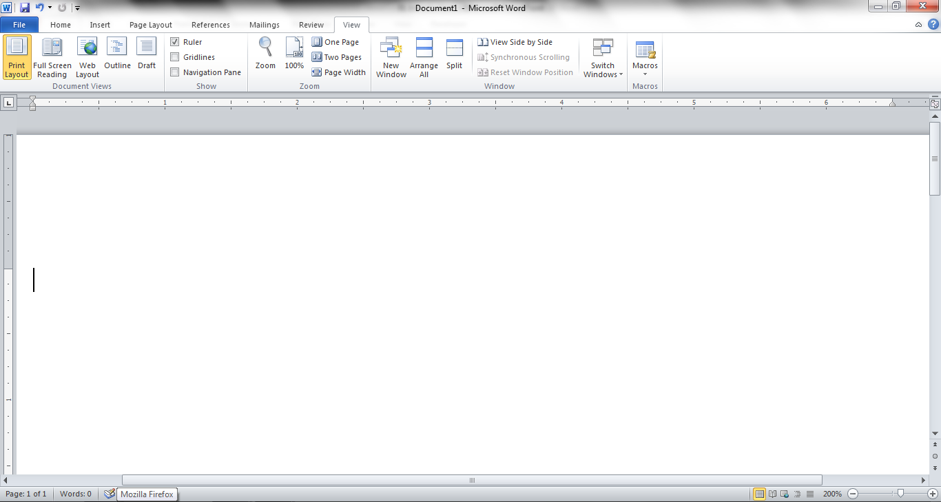
The View Tab groups contain the commands most commonly associated with the variety of ways you can “look at” a document or documents.
Document
Views
Show
Zoom
Window
Macros

Slide 17
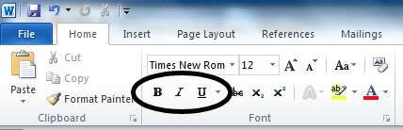
Editing and formating a document
Bold
Italic
Under Line
Normal

Slide 18
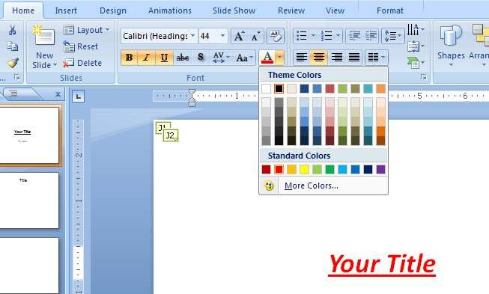
Font Type
Font Size
Font colour
Alignment of text

Slide 19
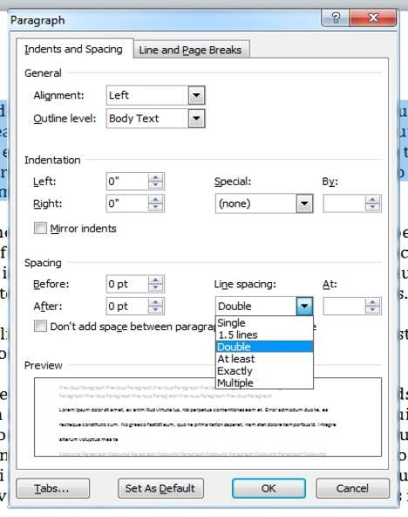
Paragraph formating
Alignment of Paragrap
Line spacing in paragra
Space between Line

Slide 20
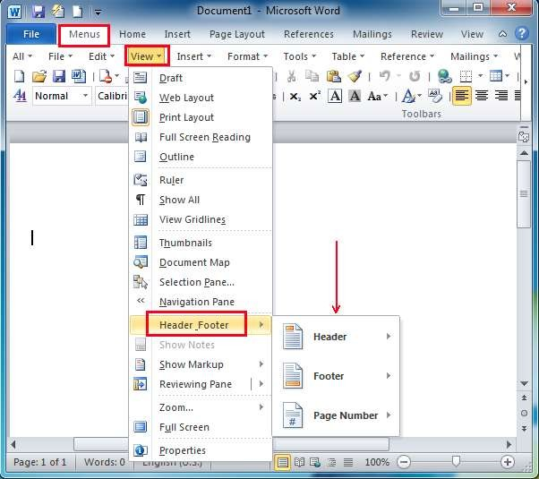
Inserting Header and Footer and page number

Slide 21
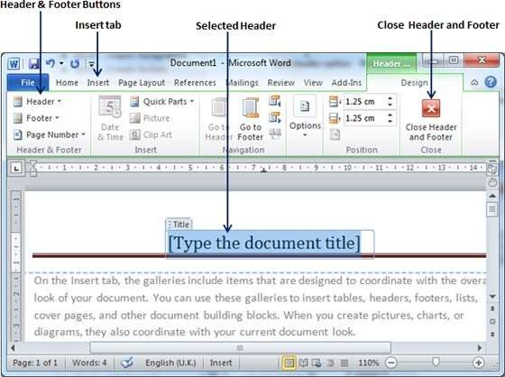

Slide 22
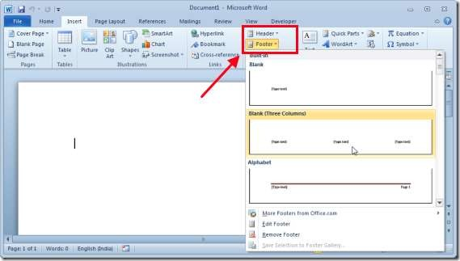
Insert Footer

Slide 23
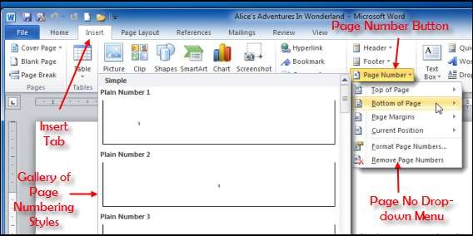

Slide 24
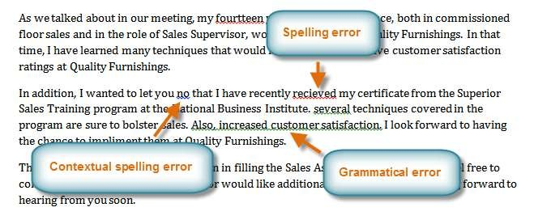
Checking Spelling and Grammer

Slide 25
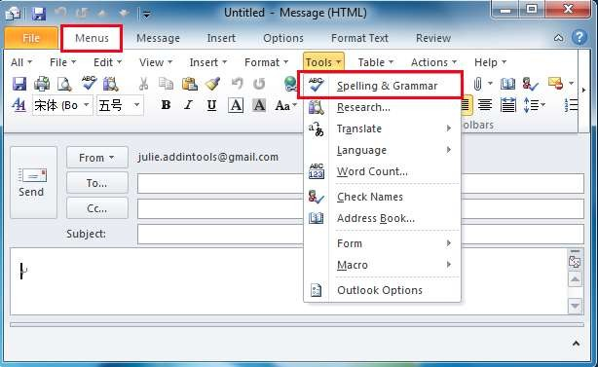

Slide 26
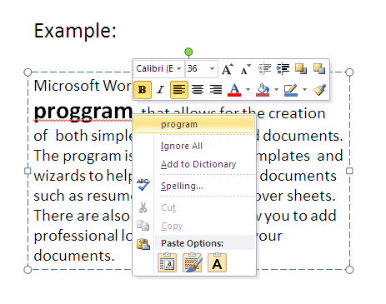

Slide 27
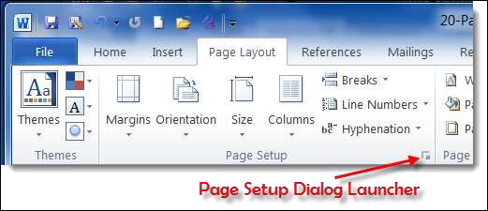
Page Setup

Slide 28
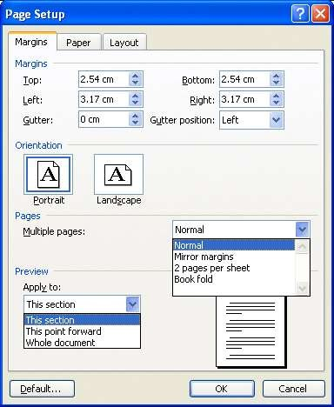
Set Margins
Preview

Slide 29
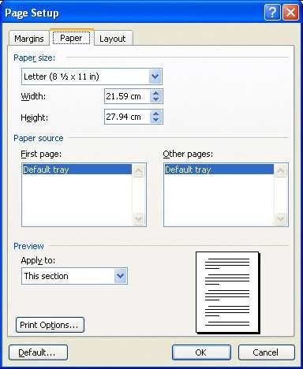
Paper Setup
Preview

Slide 30
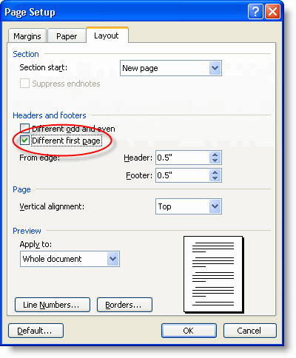
Layout Setup
Preview

Slide 31
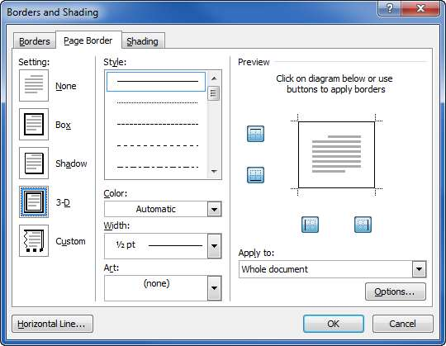
Borders and Shading
Border Prev
Select border width
Select border style
Select border color

Slide 32
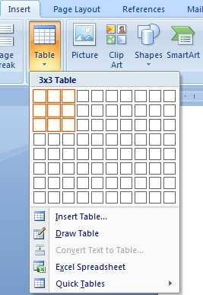
Inserting Table in file
Visually select the size of table
Or click
“ insert table”

