Slide 1
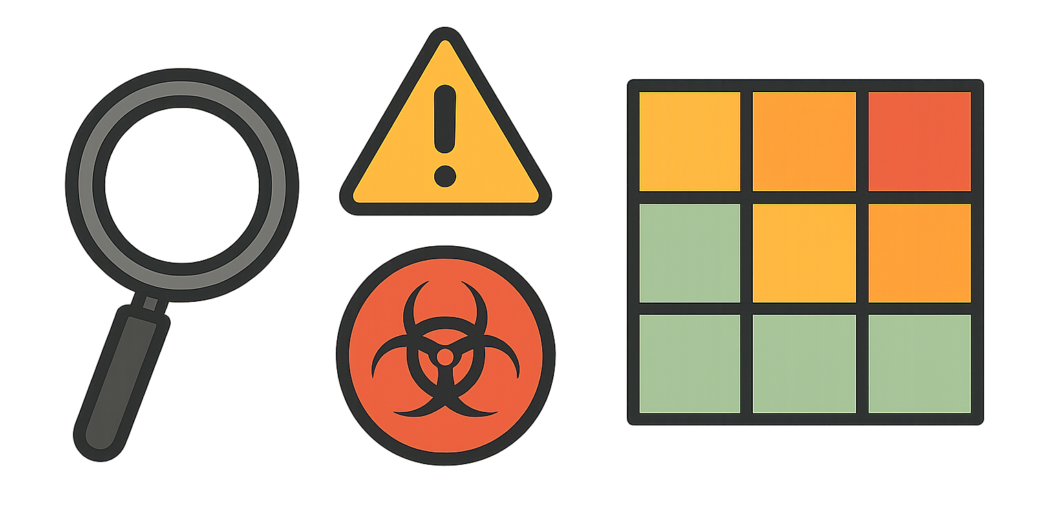
Democratic and Popular Republic of Algeria
Ministry of Higher Education and Scientific Research
Abd El-Hafid Boussouf University - Mila
Faculty of Sciences & Technology
Department of Process Engineering
HSE in Industrial Installations – UED2.1
Week IV:
Workplace Risk Analysis Methods

Slide 2
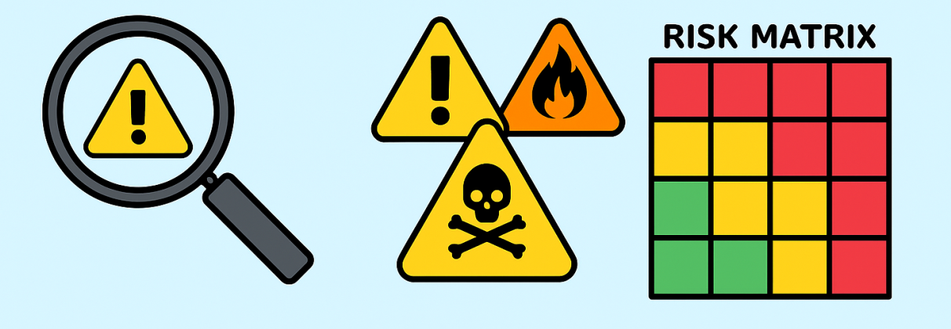
Learning Outcomes
By the end of this session, students will be able to:
Apply observation-based techniques to identify hazards in the workplace.
Construct and interpret a risk map (cartographie des risques).
Use a risk assessment matrix (severity × probability).
Perform a basic hazard identification exercise (case study).

Slide 3

1. Introduction to Workplace Risk Analysis
Risk analysis is a systematic approach used to detect, understand, and evaluate dangers present in an installation before they lead to an accident.
Why it matters in process engineering :
Reduces accident frequency and severity.
Improves equipment reliability.
Helps decision-making for preventive measures.
Required by ISO 45001 and industrial auditing systems.
Example:
At a chemical mixing unit, operators frequently climb stairs while carrying solvents. A risk analysis reveals:
→ risk of slipping, fall from height, chemical exposure, ergonomic strain.

Slide 4
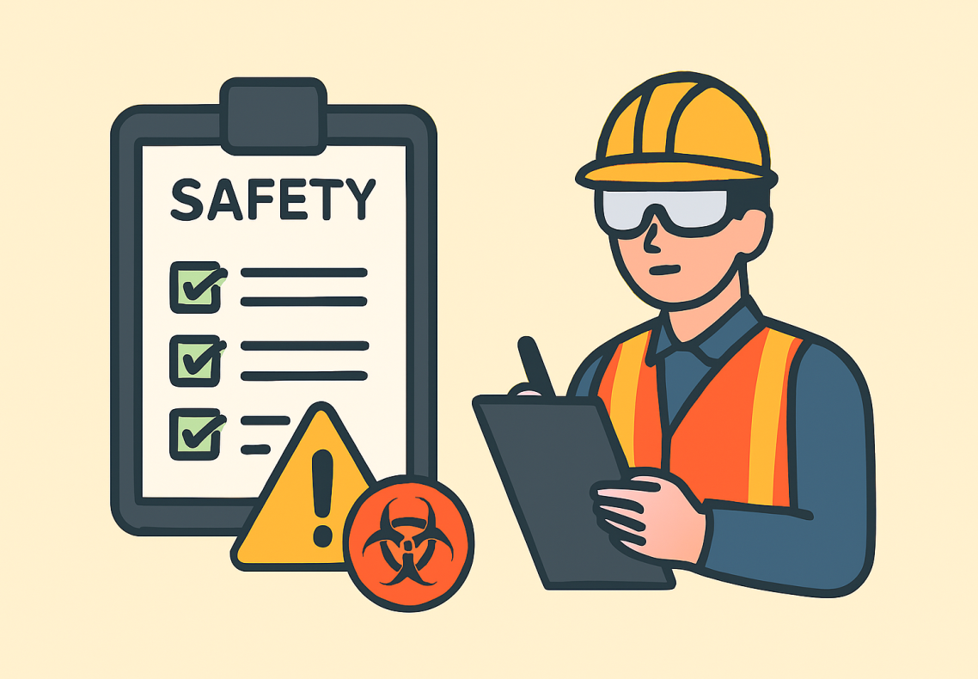
1I. Observation Techniques: Overview
Observation techniques focus on direct inspection of work situations to identify visible and hidden hazards.
تقنيات المراقبة
Planned Observation :
Structured visit using a checklist.
Spontaneous Observation :
Unscheduled visit during normal operations.
Task Analysis Observation :
Breakdown of tasks into steps to identify hazards.
Behavior-Based Safety Observation (BBS) :
Focus on worker behavior relative to safety standards.

Slide 5
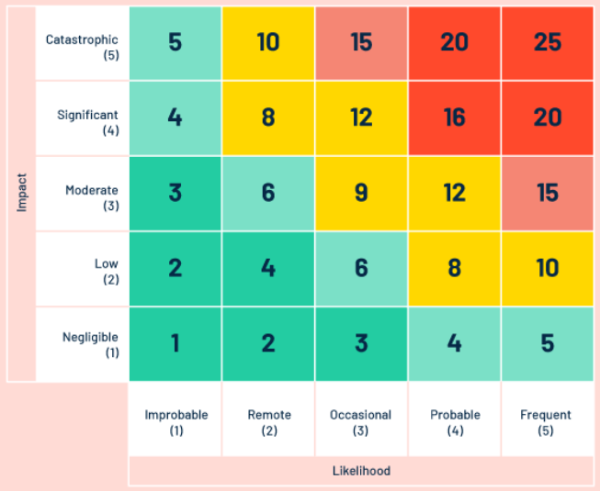
III. Risk Mapping
A risk map is a visual representation of all identified hazards in a workplace or industrial unit.
It provides:
Location of hazards (geographical or process-based).
Nature / type of hazards (chemical, mechanical, thermal…).
Risk level (coding with colors).
Priority zones for intervention.

Slide 6
IV. How to Build a Risk Mapping
Step 1 – Identify the area
Define the boundaries of the zone (e.g., distillation unit, storage area).
Step 2 – Collect information
Using:
Site visits and observations
Accident history
Near miss reports
Worker interviews
Step 3 – Identify hazards
For each workplace: chemical, physical, mechanical, ergonomic, biological.
Step 4 – Assess risk level
(using the risk matrix introduced later).
Step 5 – Plot hazards on the map
Use icons, colors, or labels depending on severity.
Step 6 – Validate with HSE team and supervisors

Slide 7
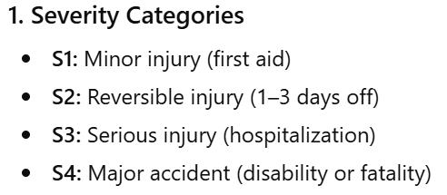
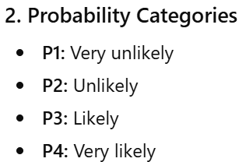
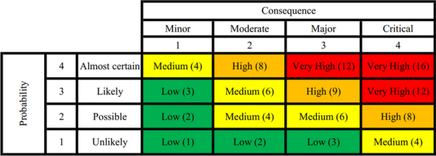
V. Risk Assessment Matrices
A risk assessment matrix combines the severity of consequences with the probability of occurrence.
The matrix cross-combines S and P to produce risk levels
(low / medium / high / critical).

Slide 8
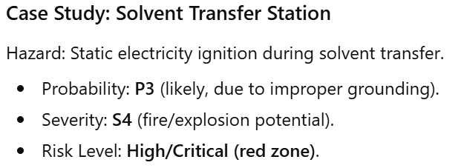
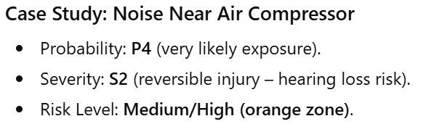
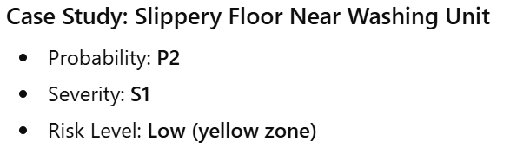
VI. Example: Risk Matrix Interpretation

Slide 9
IIIX. Summary
Observation techniques allow direct detection of hazards.
Risk mapping visualizes location, nature, and intensity of hazards.
Risk matrices objectively classify risks to prioritize interventions.

Slide 10
IIX. Next Session
Week 5: Accident Analysis – Introduction to Tree of Causes
Thank you for your attention!
See you next class.

