Slide 1
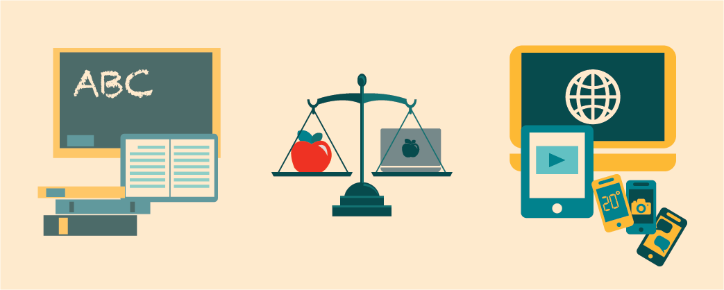
Literacy vs. Digital Literacy
Understanding the Evolution of Reading and Writing in the Digital Age

Slide 2






What is Classical Literacy?
Key Attributes
"The ability to read and write to understand and produce meaning from printed language"
Linear, page-by-page navigation
— UNESCO
Fixed, stable texts (ink on paper)
Authority anchored in authorship and print publication
Three Cognitive Processes
Decoding graphic symbols (letters, words)
Comprehending ideas in context
Encoding and expressing ideas in written form

Slide 3







What is Digital Literacy?
Key Shifts
Digital literacy emerged when reading and writing shifted onto networked screens
From print to screens
From linear to non-linear navigation
From text-only to multimedia
Gilster (1997)
From isolated to networked information
"The ability to understand and use information in multiple formats from a wide range of sources when it is presented via computers."
From passive consumption to active participation
Lanham (1995)
Extends literacy "from words alone to images, sounds and multimedia."

Slide 4









Modern Definitions of Digital Literacy
American Library Association
UNESCO
Digital Literacy Task Force (2013)
(2022)
"Digital literacy is the ability to use information and communication technologies to find, evaluate, create and communicate information, requiring both cognitive and technical skills."
"Digital literacy is the confident and critical use of digital technologies for information, communication and problem-solving."
Confident Use
Critical Thinking
Find
Evaluate
Create
Communicate
Problem-Solving

Slide 5
Key Differences Between Classical and Digital Literacy
Dimension | Classical Literacy | Digital Literacy
Medium | Print (paper) | Screens, hypertext, multimodal media
Navigation | Linear (page order) | Non-linear (links, tabs, embeds)
Skills set | Decoding text, composition | Technical (device use), critical search & evaluation, content creation
Authority check | Publisher reputation | Domain analysis, peer-review signals, metadata, social validation
Participation | Primarily consumption | Read/Write/Share culture; user-generated content

Slide 6

















Digital Literacy Frameworks
Gilster's Four Core Skills
DigComp 2.2
Eshet-Alkalai's Six-Skill Model
(1997)
(EU, 2022)
(2004)
Knowledge assembly - Connecting information from multiple sources
A comprehensive framework for citizens' digital competence
Photo-visual - Understanding visual information
1) Information & data literacy - Finding, evaluating and managing information
Content evaluation - Assessing credibility and relevance
Reproduction - Digital content creation
2) Communication & collaboration - Interacting through digital technologies
Information - Evaluating digital content
Web searching - Finding information efficiently
Hypertext navigation - Moving through digital spaces
Branching - Navigating non-linear spaces
3) Digital content creation - Creating and editing digital content
Socio-emotional - Digital communication
4) Safety - Protecting devices, content and personal data
Real-time thinking - Processing multiple inputs
5) Problem-solving - Identifying and solving technical problems

Slide 7





Why Digital Literacy Matters
Digital literacy accelerates every phase of research methodology
Access
Evaluation
Locate peer-reviewed sources hidden behind paywalls or scattered across databases
Distinguish credible journals from predatory outlets in seconds
Advanced search techniques
Critical source assessment
Synthesis
Communication
Integrate multimodal evidence into a coherent literature review
Present findings via multiple formats for different audiences
Articles, datasets, infographics
PDFs, infographics, blog posts, posters

Slide 8


Common Misconceptions vs. Reality
Let's clear up some common myths about digital literacy
"If I can use social media, I'm digitally literate."
Social familiarity ≠ critical research skills
"Digital literacy replaces traditional literacy."
It builds on classical reading/writing; both are needed
"Digital literacy is just 'computer skills.'"
Technical use is foundational; evaluation and ethical creation are equally central

Slide 9



Key Takeaways
The most important points to remember about literacy in the digital age
Literacy today spans print and digital modalities, requiring skills across both traditional and digital environments
Digital literacy integrates technical, cognitive, and ethical dimensions for effective digital participation
For researchers, mastering digital literacy accelerates every phase from literature search to dissemination

Slide 10



Suggested Readings
Explore these foundational works to deepen your understanding of digital literacy
Gilster, P.
"Digital Literacy"
1997
Lanham, R.
"Digital literacy."
1995
European Commission
"DigComp 2.2: The Digital Competence Framework"
2022
Eshet-Alkalai, Y.
"Digital literacy: A conceptual framework for survival skills in the digital era."
2004

