Slide 1
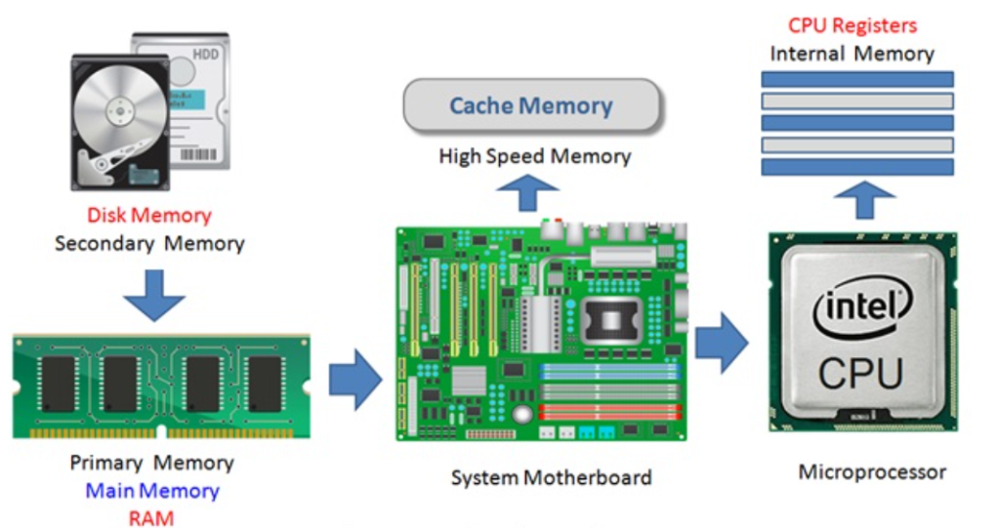



Understanding Computer Systems
Hardware and Software Fundamentals
Hardware
Software
Operating Systems
Karim Tabet

Slide 2
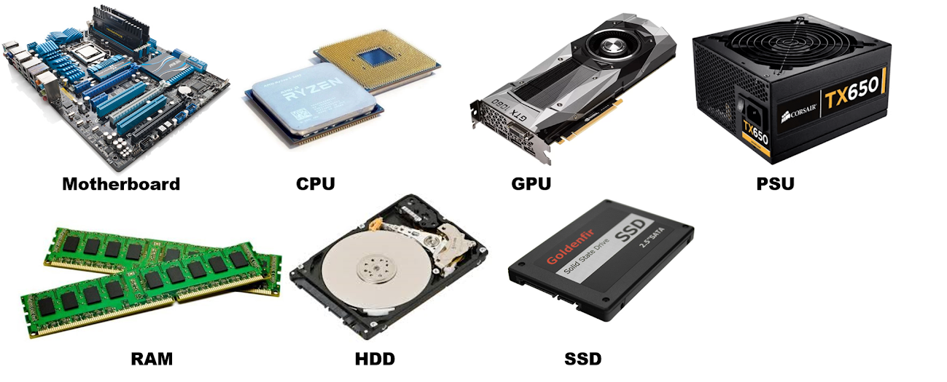



Introduction to Computer Systems
What is a Computer System?
A complete computer system consists of hardware components that you can physically touch, and software that provides instructions for the hardware to execute.
Understanding computer systems helps you navigate technology, make informed decisions, and work effectively in any digital environment.
Hardware Components
Software Types
Operating Systems
Karim Tabet

Slide 3


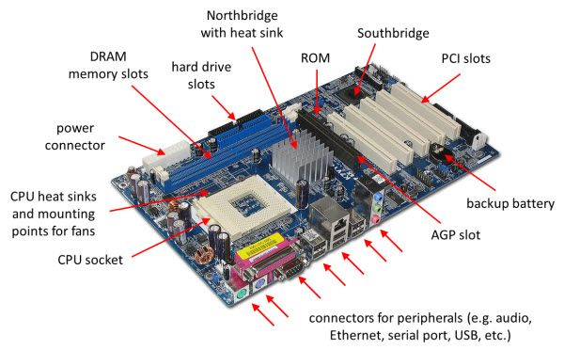
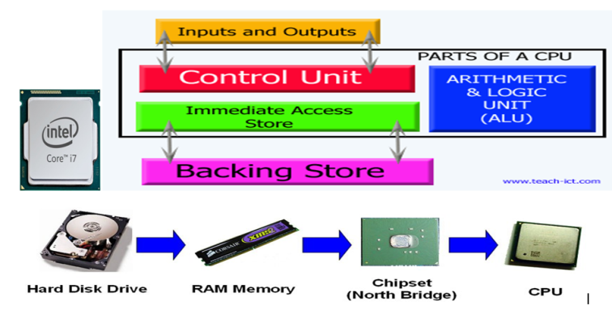

Hardware Components - Part 1
Motherboard
CPU
Giant circuit board linking all components
The "brain" of the computer
Allows communication via electrical signals
Carries out instructions and calculations
Holds slots for CPU and RAM
Processes commands from programs
Provides ports for USB, monitors, speakers
Multiple cores enable multitasking
The "backbone" of your computer system
Determines processing speed and capability
Karim Tabet

Slide 4

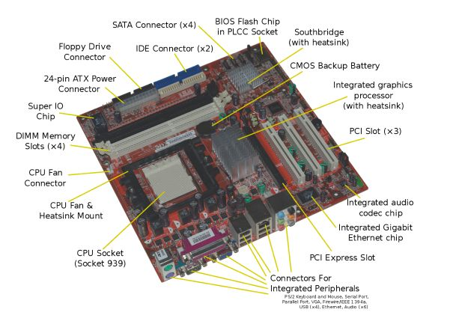
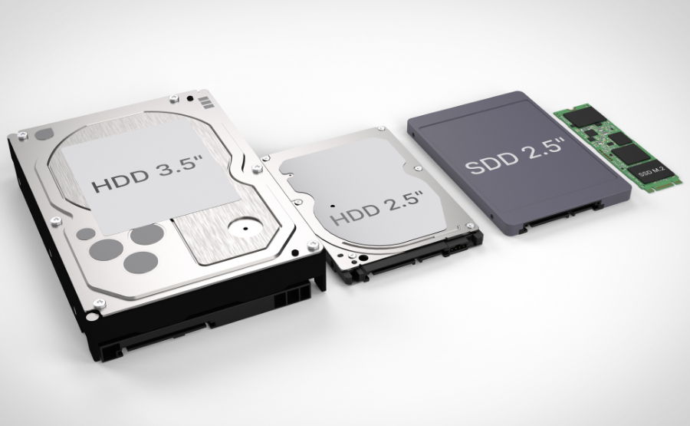


Hardware Components - Part 2
RAM
Storage Devices
Temporary storage for active data
Long-term memory that persists after power off
Like short-term memory
Fast access but volatile (lost when power off)
HDD
SSD
More RAM = better multitasking
Spinning disks
Microchips
Lower cost
Faster access
Slower speed
More reliable
Enables smooth switching between programs
SSDs are faster but cost more than HDDs
Karim Tabet

Slide 5


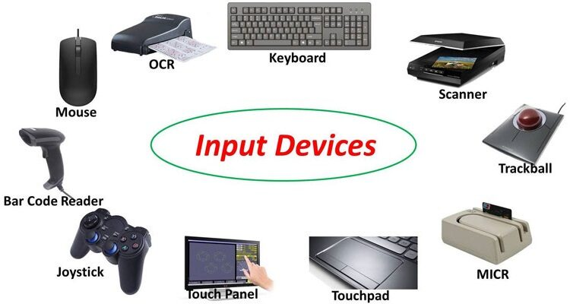
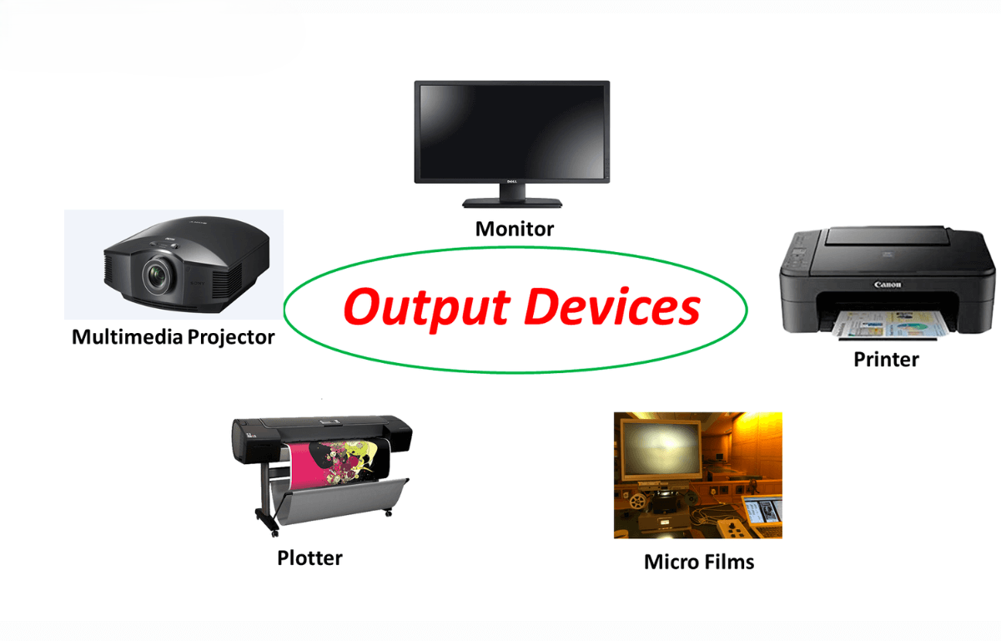












Hardware Components - Part 3
Input Devices
Output Devices
Devices that allow humans to give data to the computer
Devices that help the computer send information back to us
Keyboard
Mouse
Monitor
Speakers
Microphone
Scanner
Printer
Headphones
Touchscreen
Webcam
Projector
Smart Display
Convert human actions into digital signals
Convert digital signals into human-perceivable forms

Slide 6















Computer Software
System Software
Application Software
Runs in the background, making hardware and user programs work together
Software you use directly to accomplish specific tasks or for entertainment
Manages memory
Controlled directly by users
Controls input/output
Requires operating system to work
Starts up the computer
Helps accomplish specific tasks
Keeps everything running smoothly
Provides entertainment options
Examples
Examples
Operating Systems
Device Drivers
Utilities
Firmware
Word Processors
Web Browsers
Media Players
Games
Key Differences
System software is essential for computer to work
Application software makes computer useful
System software works mostly behind scenes
Application software is controlled directly

Slide 7



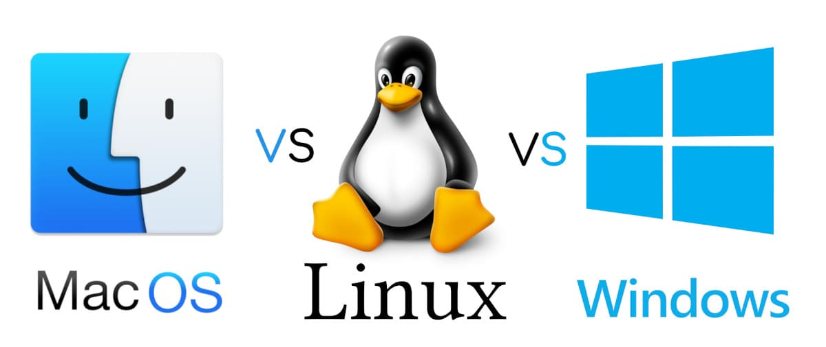



Operating Systems
Windows
macOS
Linux
Microsoft
Apple
Open Source
Used on most PCs
Runs only on Macs
Free and open-source
Easy-to-use interface
Famous for creative work
Popular among programmers
Compatible with thousands of programs
Tight integration with Apple devices
Very flexible and secure
Universal compatibility
Elegant and simple
Free and customizable

Slide 8


















Key Takeaways
Hardware Components
Software Types
Motherboard: Links all components
System Software: Manages hardware
CPU: Computer's "brain"
Application Software: User-facing tools
RAM: Temporary working memory
Key Difference: Essential vs. Useful
Storage: Long-term data retention
Visibility: Background vs. Direct control
I/O Devices: Human-computer interaction
Operating Systems
Why It Matters
Windows: Universal compatibility
Talk confidently about computers
macOS: Elegant design
Ask better questions for tech help
Linux: Free & customizable
Prepare for future classes & jobs
Function: Translates between hardware & software
Navigate digital environments effectively
Core Concept
Computer systems consist of physical hardware that processes information and software that provides instructions, all managed by an operating system that bridges the gap between users and technology.

