Slide 1


Information, Data, and Media Literacy
Teacher: Abdelkarim Tabet

Slide 2




What is Information Literacy?
The ability to recognize when information is needed, locate it effectively, critically evaluate it, and use it responsibly.
Pivotal in academic research and everyday decision-making
Digital natives often assume online information is true
True literacy requires critical evaluation of sources
— Ng (2012)

Slide 3












Information Literacy Examples
Health Information Evaluation
Information Evaluation Process
You encounter a viral post claiming a health cure.
Question the source
Check author's credentials
Analyze the evidence
Review scientific consensus
Consider multiple perspectives
Corroborate with trusted institutions like WHO
Verify with authoritative sources
Reliable Research Sources
Google Scholar
JSTOR

Slide 4









Understanding Data, Privacy, and Security
Data vs. Information
Protecting Your Data
Data
Information
Create strong, unique passwords
Raw facts
Organized & interpreted
Monitor and limit cookies and trackers
Be cautious about sharing personal information
When organized and interpreted, data becomes useful information for decision-making.
Data Footprints & Privacy
Online behaviors generate large data footprints
Data mishandling can jeopardize privacy
— Buckingham (2007)

Slide 5






Data Security Best Practices
Strong Passwords
Control Tracking
Create unique passwords for each account
Monitor cookies and trackers via browser settings
Use password managers for secure storage
Use browser extensions to block trackers
Include numbers, symbols, and mixed case
Regularly clear browsing data
Personal Information
Two-Factor Authentication
Be cautious about sharing on social media
Add extra security layer to accounts
Review privacy settings regularly
Use authenticator apps over SMS
Avoid oversharing location data
Example
A student uses two-factor authentication for email accounts to prevent unauthorized access
— Cloudian (2024)

Slide 6





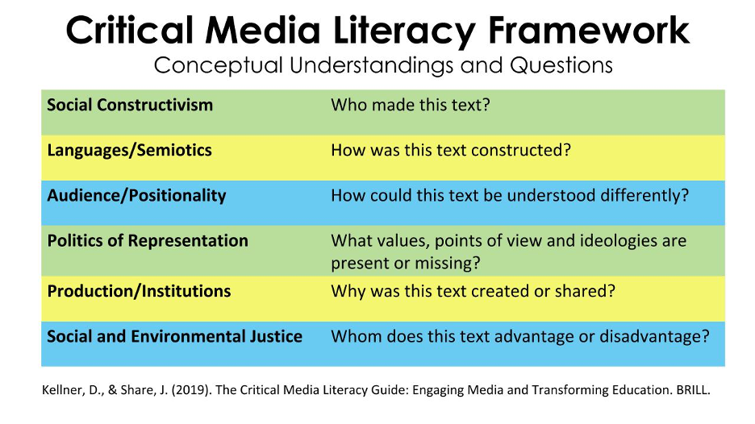

Media Literacy: Recognizing Media Influence
What is Media Literacy?
Understanding how texts, images, and videos are constructed to influence opinions and emotions.
Media can frame news stories selectively
Emphasizing some facts while downplaying others
Shapes public perception and discourse
Example: Comparing News Coverage
— Livingstone (2004)
Comparing coverage of a political event from two news outlets reveals different perspectives:
Outlet A
Outlet B
Headline: "Protesters Disrupt Peaceful Event"
Image: Focus on chaos
Headline: "Citizens Exercise Right to Protest"
Image: Focus on signs and faces
Prompts viewers to question potential bias or framing

Slide 7




Critical Digital Literacy
Beyond Media Awareness
Activity: Climate Change Posts
Extends beyond media awareness to questioning deeper ideologies and biases in digital content.
1
Review social media posts about climate change
Identify posts using scientific evidence vs. misinformation
Analyze who benefits from a message
2
Identify voices included or excluded
3
Discuss motives behind misinformation:
Question underlying assumptions
• Economic interests
• Political agendas
• Ideological beliefs
— Bulger & Davison (2018)

Slide 8









Practical Application: Creating Visual Summaries
Digital Design Tools
Creating Infographics
Visual summaries of research findings or news stories help develop critical thinking and communication skills.
Canva
Piktochart
User-friendly design platform
Infographics & presentations
Infographic Applications
Enhances comprehension of complex information
Research findings
News story analysis
Increases engagement with content
Data visualization
Source comparison
Builds digital and media literacy skills
— Canva Education (2024)
Simplifies complex information
Promotes critical evaluation of sources

Slide 9





Key Takeaways
Evaluate Sources
Protect Data
Media Awareness
Use established criteria like accuracy, authority, and bias to critically assess information
Implement secure digital habits including strong passwords and privacy settings
Understand how media shapes perceptions to avoid misinformation pitfalls
Critical Thinking
Visual Communication
Interrogate digital content and its underlying motives and perspectives
Use digital design tools to communicate information clearly and engagingly

Slide 10





References
Buckingham, D. (2007). Digital Media Literacies: Rethinking Media Education.
Bulger, M., & Davison, P. (2018). The Promises, Challenges, and Futures of Media Literacy. Journal of Media Literacy Education, 10(1).
Canva Education (2024). Canva for Education.
Cloudian (2024). 8 Data Security Best Practices You Must Know.
Livingstone, S. (2004). Media Literacy and the Challenge of New Information and Communication Technologies.
Ng, W. (2012). Can We Teach Digital Natives Digital Literacy? Computers & Education, 59(3).

