Slide 1



Democratic and Popular Republic of Algeria
Ministry of Higher Education and Scientific Research
Abd El-Hafid Boussouf University - Mila
Faculty of Sciences & Technology
Department of Process Engineering
HSE in Industrial Installations – UED2.1
Week III:
ACCIDENT INDICATORS
IN INDUSTRIAL SAFETY

Slide 2
Learning Outcomes
By the end of this session, students will be able to:
Define and interpret the main accident indicators:
  Frequency rate,
  Severity rate,
  Incidence rate.
Calculate those indicators using real data.
Explain the important of near miss analysis.
Discuss how accident indicators contribute to continuous safety improvement.

Slide 3

1. Introduction to Accident Indicators
What is an Industrial Accident ?
An industrial accident is an unplanned and undesired event occurring in the course of work, which results in:
Injury to personnel,
Material damage, or
Interruption of production.
Example:
A maintenance technician receives a burn due to contact with a hot steam pipe while performing a repair — this is an occupational accident causing injury and lost workdays.

Slide 4
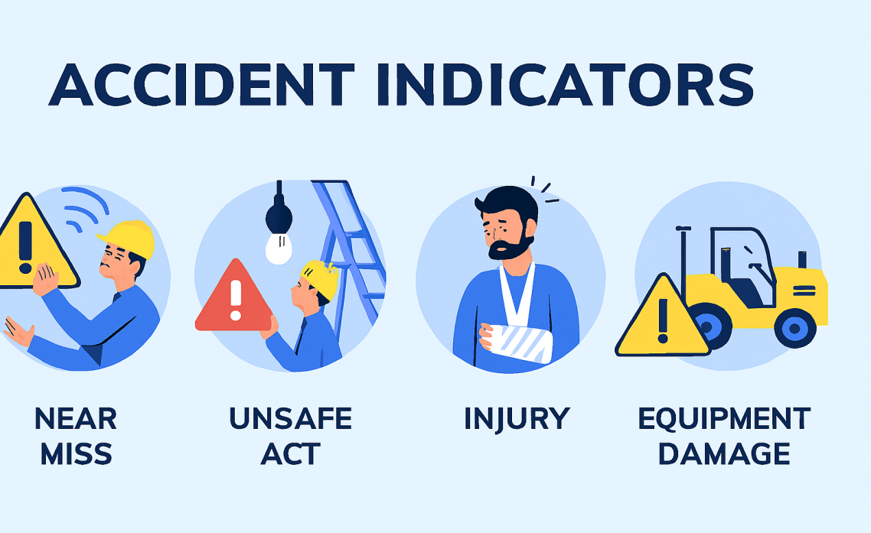
1. Introduction to Accident Indicators
Definition of Accident Indicators:
Accident indicators are statistical ratios that express the occurrence and seriousness of workplace accidents over a defined period.
Example:
If Plant A reports a frequency rate of 10, and Plant B reports 3, it indicates that Plant A experiences more frequent accidents per million hours worked — prompting investigation and preventive measures.

Slide 5


A) Frequency rate (Fr):
Definition:
The frequency rate (Fr) measures the number of accidents with lost workdays per million hours worked.
Formula:
N: number of accidents with lost workdays.
H: total number of hours worked.
Interpretation: → Indicates how often accidents occur.
Example: In one year, 4 accidents occurred in a plant where employees worked 800,000 hours:
➡ Frequency rate = 5 accidents per million hours worked.

Slide 6


B) Severity rate (Sr):
Definition:
The severity rate (Sr) measures the total number of days lost due to accidents per thousand hours worked.
Formula:
D: total number of lost workdays.
H: total number of hours worked.
Interpretation: → Indicates how serious the accidents are.
Example: If 4 accidents caused a total of 60 lost workdays for 800,000 hours worked:
➡ Severity rate = 0.075 days lost per 1000 hours worked.

Slide 7


C) Incidence rate (Ir):
Definition:
The incidence rate (Ir) measures the number of accidents with lost workdays per thousand employees.
Formula:
N: number of accidents.
E: average number of employees.
A high incidence rate indicates that a large fraction of the workforce has been affected by accidents — suggesting widespread exposure to hazards or insufficient preventive measures.
A low incidence rate reflects better worker protection and more effective safety management.
Example: If a company has 4 accidents in a year and 250 employees:
➡ Incidence rate = 16 accidents per 1,000 workers.

Slide 8

II. Interpreting and Using Indicators
Comparative Use:
Compare internal performance over time (monthly, yearly).
Benchmark against industry averages.
Identify “at-risk” departments or units.
Practical Case:
A plant with a frequency rate of 8, compared to the industry average of 5, indicates a need for enhanced safety procedures and worker training.

Slide 9


III. Near miss reporting:
Definition:
A near miss is an unplanned event that did not result in injury, illness, or damage, but had the potential to do so if conditions had been slightly different.
🔧 Example:
A worker slips on an oily floor but doesn’t fall — this should be reported to correct the hazard before an accident happens.
⚙ Example:
During the transfer of a flammable solvent between two tanks, an operator notices a small static spark at the connection point but no ignition occurs.

Slide 10
III. Summary
Frequency rate → How often accidents occur.
Severity rate → How serious accidents are.
Incidence rate → Relation to number of workers.
Near misses → Key indicators for proactive prevention.
Quantitative indicators = Essential tools for decision-making and continuous safety improvement.

Slide 11
IV. Next Session
Week 4: Workplace Risk Analysis Methods
Thank you for your attention!
See you next class.

